Slide 1

26th June 2019
Mercure Hotel, Bingley
Head Teacher Briefing Session

Slide 2
Welcome
Yasmin Umarji
Strategic Manager – Education & Learning

Slide 3
Children’s Services Structure
Yasmin Umarji
Strategic Manager – Education & Learning

Slide 4
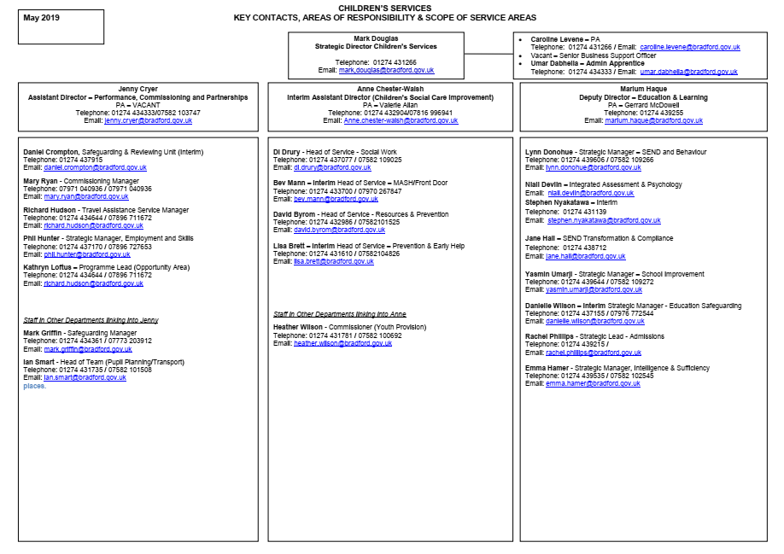

Slide 5
Relationships and Sex Education Guidance
Jenny Fox and Bankfoot School

Slide 6
Relationships and Sex
Education
Jenny Fox
Education Safeguarding

Slide 7
Statutory from September 2020
(and optional from 2019)
Relationships Education in primary schools
Relationships and Sex Education in secondary schools
Health Education in all schools except independents

Slide 8
Will primary pupils be taught about sex?
Sex education will not be compulsory in primary schools
DfE recommends that schools continue to teach sex education appropriate to the age and understanding of their pupils
Primary schools must honour parental requests to withdraw children from the lessons
This only applies to sex education delivered as part of RSE, not science. No right to withdraw from Relationships Education.

Slide 9
Will secondary pupils have to learn about sex?
Parents have the right to request that their child be excused from sex education.
School should discuss the request with the parent and record the content of the meeting. It may be that the request is based on misunderstanding and school should outline the benefits of attendance.
If the request still stands, you should honour it unless exceptional circumstances apply.
This only applies to sex education delivered as part of RSE, not science. No right to withdraw from Relationships Education.

Slide 10
Can a young person make their own decision about sex education lessons?
It is the parents’ decision until three terms before the child turns 16
A child can then decide for themselves at that point
In that circumstance, school should provide sex education during one of those three terms

Slide 11
Will parents have to be consulted on the RSE policy?
Yes. You should:
consult parents in developing and reviewing the policy
Ensure it meets the needs of your pupils and parents and reflects your community
Publish it on the school website

Slide 12
Will the DfE provide a detailed programme of study for RSE?
Statutory guidance tells us what must be taught be the end of each phase
The decision on when and how to deliver the content of the curriculum is up to schools
RSE will not be an exam subject

Slide 13
Do the regulations apply to faith schools?
Yes, but the distinctive faith perspective on relationships may be taught
In all schools, teaching should reflect the law as it applies to relationships, so that young people understand what the law allows and does not allow
In any school you must take into account the religious background of all pupils but you must still deliver the statutory curriculum to all pupils

Slide 14
What exactly do we have to teach about gay relationships?
Schools decide for themselves how they address LGBT specific content in the curriculum
LGBT community also protected under the Equality Act (2010)
RSE should promote inclusion and respect, and challenge discrimination and bullying

Slide 15
What about pupils with SEND?
RSE should be differentiated and personalised for pupils with SEND
Preparing for adulthood outcomes, as set out in the SEND code of practice
Vulnerabilities of pupils with SEND make RSE a priority for this group

Slide 16
SEND Changes and
Update
Emma Hamer
Intelligence & Sufficiency Manager
Stephen Nyakatawa
Strategic Manager, Integrated Assessment

Slide 17
Sufficiency of Specialist places for
Children and Young People with
Special Educational Needs & Disabilities across the District
Emma Hamer – Strategic Manager, Intelligence & Sufficiency
Diane Cochrane – SEND Planning & Strategy Lead
Notes:
Good Morning everyone

Slide 18

Bradford Context & Local Landscape
8
Special schools
4
FE
providers
2
Hospital schools
206
Mainstream primary and secondary
20
DSPs
5
ARCs
7
Nursery schools
(including 4 EYESPs)
4
PRUs
579
Early years PVI and Primary schools with nurseries
1
Alternative Provision
Academy
Notes:
Bradford is the UK’s youngest city with well over 150,000 children and young people aged under 18 with an increasing and complex Special Education Needs and Disabilities (SEND) population. Bradford has experienced a significant increase in the number of children and young people with Education, Health and Care Plans (EHCP’s) requiring specialist provision to ensure they are able to have their complex needs fully met and receive the specialist support that is required for them to thrive.
In 2014 there were approximately 2145 statements/EHCP’s, a number which has increased significantly to date.
Bradford has high aspirations for the District’s children and young people. Resources invested here will directly impact on the lives of children and young people with Special Educational Needs and Disabilities and their families. Currently we have a number of children and young people with Social Emotional and Mental Health Needs (SEMH) and Autism placed out of the local authority, we want to be able to educate them close to their families and communities.
Bradford now has a growing demand for additional specialist places. Our analysis shows, based on the SEND forecast and current specialist places that we require these additional places to not only meet the increase in demand but to ensure children and young people can be educated locally.

Slide 19
Bradford Context & Local Landscape
Statutory school age population
103,772
(current)
392 with EHCP 281 with EA1
Early Years
18,158
children in funded early education provision
(2-4 y.o 2018.)
3,721
Total EHCPs
(current)
School SEN support
14,151
(2018 –SFR)
LAC with EHCPs
178
Notes:
The School population has continued to increase over the last few years, however all the data is showing a plato – decrease in the birth rates.
However Bradford has seen a significant increase in the no. of C&YP requiring assessment for an EHCP:
In 2015 the number of assessments yearly were approx. at 500, to date now at over 800 a year with approx. only 8-9% declined, approx. 700 EHCP’s a year
No. of EHCP’s significantly increased:
2015 – 2225
2018 – 3299
Latest 3721

Slide 20
Bradford Context & Local Landscape
  The complexity of need and the number of children and young people with SEND in Bradford is increasing
  The number of referrals for an Education Health and Care Assessment (EHCA) has risen from 520 in 2014/2015 to 836 in 2017/2018
  The number of children and young people with EHCPs stands at 3,721. This has risen from 2145 in 2014.
  We are working in a challenging landscape both financially and educationally
Notes:
Cuts in SEN funding from central gov
Cuts in schools block funding
Increasing pressures on council services
P&EH Restructure

Slide 21
Development of Provision
Bradford is committed to develop a continuum of specialist provision to meet the complex needs of the District’s children and young people.
Recent and/or on-going developments are taking place in the following provisions:
Special Schools
Early Years Enhanced Specialist Provisions (EYESPs)
Mainstream Designated Specialist Provisions (DSPs)
New Resourced Provision (RPs)
Notes:
In April we started the consultation process to gain information from a wide range of people across the district to assist in shaping the future of provision for C & Y with SEND. 125 people responded to the on-line consultation, with an additional 4, at public meetings. The main group of respondents were parents. 100% of the respondents agreed there was need for additional provision. The strong message that came out of the on-line and public meetings was: that there needs to be more suitable, sustainable, well-funded local provision to ensure children and young people’s needs are being met within their local community.
In Bradford there is a strong commitment to pupils with all special educational needs and disabilities including social, emotional and mental health needs and our expectation would be that any proposed partner would become an integral part of our District wide continuum of provision. This would include working closely with the special and mainstream sector, as well as the Local Authority.
Bradford has a growing demand for additional specialist places. Our analysis shows, based on the SEND forecast and the current specialist places, that we require schools to not only meet the increase in demand but to ensure children and young people can be educated locally.
The budget for the education aspect of the school provision will come from the High Needs Block; it is that, which currently funds out of authority placements. Expensive specialist placements with independent providers out of area and the associated substantial transport costs have contributed to significant pressure on High Needs Block spend. It is anticipated that the cost of out of authority education and transport will reduce over time, relieving pressure on the High Needs Block.
Parents/carers, families, children and young people have a strong preference for placements in the local District. This enables more focused family support and better longer-term outcomes for the children and young people. Bradford has committed to developing a continuum of specialist provision
Specialist educational provision in the District has developed over time, in line with changes in needs and growing demand. Always with the imperative to provide good education and outcomes within the parameters of the efficient use of public resources, which is made up of
Special Schools, Enhanced Designated Specialist Provision (EDSP)
Designated Specialist Provision (DSP) in mainstream schools,
Additionally Resourced Centres (ARC’s), Pupil Referral Units (PRU’s),
College provision and Early Years Enhanced Specialist Provision (EYESP).
And Now with Resourced Provision RP- Next slide

Slide 22
What is Resourced Provision?
All pupils will be on roll of the school and have access to both mainstream and the Resourced Provision, dependent on individual needs.
The mainstream schools/academies will receive an amount of delegated funding to provide the Resourced Provision places
The Funding model for Resourced Provision is the de-delegation of element two and three, to the central SEND council service, who will provide the specialist staffing and resources in the host school.
The responsibility of the staff deployed to the Resourced Provision rests with the SEND & Behaviour Strategic Manager on the behalf of the LA, and the Headteacher of the school.

Slide 23
Consultation
The Statutory Consultation period on establishing and expanding specialist provision across the district ended on Thursday 20th June 2019.
The Consultation gathered views on the below proposals, for both maintained and academies:
34 new Resourced Provision places in primary maintained schools
40 additional maintained special school places
36 new Resourced Provision places in primary and secondary academy schools
24 additional Designated Specialist Provision places in primary academy schools
Notes:
LA not able to open new schools
Free School route- DfE approval
An initial (pre-publication) consultation phase was held from 14 March to 11 April 2019. This was to share and gather information on the development of further specialist provision places to enhance the current specialist provision offer across the district and inform the proposals moving forward.
The Council is working closely with the academies and is carrying out the academy school consultations on behalf of the academy trusts alongside the consultation process for maintained schools. However the final decision on the academies proposals rests with the DfE and the Regional Schools Commissioner not the Councils Executive as it does with LA maintained proposals.

Slide 24
Proposals in Maintained Schools
The Local Authority is seeking approval from the Council Executive on 9th July 2019, on the following proposals:
Increasing Special School places for secondary aged children and young people with Social, Emotional and Mental Health needs (SEMH) at:
Oastlers Special School - 40 additional places - proposed by September 2019 taking the current number of places from 94 to 134.
Development of two new Resourced Provision for primary aged children with communication and interaction needs including Autistic Spectrum disorders (ASD) at:
Princeville Primary School – 22 places
Mirium Lord Primary School – 12 places
Notes:
SEMH along with ASD have growing demand for places
All the following are subject to the outcome of the consultation, feedback we receive today
Oastlers school we are exploring use of buildings to support Oastlers developing onto a split site to provider 40 Secondary places for children with SEMH in order to meet pupils needs and reduce the need for travel for some students
Princeville Primary school have had falling rolls and have space within the school that needs slight adaptions in order to deliver a DSP
Mirium Lord has falling rolls and has a class rooms that will be used to give additional support for pupils
The Local Authority has also increased the provision at Delius Special School, however as the increase in places is within 10% there is no requirement to follow a statutory process which includes publishing formal statutory notices for this change. (if able- Delius will be operating on a split site – explain CC)

Slide 25
Proposals in Academies
The following Academies are is seeking approval from the Regional Schools Commissioner and Headteacher Board on the following proposals:
Expanding/developing provision for primary aged children and young people with communication and interaction needs including Autistic Spectrum Disorders (ASD) and Complex SEND at:
Crossley Hall Primary School from 12 places to 24 places proposed by September 2019 for primary aged children with (ASD)
Horton Park Primary School – 12 new places proposed by September 2019 for primary aged children (key stage 1) with Complex SEND.
Notes:
Crossley Hall currently have a DSP and wish to expand their current facilities
Horton Park Primary will work closely with Canterbury Primary school to meet children’s needs in the area

Slide 26
Proposals for Academies Continued…..
The following Academies are proposing to develop Resourced Provision places for pupils in academy schools with effect from 1st September 2019 :
Hollingwood Primary School – 16 places proposed by September 2019 for primary aged children with Social Emotional and Mental Health needs (SEMH).
Appleton Academy – 20 places proposed by September 2019 for secondary aged children with communication and interaction needs including Autistic Spectrum Disorders (ASD).
Notes:
Hollingwood and Appleton are reconfiguring underused space within the schools in order to deliver Resourced Provisions. Both schools currently have nurture areas and will work with the LA to develop the new provision
These proposals including the academies proposals will deliver in total 134 additional specialist
places out of the agreed 354 commissioned SEND places agreed by School Forum in January
2019.
Further developments with a number of LA maintained schools and academies are planned
for the autumn term and will be consulted on at a later date.

Slide 27
Key Dates
9th July – Council Executive
(decision on LA maintained proposals)
15th July – HTB/RSC Meeting
(decision on Academy proposals)
1st September
Provisions open and start to admit children and young people

Slide 28
Workload Toolkit
Liz Whetham
Holy Trinity School

Slide 29
Tackling Workload
Bradford Primary Heads
Wednesday 26th June 2019
Elizabeth Whetham, lle, Headteacher – holy trinity primary school, halifax

Slide 30



WHY?
  Teachers are satisfied with their jobs and income, but not with their leisure time. Nearly four in five teachers say they are satisfied with their jobs and income levels, which is mostly higher than the other professions. However, only 47 per cent of teachers say they are satisfied with their leisure time, the lowest of the three professions.”
Concerns over teacher mental health because of workload and leadership pressure.
Three in 10 teachers say they have turned to medication over the last year to deal with the physical and mental toll their job is taking on them, a survey has found.
75% of 1,250 school and college staff and leaders surveyed said they had experienced psychological, physical or behavioural symptoms because of work.
45% felt they don’t achieve the right work-life balance (Education Support Partnership, 2017)
Chief Inspector of Schools Amanda Spielman said that she want to look at how Ofsted can play its part in reducing workload.
‘how policies and accountability measures are translated by school leaders into day-to-day management tools such as policies for planning, assessment and marking. Endless data cuts, triple marking, 10 page lesson plans, and, worst of all, Mocksteds are a distraction from the core purpose of education. ‘

Slide 31
What is the picture regarding teacher/leader workload?

Slide 32
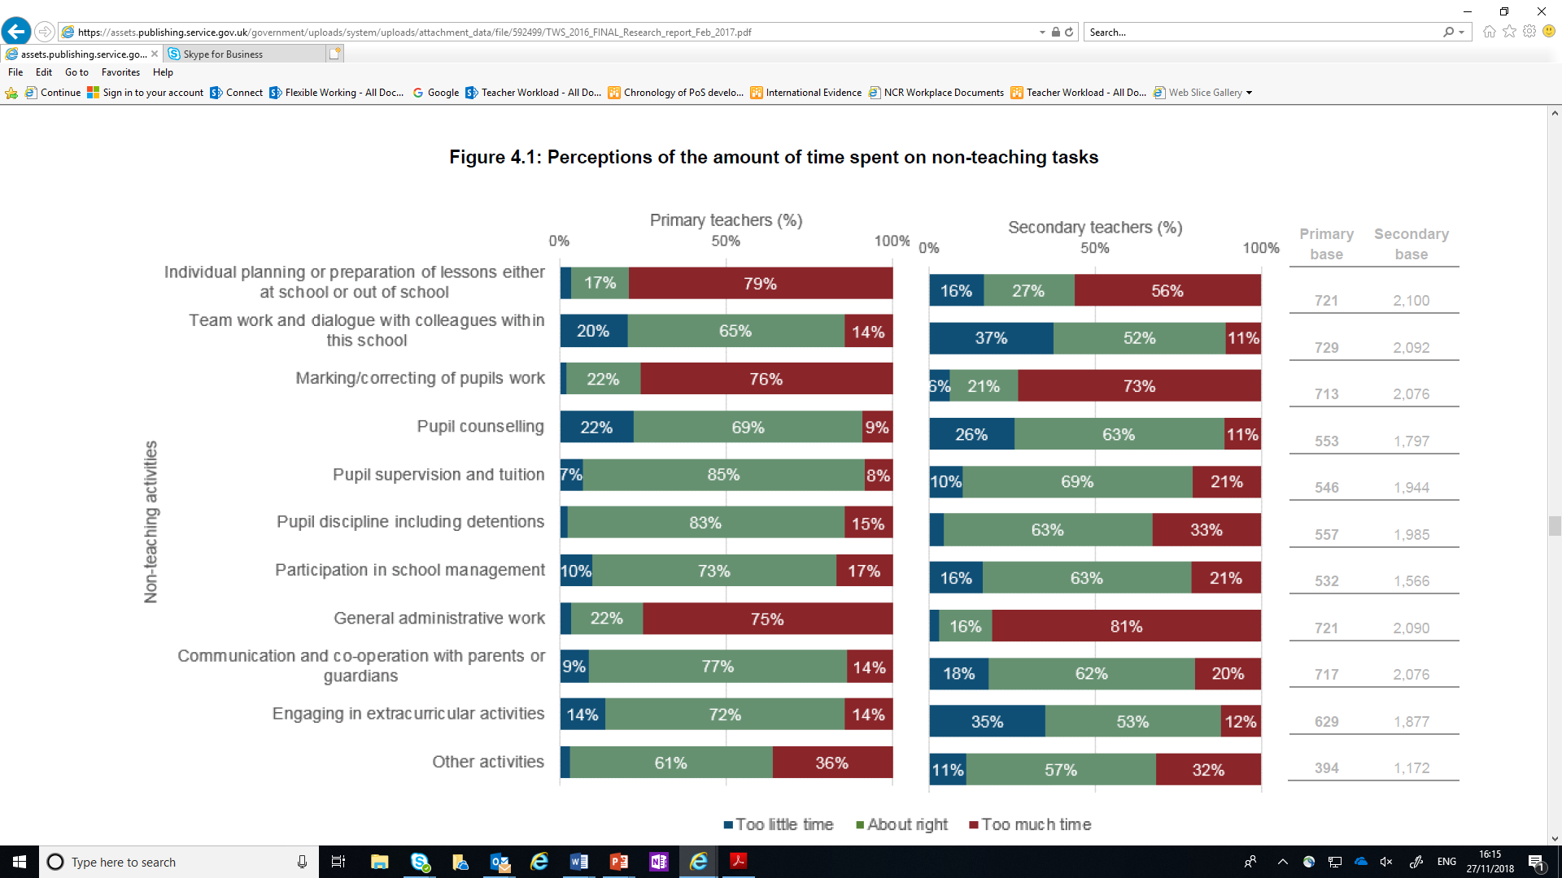
What is taking up teachers’ non-teaching time?

Slide 33



What are the current workload challenges leaders / teachers face in bradford schools?

Slide 34

Education Secretary DfE
HOW?
In his speech to the ASCL conference, the Education Secretary pledged to tackle workload, together with Ofsted and school leaders. He announced:
  a strategy to drive recruitment and boost retention of teachers working with teaching unions and professional bodies to devise ways of attracting, and keeping, the brightest and best graduates
  a commitment to work with Ofsted, regional schools commissioners, the Education and Skills Funding Agency and multi-academy trusts – to clarify their roles and ensure teachers and school leaders have a clear understanding of who they are accountable to, and for what
  that there will be no new tests or assessment for primary schools and no changes to the national curriculum, GCSE or A levels for the remainder of this parliament, beyond those already announced
  I will also look at the accountability system and how it can drive unnecessary workload.
  https://www.gov.uk/government/publications/reducing-teachers-workload/reducing-teachers-workload

Slide 35
What’s been done so far?
Workload Challenge survey – Autumn 2014
DfE Protocol published February 2015 and reissued February 2017
Three independent review groups (marking, planning and data management) - reports published March 2016
Teacher Workload Survey (TWS) 2016 published in February 2017
Action Plan to address issues in the TWS – February 2017
Poster and Pamphlet summarising the workload reports – February 2017
DfE ‘Teaching Blog’ and TES Workload hub – sharing practical examples
Series of 10 workload events around the country, November 2017 – March 2018
11 Research and Development projects funded– reports published March 2018
New commitments from the Secretary of State to tackle workload associated with accountability and government reforms – ASCL, NAHT and NGA conferences 2018
Workload Reduction Toolkit published – July 2018
Impact on schools tools developed and trials initiated – September 2018
Videos from SoS, Minister of State and stakeholders – March and July 2018
Advice for ITE providers on addressing trainees’ workload – November 2018
Workload Advisory Group report, government response and letter to all school leaders from SoS and stakeholders – November 2018
FROM NLE JANUARY BRIEFING PRESENTATION – Jane Hough

Slide 36
Update since the toolkit July 2018
Workload Advisory Group report, government response and letter to all school leaders from SoS and stakeholders – November 2018
Develop the toolkit to include reducing workload around behaviour.
Develop the toolkit to include governance.
Further develop work around SLT workload.

Slide 37
The Workload Advisory Group Report
Principles:
The purpose and use of data is clear, is relevant to the intended audience and is in line with school values and aims.
The precision and limitations of data, and what can be inferred from it, are well understood.
The amount of data collected and the frequency with which it is collected is proportionate.
School leaders review processes for both collecting data and for making use of the data once gathered.

Slide 38
What this means for schools
Recommendations for DfE:
Beyond statutory data collections (such as the results of Key Stage 1 assessments), do not request regular attainment data from schools unless they meet a trigger for intervention.
Not to request data on pupil targets and predictions to hold schools to account.
Some examples:
School leaders should minimise or eliminate the number of pieces of information teachers are expected to compile.
School leaders should give teachers goals that are within their control, are closely tied to genuinely actionable behaviours that you want them to change, and are aspirational yet potentially achievable.
School leaders should not: have more than two or three attainment data collection points a year, which should be used to inform clear actions. Increasing assessment frequency is not inherently likely to improve outcomes for pupils.
School leaders should not link pay progression for teachers solely to test outcomes.

Slide 39
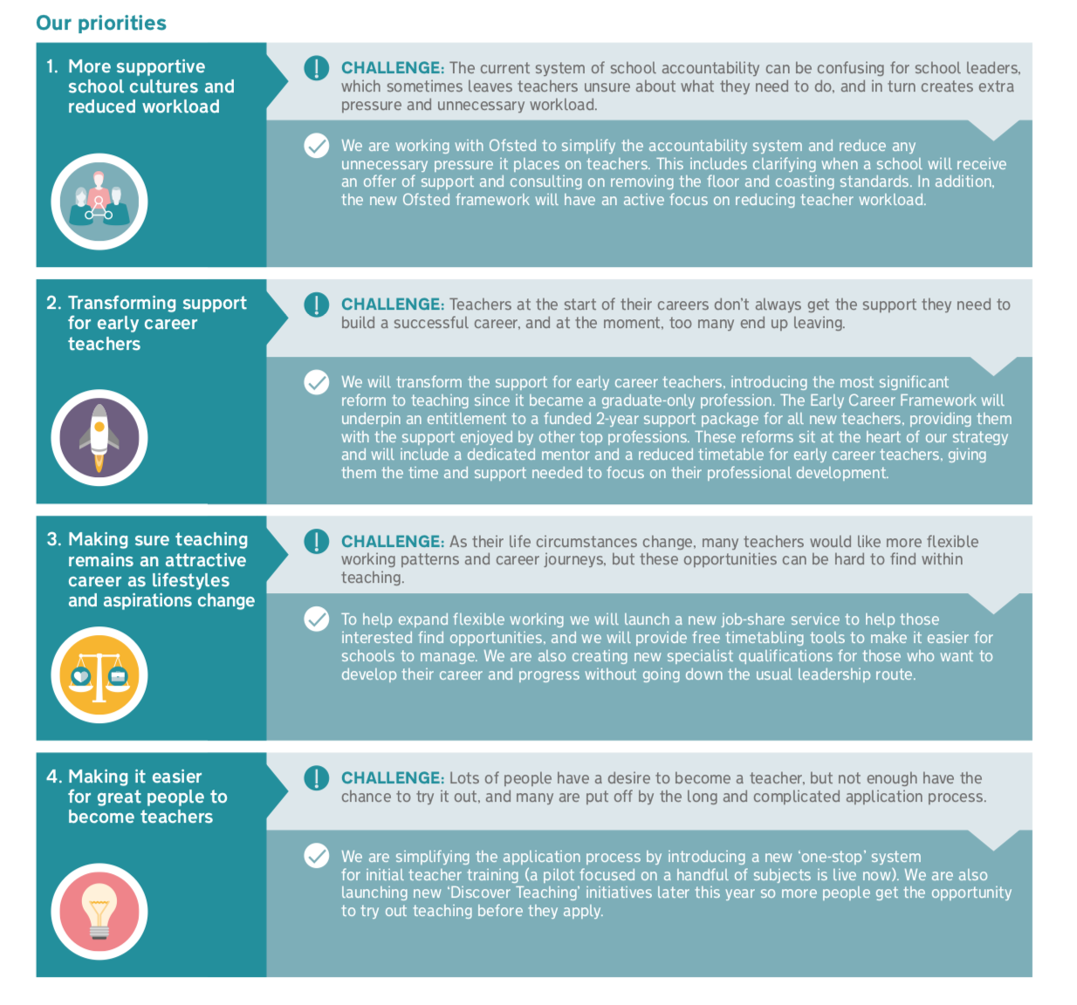

DfE Strategy

Slide 40

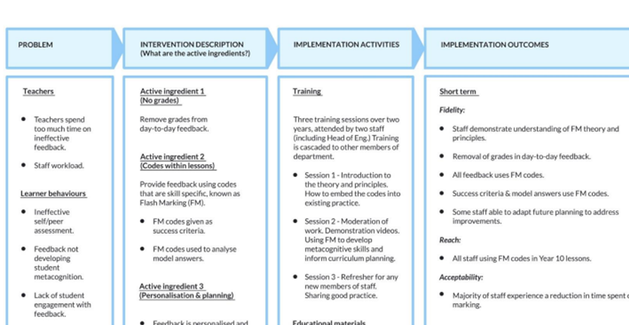
EEF Guidance

Slide 41
Stage 1
Identifying the issues –
impact assessment tools; survey; structured conversations
Actions taken to reduce workload
in schools
Stage 2
Addressing the issues in schools
Communications, including use of email;
Curriculum planning and resources;
Data management;
Feedback and marking;
Managing change, including planning the yearly calendar and managing ‘pinch points’; and
Advice to support early career teachers
Stage 3
Evaluating the impact
What is the Workload Reduction Toolkit?
‘We know that teacher workload is an issue for everyone to address – including government. As well as tackling the drivers of workload nationally, we have recently published a toolkit for schools. This provides free online training materials, audit tools, practical examples and model policies, developed and tested by school leaders and teachers.’

Slide 42
Key questions: SYSTEM LEADERS
Are all tasks considered in the context of impact on the quality of teaching and learning or pupil outcomes?
Are there any tasks that could be taken away?
How involved do teachers feel about their workload? (SRA Control)
Amount of Workload
High
Low
Low
High
Impact on Teaching and Learning

Slide 43
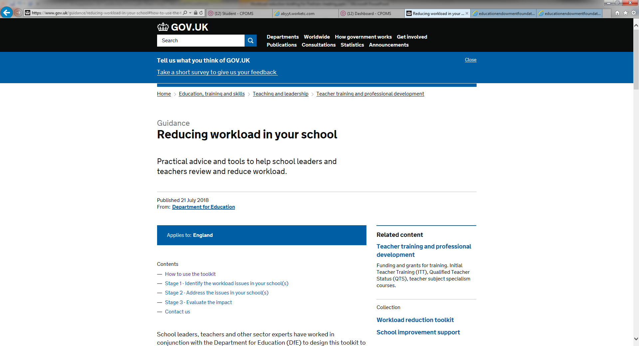

Slide 44
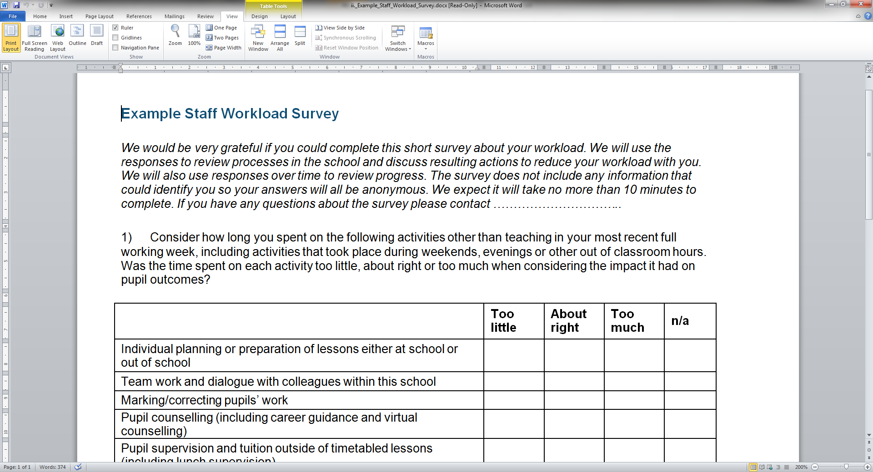

Slide 45
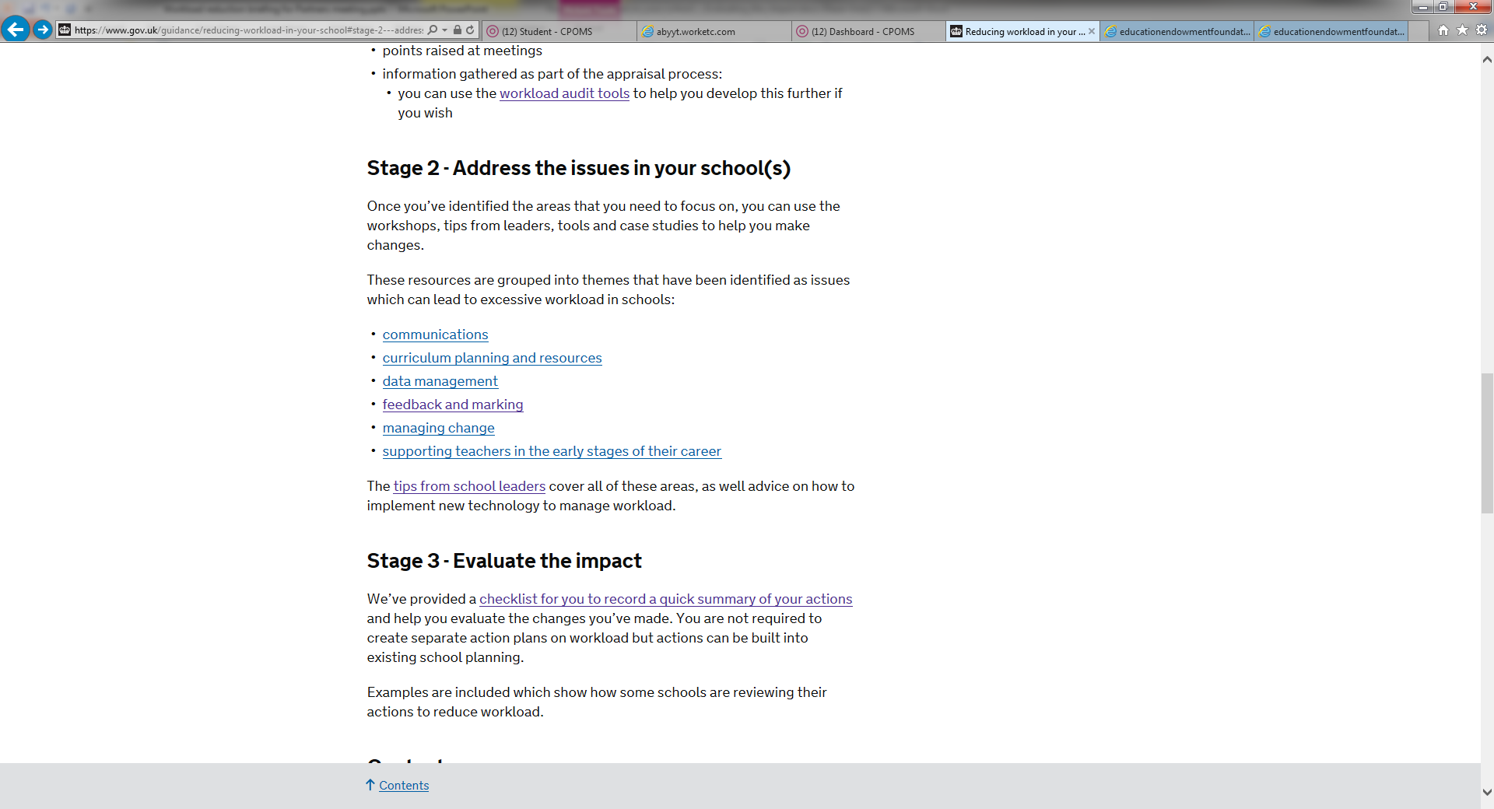

Slide 46


Slide 47
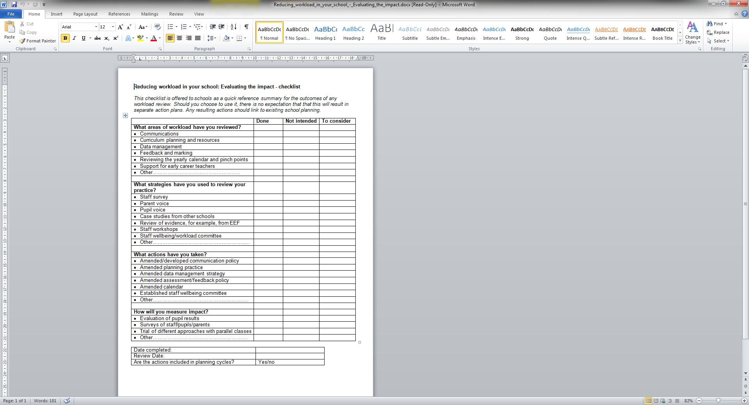

Slide 48




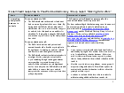
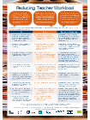



Resources available to support:
Workload Reduction Toolkit: https://www.gov.uk/guidance/reducing-workload-in-your-school
Workload Advisory Group report and Government response: https://www.gov.uk/government/publications/teacher-workload-advisory-group-report-and-government-response
Teaching Blog – https://teaching.blog.gov.uk
Report and posters of school based research: https://www.gov.uk/government/publications/teacher-workload-challenge-school-research-project-reports

Slide 49
Contact
Liz Whetham
07827666821
liz.whetham@holytrinitycofe.calderdale.sch.uk

Slide 50
New Framework Pilot
Paul Urry
Headteacher - St Stephens Primary School

Slide 51
Music Hub Offer
Tony Johnson
Head of Music & Arts
Felicity French
Assistant Head Ensemble

Slide 52
Skills 4 Bradford - New Website Launch
Adele Baines
Commercial Services Manager

Slide 53

Bradford Council
Commercial Services for Schools

Slide 54

New Website

Slide 55

Service Groups

Slide 56

Service Pages

Slide 57

Individual Services

Slide 58
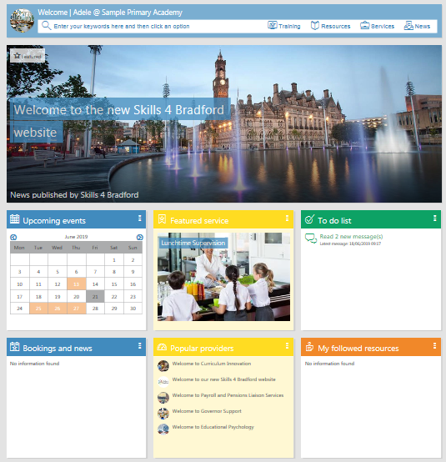
Members Portal

Slide 59
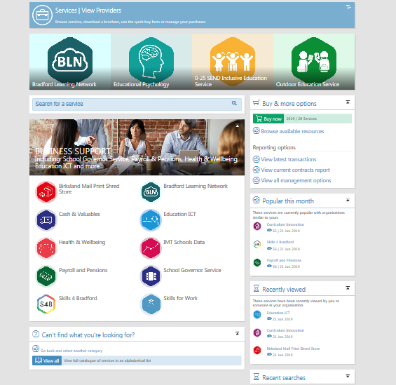
Services

Slide 60
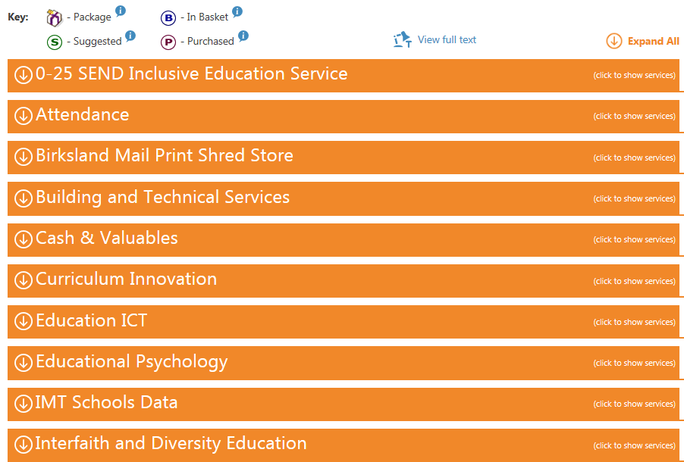
Buying

Slide 61
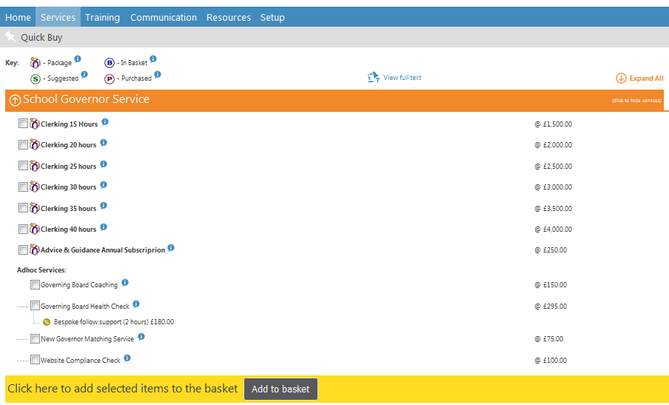
Buying

Slide 62
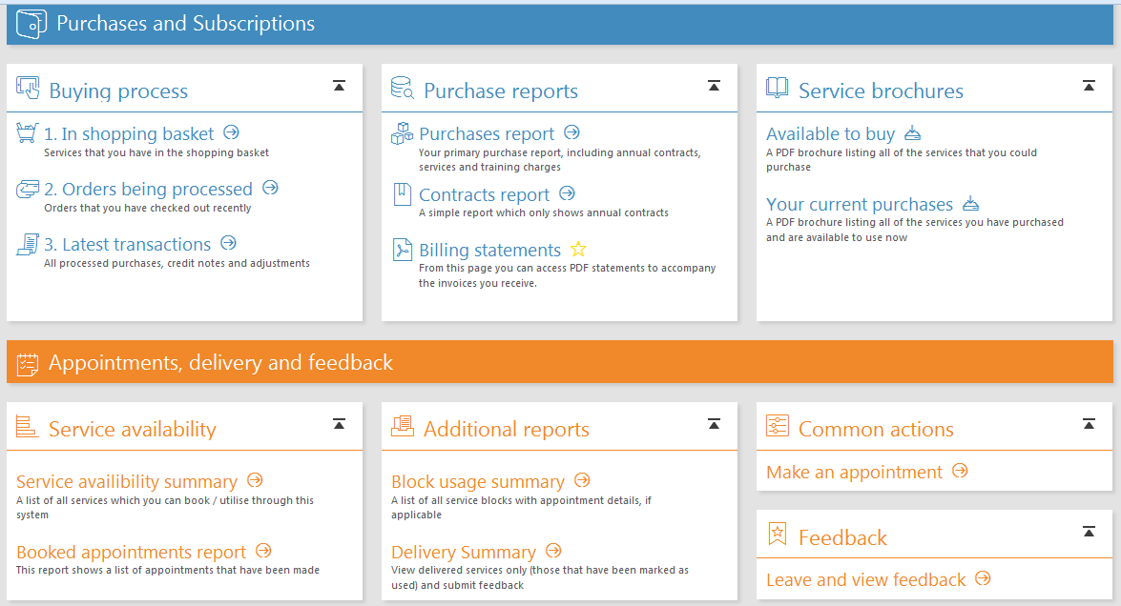
Management
Functions

Slide 63
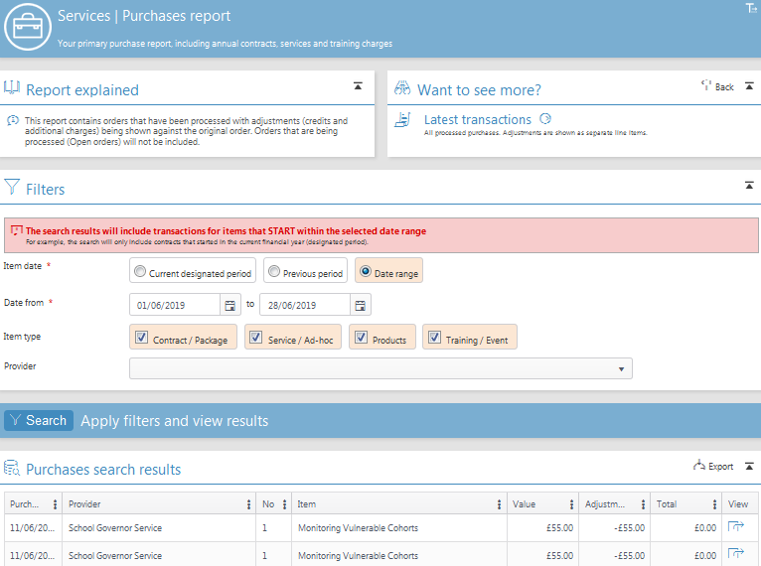
Reports

Slide 64
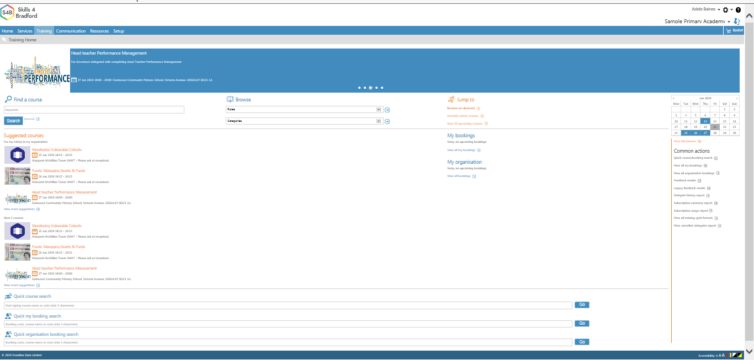
Training

Slide 65
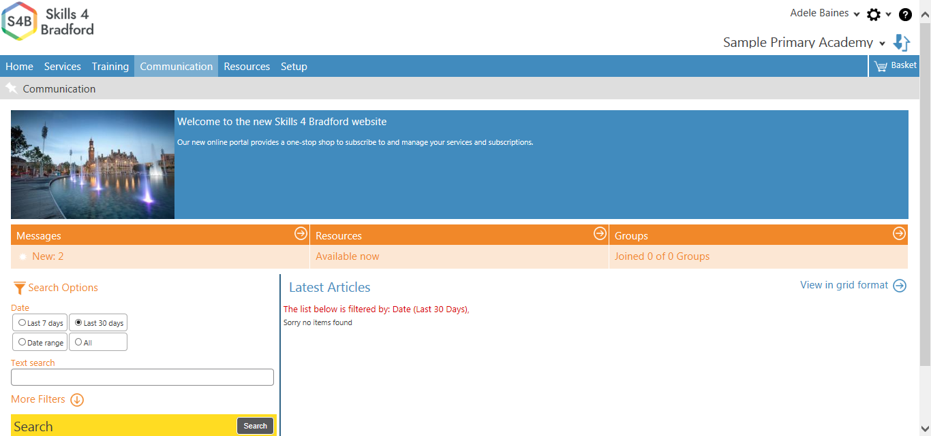
Communication
Will include group forums for member discussions e.g.:
Head Teachers School Business Managers
Governors Subject leaders

Slide 66
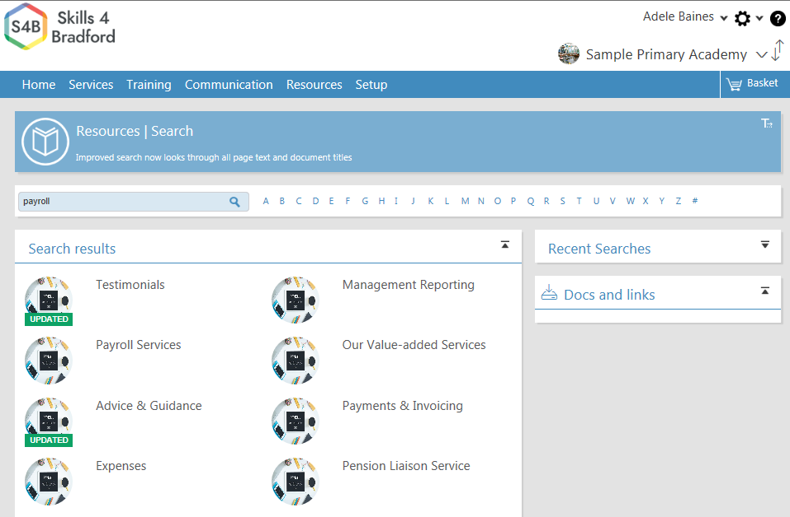
Resources

Slide 67
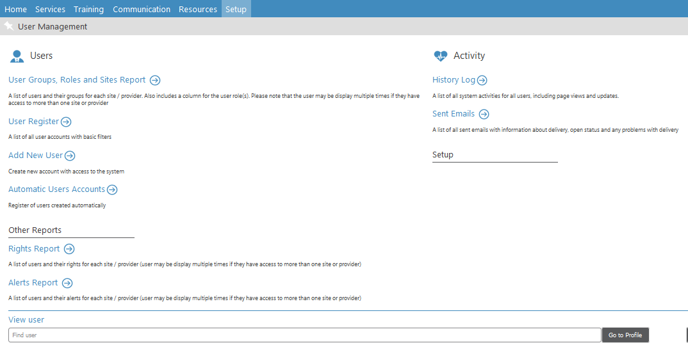
Set Up

Slide 68
Next Steps
Majority of schools have 1 or 2 users set up if existing clients (not generic emails – accountability of buying function);
New User Request Form.
School user training session.
Coming in the Autumn term:
  Governor Module
  Card payments

Slide 69
Thank you for your time
Any questions?

Slide 70
Hate Crime
Mohammed Dhalech
Kate Butler

Slide 71

Bradford hate crime Alliance
52 Cornwall Road
Manningham
Bradford
BD8 7JN
Tel: 07915 119 022
Email: mohammed@bradfordhatecrimealliance.org.uk
kate@bradfordhatecrimealliance.org.uk

Slide 72
ILACS Inspection Update
Dr Marium Haque
Deputy Director Education & Learning

Slide 73
Thank you for your support and
co-operation
Wishing you all a good summer

