Slide 1

Senco Network
Autumn Term 2022

Slide 2
Agenda
 | Agenda | Presenter | Time
9.00 | Introductions and welcome | Ruth Dennis – Principal Educational Psychologist | 5 minutes
9.05 | Improving Outcomes for Children with SEND in Bradford | Ruth Dennis– Principal Educational Psychologist / | 15 minutes
9.20 | Bradford SEND Inclusion Chartermark | Josh Wadsworth - Transformation and Compliance Coordinator | 25 minutes
9.45 | Update from the Virtual School | Louise Coates-Black SEND Lead Specialist teacher and Attachment Lead | 15 minutes
10.00 | Break |  | 20 minutes
10.20 | Update from the SEN Assessment Team | Bev Williams, Lead Officer Quality Assurance Integrated Assessment Team | 30 minutes
10.50 | SCIL Team delivery model 2022 - 23 | Lucy Stead - Service Manager Social, Communication, Interaction and Learning (SCIL) Team | 25 minutes
11.15 | SEND Q and A | Niall Devlin / Charlie Lowe Strategic Manager, Integrated Assessment and Psychology | 30 minutes

Slide 3
Improving Outcomes for Children with SEND in Bradford
Ruth Dennis
Principal Educational Psychologist

Slide 4
SEND Green Paper
It sets out plans for an inclusive system:
  improved mainstream provision
  early and accurate identification of needs
  high-quality teaching
  prompt access to targeted support
Timely access to specialist services and support
Strong co-production with families
Accountability at every level
Improved data collection to give a timely picture of how the system is performing.

Slide 5
Ofsted Judgement
Better communication across the system – aims and vision
Greater focus on SEND Support
Greater focus on progress for children with SEND

Slide 6
Improving Outcomes for Children with SEND in Bradford
Neurodiversity Future Pathway
Mental Health and Emotional Wellbeing
Trauma and Resilience
Improving progress for children with SEND
Meeting Individual Needs

Slide 7
Improving progress for children with SEND
Supporting schools via
Bradford Inclusion Chartermark
SCIL / EPT / Exclusions teams core offers
SEND Spotlight Conferences
Improving Progress for Children with SEND Project
Developing SEND good practice ‘Beacon schools’

Slide 8
SEND Spotlight Conferences
2022 - 23 | Autumn 1 Senco Network (online) | Autumn 2 SEND Spotlight Conference – Improving Outcomes for children with SEND | Spring 1 Senco Network (online) | Spring 2 SEND Spotlight Conference – Trauma and Resilience | Summer 1 Senco Network (online) | Summer 2 SEND Spotlight Conference – Mental Health
 | 21/09/22 | 06/12/2022 | 18/01/23 | 22/03/2023 | 03/05/23 | 05/07/2023

Slide 9




Schools Inclusion Chartermark
August 2022
V1.0

Slide 10

SEND: Code of Practice
Equality and inclusion
6.8
Schools support pupils with a wide range of SEN. They should regularly review and evaluate the breadth and impact of the support they offer or can access. Schools must co-operate with the local authority in reviewing the provision that is available locally (Chapter 3) and in developing the Local Offer (Chapter 4). Schools should also collaborate with other local education providers to explore how different needs can be met most effectively. They must have due regard to general duties to promote disability equality.

Slide 11
Establishing an Ethos
“The National Curriculum Inclusion Statement states that teachers should set high expectations for every pupil, whatever their prior attainment.”
SEND: CoP 6.12
Branding
Peer to Peer Support, led by School Leaders
Every Teacher a teacher of children with SEND
Every school inclusive and ambitious for children with SEND
The brand will allow stakeholders to identify you as an inclusive school, as per Bradford’s Committed to Inclusion Chartermark.
Critical friendship and challenge is essential to successful collaborative R&D. Cross-alliance links between peers sharpens thinking, provides further options and can help create the regional and national connections that are more likely to promote system-wide change.
Stoll, L. (2015) Three greats for a self- improving school system: pedagogy, professional
development and leadership: executive summary (Teaching schools R&D network
national themes project 2012-14). London: Department for Education (DfE).

Slide 12

Local recognition
Inclusive Practice Framework
Peer to Peer Support
Targeted training
Inclusion Kite Mark

Slide 13
3 year plan
Year 1 – Define a small number of criteria and identify schools that meet these and award these with the Committed to Inclusion Chartermark
Year 2 – Increase number of criteria, identify School Leaders who would be happy to be a lead stakeholder
Year 3 – Set-up peer to peer working groups

Slide 14
How to gain the award
Schools are encouraged to collect credits, by meeting a number of key indicators selected by stakeholders across the local partnership.
In the first year these focus on minimum standards set out in the SEND Code of Practice, as well as the level of engagement with the Local Area’s initiatives to help improve inclusive practice.
Schools who are awarded with the Chartermark, will be entitled to display the award and include it in their school publicity.

Slide 15
Inclusive Practice Framework - Criteria
Credits | Key Indicators | How we will know | How we will support you
5 | Have a designated SENCo | Registered with SEN / Assistant EP contact | SCIL SEND Specialist Support EP team traded and universal offer Exclusions Team offer Integrated Assessment SEND TEAM PLUS Additional SCIL / EPT / Exclusions team support where required to enable schools to gain the award.
5 | Have a named Mental Health Champion | MHC records
5 | Have a published Local Offer on your school’s website | School website
10 | Sign up and attend/watch all SENCo Network meetings | Register
15 | A reduction in the number of E and K code suspensions | Exclusion team records
20 | Improvement on: RWM - achieved standard P8 score | NCER
20 | Take up of SCIL SEND Specialist Support | SCIL records
20 | Senco engages with the EP team through traded work, hub consultations, projects or research | EP records
In 2022 – 2023 the Committed to Inclusion award will be presented to schools which gain 40 credits or above, demonstrating the positive impact that they have had on pupils and young people in school.

Slide 16
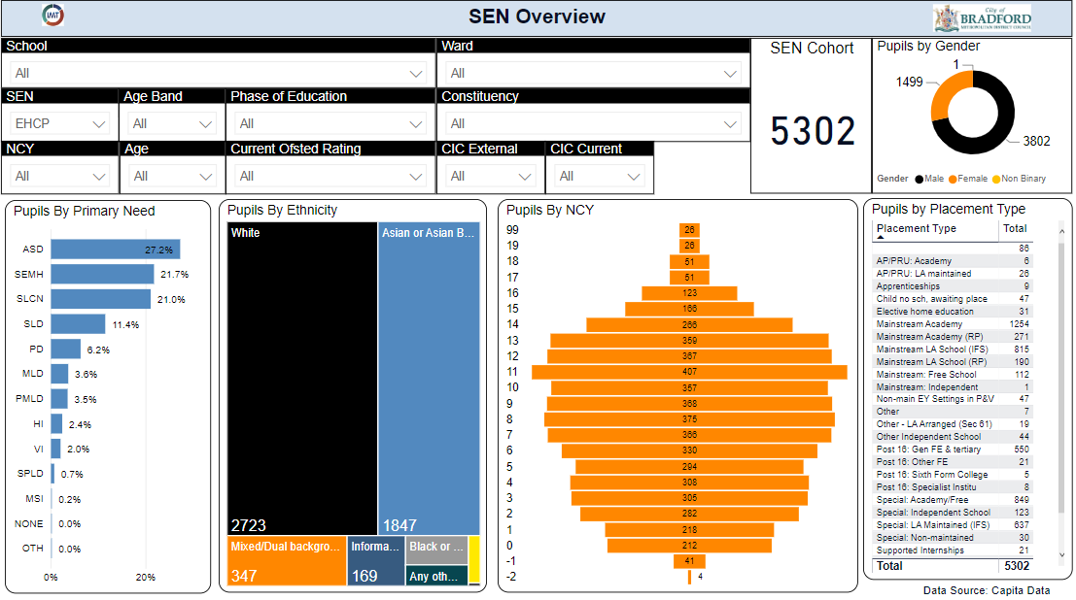


Inclusive Practice & Data
A good understanding of what is happening in the local area
Agree a set of key indicators which we can measure inclusive practice by
Identify strengths/areas for development, look at setting up peer-to-peer groups and training for certain schools for help and support

Slide 17
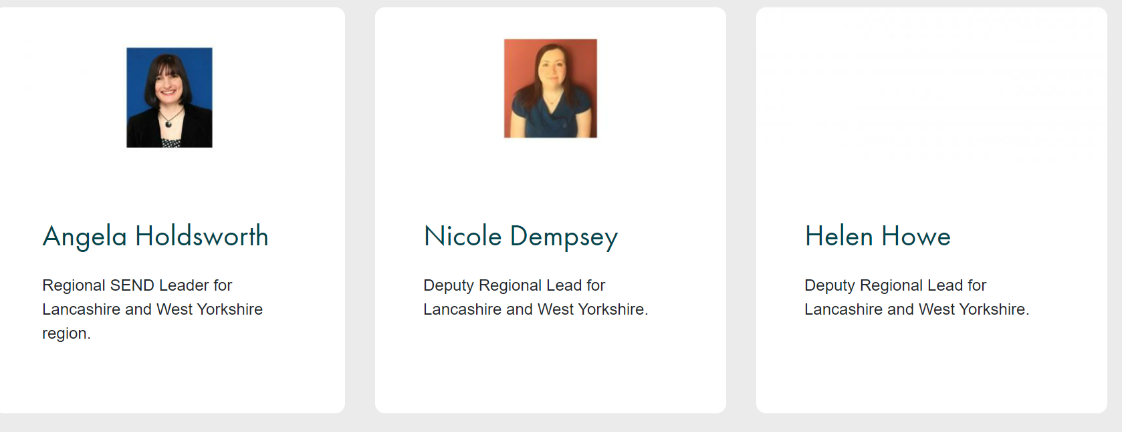

NASEN Guidance and Training
Online learning
Resources and publication
Whole School SEND materials
SEND Reviewer Training

Slide 18
Peer to Peer Support
What’s worked for them
Practice Leaders
Support
Challenge
In-reach
Outreach
NASEN SEND Review
Feasibility
Visits

Slide 19
Targeted Training
Link training, attendance at events and other must do activities to credits
Develop plan for academic year
Publish and track take-up / attendance
Those that meet the agreed standard receive the award

Slide 20
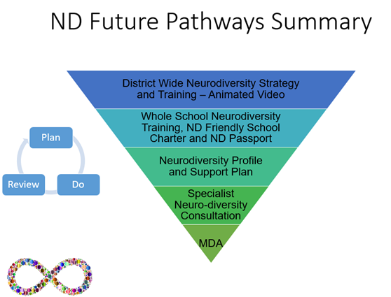
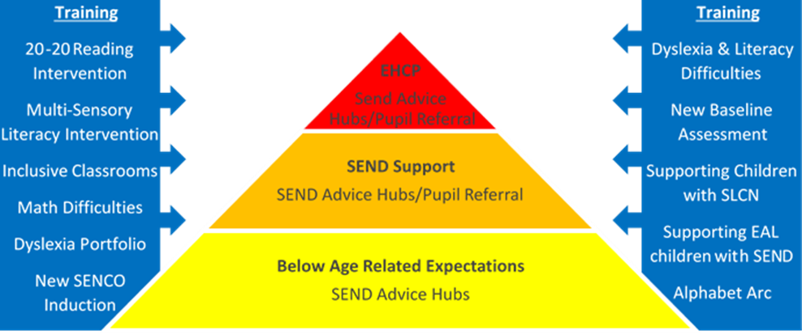

Synergy – Building on the foundations
Continue to review and strengthen the use of data to inform which schools are doing well and which need support
Use the data to help the Local Area understand whether the correct pupils are at SEND support (are settings holding CYP at SEND support or putting in for an EHCA potentially too early?)
Ensure schools are familiar with the support available:
  Relevant training from all services
  SEND Advice Hubs ran by the SCIL Team
  Best Endeavours and Quality First Teaching Spreadsheet
  SENCO Network training
  Healthy Minds Chartermark
  Thrive framework (MHST & MH champions)
  ND Future Pathway Project
Raising Attainment Strategy 5 year plan

Slide 21
How Committed to Inclusion will be awarded
The award will be renewed annually, with the opportunity to progress to silver and gold in subsequent years, based on additional criteria, the awards will be presented at a SEND conference at the end of this academic year or SENCo Networks.
Throughout the year schools demonstrating excellent practice will be identified by the help of the EP team, SCIL team, SEN Assessment team, Attendance team and Exclusions team and they will work with them to enable them to become ‘Beacon Schools’ and to share their practice with other schools in the district.
They will simultaneously be working together to identify schools who require additional support to develop their inclusive practice. They will be able to offer advice, support and training to help progress this, as well as linking to ‘Beacon Schools’.
It is important to maintain the credibility of this award and there may be times when we need to contact schools to understand the circumstances about a concern which has been brought to the attention of Local Authority officers about SEND practice.

Slide 22
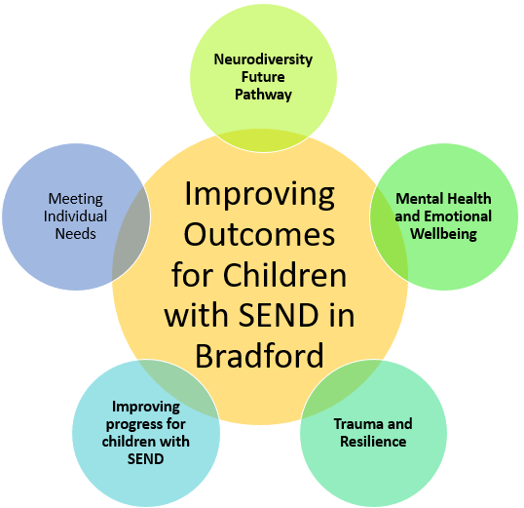
Better Outcomes for CYP with SEND
Suspensions
Attendance
Qualitative
Vita
Vital Signs
My Support plans
Quantitative
EHC plans
ND Future Pathway Project
QFT
Act as One Pathway
SEND Improvement Programme
SEND Partnership Board
Best Endeavours
ETE & Cities of Learning
SEND specific training
Better Start Bradford
Raising Attainment Strategy
How do we know?
ACEs Trauma Resilience Strategy

Slide 23
Finally
We want it led by school leaders (the ‘people on the ground’)
Start small and build on year by year
Celebrate success - invest in an event which recognises achievement and good practice
We will be looking at endorsements from the local University

Slide 24





SENCO Network
21st September 2022
Social, Communication, Interaction and Learning (SCIL) Team
Lucy Stead
Service Manager
Early Years
Learning Support
Communication and Interaction
Access and Inclusion Officers
Social, Emotional and Mental health
© Copyright applies to the whole document - Written and developed by 0-25 Specialist Teaching & Support Services, City of Bradford MDC
Notes:
For anyone who may not know me or the team, Introduce myself as service manager of the SCIL Team (explain acronym).
We are a team of Specialist Teachers and Practitioners (supporting schools), Access and Inclusion Officers (supporting private, voluntary and independent (PVI) (birth-5 years) settings).
We offer specialisms in four key areas: Early Years, Communication and Interaction, Learning Support and Social Emotional and Mental Health.

Slide 25
Specialist Teaching and Support Service (STaSS)
Social, Communication, Interaction and Learning (SCIL) Team | Low Incidence Team (LIT) and Sensory Service | Local Authority Lead Resourced Provisions (LARPs) | Medical Needs and Hospital Education Services (MNHES)
Notes:
To set the team in context, SCIL is part of the Specialist Teaching and Support Service (STaSS) also made up of: The Low Incidence Team (Sensory Service), The Local Authority Led Resourced Provisions and the Medical Needs and Hospital Education Service.
Alice Ngondi – Strategic Manager

Slide 26

Vision for all Teams across STaSS
“Our vision is to provide high quality support for all Bradford children and young people using a collaborative approach through transformational learning experiences so that they can flourish, make excellent holistic progress and successfully transition to responsible citizens”.
Notes:
The STaSS vision is displayed (give a moment to read it)

Slide 27
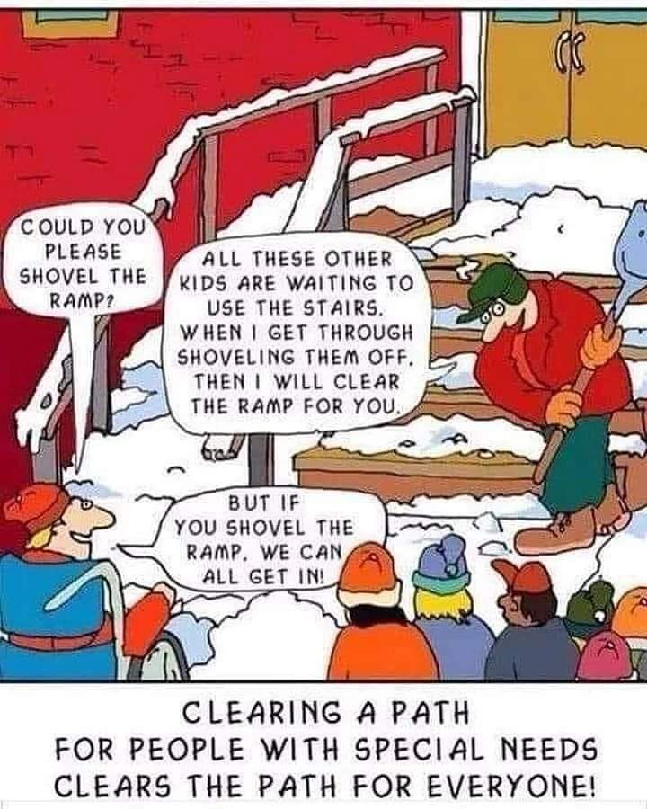
Posted on Twitter 11th April 2022 4.10pm @teachergoal (origin of the photo – unknown)
Notes:
(give a moment to read/look at) - good SEN practice benefits all our children.
Every Teacher is a teacher of children with SEND

Slide 28

The SCIL Team Offer
Our offer focuses on equipping mainstream schools/settings to identify and effectively support children and young people with Special Education Needs and Disabilities through high quality teaching, reasonable adjustments and additional provision.
We will achieve this by working alongside key staff in schools and settings to:
share our specialist knowledge, skills and experience,
develop inclusive practice of staff and,
support the graduated approach.
Notes:
We have launched our enhanced offer from September.
The SCIL Team will provide pro-active support on a wider school level bespoke to your needs rather than the previous model of responding to individual referrals.

Slide 29
Individual
children
High quality teaching/provision, classroom/setting adjustments, whole school/setting processes
Interventions
Small group support
Notes:
Using the visual of a 3 tier triangle
Previously our offer was all at the top tier.
Now the balance of our offer will be flipped to provide support to impact whole school inclusive practice, high quality teaching (the foundations 1st tier) and to support interventions (2nd tier). We will maximise time spent in schools/settings. We will spend regular time in schools/settings modelling, supporting, coaching.
We understand that a small number of children and young people with more complex needs may require individual targeted specialist advice and this will follow a graduated approach (once the first 2 tiers are in place).

Slide 30
A. SEND Specialist Support Request
Notes:
How it works – received many requests already
You can access SEND specialist support by completing a one page form on Skills 4 Bradford to provide key contact information, determine a specialism and select priority areas for support. We will expect a commitment for appropriate staff to engage with the support offered.
A link SCIL Specialist Teacher/Specialist Practitioner will provide support, modelling and training around the priority areas by working alongside key staff to develop skills, knowledge and confidence.
A review of the support will take place termly by discussing progress towards the priorities

Slide 31
B. Support for individual children
Notes:
Following a graduated approach, advice for individual children/young people will be supported through a hub in the first instance. In the hub appointment, information will be gathered and recommendations will be provided around identified priorities. The Senco and staff working with the individual child/young person as well as the parent/carer can attend the virtual appointment. Hubs are advertised and booked via Training & Events | Skills 4 Bradford.
Following the implementation of the recommendations, if progress isn’t being made after at least six weeks, a request can made by the Senco for further individual support (via the hub feedback form).
Once the individual input is completed, progress and impact will be monitored.

Slide 32

C. Training
Fundamentals for Inclusion
Making Sense of Autism
SENCO essentials
Scheduled training
On demand training
Notes:
Each team (Early Years, Communication and Interaction, Learning Support and Social, Emotional and Mental Health) is offering a ‘Fundamentals for Inclusion’ continuous professional development programme for up to two key members of staff in a school/setting, one being a member of the Senior Leadership Team or Senco. The programme will take place over two or three terms and provide materials and resources to disseminate to colleagues focusing on implementing and embedding inclusive practice in schools/settings. There is no cost to these programmes. We would expect you to engage in one programme in line with your school/setting priorities.
Further training is also offered, subject to availability, at no cost such as: ‘Making Sense of Autism’ delivered on demand to schools. This training is accredited by the Autism Education Trust (AET), the DFE and is CPD certified. Senco Essentials training that includes the New Senco Induction.
Training can be accessed as a scheduled course or delivered on demand to schools/settings with additional costs.

Slide 33

Any Questions or Comments?
Contact Details:
lucy.stead@bradford.gov.uk
07582 100955

Slide 34

Break

Slide 35
Education Emotional Wellbeing Practitioners
The Education Emotional Wellbeing Practitioners' (EEWP) team are part of the Educational Psychology team
The team is fully funded and operates in schools that do not have access to an NHS MHST; this is to increase equity of access to services across the Bradford District.
EEWPs work with CYP within school and college settings who may be experiencing mild to moderate emotional difficulties, the most common being low mood and anxiety.
The EEWPs offer three strands of support: 1:1 interventions, Therapeutic Story Writing groups and whole setting workshops.
For further information around the range of support available please visit:
Education based Emotional Wellbeing Practitioners (EEWP) Team | Bradford Schools Online
Alternatively contact the Lead practitioner via email to discuss how the team could support a child or children further:
EdEmotionalWellbeing@bradford.gov.uk

Slide 36


Bradford Virtual School Training and Development
SENDCO NETWORK
Bradford Virtual School For Looked After and Previously Looked After Children
Louise Coates-Black

Slide 37
Bradford Virtual School
Virtual School Head
Jonathan Cooper
Business Support Officers
Yvett Green, Fiona Wood, Joanne Henry
Deputy Virtual School Head
Caroline Dolan
Specialist Teacher
(Secondary)
Rita Kumar
Specialist Teacher
(SEND)
Louise Coates-Black
Specialist Lead Teacher (Primary)
Vacancy
Secondary Link Teachers
Lisa Trusdale
Rachel Davies
SEND Link Teacher & Support Officer
Frances McGoldrick
Hollie Carter
Primary Link Teachers
Heather Dey
Felicity Rushworth
Post 16 transitions
Richard Miller
Link Teacher (OOA)
Aileen Whiteley

Slide 38


Statutory Guidance for Local Authorities & Schools
Promoting Educational Achievement
Notes:
Caroline

Slide 39
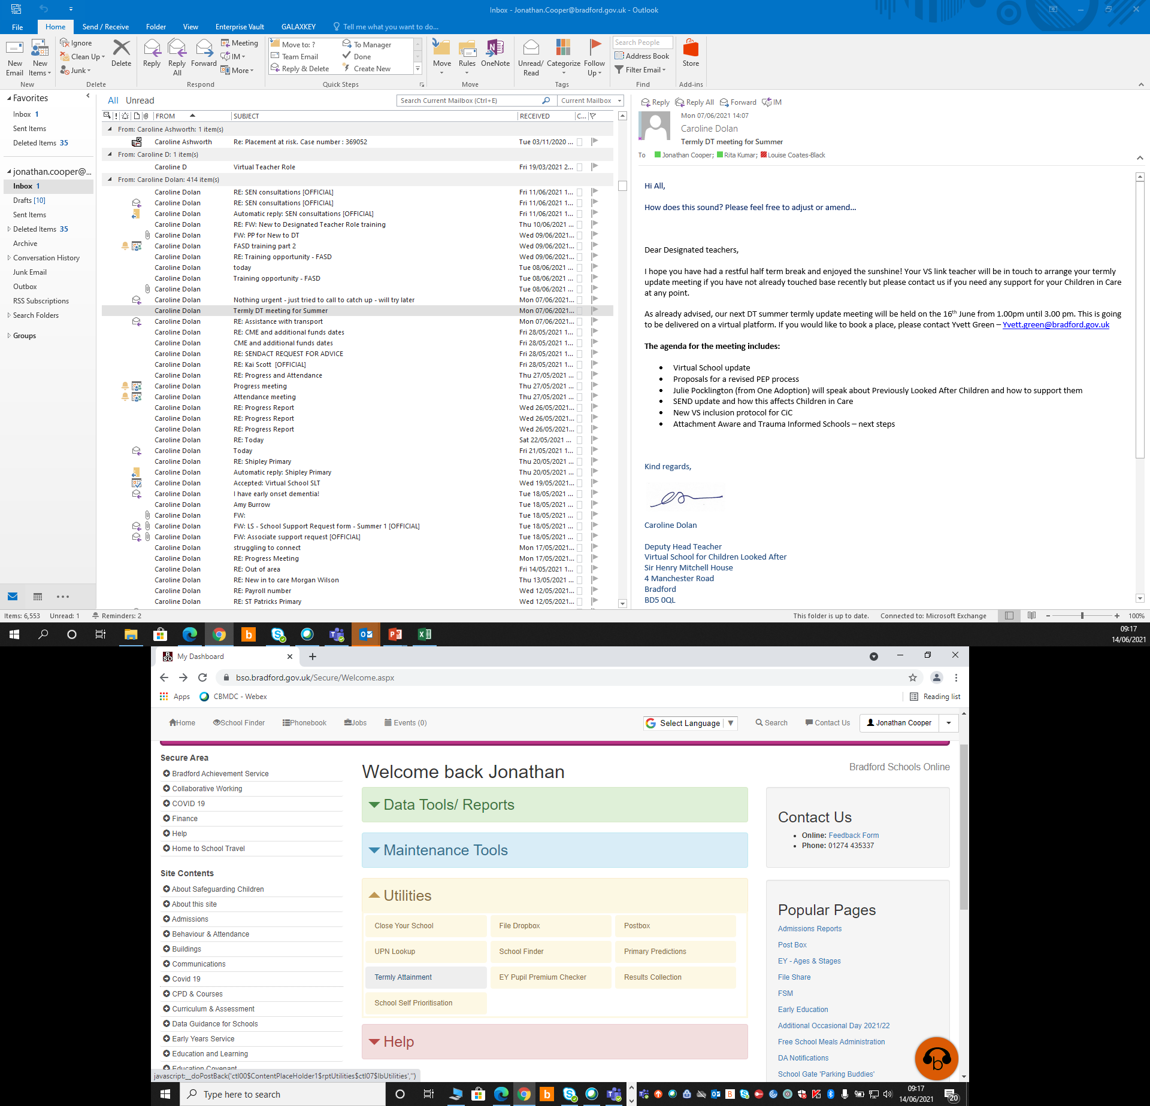
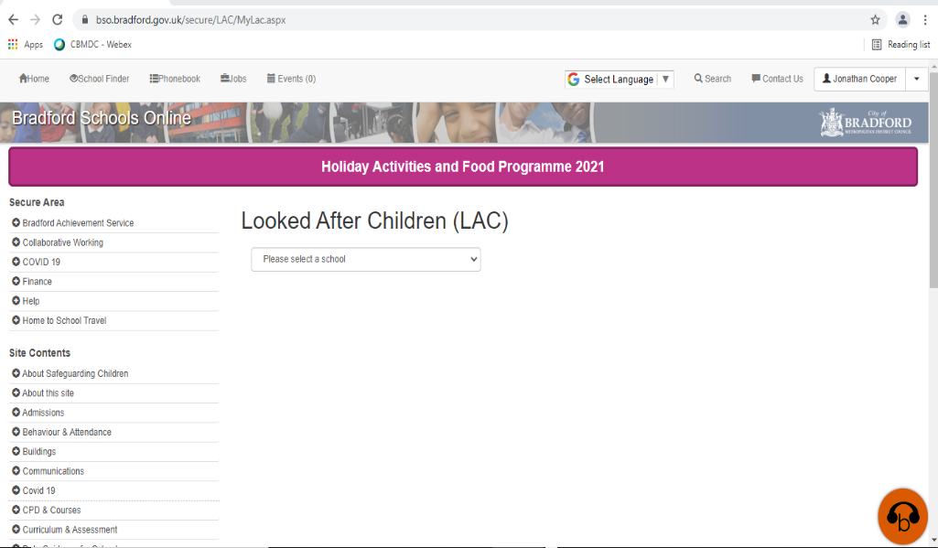
Bradford Schools Online

Slide 40

SEND support
Notify VS link teacher of any changes
SEMH needs
Graduated response
Bradford Matrix of Needs V2.2
My Support Plans
Involvement of outside agencies includes VS
Requesting EHCAs
Involvement of social care when requesting
VS support with reports

Slide 41
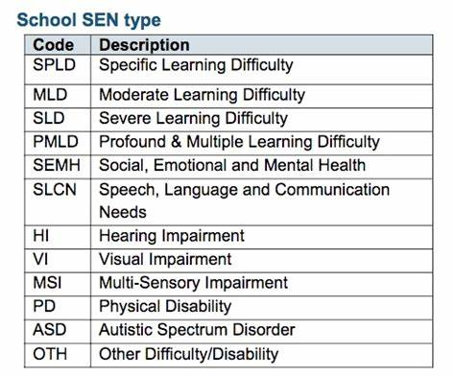
SEND support
Health & social care contributions
EHCP guidance for social workers
Work with SENCo to increase number of EHCA for children with a social worker

Slide 42
SEND Q and A
Niall Devlin, Strategic Manager, Integrated Assessment and Psychology /Charlie Lowe SEN Assessment Team Manager

Slide 43
Feedback or Questions
Ruth Dennis - Principal Educational Psychologist
City Of Bradford Metropolitan District Council
Margaret McMillan Tower
Princes Way
BRADFORD
BD1 1NN
ruth.dennis@bradford.gov.uk
07582 109129
01274 439417
Panel Volunteers contact: June.Eaton@bradford.gov.uk

Slide 44
Date of next meetings
Spring 2023: 18th January
Summer 2023: 03 May
Book via S4B

Slide 45

Questions

