Slide 1
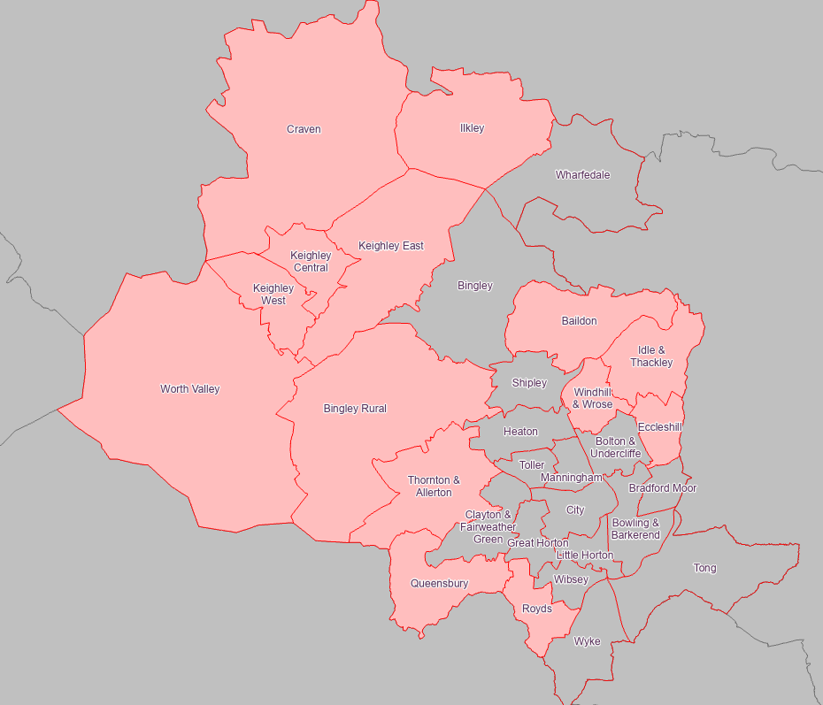
Childcare sufficiency picture - Under 2s
Wards with potential sufficiency issues
Baildon | Keighley East
Bingley Rural | Keighley West
Craven | Queensbury
Eccleshill | Royds
Idle and Thackley | Thornton and Allerton
Ilkley | Windhill and Wrose
Keighley Central | Worth Valley

Slide 2
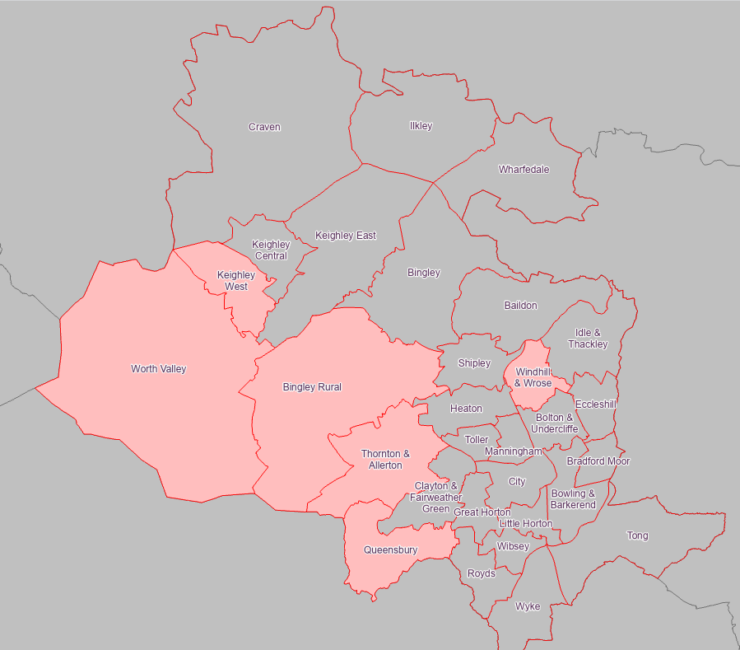
Childcare sufficiency picture – 2-year-olds
Wards with potential sufficiency issues
Bingley Rural | Thornton and Allerton
Keighley West | Windhill and Wrose
Queensbury | Worth Valley

