Slide 1
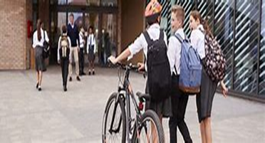
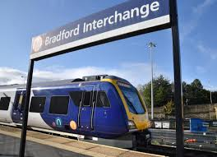
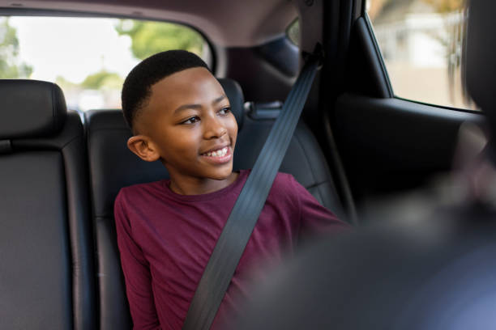
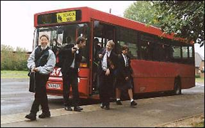
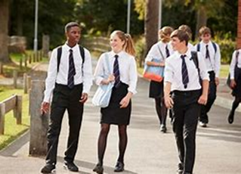
Are you ‘Good to Go?’
Notes:
Introduction
This is a presentation about staying safe on the road. You probably had road safety sessions or Bikeability training in primary school. Road Safety is an important subject as it is part of our every day lives - everyone here will have crossed a road or travelled on a road today to come to school.
Road Safety can be a sensitive issue for many people – some of you might know someone who has been involved in an incident on the road, or some of you may have been involved in one yourself. If you do feel uncomfortable with anything we talk about then talk to your teachers at the end of the session.

Slide 2

Time a Minute
Notes:
Before we go any further, we have a short exercise for you. We would like you all to stand up and time a minute (that’s 60 seconds) in your head and sit down as soon as you reach a minute.
(Make observations, did they look at their teacher, look at each other?) Don’t comment on it at this point.
Wait until about 1 min 10 seconds (or when everyone has sat down). Tell them you will come back to the exercise and why they did it later.

Slide 3

“Road Safety is something that young children learn….
“I know how to cross the road. Been there, done that. I don’t know anyone who has been hurt on the road, so I don’t need to worry about it.”
Notes:
In this presentation we will be covering the different ways in which people your age are hurt on the road – as pedestrians, car passengers and cyclists.
Q: How do you feel about listening to a road safety presentation?
The speech bubbles represent common thoughts of Year 7 students towards the topic of road safety. Click on the slide and read out the speech bubbles.
So why are we doing this with you? (Click on next slide to find out)

Slide 4
Fact
Road traffic incidents are the single biggest killer of young people aged 10-18 in the UK.
Notes:
(Read slide out).
This is why it is still important to think about and discuss road safety at your age.
Q. Why do you think traffic incidents are the biggest killer of 10 to18 year olds?
Possible answers might include:
-Making journeys independently
-Taking risks - thinking it won’t happen to them
-Using phones / headphones etc. while crossing the road
-Distracted by friends / messing around near the road
-Not wearing seat belts in cars
-The need to feel included or accepted by friends, causing them to do things which they otherwise would not do (peer pressure).

Slide 5
Mystery Graph……..
Child Casualties by age in West Yorkshire 2023
AGE
Notes:
Mystery Graph
Q. What do you think this graph shows? - take ideas.
Click to uncover the blue blocks & reveal the answer – child road casualties and their age in West Yorkshire in 2023. The blue lines represent the total number of casualties for that age group in West Yorkshire in 2023. The orange lines are the number killed & seriously injured.
Q. What do you notice happens in the graph? (sharp increase from 11 – 13 years old, casualties at age 11 are more than double the number at age 8).
Q. Why do you think this significant incline is specifically happening to your age group? (Mention that 2023 is not the only year this has happened, it is consistent every year).
Answers could include:
-Given more independence & responsibility (not out with parents all the time now)
-longer / more complicated journeys – sometimes unsure of the safest route
-Distractions, including friends, phones, music etc.
-Taking risks
-Not using the crossings or crossing where it is not safe
-Messing about near the road

Slide 6
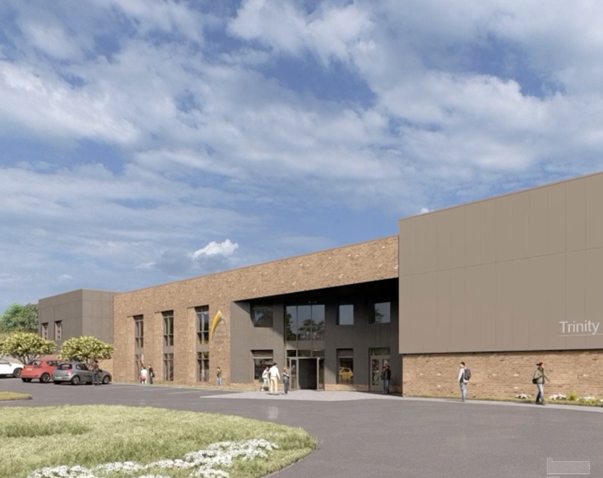
Why?
Being in groups -crowding, pushing, running into road
Unable to properly judge the speed of a vehicle
Distractions / not looking carefully
Crossing between parked vehicles / not using crossings
Driver is distracted or not looking properly
Notes:
This slide shows the top 5 causes of injuries to pedestrians your age recorded by the police. Some link back to the reasons we have just mentioned.
1. Crossing between parked vehicles – crossing between parked cars is not safe. Only do it if you have to & there are no safer alternatives. Remember - if you can’t see the driver, the driver can’t see you and a driver needs time to plan to brake.
Not using crossings - Many people are run over a few metres away from a crossing because the driver was expecting them to be using it, not crossing a few metres away from it, so didn’t have time to stop. It is usually much quicker to walk that bit further to a crossing.
2. Unable to judge the speed of a vehicle - It is hard to tell how fast a vehicle is travelling sometimes. They could be going a lot faster than they look and the faster they are travelling, the longer it takes them to stop.
Q. Does anyone know how many metres it takes for a car travelling at 30mph to stop?
A. 23 metres (5 to 6 car lengths). You might think you have time to cross, but the driver needs time to react and to apply the brakes and then the car needs time to slow down or stop, if you’re not sure whether there is enough time to cross safely, then it is best not to take the risk.
3. Driver is distracted or not looking properly – It is not always the pedestrian’s fault. Drivers are sometimes distracted – by passengers or their mobile phone, for example. We can’t always rely on them to be driving safely and that is why it is important that we look after ourselves by using the crossings and looking properly. If you appear from between parked cars in front of a driver who is distracted, then you have little chance of them stopping in time.
4. Being in groups – crowding, pushing, running into the road - We have all witnessed this happening at the end of school when everyone flocks out in crowds. Drivers are not expecting a child to suddenly appear in front of their car and might not be able to stop in time.
5. Distractions / not looking carefully – what could take your attention away from the road? (phones, friends, headphones…) What is the first thing you do when you get out of school? (Meet your friends & chat, get your phones out & start reading messages etc.) The most common reason given on all pedestrian accident reports is ‘failure to look’.
Q. Thinking about these reasons, how can you prevent yourselves getting hurt as a pedestrian?
Prompts if needed:
-What could you do so you’re not distracted by your phone while crossing a road? (put them in your pocket / bag)
-What could you do if the road you’re crossing is busy with parked cars? (move away to a space you can see clearly or cross between them -safely – stop at the edge of the cars where you can see).
-What would you do if you didn’t like the way that people you walked to school with were behaving?
It is also a good idea to set off on time so you’re not rushing – this is when we make mistakes & are tempted to take risks.

Slide 7
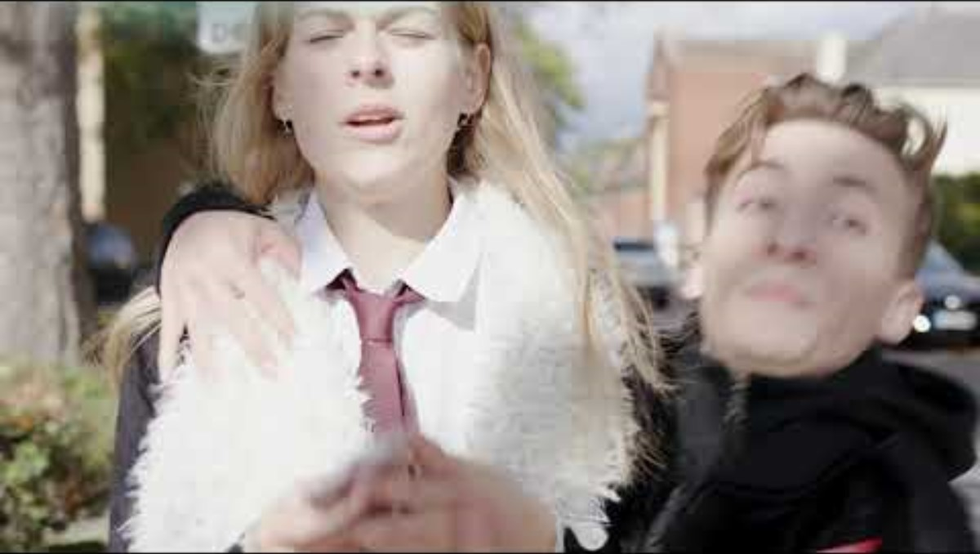
Notes:
Watch the film – it demonstrates how distracted we can be by our phones and what could happen.

Slide 8
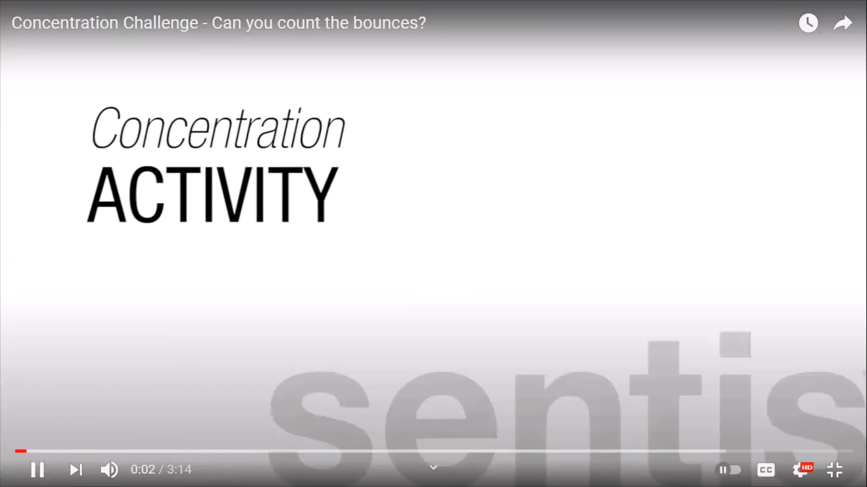
Notes:
This is a concentration activity. The man in the clip will explain what to do.
After the clip:
Listening to music, talking on a mobile phone, or with friends are all distractions which take your attention away from the road. Concentrating on two or more things at once is difficult and we often miss important things when trying to do it. That is why it’s important to give your full attention to the road while you are crossing – you don’t want to be looking down at your phone when you’re about to cross the road and miss the lorry pulling out of the junction right next to you.

Slide 9
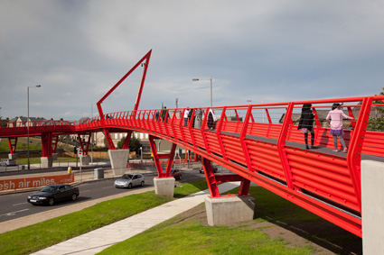
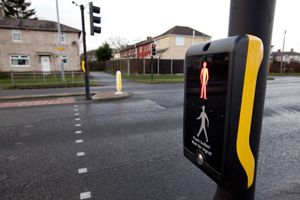
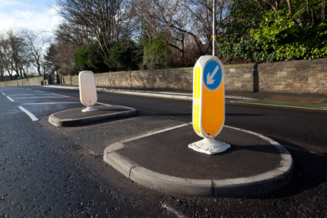
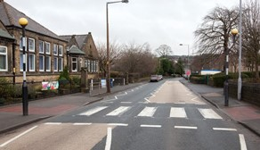
Use the Green Cross Code
Find a Safe Place
Stop
Look
Listen
Think
Notes:
It’s vital to recap on this while we’re talking about pedestrian safety, the Green Cross Code. You will have all learnt it in Primary School. It’s just as important to remember and to use it now - every time you cross.
Find a safe place – refer to the safe place you have outside / near school – please always use it.

Slide 10
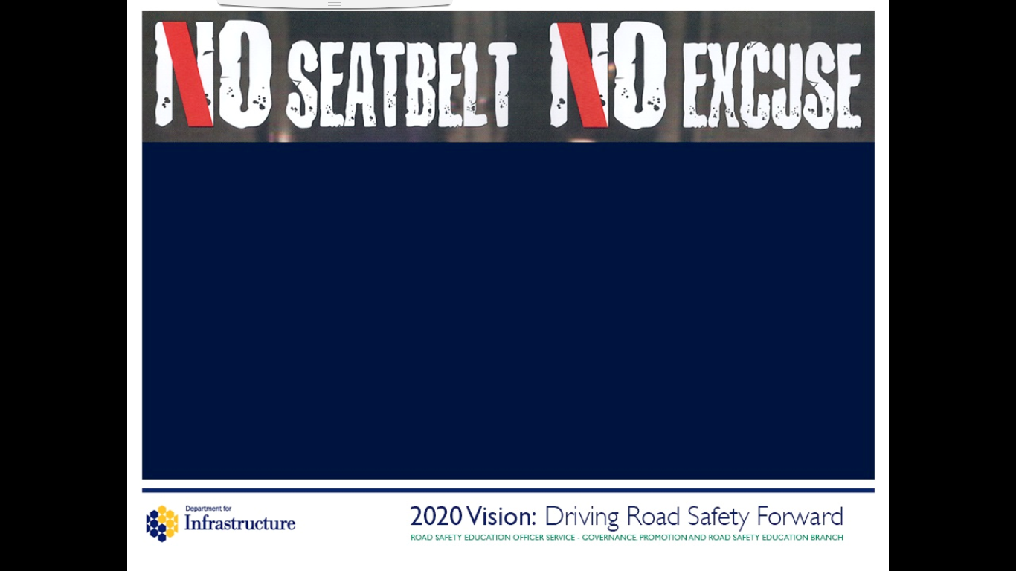
Seat Belt Law
Seat belts must be worn where fitted
Only one person per seat belt
Children must use the correct car seat
At 14 years old you are responsible for
wearing your own seat belt
In a crash, you’re twice as likely to die
if you don’t wear a seat belt!
Notes:
In Car Safety
Up until now we have talked about being a pedestrian, but another major way in which many people are hurt on the road is as passengers in cars.
Many children are hurt & killed in crashes when they didn’t need to be – often because they were not wearing a seat belt.
The seatbelt law is very simple (see slide) – it must be worn – by everybody, no matter what age or where in the car you are sat. If a seat belt is there, you must use it.

Slide 11
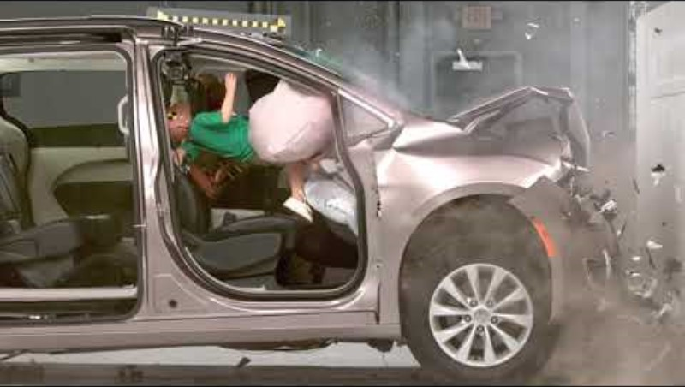
Notes:
And this is why we have seat belts….. Play clip.
If you are not wearing a seat belt and the car crashes or the driver brakes suddenly, then everyone who is not wearing one will be thrown through the car at the same speed the car was travelling – so that could be 30 / 40 mph. If you’re sat in the back, you could be thrown into the person sat in front of you and crush and potentially kill them. If you are in the front you could end up being thrown through the windscreen and onto the road - not many people survive that.
You will find that over the next few years some of your friends may choose not to put their seat belt on. We urge you not to travel in a car where other passengers are not wearing their seat belt. If you do, you are risking your life, even if you have your own seat belt on. You could try saying to the other passengers; “if you care about me, you’d wear your belt too”.
Q. If you are ever in a car where you don’t feel safe – perhaps the driver is going too fast, or is using their phone, or doing something else that you feel uneasy about, then what can you do?
Speak up! Tell them you don’t like the way they are driving, and you don’t feel it is safe. This is often hard to do, but how would you feel if you didn’t, and an accident happened, and your friends were hurt? If you do speak up, then others in the car may agree and back you up – you’re probably not the only one feeling that way. And you can back your friends up too if they speak out about things they are unhappy with.
Make an excuse for them to pull in (you’re feeling sick – no one wants someone being sick in their car!)

Slide 12
What would you do?
You’re travelling in the car with a friend, and they do not fasten their seat belt
The driver of the car you’re in starts replying to a text message
The driver of the car you’re in is driving too fast

Slide 13
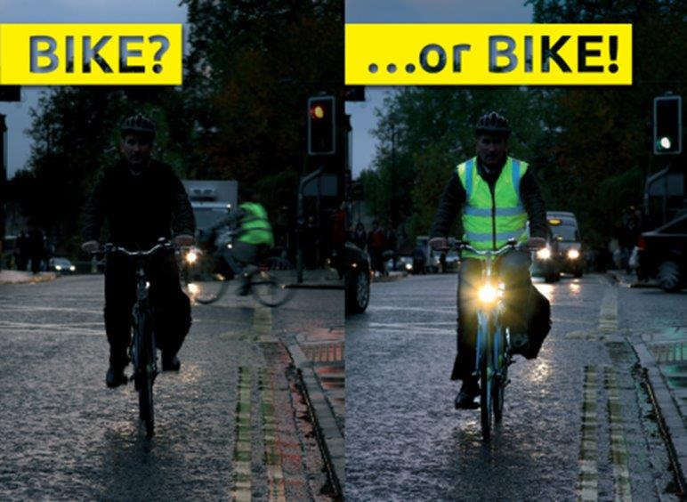
Cycling Safely
Be visible. Use lights after dark and in poor weather conditions (it is the law).
Wear something bright
Check your bike is safe to ride – working brakes, inflated tyres, the right size for you
Cycle on the left & use cycle lanes where available
Show drivers what you plan to do. Always look and signal before you set off, stop or turn
Notes:
Lots of you will have bikes and that’s great. Does anyone here cycle to school?
Make sure you keep safe when riding (read slide). Remember that when you are riding on the road you are part of the traffic. Which side of the road should you cycle on? (left!) Never weave in and out of traffic!
Lights are vital – it is the law to have working lights – white at the front and red at the back and red rear reflectors. If you don’t have lights, then drivers can’t see you!

Slide 14
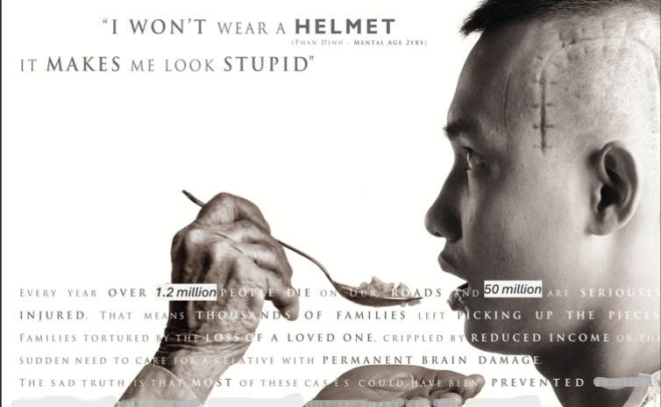
Notes:
And always wear a helmet! Head injuries are very common amongst cyclists. Yet many children your age don’t wear one.
Q. Why?
Answers may include:
-Gives you a sweaty head, messes up your hair, they’re uncomfortable, they look silly, and people will laugh at you.
The consequences of choosing not to wear one could last a lifetime. This is Phan Dinh – he now has a mental age of 2 years.
Words on the picture…
Every year over 1.2 million people die on our roads and 50 million are seriously injured worldwide. That means thousands of families are left picking up the pieces, families tortured by the loss of a loved one. Crippled by reduced income or the sudden need to care for a relative with permanent brain damage. The sad truth is that most of these cases could have been prevented.

Slide 15
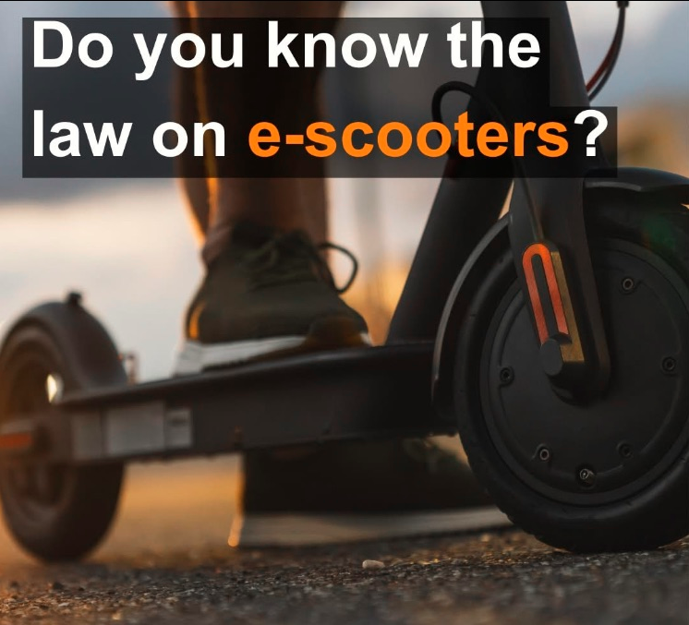
It is illegal to use them on public roads, footpaths and cycle lanes in West Yorkshire
They are classed as motor vehicles, so are subject to the same legal requirements (an MOT, licensing, tax & insurance)
If you use an e-scooter on public roads, you risk receiving a fine, penalty points & having the scooter seized
Notes:
Has anyone got an e-scooter?
Read slide. You can only use an e-scooter on private land, such as in a garden (make sure you have permission of the landowner).
If you do still choose to use one on the road or footpath, think about what we have mentioned with cyclists – make sure you are visible to other road users & you’re wearing a helmet.

Slide 16
Notes:
Back to the time a minute exercise we did at the start.
Q. Why do you think I asked you to do that? What does it have to do with road safety?
Who looked around? Who was influenced by other people sitting down? We asked you to do it to see if you were able to think and make decisions for yourselves and not be influenced or pressured by what other people around you did. If they started sitting down before you had finished counting, did it influence your decision, and did you follow them?
Make appropriate comments based on what the children did, e.g. domino effect, one sat down & others copied. This is sometimes what happens near the road – your friends run across the road & so you follow them, or your friends don’t wear a seat belt, so you don’t either (this is peer pressure).
It is normal to feel pressured to follow the crowd, but when it comes to safety, we need to think for ourselves and decide whether it is worth taking the risk. Perhaps if you walk to the crossing, or you put your seat belt on first in the car, then your friends will follow you. Sometimes it only takes one person to do the right thing. Let’s try and influence each other in a positive, safe way.

Slide 17
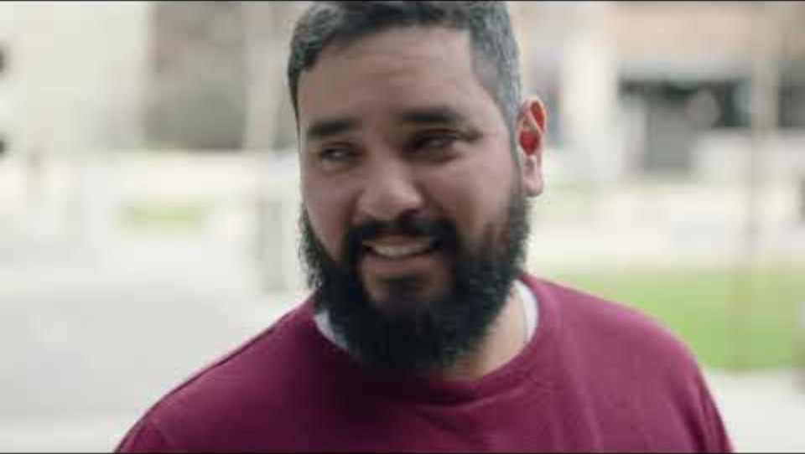
Notes:
Vision Zero is a road safety aim to eliminate all road deaths and serious injuries. It is based on the belief that no death or serious injury is acceptable on roads. We need your help to achieve this.
1,450 were killed or seriously injured on West Yorkshire roads in 2023.

Slide 18
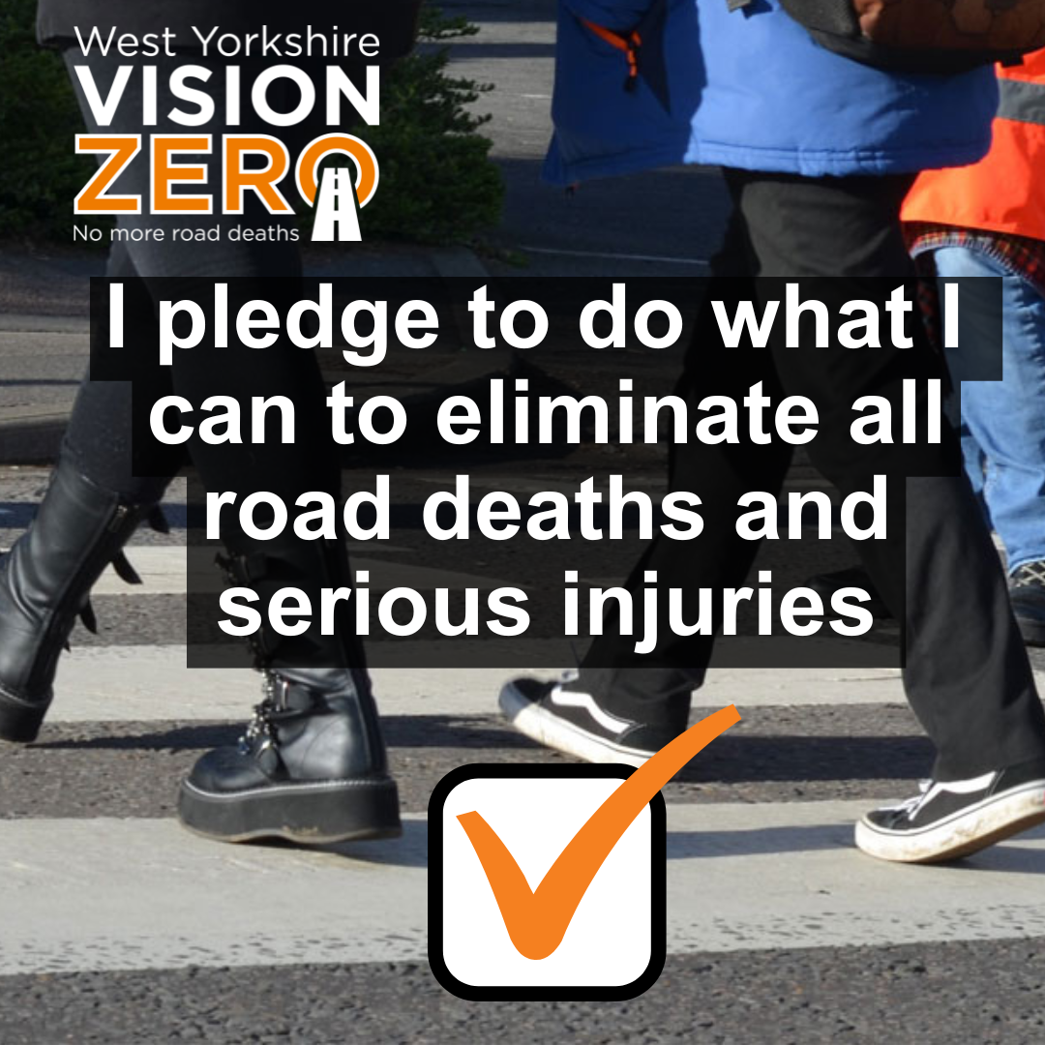
Notes:
We all have a responsibility to keep each other safe on our roads. Please sign the pledge. Vision Zero pledge

