Slide 1
Road Safety –
Not my problem,
doesn’t affect me
(I don’t even drive!)

Slide 2
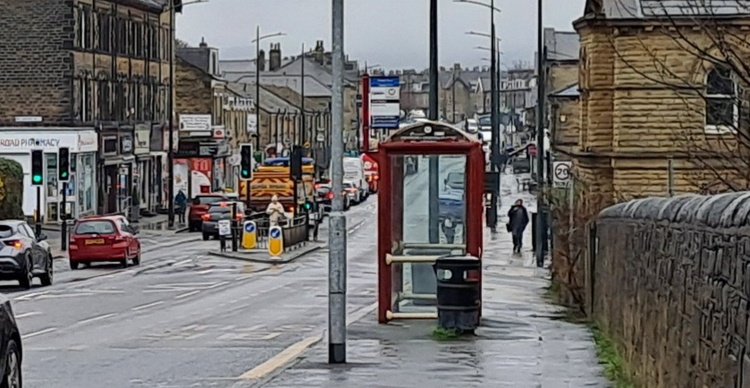
Bradford’s Roads – Discuss……
Notes:
Have a discussion based on the above, we all use the roads (not just drivers), they are everyone’s business and we all contribute towards the increasing footfall.
Revisit ‘road safety, not my problem, doesn’t affect me, I don’t drive’ – based on the above discussions, pointing out we all use the roads in whatever mode of transport, and all have a responsibility to be safe and keep safe on them.

Slide 3
Fatal 5
Speeding
Drink / drug driving
Not wearing a seat belt
Careless driving
Using a mobile phone

Slide 4
Higher or Lower?

Slide 5
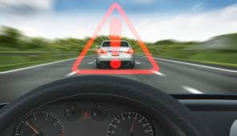
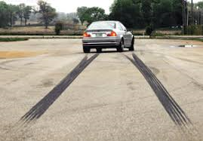
Q1: What is the average stopping distance for a car travelling at 30mph?
SPEED
23 Metres
Notes:
ANSWER: 23 metres
9m Thinking
14m Braking
6 Car lengths
Double in rain
X10 Ice
Adjust your speed accordingly for the weather and road conditions.
The speed limit is a limit - not a target.

Slide 6
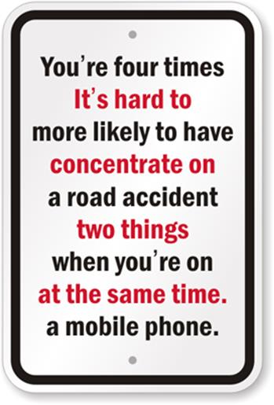
Notes:
Reaction timer – read the red writing while waiting for the break lights. Do it again but focus on the task instead of reading. What is the difference?
Using a phone while driving dramatically slows down your reaction time. Difficult to concentrate on two things at once. This applies to using your phone as a pedestrian crossing the road as well.

Slide 7
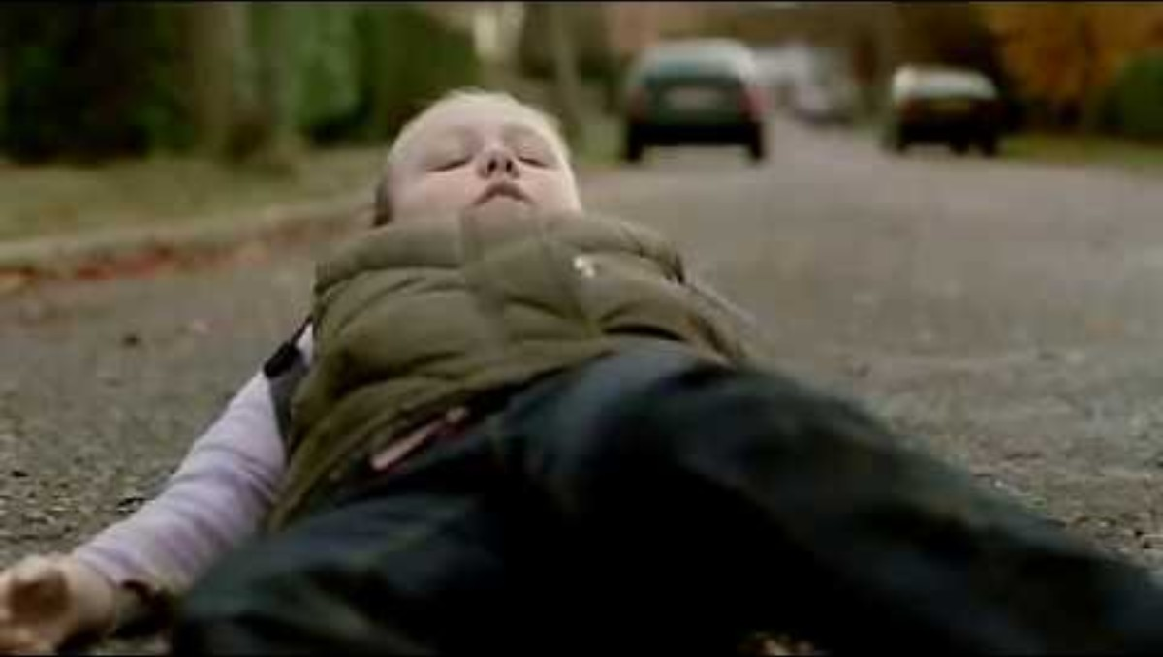
https://www.bing.com/videos/riverview/relatedvideo?&q=its+30+for+a+reason+speeding+campaign&&mid=1B09B17F86DC946584DD1B09B17F86DC946584DD&&FORM=VRDGAR
SPEEDING KILLS
Notes:
It also takes longer to stop if you are speeding.
Speeding contributory to 1 in 3 fatal crashes.
Twice as likely to kill someone travelling at 35mph than at 30mph.
Film – ‘hit someone at 40 mph & 80% chance that they’ll die, hit someone at 30mph & 80% chance that they’ll live’.

Slide 8
Scenario:
You’re in a car and your friend is driving too fast, and you don’t feel safe. What can you do?

Slide 9
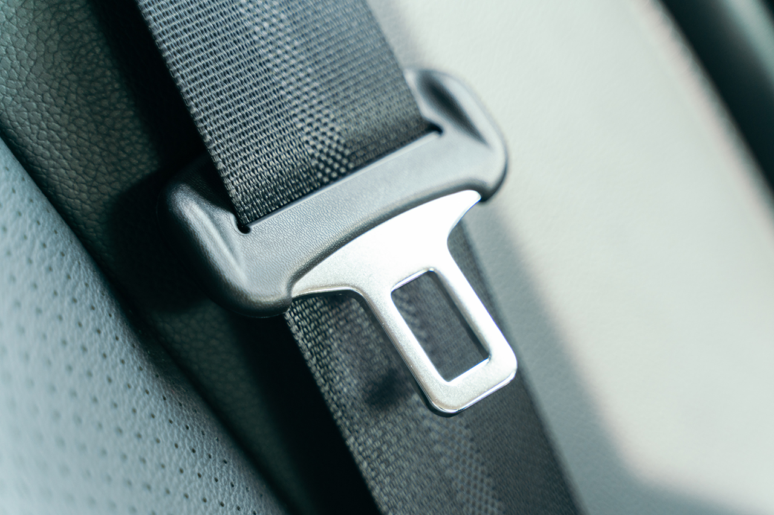
Who doesn’t wear a seatbelt?

Slide 10
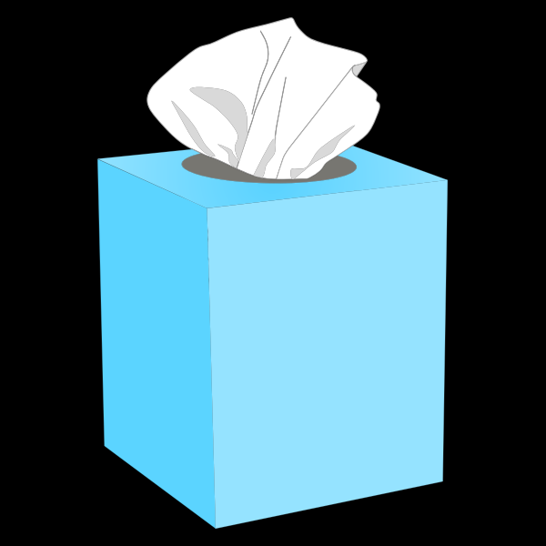
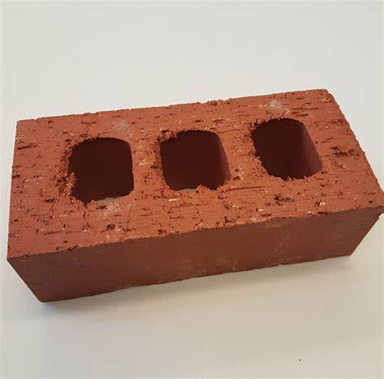
SEAT BELTS
25% of drivers and 26% of passengers don’t wear a seatbelt.
Drivers & passengers aged 17-34 have the lowest seat belt wearing rates, combined with the highest accident rate
At 30 mph a loose box of tissues will become the
weight of a house brick in an emergency stop!
Notes:
You keep moving through the car at the same speed you were last travelling at.
If you are involved in a collision and not wearing a seat belt, you will sustain far worse injuries than if you were wearing one.
Talk about The box of tissues and the brick.
This could be a mobile phone from your friends sat in the back seat.
A loose person or object can kill or seriously injure anyone else in the car.
In a 30mph crash a person weighing 10 stone will become around 300 stone
(10 stone x 30mph = 300 stone).
This is the weight of an average size elephant.
They will be thrown through the vehicle at the same speed it was travelling before it crashed.

Slide 11
Scenario
You’re travelling in a car, and your friend doesn’t bother with their seat belt. What would you do?

Slide 12
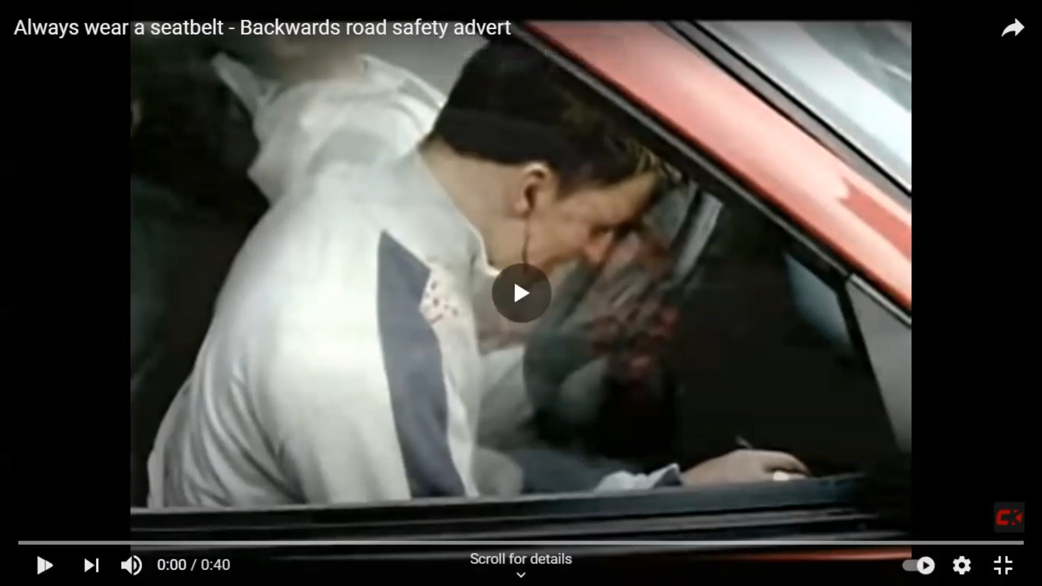
THINK! ALWAYS WEAR A SEAT BELT.
Notes:
Ask students:
-Would you feel comfortable travelling in a car in which somebody was not wearing a seat belt?
-What could you say to your friends to encourage them to wear a seat belt?
Did you see the lose objects on the parcel shelf?
Where did the pizza end up?

Slide 13
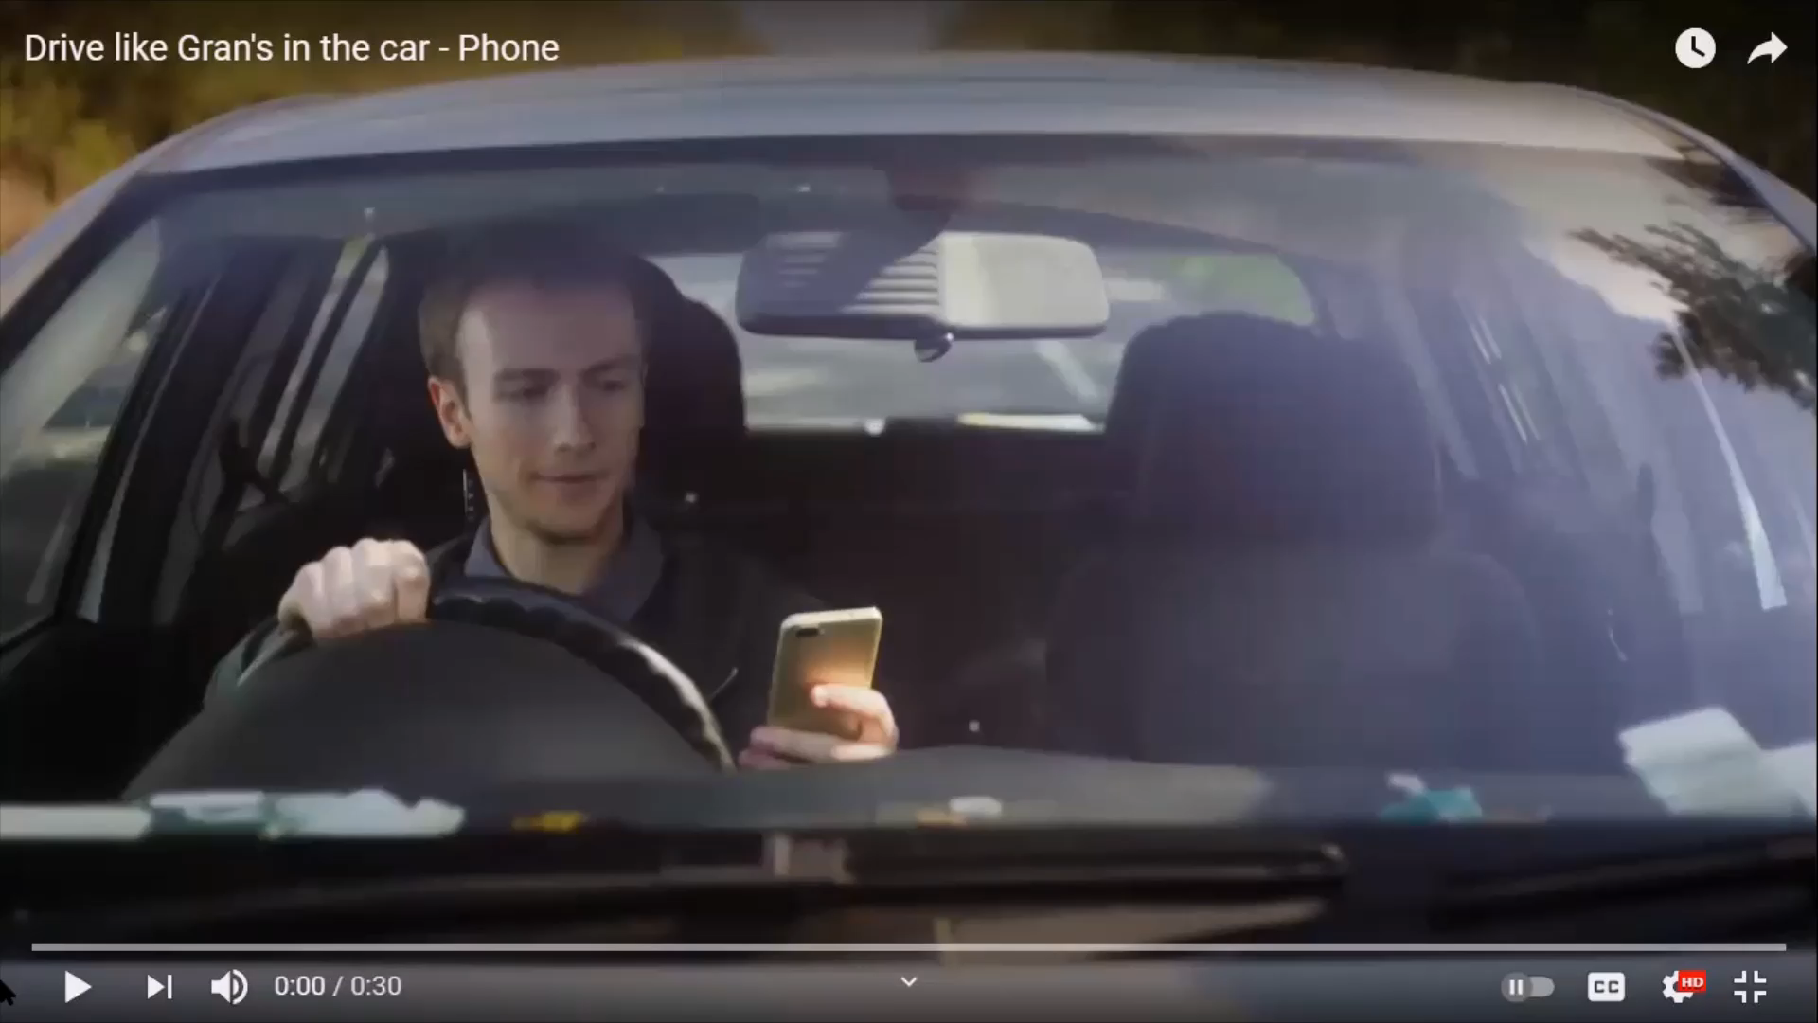
How would you drive?
Notes:
PEER PRESSURE – One reason why a person may speed or not wear a seat belt is peer pressure.
When carrying older adult passengers, young drivers are less likely to crash indicating it is peer pressure rather than simply the pressure of passengers that increases the risk.
-What would your driving style be like if you had your gran in the car compared to your friends? (GRAN ADVERT)
Their driving behaviour changes depending on who they have in the car with them.
Those questioned said they drove more carefully when someone like their Gran was in the car.
Next time drivers see themselves slipping into bad habits they should imagine that Gran is in the car with them.
Research shows that peer pressure can encourage bad driving and result in drivers ‘showing off’ to their passengers and taking more risks.
“When carrying older adult passengers, young drivers are less likely to crash, indicating it is peer pressure rather than simply the presence of passengers that raises the risk” (Brake.org.uk)

Slide 14
Scenario:
You’re in a car where the driver is under the influence of drugs or alcohol / using their phone / eating / drinking and you don’t feel they are properly in control of the car. What would you do?

Slide 15
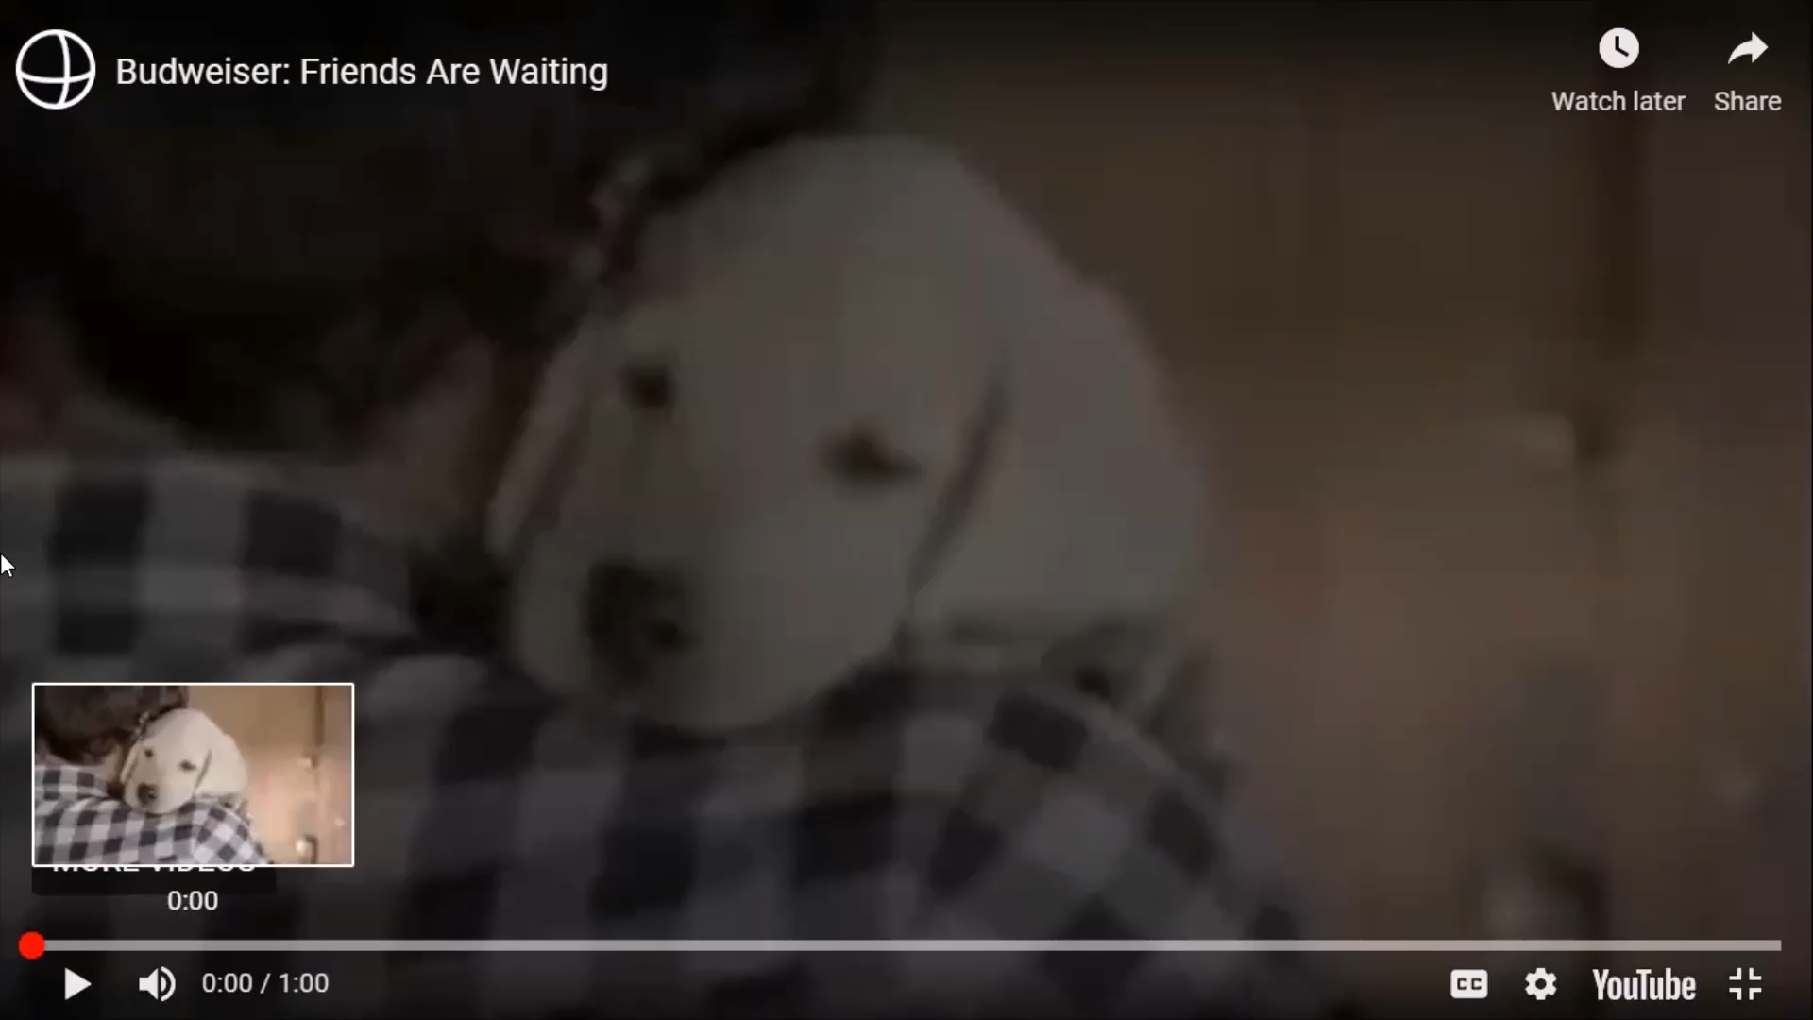
Pint Block
Notes:
Safe drivers avoid alcohol and drugs entirely before driving.
Research shows even just 1 alcoholic drink affects a person’s reaction times and assessment of risk. Noone knows their limit – everyone is different and many factors affect it, so the best thing is not to drink & drive.
Click on the link at the bottom of the slide to learn more about the Think! campaign - ‘Pint Block’ ‘A mate doesn’t let a mate drink drive’.

Slide 16
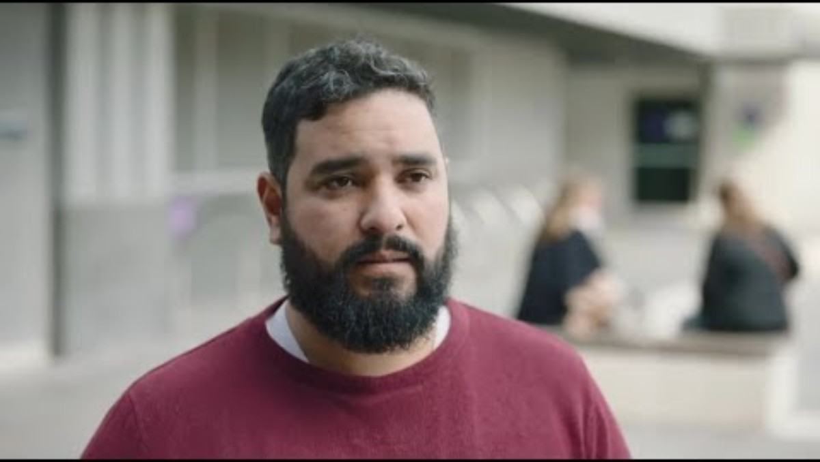
https://www.youtube.com/watch?v=ra5LK8x86zU
Notes:
How many deaths on the road is acceptable, what do you think?

Slide 17
-What road safety issues are important to you and other young people?.
-What do you think are the emerging issues for road safety?

