Slide 1

Bradford Road Safety Team
Charlie’s Accident
Helping you to be safer pedestrians
Notes:
Q. Who thinks they know a lot about road safety?
I'm going to test your knowledge with 3 multiple choice questions.

Slide 2
Q. Before crossing the road, you must….
A) Look and listen
B) Find a safer place, stop, look, listen and think
C) Check what your friends are doing and copy them
Notes:
Answer:
B) Find a safer place, Stop, Look, Listen, Think
-Does anyone know what this ‘set of rules’ is called? (The Green Cross Code)

Slide 3
If a child runs out in front of a car travelling at 30mph, how many metres would it take that driver to stop?
*Remember it takes the driver time to react and to press the brake before the car stops
A) 2 metres
B) 12 metres
C) 23 metres
Q.
Notes:
Answer:
C) 23 metres
To give the children an idea of how far this is, you could roughly measure the length of the classroom in strides.
-It is important to remember this when crossing the road and if you do not think you have enough time to cross safely, then you shouldn’t take the risk. They may not be able to stop their car in time.
It takes time for the driver to react and press the brake before the car stops.

Slide 4
Q. Which age group is more at risk of being hit by vehicle?
A) 0-4 year olds
B) 5-8 year olds
C) 10-13 year olds
Notes:
Answer:
C) 10-13 year olds
Why do you think this is?
Ideas:
-Given more independence & responsibility (not out with parents all the time now)
-Travelling to a new school, often without an adult for the first time. High School is usually further away than Primary School was and could involve an unfamiliar route & busy roads
-Being distracted by friends or trying to impress new friends
-Taking risks - thinking it won’t happen to you
-Distracted by mobile phones or listening to music with headphones in

Slide 5

Notes:
Given the answer to the last question and that this is your age group, it is important that we take some time to think about road safety, so that you don’t end up being one of the children hurt on the road.
You are going to hear about an accident that happened to a boy your age. This is the emergency call that was made immediately after the accident.
(Click on the sound icon to hear the emergency call)
What do you think has happened?

Slide 6
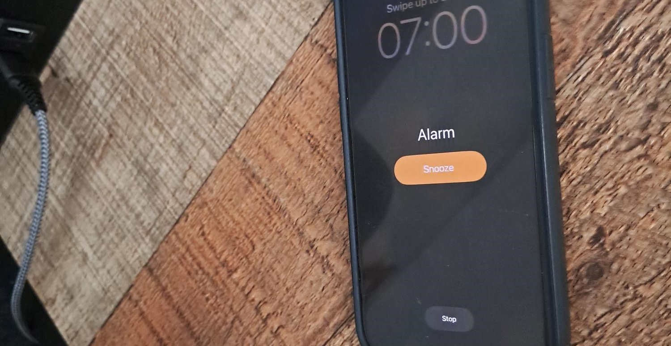
Notes:
Slides 6 – 14 tell the story leading up to the accident
Charlie’s Accident – the story
To read aloud:
This is based on a true story.
Charlie had been at high school for a couple of months now. The first day nerves were well and truly gone and he felt like he’d always been there. Primary School was a distant memory.
The day of the accident started just like any other day. He’d set his alarm for 7.00, which gave him half an hour to get ready and 15 minutes to walk to the bus stop. Charlie hated the early start; he hated getting up in the morning, especially on a school day and always left it to the last minute to get out of bed. So, when his alarm went off, he hit the snooze button, turned over and went back to sleep.
After a while, his mum realised he still wasn’t up, and called upstairs, “Charlie, are you getting up? You’re going to miss the bus!” Eventually, after a lot of moaning & groaning, he climbed out of bed.
Click for next slide

Slide 7
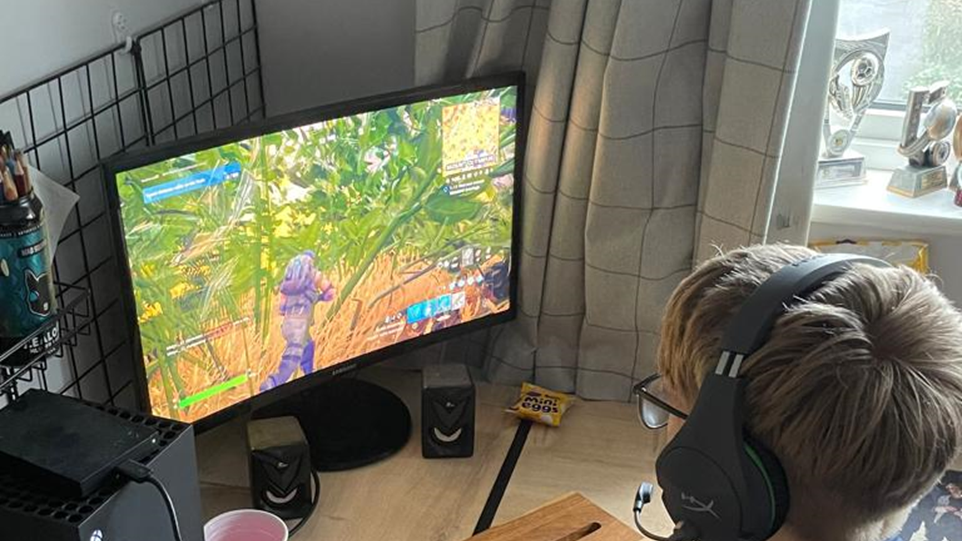

Notes:
But then he spotted his X Box in the corner of his room and couldn’t help having a few minutes on his new game. Is it possible to have just a few minutes on a game?
A few minutes turned into a lot longer and by now he was running late! He finally turned his X Box off and threw on his uniform…
Click for next slide

Slide 8
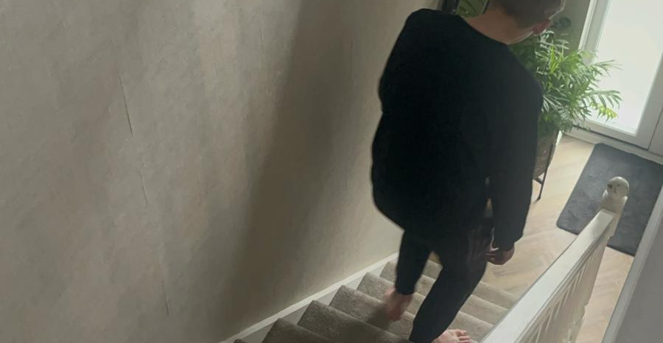
Notes:
He ran downstairs to get some breakfast, and then he realised he’d forgotten to put his socks on, so had to run back upstairs to grab some. By this point he was running VERY late!
Click for next slide

Slide 9
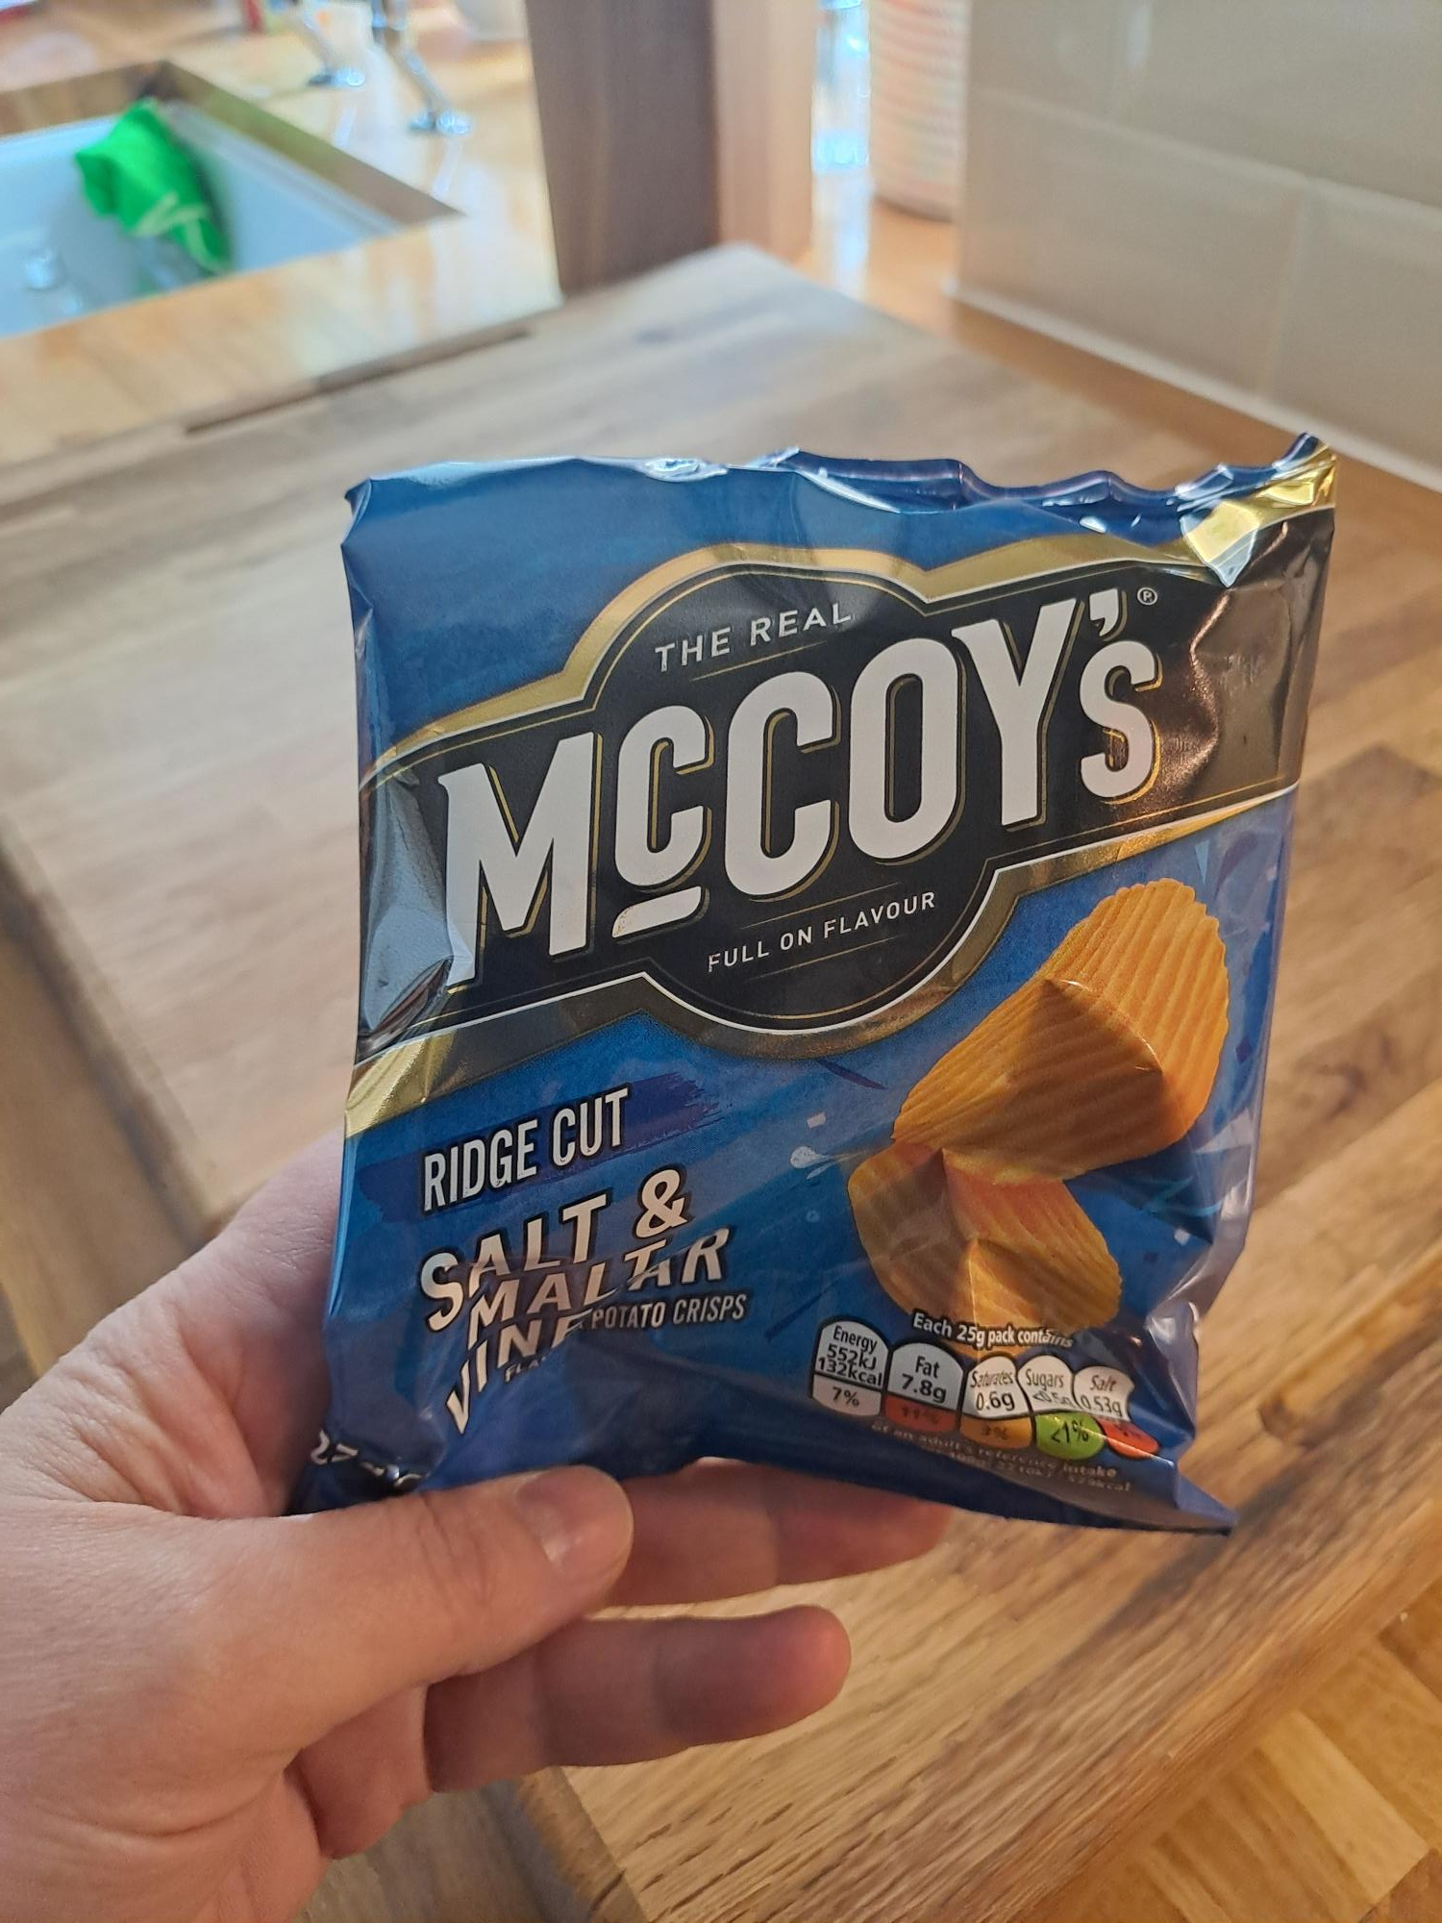
Notes:
He realised he didn’t have time for breakfast, so he grabbed a packet of crisps (much to his mum’s disapproval)…
Click for next slide

Slide 10
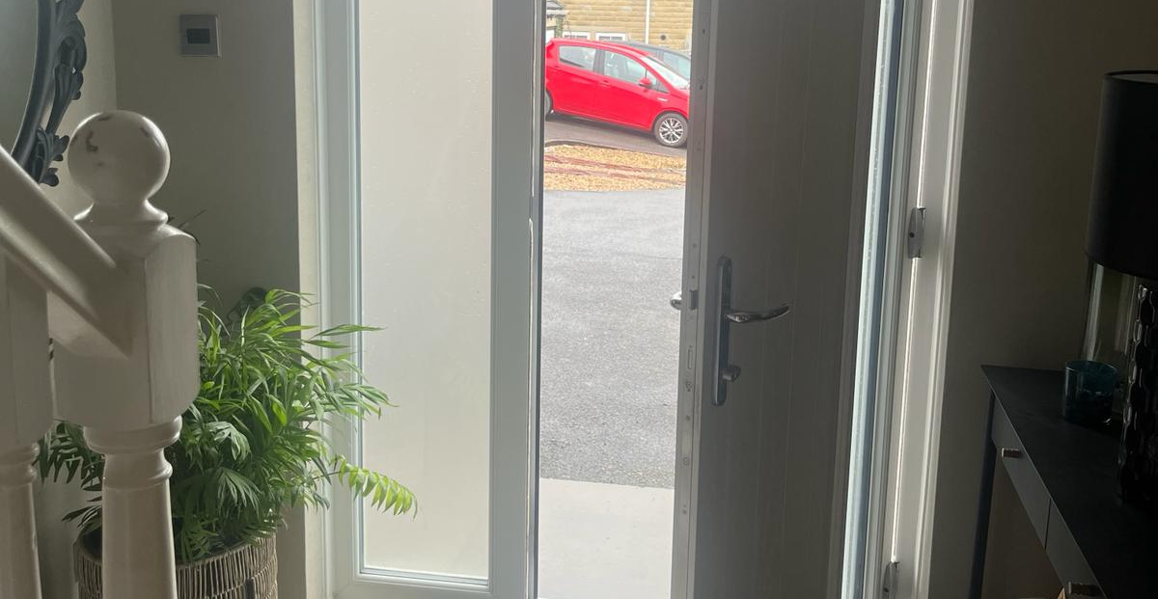
Notes:
….picked up his mobile phone and ran out of the house calling, “Bye Mum!”
Click for next slide

Slide 11
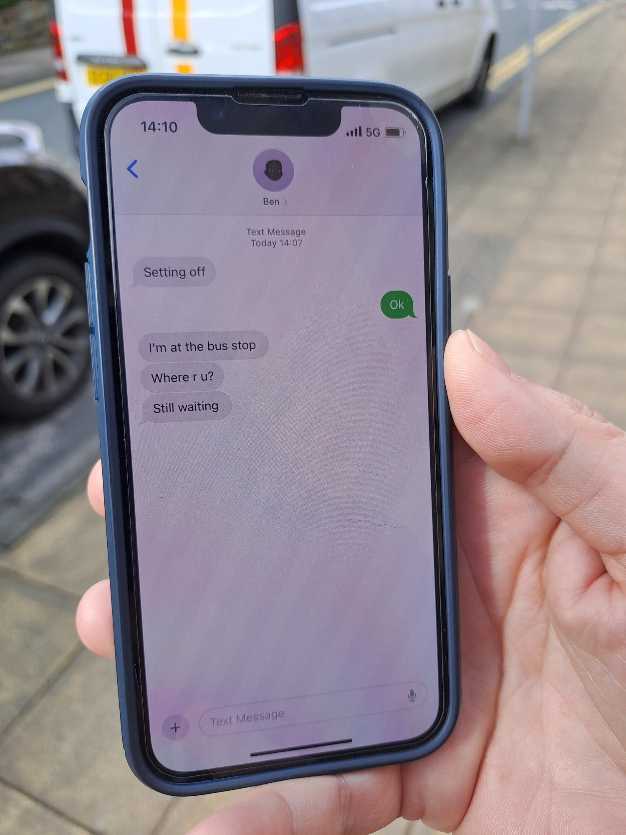


Notes:
He was going to have to run to the bus stop now to get there on time. As he was running, his phone beeped, it was a message from Ben wondering where he was. He often met Ben on his way to school, but Ben was already at the bus stop now waiting.
Click for next slide…

Slide 12
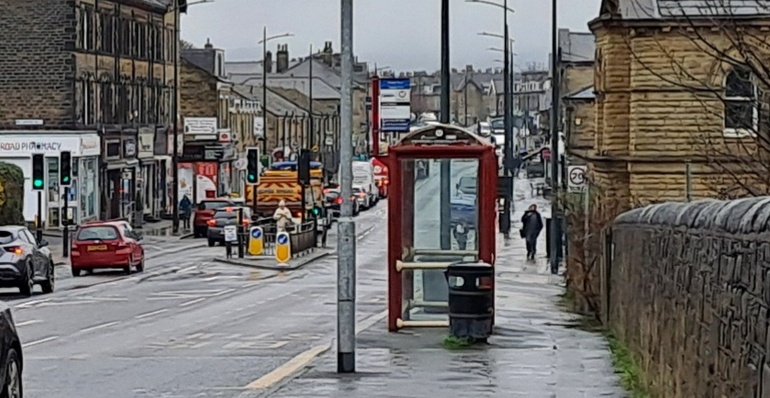
Notes:
Just then, Ben, who had been waiting at the bus stop for some time, spotted Charlie at the opposite side of the road. Charlie was looking down at his phone.
Q. What do you think Ben did to get his attention?
A. He shouted; “CHARLIE, OVER HERE, HURRY UP!”
Q. And what do you think Charlie did then?
A. He ran into the road without checking first and looking down at his phone.
Click for next slide…

Slide 13
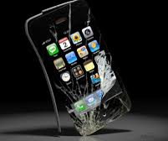
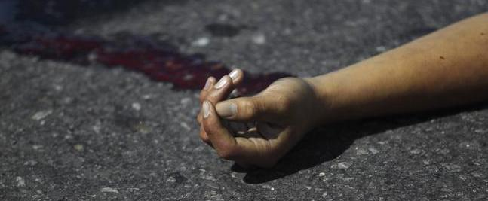
Notes:
Charlie was hit by a car. The driver did not stop in time.
Click for next slide…

Slide 14
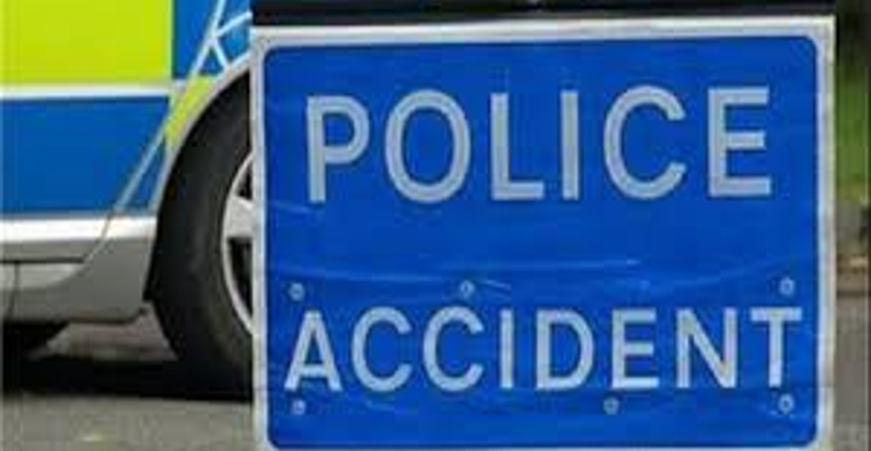
Notes:
And that was how Charlie’s accident happened. Just one mistake and his life has changed forever.
Click for next slide…

Slide 15
Driver’s statement
Ben’s statement
Notes:
Before playing the statements, discuss the driver and Ben.
Charlie was severely affected by this accident, but he was not the only one. There were two other people in the story who would have been affected – who are they? (The driver & Ben).
Q. Does anyone think that the driver is to blame? Ask those with their hand up why they think it could be the driver’s fault.
Q. What kind of things could the driver have been doing to cause an accident?
A. Speeding, driving when drunk, distracted, using a mobile phone.
The driver in this story was found not to have been doing any of these things. In this case, like in many cases, it was NOT the driver’s fault.
Q. Why didn’t he stop in time?
A. He couldn’t! Remember how long it takes a driver to stop a car at 30mph – 23 metres.
Q. How do you think the driver feels?
Play driver’s statement
Q. Is Ben responsible at all? (take answers)
Q. What should you do if you witness an accident like this happen?
Call 999.
Q. What information do you need to give?
Location – address or landmark & explain what has happened.
You may prefer to ask an adult to make the call - like Ben did (it was an adult who made the emergency call at the beginning).
Q. Should you go into the road to see if he is ok?
A. No - you could get hit too. It is important to keep yourself safe.
Q. How do you think Ben felt seeing this happen to his friend?
Play Ben’s Statement
Charlie
Explain that we haven’t got a statement from him – why do you think that might be? (Injuries are too severe - refer to the driver’s statement – ‘his head hit my windscreen’).
- If appropriate and you feel the audience need to hear the full extent of his injuries-
Charlie cannot walk or talk now. He needs help with a lot of things, like getting dressed, eating and using the bathroom (things we all take for granted).
Q. Can you think of anyone else who would be affected by this accident?
A. Charlie’s family, friends, teachers, the local community, witnesses who saw the accident happen, emergency services…

Slide 16
How can I keep myself safe on the road?
Plan your journey & leave enough time
Don’t take risks
Put phones & headphones away
Don’t be distracted or distract others
Think for yourself – don’t just follow the crowd
Be Bright Be Seen
Use the Green Cross Code
Cross at a safe place
Notes:
Q. How can you keep yourself safe so an accident like Charlie’s doesn’t happen to you? (Ask for ideas before revealing the answers. Ideas could be written on the board or large sheet of paper if time).
Plan your journey – set off in plenty of time, don’t leave it until the last minute (like Charlie did). Rushing leads to us taking risks and making mistakes. Discuss the route you will take to secondary school with your parents and practise it in the holidays. Don’t leave the first time you make the journey until the day you start – you will have lots on your mind that morning.
Taking risks – if you’re not sure it is safe then don’t risk it! Accidents happen when we take dangerous risks. Reduce the temptation to take risks by giving yourself enough time to get where you’re going.
Mobile phones – put them in your pocket / bag while crossing road and give the road your full attention. Phones are very useful but are one of the main causes of road accidents to children your age.
Headphones – take them out before you cross the road. You need to hear the traffic as well as see it. Sometimes we can hear vehicles coming before we see them, but not if we have headphones in!
Don’t be distracted or distract others near the road – stop the conversation when you reach the road and give it your full attention. Keep yourself and your friends safe.
Think for yourself – don’t just follow the crowd - sometimes when we are with friends, we do things we would never consider doing if we were on our own. Think for yourselves – your friends may not be making the safest choice.
Be Bright Be Seen – make yourself visible to drivers by wearing something bright/fluorescent & reflective especially from October when the clocks go back.
Use the Green Cross Code – Find a Safer Place, Stop, Look, Listen, Think
Cross at a safe place – see next slide for a reminder of these. If there is not a pedestrian crossing available then choose a place where you can see clearly in all directions, away from bends & parked cars.

Slide 17
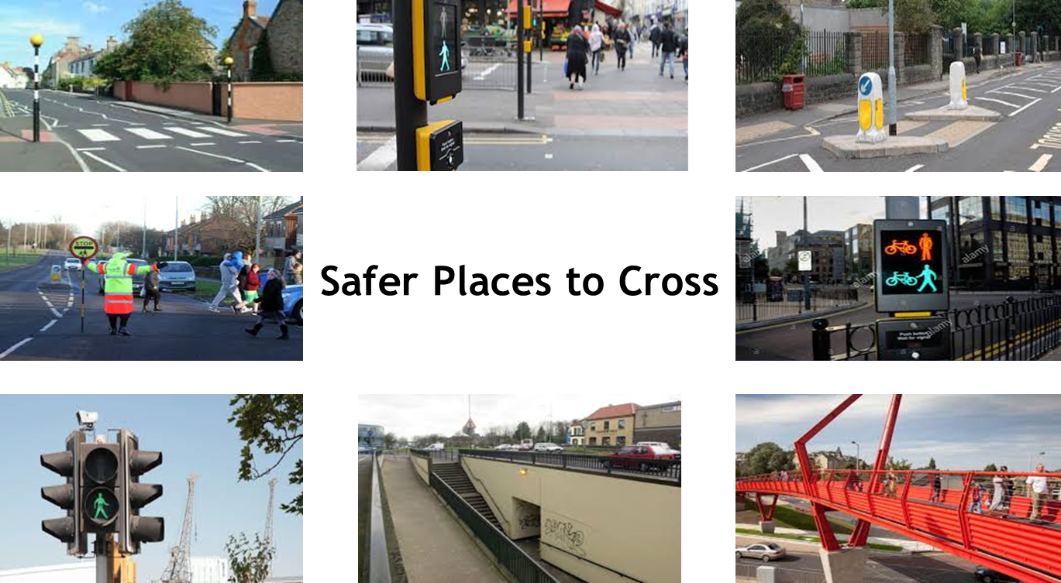
Notes:
Can you name any of the safer places to cross?
Zebra Crossing – drivers should stop to let you cross, but don’t always! Make sure vehicles have stopped on both sides before crossing
Puffin Crossing – the red & green men are with the button and the crossing operates on a smart sensor which detects when people are crossing
Traffic Island – divides busy roads into two so you can make two separate crossings
School Crossing Patrol (Lollipop Person) – do you have one outside your school?
Toucan Crossing – cyclists can ride their bike across this crossing. Toucan meaning ”two can” cross together referring to pedestrians and cyclists
Pelican Crossing – the red & green men are at the opposite side of the road to the button and the crossing operates on a timer not a sensor
Subway – should only be used accompanied by an adult
Footbridge

Slide 18

Notes:
Peer Pressure – Task 1
Check children can’t see a clock and arms are behind backs if they have a watch.
Ask them to time a minute (60 seconds) in their head silently and when they think they have finished to sit down.
Teacher can use a timer but assess when pupils sit down and whether they were looking around / checking what others were doing.
Q: Does anybody know why we set that task?
It was to see if you were able to think and make decisions for yourselves and not be influenced or pressured by what other people did. If they started sitting down before you had finished counting, did it influence your decision, and did you follow them?
Make appropriate comments based on what the children did, e.g. domino effect, one sat down & others copied. This is sometimes what happens near the road – your friends run across the road & so you do (peer influence). It is normal to follow the crowd, but it is important we think for ourselves and not be negatively influenced by other people. It is OK to say no to friends, especially when your safety might be at risk.

Slide 19
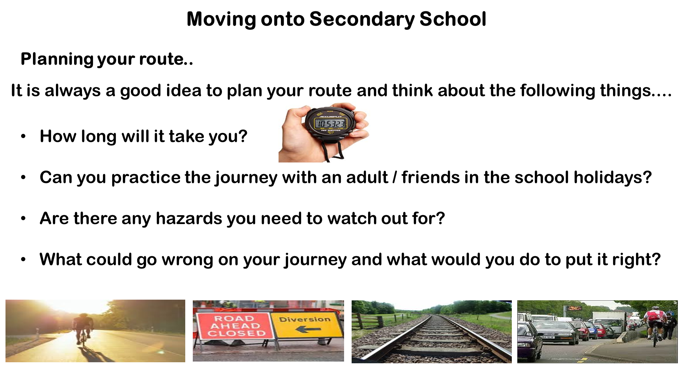
Notes:
The risk of injury to young pedestrians peak in Year 7 (for the reasons mentioned at the beginning of the presentation). It is important to think about what you can do to prevent this happening to you.
Think about how will you will travel to secondary school? Do you know how long it will take?
It is a good idea to practise the route in the holidays - before the first day (you will have enough to think about on your first day).
Walking?
-Remember the safest route is not always the quickest.
-Your journey is likely to be at peak times, when it is busier – make sure you factor this into the time you give yourself.
-Think about the safer places to cross on the route to your new school & remember to include them when you plan your journey.
Q. What would you do if you slept in?
-Don’t panic – rushing leads to us making mistakes.
-Quickly get ready and travel to school via your normal route.
-Inform school as soon as possible.
Q. What would you do if you have missed your bus?
-Discuss with your parents what they would like you to do if this happens.
-Check the bus timetables – is there another bus you can catch?
-Inform school as soon as possible.
Q. The friend you normally walk to school with is ill what would you do?
-Discuss situations like this beforehand with your parents and find out what they would like you to do and agree a backup plan with them. Is there another friend you could arrange to walk with?
Cycling?
Look out for cycle lanes to use
Avoid very busy roads if possible
Practise the route on your bike beforehand & time how long it takes so you know what time you need to set off
Check your bike is safe & working properly. Would you know what to do if you got a puncture?
Refresh your skills – find out what courses are available.
- If you have a mobile phone keep it fully charged and have emergency contact numbers saved.

Slide 20
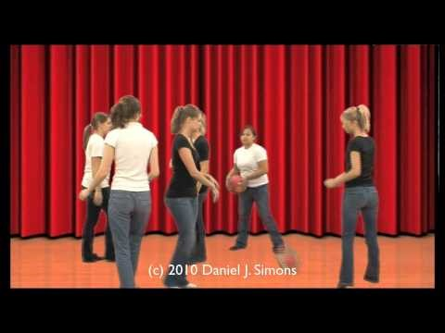
Awareness Test
How is this task relevant to your journeys to school?
Notes:
Awareness Test
When you are concentrating on something, you are often excluding everything else. Some people may have noticed some of the things that happened in the film, for example the gorilla, but it would be surprising if anyone noticed all of them, because our mind is focussed on counting the passes.
You might attempt to cross the road while looking at your mobile phone and / or talking to your friends, but is it possible to do that safely? Can you give the road your full attention while looking at your phone or chatting to friends? You can easily miss important things going on around you.
Put distractions away and give the road your full attention.

Slide 21
Think about what you might need to take the night before and get your bag ready
PE Kit
School bag / pencil case
Lunch/drink/ snacks
Mobile phone/ charger
Cycle Helmet / Bike Lock
Money / Keys
Homework
Notes:
Be prepared..
Q. Why is it a good idea to pack your bag the night before?
It will give you more time in the morning and help you to stay calm, so you don’t need to rush to school. Rushing often results in making mistakes and taking unnecessary risks. Think back to Charlie’s accident – this ultimately happened because he slept in and was running late.

Slide 22
Did you know..
Around 200 children are involved in a road traffic accident in Bradford every year.
Who is the best person to keep you safe?
YOU!
STAY SAFE!
Notes:
200 children - over 6 full classes of children per year!
Finish with who is the best person to keep you safe? – You! By being sensible and prepared and remembering all we have discussed today.

Slide 23

Useful Websites
l Websites
CityConnect Journey Planner - cyclemap.cyclecityconnect.co.uk
Choose between the fastest and quietest routes for cycling or walking
Google Maps can help you do all sorts –
-Get directions.
-Find out where to cross safely using the yellow peg.
-See if there’s a quieter, safer route.
-Work out what time you need to set off.
Make it ‘Appen! - Companies like Arriva & FirstBus have apps to download
West Yorkshire Metro – www.wymetro.com/plan-a-journey
The school’s section has loads of information to help you travel safely all-over West Yorkshire
Check if your school offers a cycling course like Bikeability.
www.bikeability.org.uk

