Slide 1
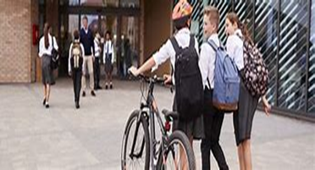
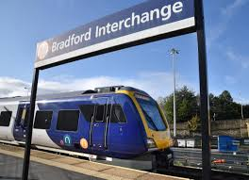
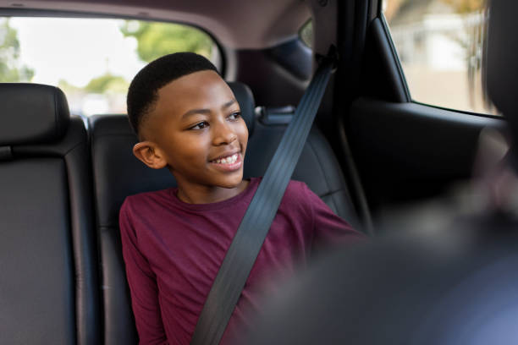
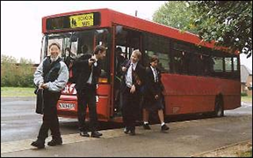
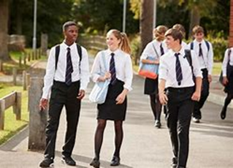
Are you ‘Good to Go?’
Notes:
Introduction
My name is….. And I am from the Road Safety Team. I might have met some of you before when I visited your school to talk about road safety. Road Safety is part everyone’s every day lives - we have crossed a road or travelled on a road – multiple times already today.

Slide 2
Time a Minute
Notes:
Before we go any further, we have a short exercise for you. We would like you all to stand up and time a minute (that’s 60 seconds) in your head and sit down as soon as you reach a minute.
(Make observations, did they look at their teacher, look at each other?) Don’t comment on it at this point.
Wait until about 1 min 10 seconds (or when everyone has sat down). Tell them you will come back to the exercise and why they did it later.

Slide 3

“Road Safety is something that young children learn….
“I know how to cross the road. Been there, done that. I don’t know anyone who has been hurt on the road, so I don’t need to worry about it.”
Notes:
In this presentation we will be covering the different ways in which people your age are hurt on the road – as pedestrians, car passengers and cyclists.
Q: How do you feel about listening to a road safety presentation?
The speech bubbles represent common thoughts of Year 6 students towards the topic of road safety. Read out the speech bubbles.
So why is road safety important for you age group? CLICK for next slide.

Slide 4
Fact
Road traffic incidents are the single biggest killer of young people aged 10-18 in the UK.
Notes:
(Read slide out).
This is why it is still important to think about and discuss road safety at your age.
Q. Why do you think traffic incidents are the biggest killer of 10 to18 year olds?
Possible answers might include:
-Making journeys independently
-Taking risks - thinking it won’t happen to them
-Using phones / headphones etc. while crossing the road
-Distracted by friends / messing around near the road
-Not wearing seat belts in cars
-The need to feel included or accepted by friends, causing them to do things which they otherwise would not do (peer pressure).

Slide 5
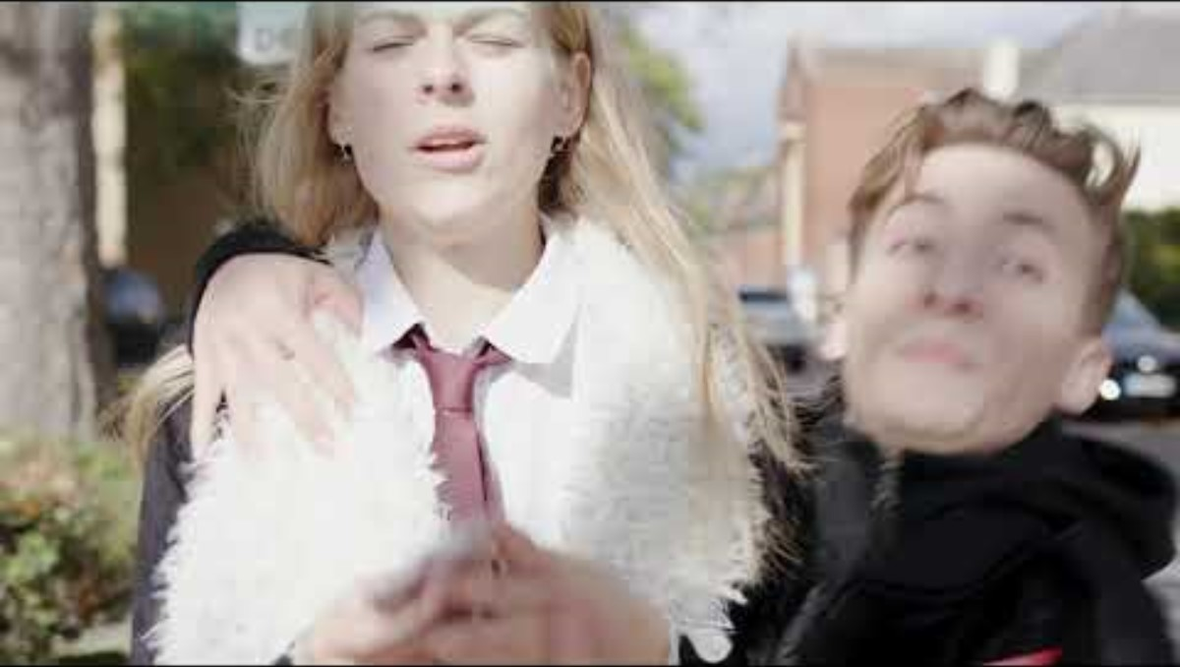
Notes:
Watch the film – it demonstrates how distracted we can be by our phones and what could happen.

Slide 6
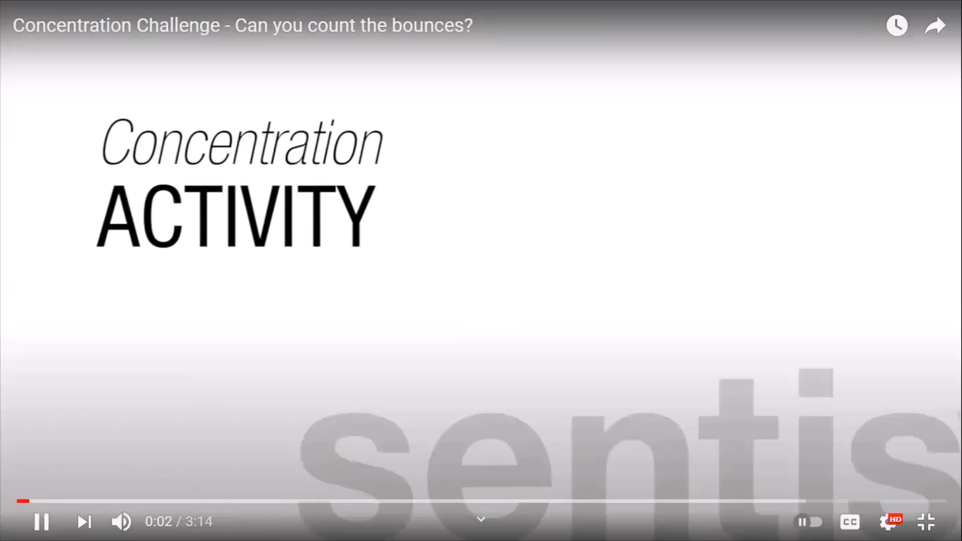
Notes:
This is a concentration activity. How many times did the balls hit the ground? (30) What else did you see? Did you notice the balls change shape? The background change colour? Did you still get the correct number of bounces? Our brains can only take in certain information, even if it is clearly in front of us!
After the clip:
Listening to music, talking on a mobile phone, or with friends are all distractions which take your attention away from the road. Concentrating on two or more things at once is difficult and we often miss important things when trying to do it. That is why it’s important to give your full attention to the road while you are crossing – you don’t want to be looking down at your phone when you’re about to cross the road and miss the lorry pulling out of the junction right next to you.
What can you do with your phone when you need to cross the road?

Slide 7
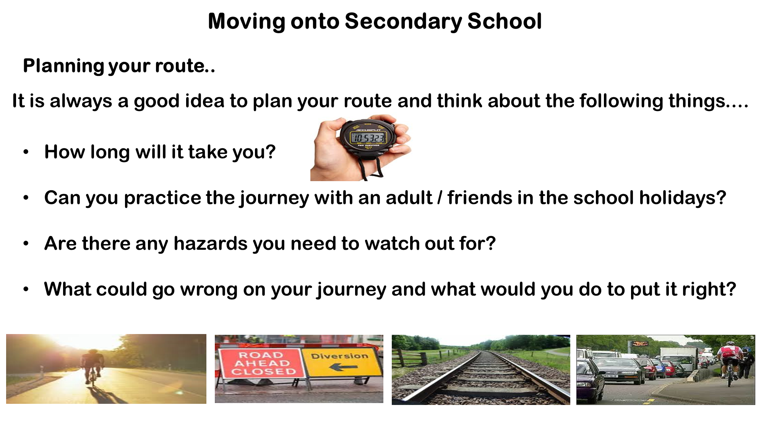

Slide 8
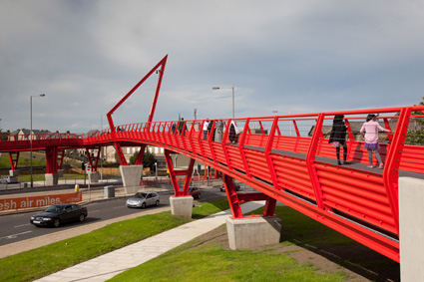
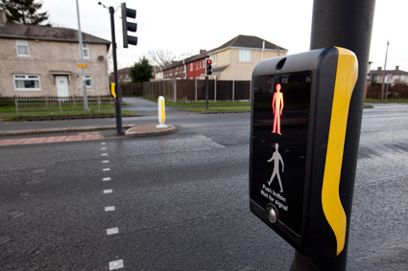
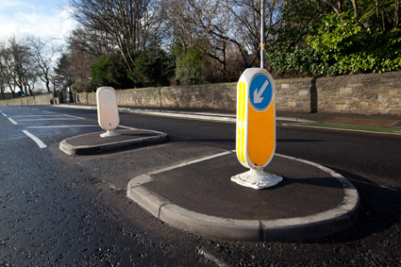
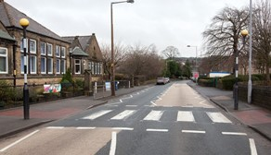
Use the Green Cross Code
Find a Safe Place
Stop
Look
Listen
Think
Notes:
It’s vital to recap on this while we’re talking about pedestrian safety, the Green Cross Code.
Find a safe place – important to use these on your way to high school. Plan your safest route and try and cross at these.

Slide 9
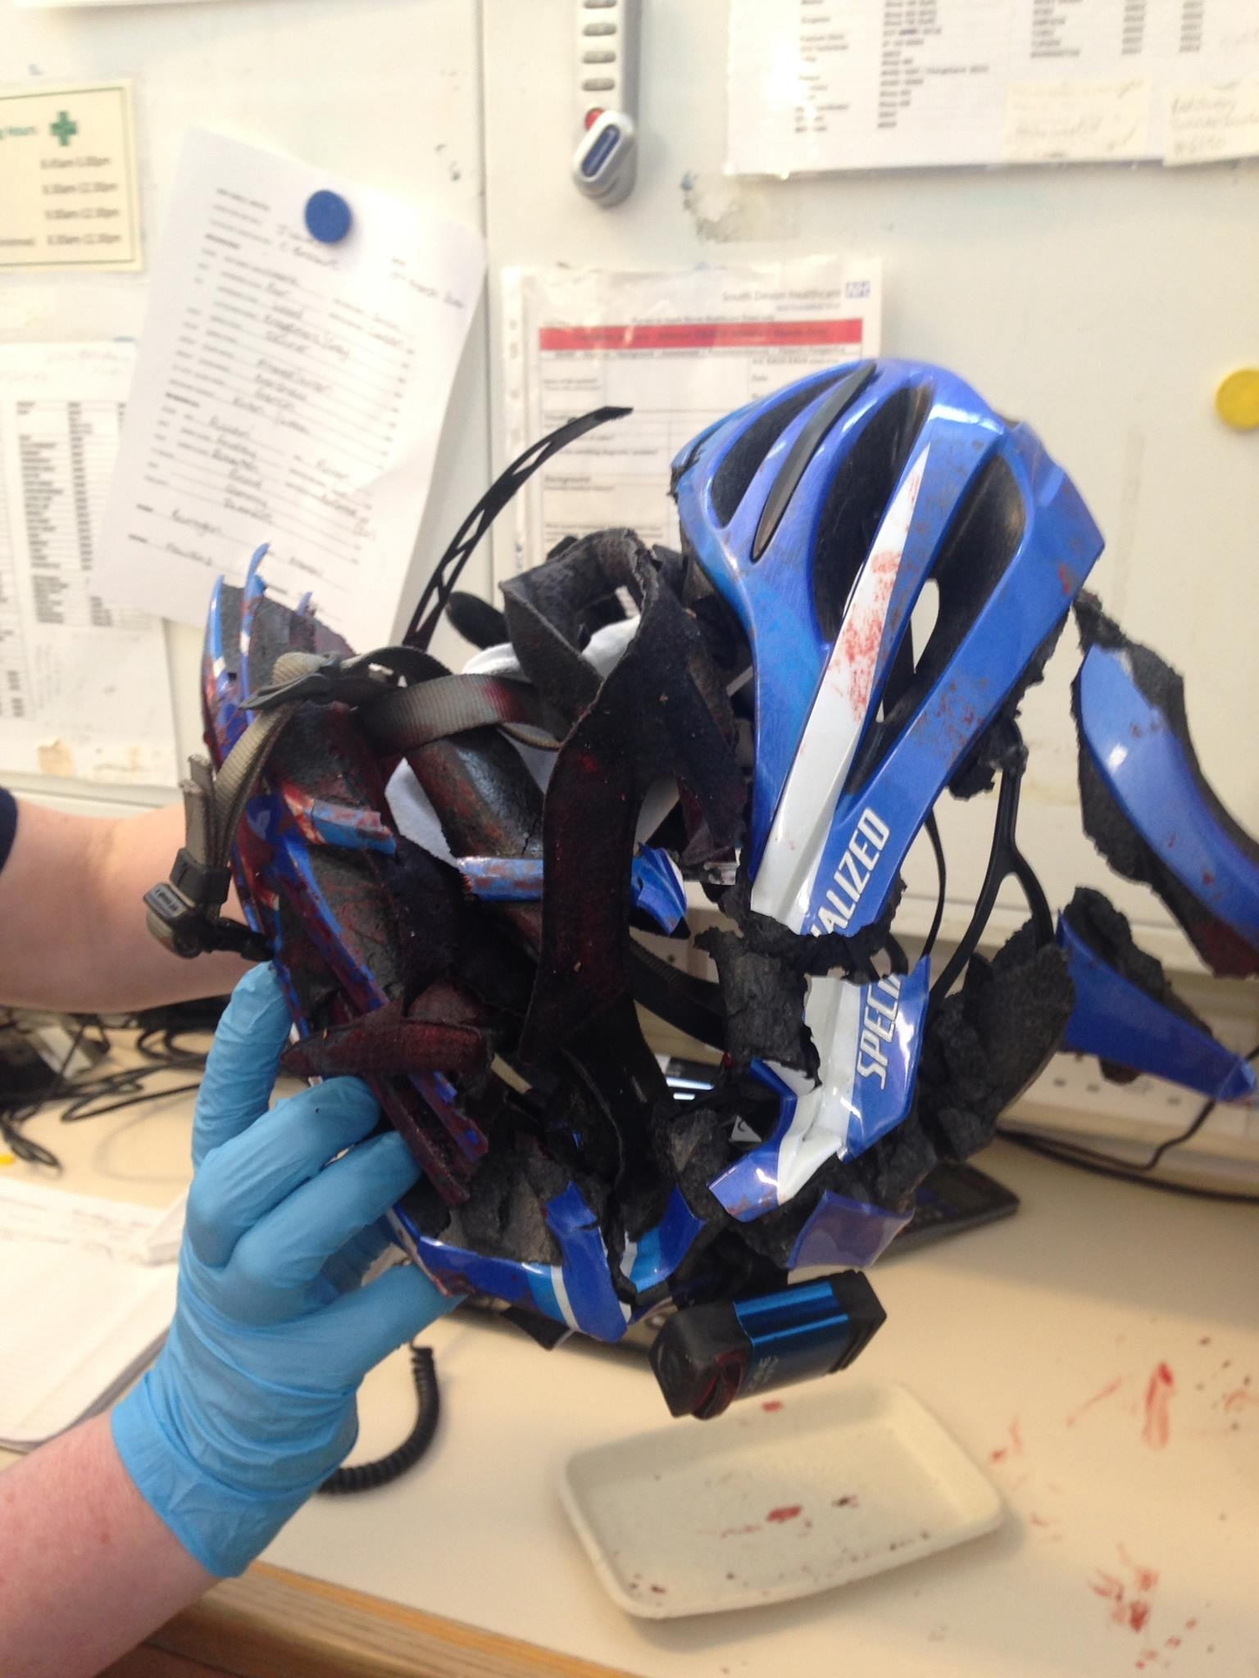
Notes:
This photo was taken by a doctor is A&E – it is a helmet that was on a cyclist who was hit by a car. The helmet could have saved his life.

Slide 10
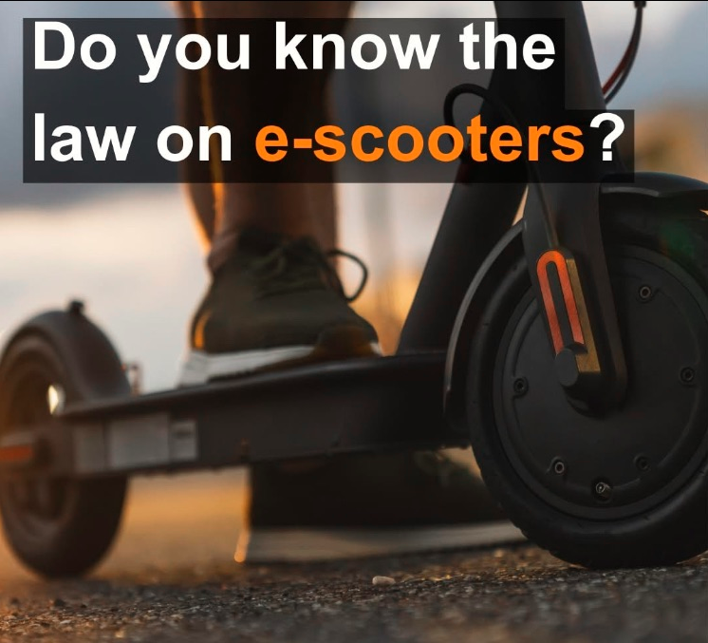
It is illegal to use them on public roads, footpaths and cycle lanes in West Yorkshire
If you use an e-scooter on public roads, you risk receiving a fine, penalty points & having the scooter seized
Notes:
Has anyone got an e-scooter?
Read slide. You can only use an e-scooter on private land, such as in a garden (make sure you have permission of the landowner).
If you do still choose to use one on the road or footpath, think about what we have mentioned with cyclists – make sure you are visible to other road users & you’re wearing a helmet.

Slide 11
Notes:
Back to the time a minute exercise we did at the start.
Q. Why do you think I asked you to do that? What does it have to do with road safety?
Who looked around? Who was influenced by other people sitting down? We asked you to do it to see if you were able to think and make decisions for yourselves and not be influenced or pressured by what other people around you did. If they started sitting down before you had finished counting, did it influence your decision, and did you follow them?
Make appropriate comments based on what the children did, e.g. domino effect, one sat down & others copied. This is sometimes what happens near the road – your friends run across the road & so you follow them, or your friends don’t wear a seat belt, so you don’t either (this is peer pressure).
It is normal to feel pressured to follow the crowd, but when it comes to safety, we need to think for ourselves and decide whether it is worth taking the risk. Perhaps if you walk to the crossing, or you put your seat belt on first in the car, then your friends will follow you. Sometimes it only takes one person to do the right thing. Let’s try and influence each other in a positive, safe way.

Slide 12
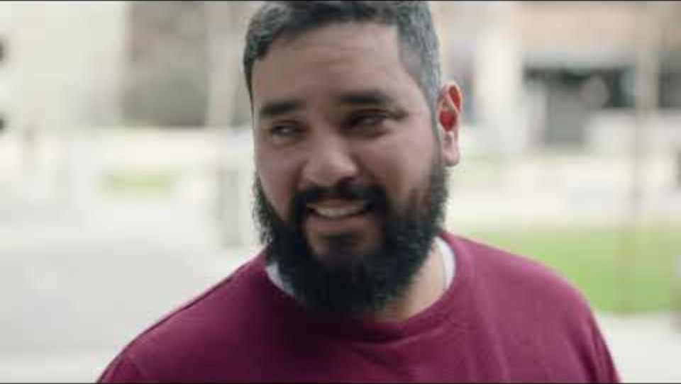
Vision Zero
Notes:
How many road deaths are acceptable a year?
What do you think?

