Slide 1
1. How are most children hurt on the roads in the Bradford District?
As pedestrians OR In cars
Around 200 children hurt every year – the majority are as pedestrians, but we still have a high number of children hurt in car crashes
- In 2023 there were 1,390 casualties on Bradford’s roads

Slide 2
2. Can children under the age of 7 cross roads safely without an adult?
Yes No
• They have poor concentration & are easily distracted
They lack experience – run out between parked cars
• They find it hard to judge speed & distance
• Their peripheral vision is not fully developed
• They cannot be seen easily because of their height

Slide 3
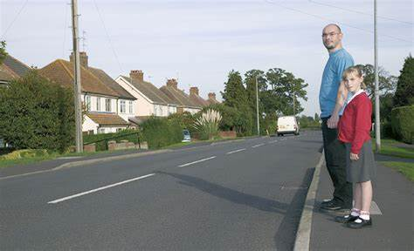
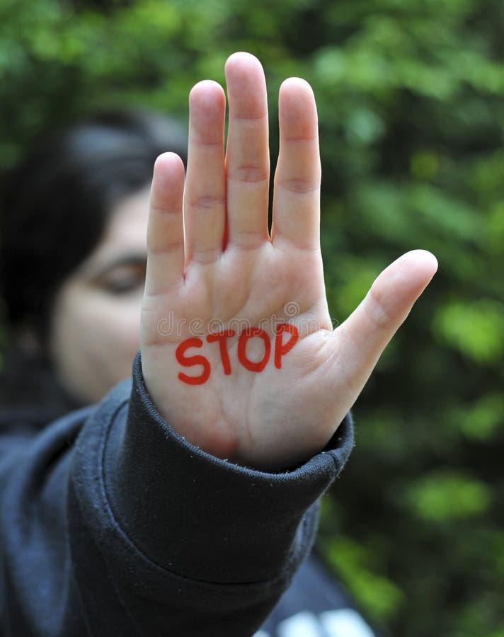
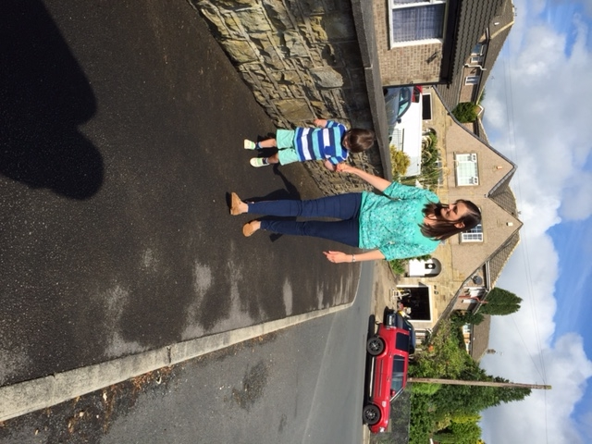
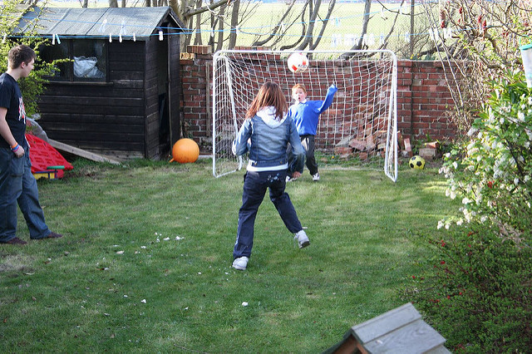
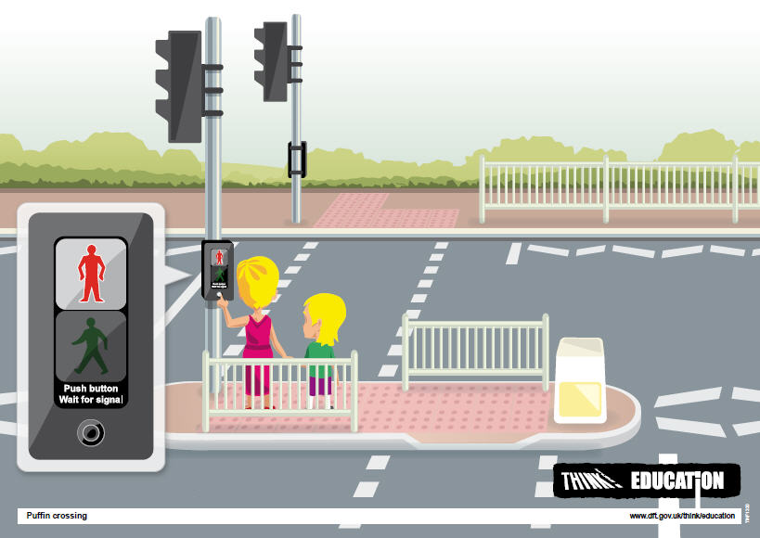
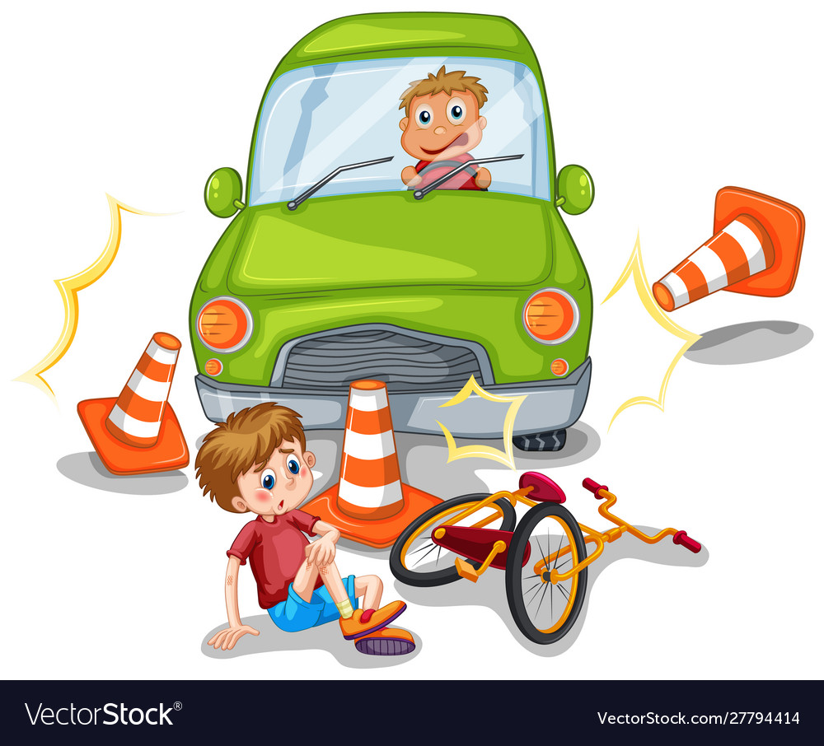
Teach how to cross from young age
Teach the meaning of…..
Hold hands / use reins.
What can I do to keep my children safe near the road
And the dangers of traffic…
Use the crossings - set a good example
Safe places to play. Secure garden gates

Slide 4
The Green Cross Code
HOLD
HANDS
LOOK
LISTEN
THINK
FIND A SAFER PLACE
STOP
Teach and practise the Green Cross Code with your child as early as possible

Slide 5
3. At what age are children most likely to have accidents on the road?
4-5 years 7-8 years 11-12 years
• Secondary school – longer journey without adult
• Given more independence – allowed out on their own
• Distractions - mobile phones / headphones / friends
• Peer pressure - follow the crowd, try to impress friends, take risks
• More males than females

Slide 6
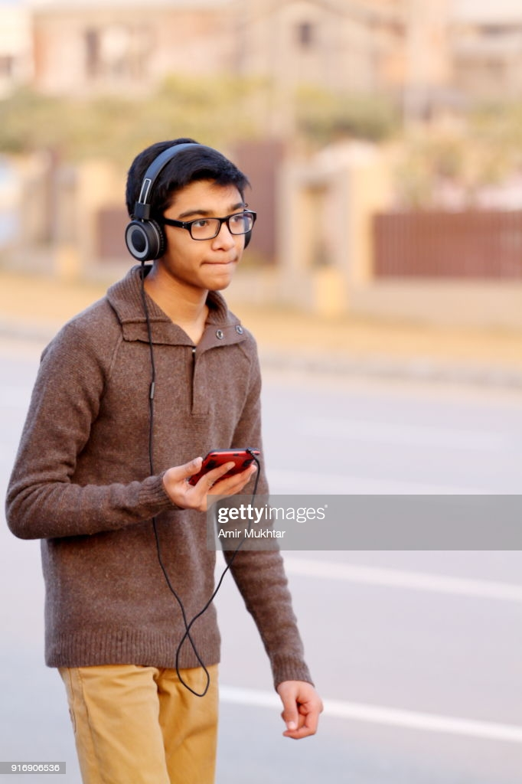

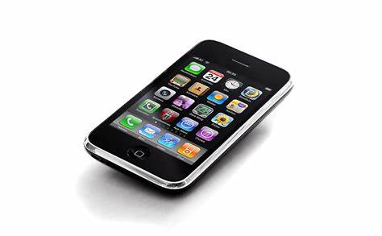
What can you do?
• Practise with them any regular journeys they need to make
• Encourage them to be better organised so that they are not rushing / running late
• Talk to them about concentrating when crossing the road –
mobile in pocket

Slide 7
4. Where are children most likely to be hit by a car?
Main Road Quiet Street
Familiar place so parents relax more
Drivers (often local) are complacent
Running out between parked cars – often chasing balls
Children play on road– sometimes on small wheelie toys – difficult for drivers to see
Parents leave older siblings (e.g. age 7/8) to supervise younger children

Slide 8
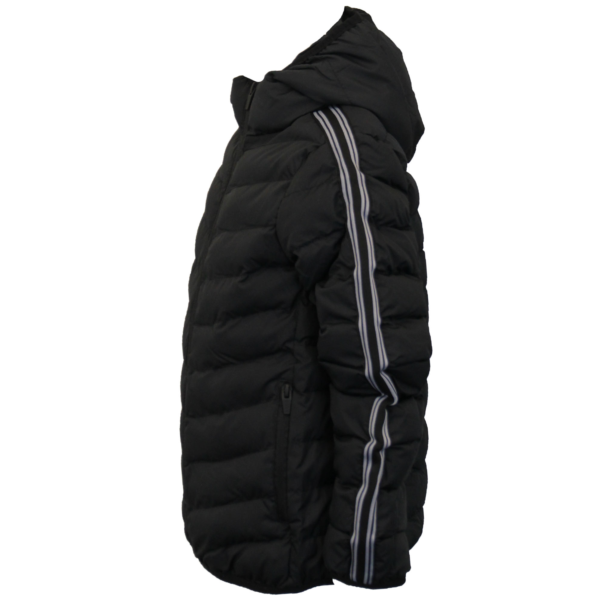
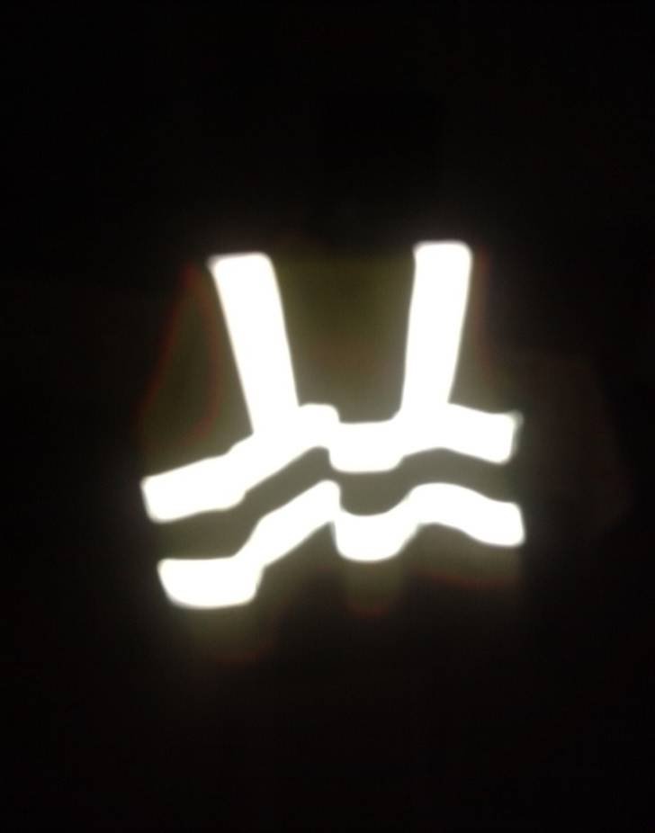
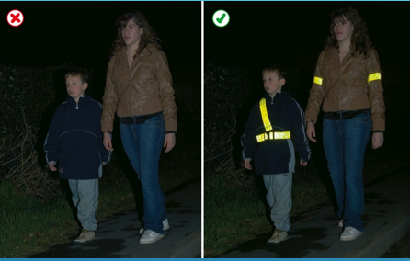
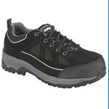
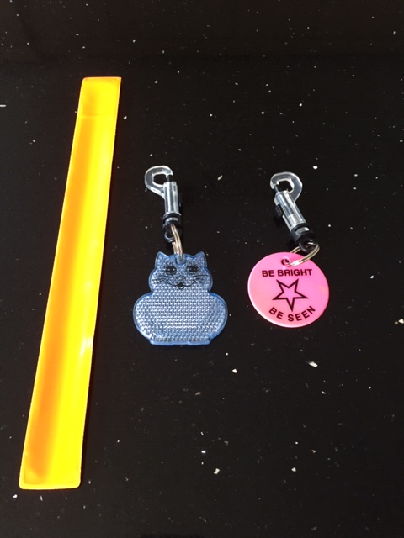
5.) When would you wear something reflective?
Daylight Dark
Reflective – for night time
Fluorescent – for day time

Slide 9
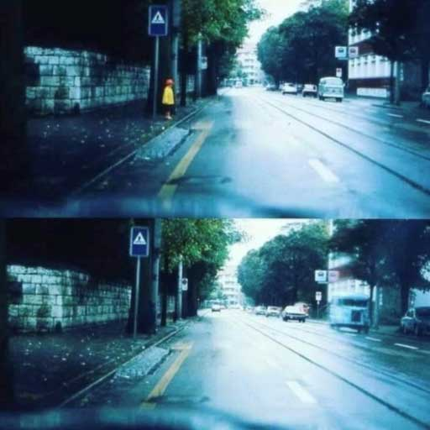
Spot the
child!

Slide 10
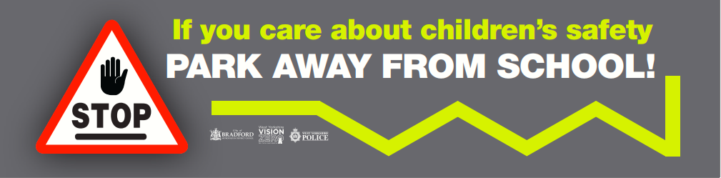
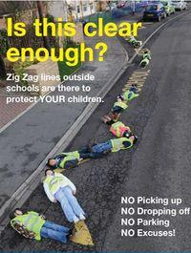
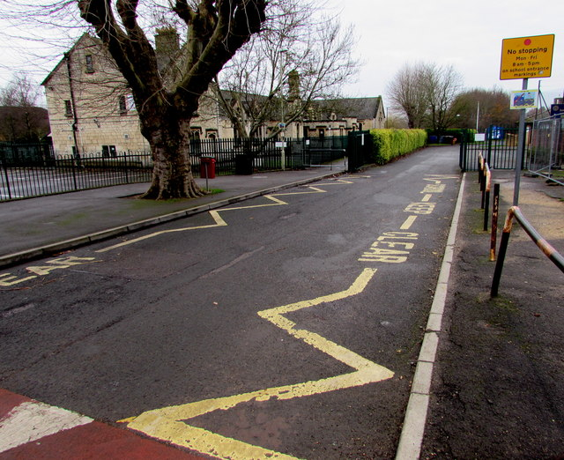

Slide 11
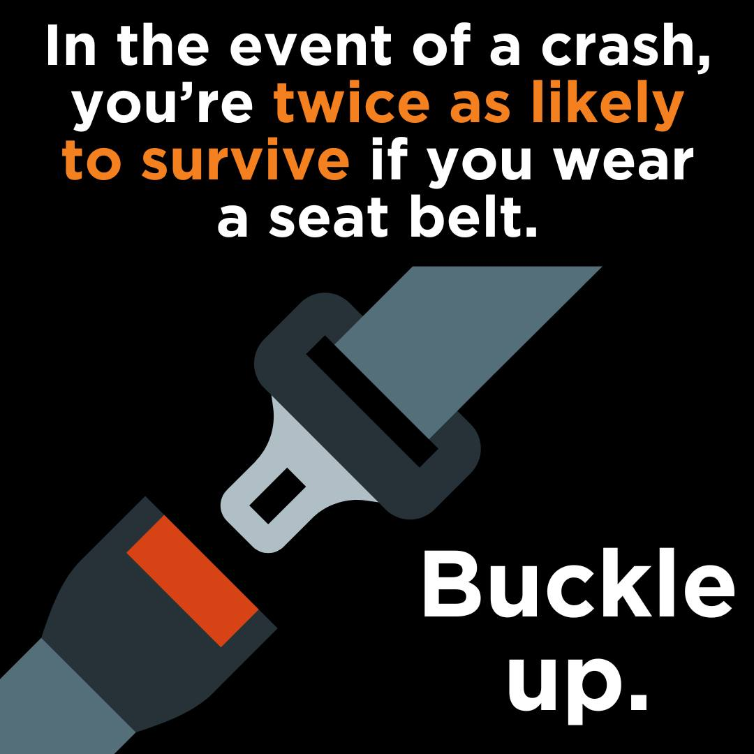

Slide 12
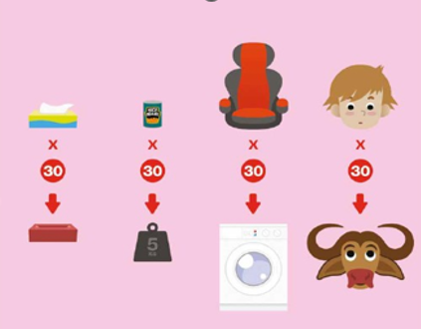
6. Is it the Law to wear a seatbelt in both the front and back seats?
  A) No, just the front B) Yes, both front and back
it is the law for everyone
£100 on the spot fine –
if prosecuted up to £500
Do not carry more passengers
than you have seat belts
No Seat belt at the back

Slide 13
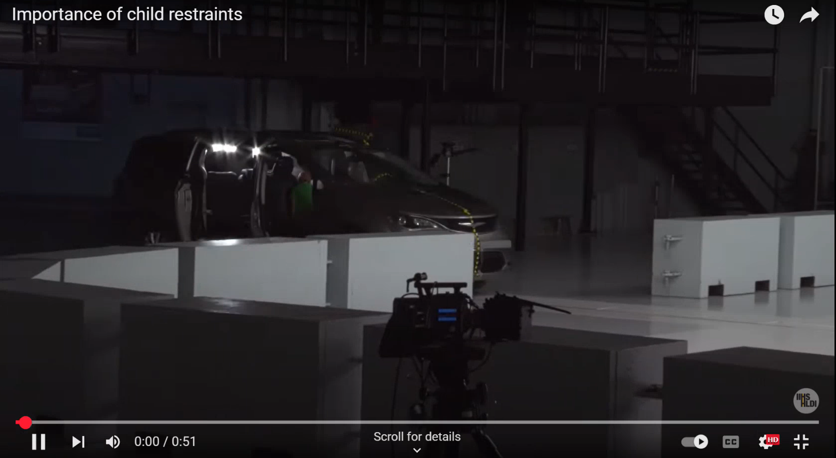

Slide 14
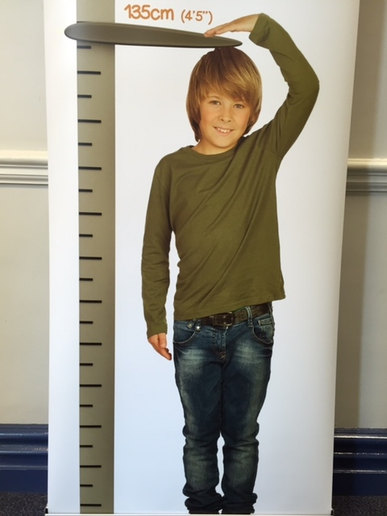
7. How tall must a child be before they can travel without a car seat?
A) 110cm B) 135cm C) 85cm
Law – 135cm (4ft 5ins) OR age 12 – whichever they reach first
It is much safer to keep a child in a booster seat until 150cm
If a child is using a car seat & seat belt, they are 90% less likely to be killed in a crash!

Slide 15
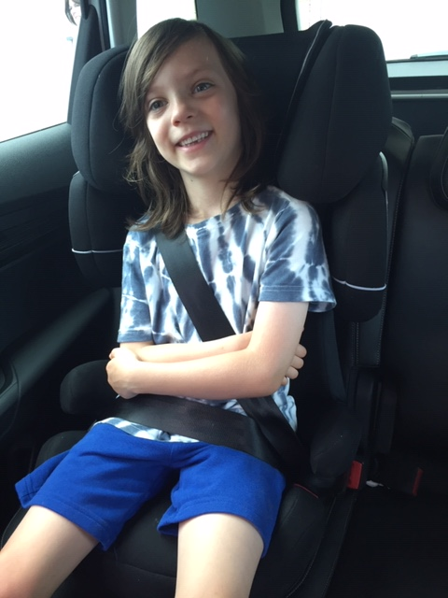
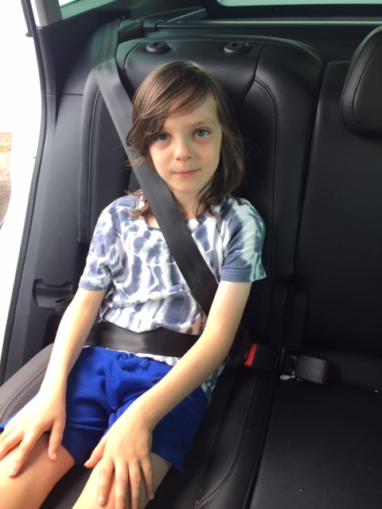
No Booster Seat

Slide 16
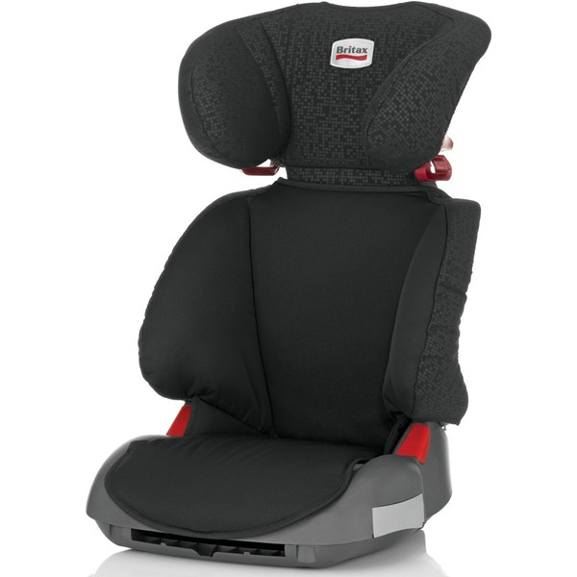
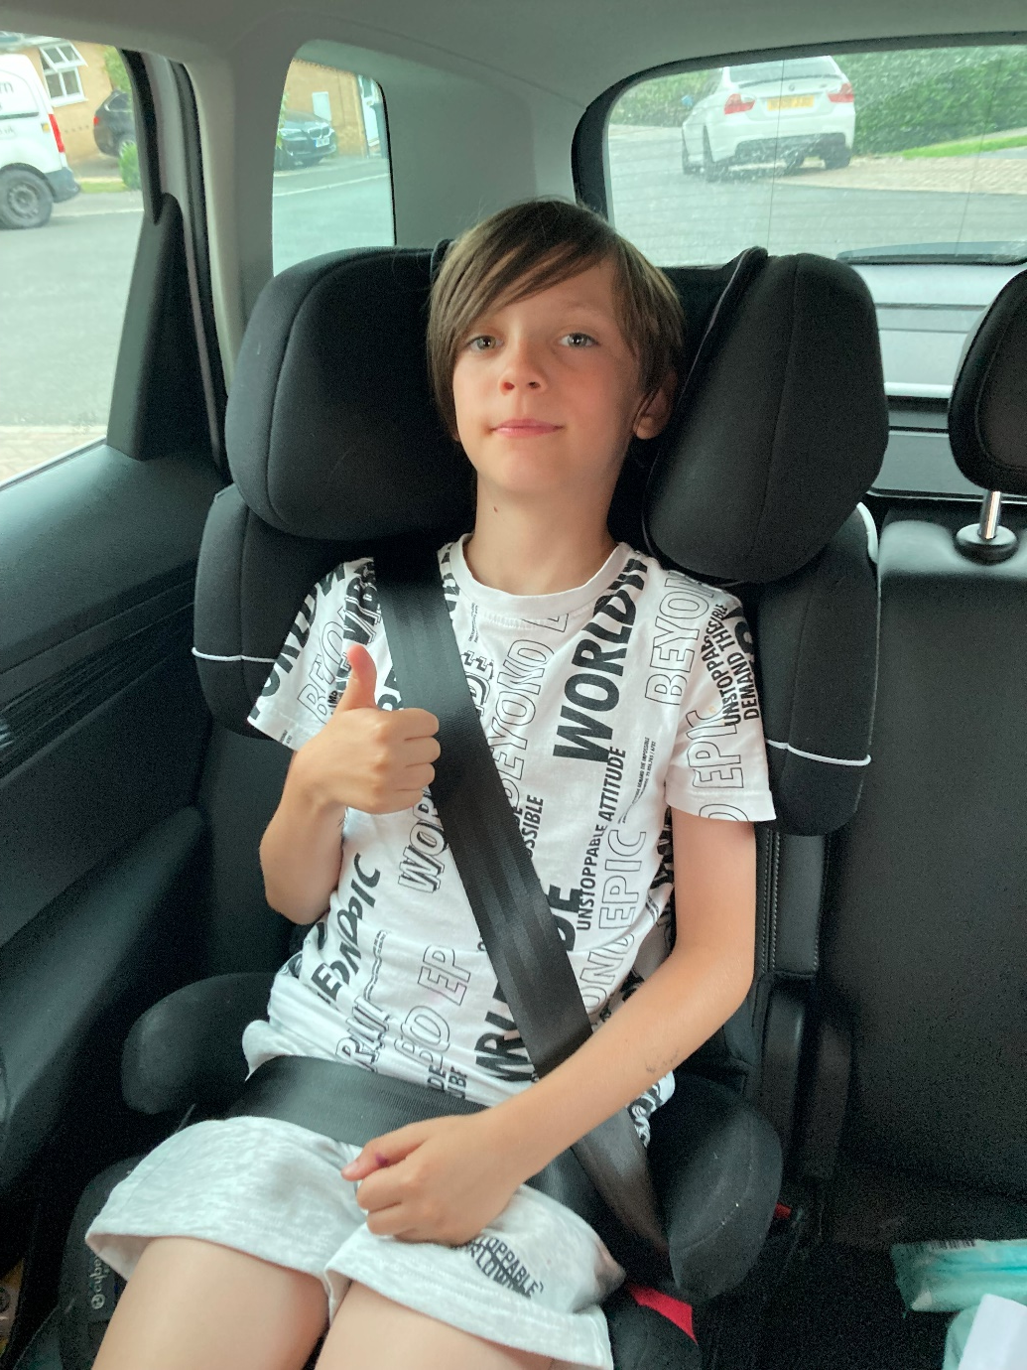
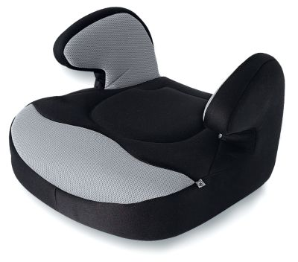
8.) Which seat is safer?
A) Booster Cushion B) High Back Booster Seat
SAFER
A high back booster seat is much safer than a booster cushion (even for older children).
It protects the back, neck & head and provides protection from side impacts.
Notes:
Booster cushions are no longer recommended. Younger children should be in either a car seat with harness (if they are still within the right height & weight), or a high back booster seat. Booster cushions offer no protection. High back boosters have side, back, head protection & clips to keep the seat belt in the correct place on the shoulder. The head rest can be adjusted as child grows and some also expand widthways.

Slide 17
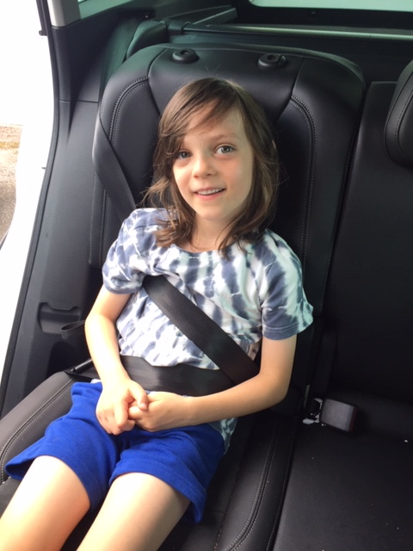
NOT SAFE
Notes:
Often children put the seat belt under their arm or behind their back if they are finding it uncomfortable (usually because they should still be using a booster seat. Travelling like this is not safe – in the crash the seat belt could damage the internal organs, he could head butt his knees and damage his spine.

Slide 18
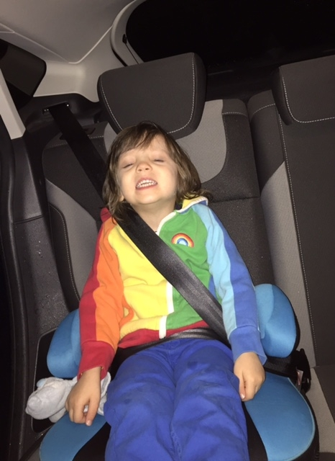
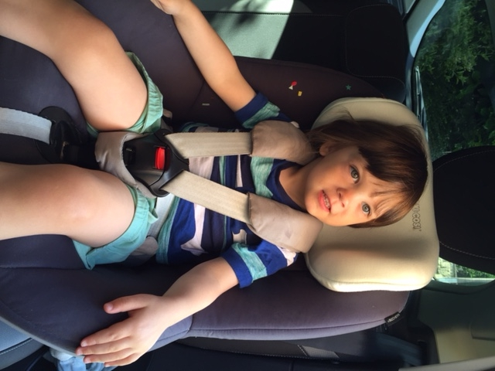
Notes:
The boy is far too small to be using a booster cushion & adult seat belt. The seat belt is cutting into his neck – this would cause serious injuries to his neck and stomach / internal organs if the car crashed. He may even slip under the seat belt. He needs to be in a seat with a harness like in the second picture (rear facing is the safest option).

Slide 19
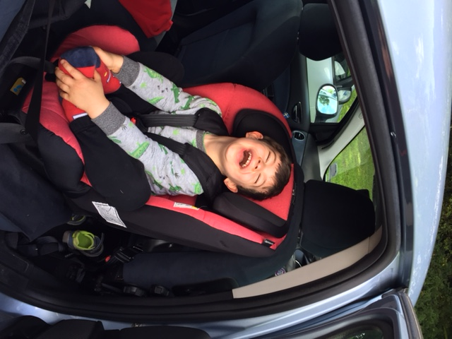
- Keep your child rear-facing for as long as your seat allows.
Rear-facing is 5 times safer!
Children can stay rear – facing in some seats until age 7

Slide 20
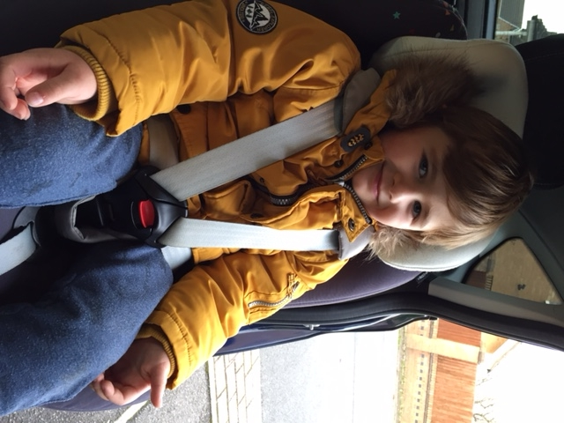
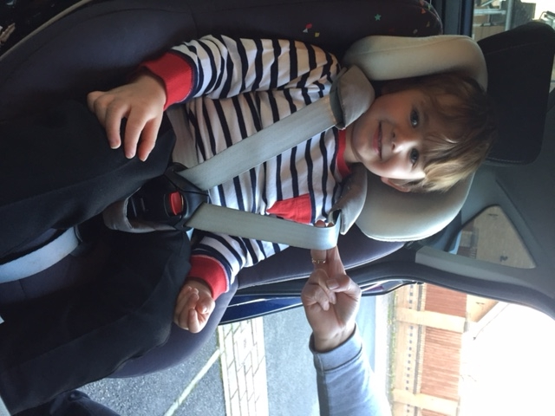
Winter coats are NOT SAFE
in the car!
Coat removed
means
harness is too
loose!
Wear indoor clothes in the car
Notes:
A thick coat prevents the harness from being pulled tightly enough and in a collision the child may not be restrained properly. It is possible that the straps could be so loose the child may slip out of the restraint. Your child is at risk of overheating in the car if you leave their coats on. Use blankets over the top of the car seat if the child is cold.

Slide 21
9. It is safe to buy a second hand car seat?
A)Yes, it is safe B) No, it is not safe
It is dangerous to use a seat with an unknown history.
If it has been involved in a crash the plastic may be weakened.
It may not have been looked after properly (thrown about / stored in extreme hot or cold conditions).
Could be missing parts (e.g. pads).
It could have reached its expiry date.

Slide 22
CAR SEAT Safety Tips
Take your time when choosing a seat – do your research
Make sure the seat you choose fits all cars it will be used in
Check your seat is correctly fitted
Check harness height and tension (keep an eye on growth spurts)
Check no twists in the harness or seat belt and all pads are present
Always make sure you set a good example by fastening own seat belt.
There is no point your child being safely fastened in if you are loose!

Slide 23

Towards Zero Campaign (60 sec)
Please
Sign the Pledge

