Slide 1
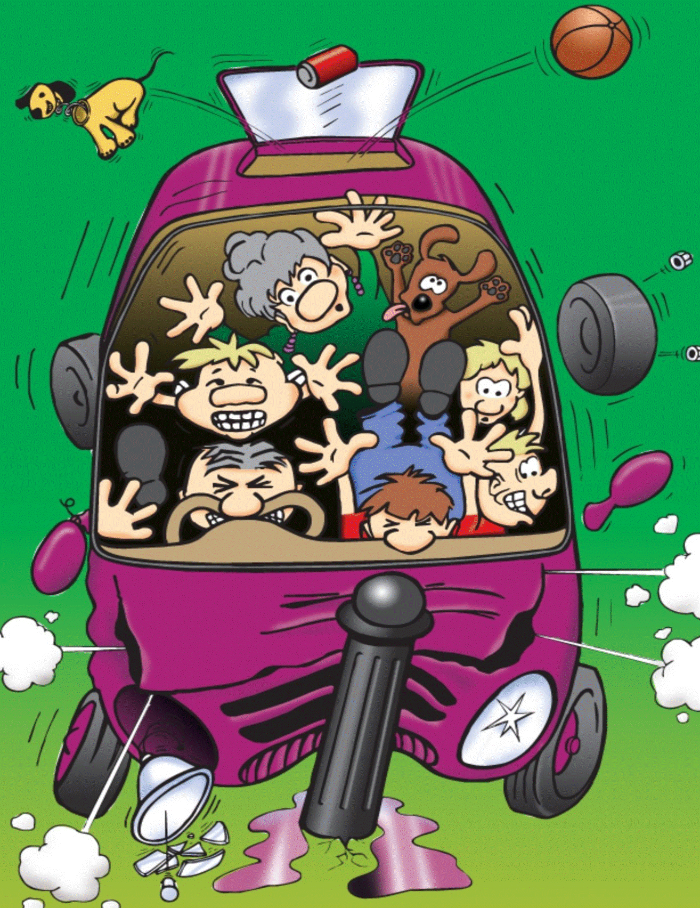
KS1 In Car Safety

Slide 2
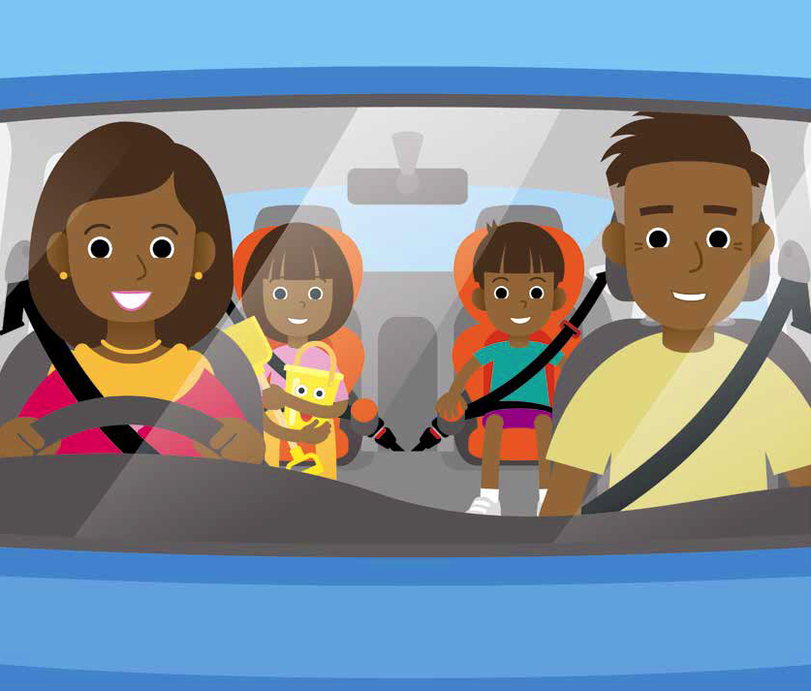
Who travelled to school in a car today?
What do you use to keep yourself safe in the car?
Notes:
Answer: Seat belts, car seats / booster cushions

Slide 3
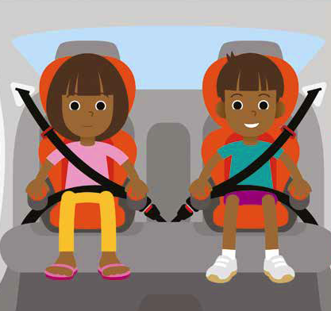
How does a seat belt keep you safe?
Notes:
A seat belt holds you in your seat if the vehicle crashes or brakes suddenly. The seat belt stops you from being thrown through the car & injuring yourself.
Car seats & booster cushions also help keep you safe.

Slide 4
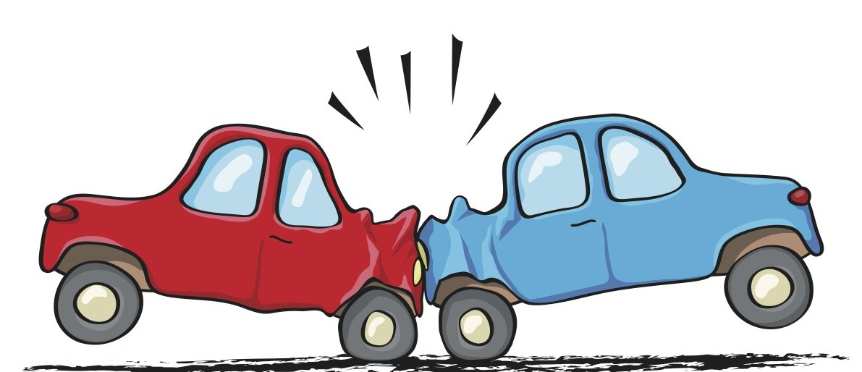
What happens in a crash if you are wearing a seat belt?
What happens in a crash if you are not wearing a seat belt?
Notes:
A: You would be thrown into your seat belt. When a car crashes you continue to travel at the same speed the car was going until something stops you – this would be the seat belt if you were wearing one.
If you are not wearing a seat belt and anything loose in the car will carry on travelling through the car towards the dashboard and windscreen. You could hit other passengers in the car and injure them. There have been many crashes where passengers have actually been thrown through the windscreen onto the road.

Slide 5
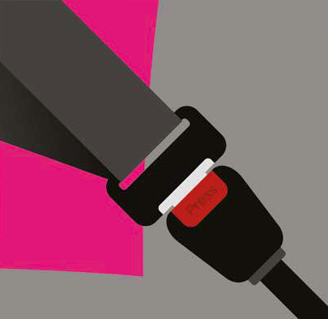
Seat belts save over 2,000 lives in Britain every year. That’s like all the children in four big schools!

Slide 6
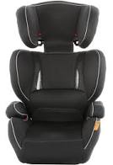
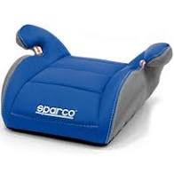
Booster Seats
Booster seats also keep you safe in the car
High Back Booster
Booster Cushion
Notes:
- Q: Which seat do you think is safer?
High back booster is much safer – it protects the head, body & spine. The seat belt clip under the head rest keeps the seat belt in the correct position on the shoulder and pelvis. The high back booster is not only for young children – the height adjusts to fit children up to 150cm. Some seats adjust widthways too.
The booster cushion is certainly better than no seat at all, but the high backed booster is recommended for all children (especially those in KS1). The booster cushion will lift the child up so that the seat belt rests in the correct place on the body (on the bony collar bone and hips), but it offers no extra protection like the high back booster does.
Children should be using a high back booster for as long as they can comfortably fit in it.

Slide 7
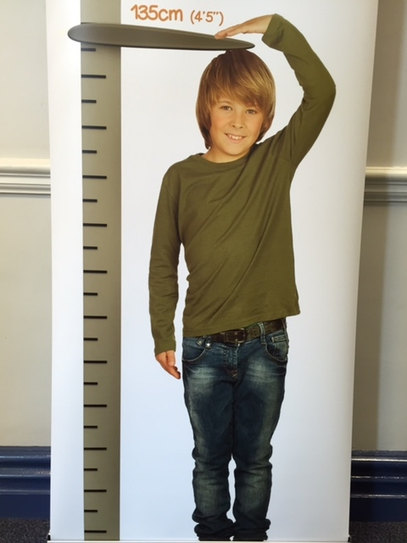
The Law
All children must wear a seat belt and use a car seat until they are 135cm tall or 12 years old – whichever they reach first.
It is safer to use a seat until 150cm tall.
Notes:
Although the law says children must use a car seat until 135cm, it is safer for children to use a car seat until they reach 150cm (the next slide explains why).
Suggested activity:
Bring a few children out to measure or ask them to measure each other and record their height. A class graph could be made to show the heights of the children.

Slide 8
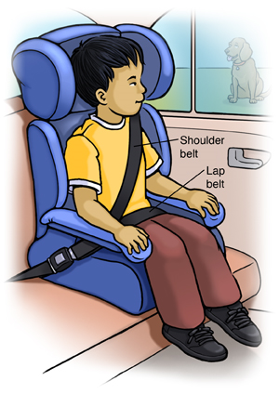
Why do we need to use a car seat?
A car seat or booster cushion makes sure that the seat belt sits on the bony part of your shoulder and hips and NOT on the soft parts of your neck and tummy which could be dangerous.
Notes:
Ask the children to feel their bony collar bone and hips – this is where the seat belt should sit to keep you safe.
Adult seat belts do not fit children properly as the seat belt rests on the soft tissues of the neck and tummy, rather than the strong bones of the upper thigh/pelvis and collar bone. In a crash this could cause serious injuries to the neck and internal organs. Younger children may also slip underneath the seat belt. A child seat or booster cushion ensures that the seat belt is in the correct place and can do its job properly.

Slide 9
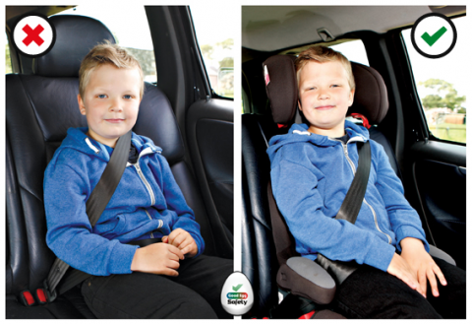
Images supplied by www.goodeggcarsafety.com
Notes:
Discuss the difference between the two pictures. Which is safer?
The pictures demonstrate where the seat belt sits on the boy with and without a booster seat. In the first picture the seatbelt is resting on his neck and cutting into his face. The lap belt is across his tummy which, in a crash, can be dangerous. He needs a booster seat (as shown in the second picture) to put the seat belt in the correct place. Many children above 135cm still need a booster seat for the seat belt to fit correctly.

Slide 10
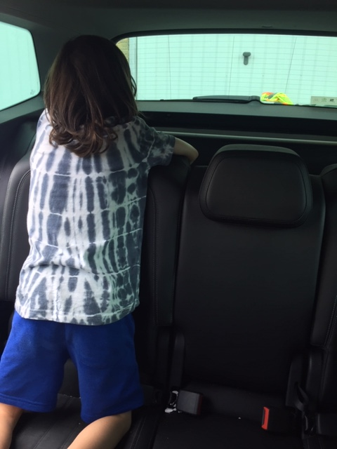
What would happen to the boy if the car crashed?
What should he be using?
Notes:
The boy is kneeling on the seat & not using a seat belt or car seat. In a crash he would be thrown through the car and could injure himself, the driver & other passengers.
Q. What should the boy be doing when travelling in a car?

Slide 11
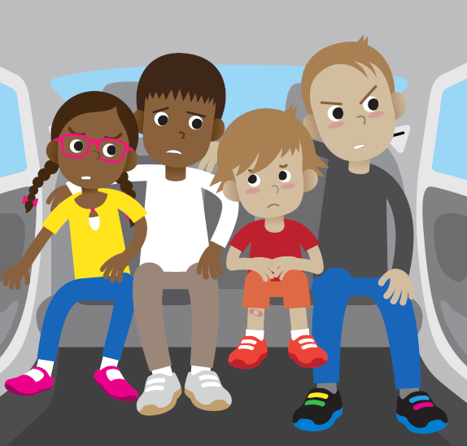
What is wrong in this car?
Notes:
-None of the passengers are wearing a seat belt.
-There are too many people in the back of the car for the number of seat belts.
-They are breaking the law.
-Loose people can be thrown around the car in a crash and can seriously injure one other.
Q. What should the children in the picture do?
-There should only be 3 sat in the back (the biggest child could sit in the front).
-All should be wearing a seat belt and using a booster seat if needed.

Slide 12
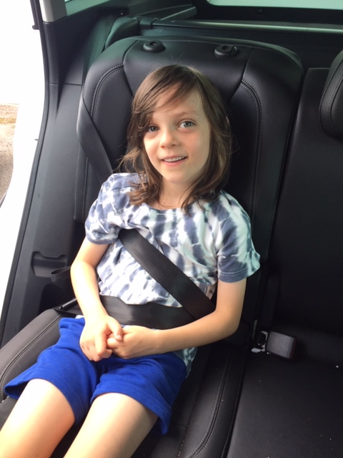
What is wrong with the boy’s seat belt?
What should he be using?
Notes:
The boy has put the seat belt under his arm. He probably put it here to stop it cutting into his face as he doesn’t have a booster seat. In a crash he could be seriously injured (he may head butt his knees and damage his back).
- He should be using a booster seat.

Slide 13
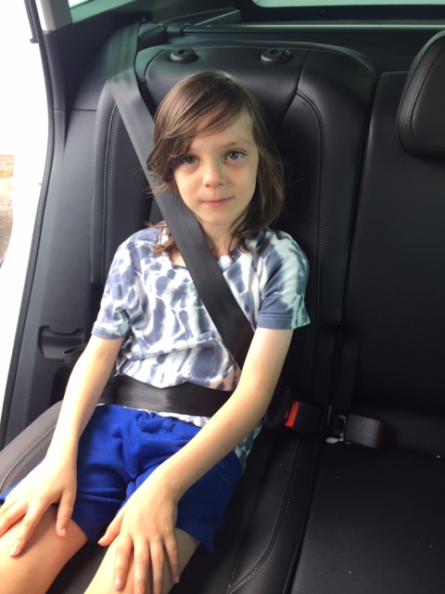
Why is the boy not safe?
What does he need to use to make him safe?
Notes:
The seat belt does not fit the boy correctly & is resting on his tummy and cutting into his neck. This could cause a lot of injuries if the car had to break suddenly or crashed.
He needs a booster seat to put the seat belt in the correct place. The driver could be fined because he is not using one.

Slide 14
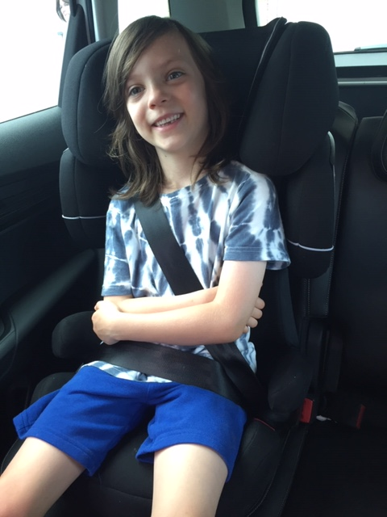
Notes:
This is much safer. The seat belt is in the correct place now and the seat will protect his body, spine and head in a crash.

Slide 15
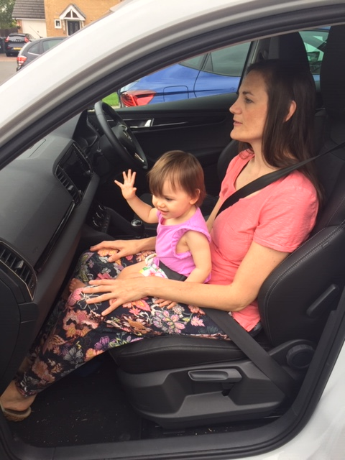
What is wrong in this photo?
What could happen to the baby if the car crashed?
Notes:
Young children should never sit on knees – even with a seat belt around them. If the car crashed the smaller person could be crushed between the seat belt and the bigger person. Their heads could bang together causing serious injury. It is impossible to keep hold of a baby in a crash. The baby could be thrown with force into the dashboard and windscreen.
A seat belt is designed for one person only and should never be shared.
Q. Where should the baby be?
In a baby seat (often called infant or baby carriers) in the back of the car.

Slide 16
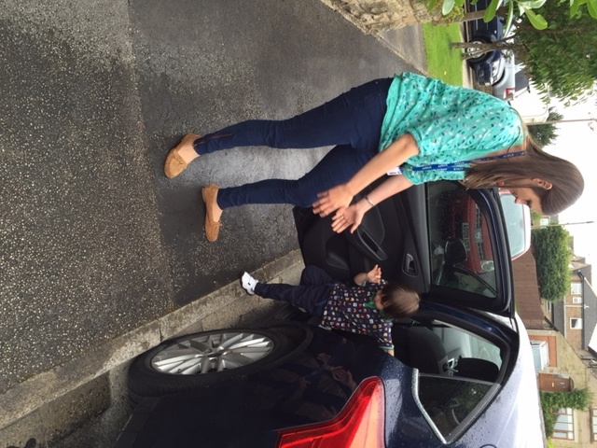
Always get out of the car onto the pavement -NOT the road!
Wait until your adult tells you it is safe.
Notes:
Make sure that the children know they should only take off their seat belts when the vehicle has stopped, the engine is turned off and their adult has told them they can.
They should wait for their grown up before opening the car door and always step out onto the pavement, not onto the road.

Slide 17
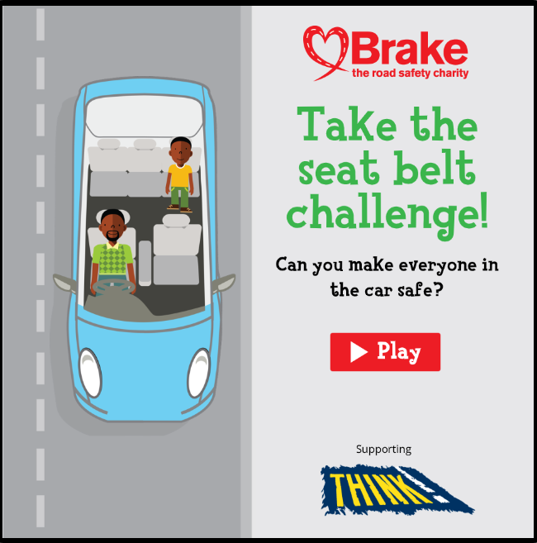
Play a game and make a promise
Seat belt challenge v1-09 (brakeresources.s3.eu-west-2.amazonaws.com)
Notes:
This is good to do on an interactive white board to open up discussion. Click on the website (when in full presentation mode).
Why should the girl not travel in the front seat? – the back of the car is always the safest place to travel especially for children).
Why should the bag and the cat carrier be placed in the boot? – Remember any items not tied down will travel on their own if the vehicle crashes or breaks sharply. This could hit and injure the passengers.
Why should the driver and the boy wear a seat belt? – It will protect them in a crash and stop them from flying through the car and injuring themselves / each other.

Slide 18
Seat Belt Rhyme
‘5, 4, 3, 2, 1, we’ve all got our seat belts on,
1, 2, 3, 4, 5, cos we want to stay alive!’
Notes:
A rhyme that the children can all say together with actions.

Slide 19

Twinkle Twinkle
Twinkle, Twinkle, I’m a star,
I wear my seat belt in the car,
If my mum and dad forget,
I tell them I’m not ready yet,
Twinkle, Twinkle, I’m a star,
I wear my seat belt in the car.
Notes:
‘Twinkle Twinkle song’ (may not be age-appropriate for all KS1 classes).
Recap the session by asking the children what two things they need to use every time they go in the car (or a taxi) to keep safe?
If you require anymore information, please contact the Bradford Road Safety Team 01274 437409.
PowerPoints for all year groups on pedestrian safety are available on our BSO page Road Safety | Bradford Schools Online

