Slide 1
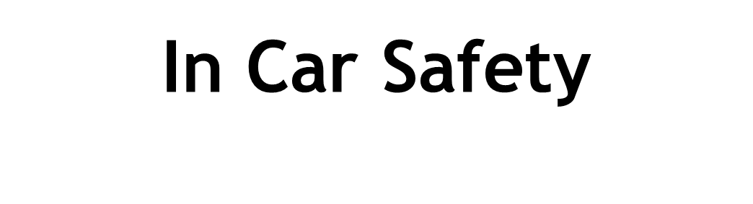

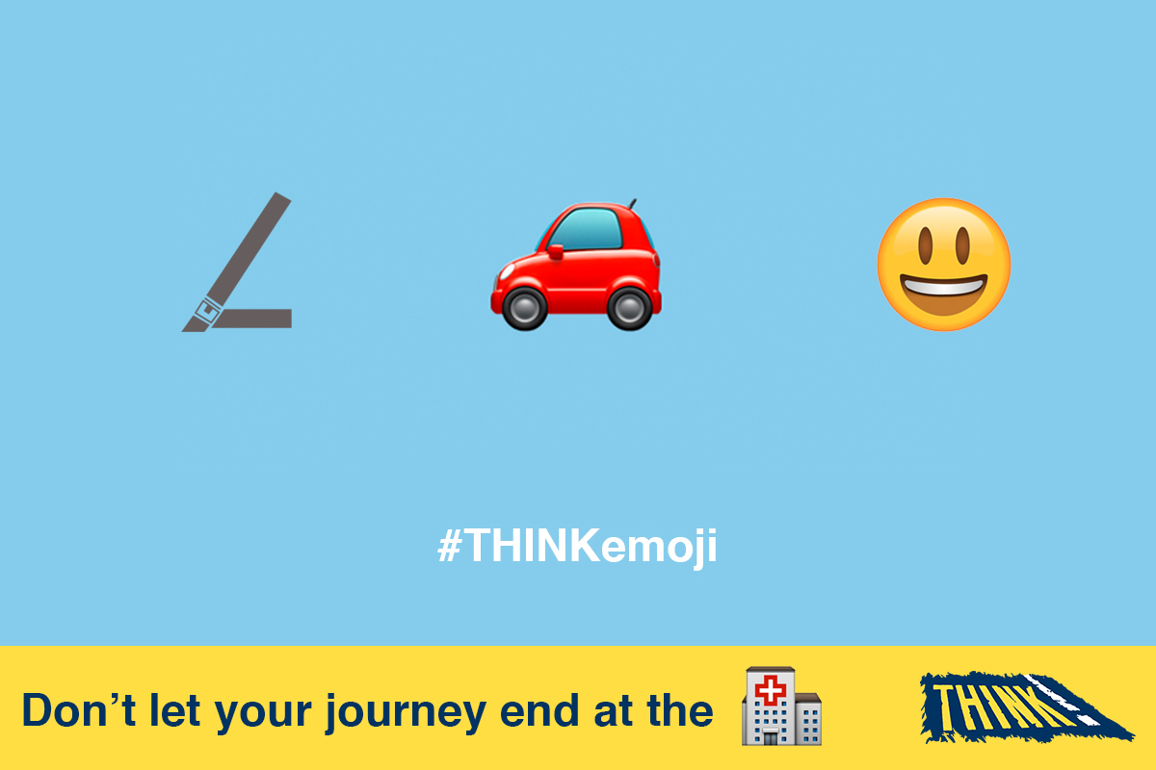

Slide 2
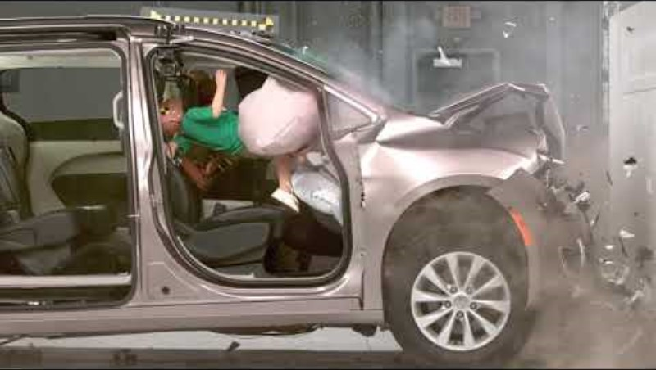
Notes:
Talk about passengers bring thrown around the car in a crash. If you’re sat in the back, you could injure the passengers in front.
Weight multiples at least 30 times in a 30mph crash (5 stone person would be 150 stone).
Did you see how ineffective the air bags were without a seatbelt?

Slide 3
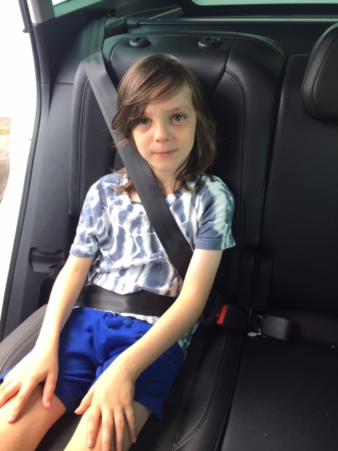
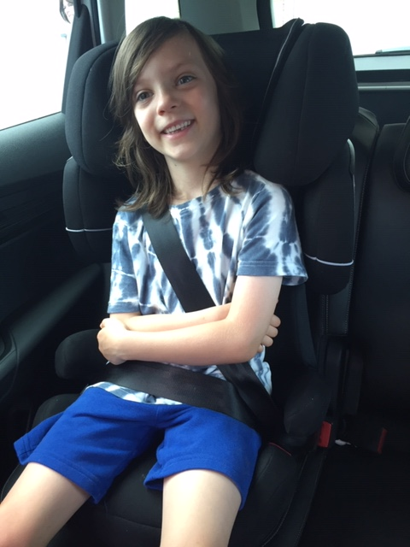
Notes:
Ask the audience if they think the boy is as safe as he should be?
What is wrong?
The seat belt does not fit the boy correctly & is resting on his tummy and cutting into his neck. This could cause a lot of injuries if the car had to break suddenly or crashed.
He needs a booster seat to put the seat belt in the correct place. Click for second photo.

Slide 4
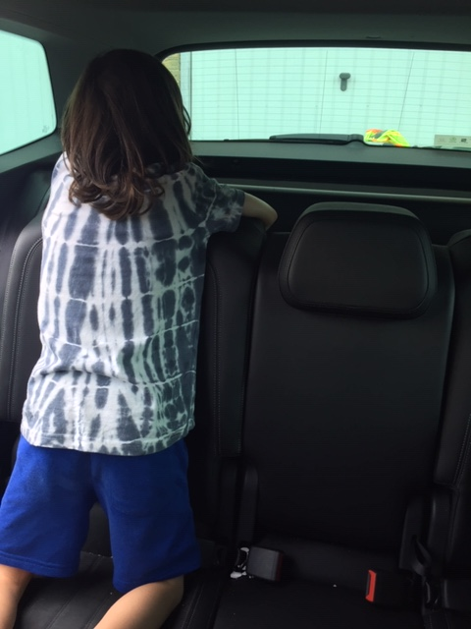
Notes:
The boy is kneeling on the seat & not using a seat belt or car seat. In a crash he would be thrown through the car and could injure himself, the driver & other passengers.
Q. What should the boy be doing when travelling in a car?

Slide 5
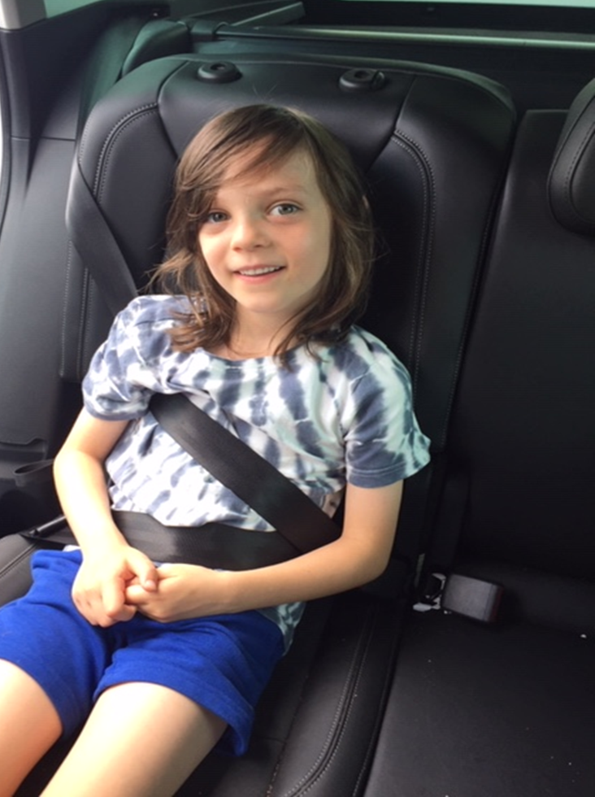
Notes:
The boy has put the seat belt under his arm. He probably put it here because it was uncomfortable as he doesn’t have a booster seat to ensure it lies on his shoulder. In a crash he could be seriously injured (he may head butt his knees and damage his back).
- He should be using a booster seat.

Slide 6
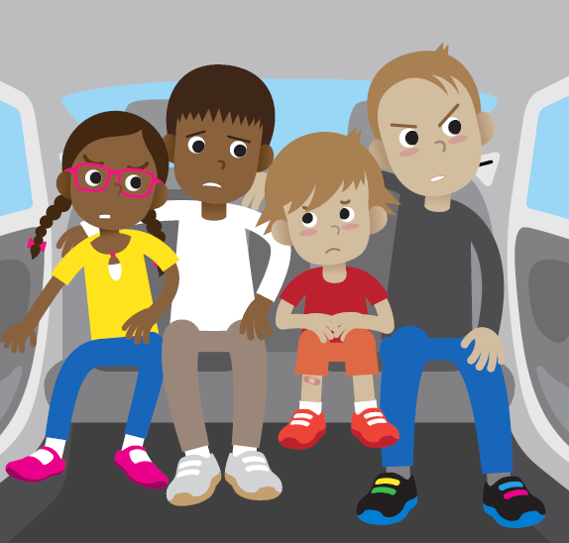
Notes:
-None of the passengers are wearing a seat belt.
-There are too many people in the back of the car for the number of seat belts.
-They are breaking the law.
-Loose people can be thrown around the car in a crash and can seriously injure one other.
-There should only be 3 sat in the back (the biggest child could sit in the front).
-All should be wearing a seat belt and using a booster seat if needed.

Slide 7
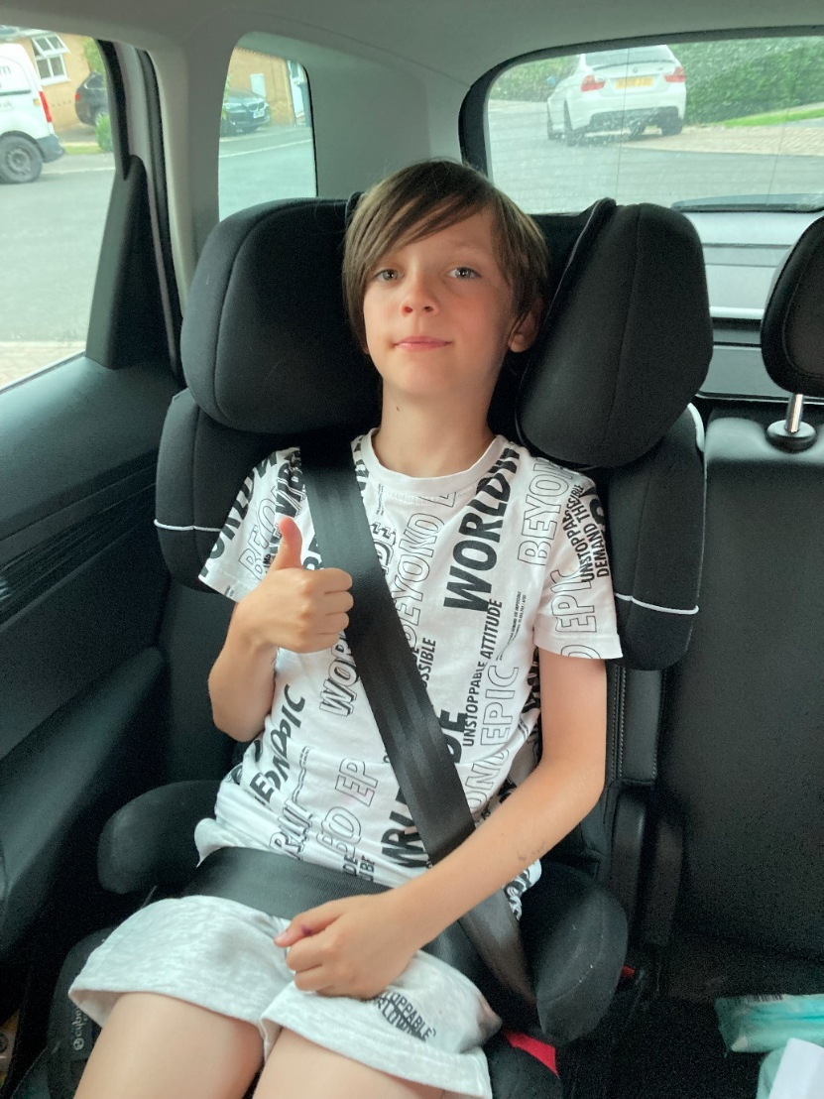
Notes:
The boy is travelling safely – he is using a booster seat and has a seat belt on.

Slide 8
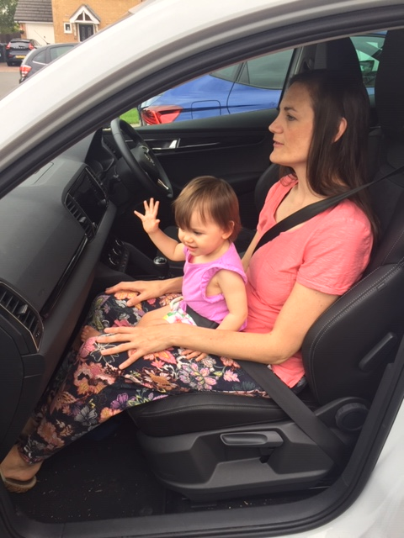
Notes:
Young children should never sit on knees – even with a seat belt around them. If the car crashed the smaller person could be crushed between the seat belt and the bigger person. Their heads could bang together causing serious injury. A seat belt should only be used for one person.
If the seat belt was not around the baby, she would be thrown with force into the dashboard and windscreen. It is impossible to keep hold of a baby in a crash.
Q. Where should the baby be?
In a baby seat (often called infant or baby carriers) in the back of the car.

Slide 9
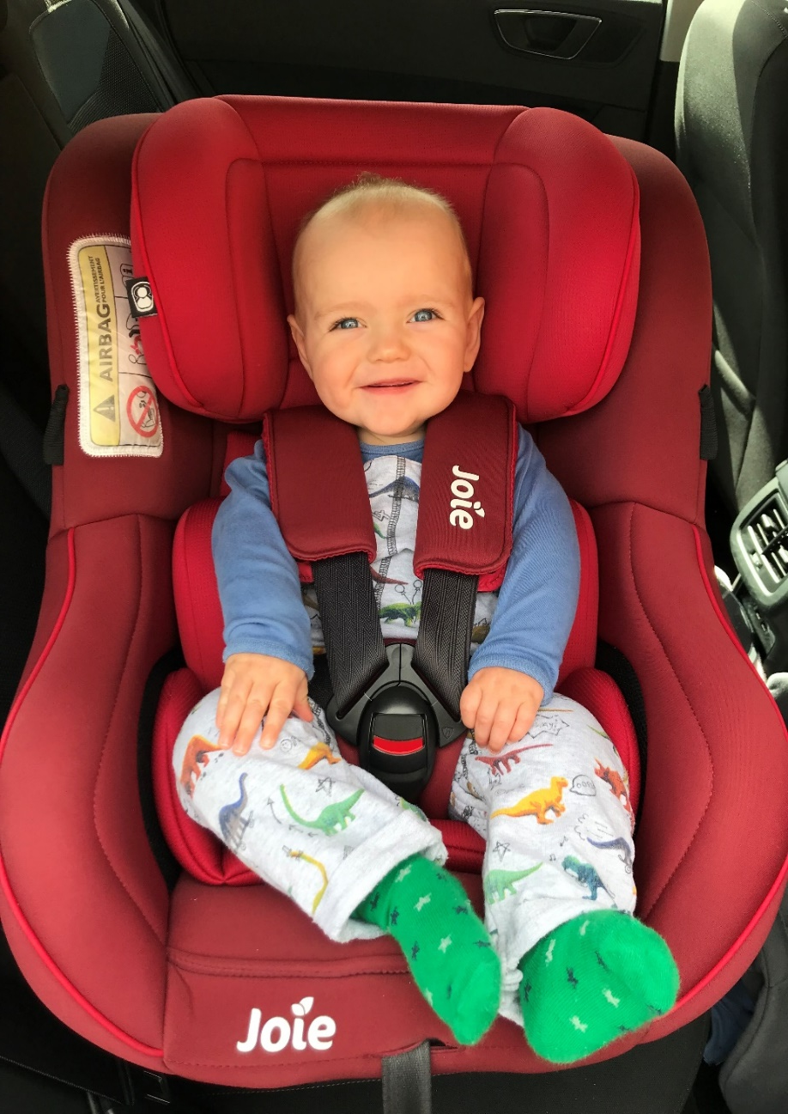
Notes:
The baby is safe in his child seat with his harness fastened.

Slide 10
Seat Belt Rhyme
‘5 4 3 2 1, we’ve all got our seat belts on,
1 2 3 4 5, BECAUSE we want to stay alive!’
Notes:
A rhyme that the class can do together with actions.

