Slide 1
How To Be A Road Safety Hero

Slide 2
There are lots of Superheroes
Can you name any?
The next slide has just a few
There is one superhero missing – that’s YOU!

Slide 3
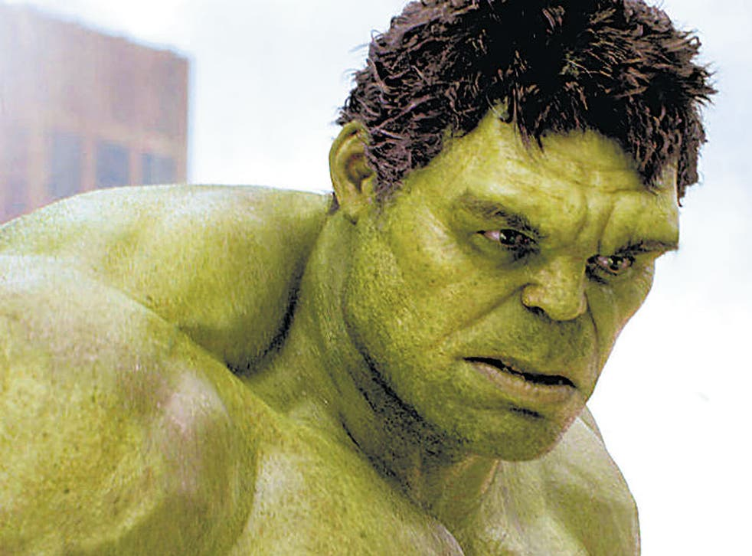
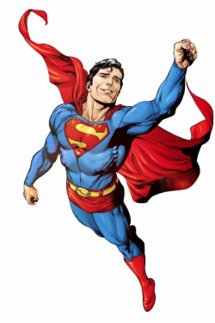
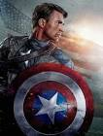
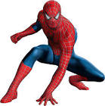
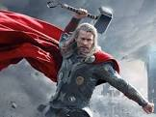

Slide 4
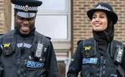
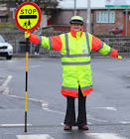
What do Superheroes do?
They save lives!
You can be a superhero too!
A Road Safety Superhero!
These people are already Road Safety Superheroes
Are you ready to accept the challenges to become a Road Safety Superhero?

Slide 5
Can you be a Road Safety Superhero?
Challenge 1
To know the Green Cross Code?
Can you put the rules of the road in the right order?
Notes:
Before you show the next slide, can the children recall any of the rules we use to keep us safe while we are crossing the road?

Slide 6
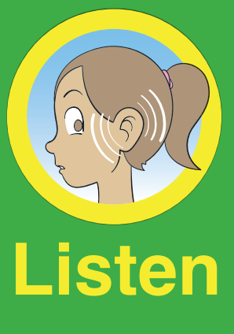
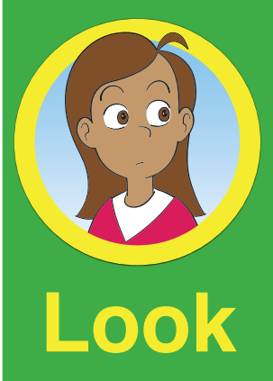
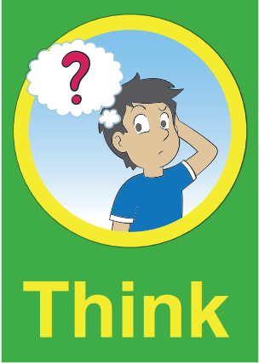
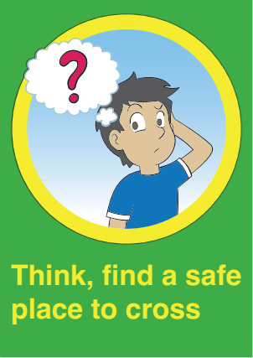
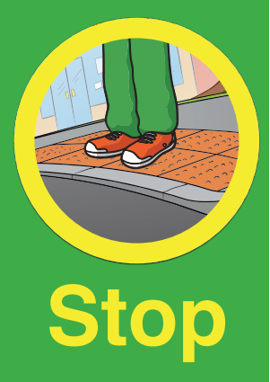
Notes:
For younger children, it is helpful to discuss holding the hand of their grown up and walking furthest away from the road and traffic.

Slide 7
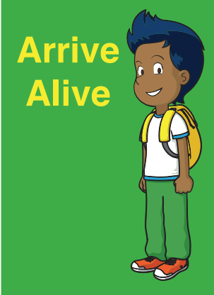
The Green Cross Code
Did you do it?
Can you cross the road safely?
Notes:
Do the children know what we mean by ‘a safe place to cross?’ This will be covered in the next challenge but it is a good starting point now.
Do the children know which way we should look first? To the right as in this country the vehicles which are closest to us come from the right hand side.
It is also a good idea to discuss the increase in the use of electric vehicles on our roads and how quiet they are. We need to constantly be looking around us as well as listening when we are actually crossing the road.

Slide 8
Challenge 2
The next slide will show you some safer places to cross. Can you name them and discuss how to use them safely?

Slide 9
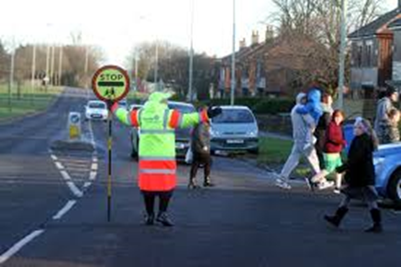
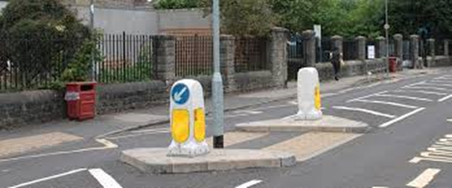
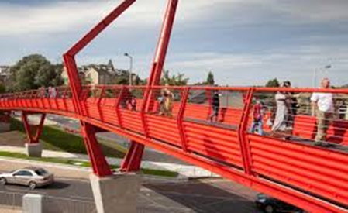
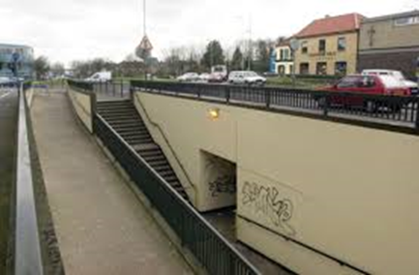
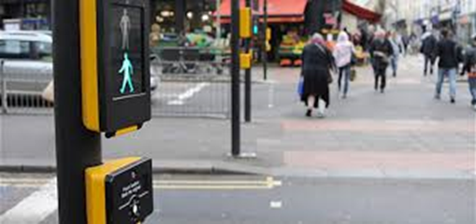
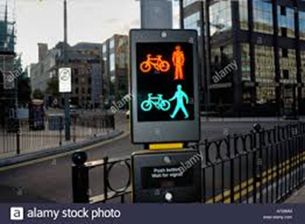
Remember these are only ‘safer’ if used correctly!
Notes:
Zebra Crossing. STOP. Ensure the traffic on both sides has stopped before using.
School Crossing Patrol or lollipop person. Wait until they have told you it is safe to cross, then always walk in front of them.
Traffic Island. Look right and left and right again. Cross when safe. Stop on island. Look left and right and left again. Cross when safe. Talk about traffic direction and flow – reinforce looking all round.
Footbridge. It may seem like a longer way to walk, but it is the safest.
Subway. Whilst these are a safer place to cross, they can often be dark, so always make sure you use these with an adult you know.
Puffin Crossing. STOP. Press the button, wait for the green man to come on. Make sure the traffic on both sides has stopped before crossing. Has anyone ever seen a car go through a red light?
Toucan Crossing. The only crossing where you can actually ride your bike across. Use in the same way as a Puffin Crossing.
Pegasus Crossing. For horse riders. Use in the same way as a Toucan or Puffin Crossing.
Emphasise to pupils that they need to use the safer crossing places correctly and always concentrate because drivers are not always paying attention.
In doing this they will be their own road safety superhero!

Slide 10
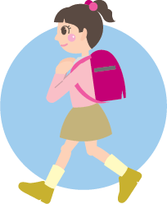
Challenge 3
You can be a superhero by walking to school instead of taking the car
Can you think of any benefits of walking to school?
Better concentration
Improves your health & fitness
Improve your road safety skills
Reduces traffic congestion & parking problems near school
Notes:
Encourage children to discuss the benefits of walking to school.
If children need to be driven, then perhaps they could be a superhero and encourage their adult to park a little further away from school and walk the last part of the journey. Even a short 5 minute walk can make a big difference.
Sometimes parking a bit further away where it is quieter and easier to find a space can be less stressful for their adults and actually be quicker than trying to park nearer. Often when drivers do try to park really close to school, they end up getting stuck in a big queue and can’t even find anywhere to park because it is too crowded.

Slide 11
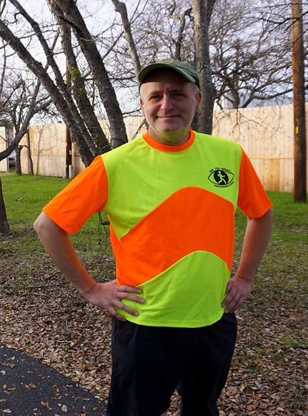
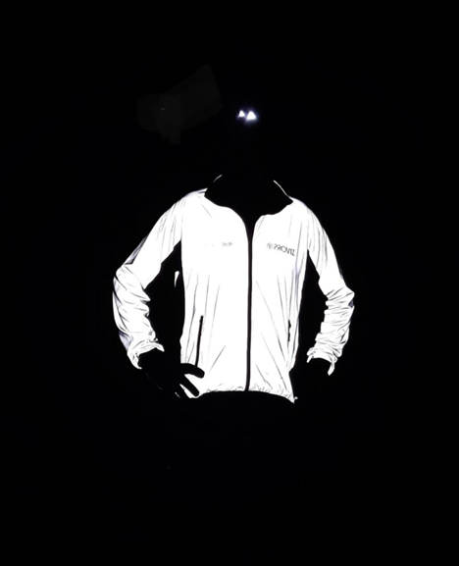
Challenge 4
How can you make yourself visible to other road users at all times?
Can you complete this game to keep the people safe?
Be bright be seen game – THINK!
Fluorescent clothing Reflective clothing for day for night
Notes:
Fluorescent clothing (often referred to as hi-viz) helps you to be seen easily during the day. The sun’s ultra violet rays react with the fluorescent colours to make them appear to ‘glow.’ This helps you to be seen more easily. Fluorescent or hi-viz clothing and accessories work really well when the light conditions are poor (i.e. gloomy, rainy, foggy or misty days, or when dusk is approaching). Fluorescent material doesn’t help you to be seen at night when it is dark. For this you would need reflective clothing or materials.
Lots of colours can be fluorescent and are used for hi-vis clothing and accessories. Yellow, orange, green or pink are commonly used. Red can be used too. Blue is less effective because its wavelength it is not good at emitting light. In general the human eye is not so good at seeing blue, so if the uniform at your school is blue, it’s a really good idea to encourage the children to also wear or carry something fluorescent to help them to be seen.
Reflective materials work at night. They are designed to bounce back light to its source instead of scattering it. This means that the light from a drivers’ headlights bounces straight back to the driver who will see the reflective materials REALLY well. If drivers have their car headlights on then reflective materials can help them to see you up to three seconds sooner at night – which could save your life.
It is useful to point out to the children the differences between fluorescent material and reflective material. Many people (including a lot of adults) are not fully aware that reflective material on your clothing will not reliably help you to be seen during the daytime. Although reflective tape may sometimes glint in the sunlight it doesn’t show up properly to drivers until it is dark and they are using their headlights.
Fluorescent / hi-viz material is needed for daylight hours and reflective material is needed for night time.
Ideally hi-viz clothing or accessories will incorporate both fluorescent and reflective elements to help wearers be seen more easily at all times of day.

Slide 12
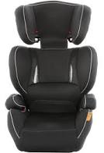
Challenge 5
Not all superheroes wear a cape but they will always wear a seat belt!
Can you think of anything else you should be using to keep safe in the car?
A Booster Seat
Notes:
Discussion Points:
- Seat belts are not designed to be shared (one person per seat belt).
By law and for safety all children need to use a car seat or booster cushion until they are 135cm or 12 years of age (whichever comes first). This is because seat belts are designed for adults. The car/ booster seat ensures that the child is lifted into the correct position to allow the seat belt to lie across their shoulder and hips and pelvis rather than across their neck and abdomen. An incorrectly positioned seat belt (i.e. one that lies across neck/ abdomen) could actually cause injuries to a child if the vehicle was involved in a collision. A very small child using only the adult seat belt could actually slip under the seat belt altogether in a collision resulting in catastrophic injuries.
Some children will tell you that they don’t wear a seat belt as they are uncomfortable. If the seat belt rubs their neck, they may have got rid of their booster seat too soon.
It is important that everyone in the car/ vehicle wears a seat belt. If there was a crash people not wearing a seatbelt could be flung into other passengers and injure them.
Can the children be road safety superheroes and always wear their own seat belt and remind everyone else in the car to wear theirs too?
If time allows, get children to think about how else they could be superheroes in the car. For example, not distracting the driver, reminding the driver not to use their mobile phone.

Slide 13
Congratulations! Road Safety Superhero! hero

Slide 14
Can you now encourage others to become Road Safety Superheroes?
You could:
Design a poster for your classroom, detailing all you have learnt in becoming a road safety superhero
Make a comic strip with your own superhero, saving lives on the road
Design your own road safety superhero cape with the Green Cross Code on it
Challenge your grown ups to become road safety superheroes too
Write a letter or a thank you card to your own road safety hero – is there a lollipop person who helps you cross the road, or a Community Police Officer who visits your school?

