Slide 1
The Nurturing Schools
Programme
Yvonne Monaghan
Head of Consultancy
Nurture Group Network
Bradford 2017

Slide 2
Northern Ireland research findings 2016
The Nurture Unit Signature Pilot Project
A project to assess the effectiveness of Nurture Unit (Group) provision
20 primary schools selected on criteria of deprivation indices
New Nurture Groups funded completely including setting up, training and support
10 further existing Nurture Groups granted support funding
A two-year project extended through further Department of Education funding

Slide 3
Northern Ireland research findings 2016
Was announced last week in Belfast:
The impact and cost effectiveness of Nurture Groups in Primary Schools in Northern Ireland
Commissioned by the Department of Education, the objectives of the evaluation are:
To assess the effectiveness of nurture provision in improving child social, emotional and behavioural development, and ability to learn, both within the Nurture Group and following reintegration with the mainstream class;
To assess the cost-effectiveness of nurture provision in achieving its objectives.
Source: Sloan, S., Winter, K., Lynn, F., Gildea, A. & Connolly, P. (2016) The impact and cost effectiveness of Nurture Groups in Primary Schools in Northern Ireland. Belfast: Centre for Effective Education, Queen's University Belfast.

Slide 4
Northern Ireland research findings 2016
Announced last week in Belfast:
Impact of Nurture Group Provision
“This evaluation found clear evidence that Nurture Group provision in Northern Ireland is highly successful in its primary aim of achieving improvements in the social, emotional and behavioural skills of children from deprived areas exhibiting significant difficulties.”
Source: Sloan, S., Winter, K., Lynn, F., Gildea, A. & Connolly, P. (2016) The impact and cost effectiveness of Nurture Groups in Primary Schools in Northern Ireland. Belfast: Centre for Effective Education, Queen's University Belfast.

Slide 5
Northern Ireland research findings 2016
Four main elements to the research and evaluation:
Stage 1: an analysis of data for 529 children from 30 primary schools who had previously attended Nurture Groups (the 20 Signature Project schools and the 10 established Nurture Groups) to assess their progress during their time in the Groups and the potential factors associated with the progress made;
Stage 2: a quasi-experimental trial involving 384 children in total and comparing the progress of those currently attending Nurture Groups in the 30 primary schools (during the 2014/15 school year) with children in 14 matched schools with no Nurture Group provision;
a cost-effectiveness analysis and economic review of Nurture Group provision; and
A qualitative process evaluation involving interviews with school principals, Nurture Group teachers and class assistants, mainstream teachers, parents and children as well as observations of the Nurture Groups in practice.
Source: Sloan, S., Winter, K., Lynn, F., Gildea, A. & Connolly, P. (2016) The impact and cost effectiveness of Nurture Groups in Primary Schools in Northern Ireland. Belfast: Centre for Effective Education, Queen's University Belfast.

Slide 6
Northern Ireland research findings 2016
Key findings from Stage 1 – the original data:
On average children ‘made consistently large improvements in social, emotional and behavioural development’
‘levels of improvement were found to occur for all groups of children regardless of gender, age, social services involvement or stage of SEN Code of Practice on entry to the NG’
‘there was evidence that greater progress was being made by those attending on full-time basis, looked after children and those not eligible for free school meals’
‘there were also smaller, but significant improvements in relation to academic achievement in literacy and numeracy’
Source: Sloan, S., Winter, K., Lynn, F., Gildea, A. & Connolly, P. (2016) The impact and cost effectiveness of Nurture Groups in Primary Schools in Northern Ireland. Belfast: Centre for Effective Education, Queen's University Belfast.

Slide 7
Northern Ireland research findings 2016
Key findings from Stage 2 – the quasi-experimental trial:
‘most notably, Nurture Group children experienced large gains in social, emotional and behavioural skills, there was no evidence of any change found among similar children attending the matched control schools with no NG provision’
‘77% of children who entered Nurture Groups were exhibiting difficult behaviour (measured by SDQ) this reduced to 20.6% post intervention – those in control schools reduced from 62.8% at the start of the year to 61.9% post test’
‘Nurture Group pupils reported significantly greater enjoyment of school compared to pupils in the control group’
Improvements in academic attainment may be medium to longer-term outcomes of NG provision, teachers felt that barriers to learning were removed through nurture provision, facilitating pupil engagement in the classroom’
Source: Sloan, S., Winter, K., Lynn, F., Gildea, A. & Connolly, P. (2016) The impact and cost effectiveness of Nurture Groups in Primary Schools in Northern Ireland. Belfast: Centre for Effective Education, Queen's University Belfast.

Slide 8
Northern Ireland research findings 2016
Key findings – cost effectiveness:
‘comparison with the estimated costs of providing other additional educational services to children with behavioural difficulties, suggests that effective Nurture Group provision will present direct savings to the education system’
‘investment in Nurture Group provision is likely to pay for itself after just two years for each child whose problem behaviour is reduced to the normal range’
‘taking a lifetime approach is it estimated that preventing conduct disorders would save public services £150,000 per case averted’
Investment in Nurture Groups ‘is therefore likely to be cost-effective and represent significant economic return to society’
Source: Sloan, S., Winter, K., Lynn, F., Gildea, A. & Connolly, P. (2016) The impact and cost effectiveness of Nurture Groups in Primary Schools in Northern Ireland. Belfast: Centre for Effective Education, Queen's University Belfast.

Slide 9
Northern Ireland research findings 2016
Key findings – stakeholder perspectives:
‘Nurture Group provision was very positively regarded and well received by school principals (Heads) and teachers and by parents and children’
‘teachers could see clear improvements in children in relation to punctuality, attendance, and significant reductions in social, emotional and behavioural difficulties’
‘Parents found Nurture Group staff very approachable and felt they could see positive benefits for their children’
‘Children reported feeling more involved in their lessons, that it had impacted on their behaviour; noting they felt more confident, calmer and less aggressive’
Source: Sloan, S., Winter, K., Lynn, F., Gildea, A. & Connolly, P. (2016) The impact and cost effectiveness of Nurture Groups in Primary Schools in Northern Ireland. Belfast: Centre for Effective Education, Queen's University Belfast.

Slide 10
Northern Ireland research findings 2016
Key components of a successful Nurture Group Provision:
School leadership
Recruitment of Nurture Group teachers
Training
Identification of children
Careful planning
Whole-school approach
Managing transitions
Relationships with parents
Engagement in wider Nurture Group networks
Funding
Source: Sloan, S., Winter, K., Lynn, F., Gildea, A. & Connolly, P. (2016) The impact and cost effectiveness of Nurture Groups in Primary Schools in Northern Ireland. Belfast: Centre for Effective Education, Queen's University Belfast.

Slide 11
Northern Ireland research findings 2016
‘Overall there is clear and convincing evidence that Nurture Groups are:
Well received by schools, parents and children and that they can be successfully developed across a wide range of schools;
Having a consistent, significant and large effect in improving social, emotional and behavioural outcomes among children from some of the most deprived areas and demonstrating high levels of difficulty
Successful in improving pupil enjoyment of school in the short-term although longer follow-up is necessary
Cost effective and have the potential to result in a significant saving to the education system and an even greater return to society by preventing the cumulative additional costs to the family, public services and voluntary sector associated with anti-social behaviour and conduct problems.’
Source: Sloan, S., Winter, K., Lynn, F., Gildea, A. & Connolly, P. (2016) The impact and cost effectiveness of Nurture Groups in Primary Schools in Northern Ireland. Belfast: Centre for Effective Education, Queen's University Belfast.

Slide 12
Northern Ireland research findings 2016
Recommendation –
‘It is therefore recommended strongly that the Department of Education continue to support Nurture Group provision in Northern Ireland.’
Source: Sloan, S., Winter, K., Lynn, F., Gildea, A. & Connolly, P. (2016) The impact and cost effectiveness of Nurture Groups in Primary Schools in Northern Ireland. Belfast: Centre for Effective Education, Queen's University Belfast.

Slide 13
But what about the whole-school setting?
Notes:
Is yours a nurturing school? Then prove it!

Slide 14
National Nurturing School Programme
First Northern Irish school has attended the initial two day training in the two year programme.
What is it?

Slide 15
Notes:
Is yours a nurturing school?

Slide 16
This does not replace Nurture Groups – it’s a way of bringing more schools into nurture and enhancing the provision of those already with Nurture Groups
Notes:
This programme will launch nationwide next year and it is the intention of NGN that this does not replace NGs or is seen as NG’s light – but as a way of bringing more schools into nurture and then developing more NGs as the more focussed intervention for more needy children. The NNSP is run on Nurture Group Principles as Wendy will now explain

Slide 17
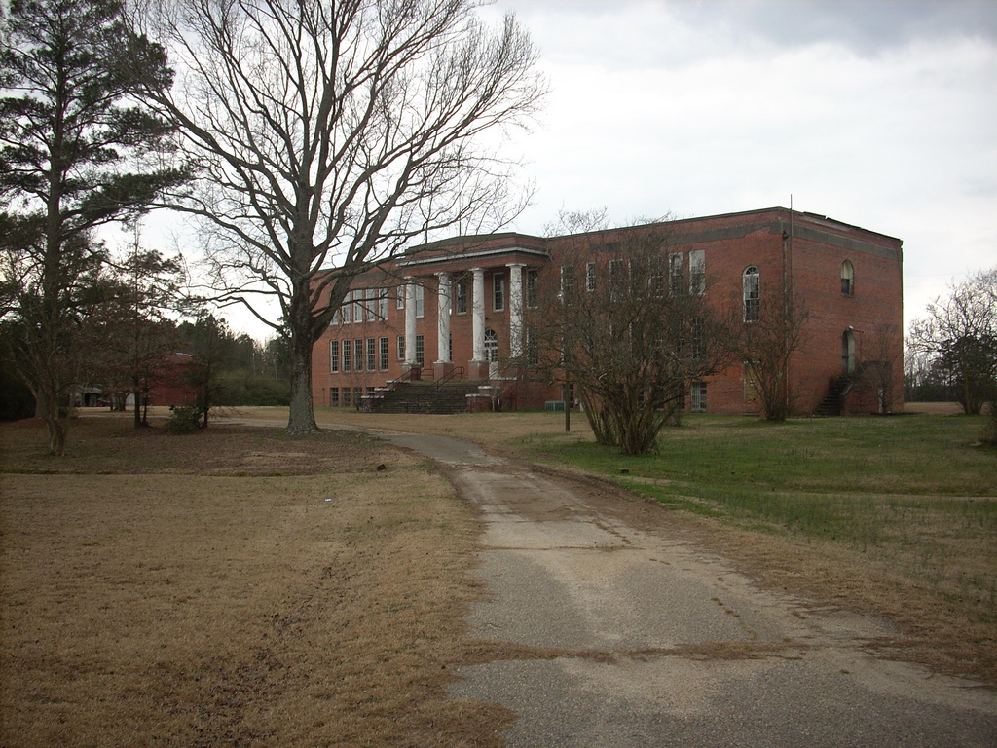
Since The Launch and Pilot
Since Oct 2015:
Norwich
Wigan
Lanarkshire
Aberdeen
Wilmslow
Birmingham
Halton –nurture LA
Wales

Slide 18
The last twelve months
14 course delivered in 2016 (5 closed, 9 open)
184 delegates attended
(covered ALL areas of the development)

Slide 19
In blue –
How well did the training aims meet your expectations?
89% answered 8 or above
8.7% answered between 7 and
2.1% answered 4 or less
Average answer is 9.04
In Orange-
Q2 How much will the training influence your professional
practice?
88.5% answered 8 or above
10.9% answered between 7 and 5
Average answer is 8.99

Slide 20
Notes:
Pupils benefit – from the approach that supports them in their specific needs while delivering teaching and learning in a way that all can access. The pupil is at the heart of the school focus and their learning is understood developmentally.
Parents benefit – from being involved and welcomed in the school, in seeing the improvement in the children’s learning, behaviour, confidence and attendance. A better outcome for their children both in and out of the school and classroom.
Teachers benefit – from a renewed focus on their pupils and a culture change where every voice counts. A more balanced measure of outcomes for individual pupils ensues.
Schools benefit – from showing their commitment to developing an ethos and culture that is inclusive supports everyone in and associated with the school
Communities benefit – from having a school that wants to be at the heart of the community and demonstrates its central role in children and young people’s lives.

Slide 21
Nurture Group Principles
Children’s learning is understood developmentally.
The classroom offers a safe base.
The importance of nurture for the development of wellbeing.
Language is a vital means of communication.
All behaviour is communication.
The importance of transition in children's lives.
Notes:
You’re all familiar with our six principles and these remain the foundation of all our nurture work

Slide 22
Ecosystemic Theory
Notes:
Ecological systems theory, also called development in context or human ecology theory, identifies five environmental systems with which an individual interacts. This theory provides the framework from which community psychologists study the relationships with individuals' contexts within communities and the wider society. Ecological systems theory was developed by Urie Bronfenbrenner, 1979.

Slide 23
Areas for Development
1. Stakeholders | 2. Delivery | 3. Leadership & Management
a. Pupils b. Staff c. Parents d. The community | a. Meeting Pupils’ Needs b. Wellbeing c. Environment | a. Policy b. Partnership c. Resources d. Monitoring and Evaluation

Slide 24
Laurance Haines School
A school’s experience

Slide 25
LAURANCE HAINES SCHOOL

Slide 26
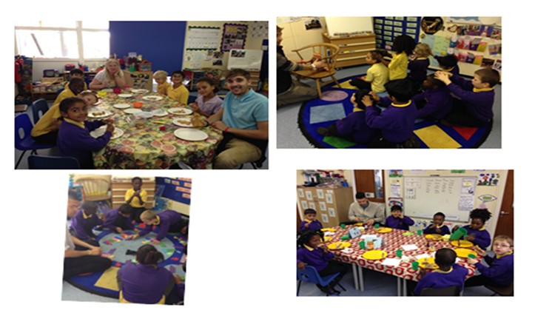

Slide 28
How is the National Nurturing Schools Programme impacting on their school …
Writing a wellbeing and mental health policy to reflect current practice and incorporate the principles of nurture
Created a Pastoral Support Team
Developing stakeholder knowledge about the 6 principles
Strengthening voices for all
Launching new initiatives to develop children’s wellbeing
Refreshing the house system
Re-launching peer mediation & transformers
Extending transition
Designing a child-friendly version of the 6 principles
Strengthening community links

Slide 29
Stakeholders
Nurturing Schools
Quality Mark Award
Leadership and
Management
Delivery
Notes:
Joined up thinking is essential for success

Slide 30
We want every school to be a Nurturing School
We want every child to have an independent learning plan informed by the Boxall Profile
We want an education system that TRULY values every child
Notes:
staff in schools are the superheroes, the child’s advocate

Slide 32
More Venues for the NNSP
and Consultancy
We are here to
help and to work
with and for
schools

Slide 33
Notes:
The proposed Award plaque

Slide 35
Shanes Video

Slide 36
Notes:
you are all leaders

