Slide 1
Assembly- Year 5 and 6

Slide 2
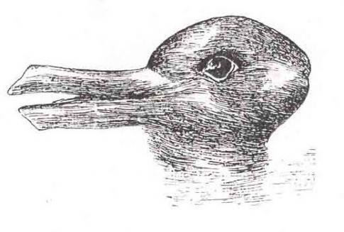
What do you see?
Duck
Rabbit
Notes:
https://www.theschoolrun.com/teaching-children-tolerance
Now look at this picture – what do you see. Put your hands up if you see a DUCK! Put your hands up if you see a RABBIT.

Slide 3
What do you see?
Old or young woman?
Notes:
Old or young woman? Or both?

Slide 4
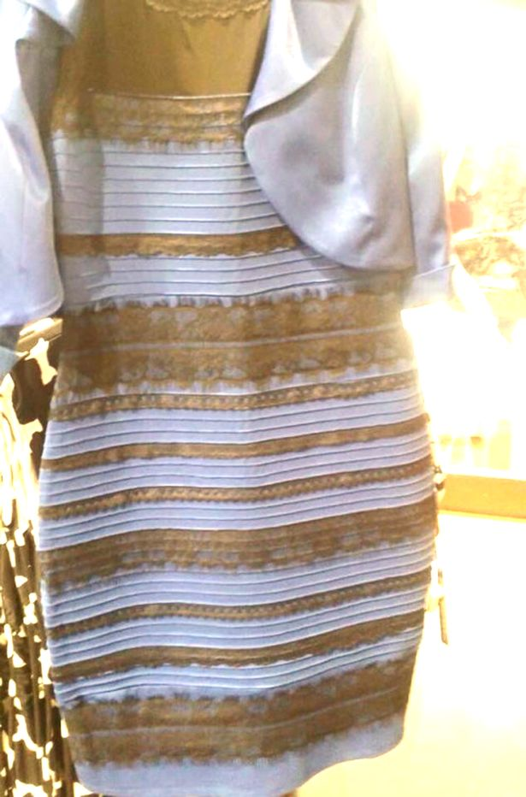
What do you see?
Gold and white? Blue and black?
Notes:
Blue and black/ Gold and white?
Can you see both? We can’t see everything in the same way and just because someone sees something different to you, doesn’t mean they are wrong or you are wrong- it is just different. You can really like something without really hating something else. Learning to accept this is called being tolerant.

Slide 5
Tolerance
All of this is called tolerance-accepting that people have differences and not falling out with them about it. Being tolerant and accepting people’s differences is an important part of our British values and what makes us good citizens.
Tolerance means showing respect for the
Race
Religion
Age
Gender
Opinions
of other people or groups.
Notes:
Go through what tolerance means and give/ask for examples of it in action in our world.

Slide 6
We are all different in many ways…
What you have done
What you are good at
This is called DIVERSITY
What you believe in
Where you are from
Things you like doing
Things you like to eat
How you see things
How you look
This is called is called DIVERSITY
Notes:
These are all examples of how we are different. People are different by all sorts of ways. So far we have seen examples of difference:
Alex prep people to come up to come up things to share – school council.
We all have different talents – we are all different in different thing
What theyre good at
Favourite things
“I believe we have a few volunteers…”

Slide 7
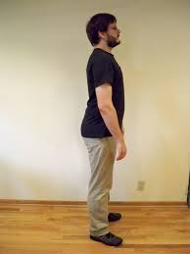
Imagine a world where we were all the same….
Notes:
Imagine a world where everyone had exactly the same views on everything, where everyone looked the same and had identical tastes regarding art, film, football, and music…
What would we miss out on if everyone was the same?..

Slide 8
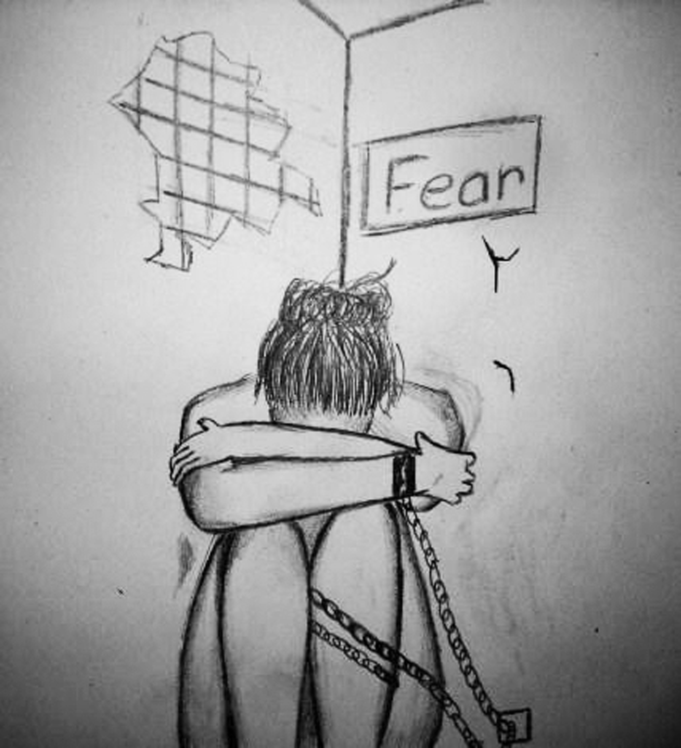
Differences can seem scary at first
Sometimes trying new things and keeping an open mind is scary. We are comfortable with what is familiar and sometimes threatened by what is not.
But if we close our minds to differences we can miss out

Slide 9
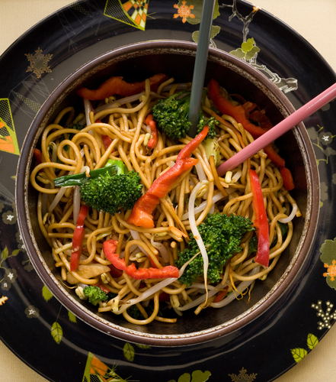
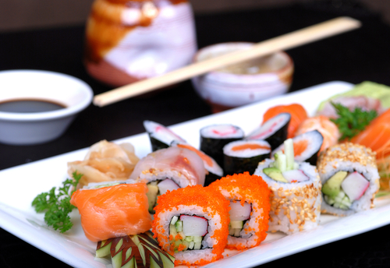
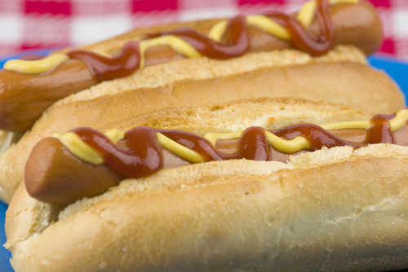
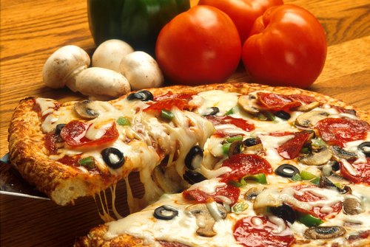
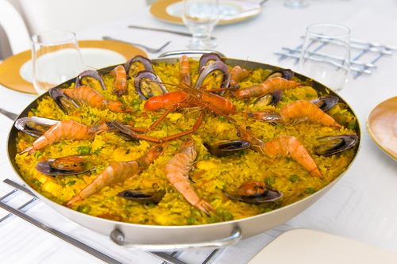
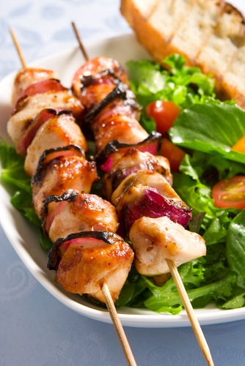
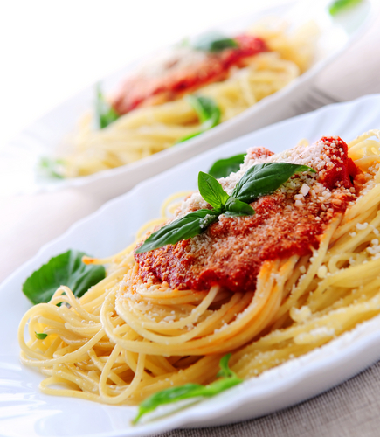
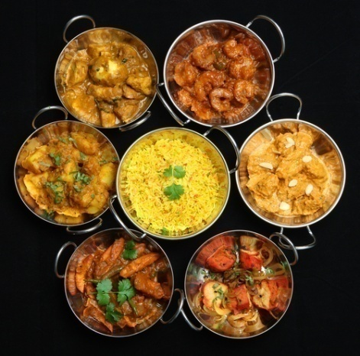
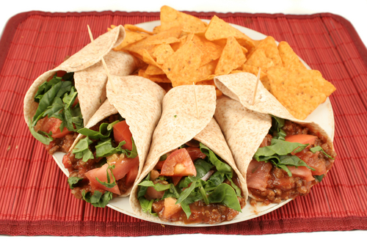
A mix of food
Notes:
Possible exercise – hands up If you like eating….

Slide 10
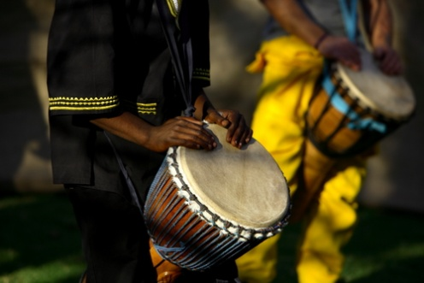
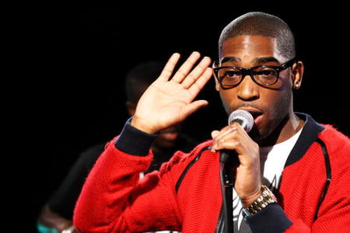
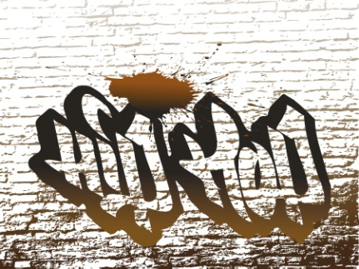
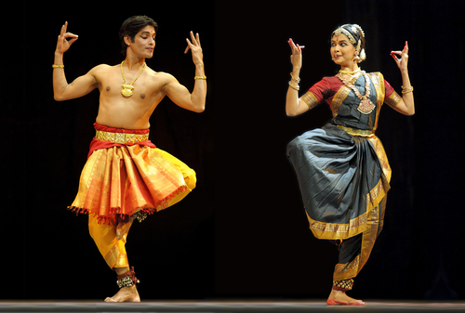
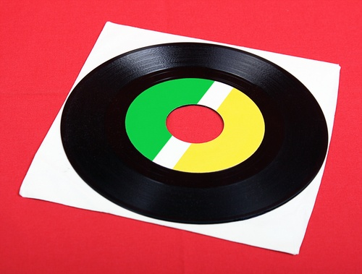
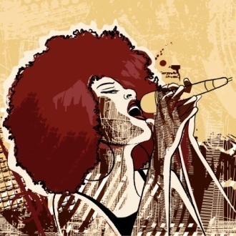
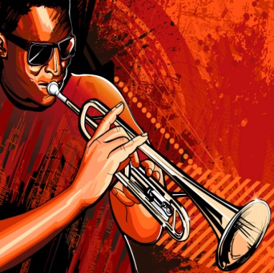
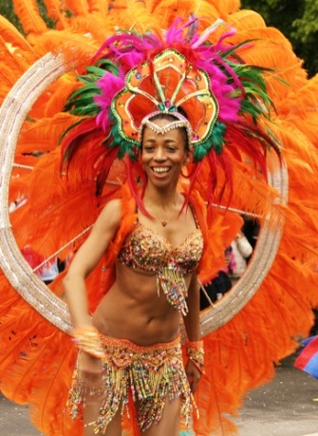
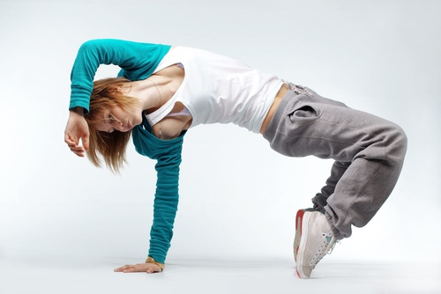
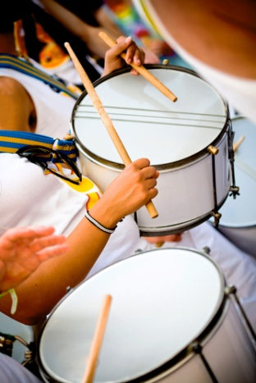
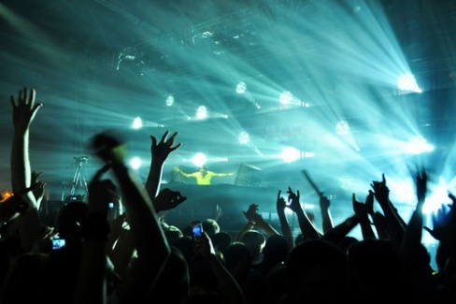
A mix of music and dance
Notes:
Maybe play different music or show different dance

Slide 11
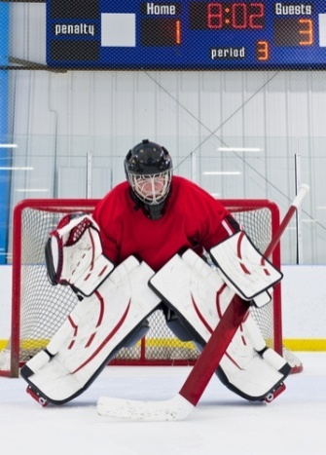
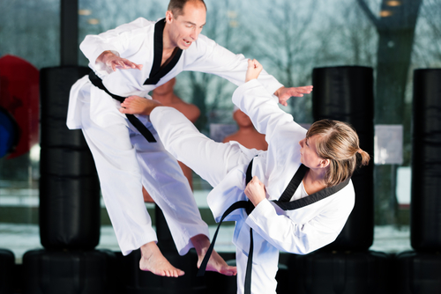
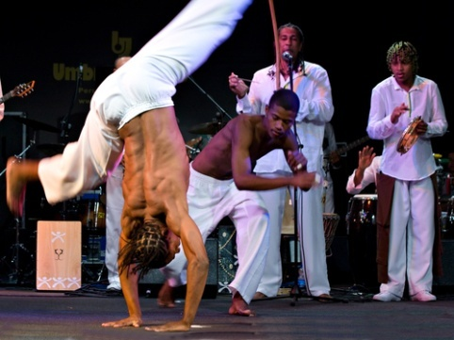
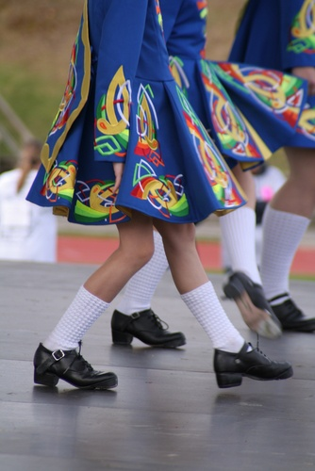
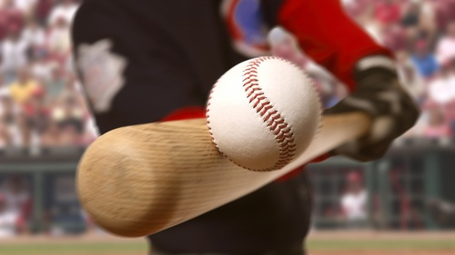
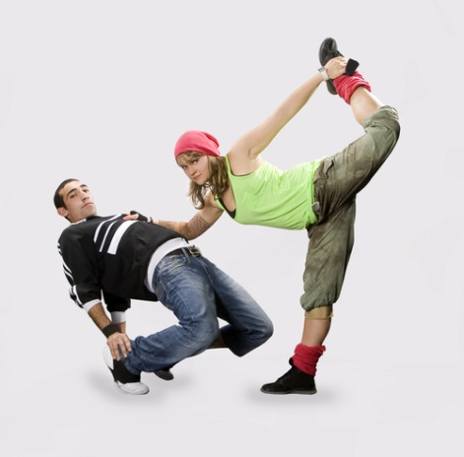
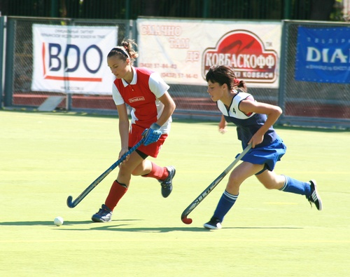
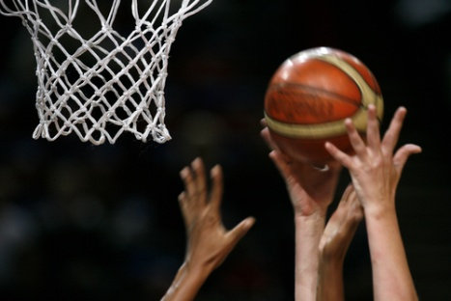
A mix of sports

Slide 12
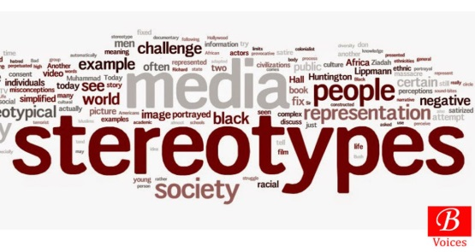
Stereotypes
People may feel more comfortable with similarities but they can sometimes not be helpful.
We sometimes imagine all people in a group are the same and we stereotype them. The Media can be particularly guilty of doing this and it can lead to fear and intolerance
Groups of people sometimes get blamed for things they aren’t responsible for.
All members of certain groups can get blamed for the behaviour and actions of just a few.
That’s not fair!

Slide 13
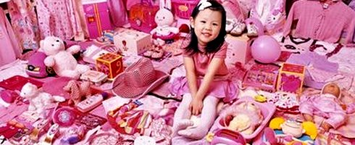

Slide 14
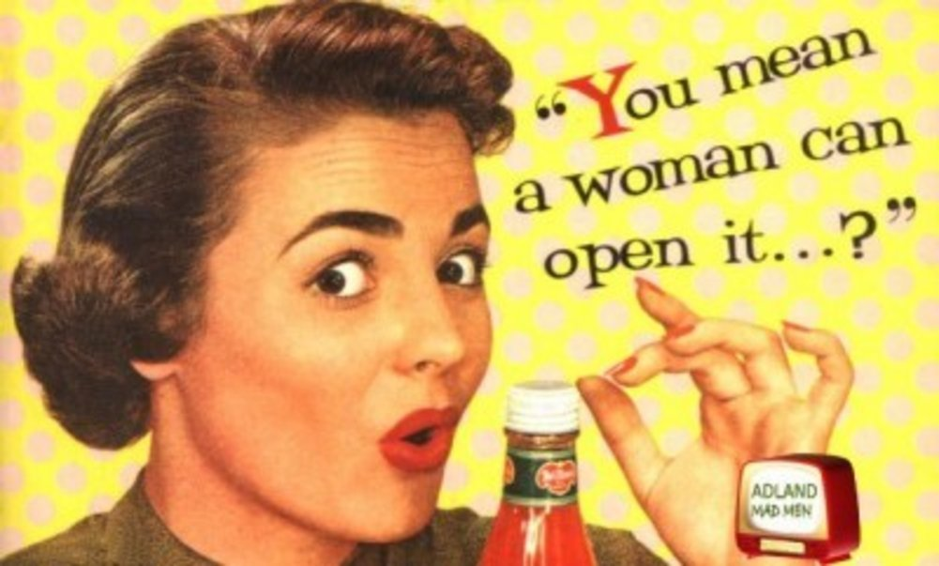

Slide 15
Under-18s commit a quarter of all crimes: Young offenders responsible for more than a million crimes in just one year
By Jack Doyle for the Daily Mail

Slide 17
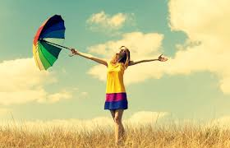
We are free when others respect our differences
Notes:
And so to respect difference, even if we do not agree with the other person, is to encourage a world that gives us variety food, music, etc. And this is what we call TOLERANCE
With freedom and diversity comes a need to respect difference!
If we want to live in a world where we can be who we want to be, listen to the music we like, eat the foods we enjoy, dress how we like to dress etc?
Then we must remember that the person next to us has the freedom and right to do the same.
And they are different...

Slide 18
Special task…
Celebrate difference
Notes:
This week observe differences and in people.
Different ways people dress, act, eat, think, speak etc.
Then celebrate their differences and think about how it makes them unique and special and adds to our diverse and interesting culture!

