Slide 1
Nominating a school’s induction tutor – user journey
29th April 2021

Slide 2
Screens that an induction tutor would see if their school is planning to use a funded training provider or deliver the accredited training materials themselves.
DfE Transformation and Digital
GDS

Slide 3
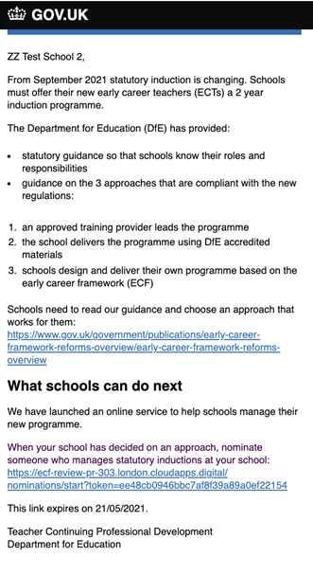
Initial invitation email
N.B. this is not a deadline for schools by which they have to set up their details. They can generated a fresh link after that date very easily
DfE Transformation and Digital
GDS

Slide 4
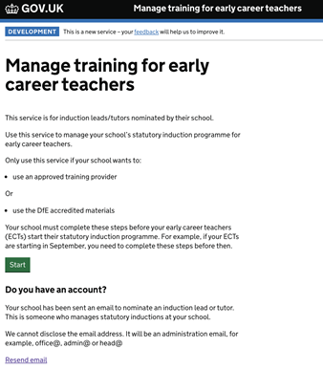
Sign into the service
DfE Transformation and Digital
GDS

Slide 5
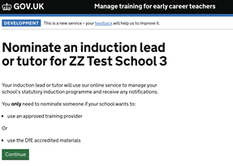
Ask the school to nominate their induction tutor
DfE Transformation and Digital
GDS

Slide 6
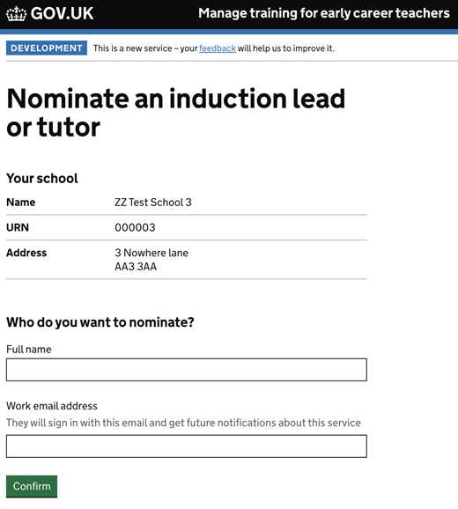
Provide details for the induction tutor
DfE Transformation and Digital
GDS

Slide 7
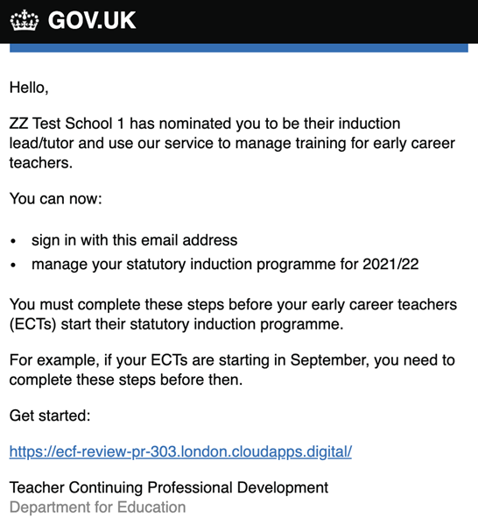
Invitation email to induction tutor
DfE Transformation and Digital
GDS

Slide 8
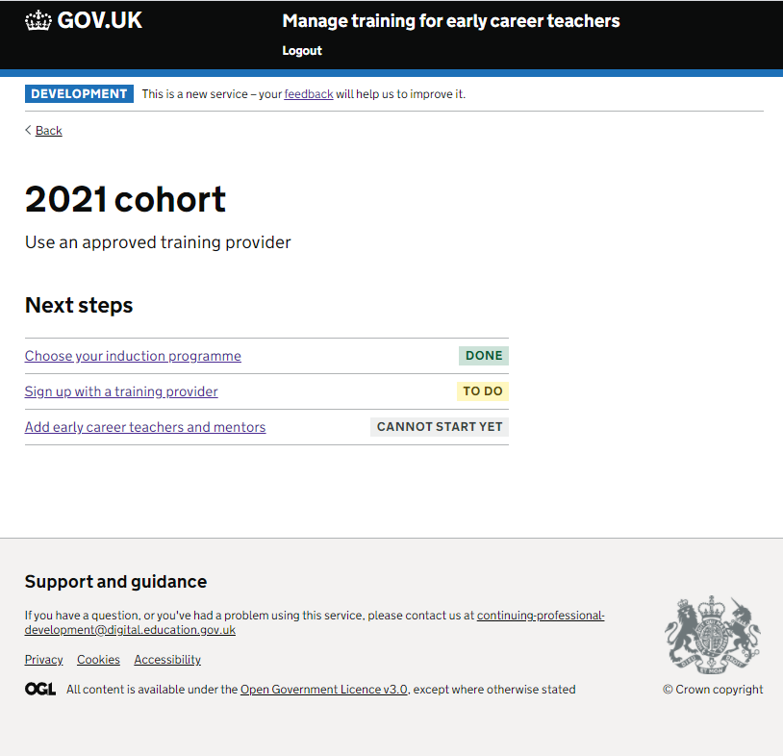
Once induction tutor is logged in: Select cohort screen for school who has decided to use a funded training provider
This functionality will be available before September
DfE Transformation and Digital
GDS

Slide 9
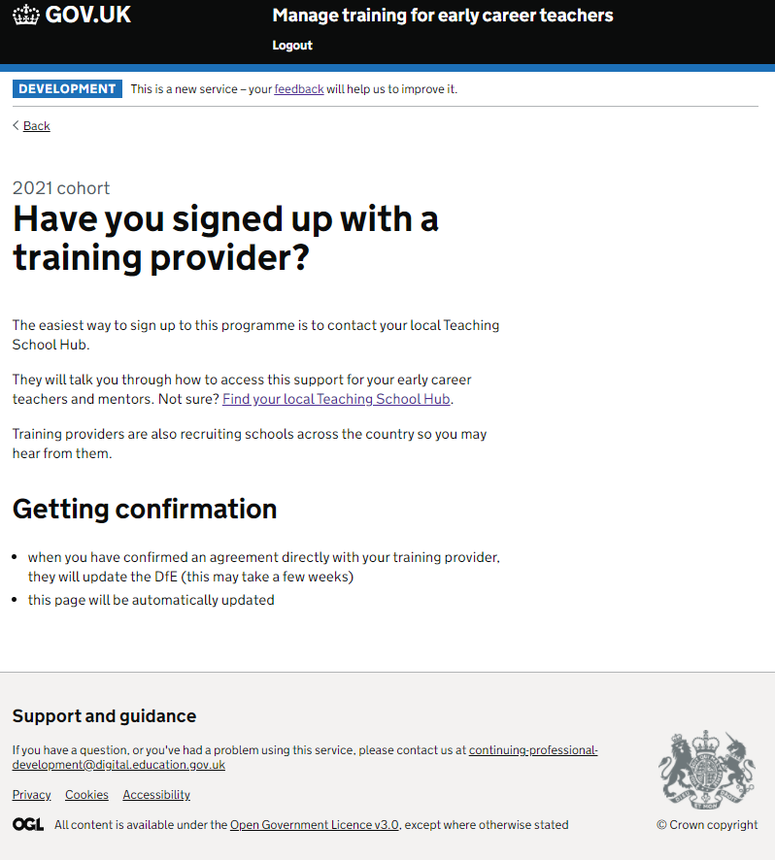
If a school then selects ‘Sign up with a training provider’
DfE Transformation and Digital
GDS

Slide 10
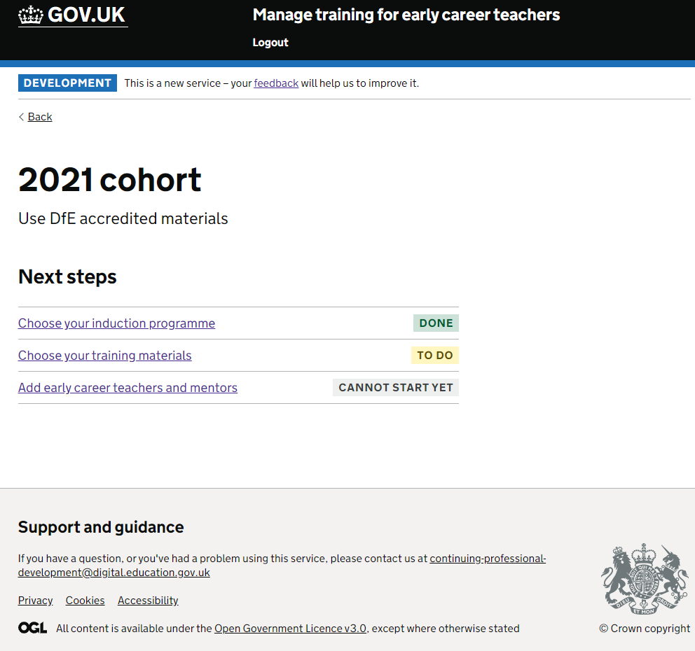
2021 cohort next steps screen for school choosing to deliver accredited materials themselves
DfE Transformation and Digital
GDS

