Slide 1
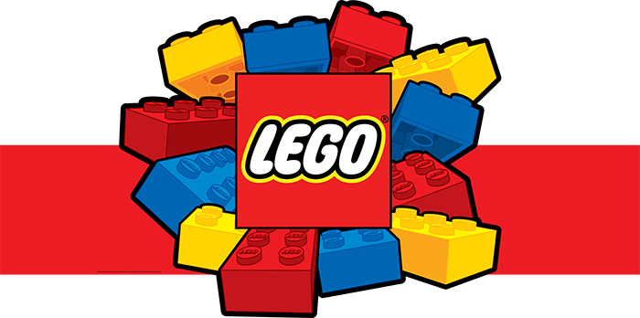
Lego Therapy Sharon Carr

Slide 2
Aims of the workshop
To have a greater awareness of Lego therapy and its role in supporting the social development of children and young people.
To be equipped with the resources and information to start using Lego therapy in schools we work in.

Slide 3
What is Lego Therapy?
Uses Lego in a structured environment in which the children/young people have clearly defined roles.
Rules are formulated to decide appropriate behavioural conduct.
Draws on a shared interest in Lego to aid the acquisition of social skills, development of perspective taking and sharing.
Increases interest in engaging with peers and building friendships.
The focus of the group is on the Lego. The focus of the group leader is on social communication and the collaboration of the participants.

Slide 4
Lego Therapy was originally conceived by Daniel B. LeGoff in the United states and researched by Gina Gomez de la Cuesta and colleagues at the autism Research Centre, University of Cambridge.

Slide 5
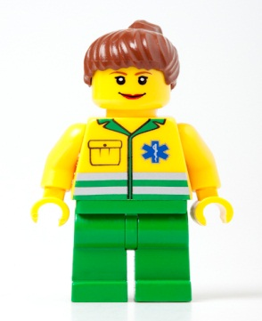
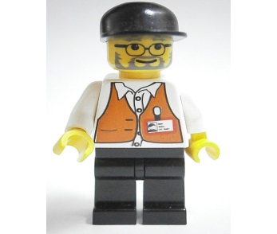
Example of a mode of intervention
Building with 3 pupils -
Engineer
Supplier
Builder

Slide 6
Engineer
Holds and looks at the plans.
Asks the supplier to find the pieces.
Gives the Builder instructions.

Slide 7
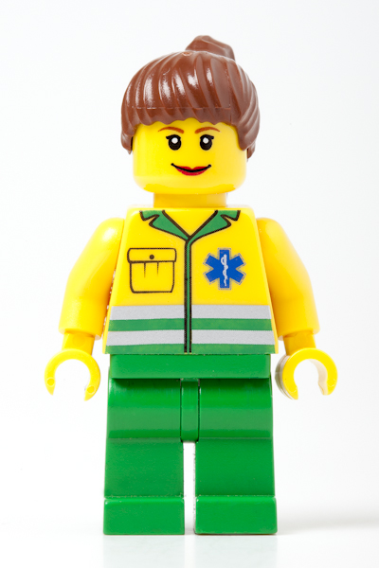
Supplier
Keeps all of the pieces.
Listens to the Engineer.
Follows the Engineers instructions.
Gives the Builder the correct pieces.

Slide 8
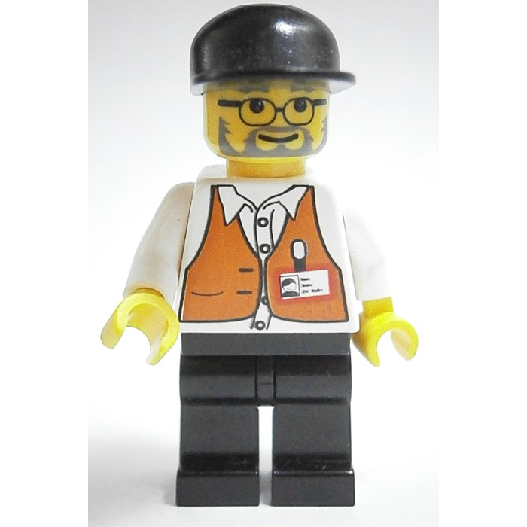
Builder
Takes the pieces from the Supplier.
Listens to the Engineer.
Uses the pieces to build the model.

Slide 9
Choosing the resources
Choosing materials is an integral part of the therapy.
Consider the age ranges, number of pieces etc.
Popular Lego sets, themes etc.
Duplo for younger pupils.
Lego Technic or Mindstorms for older and more able pupils.
Instructions are available from http://service.lego.com/en-us/buildinginstructions

Slide 10
Vocabulary
Introduce and assess the language capabilities of the pupils.
Preliminary games and activities e.g. Lego Mind Map.
Provide examples of the concepts to be used
- colour - attributes
- shape - features
- size - prepositional language

Slide 11
Running the Lego session
Introduce/remind of basic rules. Support the group to make their own rules in future sessions.
Discuss role descriptions, allocate roles and choose a kit to make.
Build the kit (This may take more than one session).
Compliments and evaluation of skills used.

Slide 12
Differentiation
Groupings
- Individual, pairs, three’s or four (Add a Director)
Resources
- Which kit to use? how many pieces?
Langauge
Visual support

Slide 13
Target setting and evaluation
Examples of targets:
Build models with other children.
Initiate interaction with other children.
Respond positively to other children.
Take turns.
Use strategies for compromise and negotiation.
Use strategies for reconciliation.

Slide 14
Behaviour Management and Rewards
Lego Club Level System
Lego Helper
Lego Builder
Lego Creator
Lego Master
Lego Genius
Points and certificates

Slide 15
Top Tips
Refer to ‘Lego club’ rather than ‘Lego Therapy’ when talking with participants and parents.
Encourage participants to develop their own club rules.
Facilitate participation and interaction – be aware of children or young people who may be overwhelmed or anxious – consider the make up of groups carefully.
Consider how girls can be encouraged to participate. Let them show their talents and take leadership.
Consider the extent to which the adult acts as facilitator.
Keep in mind that it’s not really about the Lego. It’s about the social skills and communication development.
Highlight achievements – pictures, certificates, web-sites. Consider permissions and confidentiality.

Slide 16
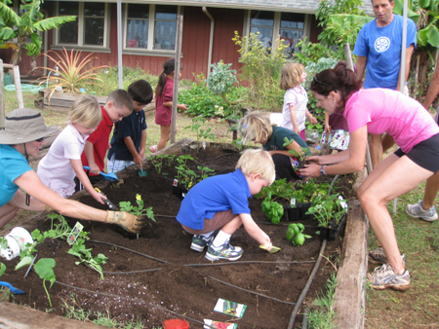
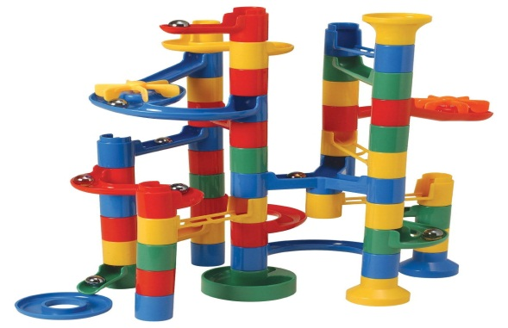
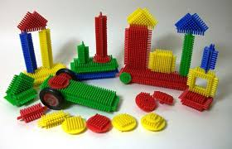
Using the Lego Therapy approach
Other construction resources: Knex, stickle bricks, Meccano.
The approach may be used in other circumstances e.g. Marble runs, Mr Potato Head, cooking – recipes, gardening.

Slide 17
Resources
Lego – Based Therapy. How to build social competence through Lego-Based clubs for children with autism and related conditions. Jessica Kingsley Publications ISBN 978-1-84905-537-6
Lego Digital Designer (App or PC)
www.Legoclub.com
www.lego.co.uk
www.legotherapy.com

