Slide 1
Knives and the Law
#knifefree
Notes:
CHECK
Have I spoken with the class teacher first? (see separate checklist)?
Have I explained the ground rules? (Join in; hands up to answer; respect each others contributions)?
Have I introduced myself and my reason for being in school?
Introduction
Clarify what is meant by ‘knife’. What do I mean by Knife Awareness? I know that most, if not all of you here, don’t carry a knife, and would never carry a knife. Most people don’t! We call them, the healthy majority (you, me your teachers, etc) However, sometimes in life, people make mistakes, or, for a range of different reasons, choose to make a risky decision, and as you start mixing with a wider group of people, perhaps at secondary school, perhaps through youth clubs or after school clubs, there is always a chance that you may come into contact with someone who makes a bad decision around knife carrying, or, indeed, you may be in a position where you think about it.
However – today, we are going to learn one simple thing -
IF YOU CARRY A KNIFE YOU ARE MORE LIKEY TO BE ARRESTED OR INJURED THAN IF YOU DON’T CARRY ONE!!– Repeat this phrase often.

Slide 2
Key Learning Fact You are more likely to be injured or arrested if you carry a knife.
1 IN 3 KNIFE INJURIES
IS CAUSED BY THE PERSON’S OWN KNIFE
Notes:
Ask children to stand.
All imagine they have been injured in a knife attack. Then ask them to group into 3’s and ask 2 out of each 3 to sit. The ones who are standing have all been injured by their own knife.
This is real evidence NOT to pick up a knife for any reason.

Slide 3
Why do young people carry a knife?
Fear
Forced to carry
Peer pressure
Revenge
Protection
Defend
Fake Confidence
Reputation
Every one else has one (don’t they?)
Fact –
Most young people don’t, and never will carry a knife.
Notes:
A very few young people do carry a knife. Why might this be?
Ask for ideas from children, then check all ideas have been covered. Expand on some of the reasons, especially making clear that carrying a knife for protection or defence isn’t very effective. People who get attacked with a knife are usually taken unawares, and there isn’t a warning slot of time to get your knife out. In the haste you might drop it, and someone else may pick it up. The best defence is to get away from danger, even if it means you back down. It isn’t worth taking a risk for.
Being forced to carry – why does someone else want you to carry a knife for them? Because they don’t want to get caught with it. They know the risks!
Point out how the last reason is a misconception. We are often lead to believe, by news and the media, that many young people carry a knife, or that it’s more common than it really is.
Some people may actually say they have one even if they don’t, just to look tough.
The FACT is, the majority of young people don’t and never will carry a knife.

Slide 4
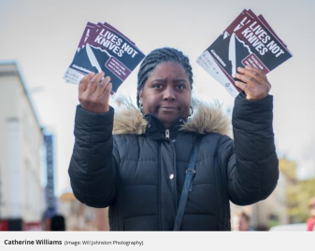
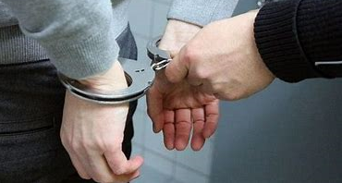
Consequences
Notes:
What are the possible consequences of carrying a knife (some children might not understand the word consequences, so clarify for them, what might happen as a result?)
Take ideas before clicking the answers.
The woman is Catherine Williams, mother of a 20 year old who was stabbed in Leicester in 2017.

Slide 5
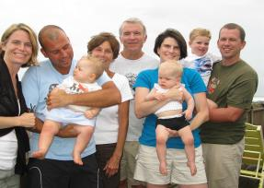
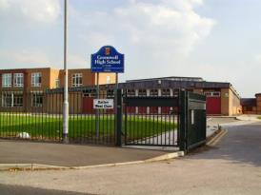
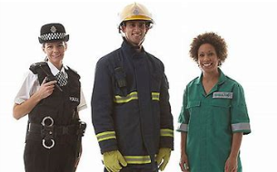
How many people are affected when someone loses their life?
Matthew Rothery, from Nottingham, was 18 years old when he lost his life in a knife attack in 2017
Notes:
Knife crime can have devastating consequences, not only those individuals directly caught up in it including families of people injured or killed through knife crime or sent to prison because of it, but also their wider communities and the service providers who have to attend the scene and deal with injuries.
Some will carry the grief with them for the rest of their lives.
The photo is of a young man, Matthew Rothery, aged 18 years, from Nottingham. He is one of the young people killed in 2017 in a knife attack. The other pictures are only generic, and are intended to show the extent of the people affected. They are not real family members or places related to the crime.

Slide 6
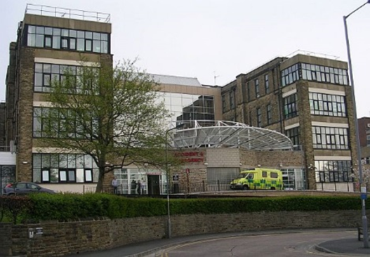
Hospital admissions
There were 5,053 Hospital admissions for people with injuries by knife crime in 2017/18
Notes:
A bladed object can include any items which ae capable of piercing the skin – so anything sharp, even a pointed/broken stick, broken glass etc

Slide 7
True or false?
A knife can do as much damage to someone
as a gun
True
Both can kill
It’s not an offence to carry a knife if you don’t use it, or threaten to use it
FALSE
It is an offence to have a knife in public
or at school premises.
Notes:
Slides 7 and 8
True or false quiz using ‘true’ and ‘false’ cards from envelope (see resources)
Use the quiz to explain about the law and knife carrying. Answer any
related questions.

Slide 8
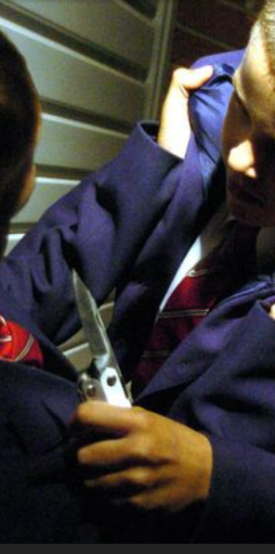
Teachers have the legal power
to search students for knives,
but
only with the student’s consent.
False
Teachers can search you
even if you don’t consent
Notes:
This is because they are responsible for keeping you and your class safe. If they believe there is a risk, it is their duty to safeguard pupils in their care.

Slide 9
What should you do if you have seen or heard
someone has a knife?
Tell an adult –
Teacher, parent, Police Officer, PCSO
If the knife is seen, call 999
and get to a place of safety immediately.
Police take knife crime very seriously
Notes:
Read through the slide.
Explain how getting away from a knife is a brave thing to do which could save you from getting injured or worse.

Slide 10
Scenarios
What would you do?
Discussion activities based on real situations
Notes:
These discussion activities are optional extras. They are very useful to help children talk about and plan through different responses to situations and consider potential outcomes, however, if time is short, they could either be missed, or returned to on another occasion. Returning to the topic on another day actually helps learning by going over the key message again and reinforcing them.

Slide 11
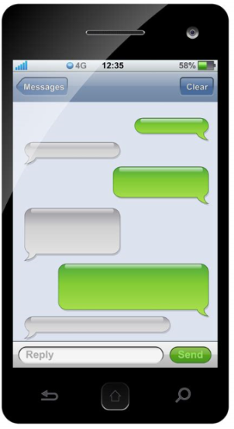
What would you do…
You see this on your older brother’s phone.
What would you do?
What are the possible consequences?
Key actions
Tell your parent/carer
Speak to a teacher/adult at school – you can ask do this in private
Hey
Mr Todd today
Yea, hate maths, hate Todd
Me too. Taking a knife in.. If he starts on me..
What?!! u crazy? You’ll get caught..
Only if u grass
Notes:
Tell the story of the girl who this really happened to in West Yorkshire. She was really in this situation.
She went to school and told a teacher.
Mr Todd was taken to a safe place, the boy who said he was taking in a knife had his bag searched, and police went to his home and searched his bedroom. The boy got help.
What could have happened if she hadn’t said anything?

Slide 12
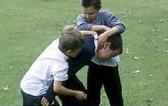
What would you do…
You see some children who you know fighting, and notice someone holding a sharp object in their hand.
What would you do?
What are the possible consequences?
Key Actions;
Immediately get into a place of safety
Tell an adult
Notes:
Discuss that whenever there is potential danger, even if it means backing down, running away or losing face, it is always best to get out of a dangerous situation. Make up excuses even. It could save you from being involved or hurt.
Talk about joint enterprise. This is when someone encourages or assists in a crime but doesn’t actually commit the crime (a watch out, jeerer, etc. Being accidentally present doesn’t count as joint enterprise).

Slide 13
Video from London Needs You Alive Campaign
Notes:
Link for video: London needs you alive

