Slide 1

Knife Awareness
Notes:
Introduce yourself, the length/end of the session (lasts about 50 minutes), rules for listening politely, joining in and responsibly discussing what might, at times, be an emotive subject. Mention the school safeguarding lead by name if there is one or an adult who can be spoken to in confidence regarding any issues that occur as a result of the sessions.
I’ll be explaining more about this throughout the session.
Introduction
Most people don’t! We call them, the healthy majority (you, me your teachers, etc) However, sometimes in life, people make mistakes, or, for a range of different reasons, choose to make the decision to carry a knife. there is always a chance that you may come into contact with someone who makes a bad decision around knife carrying, or, indeed, you may be in a position where you think about it.
The aim of this session is to learn –
IF YOU CARRY A KNIFE YOU ARE MORE LIKEY TO BECOME A VICTIM OF A KNIFE ATTACK. – Repeat this phrase often – drill it home!

Slide 2
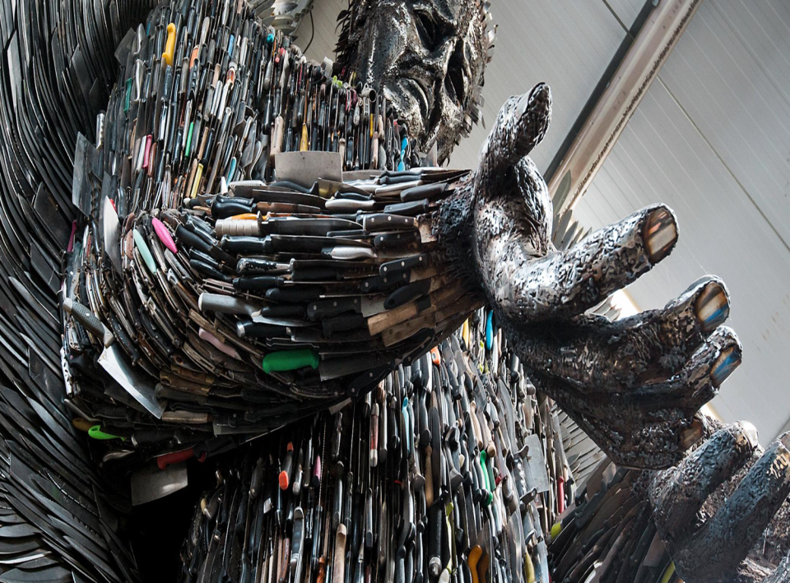
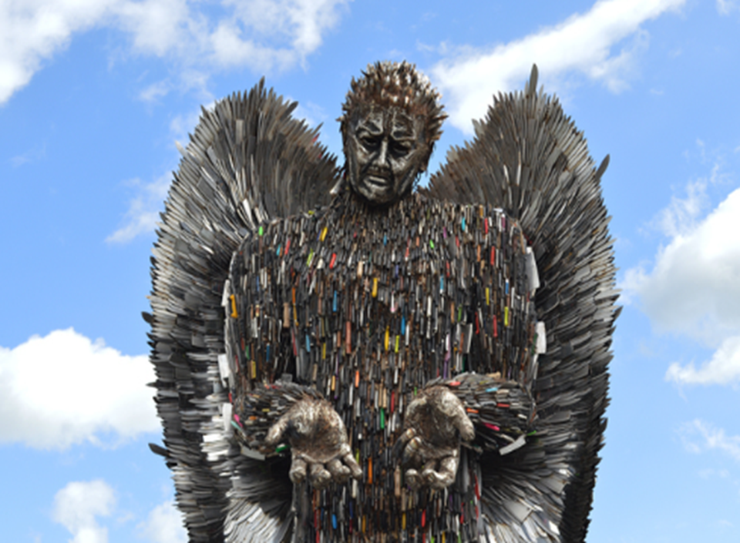
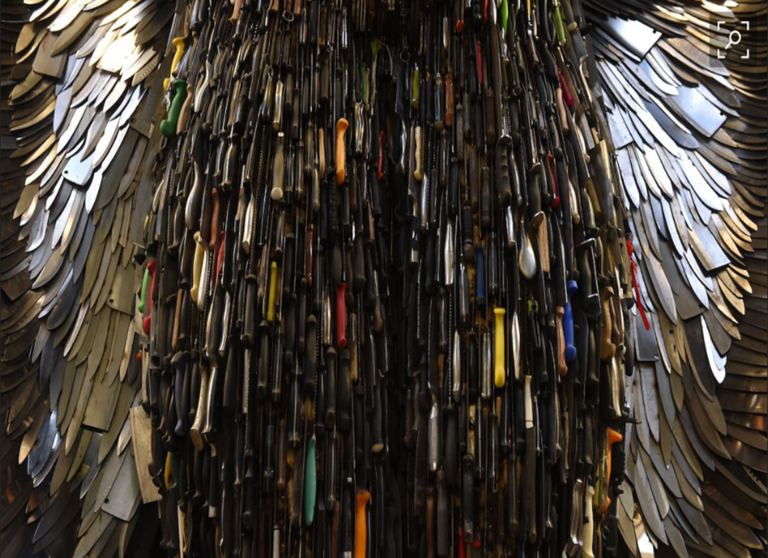
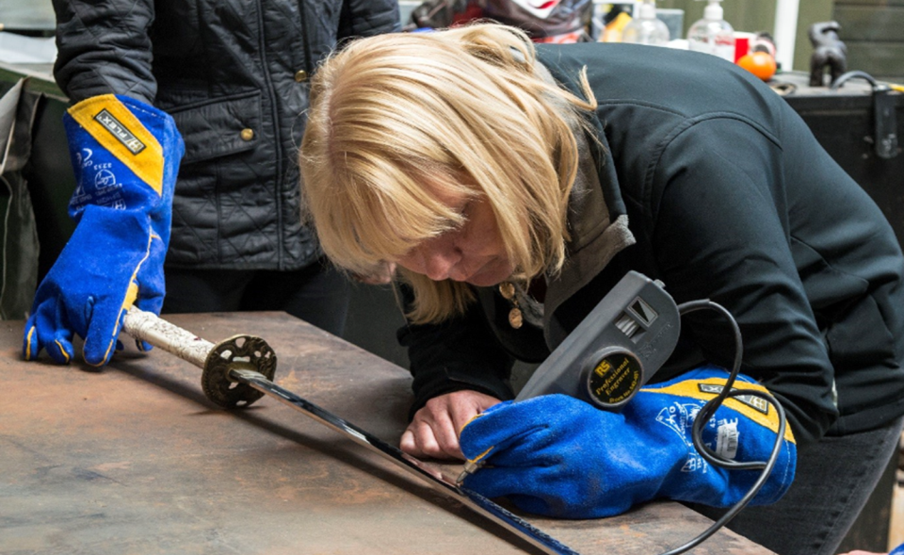
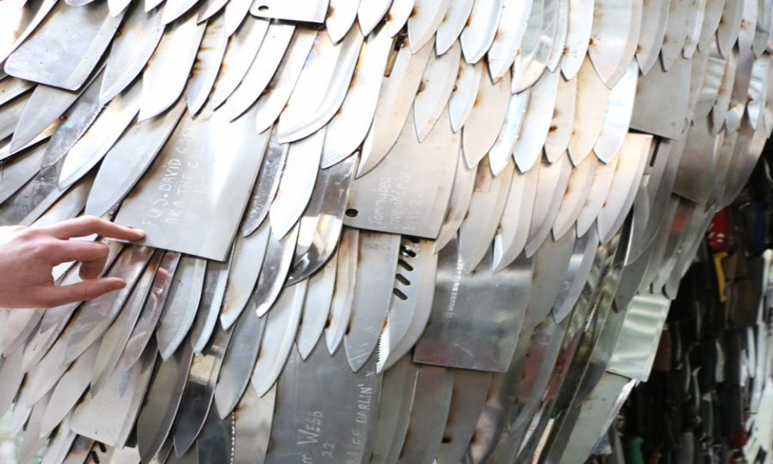
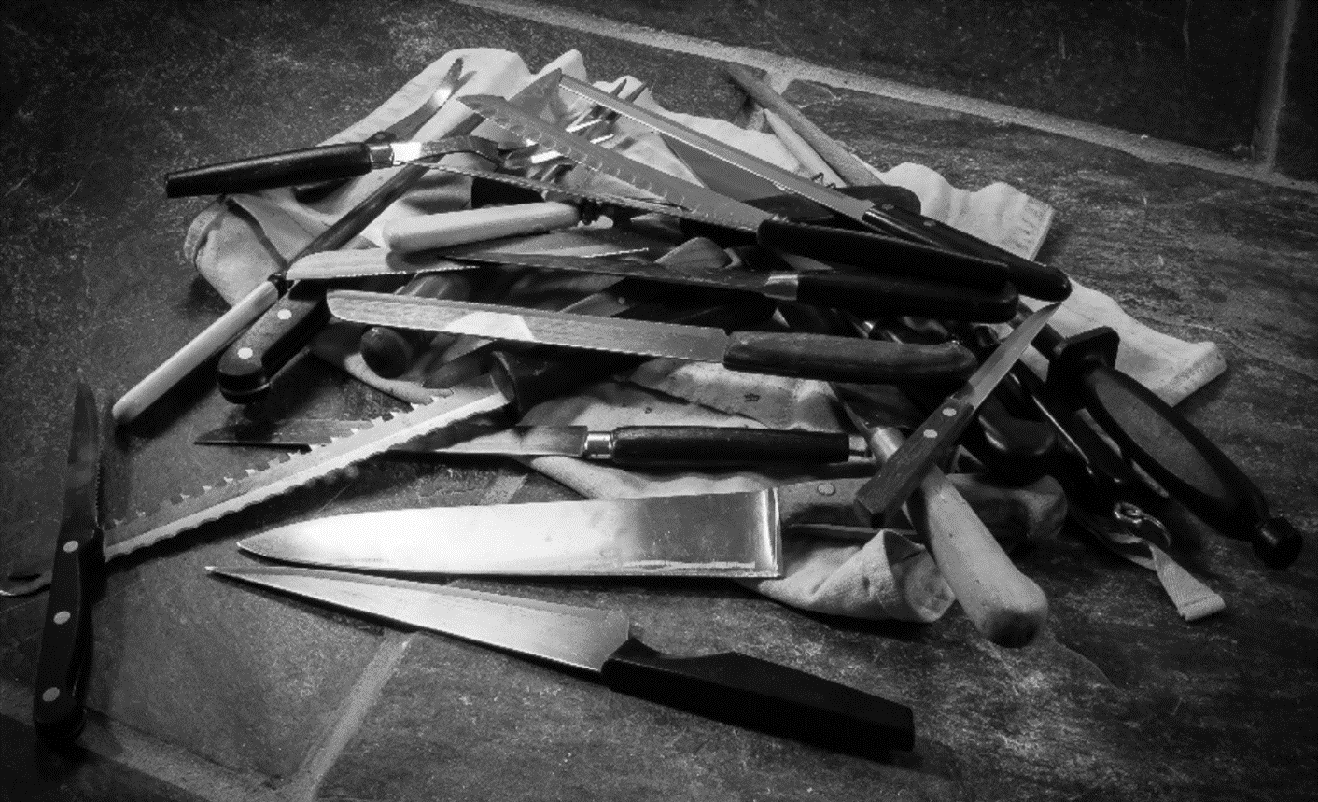
Notes:
I am going to show you some pictures, and I’d like you to look at them, and see if you can work out what they are, or anything at all about them.
Take suggestions.
Next slide

Slide 3
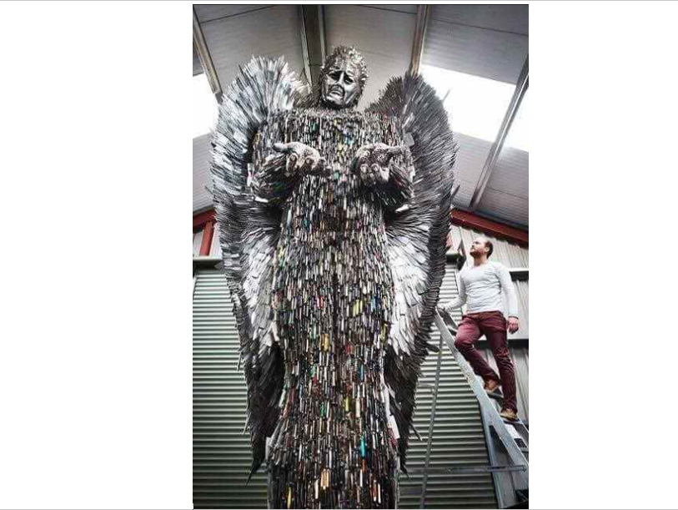
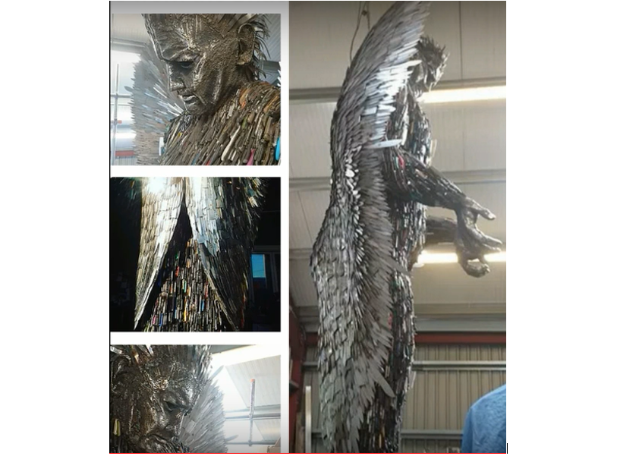
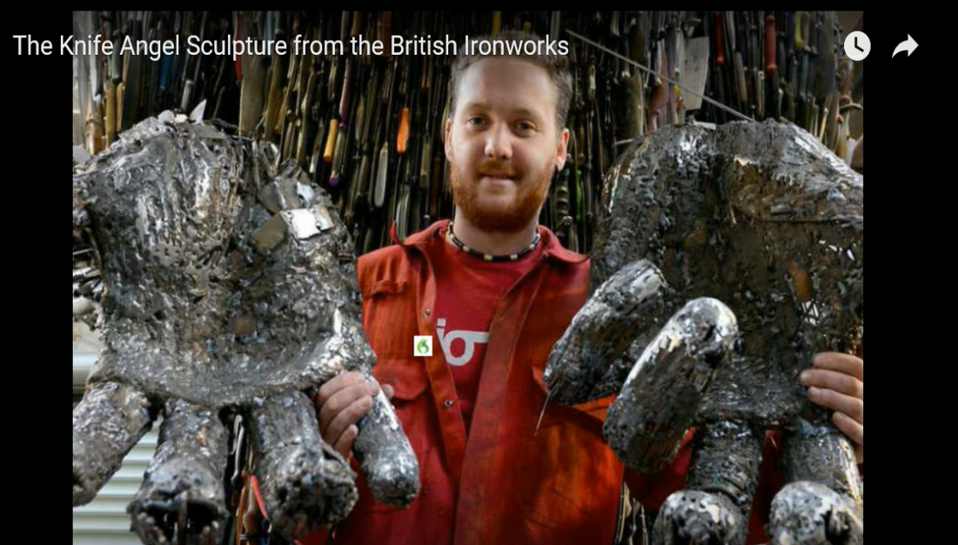
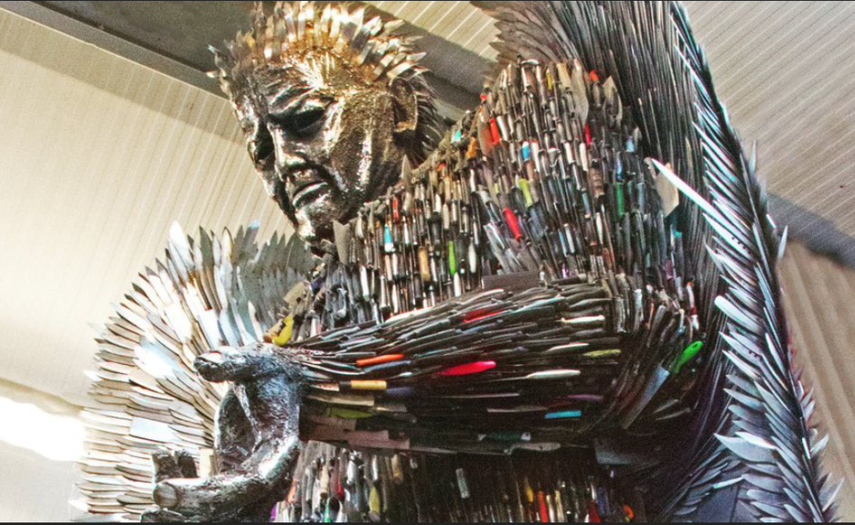
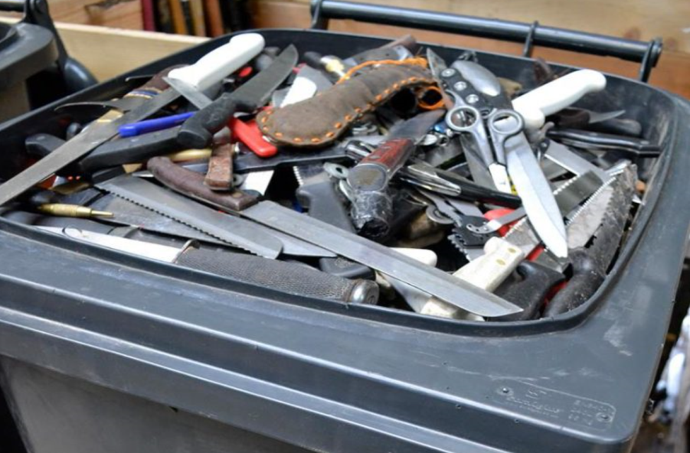
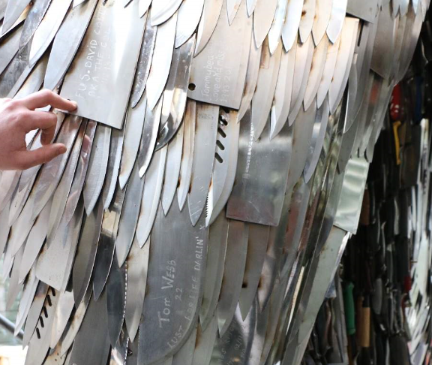

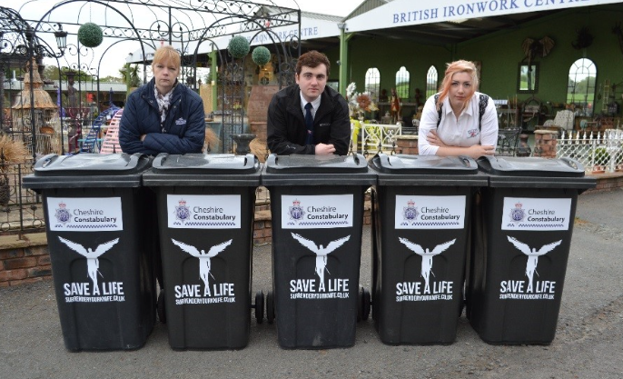

Notes:
The British Ironworks – (a place you can visit in Shropshire, and displays some of the UK’s largest metal sculptures) heard, that there had been a rise in knife crimes, and they wanted to do something to bring this to the attention of the public, and to help in some way. So they got permission from the government to have a Knife Amnesty, to place 200 bins – just like the big plastic bins you put your rubbish in – all around the country. Does anyone know what a knife amnesty is? Explain if needed. Also explain that they don’t actually reduce knife crime – why? Why do them? Also make clear that in West Yorkshire we only do weapons surrenders. This means we would make enquiries if a knife was handed in which we thought had been involved in a crime. A knife amnesty asks no questions.
Have a guess how many knives were collected? Over 100,000 knives were collected. Some even had blood on them! The knives were cleaned and blunted, and a sculptor called Alfie made the Knife Angel. Over 80 people have written messages on the blades of the knives, some to remember a family member they have lost, (the lady you see was writing an inscription for her son, Danny, who was killed in a knife attack), but also some perpetrators have written messages of regret, to say sorry for what they have done.
The British Ironworks would like the Knife Angel to be displayed in London, at Trafalgar Square, but the Mayor of London, has said, no. There is currently a petition to get 12,000 signatures to ask for the knife angel to go to London?
QUESTIONS FOR DISCUSSION
Why would the mayor not want it displayed at London? Have a chat about if you would like it displayed in – (state the village where the school is based)? Take some reasons from the children. (Getting children to discuss an idea helps them think more deeply about it and rationalise their feelings and thoughts on the subject. It makes for better understanding of the complexities of the issues).

Slide 4
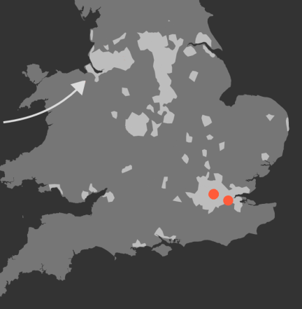
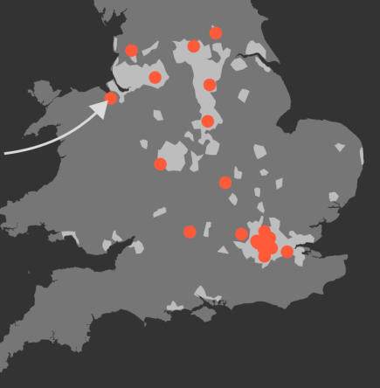
Child Knife Deaths
1980’s 2017
Notes:
The reason why we are doing this knife input is because children under the age of 19, nationally and locally, are getting injured and killed by knives. The red dots show the occurrence of child knife deaths in the specified years)
(Statistics in the early 2000’s were in the 10’s) – point this out.
What do you think the trend is with knife deaths, what’s happening?
If we don’t work to stop this, what might this picture look like at the end of the year, or at the end of next year?
In August 2017 (when these dots were shown, there had been 26 deaths. By the end of 2017, it was 43 – The most ever recorded.

Slide 5
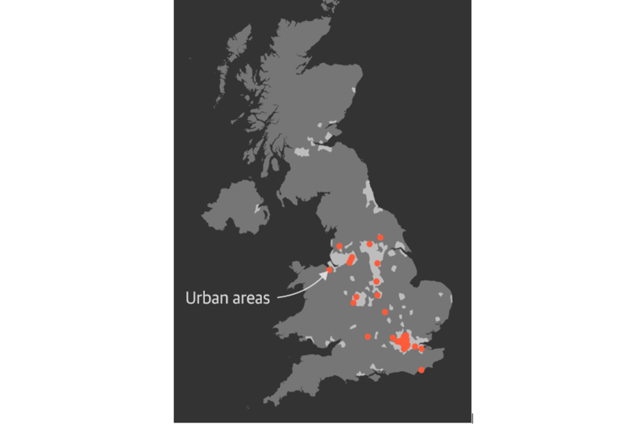

What about Scotland?
Notes:
Why aren’t there any red dots in Scotland?
Take ideas.
In 2005, Glasgow had the worst recorded levels of violence, including knife crime, in the developed world!
Take more ideas.
In Scotland, the police, education service and the National health service all decided to work together to tackle this issue. Look what has happened!! Scotland didn’t have one single knife related death of a young person in 2017.
If Scotland can do it, so can we!

Slide 6

Notes:
This is a video of a father talking after he lost his son in a knife attack last year (2017). Is there anyone who doesn’t want to see this video? – (it shows actual footage from the night he was stabbed)
Who else is affected by the stabbing of a young person?
Video Link: A father’s Story

Slide 7
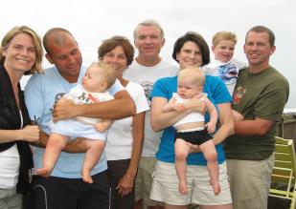

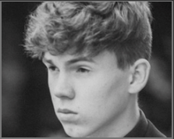
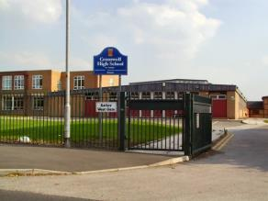
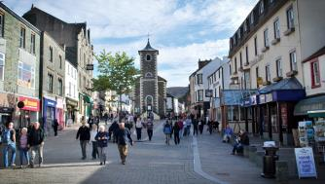
How many people are affected?
Notes:
43 young people were killed in a knife attack in 2017
Each one has left a family, a school, a street, a community who are all affected by their death. Some will carry the grief with them for the rest of their lives.
The photo is of a young man, Matthew Rothery, aged 18 years, from Nottingham. He is one of the young people killed this year in a knife attack.
Who else is missing? – The perpetrator and te same surrounding people, also the emergency services.

Slide 8


























26
Children and teenagers killed in knife attacks this year up to August 2017
Notes:
These are the 26 children and young people who had been stabbed in August 2017 when I first started doing this presentation. I hoped that no more spaces would be filled, but sadly, they were.
(If you wish to know more about each person, search, “Beyond the Blade Marking the Death of every Child Killed by a Knife – Guardian Newspaper”.

Slide 9
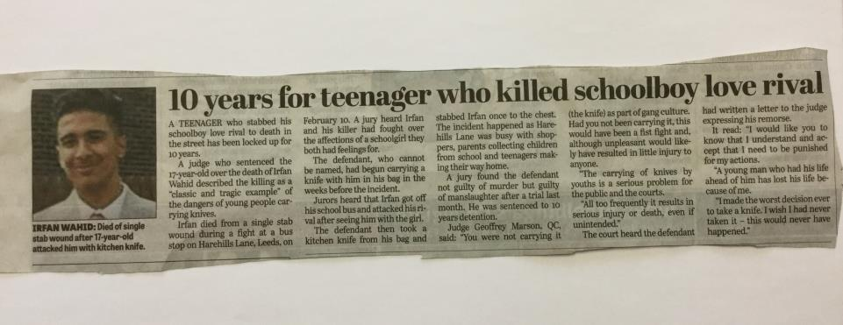
Notes:
Irfan Wahid – from Leeds
What about those who witness the attack, the family of the perpetrator?
Estimate now how many people are affected by each death?
And there were 43 dots on 2017.

Slide 10
or weapon?
Why do young people carry a knife?
Notes:
Get the students thinking about why young people carry knives.
Ask;
Why do young people carry knives?
(This will help us later when we look at ways of addressing these reasons.)
Ask students to discuss in pairs or 3’s all the reasons they can think of.
List these on the board as a reminder and for everyone to see.
Star (*) the 3 that the group think are the most significant (show of hands).

Slide 11

everyone else is carrying
defend
attack
Notes:
Some young members of a London gang were asked their reasons for carrying knives.
These were there top 3 answers.
The main reason, they thought, was because everyone else was doing it. Is this is a good reason for doing something which could get you arrested or injured?
Also remember the ‘healthy majority’. Some people might say they carry, or have carried a knife to look tough, or to keep in with their mates, when actually they haven’t. Don’t be fooled by this. Remember the healthy majority and stay one of them!

Slide 12
Warning –
Graphic Images
Notes:
Warn the real knife injuries are going to be shown.
The pupils may look away if they don’t want to see.

Slide 13
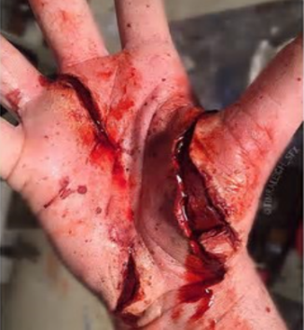
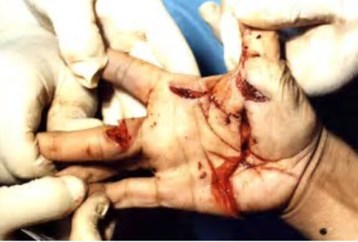
Knife Wounds

Slide 14
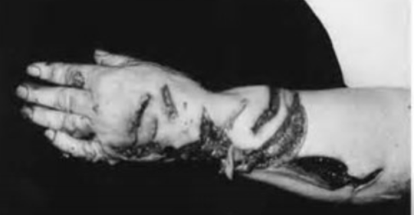
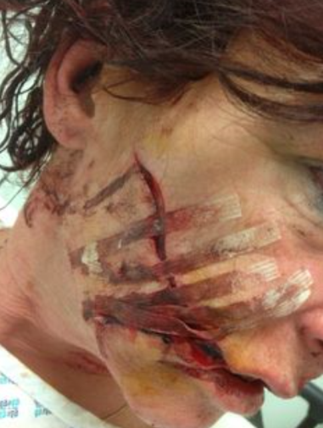
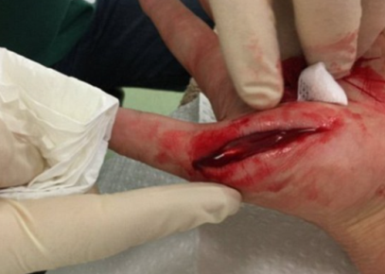
Notes:
Talk about how a facial injury will affect the rest of your life – and how people make a judgement about your character in the first 7 seconds of seeing you.
1 in 3 injured by own weapon – physically demonstrate

Slide 15
Knife Injury Statistics
1 IN 3 KNIFE INJURIES
IS CAUSED BY THE PERSON’S OWN KNIFE

Slide 16

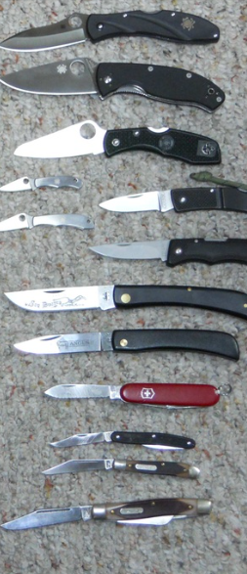
It’s ok to carry a knife if you don’t intend to use it.
FALSE
It is an offence to have a knife in public
or at school premises.
Even if you are looking after the knife for someone else…even if it isn’t yours…even if you don’t intend to use it…even if you are only hiding it for a few minutes for someone…even if you are a girl…even if it’s being carried to defend yourself.
Notes:
Slides 6 – 15.
True or false quiz using ‘true’ and ‘false’ cards from envelope (see resources)
Use the quiz to explain about the law and knife carrying. Answer any
related questions.

Slide 17
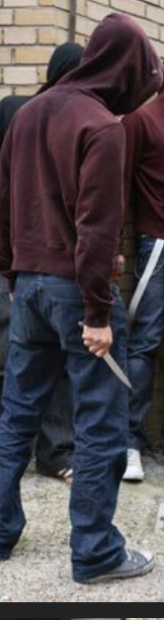


You only get a warning for carrying a knife
FALSE
You can get up to 4 years in prison just for carrying a knife
18 year old Matthew Bryce-Trainor from Huddersfield was sentenced to 8 weeks in prison after a knife was found in his bag. The teenager looked stunned as he was led away by prison staff and his mother wept. He had been due to start university.
Notes:
Slides 6 – 15.
True or false quiz using ‘true’ and ‘false’ cards from envelope (see resources)
Use the quiz to explain about the law and knife carrying. Answer any
related questions.

Slide 18

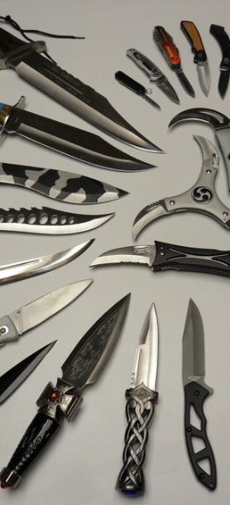

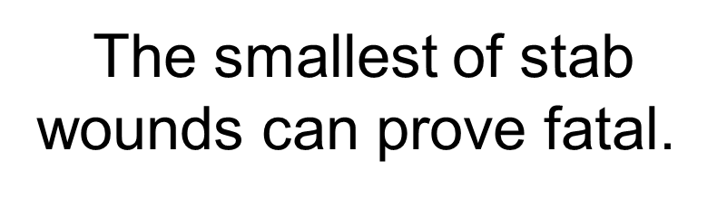

A knife can do as much damage to someone
as a gun.
True
Some people believe there are ‘safe places’ to stab (leg/arm).
The truth is there are NO safe places to stab.
Notes:
Slides 6 – 15.
True or false quiz using ‘true’ and ‘false’ cards from envelope (see resources)
Use the quiz to explain about the law and knife carrying. Answer any
related questions.

Slide 19
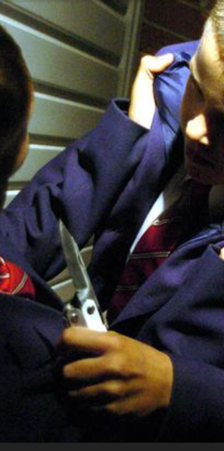
Teachers have the legal power
to search students for knives,
but
only with the students' consent.
False
Teachers can search you
even if you don’t consent
Notes:
Slides 6 – 15.
True or false quiz using ‘true’ and ‘false’ cards from envelope (see resources)
Use the quiz to explain about the law and knife carrying. Answer any
related questions.

Slide 20

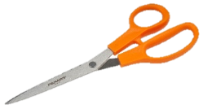
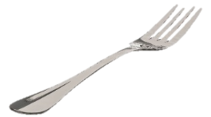
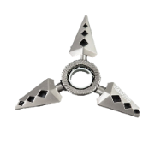

It’s not illegal to carry a sharp object that isn’t a knife
True But…
Threatening with a blade or sharply pointed article or offensive weapon in a public place (including school) is an offence
Notes:
Slides 6 – 15.
True or false quiz using ‘true’ and ‘false’ cards from envelope (see resources)
Use the quiz to explain about the law and knife carrying. Answer any
related questions.

Slide 21
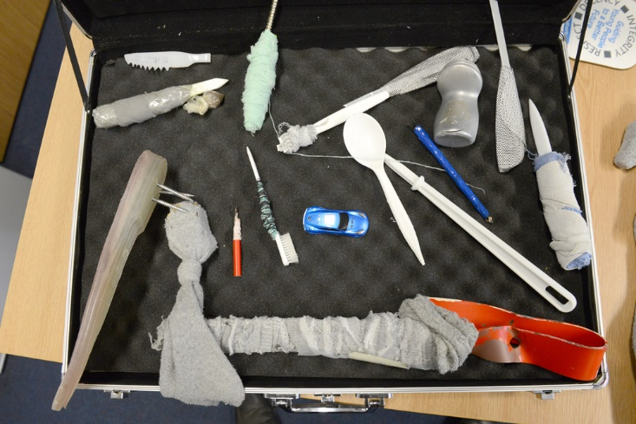
Improvised Weapons from Wetherby YOI
Notes:
If these weapons can be made where there is no access to weapons, just think how many dangerous items are available to you.
It’s about knowing about risks involved and making ‘healthy majority’ choices.

Slide 22
A True Story …
Told, because the parent’s want the story to save someone’s life.

Slide 23
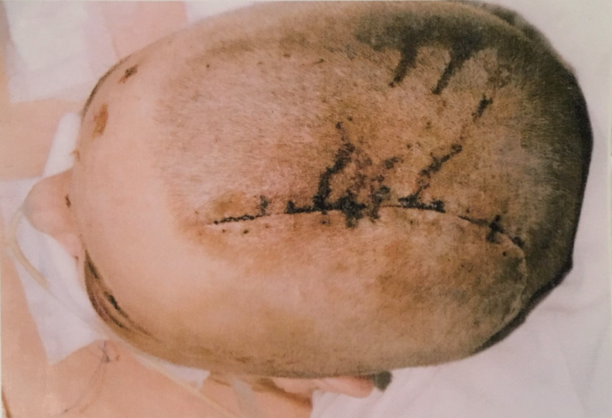
Notes:
The girl in these pictures was 15 years old. She wasn’t a bad girl and had never been in trouble with the police or school. She was a confident girl and decided she wanted to go to a nightclub, even though underage at the time. She went to a club in East London called Benjy’s. Once inside, she saw a boy who she liked and went over to talk with him. There were two other girls in the club that regarded this boy as ‘theirs’. Neither was going out with the boy, but they didn’t like that another girl was ‘muscling in’ on one of their group. They waited for her to go to the toilet and followed her. There was a brief argument, during which they told her to get out of the club. She refused. Then there was a small fight, mainly just pushing and shoving and a lot of shouting. The doorman was called and all three girls were thrown out of the club. Once outside, the girls beat her up, but not sufficiently to require hospital treatment.
The girl went home, but the incident played heavily on her mind. She kept wondering why she had allowed the girls to treat her like that, why she hadn’t fought back better. Why had she let them get away with it? She decided that she would go back to the night club next week, but this time she would be ready for them.
Before leaving for the club, she armed herself with a 6” long boning knife from her father’s butchers shop. When she got to the club, the girls were there again and virtually the same thing happened. When they had all been turned o9ut of the club, the two girls turned on her again, and this time she pulled out her knife (probably thinking the girls would run away). One of the girls got the knife off her and stabbed her straight through the top of her skull (the hardest part of the human body, apart from teeth) and snapped off inside her brain.
The girl was operated on but the surgeons could not get the blade out. The black eyes were caused by the shock and trauma of the stab. The surgeons made the large scar on her head. She died shortly after the photos were taken (she was on a life support machine).
She died at the age of 15. It was her own knife that killed her.
The girls who killed her were never convicted of the offence as even the doormen at the club who witnessed the offence were too afraid to testify against them.

Slide 24
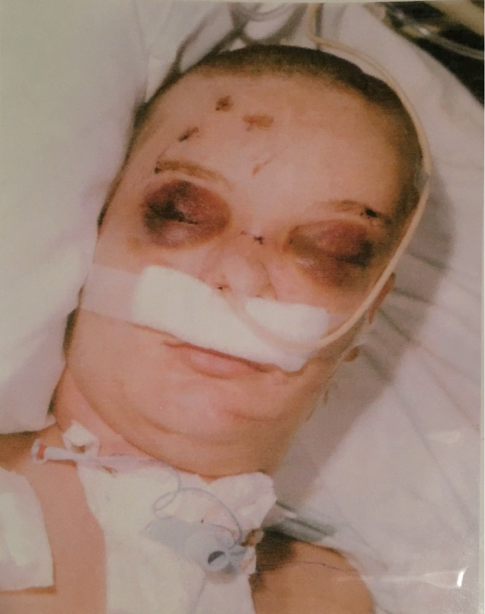

Slide 25
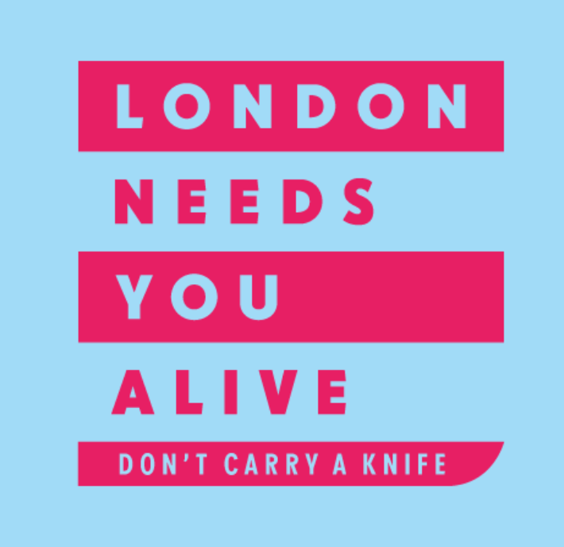
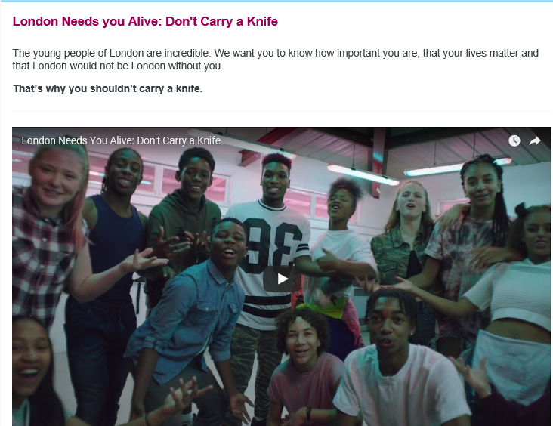
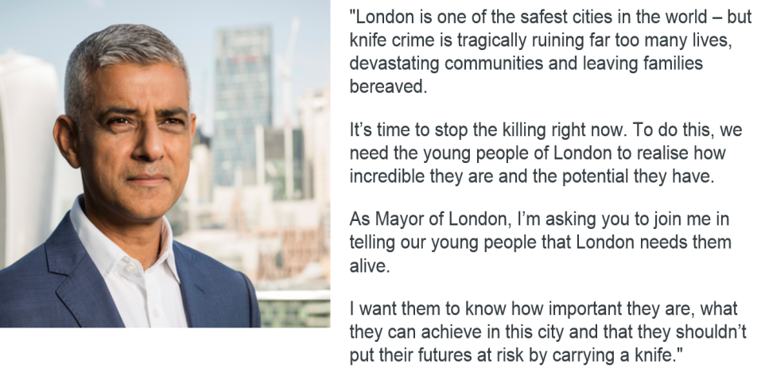
Notes:
23. Sadiq Khan, the Mayor of London is doing a lot of work around social media to inform young people about knife crime and how not to become a victim. He got some young people to create a video. (next slide)

Slide 27
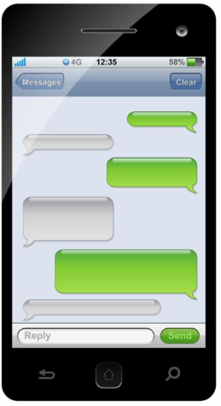
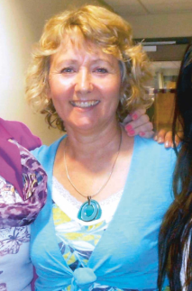
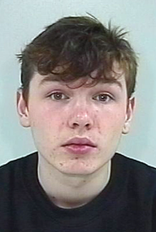


What would you do…
A girl sees this screen on her older brother’s phone.
What should she do?
What should her brother do?
Hey
Mr Todd today
Yea, hate maths, hate Todd
Me too. Taking a knife in.. If he starts on me..
What?!! u crazy? You’ll get caught..
Only if u grass
Notes:
Tell the story of the girl who this really happened to in West Yorkshire. She was really in this situation.
She went to school and told a teacher.
Mr Todd was taken to a safe place, the boy who said he was taking in a knife had his bag searched, and police went to his home and searched his bedroom. The brother did nothing.
What happened? What could have happened?
Ann Maguire, a Spanish teacher at a school in West Yorkshire, is the only teacher ever to have been killed by a student using a knife in the UK. Will Cornick told lots of other students what he was going to do but nobody believed him, nobody told a teacher. Ann is now dead, and Will is in prison for a minimum of 20 years.

Slide 28
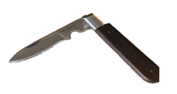

More likely to get hurt
Less likely to get hurt.
YOU ARE MORE LIKELY
TO BE INJURED OR ARRESTED
IF YOU CARRY A KNIFE.
Notes:
IF YOU CARRY A KNIFE YOU ARE MORE LIKEY TO BECOME A VICTIM OF A KNIFE ATTACK. – Repeat this phrase often – drill it home!
More likely versus less likely.
I

Slide 29
What are your thoughts about the presentation you have just seen?
Has anyone got any comments or questions or anything at all to say?
Notes:
Give children time to think, share and respect each other’s ideas, and to discuss any concerns.
Remind them they can always talk to you the next time you are in, or to their teacher at any time.
Thank-you for listening, joining in sensibly on a very serious issue, and for being committed to being one of the majority who makes healthy choices.

Slide 30

The majority of young people grow up into happy, successful people, unaffected by knife crime.
Make the right choices to become one of them.

Slide 31

Links
British Iron Works - Knife Angel
The Guardian - Beyond the Blade
The London Knife Crime Strategy
West Yorkshire Police #stopknifecrime
Resources
Poster available from above link (West Yorkshire Police) or by email from
sarah.whitehead@westyorkshire.pnn.police.uk

Slide 32

Made for
West Yorkshire Police
By Sarah Whitehead – Education Liaison officer.
November 2017

