Slide 1

A Brief Overview
Dawn Coleman

Slide 2
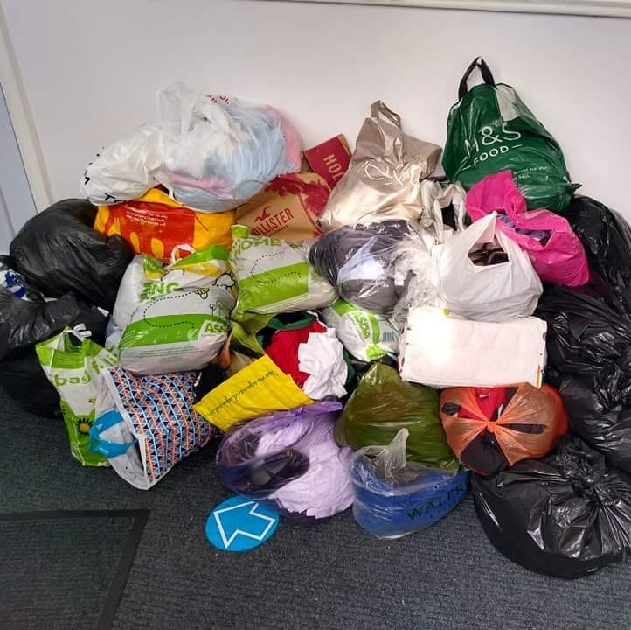
Small Start –
Big Impact
Inspired by figures from the Child Poverty Action Group in 2018 – School Uniform costings of £175 - £250 for one child in primary or secondary school.
Stigma around poverty & accepting help – how could we encourage families to access our services?
Our first month we received a school mini-bus absolutely FULL of lost property from ONE secondary school – previously destined for the tip. We realised many families may use us out of an environmental choice, reducing the stigma on accessing our services.

Slide 3
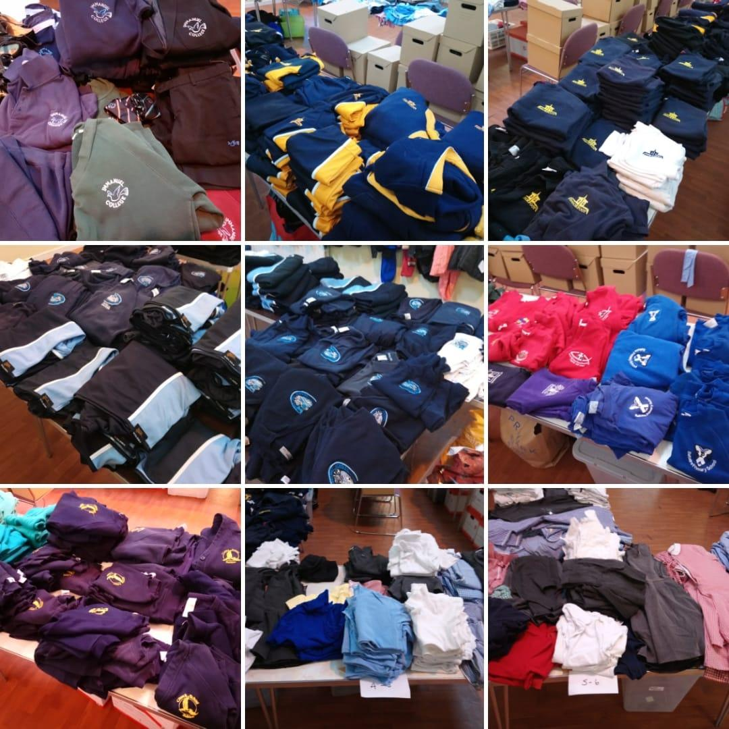
Our Service
We promote reuse of items - collecting, washing, checking and re-distributing uniform to ensure use for the full life of the item. We also act as a support & sign-posting service to all families, many of whom do not access any other services.
We currently have over 8000 items in stock. We have given out over 10,000 items in the last 5 years - many of our items look almost new, especially secondary school PE kits.
May 2018 - One post on social media.
February 2022 - 26 primary schools & 8 secondary schools. 9000 items in - 4500 items out over 4 years.
October 2023 – September 2024 – Over 4000 items out in one year. In one week in September 2024 – 153 items given out.
Spring 2025 – 69 families supported during our 8 week statistics collecting period

Slide 4
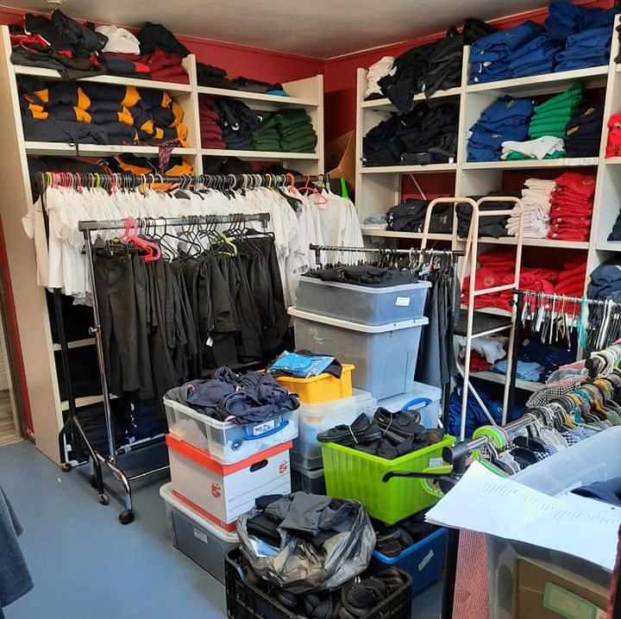
Pitfalls & Issues
Encouraging people to access the project – reducing stigma, promoting environmental values and opening up access routes
Storage issues and unsuitable donations
Managing expectations and expansion demands
Volunteer recruitment and retention
Excess stock

Slide 5

Access & Contact details
Our project is open access to the community – we can accept confidential referrals through family workers, schools, refugee projects, but also through direct requests and walk-ins from families themselves. There is no income requirement or proof needed and uniform can either be taken for free or for a ‘pay as you can afford’ donation.
Facebook – ‘Shipley Area School Uniform Bank’
Email – Dawn.Coleman@salvationarmy.org.uk
We currently have a central shop unit in Shipley with regular opening hours, open all year round with some variation in school holidays.

Slide 6
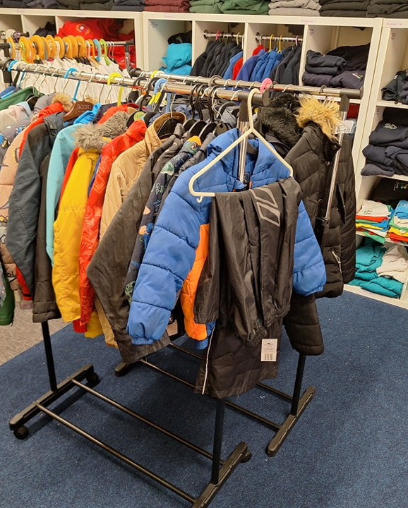
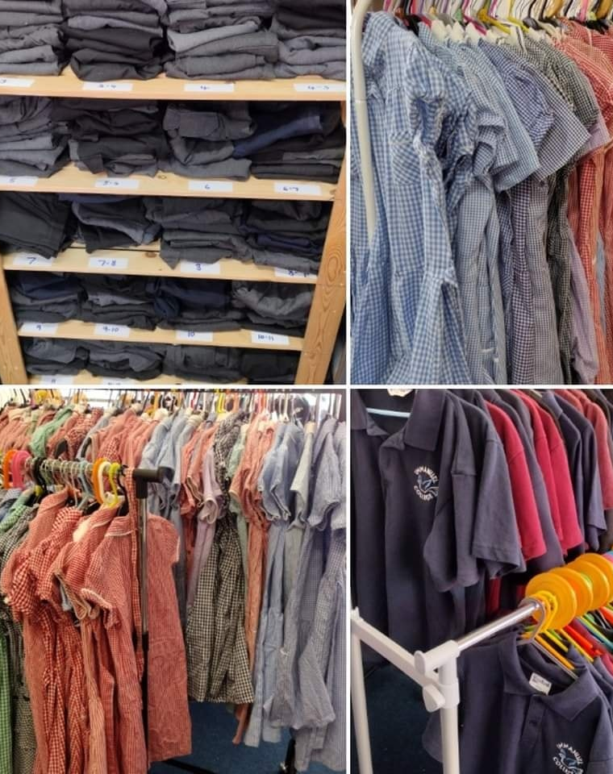
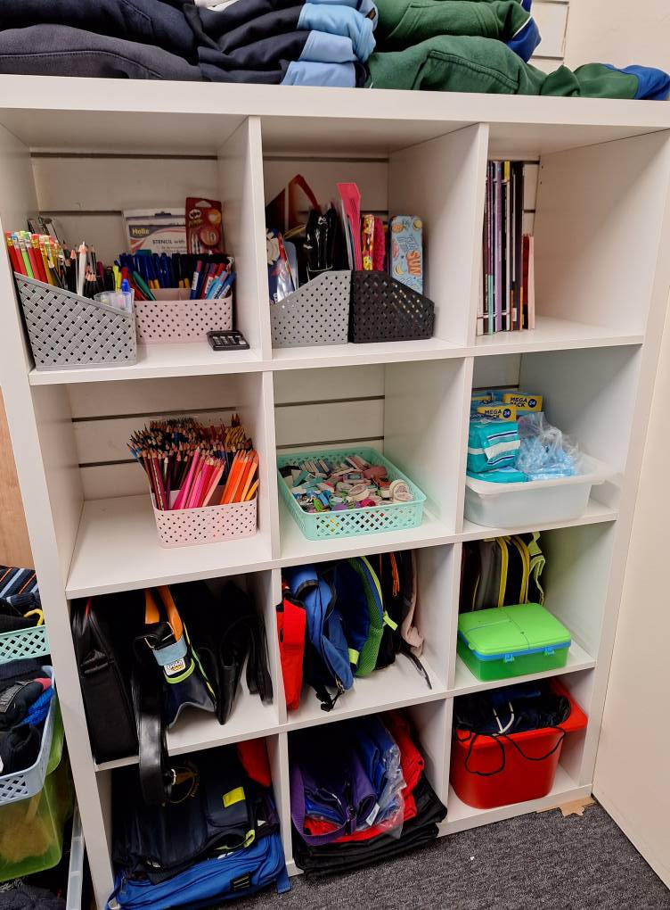
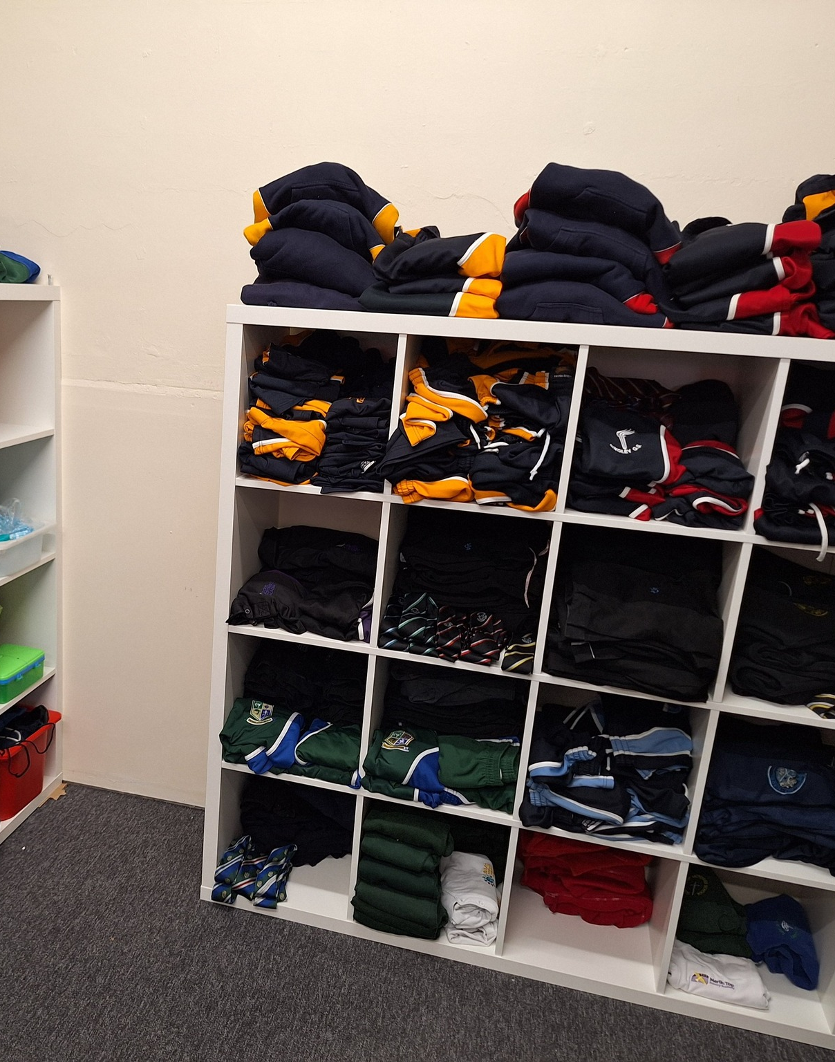
Looking to the Future…
We now stock stationery, sanitary towels, revision books, reading books, football boots, coats, summer uniform and much more…….
We now have a 20 hours paid staff role - funded through the Salvation Army Innovations Fund for 3 years.
We would like to build relationships further with schools to work with them on widening access to our service & providing feedback from families on uniform policy issues. We are available to attend parent events at schools.
We are looking into being able to offer Environmental Workshops for school, planned in line with the National Curriculum.
We need to find a solution to support the wider Bradford District & ease our stock issues.

Slide 7
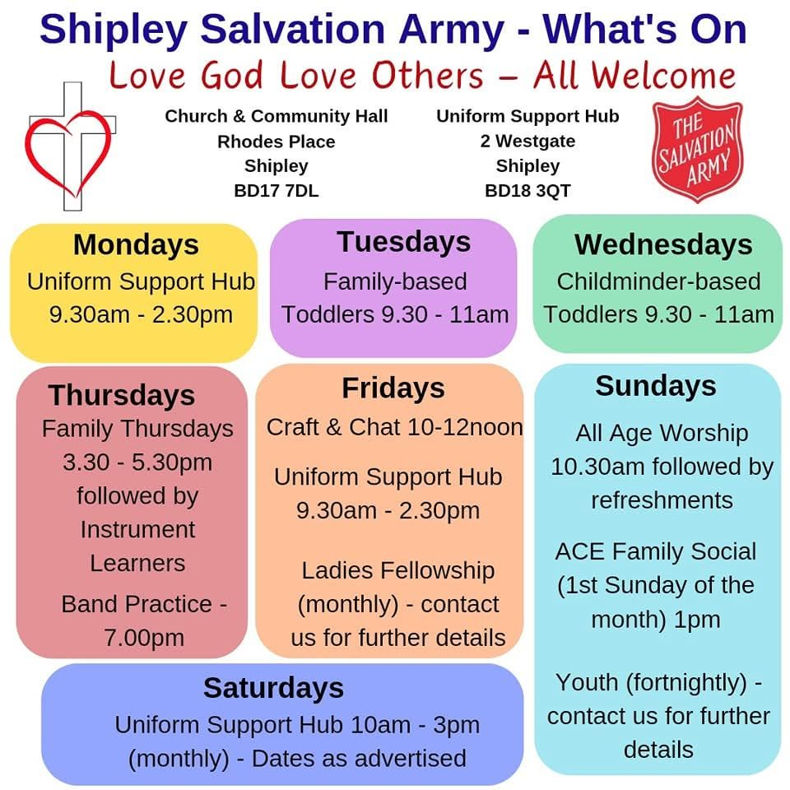



Support from Shipley Salvation Army
The Salvation Army has many resources available to support schools, children and families.
We may be able to provide volunteers for activities such as supporting reading in schools, leading an assembly, or helping with faith-based projects – please ask us!
When our building project is complete (2026-2027), we may be able to offer more services such an Ultimate Church Visit, or possibly look into the Starfish Mentoring programme if we have interest from local schools. These are Free Universal Services - find out more at https://www.salvationist.org.uk/resources/schools/ultimate-church-visit and https://www.salvationist.org.uk/learning/starfish. We will be in touch!
https://www.salvationist.org.uk/resources/discipleship/thesmallfishpodcast.
A FREE digital resource to support transition from primary to secondary.

