Slide 1
Supporting Staff Wellbeing during Covid-19 - Overview
Dr Ruth Dennis
Principal Educational Psychologist
March 2021

Slide 2
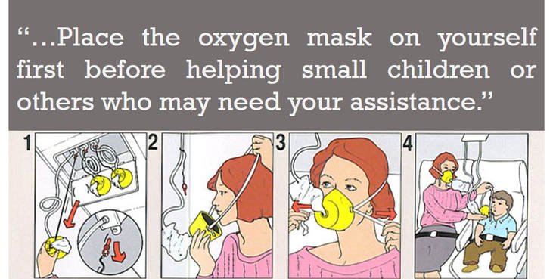

Slide 3
Purpose of the PERMA programme
To enhance staff wellbeing by:
Providing support and reassurance to school leadership teams, in relation to staff wellbeing;
Carrying out a stocktake of Emotional Wellbeing strategies you already use;
Using the PERMA framework to enhance work on supporting staff wellbeing.

Slide 4
Step 1: Management review of existing Wellbeing Strategy
1 x pre-recorded video workshop for school leadership team to work through (1 hour video, 2 hours activities).
Underpinning theory,
Audit of existing school response
Introduction to PERMA
PERMA action planning

Slide 5
Step 2: Using PERMA with Staff
Following completion of Management session, need to share with staff;
This will include consideration of what you could do at an organisational level, to support staff in this area.
The separate staff videos are available at this point and intended for individual use rather than whole school application.

Slide 6
Step 3: Whole school PERMA
Staff work through the 6 x 10 minute videos ( one per week)
School implement supportive PERMA strategies over this time
Access to monthly peer support for leaders implementing programme
Evaluation and review.

Slide 7
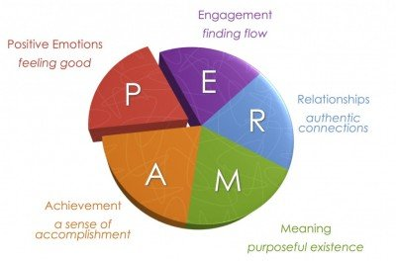
Seligman’s PERMA Model
Martin Seligman, one of the founders of positive psychology, developed a five core element of psychological well-being and happiness.
Seligman believes that these five elements can help people work towards a life of fulfilment, happiness, and meaning.
Institutions can also use this model to develop programmes that help people discover and use new cognitive and emotional tools.

Slide 8
Stop Look Listen Think
Sometimes when things are difficult, our focus is drawn to what is wrong in our lives.
PERMA encourages you to stop, look, listen and think about the small glimmers of positivity in your everyday life.
Noticing these things helps amplify them and make us more aware of them.
This has much in common with mindfulness and solution focused techniques.

Slide 9
Effectiveness of the Programme
Please complete the Staff wellbeing audit at the beginning and end of the programme to help us evaluate its effectiveness;
Please share with us any actions you take / ideas you have about promoting wellbeing in schools so that we can share them with other colleagues.

Slide 10
PERMA Programme
What | Content | Duration | Dates
Introductory web consultation for school leaders Completion of Whole school baseline audit | Introduction to programme. Discussion of logistics and commitment | Up to 1 hour | 02/03/21, 9 - 10 23/03/21, 9 - 10 27/04/21, 9 - 10 25/05/21, 9 - 10 22/06/21, 9 - 10 20/07/21, 9 - 10
1 x pre-recorded video workshop for school leadership team to work through | Underpinning theory, audit of existing school response. PERMA action planning | 1 hour video, 2 hours activities.
6 x pre-recorded PERMA video workshops for school staff | Introducing to PERMA and activities / challenges | 6 x 10 minutes
Monthly Senior management group support web consultation | Support to implement PERMA action plan / troubleshooting | As required – 1 hour per session | 02/03/21, 10 - 11 23/03/21, 10 - 11 27/04/21, 10 - 11 25/05/21, 10 - 11 22/06/21, 10 - 11 20/07/21, 10 - 11

Slide 11
Any Questions

Slide 12
Further Information
Ruth Dennis - Principal Educational Psychologist
City Of Bradford Metropolitan District Council
Margaret McMillan Tower Princes Way BRADFORD BD1 1NN
ruth.dennis@bradford.gov.uk
07582 109129
01274 439417

