Slide 1
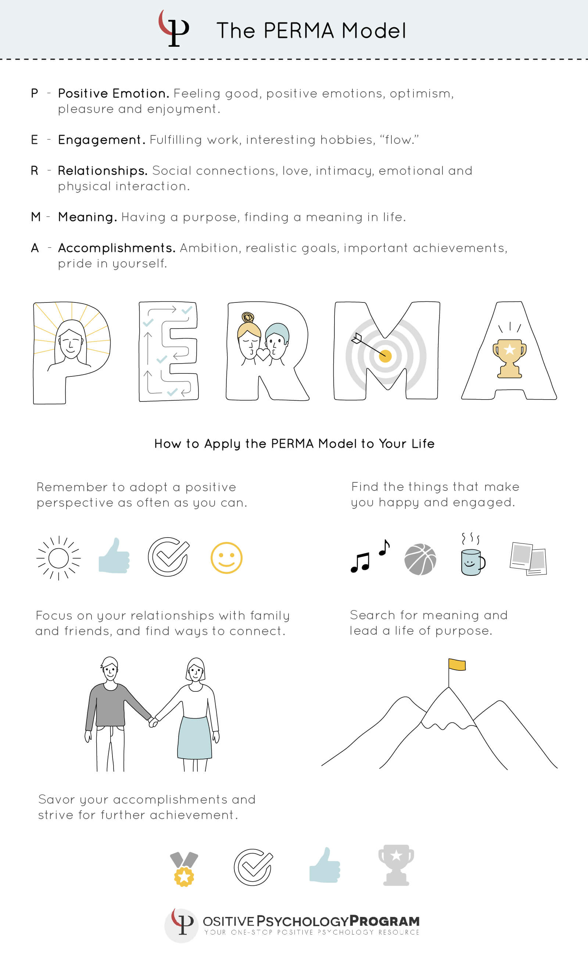
Session 3
Relationships
Dr Ruth Dennis
Principal Educational Psychologist
January 2021

Slide 2

Ready for PERMA?
Make yourself comfortable;
Get yourself a cup of tea and find somewhere quiet to watch the video and reflect.
You will need your PERMA journal and a pen.

Slide 3
Recap
Your school has requested wellbeing support from the Educational Psychology Team to assist staff and promote their wellbeing
In the first session we looked at why Covid-19 is impacting on wellbeing in school;
In the last session we looked at the PERMA model and introduced the second element: Engagement.
Today we will look at the third element: Relationships
If you have significant worries it is important that you seek support from your GP or from your line manager.

Slide 4
How did you get on?
Think about the last week.
Did you notice any times you became fully engaged and lost track of time at home or at work?
What were you doing?
How did it make you feel?
Over the next week continue to notice times when you feel like this.

Slide 5
R – Relationships
Relationships and social connections are crucial to meaningful lives.
We are social animals who are hard-wired to bond and depend on other humans. Hence, the basic need for healthy relationships.
We thrive on connections that promote love, intimacy, and a strong emotional and physical interaction with other humans.
Positive relationships with one’s relatives, co-workers, and friends is a key ingredient to overall joy.
Strong relationships also provide support in difficult times that require resilience.
We need, neurologically, to know that we belong to a group; it helps us feel safe and valued, and has for millions of years.

Slide 6
Relationships in Practice
Think of any positive interactions you have had this week with friends or family. It may have been at home / over zoom / out on a walk
It might have been a shared smile, a thank you or a walk with someone.
Think of how they made you feel – did you feel valued / appreciated / part of a group?
Over the next week, make a conscious effort to notice when you feel like this.
You may wish to use your PERMA journal to note down what it was you noticed and felt.
Sometimes you may notice more than one connection – savour this and be thankful!
Remember physical distancing NOT emotional distancing – we need interaction for connection, quality conversations and healthy relationships.

Slide 7
Relationships in the workplace
Notice when something at work gives you that ‘connected’ feeling.
It does not need to be anything big
It might be a shared smile with a colleague over a funny incident or a colleague thanking you
Is there anything you could do to help others feel more connected?
Jot your ideas down in your PERMA journal
The success or otherwise of any team is partly fuelled by the strength and dynamic of team relationships.
Building positive relationships encourages greater connectedness, a desire to support and encourage each other, and a willingness to go ‘the extra mile’ for each other.

Slide 8

Summary
PERMA is a way of supporting the development of Emotional Wellbeing;
This week your task is to notice things that give you a feeling of connectedness either at home or at work.
Be kind to yourself – if you don’t have energy one day, try again the next.

