Slide 1




Mental Health Champions from the Bradford Educational Psychology Team
Part of Living Well – Mental Health Support In Schools
Presentation by Dr. Claire Cooper-Jones
Specialist Senior Educational Psychologist for MHC (Core)
Mental Health Champions Core/Mental Health Matters in Schools Website:
https://bso.bradford.gov.uk/content/www.mentalhealthmattersinschools.org.uk
MHC Plus: https://bso.bradford.gov.uk/content/mental-health-champions-plus
Email: mhchampions@bradford.gov.uk

Slide 2



Session Aims
To provide an overview on the Mental Health Champions Project, including:
What support is on offer
How schools can access the project strands
What the expectations are of schools and individual Champions

Slide 3
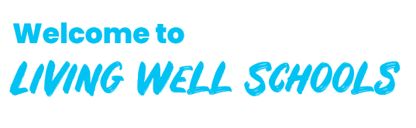
Context
Living Well Schools aims to transform the health and wellbeing of pupils to achieve better educational outcomes and live happier, healthier more fulfilling lives.
Living Well Schools is designed to help staff improve the health and wellbeing of pupils in their care.
It’s a place to access relevant guidance, resources, services and training to help make this possible.
This promotes a whole-school, tailored, cross-cutting approach to tackle complex health issues in the school-setting.
Notes:
Living Well – rather than Living Well Schools was set up some years ago to help all residents of Bradford lead a healthier lifestyle. It includes advice in topics such as stopping smoking, weight loss etc.
It also includes advice on mental health and emotional wellbeing – and this has extended to children and young people as well as adults.
Living well SCHOOLS has been launched to help education staff improve the health and wellbeing of pupils in their care. It’s a place to access relevant guidance, resources, services and training to help make this possible. This promotes a whole-school, tailored, cross-cutting approach to tackle complex health issues in the school-setting.

Slide 4
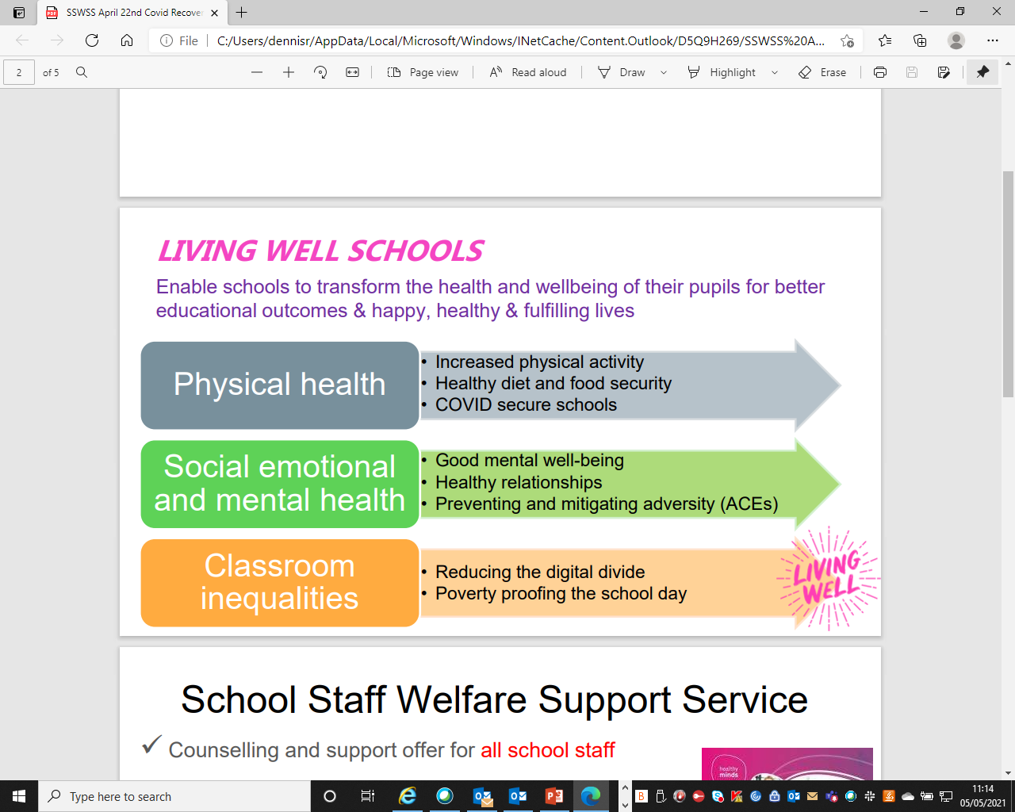
Priority Areas
Notes:
As we know, the physical and mental wellbeing of children and young people is linked – one has a direct impact on the other.
Living Well Schools believes that social, emotional and mental wellness of students is as important as physical health. It is designed to promote programmes available locally that aim to support mental health and wellbeing.
The aim is for all local schools to create an environment to enhance the mental wellbeing of its students.
We want to encourage children and young people to recognise if they are struggling emotionally and be able to find support without fear of stigma.

Slide 5

Origins of project
2014: UK Government established the ‘Children and Young People’s Mental Health & Wellbeing Taskforce
March 2015: Taskforce published its report and recommendations, “Future in Mind: promoting, protecting and improving our children and young people’s mental health and wellbeing”.
2015: results of a Health Needs Assessment carried out in Bradford in indicated that :
- Bradford had the third largest child population in the UK
- Bradford had high numbers of children living in poverty.
- 8,500 children aged between 5 and 15 with were thought to have diagnosable mental health disorders: This equates to between 3 and 4 children in every secondary school classroom
The MHC project was originally set up as a response to above findings, aiming to provide support for schools in dealing with children and young people with low level mental health or emotional wellbeing difficulties.

Slide 6
Development of the Mental Health Champions (MHC) project
A way of helping schools to find appropriate support for their pupils through training and signposting etc. (Does not provide direct support to young people)
Not intended to replace specialist support, but was a way that schools could access information and guidance for staff carrying out their day to day roles and responsibilities.
Access to the project has always been subsided by Public Health, meaning that schools do not have to pay to be a part of the project (although they would need to fund their own cover for members of staff accessing the various sessions etc if necessary)
School were asked to nominate a ‘champion’ within school to promote mental health and emotional wellbeing in schools, to help to reduce stigma, to attend training and other events, and to share information with colleagues in their settings.
The project is managed and delivered by Bradford Educational Psychology Team, meaning that training and support is based on up to date research and evidence-based practice.

Slide 7

Optional or compulsory?
The commissioners at Public Health and Directors within the Local Authority would like every school in Bradford to join the project in order to improve or enhance schools’ capacity to meet the emotional and mental health needs of students.
However, we recognise that different schools access different levels of support from other services and organisations, so we wanted to offer some flexibility to enable schools/settings to sign up to a level of support that is most relevant to their context.
We have therefore developed a two-tiered offer, meaning that schools can now opt to access the level of offer that suits their circumstances.
Notes:
Although the project was originally optional, in recent years all Bradford schools have been asked to sign up to the project – directors of education wanted every school in Bradford to be on board.
However, we listened to feedback from schools which indicated that different schools have access to different levels of support from other services and organisations, so we wanted to offer some flexibility to enable schools/settings to sign up to a level of support that is most relevant to their context.
So, we have made some changes to the project and we now offer a two different levels of support and individual schools can choose to sign up to one or the other depending on their circumstances, and therefore I am going to tell you a little more about these two offers.
NB The project continues to be fully subsided by Public Health therefore no costs to school unless they need to backfill their staff who attend.

Slide 8



New for 2021-22:
Mental Health Champions (MHC Core) and
Mental Health Champions Plus (MHC+)

Slide 9
Mental Health Champions Core Claire Cooper Jones
The Offer: Termly webinars offering key news and information regarding local and national initiatives and projects relevant to mental health/emotional wellbeing (mainly for CYP but may include some insight into staff and or/parent mental health/emotional wellbeing). N.B this will not include ‘training’ on mental health/emotional wellbeing related themes. We will also make links between Champions/your school and other organisations who offer support in this area via the webinars and through email and other communication. (N.B. we do not ‘co-ordinate’ services, but are well-placed to facilitate links between health and education) Half-termly newsletters with relevant local and national information regarding mental health and emotional wellbeing. Termly parent/carer workshops offering information and training around common issues and concerns parents/carers have regarding their children’s mental health emotional wellbeing. Access to our websites and social media accounts (TBA) for ‘snapshots’ of ideas and information.
Notes:
First of all, for schools who access a high level of support from other services and organisations, they can select to be involved in the more basic level, which is the MHC ‘Core’ offer. Mental Health Champions Core will continue to be coordinated by me, Claire.
MHC Core might be considered a ‘step down’ from what was on offer in previous years. There is no training or supervision on offer.
Schools will still be expected to nominate a MH Champion, but this person will be more of a point of contact and a person through whom we exchange information, rather than someone we expect to engage in training or carry out work with YP in school.
This slide show you what your school will be able to access through this lower level of the offer….
Termly webinars offering key news and information regarding local and national initiatives and projects relevant to mental health/emotional wellbeing (mainly for CYP but may include some insight into staff and or/parent mental health/emotional wellbeing).
We will also make links between Champions/your school and other organisations who offer support in this area via the webinars and through email and other communication. (N.B. we do not ‘co-ordinate’ services, but are well-placed to facilitate links between health and education)
Half-termly newsletters with relevant local and national information regarding mental health and emotional wellbeing.
Termly parent/carer workshops offering information and training around common issues and concerns parents/carers have regarding their children’s mental health emotional wellbeing.
Access to our websites and social media accounts (TBA) for ‘snapshots’ of ideas and information.

Slide 10
Mental Health Champions Core Claire Cooper Jones
Expectations of schools/Champions: Attendance at one webinar per term (approx. 1.5 hours each, organised by geographical area) where Champions will receive key news regarding local and national initiatives and projects. The expectation is that Champions would pass on relevant news and info etc to staff and SLT in school as appropriate. Being the key point of contact for us to send information and newsletters via email or social media, again with the expectation that they would disseminate to colleagues as you see fit. (N.B. Champions would not be expected to ‘check’ social media, all info would come via newsletter or email, social media would be an optional added bonus). Promoting our termly parent/carer workshops within school (either directly to parents or via other members of staff who would pass on the information) N.B. Only the nominated school Champion (or their representative in case of absence etc) should attend the sessions. Champions/representatives should be members of school staff, not members of other organisations working in school.
Autumn 1 | Autumn 2 | Spring 1 | Spring 2 | Summer 1 | Summer 2
MHC |  | MHC |  | MHC
Notes:
The previous slide showed you what your school can access, this one shows you what will be expected of your school and/or your Champion:
Attendance at one webinar per term (approx. 1.5 hours each, organised by geographical area) where Champions will receive key news regarding local and national initiatives and projects. The expectation is that Champions would pass on relevant news and info etc to staff and SLT in school as appropriate.
Being the key point of contact for us to send information and newsletters via email or social media, again with the expectation that they would disseminate to colleagues as you see fit. (N.B. Champions would not be expected to ‘check’ social media, all info would come via newsletter or email, social media would be an optional added bonus).
Promoting our termly parent/carer workshops within school (either directly to parents or via other members of staff who would pass on the information)
N.B. Only the nominated school Champion (or their representative in case of absence etc) should attend the sessions. Champions/representatives should be members of school staff, not members of other organisations working in school.

Slide 11
Mental Health Champions Plus (MHC+) Sophie Davis
The offer: As MHC, but with the additionality of: Termly focused training sessions, alternate half term to the MHC update sessions. (Champions only). Optional termly supervision re: whole school approaches to wellbeing and mental health. (Champions only) School Based Emotional Wellbeing Audit to support schools in evaluating their mental health provision. Access to one of six whole school intervention training sessions (More info in next few slides)
Notes:
Meanwhile, the MHC+ offer is for schools who want to access a high level of support. The enhanced or ‘plus’ offer will look similar to what we offered in previous years, but with some additionality.
MHC+s will access the same offer as the MHC Core schools, but will also receive:
- A termly training session on a particular topic, which would be run during the second half of each term to alternate with the MHC update meetings
- There will also be optional Termly supervision opportunities for MHC+ to discuss their role and their practice in developing whole-school approaches to mental health and wellbeing
We do need to point out that all MHC+ will also be asked to complete a School-Based Emotional Wellbeing Audit at the beginning and the end of the school year, as part of our obligation to the CCG. (The results of the audit will hopefully show improvements in student mental health and will therefore help to justify the continuation of the funding for the project).

Slide 12
Mental Health Champions Plus (MHC+) Sophie Davis
Expectations of Schools/Champions As MHC Core with the addition of: Attendance at termly training session (alternate half-term to the MHC update sessions) Optional termly supervision re: whole school approaches to wellbeing and mental health Completion of School Based Emotional Wellbeing Audit at the beginning and end of the school year. School would also need to be developing whole-school approaches to emotional wellbeing and mental health (e.g. whole school approach training and/or DfE Senior Mental Health Leads training)
Notes:
This slide shows you what would be expected of your school and/or Champions:
As MHC Core with the addition of:
Attendance at termly training session (alternate half-term to the MHC update sessions)
Optional termly supervision re: whole school approaches to wellbeing and mental health
Completion of School Based Emotional Wellbeing Audit at the beginning and end of the school year.
School would also need to be developing whole-school approaches to emotional wellbeing and mental health (e.g. whole school approach training and/or DfE Senior Mental Health Leads training) - more on next slide

Slide 13
Additional intervention training
Training in one of six SEMH related interventions is available to support schools who are investing in Mental Health in their setting through either:
Signing up to MHC Plus
Completing Bradford Healthy Minds Chartermark
Engaging in the Bradford version of the DfE Senior Mental Health Leads initiative
Interventions covered in this training will include:
ROAR Whole School Approach to Mental Health and Academic Resilience (primary focussed)
Nurturing Schools (secondary focussed)
Trauma Informed Practice
Zones of Regulation
Emotion Coaching
Restorative Practice
This training is subsidised by public health and free for schools participating in one of the 3 initiatives listed above.
If your school opts for the lower offer of MHC Core, you will not be able to access the training unless you sign up to one of the other two initiatives or buy in directly from the EP team via our Traded Services.
Notes:
The additional support that has not been on offer in previous year is access to training on specific interventions. This will be in addition to the training on key themes/topics/areas of mental health covered at the Plus Network Meetings. This training is also free to schools, as the funding is covered by Public Health through various grants and initiatives.
Schools who access this will be able to access whole school training in one of six SEMH interventions which are:
ROAR Whole School Approach to Mental Health and Academic Resilience (primary focussed)
Nurturing Schools (secondary focussed)
Trauma Informed Practice
Zones of Regulation
Emotion Coaching
Restorative Practice
This training is only on offer to MHC PLUS schools or schools who are accessing the DfE Senior mental Health Leads training, or the Bradford Healthy Minds Chartermark.
Schools who are only MHC core and are NOT doing the DfE Senior Leads or the Bradford Chartermark will not be able to access this training. (Unless they pay for a full training session via a different route i.e. the EP team traded services offer)
NB My colleague Kay is going to talk about the DfE Senior Leads initiative and the Chartermark in one of your other breakout sessions. She is project managing them both, so any questions about those two things can be directed to Kay. Contact details at end of presentation.

Slide 14
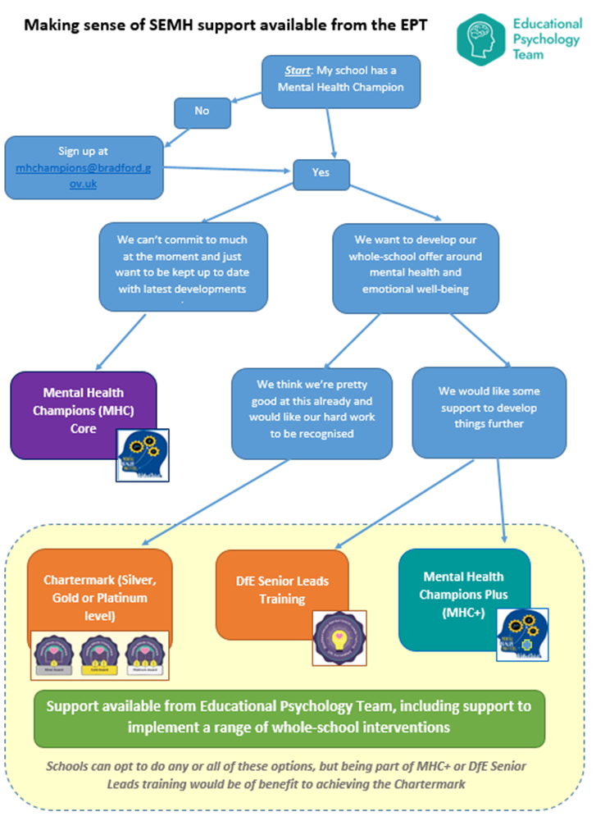
Next steps
mhchampions@Bradford.gov.uk
Notes:
If you’re one of the 85% of schools who already have a MHC, it would be helpful if you can begin to consider whether your school is likely to be a “mental health core” school, or a “mental health plus” school! This will involve having discussions with your colleagues in Senior Leadership and thinking about what you would realistically be able to commit to over the next year. (Some schools have already done this).
If you are not signed up at all, we would highly recommend you do so – contact details are coming up.

Slide 15
FAQs
Does the MHC project coordinate mental health and emotional wellbeing services locally?
No, we don’t coordinate other services, but we often serve as a link between schools/education and health, as we are in an ideal position to do so. We can often help signpost, but we don’t organise local provision.
Do you invite other services/organisations to network meetings or to deliver training?
We will sometimes invites other services to give Champions information about their offers etc, with the intention of schools/Champions being able to follow up any queries directly with those services. We don’t usually invite other services to deliver training, as we provide this directly via our ‘Plus’ offer, and other services have their own routes of delivering their training offers.
Who should school nominate as the Champion?
This depends on your school’s circumstances and whether you want your Champion to take on responsibility that is additional to the MHC role. It might be a TA or LM who works directly with CYP and would benefit from training. It might be someone who has availability to be the point of contact. It might be a member of school SLT with the authority to implement changes to school systems and policies (especially if they are undertaking the DfE Senior Mental Health Leads)
Can we have more than one Champion in our school?
It’s likely to work better if your school has only one nominated Champion, as they would be the point of contact. However, 2 people could job-share the role if needs be.

Slide 16
FAQs
Can more than one Champion attend network meetings and other events?
In circumstances where Champions job share, only one of them would be able to attend the termly network meetings and training sessions. This includes not attending a repeated version of the same event. This is because we are commissioned to involve 1 person per school, and this is reflected in our capacity during sessions.
What if our Champion can’t attend an event scheduled for our geographical area?
Champions can attend a different day/time if their scheduled geographical area event is not suitable. Or another representative can attend, as long as they contact our admin team in order to receive the invitation.
Can we change between MHC Core and Plus?
We can move your school up to Core or back down to Plus during the school year if you feel this is better suited to your circumstances. However, the projects are not interchangeable, and we would expect most schools to stay with their initial decision throughout the year. Schools stepping up to MHC Plus later in the year should be aware that they would be expected to commit to their whole school development, including completion of the audit.
How do we sign up to Core and/or Plus?
Email the MHC inbox (mhchampions@bradford.gov.uk ) and state whether you would like to register as MHC Core or Plus.
What if we have a new/different Champion to last year?
Email the MHC inbox (mhchampions@bradford.gov.uk ) to let our admin team know if your MHC details have changed.

Slide 17
Contacts
MHC Core only: Project lead: Dr Claire Cooper-Jones, Specialist Senior EP.
Email: Via the MHC inbox: mhchampions@bradford.gov.uk
BSOL page: https://bso.bradford.gov.uk/content/www.mentalhealthmattersinschools.org.uk
MHC Plus : Project lead: Dr Sophie Davis, Specialist Senior EP.
Email: Via the MHC inbox mhchampions@bradford.gov.uk
BSOL page: https://bso.bradford.gov.uk/content/mental-health-champions-plus

Slide 18
Contacts
DfE Senior Mental Health Leads: Project lead: Dr Kay Tasker-Smith, Specialist Senior EP.
Email: BradfordSeniorMentalHealthLeads@bradford.gov.uk
BSOL page: https://bso.bradford.gov.uk/content/bradford-dfe-accredited-mental-health-leads-training
Bradford Healthy Minds Chartermark: Project lead: Dr Kay Tasker-Smith, Specialist Senior EP.
Email: EmotionalWellbeingChartermark@bradford.gov.uk
BSOL page: https://bso.bradford.gov.uk/content/bradford-healthy-minds-chartermark

