Slide 1






BRADFORD
Powered by:
DARTBOARD MATHS
DARTBOARD MATHS
BATTLE DECK
BATTLE DECK
ROAD SHOW
ROAD SHOW
01 SEPTEMBER - 10 DECEMBER
PRIZES
UP FOR GRABS
HOSTED BY
DEVON PETERSEN
TERMS AND CONDITIONS

Slide 2



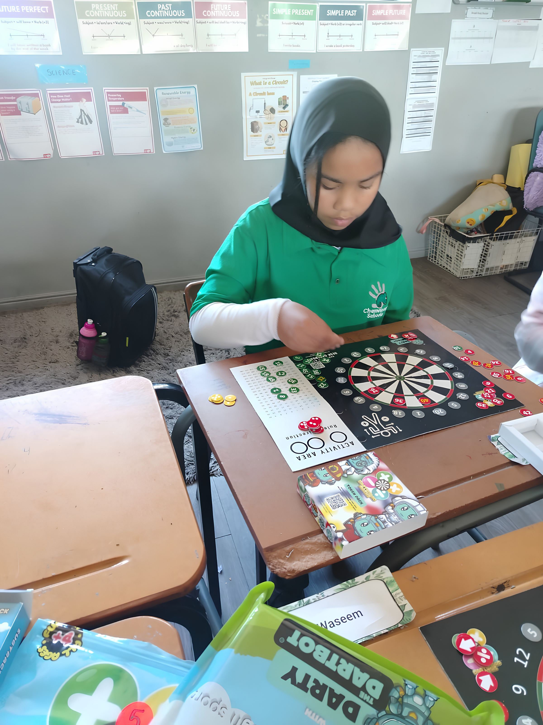

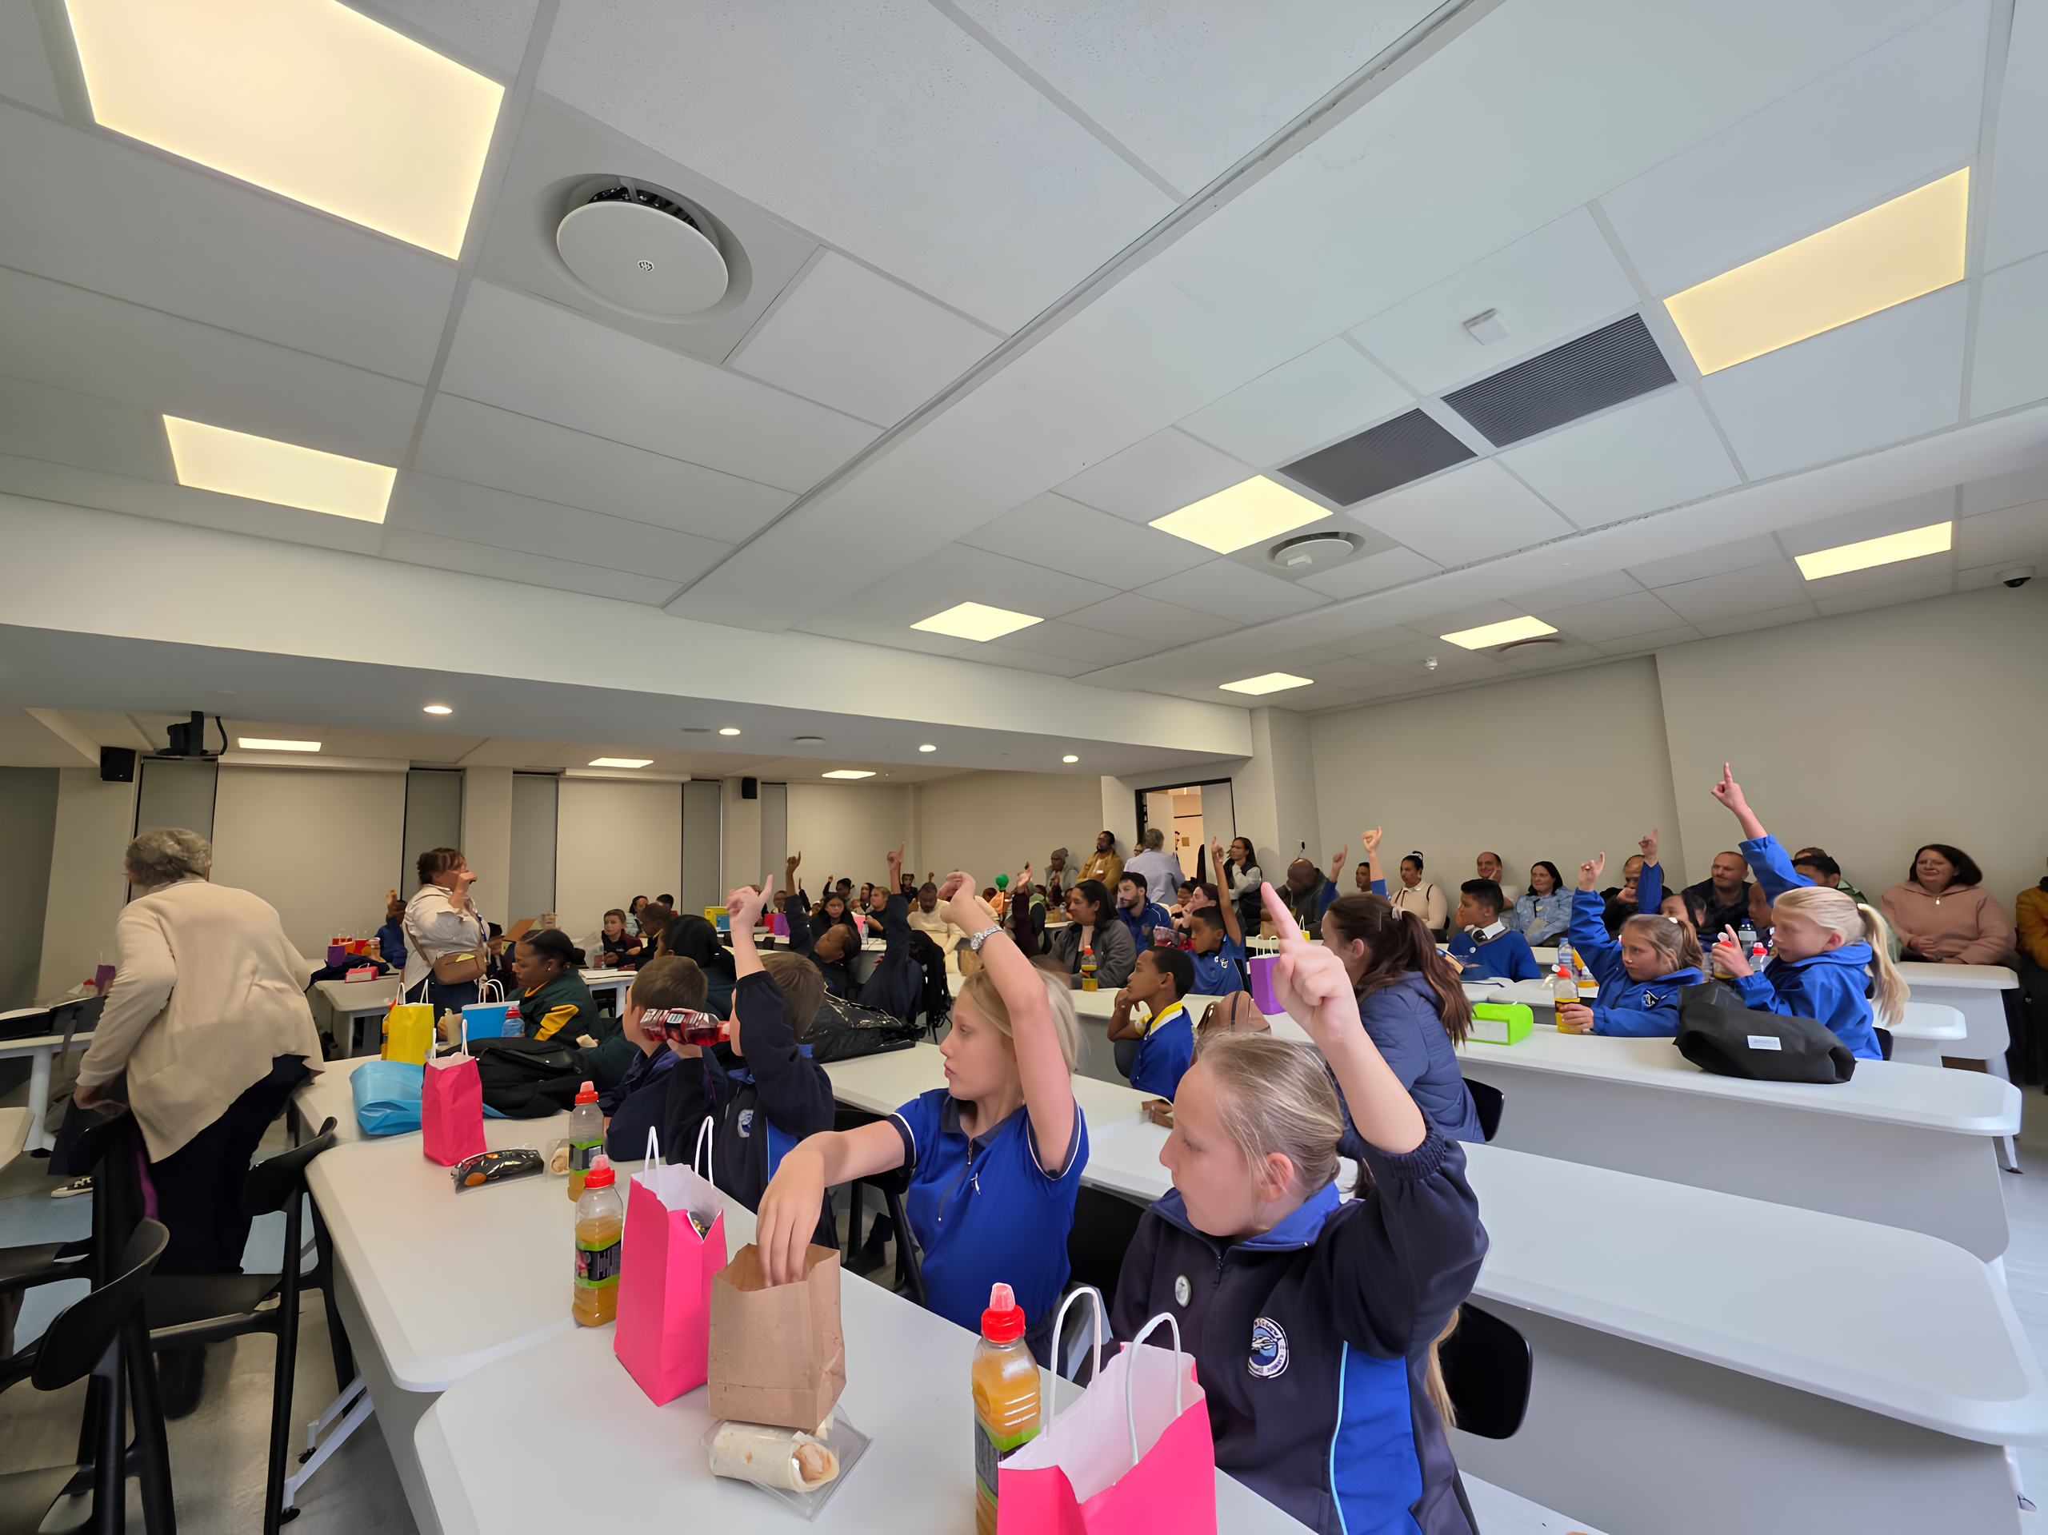
MATHS FOR CHANGE
Years 4-6
Rapid mental arithmetic challenge
The BATTLEDECK qualifier is an exciting roadshow that will visit your school and host a mathematics event inside 60 minutes.
What we require
  Learners to participate
  Years 4-6
  We bring the show
  Your learners enjoy the game
20
FIVE
ONE
ANSWERS IN THE QUICKEST TIME IN THE SCHOOL
LEARNERS QUALIFY FOR GRAND FINALS
CHAMPION

Slide 3


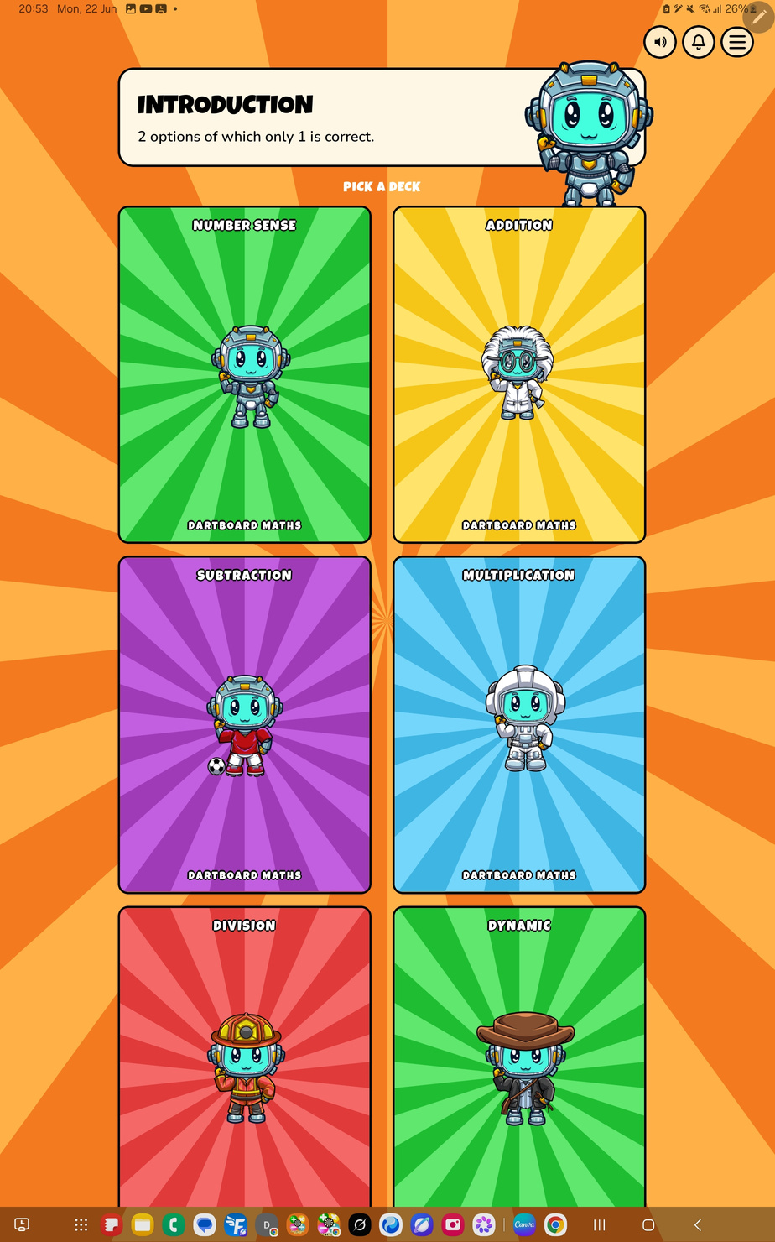

HOW TO PLAY
Years 4-6
Rapid mental arithmetic challenge
  Each learner will be placed in front of a battledeck tablet
  Each learner will complete the "20" Battledeck challenge.
  The top 5 learners with the fastest time from your school will qualify for the finals
What will the roadshow deliver
  Tablets
  Music
  Atmosphere
  Most importantly........Fun
20
FIVE
ONE
ANSWERS IN THE QUICKEST TIME IN THE SCHOOL
LEARNERS QUALIFY FOR GRAND FINALS
CHAMPION

Slide 4
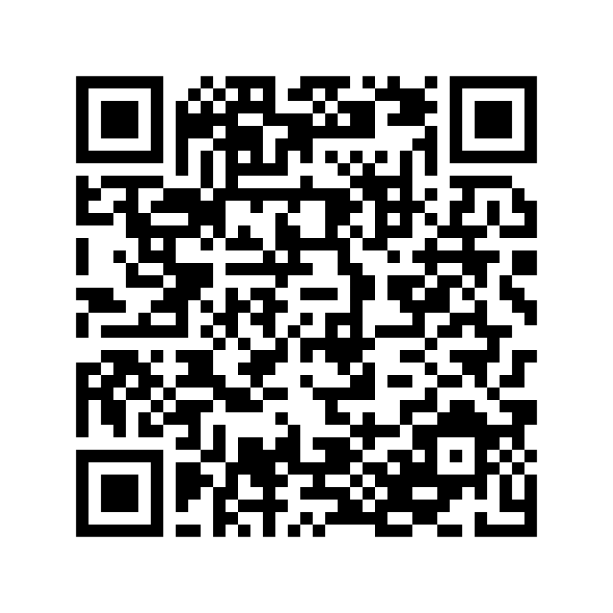

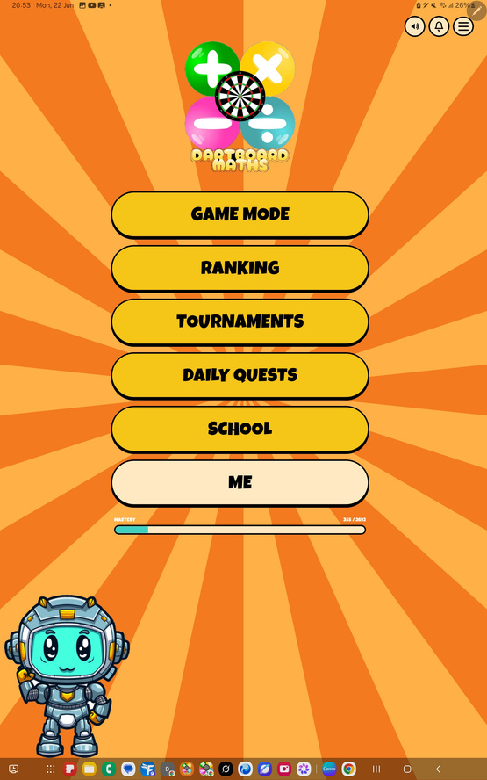
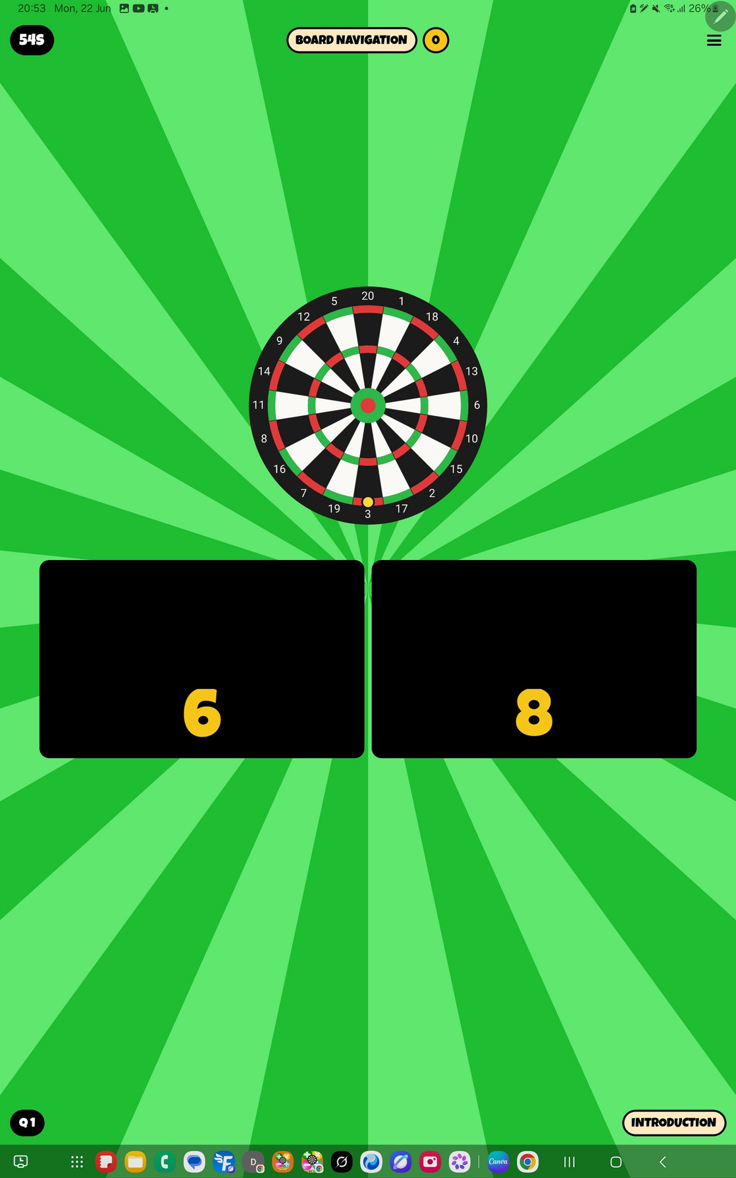
  Entry form
Powered by:
BATTLE DECK
GET READY FOR BATTLE ?
DOWNLOAD NOW
DARTBOARD MATHS-BATTLEDECK

Slide 5

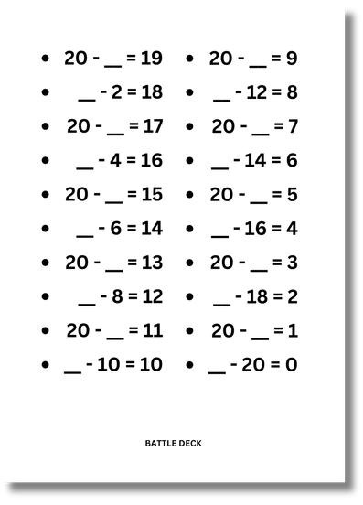

Powered by:
ROAD TO VICTORY
School Qualifier
FROM CLASSROOM TO GRAND STAGE
1 September - 13 November
AT YOUR SCHOOL
The battledeck mission is to sharpen mental arithmetic and increasing the fun of mathematics in the classroom.
Grand final
10th December 2026
MBANQ VALLEY PARADE

Slide 6
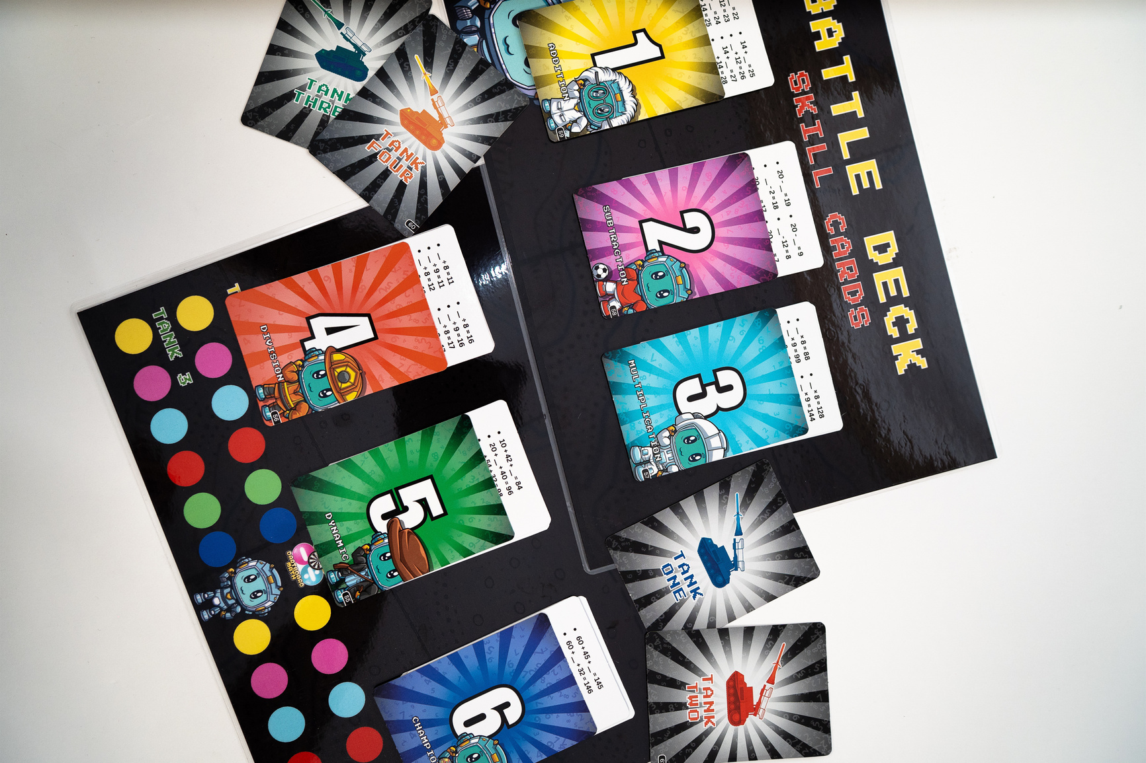


Powered by:
BRADFORD
TIME TO SIGN UP
CLICK HERE TO ENTER
LIMITED SLOTS AVAILABLE!!!

