Slide 1
Belonging

Slide 2
What does it mean to belong?
Name a place where you belong?
Why do you feel you belong there?

Slide 3
Do you feel you belong at school?
If yes, why?
If no, why?

Slide 4
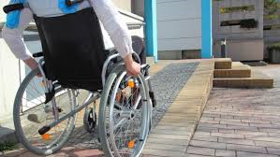
Access

Slide 5
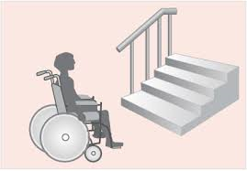
Let’s take a walk …

Slide 6
What helps?
Is there anything that doesn’t help?

Slide 7
What needs to happen?

