Slide 1







©The Story Project CIC
Notes:
Ground rule suggestions:
We listen to everyone’s opinions respectfully
We join in with the lesson calmly
It is ok to have different opinions and ideas
We are inquisitive and excited to learn
If we are worried about something, we talk to a trusted adult
If we are worried about a friend or ourselves, we talk to a trusted adult
We do not have to talk about a topic that upsets us
We have fun!

Slide 2




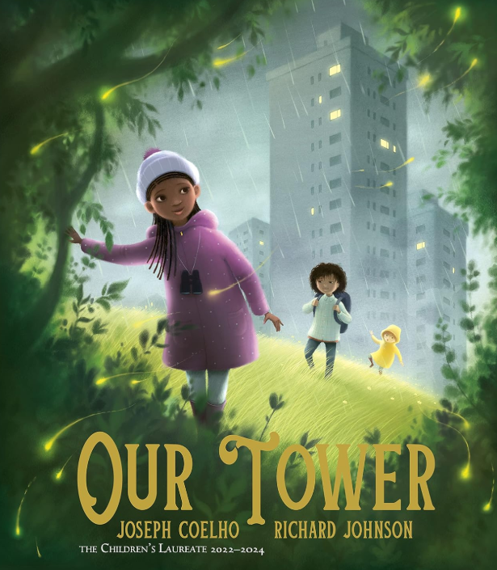


Our Book
Title:
Our Tower
Author and illustrator:
Joseph Coelho
Richard Johnson

Slide 3


Tower and Tree Stretch
ettle
Let’s spend a few minutes getting ready for our lesson.
Stand tall like a tower
Take big deep breaths
Sway like a tree from side to side
Notes:
Guide children through some simple movements to get them ready for the lesson and calm any big emotions:
Step 1: Stand up straight (eyes closed optional).
Step 2: Slowly lift your arms, stretching them above your head as though you are a strong and tall tower. Take a big deep breath.
Step 3: Lower your arms
Step 4: Sway your body gently from side to side, imaging you are a tree moving in the wind. Take a big deep breath.
Now that we've finished the activity, let's take a moment to think about how it made us feel.
Did this activity help you settle down? Take a second to notice how your body and mind feel. You can raise your hand if you felt calmer or more focused after doing the activity.
When else do you think you could use this activity? Maybe it could help before a big test, or if you're feeling a little wiggly or worried. Can anyone think of a time when this might be useful?

Slide 4
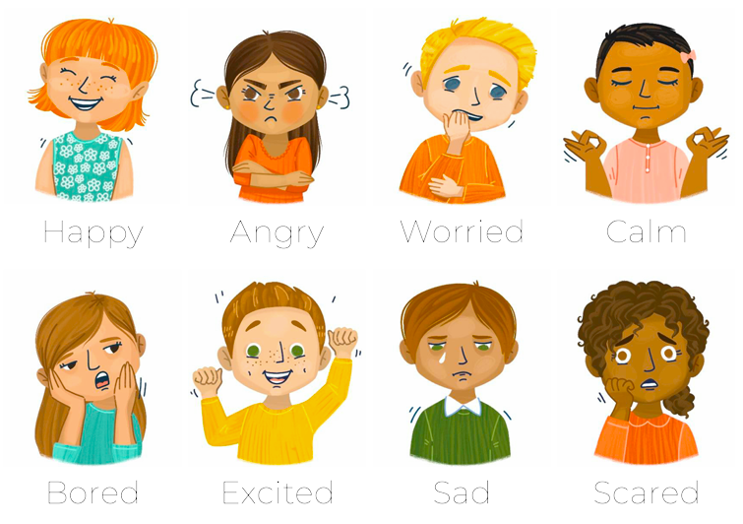

Emotional Vocabulary
Look at the front cover
How do you think the girl in the purple coat is feeling?
What makes you think this?
raining
Notes:
Look at the front cover of the book.
Use the emotional vocab grid on the following slide
Ask children: How do you think the girl in the purple coat is feeling? What makes you think this?
Encourage the discussion of new emotional vocab adjectives.

Slide 5
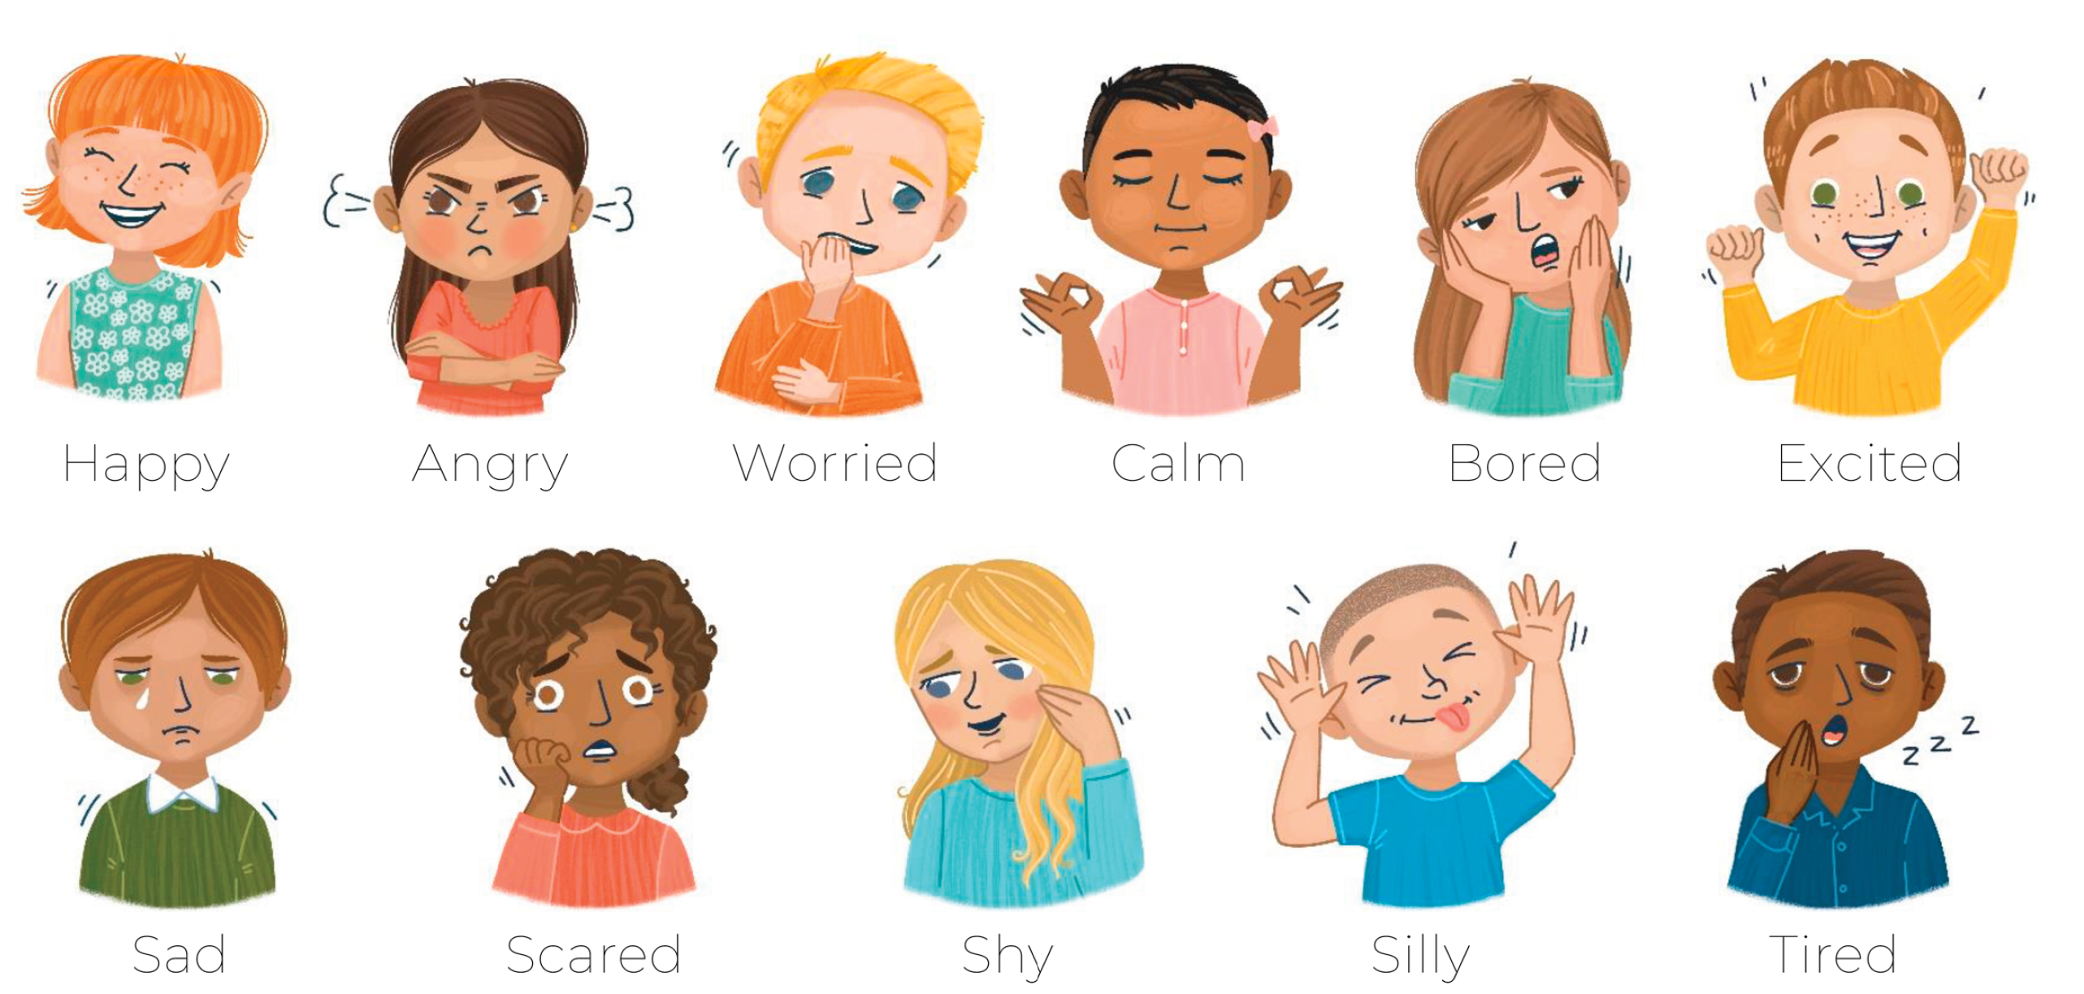

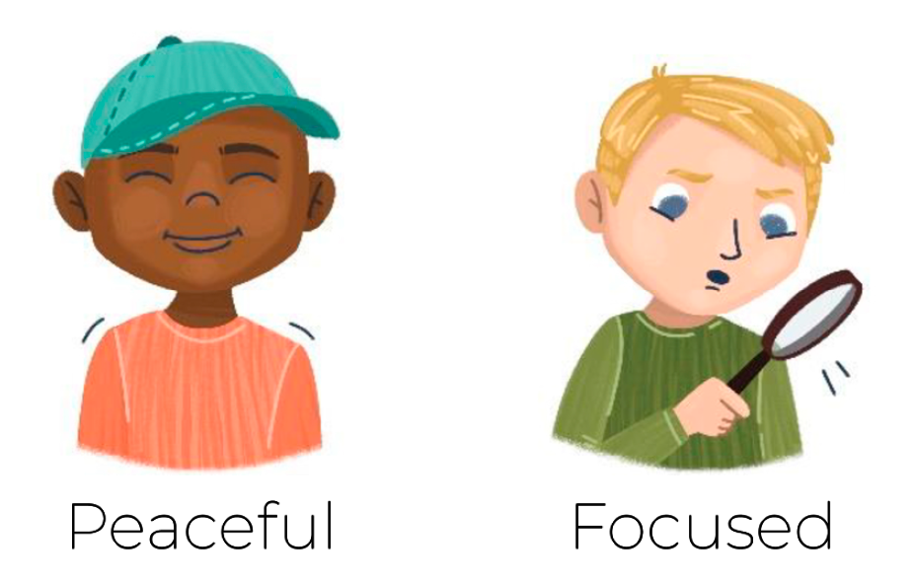
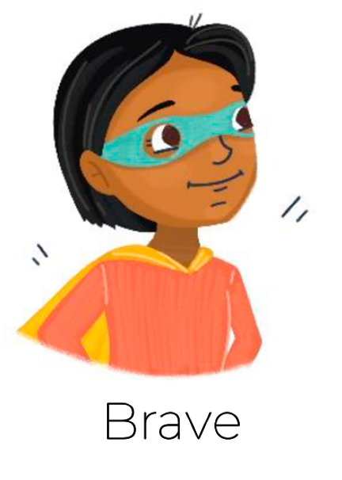

Emotional Vocabulary
raining
Notes:
Can children think of any other words to describe the characters feelings?

Slide 6

I can tell you what nature I can see in my community and how nature benefits me
bjective
Notes:
Nature definition:
Our physical, non-human made world, including plants, animals, weather etc.

Slide 7
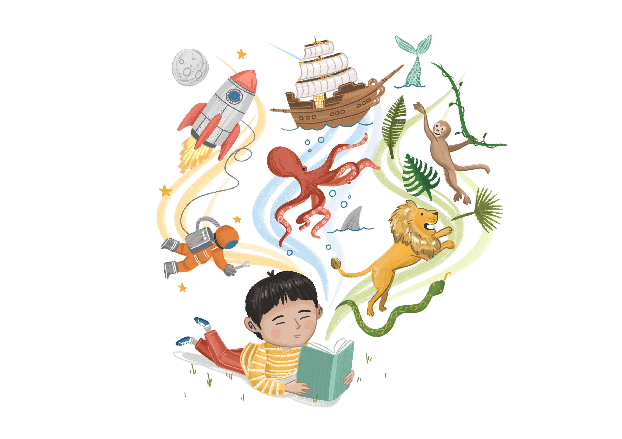
Enjoy the Story
Key Stage 1
Vocabulary:
Look at the page where they first find the old tree (p15-16). What do you think “a song of rustles and whooshes” means? Why do you think a tree might sound like that?
Retrieval:
At the end of the story, the children realise there is lots of beauty in their tower. Can you remember some of the things they see?
Inference:
Look at page 1 and 2, what nature can you see here? Now skip to the last page, how has this changed? How do you think the children feel at the end of the story compared to the beginning?
ead
Notes:
KS1
Start with a short introduction to the story to help support understanding of any abstract themes and imagery used throughout the book.
“Drawn from the author’s own experience growing up in a tower block and looking for adventure and nature. The three characters think their tower block is grey and boring. They hear, what sounds like, a song coming from the trees near where they live. They set off to find it, hoping to discover the adventure and beauty of nature. They find the tree, an old oak with a magical world inside of it, only to realise that the magic they’ve been looking for has been in the tower block the whole time. They return home and are overjoyed to see that the nature and beauty is an abundance all around them – through the community that lives there.
Share the story with pupils.
Use the suggested comprehension questions to develop pupils’ understanding of vocabulary, retrieve information, and infer meaning. KS2 questions on the following slide.
Answer Prompts
Vocab – encourage children to think about all the ways we might describe a tree. In this book, the vocab describes the way the trees move, how they sound and what they look like. ‘Rustles and whooshes’ shows how the wind changes the way we see the trees, likening it to a song.
Retrieval – Use the illustrations here to prompt children’s memory. They see families enjoying themselves, flowers on balconies, people swapping food, plants growing on windowsills, people helping each other, picnics on the grass etc.
Inference – this question is designed to help children make the connection between nature and wellbeing. At the beginning of the story the children see the tower as grey and sad, but at the end they see how wonderful it is.

Slide 8
Enjoy the Story
Key Stage 2
Vocabulary:
What do you think ‘…the humdrum can hide a flower’ means?
Inference:
Why do you think it took going on the adventure for the children to finally understand that their tower is full of nature and beauty?
Now that the children can see this, how do you think it make them feel about where they live?
Why do you think the illustrator chose to draw parts of the story in blocks? What do the shapes remind you of?
ead
Notes:
Share the story with pupils.
Use the suggested comprehension questions to develop pupils’ understanding of vocabulary, retrieve information, and infer meaning. KS2 questions on the following slide.
Answer Prompts
Vocab – we have chosen this phrase to encourage children to think about how we often ignore nature, especially when we’re busy. Its easy to forget to notice it when you live in a big city. The book talks about how adults have forgotten this – so its up to children to notice the little ways that nature shows itself around our community.
Inference – Here we are encouraging children to make the connection between nature, wellbeing and community. The beauty and magic was always in the tower, it just needed the children to notice it and after exploring in the woods and meeting the tree, they come to realise how wonderful their home is.

Slide 9
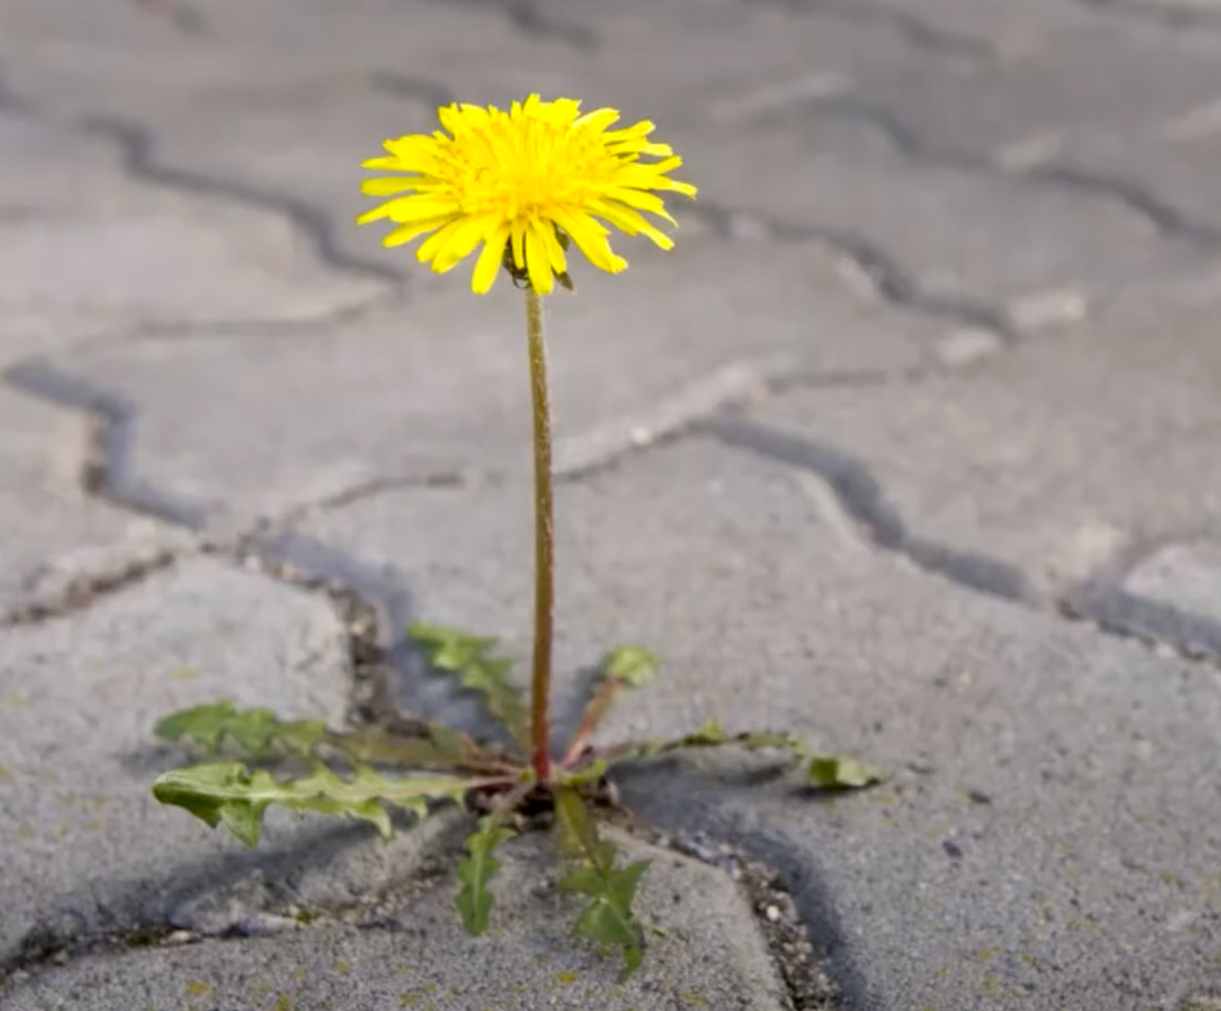
Class Discussion
Where can we see nature when we live in a big city such as Bradford?
ou
Notes:
Bradford has some wonderful places to explore nature! These include parks, such as Lister Park or Bowling Park and many more. Many of your schools also have playgrounds and fields. You may be lucky enough to have a garden at your house. Just like in the book, people often grow plants on their balconies and windowsills. You can also spot lots of animals in big cities – birds, such as pigeons, are very common and lots of gardens are visited by sparrows and magpies. Birds often sit on powerlines. At night foxes like to look for food in outdoor bins, and owls hunt for small prey. Families might also keep pets or horses.
Nature also shows up in little ways that we might not expect. Flowers can grow in the unlikeliest of places such as cracks in the pavements and walls. Plants often grow in guttering that runs around buildings. Bugs love to crawl through the cracks in pavements.
Next time you are walking in your neighbourhood try to notice all the little ways that nature survives in cities.

Slide 10
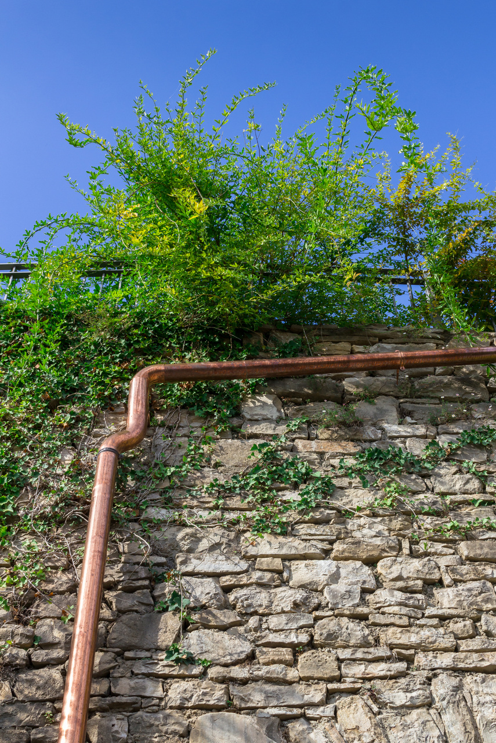
Activity A
The nature around my home
Thinking about our examples from the class discussion, decorate your house to show all the ways that nature shows itself when you live in a city.
Think about
plants big and small, indoors
and outdoors
Animals, including minibeasts
Daytime and nighttime
ou
Notes:
Using ideas from the class discussion, ask children to spend a minute or so reflecting on what nature is around their own house.
Using the templates provided below, allow each child to select a picture of a house. Children to decorate their pictures with drawings of nature. They may also write them around the image if they prefer.
Ask a few members of the class to share their drawings. Talk about how nature makes them feel and what benefits it has on them (prompts in the slide)
KS2 extension: Watch the short clip about urban habitats in the PPT. Can children think of any other examples of animals that live in cities? Why do they think the adults were so excited to see the badgers? What does this tell you about the impact of nature on our wellbeing.
BBC One - Urban Jungle, South, Urban Jungle - surprising wildlife
https://www.bbc.co.uk/programmes/p01d8r4
Encourage children to think about how nature impacts their wellbeing. Nature provides a calming space for us to enjoy, for example a walk in the park. Lots of people find the process of growing things to be very enjoyable, including growing small plants indoors and on windowsills. Nature can provide places for us to play and exercise. Noticing little examples of nature can bring moments of joy to our day.

Slide 11
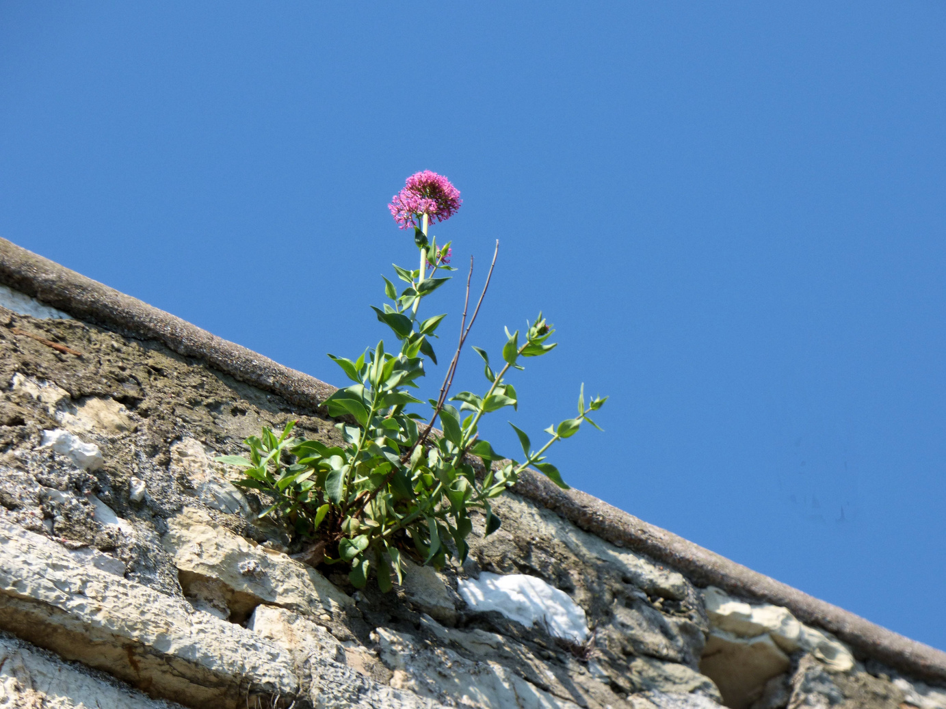
Activity B
Nature hunt!
Thinking about our class discussion, what examples of nature can you find in your playground?
Think about
Bigger plants and trees
Smaller, hidden examples of nature
Most unusual find wins!
ou
Notes:
Discuss how at the beginning of the story, the children see their tower block as grey and boring. But after their adventure, they realise that there is lots of nature and beauty where they live. They just have to look for it!
Take the class outside and ask them to search for examples of nature. Encourage children to find obvious examples e.g. flowerbeds, grass etc as well as hidden examples e.g. weeds growing in cracks of buildings, moss on rocks, minibeasts, birds perched on roofs etc. Use prompts from the class discussion to help. Most unusual find wins!
Ask the children what affect nature has on their school environment? Would it be as nice if there was no nature in their playground? What do they like about the nature they have seen?
Optional: Take clipboards or a camera with you to let the children record what they have found.

