Slide 1
What is….
Resilience
Notes:
Today we are going to be talking about something called Resilience.
Resilience is something that we all use all the time to help us when things get tricky, don’t go as we want them or for things we find difficult.
We are going to learn about what it is, why we need it and how we can build up our own resilience.

Slide 2
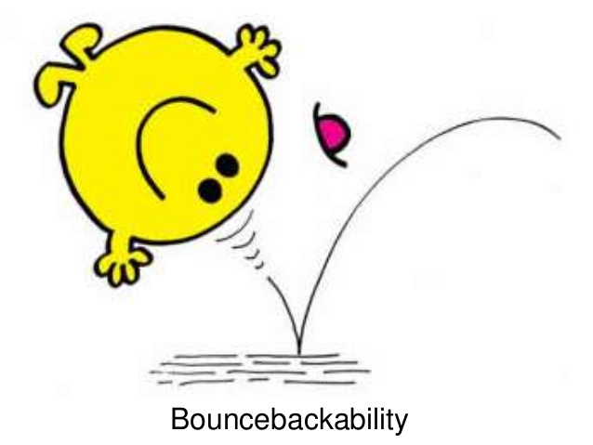
What is Resilience?
© Educational Psychology Team
Notes:
Does anybody have any ideas what Resilience is?
Brilliant – some really good ideas etc.
Resilience is how well we bounce back when something is difficult or goes wrong.
It is how we keep going when things get hard rather than giving up.
For example, if you are doing some tricky maths that you don’t understand it might be easy to give up and say ‘I can’t do that’ but with resilience you can keep trying, ask for help, try again and manage to finish your maths rather than giving up.
Or it could be when you are trying to learn a difficult football move. You are finding it difficult to do. Without resilience you may give up and say ‘I can’t do this, I’m not going to do it any more’. With resilience you keep going and practising until you can do the trick.

Slide 3
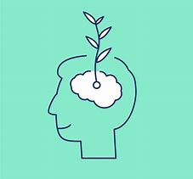
Resilience changes over time
© Educational Psychology Team
Notes:
Resilience is not something you either have or haven’t got. It changes over time and this means that we can do things to help us get more resilient. It may be that sometimes we feel less resilient but that doesn’t mean we will always feel that way. Building our resilience can take time but is something we can all do.

Slide 4
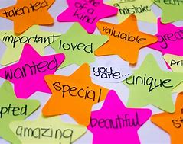
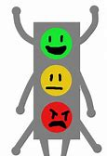
How to Build Resilience
© Educational Psychology Team
Notes:
There are three main things that help make us feel resilient and able to keep going when things get tough.
Our sense of self-esteem. This is how we good we feel about ourselves. This is valuing ourselves and looking after ourselves.
Supportive relationships with other people around us. For example, having friends who help us and look after us. Having a parent, grandparent, sister or brother or guardian at home who we can talk to and who takes care of us.
Knowing ourselves and being able to regulate our emotions. This means recognising when we are getting upset or angry and being able to do things to make us feel more calm and settled.

Slide 5
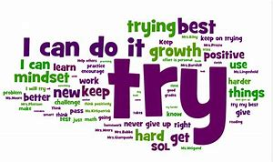
Growth Mindset
© Educational Psychology Team
Notes:
You may have heard about Growth Mindset in school already. It is a way of thinking that increases how confidently we approach tasks and helps us think about things in a useful way rather than in a way that will make us feel unhappy and give up.
Instead of thinking about the difficulties and how we can’t do something Growth Mindset suggests we think about things as challenges and look at these as opportunities for development.
Growth Mindset takes practise but is worth it.

Slide 6
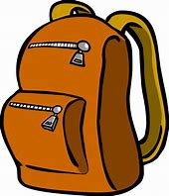
Resilience Rucksack
© Educational Psychology Team
Notes:
Growth mindset is a way of thinking and talking. There are other ways of helping us build our resilience.
Imagine you have rucksack and you can fill it with activities and ideas that can help you when you start to struggle or want to give up.
Any idea of things that may help you not give up and keep going when things get difficult?

Slide 7
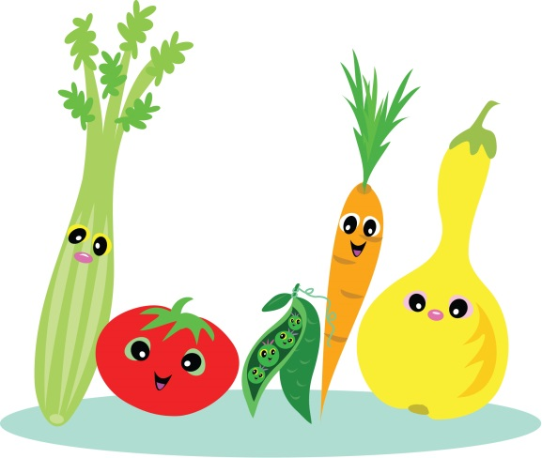
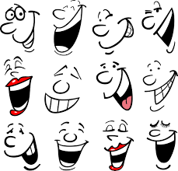
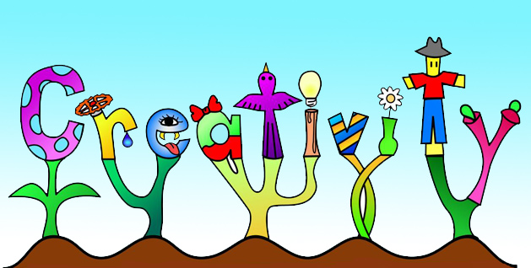
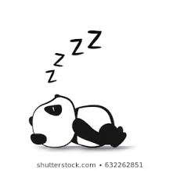
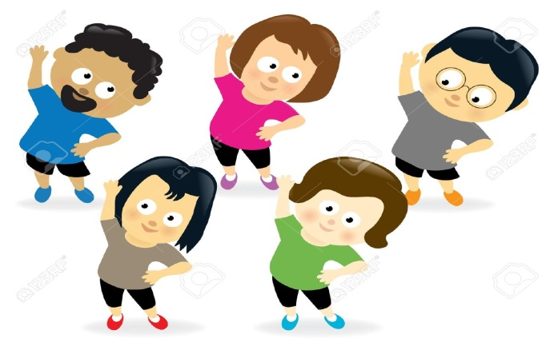
What to put in your Resilience Rucksack
© Educational Psychology Team
Notes:
Brilliant! Lots of good ideas there.
Different things work for different people but some ideas to put in your resilience ruck sack could be:
Someone you can talk to when you feel like giving up – friends or family.
Doing something creative you enjoy such as painting or drawing, making models.
Finding something that makes you laugh – laughing makes us more relaxed and positive about things and so builds our resilience.
Doing some exercise – particularly if it is something you enjoy like bouncing on a trampoline, dancing or playing football.
Making sure you are getting enough sleep.
Eating healthily - for example fruit and vegetables.
if your body is feeling happy and healthy this makes you have more resilience for all sorts of things.

Slide 8
What would you put in your Resilience Rucksack?
© Educational Psychology Team
Notes:
Thank you for listening today. Before we go have a think about some of the things that you could do to build your resilience, what you may put in your Resilience Rucksack and next time you think you need a bit of resilience they may be able to help you.

