Slide 1
?
What is…
Anxiety
?
?
© Educational Psychology Team
Notes:
The theme of today’s assembly is anxiety.
We are going to look at what anxiety is, think of ways we can understand it and learn about what is happening when we start to feel anxious or worried.
Then we are going to learn about how we can beat anxiety by ourselves and with the help of others that we trust.

Slide 2
Anxiety is…
© Educational Psychology Team
Notes:
Anxiety is a survival strategy that dates back to the pre-historic times. It is the brain and body’s built-in alarm system, designed to protect us.
In response to stress or danger, the body’s sympathetic nervous system releases adrenaline.
This prepares the body to fight back, run away or freeze.
Our ancestors were faced with very real threats to their safety, such as wild animals or hostile neighbours so this fight, flight or freeze response was essential to their survival.
Anyone can feel anxious, from mum to dad, teachers and celebrities. You will know lots of people that feel anxious, even if they don’t tell you or show you this. Can you think of anything that can make people feel anxious? (hands up and answers given)

Slide 3
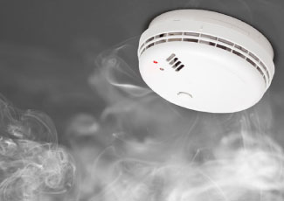
Understanding anxiety
© Educational Psychology Team
Notes:
A helpful way to think about feeling anxious can be to imagine the anxiety response like a smoke alarm.
The smoke alarm is designed to detect a house fire (a real physical threat) but it can also be triggered by someone burning the toast (not a physical threat). We cannot switch off our anxiety alarm, but we can learn to identify the level of threat and respond appropriately.
We might think of this as when most people watch a horror film they may experience a physiological response, such as tense muscles, sweaty palms, increased heart rate, but will not run screaming from the cinema. We know that nobody is going to jump out of the screen and get us. This is a great way of us seeing if we can control our anxiety response.

Slide 4
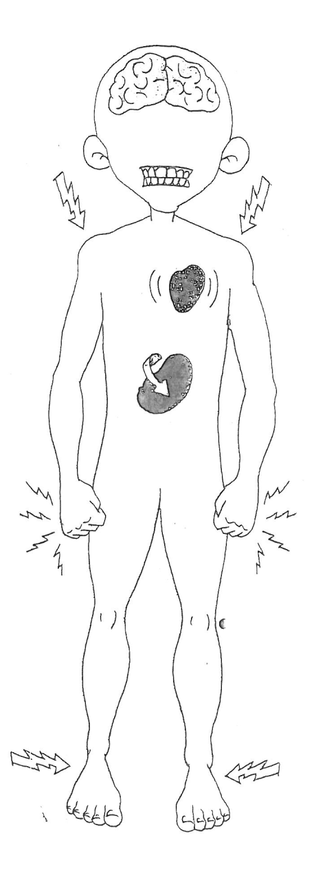
© Educational Psychology Team
Our bodies
Nausea
Sweating
Shallow breathing
Physical Appearance, such as changes to skin colour
Butterflies in your stomach
Dizziness
Increased heart rate
Dry mouth, sore eyes
Tense muscles
Notes:
Anxiety can also have a huge impact on our bodies, thoughts, feelings and behaviours.
Let’s have a look at what our bodies go through.
We might:
Sweat a lot
Feel sick
Our skin colour might look flushed or pale
We might start breathing very quickly
We might get butterflies in our stomachs
We might tense our muscles by clenching our fists
We might get a dry mouth and sore eyes
Feel dizzy and,
Our hearts might beat faster.

Slide 5
Our thoughts and feelings
“I’m never going to be able to do this”
Nervous
Excitement
Frightened
Scared
Extreme focussed thinking
Irritable and impatient
Circular and helpless thinking
Apparent slowing of time
© Educational Psychology Team
Notes:
It might also affect our thoughts and feelings.
We might feel nervous, frightened or scared
We might start thinking things such as “I’m never going to be able to do this”
We might not be able to stop thinking about what’s worrying us
We might feel irritable and cross with the people we love
We might even feel a bit excitable and not be able to control our emotions
Our thoughts might keep going round in circles and we think about everything that might go wrong and;
Things might feel as if they go on forever.

Slide 6
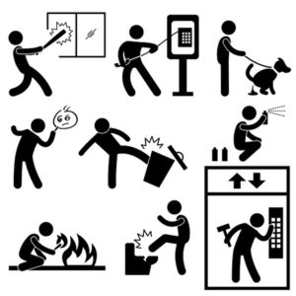
Our behaviour
Fight or flight response
Difficulties concentrating
“Shutting down”
Withdrawal
Appearing shaky or exhausted
Difficulties sleeping
Avoidant behaviours
Frozen
Sudden bursts of energy or speed
© Educational Psychology Team
Physical aggression
Notes:
It also affects our behaviour.
We might have the fight or flight response, like we talked about at the start of assembly
Our bodies might feel like they’re shutting down. This is when we feel like we can’t talk to anyone or maybe even struggle to move.
We might feel as if we have loads of energy and can run a marathon
Or we might be really tired
We might feel frozen,
We might find lessons really hard to concentrate in
We might struggle doing the things we normally enjoy
We might not be able to sleep
Sometimes, we might even hit out when our anxieties make us feel angry.
And we might also try hard to avoid seeing our friends or doing things. This might be so that others don’t see how you are feeling.
If you’re feeling anxious, you might experience very few or a lot of the things we have discussed. There is not one way to feel anxious and it will be different for everyone.

Slide 7
Helping ourselves when we feel anxious…
Talk to someone you trust
Learn to recognise what makes you feel anxious
Distract yourself by doing something you enjoy or that helps you feel calmer
What works for you might not work
for someone else…
© Educational Psychology Team
Notes:
Now we need to think about what we can do to help ourselves feel better when we experience anxiety. Anxiety is not a nice feeling and it is important to try and tackle it as soon we can.
Some things you may be able to try could be talking to someone you trust, learning to realise what makes you anxious or distracting yourself with calming and enjoyable activities.
Remember that what works for you might not work for your friends if they’re feeling anxious.
Now it’s time for all of you to get involved and learn some breathing techniques that might help you feel calmer when you start to feel anxious.

Slide 8
Breathing techniques
Start
© Educational Psychology Team
Notes:
Either look at the screen or picture a big square in your head.
Pick one of the corners of the square to start (point towards start)
What you now do is breathe in along one side for four seconds or, like we’re going to do, for four elephants. Once we’ve done this, we go along the next side but we breathe out for four elephants, and we just keep going.
So let’s start.
Take a nice long deep breath out. (allow a few seconds)
Now breathe in for one elephant, two elephant, three elephant, four elephant
Out for one elephant, two elephant, three elephant, four elephant
In for one elephant, two elephant, three elephant, four elephant
Out for one elephant, two elephant, three elephant, four elephant
(Continue for a few cycles)
Take a moment to ask yourselves how you’re feeling now?

Slide 9
What would you like to try..?
© Educational Psychology Team
Notes:
Remember, we all get anxious and that is completely normal.
So considering what we have learnt today, I want everyone to take a minute to think about something they have realised about themselves (such as what might make you feel anxious or how you show others you are anxious), or something that they want to go away and try (such as elephant breathing or talking to a trusted adult).
Thank you for listening today everyone.

