Slide 1
?
What is…
Anxiety
?
?
© Educational Psychology Team
Notes:
The theme of today’s assembly is anxiety.
We are going to look at what anxiety is, think of ways we can understand it and learn about what is happening when we start to feel anxious or worried.
Then we are going to learn about how we can beat anxiety by ourselves and with other adults and children that we trust.

Slide 2
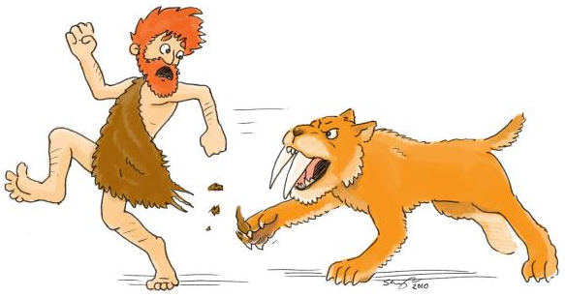
flight
or
© Educational Psychology Team
Notes:
Anxiety comes from all the way back in pre-historic times, where cavemen had to run away from danger, such as big cats like a sabre-toothed tiger.
If cavemen didn’t run away or fight back, they might get eaten by the sabre-toothed tiger!
If you were in this picture, like our caveman, how do you think you would feel? (Ask a few children and expand on flight/fright responses if given).
What we might do is either run away, like a caveman, fight the tiger or stay very still and quiet.
We might do similar things now when we start to feel anxious and worried.
Can anybody think or anything that might make them feel anxious or worried?

Slide 3
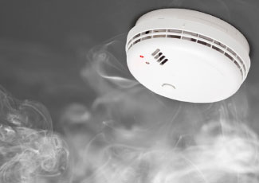
Feeling anxious
© Educational Psychology Team
Notes:
At times, our brains can get it wrong, and it sends out worried signals when we might not be in danger. We end up worrying about things that we can’t control, worrying more than we need to, or feel like things are worse than they are.
It’s a little bit like a smoke alarm. We have smoke alarms to let us know if there’s a fire, but sometimes, just like us, a smoke alarm can get it wrong, too. It can sometimes be set off when we make our toast in the morning. We know that’s not dangerous, but our smoke alarm doesn’t!
Although we can’t switch off our anxiety alarm, what we can do is learn to realise when it has been activated and deal with it in a safe way.
What we do need to remember is that everybody worries when find things difficult. It is completely normal as long as it doesn’t get too much for us.

Slide 4
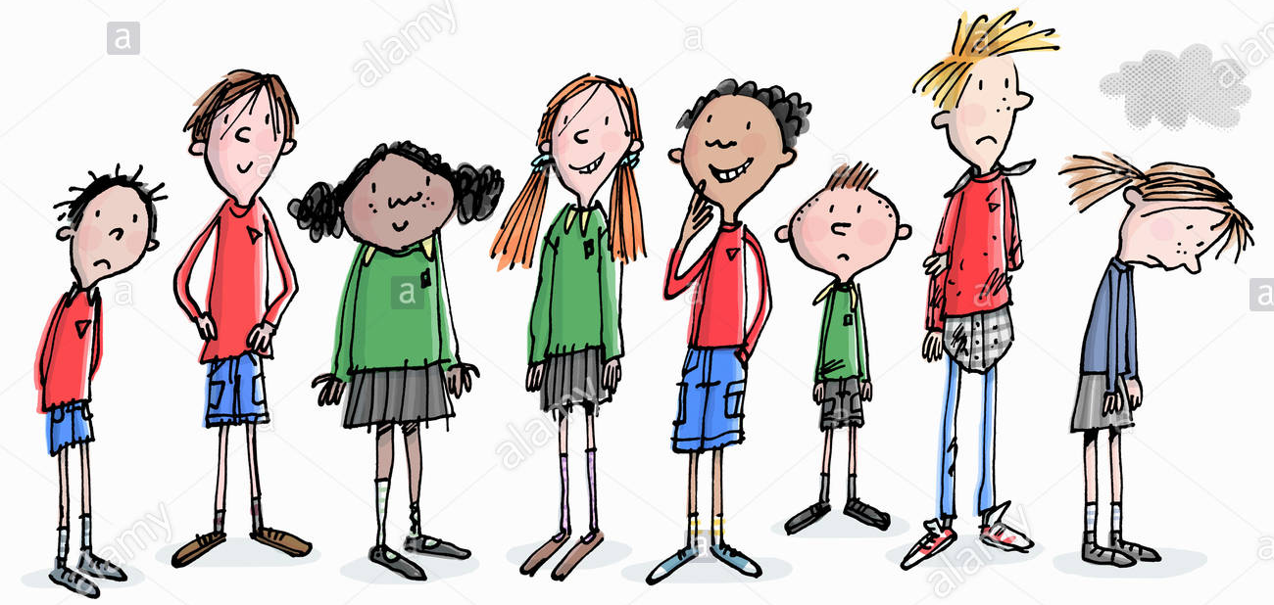
© Educational Psychology Team
I don’t want to do this
Notes:
Let’s have a think now about what happens to our bodies and our thoughts when we get anxious or worried.
Have a chat to the person next to you and think of three ideas in your pairs.
It can make our tummies ache or feel as if we have butterflies.
It can give us headaches.
It can make our hearts beat very fast.
It can make us feel sick or sweaty.
Or it could make us feel really hungry or not hungry at all.
This might make us feel sad, like some of the children up here.
We can also think about what worries us and not want to do the things we love.
Everybody is different. Some of us might feel all of these things or just a few.
It is important for us to learn what makes us feel worried and what our bodies feel like to help us look after ourselves.

Slide 5
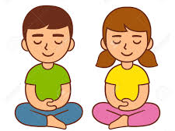
Talk to an adult
Think about a happy memory
Do something you enjoy
Sit in a calming place or do a calming activity
© Educational Psychology Team
Notes:
What we really don’t want is our worries to feel as if they are too much. We need to think of some ways that we can help ourselves to feel calmer and happier.
Can anyone tell me something that always makes you feel happy?
If we feel a little bit stuck on what we can do when we feel worried or anxious, some of these things might help you.
Things that you can do when you feel anxious or worried could be talking to an adult that you trust, thinking back to a happy memory, doing something that you really, really like, sitting in a calm and quiet place or doing a calming activity, like colouring.
If you can’t think of a calming activity, we’re going to practice one right now. Its called the pizza massage!

Slide 6
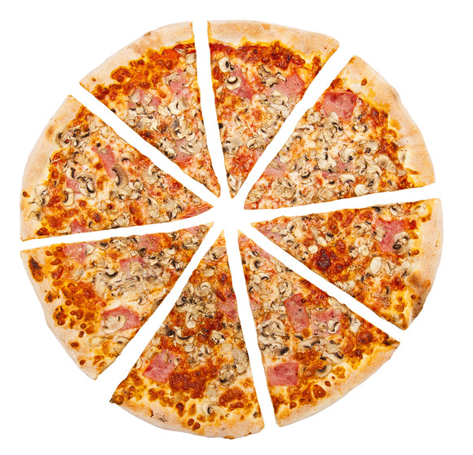
© Educational Psychology Team
Notes:
You can do the pizza massage on your own hands, on your knees or on a friend’s back, but remember to ask for their permission first!
Our first step is to roll out the dough (action: mimic smoothing out actions)
Then we put on our sauce (action: smoothing action in a consistent, slow circular motion)
Then we put on our cheese (action: gentle flicking actions)
Then we put on our toppings (action: pressing actions with fingers and palms)
Then we put the pizza in the oven (action: warm up hands by rubbing together then place on partner’s pack or own legs)
Finally, we cut our pizza up (action: mimic gently slicing a pizza on partner’s back or on own legs/hand)

Slide 7
What would you like to try..?
© Educational Psychology Team
Notes:
Remember, we all get anxious and that is completely normal.
So thinking about what we have learnt today, tell your partner one thing that helps you feel calm or one thing that you might be able to try to help you feel calmer.
Thank you for listening today everyone.

