Slide 1
Sensory Service:
Deaf and Hearing Impaired Children
Support Team for Deaf Children

Slide 2
Who we support
The Support Team for Deaf Children support children with a permanent, aidable hearing loss
age 0 to 19 i.e. from when the deafness is confirmed until the child leaves school
We support young people if they stay on in 6th Form but we don’t support in further education colleges

Slide 3
Referrals to the Service
Referrals can come from:
Local health trusts mainly Bradford and Airedale
Following Newborn Hearing Screen – babies usually under 3 months of age
Children are referred later: new to district, progressive loss
We can also receive referrals directly from schools or parents – We can work with families to support getting a diagnosis from Health
Notes:
NHSP since 2002 in Bradford – a national programme brought in because the importance of issuing hearing aids early acknowledged to improve educational outcomes and life chances in general

Slide 4
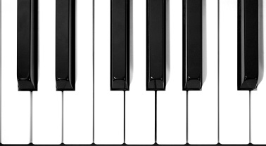
The Audiogram
The loudness of the sound is measured in dBHL. Sounds are turned up until the child is able to hear them. The louder the sound, the lower down the audiogram it appears. The pictures give an indication of where the different sounds would appear.
125
250
500
1000
2000
4000
8000
The pitch or frequency of the sound is measured in Hertz (HZ) and is shown with the low frequency sounds on the left and high frequency sounds on the right
-20
-20
0
0
dBHL
20
20
40
40
70
70
Hz
95
95
120
120
125
250
500
1000
2000
4000
8000

Slide 5
Degrees of Deafness
-20
No hearing loss
Children’s hearing is tested at around five different frequencies ranging from 250Hz to 8000Hz. The amount the sounds need to be turned up in order to hear them at each frequency is averaged and this gives the degree of deafness.
0
20
Mild
40
Moderate
70
Severe
95
Profound
120

Slide 6
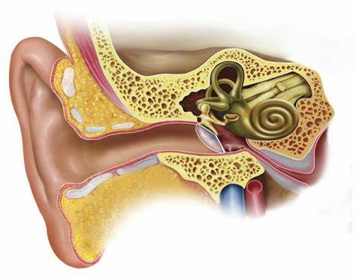
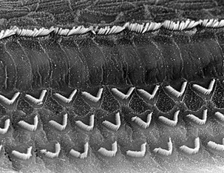
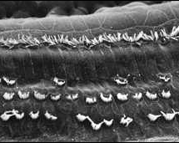
Types of Deafness
Conductive
Sensori-Neural
Affects cochlea (the organ of hearing) and/or auditory nerve
A permanent loss
Can cause a mild to profound hearing loss
Can be temporary, fluctuating or permanent
This includes Glue Ear which is very common and affects 80% of young children
Usually resolve by age 8 years old.

Slide 7
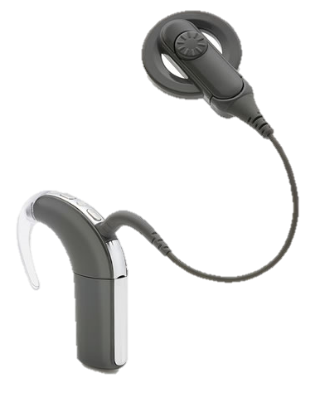
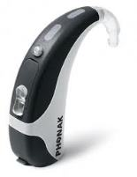
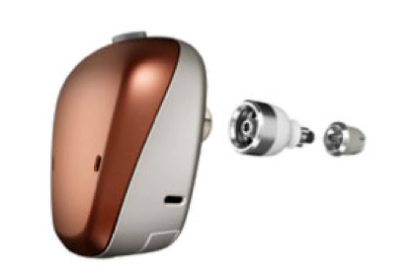
Hearing aids, BAHA and cochlear implants
Depending on the type and degree of a child’s hearing loss, one of these hearing devices could be issued by the hospital in order to help them with their hearing.

Slide 8
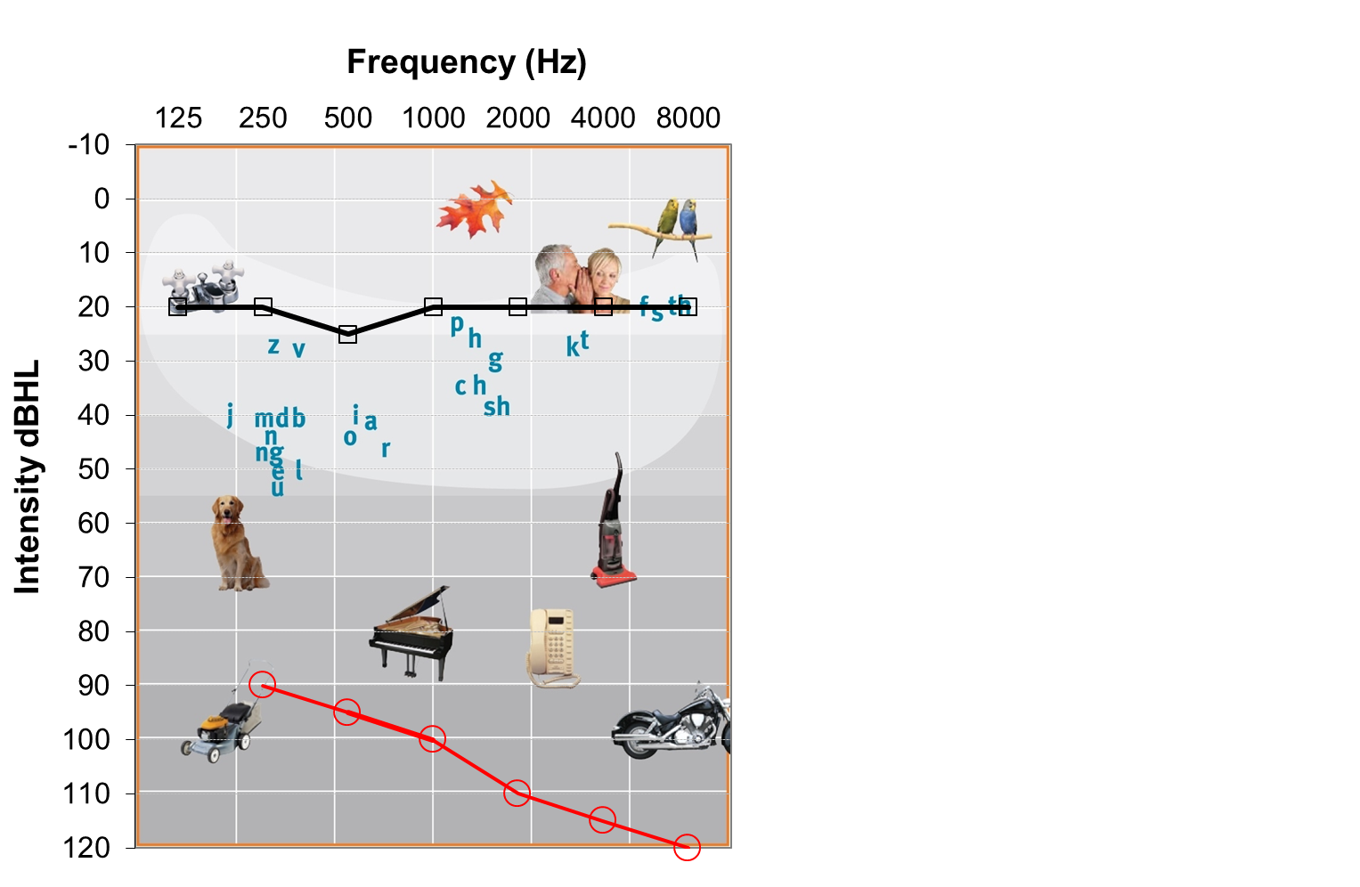
Hearing aids
Cochlear implants
These audiograms show the different way hearing aids and cochlear implants work.
Cochlear implants work in a different way and provide electrical signals to the cochlea. They can give children with a profound loss access to some very quiet sounds.
The red lines show the child’s hearing loss without amplification
The black line is an estimation of what they can hear with their hearing device.
Hearing aids add different amounts of amplification depending on the hearing loss at different frequencies.
Children can hear sounds below the line but sounds which appear above the line are too quiet to hear.
Depending on their degree of loss there can be some speech sounds which are too quiet to hear even when wearing hearing aids

Slide 9
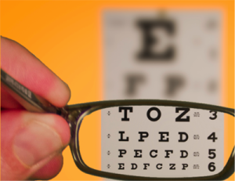
Hearing Aids vs Glasses
Hearing devices do not work in the same way as glasses.
When listening through a hearing aid or cochlear implant the signal is not crisp and clear and children still rely on a range of cues to help them understand

Slide 10
Determining the level of support
Eligibility Criteria
The Matrix of Need identifies reasonable expectation about what should be in place for CYP with a hearing loss. It indicates the Local Authority’s and school’s responsibilities and suggested support levels for Deaf CYP.
The NatSIP Eligibility Criteria is an assessment tool the Support Team for Deaf Children use to determine the amount of support a Deaf child receives from our Team.

Slide 11
The Graduated Approach
Hearing and radio aids
Daily checking of hearing aids and other technology
SEMH
Promote and support peer interactions
Quality First Teaching
As layed out in the Matrix of Need there is a graduated approach to the amount of support a CYP will need in school or nursery.
A Teacher of the Deaf will assess the CYP and provide training and support to the school or nursery to ensure they are able to meet those needs.
Click to see some of the interventions which may be required depending on need.
Pre and Post teaching
Explanation,
Clarification and
Reinforcement of lesson content and language
Assessment
Ongoing through open questioning
Modification to the presentation of assessments
Additional adult Support
Sign language or other communication modes.
Highly Individualised Curriculum
Designed to meet the specific needs of the individual CYP
Lesson delivery
Paraphrase student responses
Repetition
Break up listening periods
Reduce background noise
Give thinking time
Use accessible text
Position and seating
Use visual prompts
Display key words
EHCP+

Slide 12
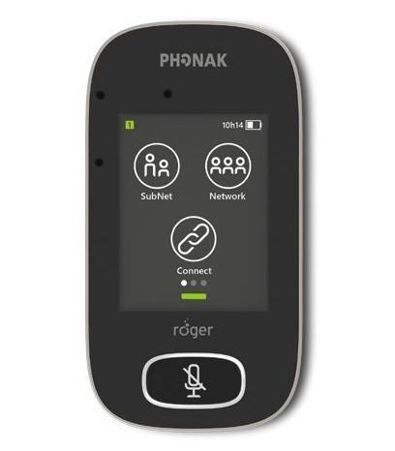
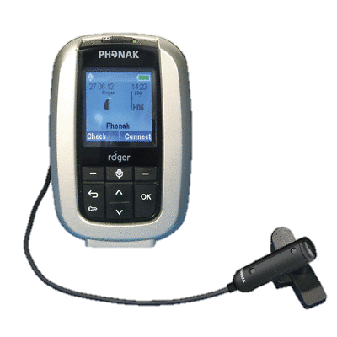
Radio Aids
Radio Aids help CYP who struggle to hear in noisy environments or at distance. They pick up a clear signal from the teacher’s voice and send it straight to the CYP’s hearing aids.
A Teacher of the Deaf will assess all CYP on caseload to see if they meet criteria and will benefit from a Radio Aid

Slide 13
Quality First Teaching
We would recommend the following strategies which benefit all children but are particularly helpful for CYP with a hearing loss and form part of quality first teaching.
Planning lessons
Delivering Lessons
Make Word/Picture walls with key vocab Refer to these as you use the language. | Plan short listening periods Intersperse with individual/group activities.
Keep presentations simple Lots of pictures, keywords, demonstrations and repetition. Use bullet points not blocks of text. | Always start with the visual material Have pictures and information visible whilst explaining them.
Sit hearing impaired students near the front with a clear view of the teacher. They also need to see the other pupils. | Stand still and face the student so they can lip-read Use facial expression/body language. Don’t stand in front of windows.
Give thinking time | Keep background noise down.
Paraphrase what the other pupils say. This gives access to other pupils and repetition | Check that a task has been understood Before the child begins ask ‘What do you have to do?’
Get the pupil’s attention Make eye contact before speaking. | Recap main points at the end Ask the child to show they have understood

