Slide 1
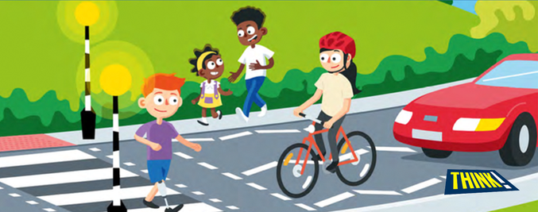

Key Stage 2
Road Safety

Slide 2
Around 200 children are hurt on the roads in Bradford every year!
The three main ways are:
As a pedestrian – hit by a car
As a car passenger
As a cyclist
Notes:
200 children – give the children an idea of how many this is – more that 6 classes of children.
Can they think of the different ways people can be hurt on the road?
Highest number is often as pedestrians, followed by in cars.
This session concentrates on keeping safe as pedestrians.

Slide 3
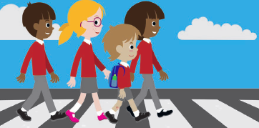
Who knows how to cross the road safely?
Notes:
Explain that today they are going to be thinking about road safety and how they can keep themselves safe as pedestrians. Check they know what a pedestrian is.
Ask for a show of hands – who knows how to cross safely? Hopefully most of them will put their hand up. Considering most of them already know how to cross the road, you are going to test their knowledge by doing a quiz.

Slide 4
Quiz Time!
Two teams – think of a team name each
First hand up gets first chance to answer – if the answer given is wrong, the question will be passed to the other team
1 point awarded for each correct answer
The team with the most points at the end wins
Rules:
Shouting out or putting your hand up before the question has been asked will result in the other team having first chance to answer
Please have an answer ready before putting up your hand
Notes:
Split the class down the middle into two teams – they might like to pick team names. Keep score on the board.

Slide 5
1. Can you name ONE rule we need to use to cross the road safely?
What is the set of rules called
that we use to cross the road?
The Green Cross Code
Notes:
Any of the following wins a point – Find a safer place to cross, Stop, Look, Listen or Think. There could be others such as; do not run, or do not use your mobile phone while crossing that you choose to accept (use your own judgement).
The Green Cross Code

Slide 6
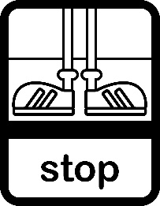


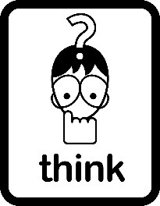
The Green Cross Code
Find a safer place
Stop on the pavement behind the kerb
Look all around for traffic
Listen for traffic. Sometimes you can
hear traffic before you see it
Think is it safe to cross the road?
Arrive Alive
Keep Looking, Listening and Thinking while you cross – do not run!
Notes:
A safer place is a pedestrian crossing – you can see these on the following slide. If there is no pedestrian crossing available, then a safer place is where you can see in all directions away from bends and parked cars.
It is important we always remember to use the Green Cross Code every time we cross the road – even on quiet roads.
Ask the children to say the words of the Green Cross Code altogether to help them remember it.

Slide 7
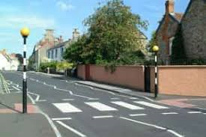
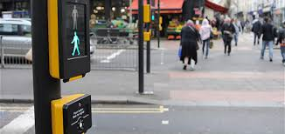
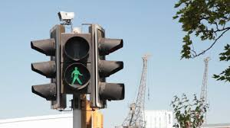
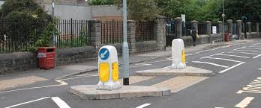
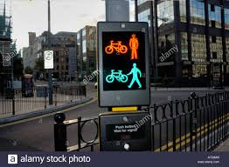
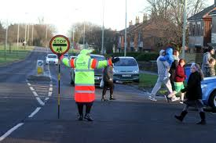
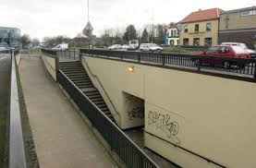
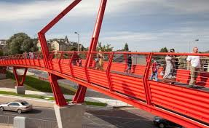
Can you name the safer places to cross the road?
(1 point for each correct answer)
Notes:
Ask the children the name and to briefly explain how to use each crossing.
Zebra Crossing – wait on the pavement behind the kerb until the traffic has stopped on both sides before crossing.
Puffin Crossing – press the button & wait for the lights to change and the green man to light up on the box where the button is. Check that the traffic has stopped on both sides before crossing (this is important as cars often go through red lights).
Pelican Crossing – works in the same way as the Puffin. The difference between a Puffin and Pelican Crossing is that the red & green man are high up at the other side of the road on a Pelican Crossing and on a Puffin they are displayed with the button (see photo). The Pelican Crossing works on a timer, whereas the Puffin Crossing has sensors, so the lights will only change when the pedestrian has reached the other side.
Toucan Crossing – for pedestrians & cyclists (‘two can cross’). Works in the same way as the Puffin Crossing.
Traffic Island – splits the road into two. The pedestrian crosses one road & stops in the middle & then repeats the Green Cross Code before crossing the next.
School Crossing Patrol or Lollipop Person – found outside schools. They stop the traffic to make it safe to cross. Always wait until they have signalled for you to go before setting off & always cross in front of them, not behind.
Foot bridge – goes over busy roads
Subway – found under busy roads. These are dark places and are not safe to use without an adult.

Slide 8

3. How might this cause you to be hit by a car?
It is a distraction
4. When you are crossing the road, what do you need to keep doing?
Keep looking all around, Listening and Thinking
Notes:
3. Mobile phones are a big cause of road accidents. Put your phones away when crossing the road and give the road your full attention.

Slide 9
5. You’re playing football and your ball rolls into a busy road. What should you do?
Ask an adult to get it for you or use the Green Cross Code to get it safely
Notes:
5. Do not stop the traffic to get the ball or crawl under any parked vehicles to get it. A ball is not worth risking your life! If you can’t get it safely then leave it.

Slide 10

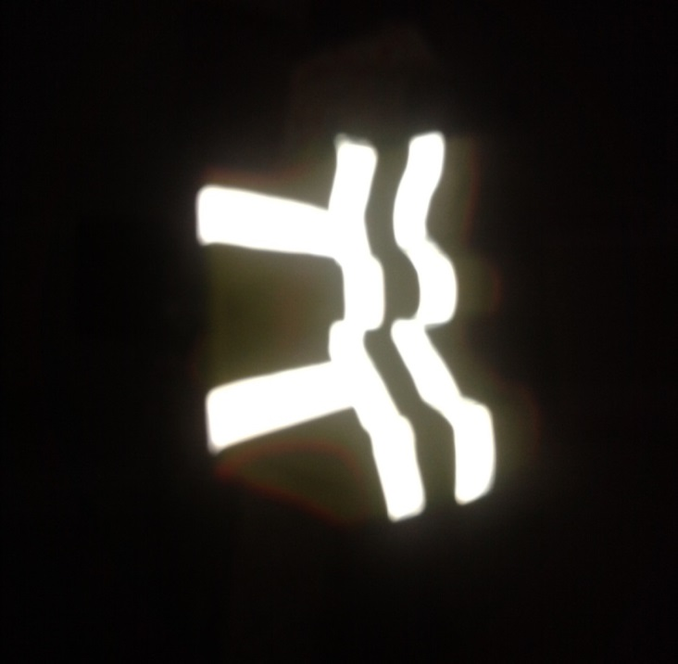
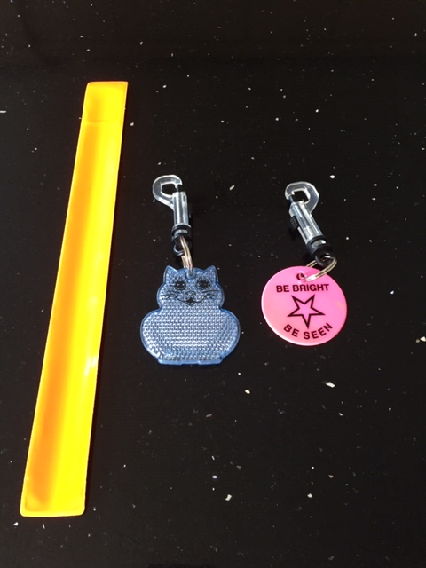
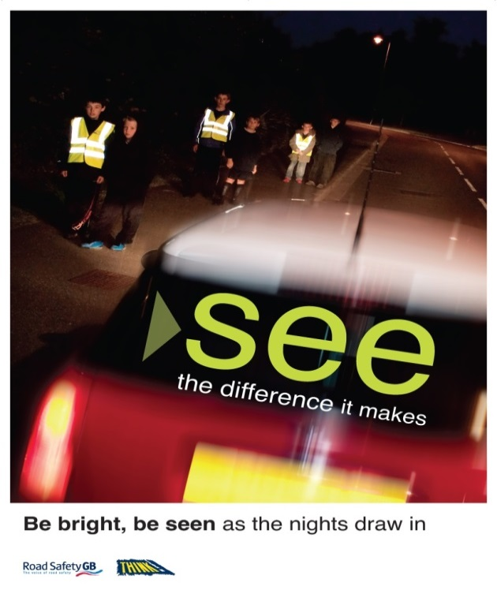
6. What do we call materials which help you to be seen by traffic at night?
Reflective
Be Bright Be Seen!
Notes:
6. It is important that children understand it can be difficult to be seen by drivers when it is dark or in bad weather. Wearing something bright or fluorescent and reflective helps them to be seen. This could be a waistcoat, or an arm band or key ring. Sometimes our coats, bags & shoes have a reflective strip. Please show any examples you have. It is particularly important to wear something fluorescent & reflective when the clocks go back in October. They might be making journeys to/from after school clubs or the mosque.
Fluorescent – for daytime – fluorescent colours are yellow, orange, green, pink.
Reflective – for the dark

Slide 11
Your friends choose to cross the road between parked cars instead of walking to the Puffin Crossing.
What should you do?
Walk to the Puffin Crossing where it is safer and encourage your friends to go with you.
Notes:
7. One of the main reasons children are hit by cars is crossing between parked vehicles – it means that they can’t see the road clearly & the drivers can’t see them.
It is important to think for themselves when crossing the road and not just follow others. If you don’t think it is safe then do not risk it. It is sometimes difficult to do something different to our friends, but it is ok to say no to them, especially when our safety is at risk. Your friends might decide to follow you when they see you doing the right thing. Set a good example.

Slide 12
8. The road is not a safe place to play. Where is a safe place to play outside?
Gardens, parks, playgrounds
9. What should you do with your phone & other devices when crossing the road?
Put them in your pocket or bag
Notes:
8. Many children suggest the pavement – this is safer than the road, but not the safest place to play. Beware of ball rolling into the road – remember not to run out after it.
9. Many people are hit by cars because they are using their phone and not paying attention to the road. Don’t be distracted.
Take headphones out before crossing. You need to be able to hear traffic coming as well as see it. Some vehicles we hear before we see, e.g. motorbikes & emergency vehicles. Some vehicles are very quiet like electric cars and cyclists, so we need to be looking more.

Slide 13
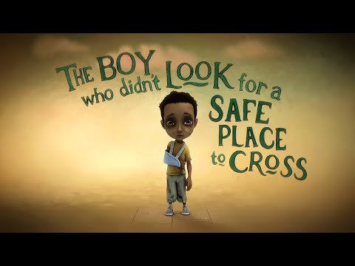
Now watch the film clip
10. Why did the boy get hit by the car?
Notes:
‘Stop, Look, Listen’ film click - To open video – right click on the link and click on ‘open hyperlink’.

Slide 14

The End of the Quiz!
Let’s add up the scores….
Notes:
Add up the scores. There is a tie-breaker question on the next slide if needed

Slide 15
Tie Breaker Question
Which one of these is not a pedestrian crossing?
A. Pegasus
B. Toucan
C. Griffin
Griffin
Notes:
C. Griffin is not a crossing.
Pegasus Crossing is for pedestrians and horse riders (the button is high up!)
Toucan Crossing is for pedestrians and cyclists

Slide 16
Find a safer place
Stop
Look
Listen
Think
Arrive Alive!
Notes:
End the session by recapping the Green Cross Code altogether.
Important that they remember to concentrate when they are outside. It is very easy to be distracted. Some of them will be starting to make journeys on their own now – perhaps with friends – without an adult. This is when accidents start to happen. In fact, the number of children hit by cars peaks between age 10-12. Year 5 are just heading into that age group.

