Slide 1
Bradford Road Safety Team
Charlie’s Accident
Helping you to be safer pedestrians
Notes:
Introduce yourself and explain that you are going to be talking about road safety.
Q. Who thinks they know a lot about road safety?
OK, I'm going to test your knowledge with 3 multiple choice questions. Ask them to think for themselves and not copy their friends.

Slide 2
Q. Before crossing the road, you must….
A) Look and listen
B) Find a safer place, stop, look, listen and think
C) Check what your friends are doing and copy them
Notes:
Answer:
B) Find a safer place, Stop, Look, Listen, Think
Does anyone know what this ‘set of rules’ is called? (The Green Cross Code)
It is important to think for themselves when crossing the road and not just follow the crowd - their friends may not be making the safest choices.

Slide 3
If a child runs out in front of a car travelling at 30mph, how many metres would it take that driver to stop?
*Remember it takes the driver time to react and to press the brake before the car stops
A) 2 metres
B) 12 metres
C) 23 metres
Q.
Notes:
Answer:
C) 23 metres
To give the children an idea of how far this is you could roughly guess the length of the classroom, 23 meters could be double the length of the classroom. Or nearly a full length of a swimming pool.
Explain that it is important to remember this when crossing the road and if they don’t think they have enough time to cross safely then not to take the risk. The driver may not be able to stop their car for them in time.

Slide 4
Q. Which age group is more at risk of getting hit by vehicle?
A) 0-4 year olds
B) 5-7 year olds
C) 10-12 year olds
Notes:
Answer:
C) 10-12
Ask if they have any ideas why this might be?
-Travelling to a new school, often without an adult for the first time. Secondary school is usually further away and could involve an unfamiliar route & busy roads
-Being distracted by friends or showing off to new friends
-Taking risks - thinking it won’t happen to you
-Distracted by mobile phones or listening to music with headphones in.

Slide 5
Notes:
Given the answer to the last question and that this is their age group, explain that it is important that we take some time to think about road safety, so that they don’t end up being one of the children hurt on the road.
Explain that they are going to hear about an accident that happened to a boy their age, this is the emergency call that was made immediately after the accident.
(Click on the sound icon to hear the emergency call).
Ask what they think has happened?

Slide 6
Notes:
Slides 6 – 14 tell the story leading up to the accident
Charlie’s Accident – the story
To read aloud:
This is based on a true story.
Charlie was 10 - nearly 11 when the accident happened. He had been asking his Mum for weeks now to let him go into town with his friend Ben. His Mum had always said no – she felt he was still too young. Charlie kept asking though and eventually his Mum said yes. He arranged to meet Ben on Saturday morning to catch the 9 o’clock bus into town.
Charlie set his alarm for 7, but he really didn’t like getting up early, especially on a weekend, so when his alarm went off he pressed the snooze button, turned over and went back to sleep!
After a while, his mum realised he still hadn’t got up and called upstairs – “Charlie, are you getting up? You’ll be late meeting Ben!”
Eventually he climbed out of bed….
Click for next slide

Slide 7
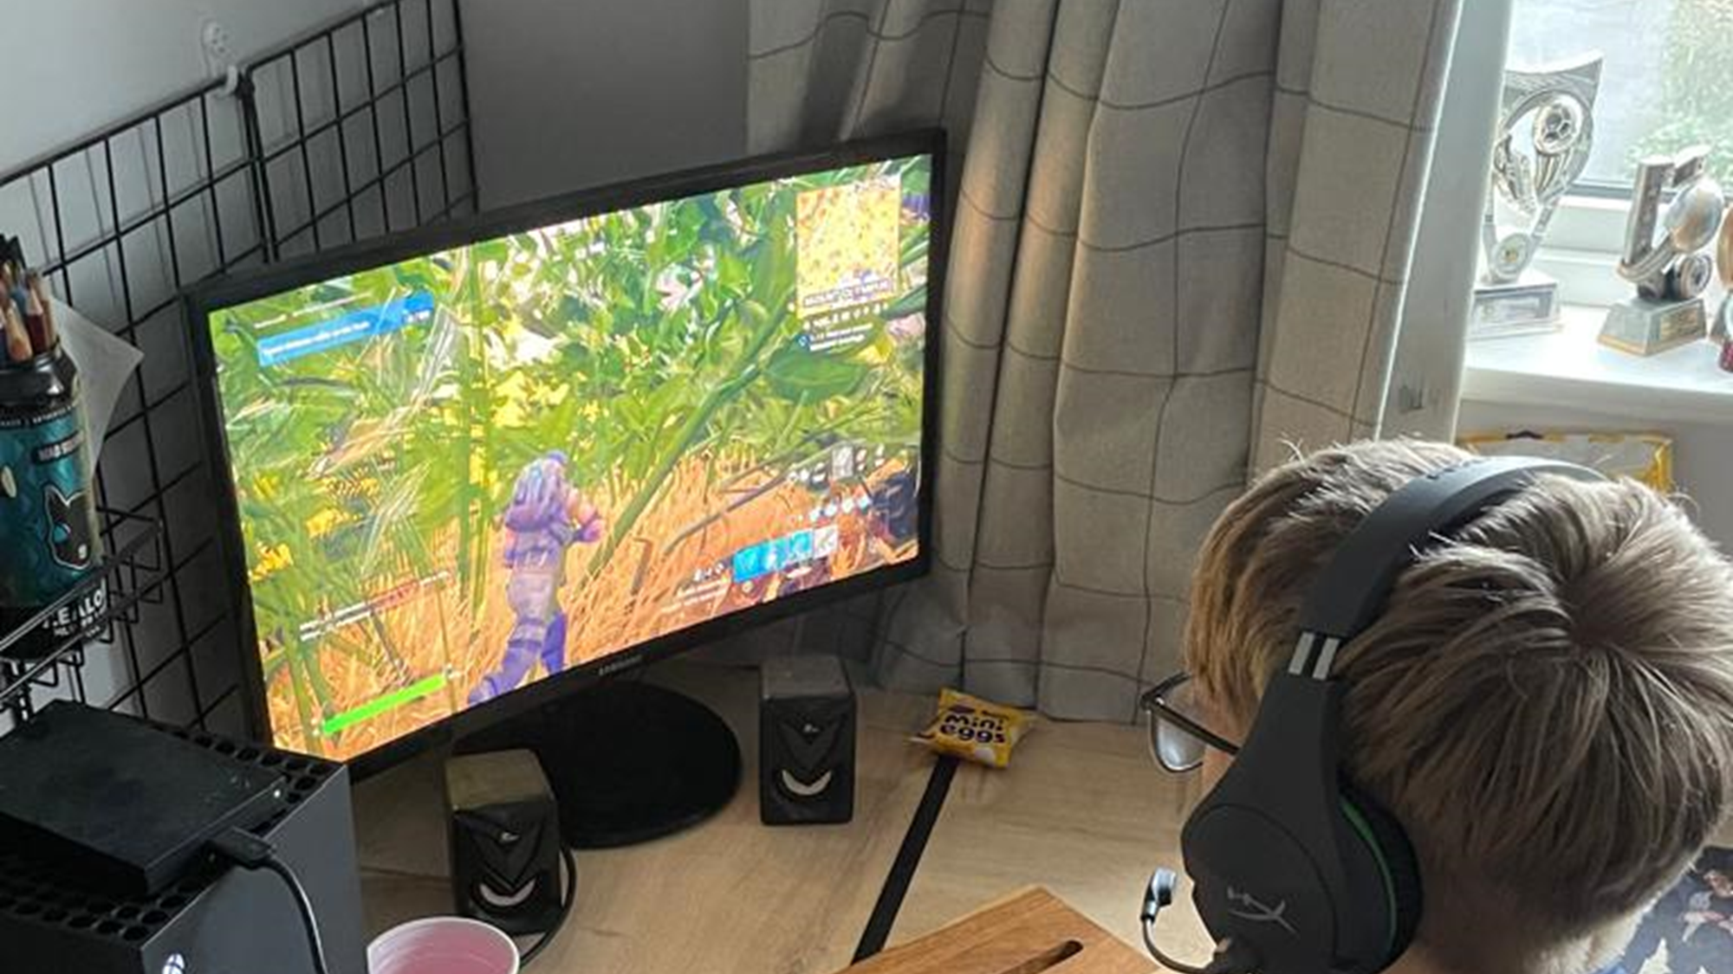
Notes:
But then he noticed his X Box in the corner of his room and thought, I’ll just have a few minutes on my new game - is it possible to have just a few minutes on a game?
A few minutes turned into a lot longer and by now he was running late!
He finally turned his X Box off and threw on yesterday’s clothes…
Click for next slide

Slide 8
Notes:
He ran downstairs…
Click for next slide

Slide 9
Notes:
…grabbed a packet of crisps because he didn’t have time for breakfast…
click for next slide

Slide 10
Notes:
…picked up his mobile phone and ran out of the door calling, “bye mum!”
Click for next slide

Slide 11
Notes:
As he was running to the bus stop, his phone beeped, it was a message from Ben wondering where he was.
(How does Ben sound from his message?)
Click for next slide…

Slide 12
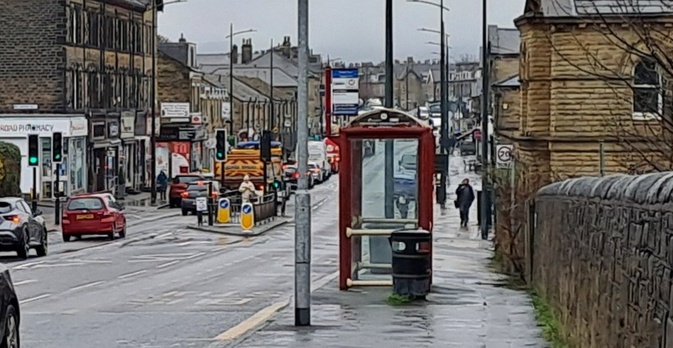
Notes:
Just then, Ben, who had been waiting at the bus stop for some time, spotted Charlie at the opposite side of the road. Charlie was looking down at his phone.
Q. What do you think Ben did to get his attention?
A. He shouted; “COME ON CHARLIE, OVER HERE!”
Q. And what do you think Charlie did then?
A. He ran into the road.
Click for next slide…

Slide 13
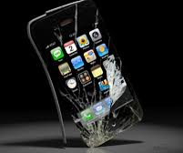
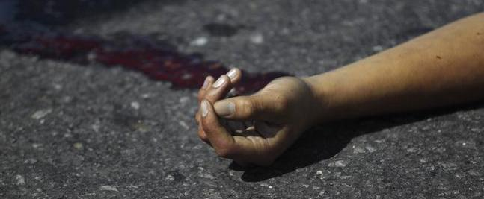

Slide 14
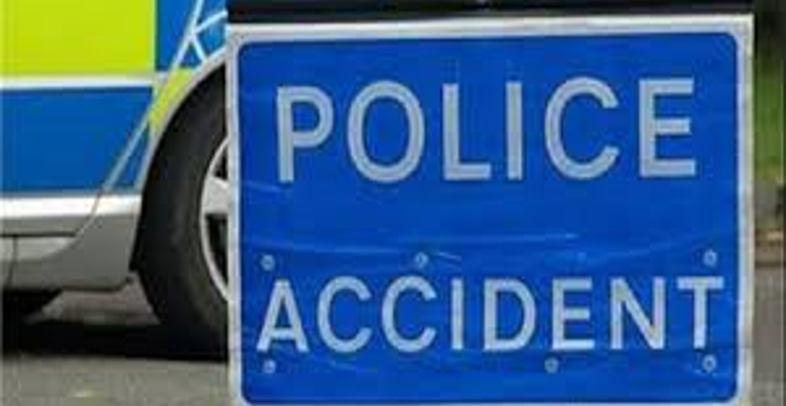
Notes:
Charlie was hit by a car. The driver did not stop in time.
And that was how Charlie’s accident happened. Just one mistake and his life has changed forever.
Click for next slide…

Slide 15
Drivers statement
Bens statement
Notes:
Charlie was severely affected by this accident, but he was not the only one. There were two other people in the story who saw the accident and would have been affected– who are they? (The driver & Ben).
Q. Does anyone think that the driver is to blame? Ask those with their hand up why they think it could be the driver’s fault.
Discuss the driver briefly –
Q. What kind of things could the driver have been doing to cause an accident?
A. speeding, drinking, distracted by people in the car, using a mobile phone.
However, the driver in this story was found not to have been doing any of these things. In this case, like in many cases, it was NOT the driver’s fault.
Q. So why didn’t he stop in time?
A. He couldn’t! Remind them how long it takes for a driver to stop a car at 30mph – 23 metres.
Q. How do you think the driver feels?
Play driver’s statement
Q. Is Ben responsible? (take answers)
Q. What should you do if you witness an accident like this happen?
Call 999.
Q. What information do you need to give?
Location – address or landmark & explain what has happened.
Q. Should you go into the run to see if he is ok?
A. No - you could get hit too. It is important to keep yourself safe. You may prefer to ask an adult to make the call - like Ben did (it was an adult who made the emergency call at the beginning).
Q. How do you think Ben felt seeing this happen to his friend?
Play Ben’s Statement
Charlie
Explain that we haven’t got a statement from him – why do you think that might be? (Injuries are too severe – refer to driver’s statement – ‘his head hit my windscreen’).
- If appropriate and you feel the audience need to hear the full extent of his injuries;-
Charlie cannot walk or talk now. He needs help with a lot things like getting dressed, eating and using the bathroom (things we all take for granted).
Q. Can you think of anyone else who would be affected by this accident?
A. Charlie’s family, friends, teachers, witnesses who saw the accident happen, emergency services…

Slide 16
Can you think of any rules to help keep you safe on the road?
Notes:
Allow answers if time then click on to the next slide to discuss.

Slide 17
How can I keep myself safe when crossing the road?
Use the Green Cross Code
Put phones & headphones away while crossing
Don’t take risks & Don’t rush
Think for yourself – don’t just follow the crowd
Be Bright Be Seen!
Plan your journey before hand
Cross at a safer place
Don’t be distracted or distract others
Notes:
It is important to think about how they can keep themselves safe, so an accident like this doesn’t happen to them (ideas could be written on the board or large sheet of paper if time).
Need to cover:-
Green cross code – Find a Safer Place, Stop, Look, Listen, Think
Safer places (see next slide info)
Peer pressure / copying friends – Sometimes when we are with our friends we do things we would never consider doing if we were on our own. Think for yourselves and do the right thing.
Mobile phones – put them in your pocket / bag while crossing road and give the road your full attention. Phones are very useful, but are one of the main causes of road accidents to children your age.
Headphones – take them out before you cross the road. You need to hear the traffic as well as see it. Sometimes we can hear vehicles coming before we see them, but not if we have headphones in!
Planning journey – set off in plenty of time, don’t leave it to the last minute (like Charlie did). Rushing leads to us taking risks and making mistakes. Discuss the route you will take to secondary school with your parents and practise it in the holidays. Don’t leave it until the day you start – you will have lots on your mind that morning.
Be Bright Be Seen – make yourself visible to drivers by wearing something bright/fluorescent & reflective especially from October when the clocks go back.
Don’t be distracted or distract others near the road – stop the conversation when you reach the road and give it your full attention. Keep yourself and your friends safe.
Taking risks – if you’re not sure it is safe then don’t risk it! Accidents happen when we take dangerous risks.
Remember actions have consequences!

Slide 18
Notes:
Can you name any of the safer places to cross?
Zebra Crossing – drivers should stop to let you cross, but don’t always! Make sure vehicles have stopped on both sides before crossing
Traffic Island
School Crossing Patrol (or Lollipop Person)
Puffin Crossing – the red & green men are with the button and the crossing operates on a smart sensor which detects when people are crossing
Toucan Crossing – cyclists can ride their bike across this crossing. Toucan meaning ”two can” cross together referring to pedestrians and cyclists
Pelican Crossing – the red & green men are at the opposite side of the road to the button and the crossing operates on a timer not a sensor
Subway – should only be used accompanied by an adult
Footbridge
Can you name any of the safer places to cross?
Zebra Crossing – drivers should stop to let you cross, but don’t always! Make sure vehicles have stopped on both sides before crossing
Traffic Island
School Crossing Patrol (or Lollipop Person)
Puffin Crossing – the red & green men are with the button and the crossing operates on a smart sensor which detects when people are crossing
Toucan Crossing – cyclists can ride their bike across this crossing. Toucan meaning ”two can” cross together referring to pedestrians and cyclists
Pelican Crossing – the red & green men are at the opposite side of the road to the button and the crossing operates on a timer not a sensor
Subway – should only be used accompanied by an adult
Footbridge

Slide 19
Notes:
Exercise 1- 60 seconds
All stand up in front of your desk, time a minute (count to 60 in your head) and then sit down.
I’m going to do it too (if there is a seat available sit down after 30 seconds).
Make observations, did they look at their teacher, look at each other etc. – but don’t say anything.
Wait until about 1 min 10 seconds or when everyone has sat down.
Q. Why do you think I did that?
Q. What has that got to do with Road Safety?
Who looked around? Who was influenced by other people?
This is what happens on the road and in lots of other situations in life. It is really important that when you are out you don’t just copy your friends and follow the crowd, as they might not be making the safest choices. Make sure you think for yourselves and look after yourselves.

Slide 20
Did you know..
Around 200 children are involved in a road traffic accident in Bradford every year.
Who is the best person to keep you safe?
YOU!
STAY SAFE!
Notes:
200 children -the impact of this, for example, is over 6 full classes of children per year!
Finish with who is the best person to keep them safe – themselves! By being sensible and prepared and remembering all we have discussed today.

