Slide 1
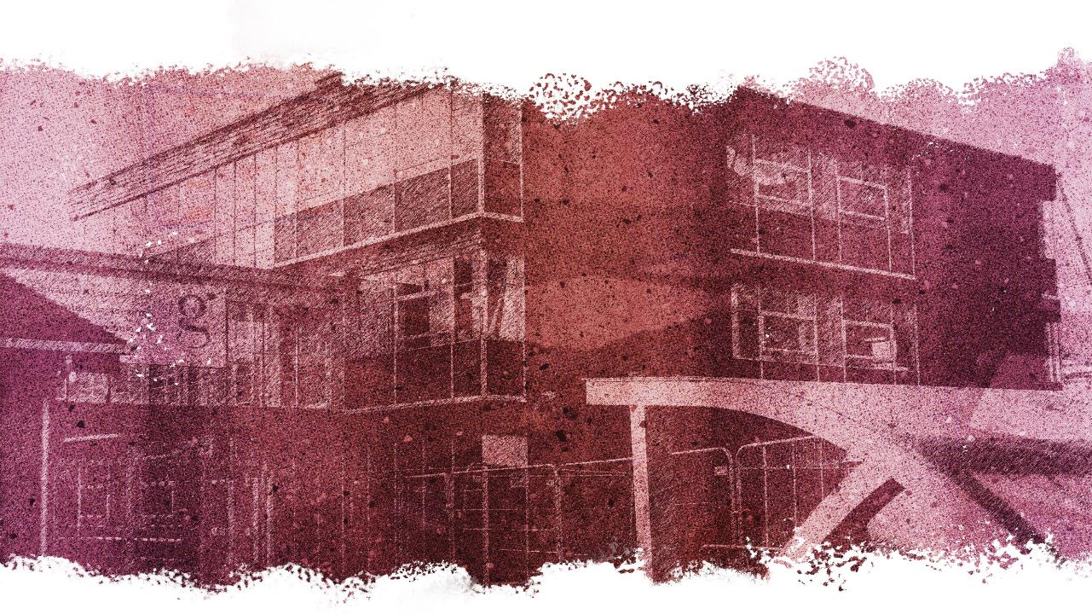


Session 4: Perception of Safety
Notes:
SESSION FOUR: PERCEPTION OF SAFETY
SESSION OBJECTIVES:
Students will develop a clear understanding of the difficulties pedestrians face when identifying and managing risks and hazards on or around roads.
Students will become aware of how brain function affects our perception of safety, and how our perception improves as our brains grow and develop.
Students will develop skills and techniques that improve their ability to identify and manage risks on and around the road.
SESSION OVERVIEW:
Students will develop an understanding of how our behaviour is directly linked to brain function, and how our perception of how safe we are around roads changes as we get older and our brain starts to grow and develop. Following the session, students will have a better understanding of why young people, as a group, are most at risk around roads, and develop ways to improve their ability to identify risks and make safer choices as pedestrians.
FILM SYNOPSIS: “The Pre-Frontal Cortex and Road Safety”
In this funny yet informative "spoof" documentary, we explore the glory of nature; specifically the mysteries of the human brain and how it influences our everyday behaviour - from the clothes we choose to wear to our ability to defend ourselves from wild hamster attacks(!) Focussing in on a small part of the frontal lobe called the Prefrontal Cortex, the film shows how our brain affects our ability to manage and identify risks around the road and how, as it grows and develops, we get better at making safer choices, leaving young people with advice on how they can work with - and not against - their brain to stay safe.
LINKS:
Use this resource below to access a helpful tips on how to teach road safety to students:
http://www.brake.org.uk/info-and-resources/resources/guide-to-teaching-road-safety
Following these activities, you might find it beneficial to access the resource below which has a range of additional activities and exercises on the topic of road safety for students:
https://www.think.gov.uk/education-resources/explore-education-resources/?age%5B%5D=13-to-16

Slide 2

FILM
vimeo.com/562695906
Notes:
PART 1: FILM (Approx. 5 mins)
Present the short film by clicking on the vimeo link to the students before delivering the workshop.
(Password: Safer-Roads-2021)

Slide 3
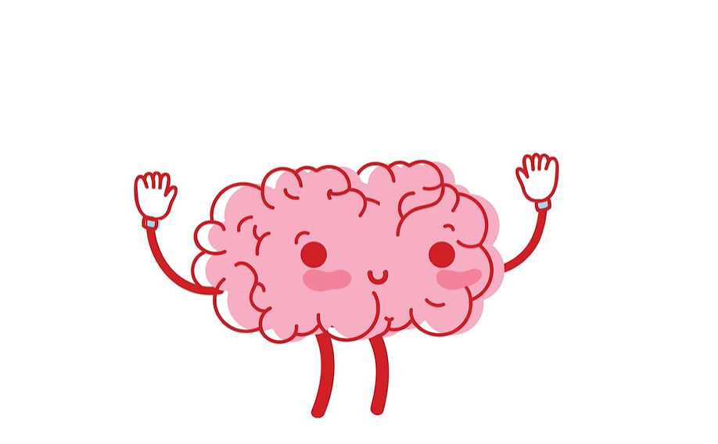
RECAP
Notes:
PART 2: RECAP (Approx. 5 mins)
CLASS DISCUSSION:
Recap the film with the students, discussing something new that they learnt or anything they found interesting, before moving onto the following questions.
LINKS:
Use the following link to access further information regarding brain development in young people, and how this impact their decision making in risky situations:
https://raisingchildren.net.au/pre-teens/development/understanding-your-pre-teen/brain-development-teens
[Next page]

Slide 4
RECAP
How does our brain impact our behaviour?
Notes:
[Continued]
Risky behaviour and your brain:
How does our brain impact our behaviour?
How does our brain change as we get older?
Why?
[Next page]

Slide 5
RECAP
How does our brain impact our behaviour?
Risk taking
Notes:
[Continued]
Risky behaviour and young people:
Why is a young person more likely to behave in a risky way?
Does being around friends make you more or less likely to take a risk? Why?
What sort of places or environments are young people most likely to take risks (such as beside a road)?
Conclude by explaining that due to the under-developed Pre-Frontal Cortex of young people, they are more likely to take risks beside the road. Consequently we need to be aware of this face in order to work against our subconscious tendencies.
[End Of Part 1]

Slide 6
HAVE YOU EVER...
...used your phone whist crossing the road?
...crossed the road without checking it was safe to do so?
...not used a crossing because it was further away?
...crossed the road whilst listening to music?
...crossed before waiting for the green symbol?
...played football or a similar game by the side of the road?
...been rude to a bus driver or passenger on a bus?
...crossed the road when my friends did rather than checking it was clear yourself?
...messed about on the bus or encouraged a friend to?
...messed around with a friend by the side of the road?
...ran across the road to meet up with friends?
Notes:
PART 3: HAVE YOU EVER... (Approx. 10 mins)
ACTIVITY AND CLASS DISCUSSION:
Individually or in pairs, get the students to go through the ’Have You Ever’ list on the slide, making note of the ones they have previously done, in order to identify any unsafe choices they might have made by the road or on the bus in the past.
Afterwards, students may also suggest additional situations to add to the list.
When finished, students should be selected at random and answers read aloud, asking for students to vote with a simple ‘hand in the air’ to gauge how common any particular behaviour might be.
[Next page]

Slide 7
HAVE YOU EVER...
...used your phone whist crossing the road?
...crossed the road without checking it was safe to do so?
...not used a crossing because it was further away?
...crossed the road whilst listening to music?
...crossed before waiting for the green symbol?
...played football or a similar game by the side of the road?
...been rude to a bus driver or passenger on a bus?
...crossed the road when my friends did rather than checking it was clear yourself?
...messed about on the bus or encouraged a friend to?
...messed around with a friend by the side of the road?
...ran across the road to meet up with friends?
Notes:
[Continued]
Referring to the ‘Have you Ever’ activity, discuss the following points with students:
What were their reasons for taking risks? I.e. lack of awareness or experience, to impress friends, carelessness, to achieve something more quickly or easily, etc.
Would they take that risk again? Why?
What might be the potential consequences of risk taking?
What could you do to avoid taking that risk in the future? I.e. putting their phone away when crossing, or not to get influenced by what their friends are doing, etc.
Conclude by explaining that we all take risks on a daily basis in some form. However, just because you took a risk and it worked out for you today, does not mean this will be the case tomorrow. It is a much better decision to avoid unnecessary risks if you want to avoid the often severe consequences.
[End Of Part 3]

Slide 8
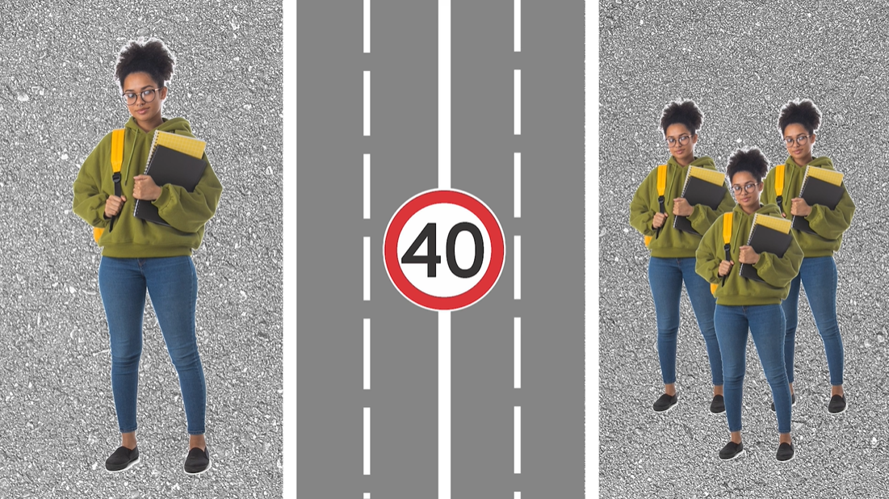
RISKS AND THE ROAD
Notes:
PART 4: RISKS AND THE ROAD (Approx. 15 mins)
GROUP DISCUSSION:
Discuss with students the potential consequences of risky behaviour on and around roads.
LINKS:
Use the following link to access further information regarding stopping distances of cars, including the many situations to look out for that may increase the distance:
www.theaa.com/breakdown-cover/advice/stopping-distances
[Next page]

Slide 9
RISKS AND THE ROAD
Young people are most likely to be involved in a road traffic incident
Notes:
[Continued]
Ask if students can recall the stat from the film surrounding young people and road traffic incidents:
“Road traffic incidents are the biggest killer of 10-18 year olds in the UK.”
Recap for students what has already been established, that the contributing factors to this are:
Under developed Prefrontal Cortex.
Young people congregating around busy roads in larger numbers.
Distractions and the potential for greater consequences when taking risks.
Ask the students how they would rate their ability to perceive the speed of traffic when trying to cross a road? Are they able to make accurate assessments that take into account:
How far away a vehicle is and how fast it is travelling?
The speed of a vehicle in comparison to the distance you will have to cover to cross the road?
How fast you will be travelling in order to cross the road before the vehicle reaches you?
[Next page]

Slide 10
RISKS AND THE ROAD
Young people are most likely to be involved in a road traffic incident
Stopping Distance
Notes:
[Continued]
Explain to students what we mean by the ‘Stopping Distance’ of a vehicle.
Thinking Distance: the total distance a car travels before the brakes are applied by the driver.
Braking Distance: the distance a car travels while the brakes slow it down.
Stopping Distance = Thinking Distance + Braking Distance.
For example:
If a car travelling at 20mph unexpectedly sees a pedestrian or obstacle in the road it will take approx 12 metres for it to stop.
NOTE: In order to help students visualise 12 metres, you can compare the distance to the size of the classroom or get students to line up shoulder to shoulder (approximating each student having a width of half a metre) or, more simply, it’s about the length of a standard, city bus.
[Next page]

Slide 11
RISKS AND THE ROAD
Young people are most likely to be involved in a road traffic incident
Stopping Distance
Estimate the Stopping Distances
Notes:
[Continued]
In pairs or small groups, get students to predict the stopping distance of cars travelling 30MPH, 40MPH, 50MPH, 60MPH, and 70MPH (which are all legal speeds).
NOTE: A key point of the discussion is for students to understand that cars cannot stop instantaneously. Other factors that drastically affect Stopping Distance include:
Thinking Distance is significantly affected by distracted or impaired drivers.
The weight of a vehicle significantly increases Braking Distance.
Poor weather conditions such as rain, snow or ice significantly affect Stopping Distance.
[Next Page]

Slide 12
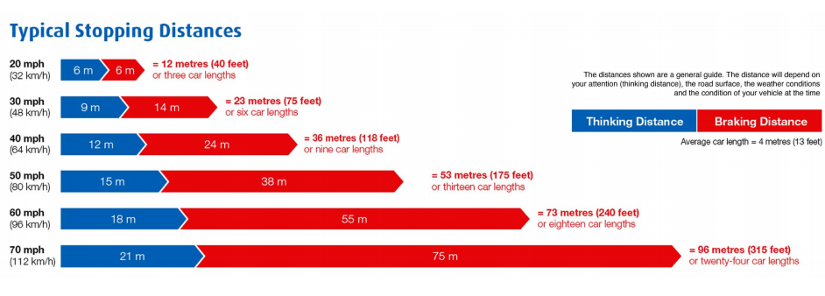
RISKS AND THE ROAD
Notes:
[Continued]
After this, hand out Worksheet 2 and present them with the real figures. Discuss the differences between their guesses, and the real Stopping Distances.
Conclude that people are often not as good as they think they are at judging vehicle speed and distance. With young people, combined with an underdeveloped Prefrontal Cortex, this judgement is further impaired.
[End Of Part 4]

Slide 13
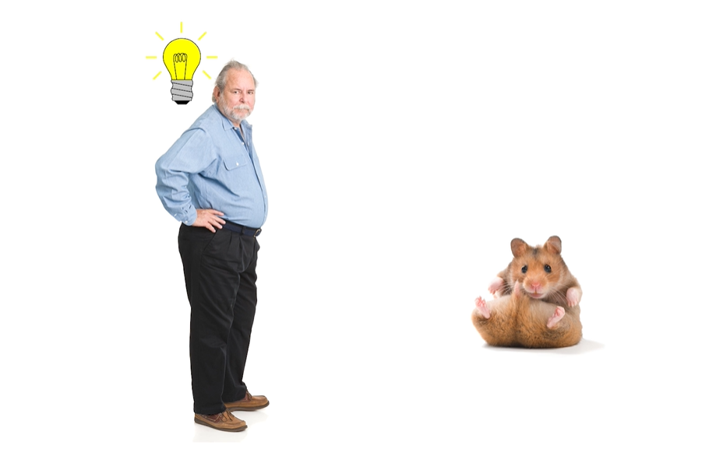
HOMEWORK
Create a questionnaire
Notes:
PART 5: HOMEWORK (Approx. 5 mins)
ACTIVITY:
Students are to create a simple 4-point questionnaire to be completed by the people they live with to assess different attitudes towards risk taking behaviour at different ages.
The questionnaire could include questions such as:
Do you feel better equipped to manage risk today than you did as a teenager, and why?
What was the last situation you were in you felt a safety risk was worth taking, and why?
Have you ever taken a risk as an adult that you wouldn’t allow a family member or friend to take, why?
The purpose of the questionnaire is to give students perspective on the risks they take on a daily basis, and to understand that the normal behaviour by those they look up to (in this case, parents or guardians), is to not take unnecessary risks by the roadside.
[End Of Part 5]

Slide 14
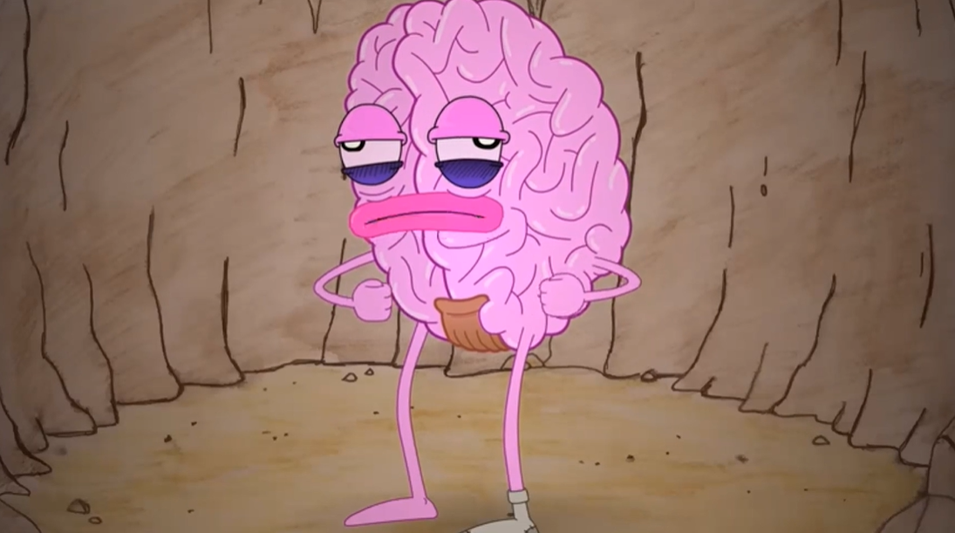
CONCLUSION
Notes:
PART 6: CONCLUSION (Approx. 5 mins)
Conclude by asking students to try and identify one thing they could possibly do differently to improve their personal safety on roads or on public transport.
Re-iterate the learning objectives and thank students for their time:
Students will develop an understanding of why it is sometimes difficult to identify risky or dangerous situations around roads.
Students will become aware of the relationship between brain development and perceptions of safety.
Students will develop skills and techniques to become better at identifying and managing risk when near the road.
[End Of Part 6]

Slide 15
EVALUATION
HANDS UP!
Notes:
EVALUATION
Please access the link below and complete the evaluation for the session, simply asking to the students to raise their hands for their chosen answer, and recording these numbers in the spaces provided:
https://forms.gle/mUpQM4fnjNpYxv8d6

