Slide 1



Session 2: Distractions
Notes:
SESSION TWO: DISTRACTIONS
SESSION OBJECTIVES:
To identify key distractions that can jeopardise safety when crossing or travelling near roads.
To establish simple actions and choices before crossing the road that can greatly improve safety.
To explore ‘Stop, Look and Listen’ within the context of distractions and more independent travel.
To motivate students to develop ways to promote simple road safety techniques to their peers.
SESSION OVERVIEW:
Devices and mediums which can be considered distractions form a huge part of our everyday lives and, in many situations, this isn’t a problem. However, by the roadside, distractions can be deadly. Consequently, this session will focus on highlighting the many distractions students will face on their journey to school, and how to combat their negative effects in order to keep themselves, and others safe.
FILM SYNOPSIS: LITTLE SIS’S FIRST DAY... (link to film on Slide 2)
It’s Sara’s first day walking independently to school – well, I say independently – actually she is following her slovenly ‘Big Bro’. Sara witnesses in awe as gets out his phone, plays his music, and puts on his hood and narrowly escapes dangerous situations – without even realising! Sara’s first journey gets a bit weird, but her brother – with his eyes glued to his phone - doesn’t seem to notice. This comedic and engaging film explores the effects that distractions can have on our comprehension of the dangers around us.
ADDITIONAL NOTES:
Please print off ‘Worksheet 1’ for students to complete when prompted.
LINKS:
Use this resource below to access a helpful tips on how to teach road safety to students:
http://www.brake.org.uk/info-and-resources/resources/guide-to-teaching-road-safety
Following these activities, you might find it beneficial to access the resource below which has a range of additional activities and exercises on the topic of road safety for students:
https://www.think.gov.uk/education-resources/explore-education-resources/?age%5B%5D=13-to-16

Slide 2

LIL SIS / BIG BRO
vimeo.com/562694870
Notes:
PART 1: “LIL SIS / BIG BRO” (Approx. 5 mins)
Click on the vimeo link on the slide and present the short film to the students before delivering the workshop.
(Password: Safer-Roads-2021).

Slide 3
LIL SIS / BIG BRO
Notes:
PART 2: RECAP (Approx. 5 mins)
CLASS DISCUSSION:
Ask the students to recap the film, identifying the following:
[Next page]

Slide 4
LIL SIS / BIG BRO
What happened in the film?
Notes:
[Continued]
What happened in the film?
How did the characters respond differently to what was going on around them?
Why did they respond differently?
Which of the characters seemed more alert, smart, ‘switched on’ and why?
[Next page]

Slide 5
LIL SIS / BIG BRO
What happened in the film?
Road safety skills?
Notes:
[Continued]
How would you rate each characters (1 – 10) on their road safety skills and why? Focussing on:
Awareness around the road
Crossing the road
Assess hazards and distractions
Get students to feedback their answers and discuss with the rest of the class.

Slide 6
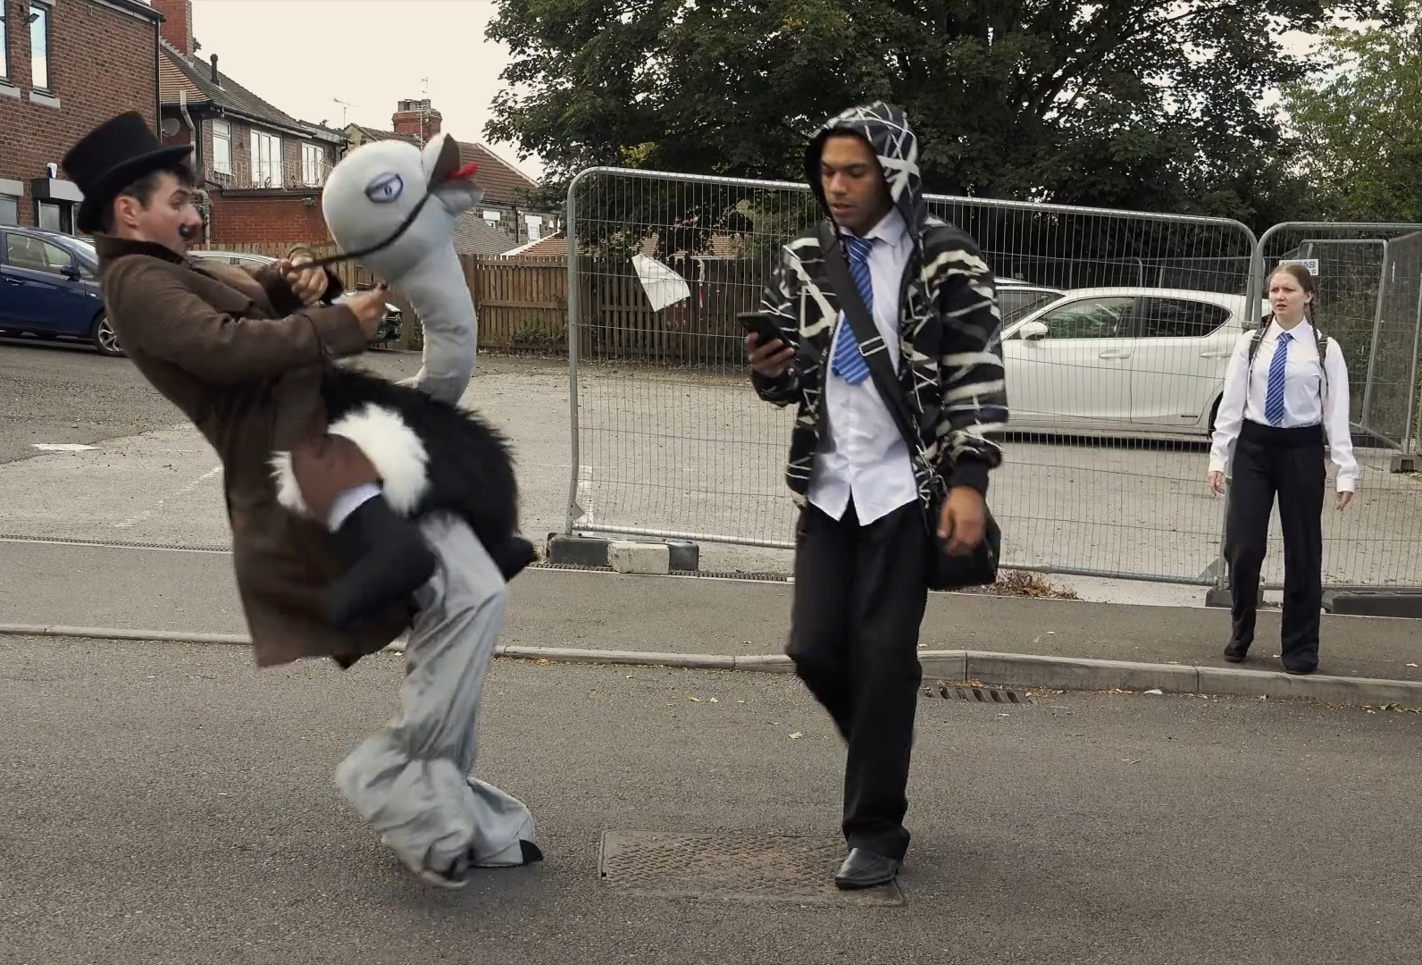
PEDESTRIAN SAFETY
Notes:
PART 3: PEDESTRIAN SAFETY (Approx. 10 mins)
GROUP DISCUSSION:
In pairs, get students to discuss pedestrian safety.
LINKS:
Follow this link to access a resource surrounding the many distractions pedestrians will encounter on their journeys:
https://roadsafety.scot/learning-zone/senior-phase/pedestrians-and-cyclists/
[Next page]

Slide 7
PEDESTRIAN SAFETY
What distracts us as pedestrians?
Notes:
[Continued]
First, hand out ‘Worksheet 1’ to students.
Next, get students to identify things that distract us as pedestrians and write them in the Distraction column on ‘Worksheet 1’, for example:
Phones
Music
Hood
Friends. Etc.
Get students to feedback their answers to the rest of the class.
ADDITIONAL NOTES:
Only the first column needs to be filled in on Worksheet 1 at this point, as later in the session you will fill in the remaining columns.
[Next page]

Slide 8
PEDESTRIAN SAFETY
What distracts us as pedestrians?
How do distractions affect us?
Notes:
[Continued]
Following this, help students identify the ways / places in which these distractions can affect our ability to be safe such as:
At a pedestrian crossing
Crossing a busy road
Walking on a narrow path with friends
Identifying any hazards blocking our path
Get students to think of their own scenarios and feedback to the class.

Slide 9
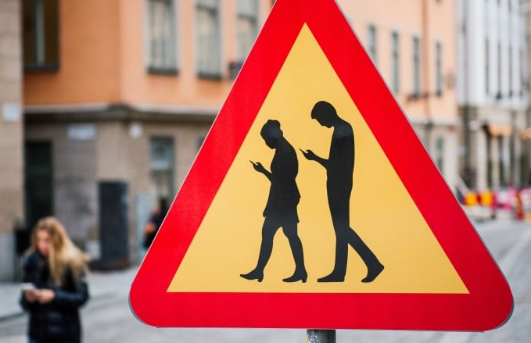
MANAGING DISTRACTIONS
Notes:
PART 4: DISTRACTIONS (Approx. 10 mins)
GROUP DISCUSSION:
Split the students into groups, such as pairs or similar, and get them to think about and discuss the following:
[Next page]

Slide 10
MANAGING DISTRACTIONS
Why do we get distracted?
Notes:
[Continued]
Why do people struggle to manage the distractions discussed in the previous section?
Why do people struggle to put their phones away, or take their headphones off when beside a road?
Following on from this, why are people sometimes reluctant to take small actions, even if they make us significantly safer around the roads?
[Next page]

Slide 11
MANAGING DISTRACTIONS
Why do we get distracted?
What can we do?
Notes:
[Continued]
Get students to fill in the next column on Worksheet 1, creating solutions for the distractions they compiled before, focusing on:
What ARE we prepared to do to make us safer (i.e., take off headphones or stop looking at phones whilst crossing, or not crowding pavements with friends and walking in the road)?
What would we advise somebody we cared about (like a friend or family member) to do if they were distracted in a way that put them in danger?

Slide 12
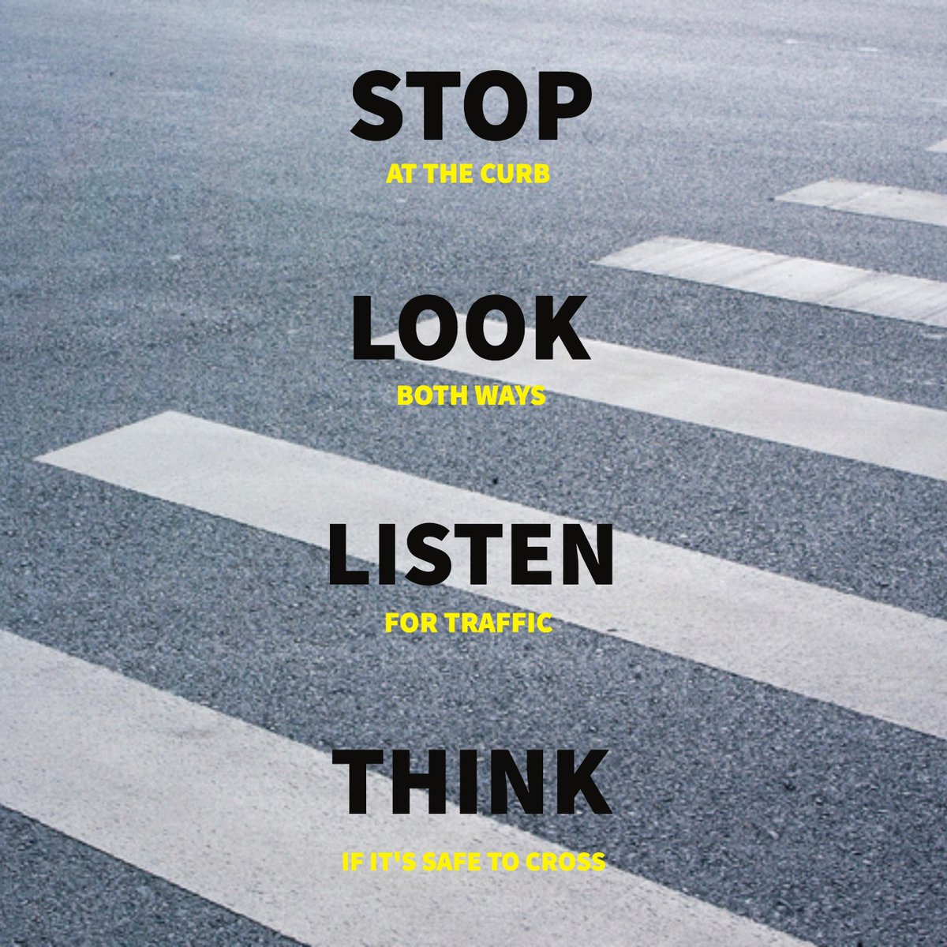
GREEN CROSS CODE
Notes:
PART 5: GREEN CROSS CODE (Approx. 10 mins)
CLASS DISCUSSION:
Firstly, ask students what we mean by ‘Stop, Look, Listen and Think’:
STOP: Find the safest place to cross then stop.
Stand on the pavement near the kerb or the edge if there is no kerb.
LOOK: Give yourself lots of time to have a good look all around. Make sure you can see if anything is coming and drivers can see you.
LISTEN: Listen carefully because you can sometimes hear traffic before you can see it.
THINK: Think about whether it is safe to cross the road – when the road is clear or all traffic has stopped
CROSS: Keep LOOKING, LISTENING and THINKING as you walk straight across to the other side.
[Next page]

Slide 13
GREEN CROSS CODE
Why might ‘Stop, Look, Listen and Think’ be more suitable for younger students?
Notes:
[Continued]
Next, lead a short discussion focussing on the following:
Why might ‘Stop, Look and Listen’ seem more relevant to a younger student than to an older student?
How does the home to school journey change for many students when they leave primary school that might make us disregard or stop using this process?
What other reasons might teenagers and adults stop using the ‘Stop, Look, Listen, Think’ process’?
Conclude that the change to our independence, the distractions we have and the peer influence and pressure we feel can have an impact on how we approach road safety.
[Next page]

Slide 14
GREEN CROSS CODE
Why might the ‘Stop, Look, Listen and Think’ be more suitable for younger students.
Re-branding ‘Stop, Look, Listen and Think’
Notes:
[Continued]
In pairs or small groups, task students to re-imagine ‘Stop, Look, Listen and Think’ to make it more engaging, relevant and impactful for their age group.
To do this, get students to refer back to distractions they labelled in ‘Worksheet 1’ and consider the following:
How can distractions be incorporated into the ‘Stop, Look. Listen, Think’ process?
How can ‘Stop, Look, Listen, Think’ be presented, concept-wise, to make it more appealing to older students?
How can ‘Stop, Look, Listen, Think’ be pitched in order to make it more mature and engaging?
[Next page]

Slide 15
GREEN CROSS CODE
Why might the ‘Stop, Look, Listen and Think’ be more suitable for younger students.
Re-branding ‘Stop, Look, Listen and Think’
Pitch your ideas!
Notes:
[Continued]
Groups pitch their ideas for a new ‘Stop, Look, Listen, Think’ campaign and the class vote for the best concept.
ADDITIONAL NOTES:
Students can continue to work up their ideas as part of a homework or form-time task.

Slide 16
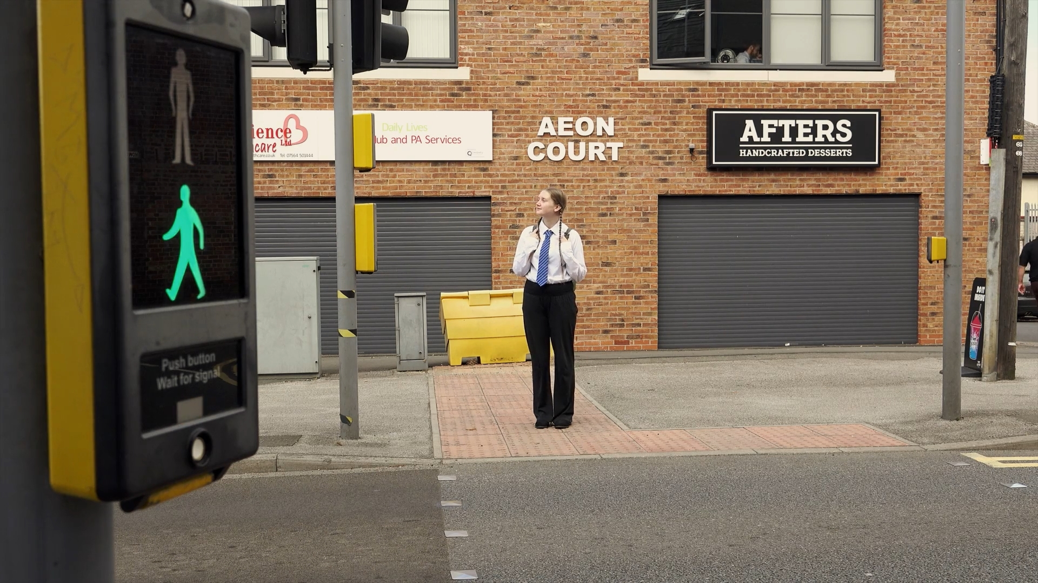
CONCLUSION
Notes:
PART 6 “CONCLUSION” (Approx. 5 mins)
Review and summarize the session.
Highlight for students how basic road safety that we’re taught from a young age may seem less essential when we’re older but is still vitally important for safety.
Simple actions – such as removing headphones, crossing at the safest possible point and putting your phone in your pocket for a few seconds – can make the difference between life and death.
Re-iterate the learning objectives and thank students for their time:
To identify key distractions that can jeopardise safety when crossing or travelling near roads.
To establish simple actions and choices before crossing the road that can greatly improve safety.
To explore ‘Stop, Look and Listen’ within the context of distractions and more independent travel.
To motivate students to develop ways to promote simple road safety techniques to their peers.

Slide 17
EVALUATION
HANDS UP!
Notes:
EVALUATION
Please access the link below and complete the evaluation for the session, simply asking to the students to raise their hands for their chosen answer, and recording these numbers in the spaces provided:
https://forms.gle/tiV3rUCqbidfmD699

