Slide 1
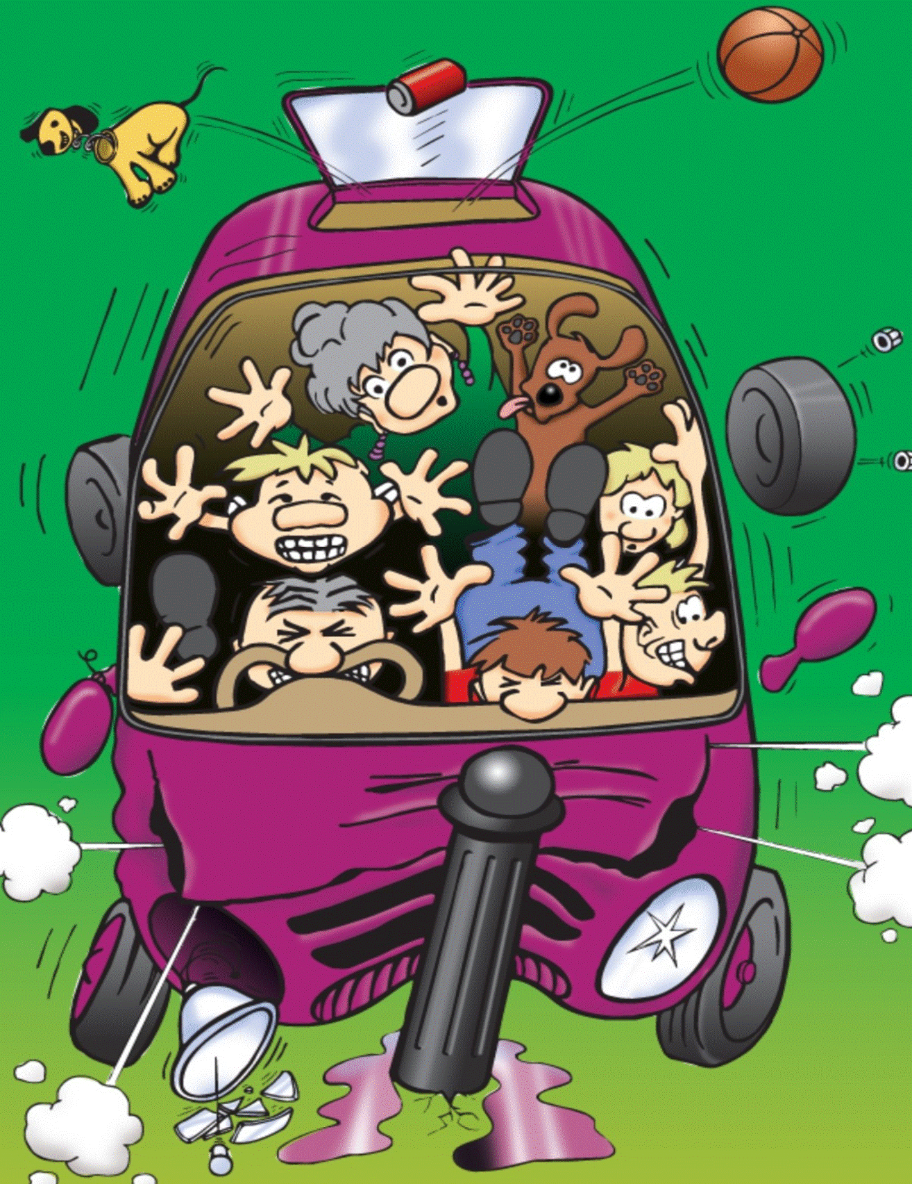
KS2 In Car Safety
Notes:
Explain that you are going to be talking about keeping safe in the car. Lots of people are injured in car crashes because they weren’t doing everything they should have been to keep safe.

Slide 2
What do you use to keep yourself safe in the car?
How does a seat belt work?
Notes:
Answer: seat belts, car seats / booster cushions
A seat belt holds you in your seat if the vehicle crashes or brakes suddenly. The seat belt will stop you from being thrown through the car or through the windscreen & seriously injuring yourself.

Slide 3
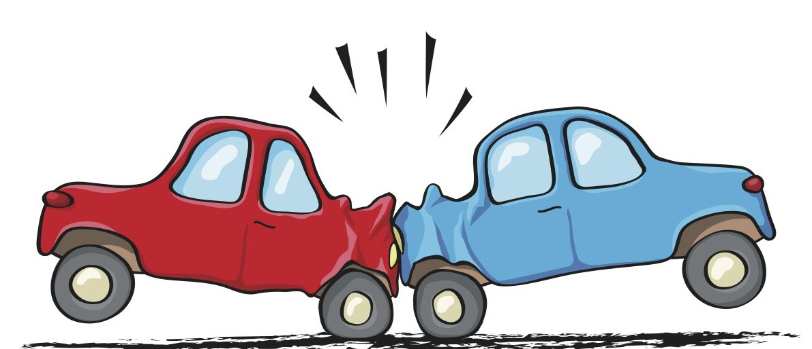
What happens in a crash if you are not wearing a seat belt?
What happens in a crash if you are wearing a seat belt?
Notes:
When a car crashes you continue to travel at the same speed the car was going until something stops you – this would be the seat belt if you were wearing one. If you are not wearing a seat belt you will carry on travelling through the car towards the dashboard and windscreen. There have been many crashes where passengers have been thrown through the windscreen and onto the road.
You would normally travel through the car head first as the head is at the top of the body and is the heaviest. When the head hits something all the force then travels through the skull and into the brain and down the spine which can cause brain damage and spinal injuries.

Slide 4
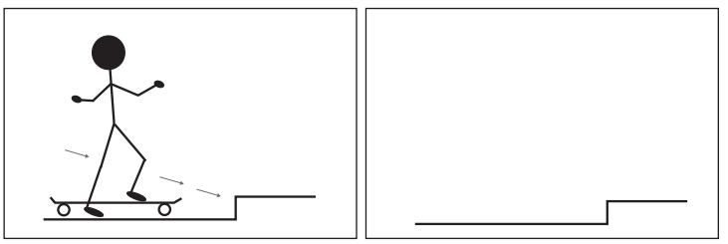
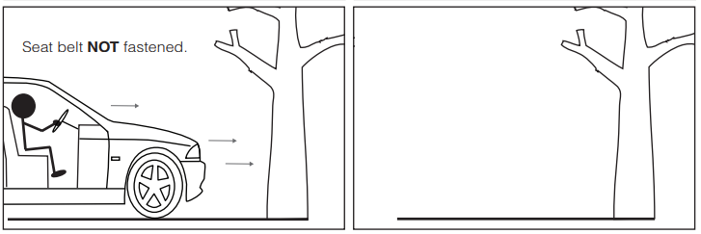
What happens next?
Notes:
Complete on the board or use individual worksheets.
The person on the skateboard will continue to travel forward when the skateboard hits the step, until they hit the floor.
When the car hits the tree the car will stop but the driver, any passengers not wearing a seat belt and anything loose in the car will continue to travel forward until they hit the dash board, windscreen, bonnet or tree. Possible injuries can be discussed.

Slide 5
What could happen to the driver or front seat passenger if you were sat in the back without a seat belt and the car crashed?
No Seat belt at the back
Where should loose objects be in the car?
Notes:
If you were sat in the back without a seat belt and the car crashed, you would be thrown forwards at the same speed the car was travelling and hit the person sat in front of you with great force. This would mean serious injuries or death for you and the person in front. See film clip (click on link in full presentation mode).
Ask the children who they sit behind in the car (usually someone they care about). How they would feel if they were responsible for injuring that person because they didn’t wear their seat belt?
Any loose objects in the car could cause serious injury in a crash (even something as small as a tissue box). Any bags / loose equipment should be placed in the boot and booster seats should be strapped in even when not in use. Click on the film clip in full screen.

Slide 6
Seatbelt Timeline
1959 Volvo introduces the seat belt
1967 All cars in the UK must be fitted with front seat belts
1983 It is compulsory to wear seat belts in the front
1989 Rear seat belts must be worn by children under age 14
1991 Seat belts must be worn by all rear passengers (adults & children)
2006 Children under age 12 or 135cm tall must use the appropriate car seat.
Notes:
The driver can be fined up to £500 if a child under 14 isn’t wearing a seat belt or using the correct car seat (information from www.gov.uk).

Slide 7
Seat belts save over 2,000 lives in Britain every year. That’s like all the children in four big schools!
How many lives have been saved by seat belts in your lifetime?

Slide 8
Why do you think people don’t wear a seat belt?
EXCUSES PEOPLE GIVE:
I’m only travelling a short distance
A crash won’t happen to me
They are uncomfortable
I don’t need one as we have an air bag
It is safe in the back seat without one
I forgot!
Notes:
Most crashes happen close to home, on short, familiar journeys we make every day.
We never know when a car may crash into us. Your mum or dad might be a very careful driver, but many drivers do not behave in a safe way. Driver behaviour can be discussed here – mobile phones, speeding, drinking & driving etc.
Often seat belts are uncomfortable for children because they still need to be using a booster seat.
Air bags are designed to work with a seat belt. They inflate at up to 200mph so could cause serious injuries for people who are not wearing one. An airbag will not stop you from being thrown around the car or through the windscreen.
You must wear your seat belt in the back as well as in the front. You can still seriously injure yourself and other passengers if you are sat in the back of the car without a seat belt. You could be thrown into the front seat at the speed the car is travelling and injure or kill the passenger in that seat.
Think of something you can do to remind you to always put on your seat belt (a sticker somewhere in the car perhaps). You can remind other people in your car to put theirs on too.

Slide 9
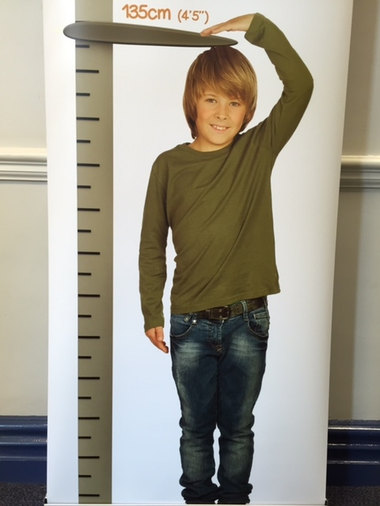
Booster Seats – The Law
All children must wear a seat belt and use a car seat until they are 135cm tall or 12 years old – whichever they reach first.
It is safer to use a seat until 150cm tall.
Notes:
It is safer for children to use a seat until they reach 150cm (the next slide explains why).
Suggested activity:
Bring a few children out to measure or ask them to measure each other and record their height. A class graph could be made to show the heights of the children.

Slide 10
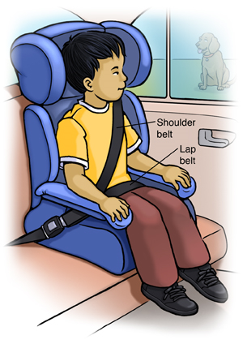
Why do we need to use a car seat?
A car seat or booster cushion makes sure that the seat belt sits on the bony part of your shoulder and hips and NOT on the soft parts of your neck and tummy which could be dangerous
Notes:
Ask the children to feel their bony collar bone and hips – this is where the seat belt should sit to keep you safe.
Adult seat belts do not fit children properly as the seat belt rests on the soft tissues of the neck and tummy rather than the strong bones of the upper thigh/pelvis and collar bone. In a crash this could cause serious injuries to the neck and internal organs. Younger children may also slip underneath the seatbelt. A child seat or booster cushion ensures that the straps are in the correct places and the crash forces are distributed evenly.

Slide 11
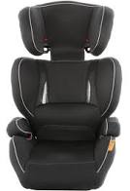
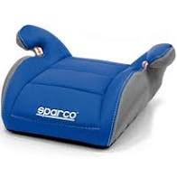
Car Seats
High Back Booster Seat
Booster Cushion
Notes:
- Which seat do you think is safer?
- High back booster is safer – it protects the head & spine. The seat belt clips keep the seat belt in the correct position on the chest, hips and thighs. The high back booster is not only for young children – its height adjusts to fit children up to 150cm. Some seats adjust widthways too.
- The booster cushion is better than no seat at all. It will lift the child up so that the seat belt is resting on the correct place on the body but offers no extra protection.

Slide 12
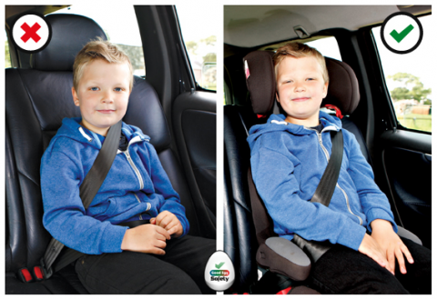
Images supplied by www.goodeggcarsafety.com
Notes:
What is the difference between the two pictures?
The pictures demonstrate where the seat belt sits on the boy with and without a booster seat.
- First picture - the seatbelt is resting on his neck and cutting into his face. The lap belt is across his tummy which, in a crash, can be dangerous. He needs a booster seat as shown in the second picture to put the seat belt in the correct place. Many children above 135cm still need a booster seat for the seat belt to fit correctly.

Slide 13
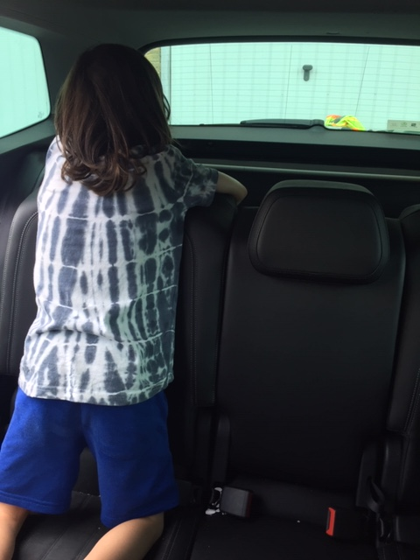
What would happen to the boy if the car crashed?
What should he be using?
Notes:
The boy is kneeling on the seat & not using a seat belt or car seat. In a crash he would be thrown through the car & could injure himself, the driver and other passengers.

Slide 14
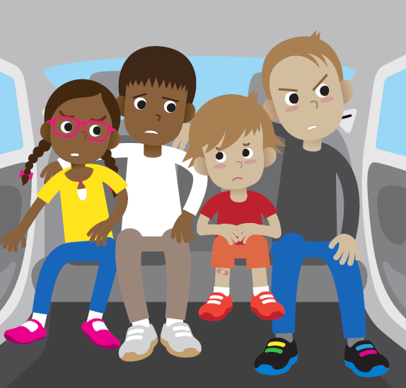
What is wrong in this car?
Notes:
-None of the passengers are wearing a seat belt.
-There are too many people in the back of the car for the number of seat belts.
-They are breaking the law.
-Loose people can be thrown around the car in a crash and can seriously injure one other.

Slide 15
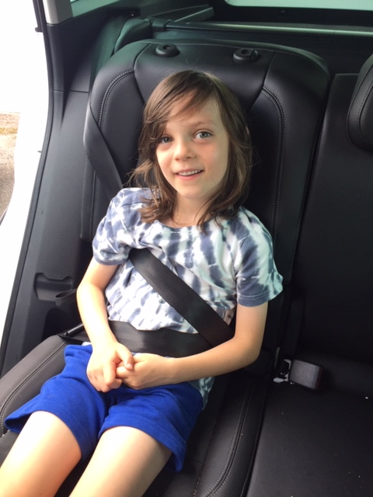
What is wrong with the boy’s seat belt?
What should he be using?
Notes:
The boy has put the seat belt under his arm to stop it cutting into his face. He probably put it there because it was uncomfortable as he doesn’t have a booster seat. In a crash he could be seriously injured (he could head butt his knees and damage his spine).
- The driver could be fined because he is not using a booster seat.

Slide 16
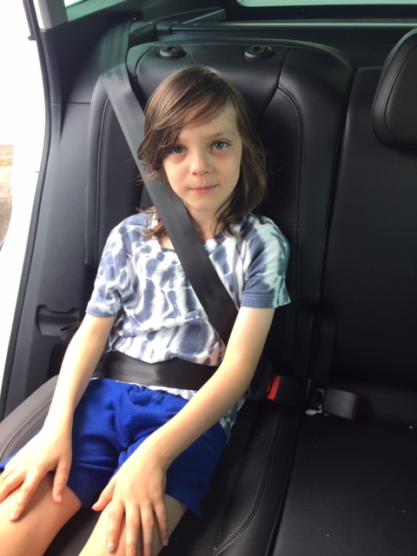
Why is the boy not safe?
What does he need to use to make him safe?
Notes:
The seat belt does not fit the boy correctly & is resting on his tummy and cutting into his neck. This could cause a lot of injuries if the car had to break suddenly or crashed.
He needs a booster seat to put the seat belt in the correct place. The driver could be fined because he is not using one.

Slide 17
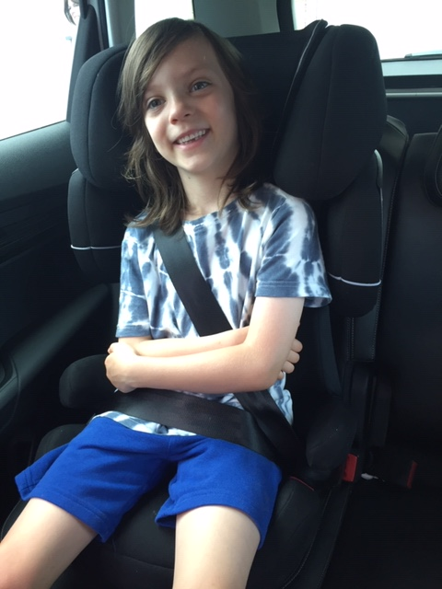
Notes:
This is much safer. The seat belt is in the correct place now and the seat will protect his body, spine and head in a crash.

Slide 18
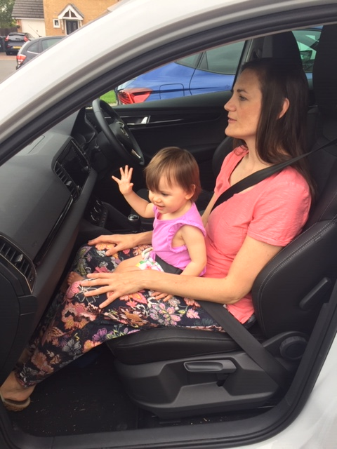
What is wrong in this photo?
What could happen to the baby if the car crashed?
Notes:
Young children should never sit on knees – even with a seat belt around them. If the car crashed the smaller person could be crushed between the seat belt and the bigger person. Their heads could bang together causing a serious injury. It is impossible to keep hold of a baby in a crash. The baby could be thrown with force into the dashboard and windscreen.
A seat belt is designed for one person and should never be shared.

Slide 19
Discussion Points
Your friend or brother/sister say
that they don’t need to wear a seat
belt or sit on a booster seat. How
would you persuade them
to use it?
Can you as a car passenger
cause a car to crash?
Notes:
Discussion points:
- You are putting other passengers & the driver at risk as well as yourself. Do you want to be responsible for injuring me or another person? If you care about me you should wear your seat belt!
-It is the law
-Seat belts save lives
-£100 fine per person (age 14 and above are responsible for paying their own fine).
-Refer back to the notes on slide 11 for the reasons why children need car seats and boosters.
Discuss safe and unsafe behaviour in the car and distracting the driver, e.g. arguing with siblings, loud music, showing them pictures on a mobile phone etc…

Slide 20
What can you do?
Always fasten your seat belt and keep it fastened until the vehicle stops
Use a booster seat if you still need one
Tell everyone in your car to wear their seat belt and use a car seat if they need one
Put any loose objects in the boot
Fasten booster seats in with the seat belt (even when they are not in use)
Be a sensible car passenger – don’t distract the driver
Pass on this information to your friends & family!
Notes:
Many children ask what age they are allowed to sit in the front. The answer to this is that all cars are different – they need to check their vehicle’s handbook. Some cars specify an age, others you can sit in the front at any age as long as you are using the appropriate car seat (& of course wearing a seat belt). However, the back is always safer (for adults & children). Air bags are in the front to protect adults – they can cause injury to children.

Slide 21
Seat Belt Rhyme
‘5, 4, 3, 2, 1, we’ve all got our seat belts on,
1, 2, 3, 4, 5, cos we want to stay alive!’
Notes:
A rhyme that the children can all say together with actions.

