Slide 1
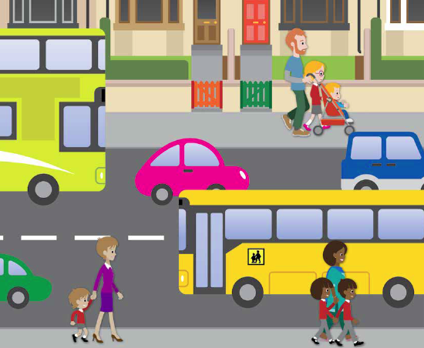

Road Safety
Key Stage 1
Notes:
Introduce the subject of road safety to the class. Explain they are going to be thinking about how they can keep safe when walking near the roads and when crossing the road.

Slide 2
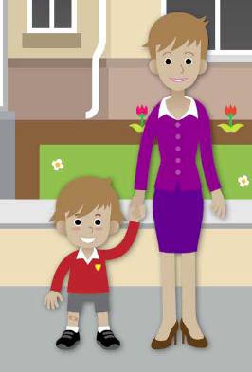
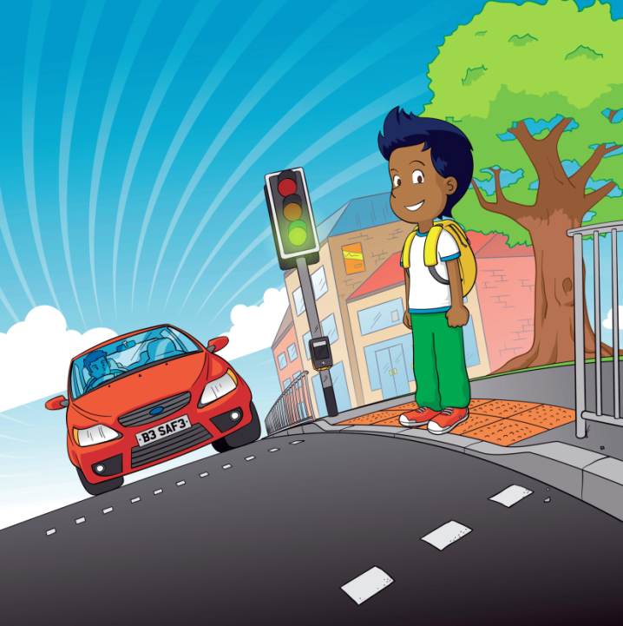
What do you know about keeping safe near the road?
Why is it important to keep safe near the road?
Notes:
We make lots of journeys during our day and usually they involve crossing at least one road. Ask the pupils to think about the journeys they make, e.g. to school, to the shops, to the park etc.
What do they do to keep themselves safe?
In Bradford around 200 children are hurt on the road every year - most of these accidents are children being hit by cars.

Slide 3
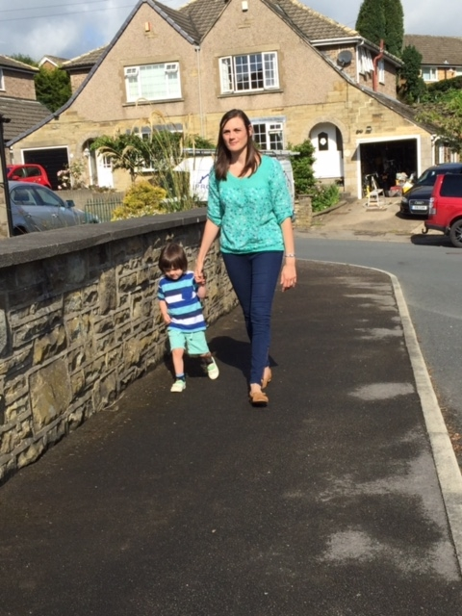
What is the name of the safe place we walk on next to the road?
Pavement
What is the edge of the pavement called?
Kerb
When we are walking we are called
Pedestrians
Notes:
Answers:
1. Pavement / footpath
2. Kerb
Show the children whereabouts the kerb is on the photo. Explain that we shouldn’t walk too close to the kerb as vehicles sometimes drive / park on the pavement. The adult should always walk nearest to the kerb. Talk to them about standing behind the kerb before we cross the road.

Slide 4
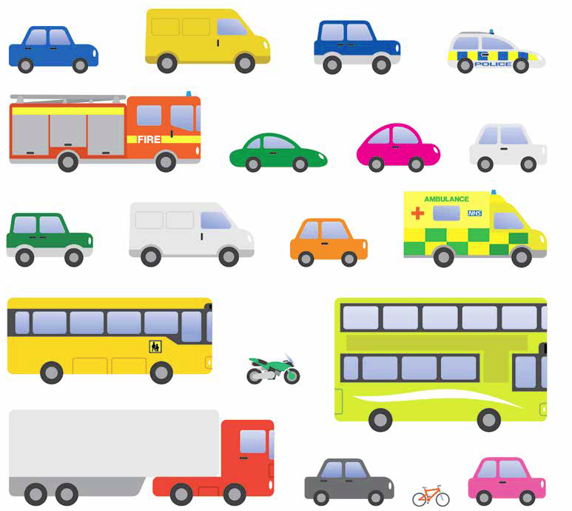
Can you name something that
travels on the road?
What is another word for the cars, lorries and other things that travel
on the road?
Traffic
Notes:
Talk about different vehicles – some are very big – can they name something really big? and some are very small (bicycles, motorbikes), but they can all go very fast and be very dangerous (young children often think large vehicles are faster & small vehicles mean they go slow).
Explain that sometimes we can hear traffic before we see it (e.g. emergency vehicles, motorbikes). Not all traffic is noisy, but it can still be travelling very fast (e.g. bicycles, electric cars).

Slide 5
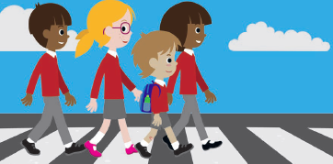

The set of rules that we use to cross the road is called
The Green Cross Code
We need to use the Green Cross Code every time we cross the road to keep us safe!
Notes:
This is covered in detail in the following slides.

Slide 6
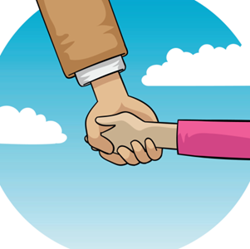
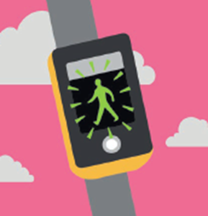
Do you know any rules in the
Green Cross Code?
HOLD HANDS
FIND A SAFER PLACE
Notes:
Do you know any words in the Green Cross Code? These pictures might give you a clue.
Who should you hold hands with?
An adult. If your grown up is pushing a pushchair, you should hold the pushchair.
Can you name any safer places to cross the road?
Safer place to cross – Zebra Crossing, Puffin / Pelican or Toucan Crossing, Traffic Island, School Crossing Patrol (Lollipop Person), Footbridge or Subway. If there is no crossing, choose a place you can see clearly in all directions, away from parked cars.
These will be covered a bit more in the PowerPoint later.

Slide 7
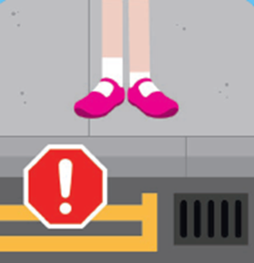
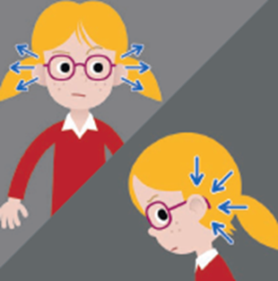
STOP
LOOK & LISTEN
Notes:
STOP on the pavement behind the kerb.
Play the ‘Stop’ game – it is important children know to stop when an adult tells them to – practise this by asking them to wriggle their fingers and stopping when you shout stop.
LOOK all around – not just right & left – traffic could come from any direction. Remember if traffic is a long way off, it may still be approaching very quickly.
LISTEN for traffic. Sometimes you can hear traffic before you see it (emergency vehicles / motor bikes / quad bikes).

Slide 8
THINK
When you cross the road make sure you keep
Looking, Listening and Thinking – do not run!
Notes:
THINK - is it safe to cross the road? Are you sure you are still holding your grown up’s hand, looking, listening and thinking?

Slide 9
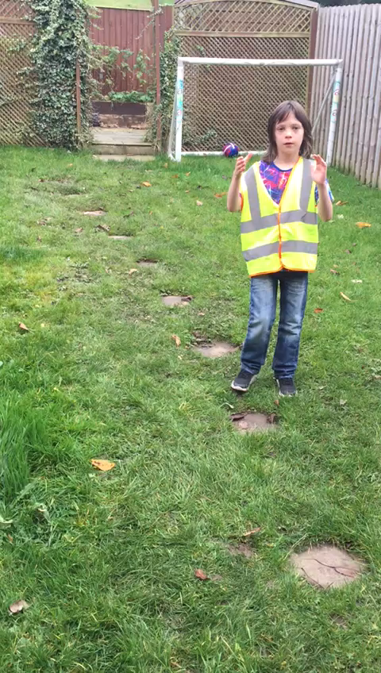
The Green Cross Code
Follow the words and actions
Notes:
Click on the video link. Encourage everyone to join in with the words and actions - this will help them remember it.
Hold hands
Find a Safer Place
Stop
Look
Listen
Think
Arrive Alive!

Slide 10
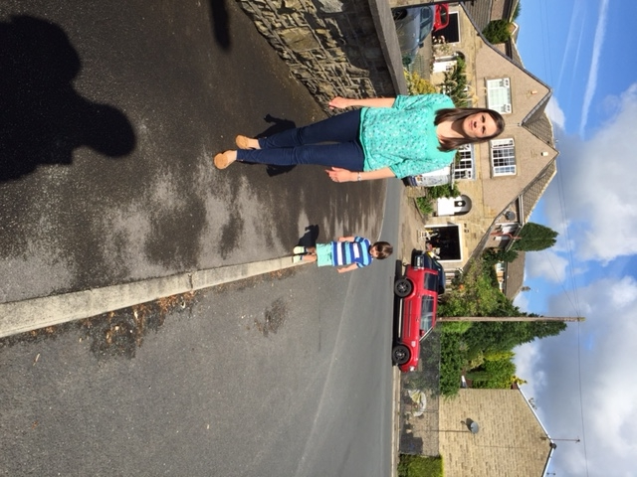
Think about the first rule…..
Is this picture safe?
What is the boy doing to keep safe?
Notes:
The first picture is not safe because the little boy is not holding hands or walking with his grown up. He is also walking very close to the road and might fall off the kerb into the road.
Picture 2 is safe - the boy is holding his mum’s hand and is walking furthest away from the road. Grown ups should always be the ones walking nearest to the road.

Slide 11

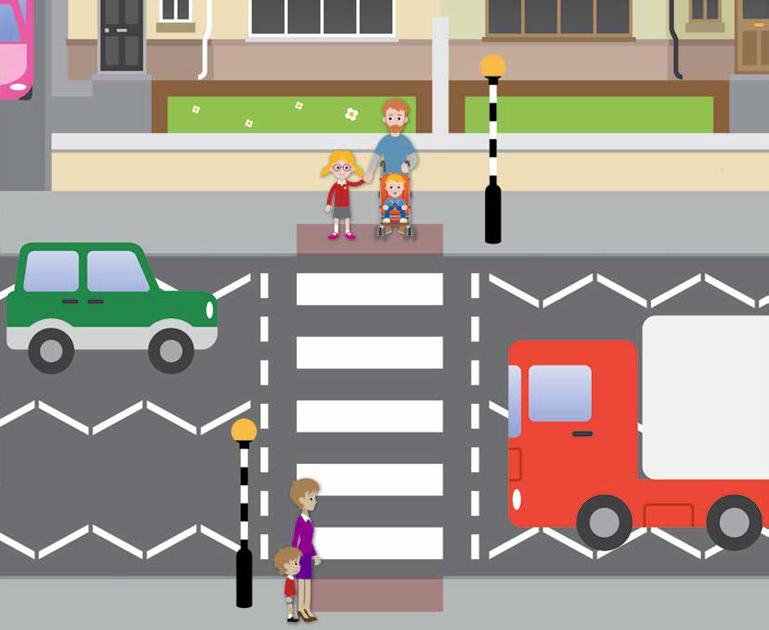
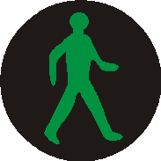
What do we call these safer places?
Zebra Crossing
Puffin Crossing
Zebra Crossing
Press the button & wait for the green man. Make sure the traffic has stopped before you cross
Make sure the traffic has stopped on both sides before crossing
Notes:
A safer place is a pedestrian crossing – here are two of the more common ones.
When we need to cross the road we should always check if there is a safer place nearby and use it.
Make sure the children understand the importance of checking that the traffic has stopped on both sides before crossing. They should not just rely on the traffic lights changing to tell them it is safe – they need to do the Green Cross Code checks still (cars often drive through red lights).

Slide 12
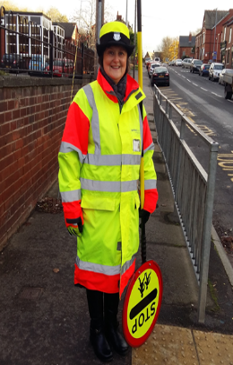
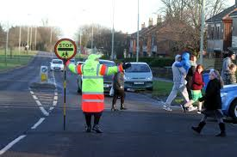
What is the name of the person who helps us cross the road?
Lollipop Person
What do they wear?
Notes:
Another safe place to cross near schools is with a School Crossing Patrol (Lollipop Person). She uses the STOP stick to signal for the traffic to stop so that children can cross safely.
You should always wait until the Lollipop Person tells you to cross before setting off. Always cross IN FRONT of them, not behind, so that they know you have crossed safely.
If you have a School Crossing Patrol dressing up outfit you could dress a child up and talk about the fluorescent & reflective clothes. This is particularly useful if you have a School Crossing Patrol outside your school.
Fluorescent - the yellow and orange colours– they are really bright to help her to be seen in daylight and at dusk.
Reflective – the silver stripes – help her to be seen in the dark - when light shines on them they reflect the light & glow.

Slide 13

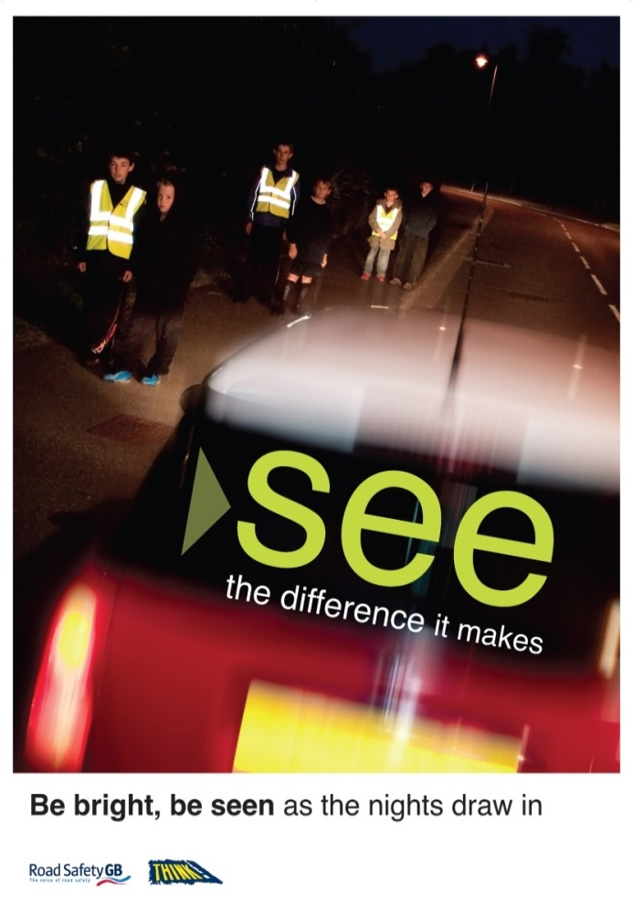
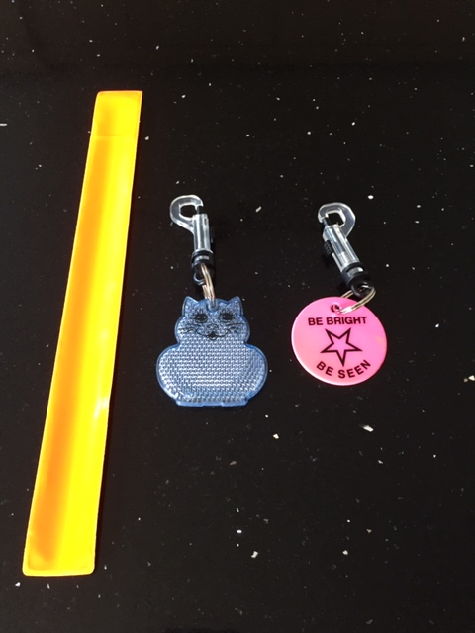
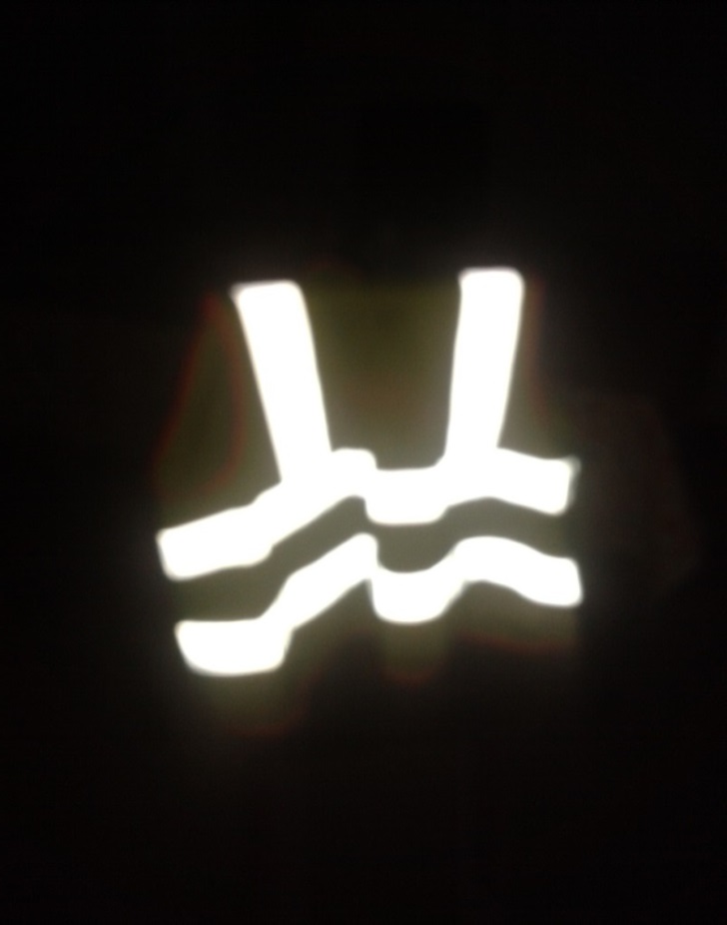
Be Bright Be Seen!
Fluorescent – for daytime Reflective – for night time
Notes:
It is important that children understand it can be difficult for drivers to see them when it is dark. Wearing something fluorescent and reflective (like the Lollipop Person wears) helps them to be seen by drivers and helps keep them safe. This could be a waist coat like in the first two pictures, or an arm band or key ring like in the third picture. Sometimes our coats, bags & shoes have a reflective strip on them.
- It is particularly important to think about being bright when the clocks go back in October and the nights become darker earlier. They could now be making journeys to & from after-school clubs, childminders or the mosque in the dark.
- Middle picture - point out the difference between the children wearing fluorescent/reflective waist coasts and the children dressed in dark colours.
Can they think of any other people who wear these clothes? (police, fire & rescue, ambulance crew, builders, pupils & teachers on school trips…)
- You could show examples of fluorescent & reflective clothing / items.

Slide 14
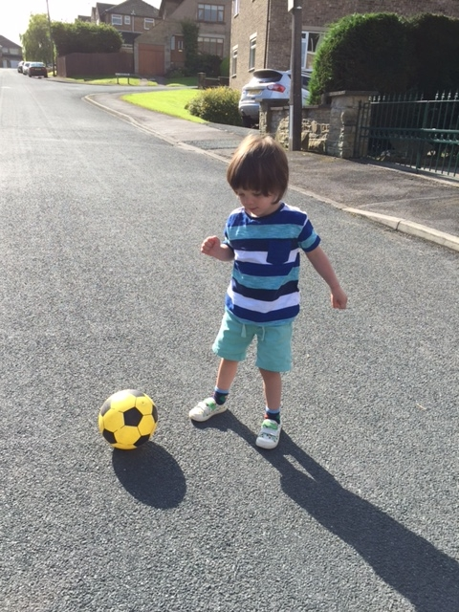
Why is the road not a safe place to play?
Is this picture safe?
Playgrounds
Where is a safe place to play outside?
Gardens
Parks
Notes:
Many children think quiet roads & cul-de-sacs are safe places to play - remind them that roads are for traffic. Pavements are not the safest place to play either – beware of the ball rolling into the road – children are often tempted to run out after it.
What should you do if playing outside and your ball rolls into a road?
Leave it and ask an adult to get it for you.

Slide 15
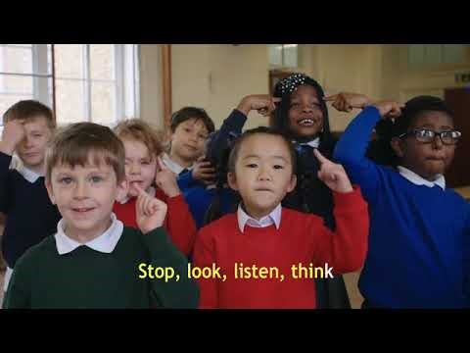
Watch the film and join in with the song!
Notes:
Right click on the link and click ‘open hyperlink’. The song lyrics can be found on the Think! website Safer journeys anthem – THINK!

Slide 16



Stop, Look, Listen Song
(to the tune of 10 Green Bottles)
Stop, Look, Listen before you cross the street
Stop, Look, Listen before you cross the street
Use your eyes,
Use your ears,
Before you use your feet
Stop, Look, Listen before you cross the street
Notes:
Optional song. This is a nice way to end the session, although it may seem too young for some Year 2 classes, so use your own judgement.
Which important words are missing in the song? (Hold hands, Find a safer place, Think)
Recap the Green Cross Code altogether saying the words and doing the actions at the end of the session: Hold Hands, Find a Safer Place, Stop, Look, Listen, Think, Arrive Alive.
Remind them to always pay attention near the road, not to act silly and to stay with their grown up. If they are running ahead, or lagging behind and not walking with their grown up, then the grown up can’t keep them safe.

