Slide 1
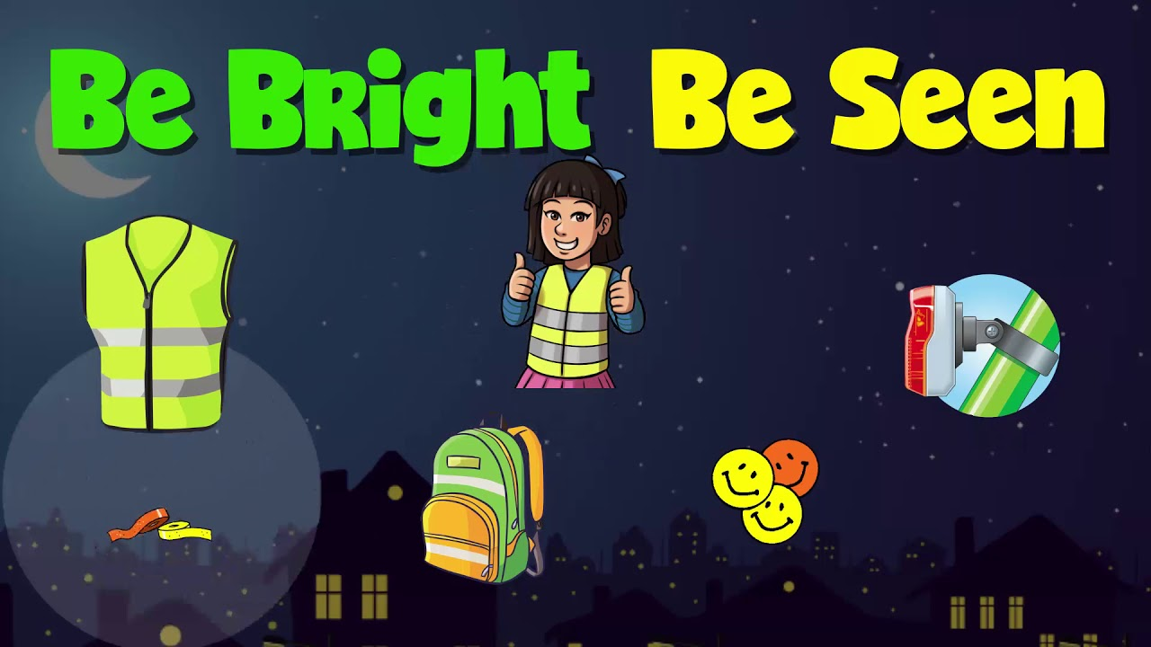
Notes:
Ask the children what they have noticed about the mornings and evenings lately. As autumn turns into winter it not only gets colder, it gets darker too.

Slide 2
Spot the child!
A
B
Notes:
Can the children spot which picture has a child in it?
There is a child in both pictures. How can we see the child in picture A but not in picture B?
Bright colours make you visible on dull days. Fluorescent colours are most effective.

Slide 3
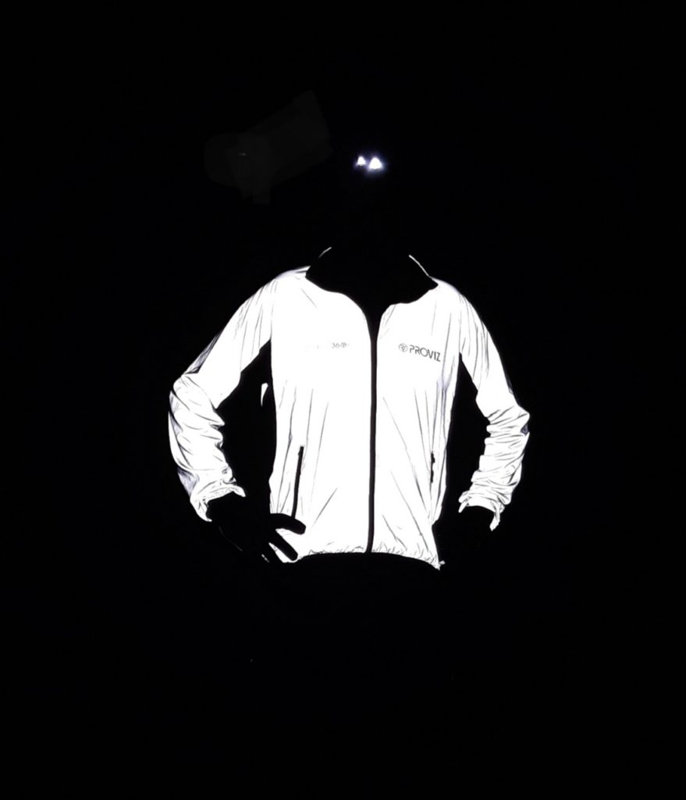
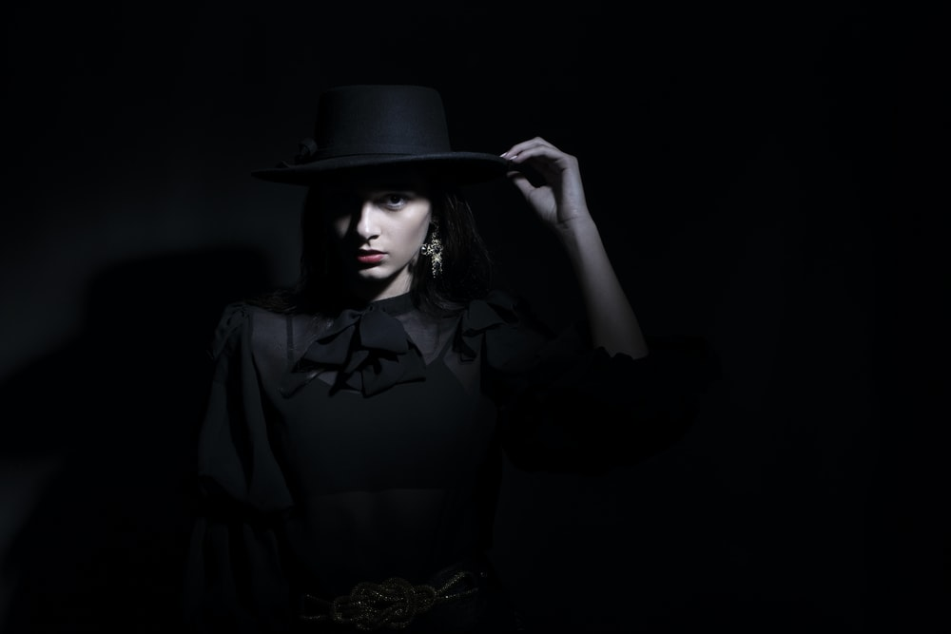
Fluorescent Clothing for
Day
Reflective Clothing for Night
Dark Clothing = Invisible
Notes:
Fluorescent clothing helps you to be seen easily during the day. The suns ultra violet rays react with the fluorescent colours to make them appear to ‘glow.’ Some colours work better than others. Hi-Viz vests are often yellow, pink, green or orange. Blue is not as effective as its wavelength is not as good at emitting light and the human eye is not as good at seeing it.
Reflective materials help us to be seen at night. The light from the car headlights bounces off the reflective material back to the driver who will see them clearly. Reflective materials can help drivers to see you 3 seconds sooner at night – which could save your life! (Source: Brightkidz.co.uk)
Dark clothing will make you invisible and appear hidden from view.

Slide 4
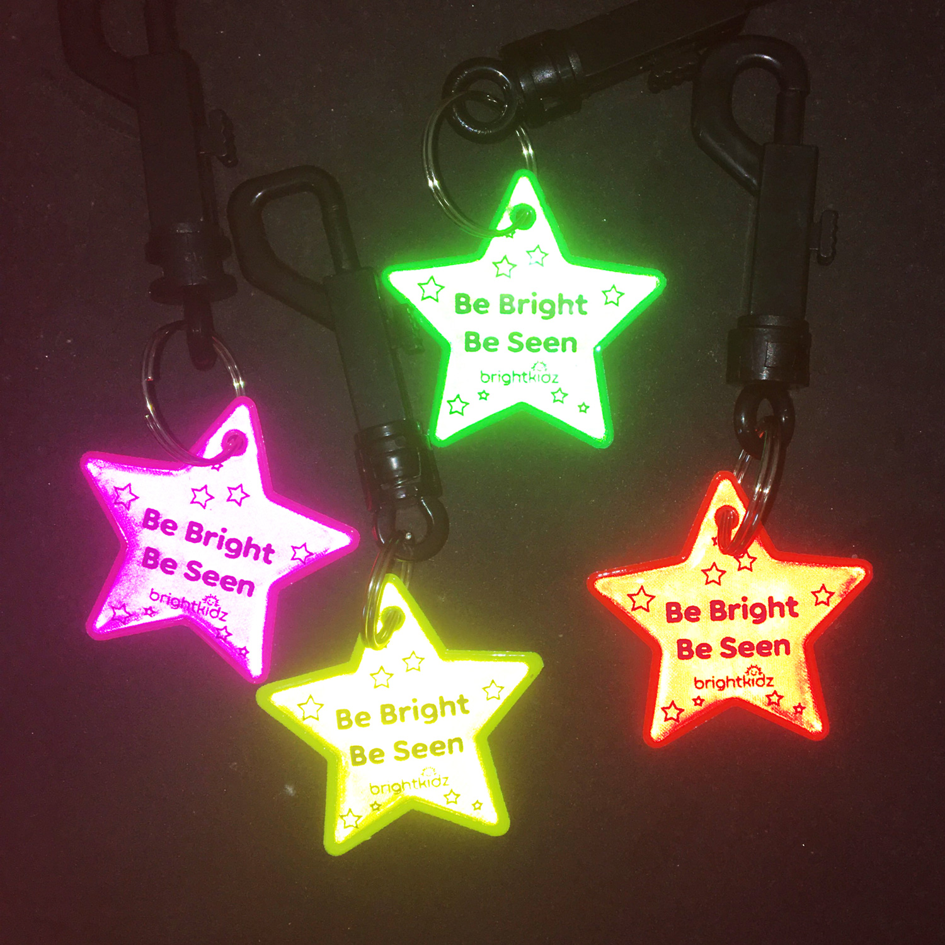
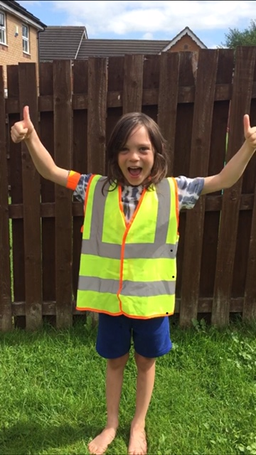
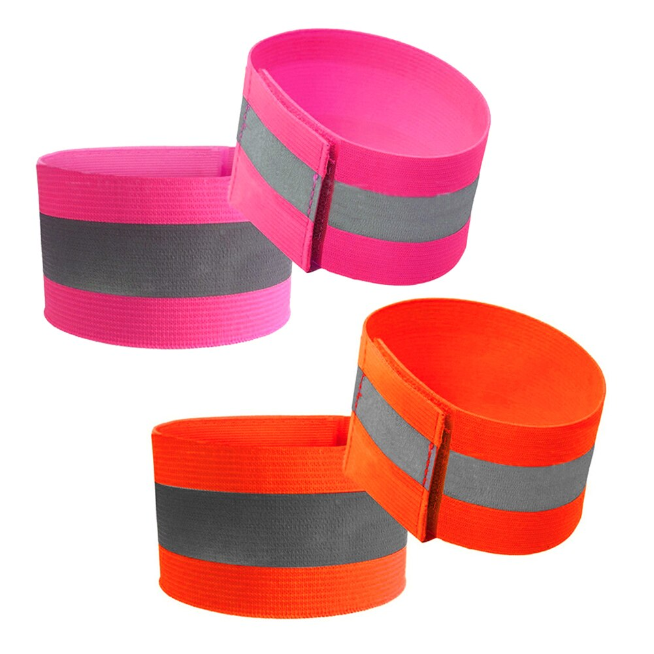
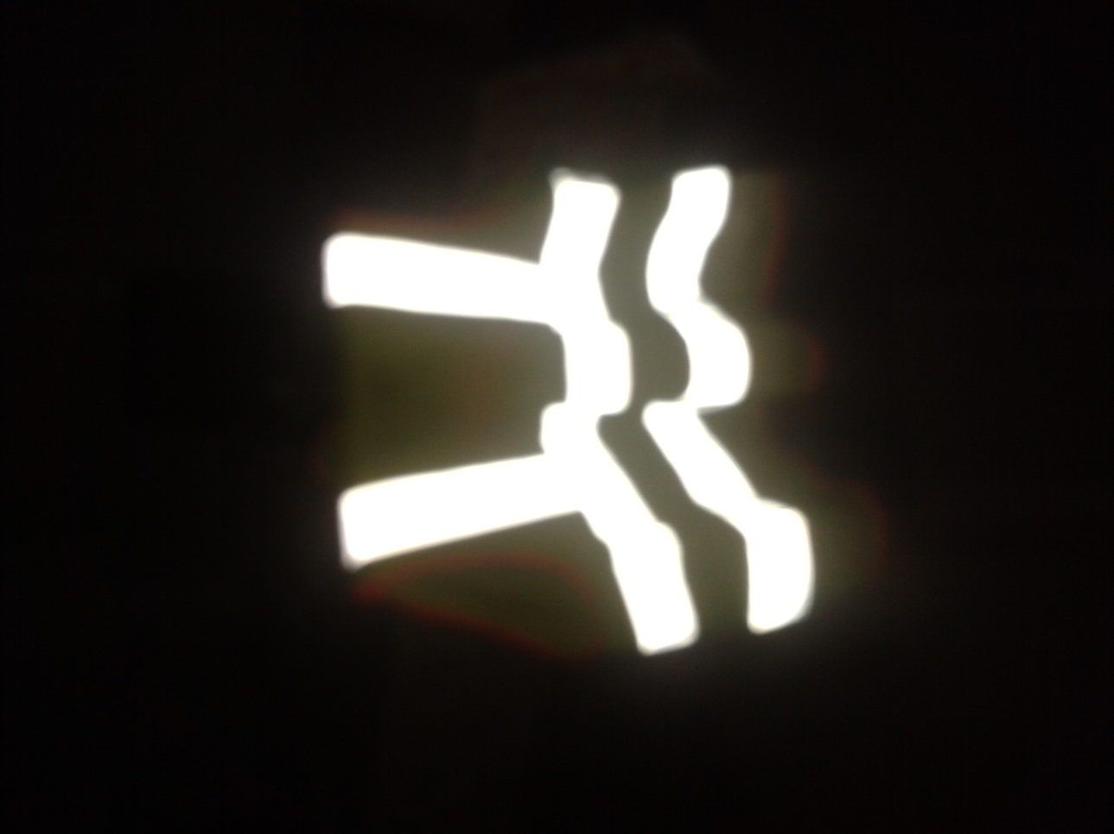
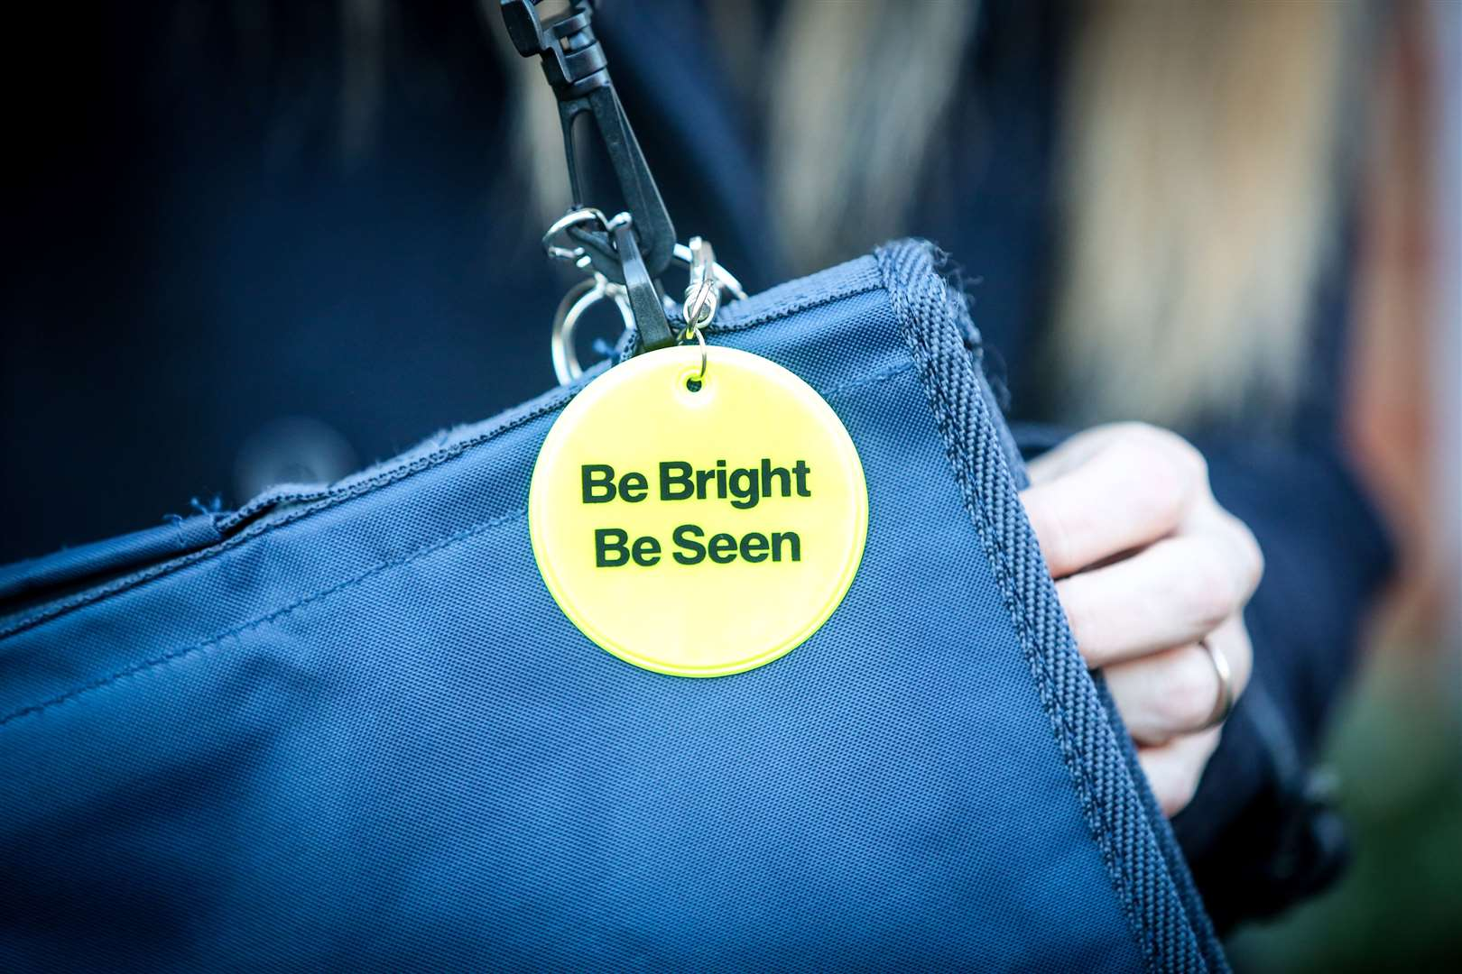
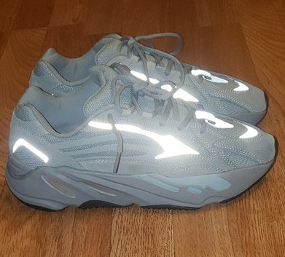
Day
Night
Notes:
Fluorescent & reflective waistcoats help you to be seen in the day and at night.
Accessories like reflective key rings and arm bands can be very effective in helping you to be seen in the dark.
Some coats, shoes & bags have their own reflective strip on them. Do any of yours?

Slide 5
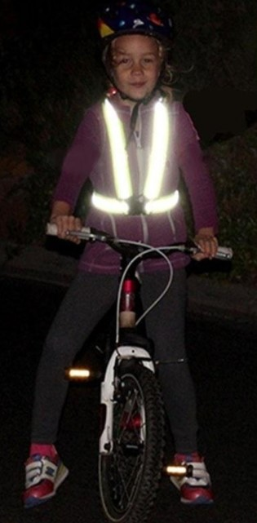
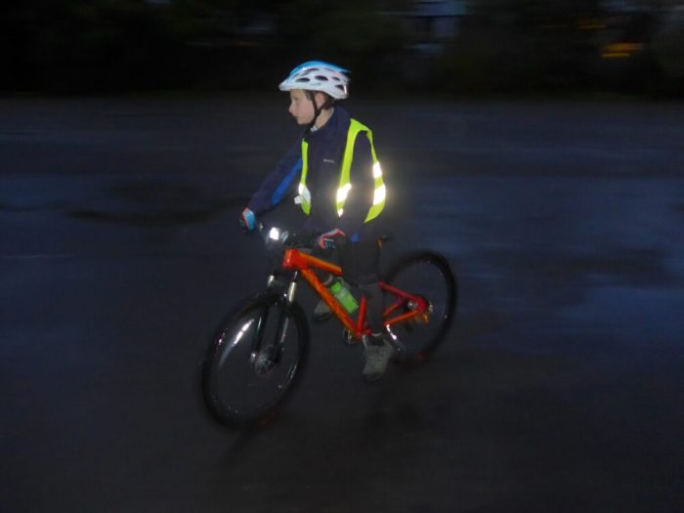
Remember to be bright when cycling or playing out especially on dull winter days
Notes:
Remember bikes need working lights (it is the law).

Slide 6
Quiz
How much can you remember?

Slide 7
1) What kind of material helps you be seen at night?
2) Which colours help you to be seen in daylight?
3) Which colour is the most difficult for the human eye to see? Yellow Pink Green Blue
4) Do fluorescent colours show up in the dark?
5) How much sooner can a car driver see you at night if you are wearing something reflective?
Notes:
Answers:
Reflective
Fluorescent
Blue
No
3 Seconds – which could save your life!

Slide 8
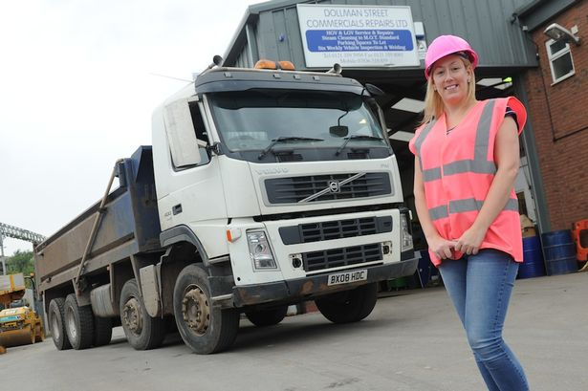
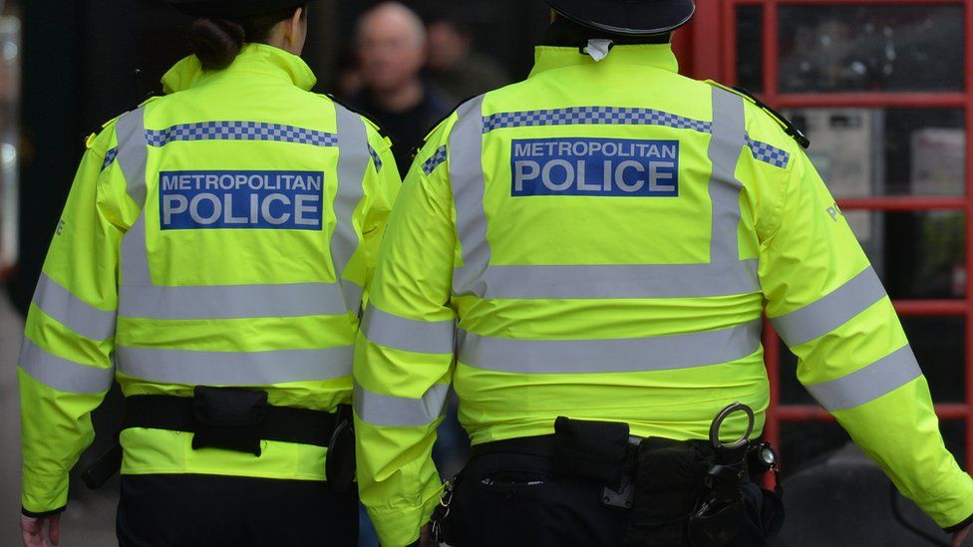
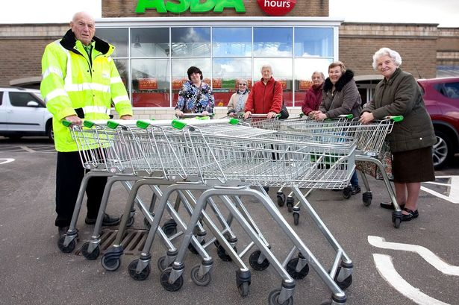
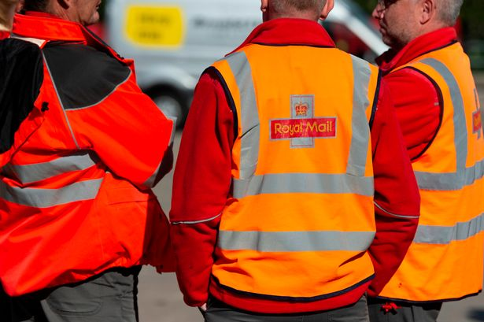
6) Name 5 types of job where fluorescent/reflective clothing is worn
Notes:
Builder
Lorry Driver
Police
Postal Worker
Trolley Collector

Slide 9
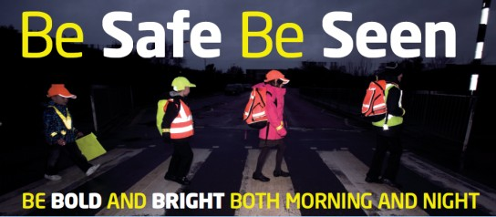
Fluorescent For Day
Reflective For Night

