Slide 1
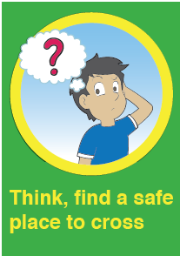

Slide 2
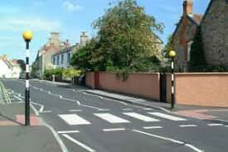
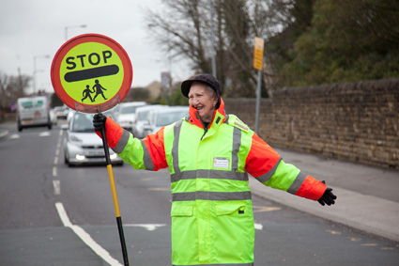
SAFER PLACES TO CROSS
ZEBRA CROSSING
School CROSSING PATROL OR LOLLIPOP PERSON

Slide 3
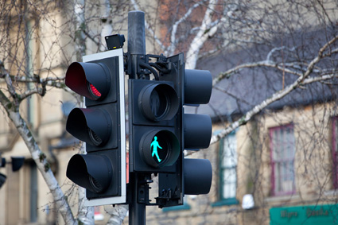
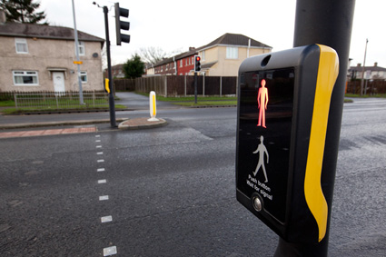
PELICAN CROSSING
PUFFIN CROSSING

Slide 4
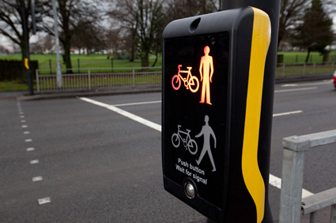
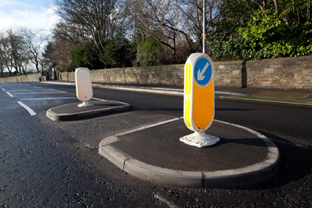
TOUCAN CROSSING
TRAFFIC ISLAND

Slide 5
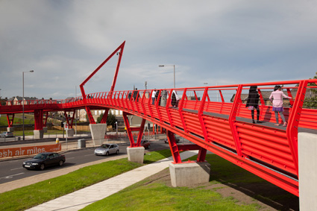
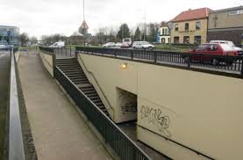
FOOT BRIDGE
SUBWAY

Slide 6
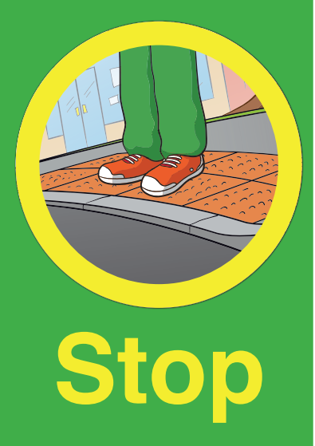

Slide 8
