Slide 1

Hand Warm-Up Exercises for Handwriting
Click on the pictures to watch the video clips!

Slide 2
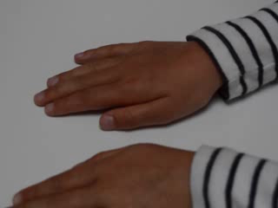
Palm up , palm down
Hand turning: Place hands palm down on the table. Turn the left hand palm up. Now turn the right hand palm up at the same time as the left hand palm down. Keep turning, speeding up until the rhythm breaks down.

Slide 3
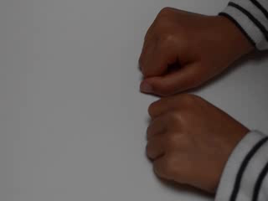
Making a fist and releasing
Clenched fist: Both hands on the table, one clenched, one stretched out. Swap clenching and stretching building up rhythm and pace. Try and do this in one fluid motion rather than moving each hand in turn.

Slide 4
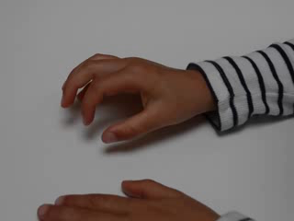
Finger to thumb
Finger loops: Touching each finger-tip in turn with the tip of the thumb.

Slide 5
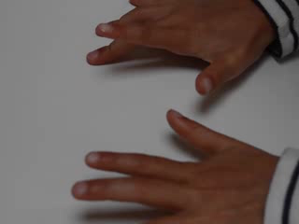
Drumming Fingers
Drumming fingers: Using the table top, tap each digit in order, then reverse order. One hand followed by the other, then reverse.

Slide 6
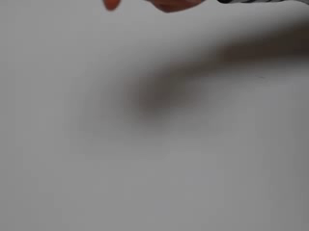
Elastic band
Tie up fingers: Put an elastic band around two fingers then wriggle it off with the fingers of the same hand.

Slide 7
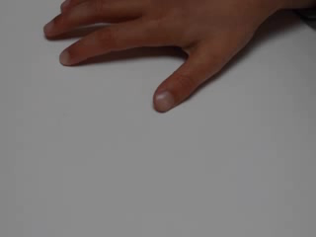
Lifting fingers
Hands flat on the table: lift each finger in turn repeat with other hand.

Slide 8
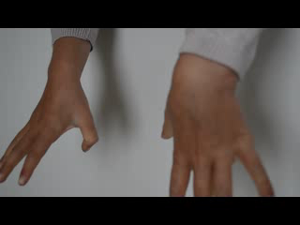
Wriggling fingers
One hand at a time: ask the pupil to wriggle fingers individually, trying to keep the other digits as still as possible.

Slide 9
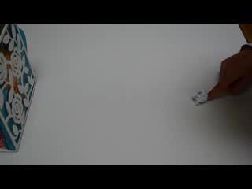
Flicking paper
Flicking paper: scrunch strips of paper into a ball – make a goal mouth with 2 bricks so that the paper can be flicked with the thumb and each finger in turn into the goal.

Slide 10
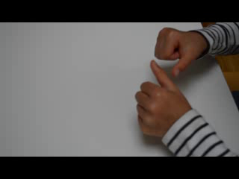
Rotating the thumb
One hand at a time: rotate thumb clockwise around first fingers, second etc.

