Slide 1
Physical Needs Team
Helping Handwriting at home
Deborah.craig@bradford.gov.uk
Department of Children’s Services

Slide 2
Primary aged children spend up to 50% of the school day emerged in writing tasks (Rosenblum, Weiss and Parish 2004)
Department of Children’s Services

Slide 3
Where to start?
Talk to your child
How do they feel about their writing?
What do they find difficult? Handwriting/ copying off board/ thinking of what to write/ any pain or tiredness in hands?
Engagement with child is very important
Department of Children’s Services

Slide 4
Where to start?
Talk to your school class teacher/ Senco
What are the difficulties as they see it?
How is handwriting taught? – scheme/ when practiced/ intervention groups
What has been tried in the past?
What alternatives are available?
Department of Children’s Services

Slide 5
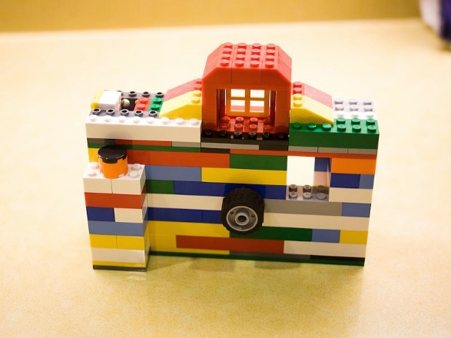
Where to start?
Be positive
Be patient
Keep it fun and short! 15 mins x 3 better than 45 mins weekly session
Handwriting practice isn’t all worksheets Click for links
Department of Children’s Services

Slide 6
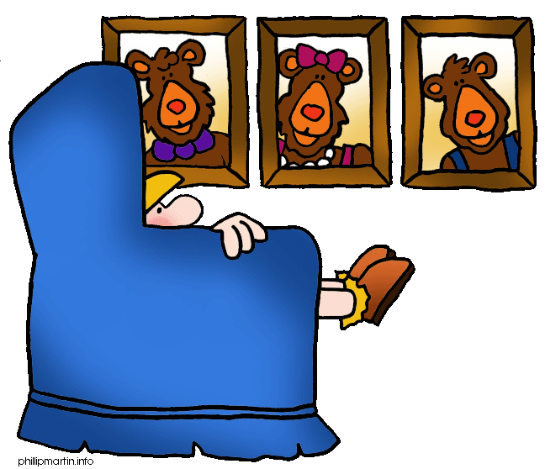
Think about chairs as well as pens or pencils
Department of Children’s Services

Slide 7
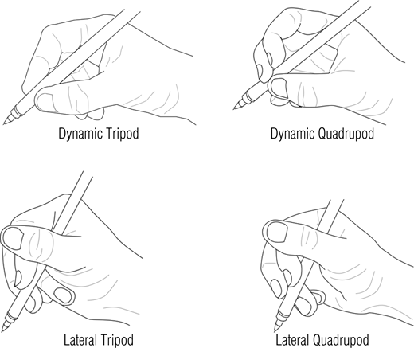
Department of Children’s Services

Slide 8
Help!! Click for links
Warm up
Fine motor
Evaluate
Pre writing patterns click for links
Handwriting practice
Department of Children’s Services

Slide 9
Frequently asked questions…….
How long shall I try this for? 20 sessions, at least more than twice a week
My child hates handwriting- what can I do?
What about using a computer?click for links
What about older students?
Department of Children’s Services

Slide 10
Remember……
You are not on your own
Progress may be in small steps
It can take time for skills to be transferred
There are other options!
Department of Children’s Services

Slide 11
For details of all the resources shared today please see our page on Bradford Schools Online
https://bso.bradford.gov.uk/content/physical-and-medical-team
Thank you!
Department of Children’s Services

