Slide 1
Supporting Children’s Emotional Wellbeing in Bradford Schools
Dr Ruth Dennis, Principal Educational Psychologist and
Lisa Stead Programme Lead and Clinical Lead
Mental Health Support Team
February 2022

Slide 2
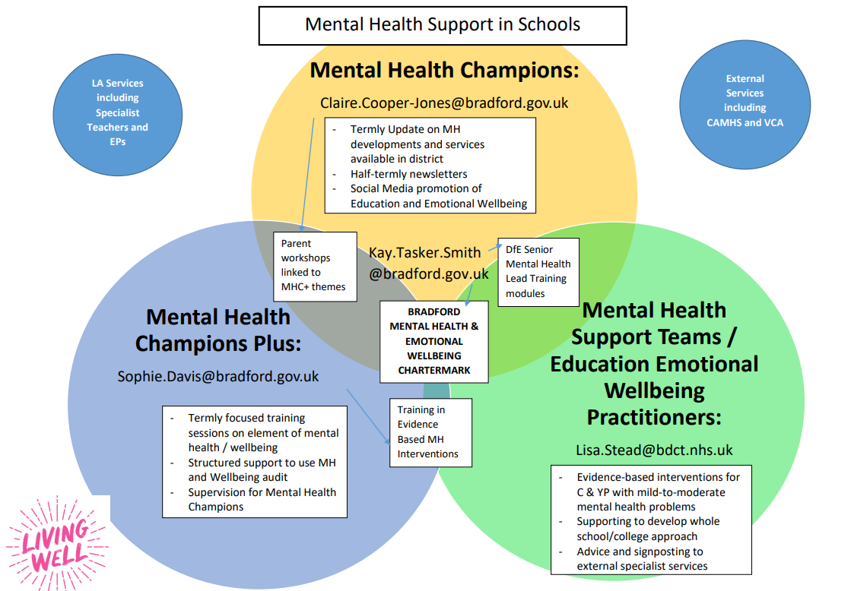

Slide 3
Mental Health Champions / Champions Plus
Sophie?
Mental Health Champions
October 2021 | 49
February 2022 | 56
May 2022
Mental Health Champions Plus
December 2021 | 51
April 2022
July 2022
Parent Workshops
December 2021 | 35
April 2022
July 2022

Slide 4
Health Minds Chartermark Data
There are 20 schools undertaking the initial stages of the Chartermark. One school dropped out as they realised they had taken too much on, but are likely to do it next year
There are 5 schools who have filled in all the paperwork formally and are gearing up to receive their award in July.
The CEO of the bdat-academies MAT is interested in the Trust doing the Chartermark –let’s see how this progresses
Bradford Grammar, independent school, have expressed an interest in the Chartermark
An early years provider has expressed interest in the Chartermark

Slide 5
EEWP reach
Number of individual referrals | 15
Number of cases seen | 10
Number of cases signposted on | 5
Gender | 9 male 6 female
Progress measures for individual cases | Data not yet available as cases not yet complete
Number of schools supported | Primary setting: 28 Secondary setting: 6
Number of children reached through Therapeutic Story Writing | 48
EEWP Workshops: CYP Evaluation
Workshop |  'average knowledge change value' |  'average whole session rating' | CYP (N)
Anxiety-Worry | 2.7 | 8.7 | 402
Exam Stress | 2.4 | 8.3 | 95
Friendship | 2.5 | 8.8 | 84
Low Mood | 3.4 | 6.9 | 9
Resilience | 2.2 | 8.8 | 11
Self Esteem | 3.8 | 9.0 | 335
 |  | Total Students reached | 936

Slide 6
EEWP and MHST Working together
Increase to 50% by 2025
Schools supported by MHST
Available to schools without MHST
Schools supported by EEWP

Slide 7
Emotional Wellbeing in Schools

Slide 8
Thrive in Bradford Schools
School Environment Promotes Good Emotional Wellbeing (MHC / MHC+ / Chartermark)
Signposted to information and support to promote Emotional Wellbeing: MHC / MHC+ / Primary Mental Health Worker / Living Well Schools /Kooth etc.
School based, goal oriented support via Graduated Approach and Matrix Of Need. Individual Plan to identify needs, implement support and monitor progress.
MHST / EEWP
Specialist services from CAMHS Crisis Team or First Response (all age crisis service) or Emergency Duty Team
Specialist goal based wellbeing support from Specialist Teacher Team / Educational Psychology / CAMHs

Slide 9
Introducing the Thrive Guide
The Thrive Guide aims to help schools identify the most appropriate support for a YP;
https://docs.google.com/document/d/1u1uB6RkuAputUTc4Ouyqkkpz5sp0I0P7/edit?usp=sharing&ouid=104706017588770577396&rtpof=true&sd=true
It should link with Living Well Schools, and hyperlink to the services and resources listed;
The Guide expands each of the THRIVE categories to include:
Information about presenting need to help you identify which level of support / intervention is required;
School based Support strategies – what you can do to support the young person
Information on which external agencies you may wish to link with based on YP needs
Suggested tools and resources that may be useful in working with the young person.

Slide 10
Questions / Next Steps
Continue Mental Health Champions and Chartermark
Approve Thrive Guidance
Share with schools
Further development of MHST / EEWP team offer
Thrive Guidance: https://docs.google.com/document/d/1u1uB6RkuAputUTc4Ouyqkkpz5sp0I0P7/edit?usp=sharing&ouid=104706017588770577396&rtpof=true&sd=true
Living Well Schools: https://schools.mylivingwell.co.uk/

