Slide 1

Senco Network
Autumn Term 2021

Slide 2
Agenda
 | Agenda (* available on you tube playlist ) | Presenter | Time
9.00 | Introductions and welcome * | Ruth Dennis – Principal Educational Psychologist | 15 minutes
9.15 | Healthy Minds Support to Schools* | Kay Tasker Smith / Sophie Davis, Specialist Senior EPs | 20 minutes
9.35 | CDC outcomes frameworks* | Josh Wadsworth - SEND Transformation and Compliance Coordinator | 15
9.50 | Update on Capita System Development* | Claire Willoughby - Business Support Manager SEND Integrated Assessment | 10 minutes
10.00 | BREAK
10.15 | 16 - 25 training* | Josh Wadsworth - SEND Transformation and Compliance Coordinator | 15
10.30 | Update from Educational Emotional Wellbeing Practitioners* | Rebecca Horn – Lead Practitioner, Education Emotional Wellbeing Team | 15 minutes
10.45 | Making request for specialist provision - what and how * | Charlie Lowe, SEND Assessment Team Manager | 10 minutes
10.55 | SEND Update and Q and A | Niall Devlin, Strategic Manager, Integrated Assessment and Psychology | 35 minutes

Slide 3
Introduction and welcome
Welcome to the virtual world!
  Senco Network live webinar
  Video available after the event
Networking opportunities – breakout groups
Skills4Bradford Senco Network: S4B / Communications / Senco Network

Slide 4
What works for you?
What topics or themes would you like to hear about at Senco network?
Are there any features you would like to see / speakers you would like to hear from?
Anything else?
Put your groups responses in the chat.

Slide 5
Health Minds Support to Schools*
Kay Tasker Smith / Sophie Davis, Specialist Senior EPs

Slide 6




Mental Health Champions (MHC) and
Mental Health Champions Plus (MHC+)
2020-21 Update
Dr Sophie Davis
Specialist Senior Educational Psychologist
October 2021
Notes:
Hi everybody, I’m Sophie Davis and I’m a Specialist Senior Educational Psychologist for mental health. This year I’m going to be working closely with Claire Cooper Jones to coordinate the Mental Health Champions and MHC+ networks. You may already be aware that there have been a few changes in this arena for the coming year so I’m just going to run through a few slides to show you what that will look like.

Slide 7

MHCs - the story so far:
Half-termly MHC network meetings:
  90mins input
  30mins small group supervision
Optional monthly supervision slots
Termly newsletters
DfE Wellbeing for Education Return training
Parent workshops
Approximately 85% Bradford schools signed up to MHC
Notes:
So, the MHC role and offer has evolved over time and every year it looks a bit different. As of last year, MHC were encouraged to access the following support from the EPT:
Half-termly network meetings, which were repeated twice for each area so that people had the flexibility to access morning or afternoon sessions. These meetings consisted of 90minutes of input, so perhaps some training on a specific topic or a presentation from a guest speaker or outside organisation, as well as some general updates. After this there was and then half an hour of smaller-group supervision.
Optional supervision slots which were offered every month, where individual MHCs had the opportunity to discuss and reflect on their own practice
MHCs also received a monthly newsletter and could access the DfE’s Wellbeing for Return to Education training.
In addition to al of this, Claire’s team also ran parent workshops in each geographical area, which usually related to the same themes covered in the MHC network meetings.
So you’ll appreciate that that was a pretty massive job for Claire and her team, especially as the vast majority of Bradford schools now have a nominated MHC. What had also become clear was that MHCs each have their own individual workloads and other commitments, and some could engage more with the MHC network than others. So, for this year it made sense to provide two slightly different offers to schools to reflect the amount of input they want and are able to commit to.

Slide 8

Changes for this year
Mental Health Champions
Mental Health Champions Plus (MHC+)
Mental Health Engaged / Enhanced / Embedded
Notes:
Towards the end of this half term the Educational Psychology Team are going to launch the various Healthy Minds-funded projects which are going to run this year. This will include the addition of a new strand of Mental Health Champions, which we’re going to call Mental Health Champions Plus, which I’ll explain in a minute.
In addition to this, we’re also introducing three new levels of engagement and support for schools, which are Mental Health Engaged, Mental Health Enhanced and Mental Health Embedded, which will also become clearer over the next few slides.

Slide 9
Mental Health Champions (MHC) “Mental Health Engaged” Claire Cooper Jones
Termly MHC update – to receive key information from Clinical Commissioning Group, other important news, and an opportunity to complete the Wellbeing in School audit Half-termly newsletter
Autumn 1 | Autumn 2 | Spring 1 | Spring 2 | Summer 1 | Summer 2
MHC |  | MHC |  | MHC
Notes:
So, what’s the difference between all of these, what would schools be committing to?
Well, as things stand at the moment, we’re planning for it to look something like this:
Mental Health Champions will continue to be coordinated by Claire, and will be for schools who identify as being “mental health engaged”. So this is schools who have a nominated MHC, who already put in some additional support for pupils around mental health and wellbeing, and who are keen to stay up to date with new developments.
This year, MHCs will be able to access termly update sessions, which will run in the first half of each term, for each geographical area, as before. These are most likely to be in Webinar format at least to start with, and will be an opportunity to receive key messages from the CCG and any other useful updates. I believe these network meetings will also be an opportunity for MHCs to complete their Wellbeing in School audits, like they’ve done before.
Claire’s team will also continue to produce a newsletter, but more frequently this year, so on a half-termly basis.

Slide 10
Mental Health Champions Plus (MHC+) “Mental Health Enhanced” Sophie Davis
As MHC, but school would also need to be developing whole-school approaches to emotional wellbeing and mental health (e.g. whole school approach training and/or DfE Senior Mental Health Leads training Termly focused training session (alternate half term to the MHC update sessions) Optional termly supervision re: whole school approaches to wellbeing and mental health School Based Emotional Wellbeing Audit
Notes:
Meanwhile, the MHC+ offer is for schools who identify as being “mental health enhanced”. So this is for schools who are doing the same things as mental health engaged schools, but who are also looking to develop whole-school approaches to mental health and wellbeing, for example by accessing training on a range of interventions such as nurture and emotion coaching, or by signing up to the DfE Senior Mental Health Leads training.
MHC+s will access the same offer as the MHCs, but will also receive:
A termly training session on a particular topic, which would be run during the second half of each term to alternate with the MHC update meetings
There will also be Termly supervision opportunities for MHC+ to discuss their role and their practice in developing whole-school approaches to mental health and wellbeing
MHC+ will also be asked to complete a School-Based Emotional Wellbeing Audit at the beginning and the end of the school year, as part of our obligation to the CCG.

Slide 11
What next?
Healthy Minds projects (MHC / MHC+ / range of emotional wellbeing whole-school interventions / Chartermark) being launched October 12th
DfE Senior Leads Training will also be promoted on this date
Begin to consider – is your school likely to be Mental Health Engaged, Mental Health Enhanced, or Mental Health Embedded?
Notes:
So that’s what things look like for this year – some changes but also lots of opportunities.
So where do we go from here?
Well, all of the Healthy Minds funded projects, so that’s all of the things I’ve been talking about, will be formally launched on 12th October.
The DfE Senior Mental Health Leads training, which you may have also heard about already, will also be promoted on this date, as Bradford are now an approved provider of training for this.
In the meantime, if you’re one of the 85% of schools who already have a MHC, it would be helpful if you can begin to consider whether your school is likely to be a “mental health engaged” school, a “mental health enhanced” school or even a “mental health embedded school! This will involve having discussions with your colleagues in Senior Leadership and thinking about what you would realistically be able to commit to over the next year.
So thank you for listening - and at this point I’m going to hand over to Kay.

Slide 12



Bradford Healthy Minds Chartermark
&
Bradford DfE Accredited Senior
Mental Health Leads Training
Bradford Educational Psychology Team
Dr Kay Tasker-Smith
Notes:
Bradford Healthy Minds Chartermark
&
Bradford DfE Accredited Senior
Mental Health Leads Training

Slide 13
Recommendations to Schools
Key Messages
We recommend that schools undertaking the Chartermark also undertake the Mental Health Leads Training, but these can be done separately
We are awaiting further instructions from the DfE regarding the grant available to schools for the Mental Health Leads Training; watch the websites
Before undertaking these initiatives, be aware that they are likely to be time consuming
Schools may choose to undertake the whole school approach via MHC+ prior to undertaking the Chartermark or the Mental Health Leads Training
Schools may already be doing an audited whole school approach; if you want to go for the Chartermark, cross reference your audit and action plan with the Chartermark audit and action plan
This collaborative partnership approach will strengthen our standing as a learning organisation

Slide 14

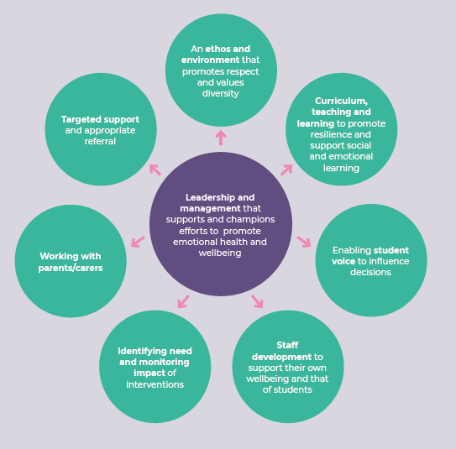
The Healthy Minds Chartermark
Rationale
The focus of the Bradford Healthy Minds Chartermark is to provide an opportunity for schools and settings to showcase the development of their whole school approach to emotional health and wellbeing.
The outcome will ensure a school ethos of attunement, relationships and connection alongside limits, safety, structure and high expectations.
The Chartermark is based on eight key principles for mental health and wellbeing as recognised by Public Health England
Notes:
The focus of the Bradford Healthy Minds Chartermark is to provide an opportunity for schools and settings to showcase the development of their whole school approach to emotional health and wellbeing.
The outcome will ensure a school ethos of attunement, relationships and connection alongside limits, safety, structure and high expectations.
The Chartermark is based on eight key principles for mental health and wellbeing as recognised by Public Health England as is the DfE Mental Health Senior Lead Training. Bradford schools undertaking the Chartermark will benefit from accessing the DfE Mental Health Senior Lead Training.

Slide 15
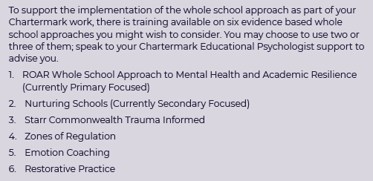
The Healthy Minds Chartermark
Trauma informed whole school approach practice is already embedded in some of our schools through the Virtual School Team who are supporting the Chartermark

Slide 16

The Healthy Minds Chartermark

Slide 17

The Healthy Minds Chartermark

Slide 18

The Healthy Minds Chartermark

Slide 19
The Healthy Minds Chartermark
Educational Psychology Team Members supporting schools include
Kay Tasker-Smith (Lead/Co-ordinator)
Carly Christie
Tessa Fox
Martin Pilkington
Cheryl Forsyth
Lisa Stead (Programme Lead and Clinical Lead Mental Health Support Team, Bradford NHS) and the team
Hannah Woods, Educational Wellbeing Practitioner Team

Slide 20
The Process
STEP 1: Have an initial consultation with Kay Tasker-Smith (contact by email in the first instance) and read STEP 2 and STEP 3 thoroughly
STEP 2: Undertake the Chartermark Self-Assessment Audit, & the Staff Questionnaire
STEP 3: (a) Do the Action Plan (b) Identify evidence
Finally Complete the Registration Form and send it through email EmotionalWellbeingChartermark@bradford.gov.uk . The Educational Psychologist allocated to your school will guide you through the form completion at the end of the process.

Slide 21
Summary of Process and Support

Slide 22


Bradford Healthy Minds Chartermark
Key Information can be found on the web page:
https://bso.bradford.gov.uk/Schools/CMSPage.aspx?mid=3582
Bradford Schools Online>Educational Psychology>Healthy Minds>Bradford Healthy Minds Chartermark
Emotional Wellbeing Chartermark email address EmotionalWellbeingChartermark@bradford.gov.uk

Slide 23
DfE Accredited Senior
Mental Health Leads Training
7 courses available to complement the Chartermark, or do separately from the Chartermark
Leadership and management
Ethos and environment
Staff development
Curriculum, teaching and learning
Coordinated support
Parents and carers
Student Voice with signposting for Audit and monitoring
Notes:
On 10 May 2021, the DfE announced £9.5m in funding so that, between September 2021 and March 2022, helping develop the knowledge and skills in settings to implement an effective whole school or college approach to mental health and wellbeing.
Bradford LA's Mental Health Senior Lead Training was approved by the DfE in August 2021, and has been written to provide learners with a thorough foundation upon which to develop a robust approach to mental health and emotional wellbeing across the school and the community it serves.
The expert and peer support offered alongside of the training will enable participants to critically evaluate their existing practice, build strategic frameworks and take practical steps to improve the emotional wellbeing of students and staff alike.
This training is designed to support school staff leading on the Healthy Minds Chartermark

Slide 24
DfE Accredited Senior
Mental Health Leads Training
The 7 available courses complement the Healthy Minds Chartermark, or can be done separately from the Chartermark
You need to do all 7 courses if you choose to do the Bradford DfE Accredited courses. They are not available individually.
There is a grant available to schools from the DfE to complete this course; please watch our own websites and the DfE website itself

Slide 25
DfE Accredited Senior
Mental Health Leads Training
Half termly group support webinar / meeting 1 hour for primary 5 - 11
Half termly group support webinar /meeting 1 hour for secondary 11 – 18
All 7 training sessions will be held on line virtually
Initial provision to set up peer support system
Initial provision to set up beacon school system
Time will be made available for all Leads who are NOT undertaking the Chartermark, for individualised support and QA of the plan they produce.
Delegates will be signposted to other websites for self directed learning of clinical aspects of the course as part of their homework offer

Slide 26

DfE Accredited Senior
Mental Health Leads Training
Key Information can be found on the web page:
https://bso.bradford.gov.uk
Bradford Schools Online>Educational Psychology>Healthy Minds>DfE Accredited Senior Leads Training
Skills4Bradford website for the dates of the two suites of 7 courses that are to be held this academic year https://skills4bradford.co.uk/
Email address: BradfordSeniorMentalHealthLeads@bradford.gov.uk

Slide 27
CDC outcomes frameworks*
Josh Wadsworth - SEND Transformation and Compliance Coordinator

Slide 28




CDC Outcomes Framework
SENCO Network Meeting September 21
V1.0

Slide 29
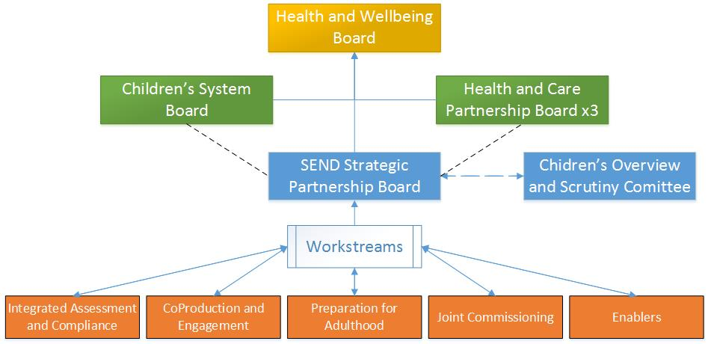
SEND Governance

Slide 30
Council Plans & Strategies - Priorities
SEND Joint Commissioning Strategy 2020 - 2023
Bradford Council SEND Strategy for Children and Young People 2018 -2022
INTERIM CHILDREN AND
YOUNG PEOPLE’S PLAN
2021-2022
  - Short Breaks - a joint comprehensive review of policy and provision in the District in response to parental feedback
  - Mental Health - improving access to the assessment pathway and support
  - Autism and ASD - improving access to the assessment pathway and support
  - Children in Care - embed processes for joint commissioning for CYP with complex care needs, through the Joint Placements Panel
  - Speech and Language Therapy – a review of contracts and provision within the local authority and CCG with a view to future joint commissioning
  - Challenging Behaviour – key feedback from parental listening events support the need for services to meet the needs of CYP with the most complex levels of behaviours that challenge
  All children and young people to:
  - Learn and achieve with the right support to be the best they can;
  - Have a voice and make decisions
  - Live in their own community;
  - Secure employment that meets individual aspirations;
  - Access health, education and social care services and information, support and guidance;
  - Access activities, short breaks and respite sessions; and
  - Participate in and contribute to their community.
  - The voice of the child
  - Prevention and early intervention
  - A whole families approach
  - Inclusion and equality
  - Partnership working and collaboration

Slide 31
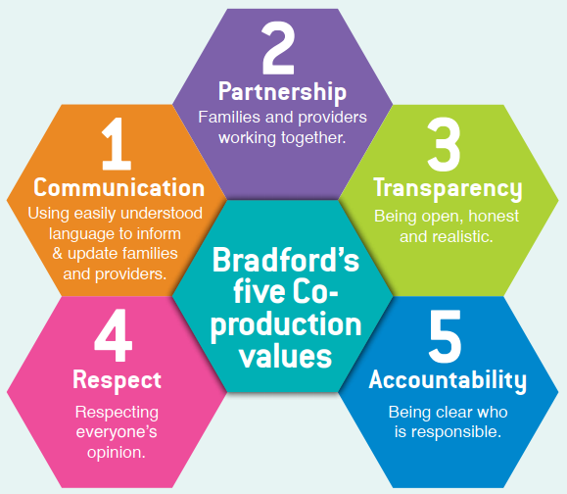

Co-production
The Outcomes have been co-produced in line with Bradford’s five Co-production values

Slide 32
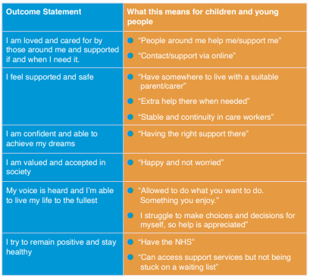

Slide 33
A good CoProduc-ed plan
I am loved and cared for by those around me and supported if and when I need it
My voice is heard and I’m able to live my life to the fullest
Person Centred Annual Reviews
QFT
Access to services
I feel supported and safe
Provision that meets needs
I try to remain positive and stay healthy
PfA
Long term outcomes
Opportun-ities post 16
I am confident and able to achieve my dreams
I am valued and accepted in society
High aspiration-s

Slide 34
A good CoProduced plan
Person Centred Annual Reviews
The Outcomes will be built into the Annual Review part of the SEND Portal and therefore be an integral part.
Ensuring outcomes are one of the main focus areas, during a review

Slide 35
Outputs vs Outcomes
An imbedded Outcomes Framework will allow Bradford to focus on what is achieved rather than what was done, following Mark Friedman’s Results Based Accountability (RBA) model.
Outcomes in Plans
Bradford’s Multi-Agency QA group have identified that Outcomes is a weak area and often confused with outputs or even provision.
It is really important that outcomes in plans are SMART and in line with CYP aspirations.

Slide 36
Outcomes Based Commissioning
Outcomes Based Commissioning (OBC) is an approach that is increasingly being adopted by Local Authorities and Clinical Commissioning Groups (CCGs), wherein services come together to develop a series of commissioning arrangements that are underpinned by the measurement of progress towards a set of shared outcomes.

Slide 37
How does OBC relate to the SEND Reforms (Children and Families Act 2014)?
  The SEND Code of Practice refers to shared outcomes as a legal ‘should’; i.e. not mandatory in the same way as a ‘must’, but nevertheless highly recommended:
“Local partners should identify the outcomes that matter to children and young people with SEN or disabilities to inform the planning and delivery of services and the monitoring of how well services have secured those outcomes.”
0-25 SEND Code of Practice

Slide 38
Council for Disabled Children – Action plan
Ensure that the 6 CYP Outcomes are communicated to teams and parent/carers through established channels.
Improve the Quality of Social Care & Health contributions to EHCPs
SEND outcomes embedded into the Annual Review Recovery Plan
Inform Quality Assurance processes
Help to develop Strategic outcomes in EHCPs
- Local Offer
- BSO
- Partnership Letter
- SENCO Network forum
- Parent Carer Groups
- Individual Service meetings
- Embedding Outcomes within the SEND Portal
SMART Outcomes
LA RP annual reviews to focus on 6 outcomes.
Tool for capturing CYP’s voice or aiding discussions
- Incorporating outcomes at system level
Monthly multi agency QA group, involving EPs, health, social care schools & parents.

Slide 39
Anticipated benefits
Better Outcomes for Children and Young People aged 0-25 years old with SEND
Clear, shared vision for professionals
Improves trust between families, professionals and strategic leads
Promotes evidenced-based commissioning
CYP’s and families’ wishes are kept front and centre
Promotes holistic view of the child
Focus on lived experience rather than delivery of services

Slide 40
Questions
If you have any questions/queries please email:
SENDTandC@bradford.gov.uk

Slide 41
16 - 25 training*
Josh Wadsworth - SEND Transformation and Compliance Coordinator

Slide 42
Family Leadership Programme
SENCO Network Meeting September 21

Slide 43
Introduction
The Family Leadership Programme is made up of 6 modules.
Each one will be delivered over 2 hours, by people with first-hand knowledge of these themes to help you support your young person.
Following Focus Groups, Listening Events and feedback from parent carer groups, it was identified that their was a lack of awareness and understanding about the support and options in Bradford. The aim of the programme is to ensure that parents and carers are well informed about opportunities and support networks that are available in Bradford. As well as promoting the importance of planning for adulthood as early as possible (Year 9 at the latest)
To address the common themes we hear via a number of channels (schools, parent/carer groups, listening events etc.)
“To ensure that families see the pathway to adulthood as a unique opportunity to look at what makes a good life for the person they care for, so each day is about their choice and their needs and interests and is a long term plan”
CEO, Snoop

Slide 44
Module 1 Introduction and Rights
To help Parents/Carers understand Person Centred Approaches, the 4 PfA Outcomes and how they can help support their young person. Describes the key elements of the Person Centred Review and how the resultant plan reflects what is important to and for the young person now and in the future, their capacities and what support they may need. Parents/Carers will also be introduced to the rights of the CYP.
Module 2 Friends, Relationships and Community Opportunities
Participants are introduced to teams and information about social inclusion and accessing community opportunities
Module 3 Independence and Independent Living
Personalises different options towards living independently, including budgeting and the various routes to many housing options including home ownership, renting, shared and supported living. Participants are introduced to a broad range of assistive technologies that support independence and listen to the personal stories of those who have taken the steps to supported independent living.
Module 4 Education, Learning and Work
Drives the vision that with the right support, people with SEND can, achieve their wants, dreams and aspirations. People with SEND can and do work and this module introduces support, including signposting to relevant professionals and organisations, routes and outcomes.
Module 5 Planning for Good Health
Parents and carers will hear about what to expect from adult health services and provision, learn about health action plans and the ways we can support young people with a learning difficulty and/or disability in mainstream health services.
Module 6 What Happens Next and Feedback
This module draws all five earlier modules together in the context of personalisation which places the young person and their aspirations at the centre of all planning and subsequent actions. To raise parents and carers awareness and how it will impact on their lives and the lives of their young person in the future. Also included Local Offer information

Slide 45
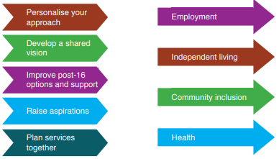
Preparation for Adulthood
  “There is a strong commitment to building on current inclusive practices. There will be a focus on key transition points in a child’s life and on life outside of settings, schools and colleges, recognising that children and young people want to enjoy play and leisure activities and to be as independent and healthy as possible in all areas of their life; be prepared for adulthood and have access to opportunities for work.”
  Bradford Council
  SEND Strategy for
  CYP 2018 -2022

Slide 46
Bradford Council SEND Strategy for CYP 2018 -2022
PfA Priorities -
I have choice and
control over things that
are important to me.
I have my plan. I am ready for the future
I can access the
activities and
information that
meet my needs and
interests.
I can live as
independently as
possible.
I am learning how
to manage my own
health and wellbeing.
I am well prepared for
the world of work.
My needs are met well by schools and settings liaising and working effectively together with health and social care agencies.
I have an effective
support network, with
friends and family.
I have access
to high quality
work experience,
supported internships
and meaningful
employment.

Slide 47
Co-production
The Family Leadership Programme (FLP) is been co-produced in line with Bradford’s five Co-production values

Slide 48
Raising awareness
“Statutory guidance accompanying the Autism Strategy places a duty on SENCOs in schools and a named person within a college with SEN oversight to inform young people with autism of their right to a community care assessment and their parents of a right to a carer’s assessment. Where a young person has an EHC plan, this should be built into their preparing for adulthood reviews.”
SEND Code of Practice Jan 2015
Bradford’s One Minute Guides
One Minute guides are a 1 page document that provide quick, simple and accessible information.
https://localoffer.bradford.gov.uk/service/1436-an-introduction--one-minute-guides

Slide 49
Legislation
The Children and Families Act 2014 came into force on September 1st 2014 and is likely to result in the most significant change to the SEN framework for over 30 years.
The SEND Code of Practice issued in June 2014 provides statutory guidance on the Act for all schools, colleges and other educational settings, local authorities and related health and care services.
The Care Act 2014 focuses on care and support of adults aged 18 and over so overlaps with The Children and Families Act 18-25 years.
The Mental Capacity Act 2005 (MCA) protects people over 16 years of age around decision making, every adult has the right to make their own decisions wherever possible.
Acts and the Code refer to person centred approaches and outcomes as an integral part of the process.

Slide 50

Resources
All resources will be made available via the Local Offer. This includes all the information covered in the modules and how to stay well-informed by using the Local Offer website.
https://localoffer.bradford.gov.uk/

Slide 51
Questions
If you have any questions/queries please email:
SENDTandC@bradford.gov.uk

Slide 52
Update from Educational Emotional Wellbeing Practitioner Team
Rebecca Horn and Lisa Aveyard
EEWP Team

Slide 53
Making request for specialist provision - what and how *
Charlie Lowe, SEND Assessment Team Manager

Slide 54
Requesting a specialist provision
Charlie Lowe
SEN Team Manager

Slide 55
Consultation process
Requested through an annual review by the Parent or those with parental responsibility
Schools cannot request a consultation
Schools have 15 days to respond

Slide 56
Special School Compatibility
CYP with a Severe or Profound cognitive impairment
Additional needs of ASD, SLCN, PD, HI, VI, MSI

Slide 57
Types of special school
SLD, PMLD, ASD, SLCN, PD, VI, HI, MSI
SEMH

Slide 58
Types of Resourced Provision
MLD/SLD
SLCN
ASD
SEMH
PD
MSI – VI / HI

Slide 59
SEND Q and A
Niall Devlin, Strategic Manager, Integrated Assessment and Psychology

Slide 60
Feedback or Questions
Ruth Dennis - Principal Educational Psychologist
City Of Bradford Metropolitan District Council
Margaret McMillan Tower
Princes Way
BRADFORD
BD1 1NN
ruth.dennis@bradford.gov.uk
07582 109129
01274 439417

Slide 61
Date of next meeting
Spring: 26/01/22
Summer: 18/05/22
Book via S4B

Slide 62

Questions

