Slide 1
Senco Network
Summer Term 2023

Slide 2
Agenda
 | Agenda | Presenter | Time
9.00 | Introductions and welcome | Ruth Dennis – Principal Educational Psychologist | 10 minutes
9.10 | Working together to Support Children with SEND | Ruth Dennis– Principal Educational Psychologist | 40 minutes
9.50 | Planning for Next Year | Ruth Dennis– Principal Educational Psychologist | 20 minutes
10.05 | Break – BSL Poster |  | 15 minutes
10.15 | Annual Reviews, Annual Review Team and Portal Including setting targets for Y5 transition reviews | Charlie Lowe SEND Team Service Manager | 60 minutes
11.15 | SEND Q and A | Charlie Lowe SEND Team Service Manager | 25 minutes

Slide 3
Introduction
Welcome
Feedback from last time:
Notional SEN Funding on BSOL
New Senco Section
WAGOLL EHCA referrals
Updates from the LA
Children’s Trust launched
Review of AD roles
Changes in SEN team

Slide 4
Working together to Support Children with SEND
Ruth Dennis – Principal Educational Psychologist
March 2023

Slide 5
Right Support, Right Place, Right Time
National standards will improve early identification of needs and intervention, and set out clear expectations for the types of support that should be ordinarily available in mainstream settings.
This will give families and providers clarity, consistency and confidence in the support that is ordinarily available, in order to be responsive to children’s needs. With these expectations, and improved mainstream provision, more children and young people will receive the support they need through ordinarily available provision in their local setting.
Fewer will therefore need to access support through an Education, Health and Care Plan (EHCP).
(Special Educational Needs and Disabilities (SEND) and Alternative Provision (AP) Improvement Plan Right Support, Right Place, Right Time March 2023)

Slide 6
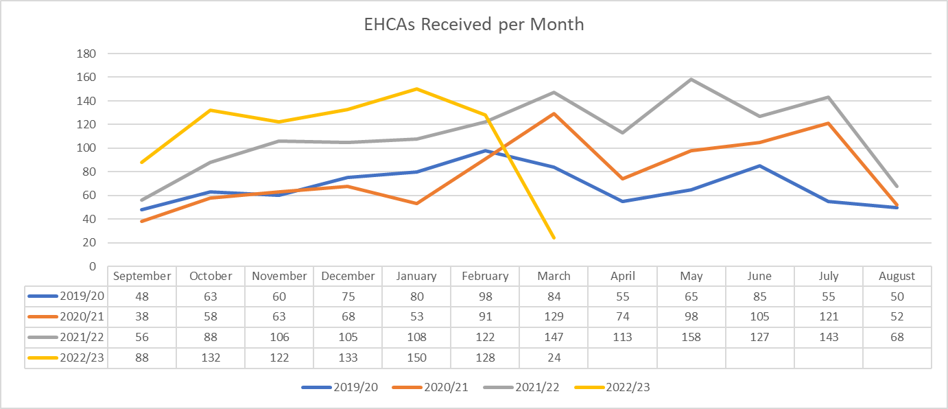
EHCA Requests
The number of CYP with an Education Health and Care (EHC) plan continues to rise and we are expecting 10% growth per year. There are currently 5547 children and young people with an EHC plan in the Bradford District (April 2023).

Slide 7
When should a local authority carry out an EHC needs assessment?
If a local authority (“LA”) is requested to carry out an EHC needs assessment by a parent, young person, school or college, they must consider:
whether the child or young person has or may have special educational needs (“SEN”);
whether they may need special educational provision to be made through an EHC plan

Slide 8
Evidence to inform decision to carry out EHCA
The local authority should consider whether there is evidence that:
“despite relevant and purposeful action to identify, assess and meet the special educational needs of the child or young person, the child or young person has not made expected progress”. *
The COP paragraph 9.1 says: LA should pay particular attention to:
evidence of the child or young person’s academic attainment (or developmental milestones in younger children) and rate of progress;
information about the nature, extent and context of the child or young person’s SEN;
evidence of the action already taken by the school or other setting;
evidence that where progress has been made, it has only been as the result of much additional intervention and support over and above that which is usually provided;
evidence of the child or young person’s physical, emotional and social development and health needs, drawing on relevant evidence from clinicians and other health professionals and what has been done to meet these by other agencies.
* Children and Families Act 2014

Slide 9
When we don’t have clear evidence…
The quality of evidence does not provide sufficient information / align to the legal criteria
Mediation
School provides additional information
Panel decision overturned – decision to assess
Panel declines
Impact on School?
Impact on family?
Impact on LA?

Slide 10
How to make things better
National standards will improve early identification of needs and intervention, and set out clear expectations for the types of support that should be ordinarily available in mainstream settings
In the meantime:
Local guidance and training as to what information is required for a good EHCA request
WAGOLL – examples of good referrals on BSOL
Best Practice checklist for referrers
School representatives on panel
Clearer feedback from panel regarding decline decision

Slide 11
Basics
Ensure parental consent
Ensure parents views included
Ensure CYP views included.

Slide 12
Evidence of the child or young person’s academic attainment and rate of progress;
National Curriculum levels (not just WT – give indicative curriculum level)
Early Support Developmental Journal (not just EYFS)
Evidence of progress over time - at least annual data (6m for EY)
EY / School age progress grids (BSOL)

Slide 13
Information about the nature, extent and context of the child or young person’s SEN;
For example
Reference Matrix of Need

Slide 14
Evidence of the action already taken by the school or other setting;
For example:
MSP / other to demonstrate intervention has been put in place over time, reviewed and refined
MSP review

Slide 15
Where progress has been made, it has been as the result of much additional intervention and support over and above that which is usually provided;
For example:
Evidence of strategies being over and above that which is usually provided at School support, not just quality first teaching (reference Matrix of Need)
Evidence of use of Notional SEN funding:
Timetable showing when supported.
Details of support (not just ‘22 hours’)
Pro rata support (1 hour as part of group of 4 = 15 minutes support)

Slide 16
Evidence from external agencies.
For Example:
Reports from external professionals eg Educational Psychology, SALT etc.
Request EP provides a provision grid as part of their work with a young person
Evidence that recommendations of professionals have been implemented and impact

Slide 17
Have your say!
Split into breakout rooms;
Discuss the element of evidence assigned to your group
Use JAM board to add any additional suggestions
https://jamboard.google.com/d/1JTJLhgYEo5Dw7548LyII9702BsrgJ1A-5-Ju4inmBHk/edit?usp=sharing

Slide 18
How to make things better
National standards will improve early identification of needs and intervention, and set out clear expectations for the types of support that should be ordinarily available in mainstream settings
In the meantime:
Local guidance and training as to what information is required for a good EHCA request
WAGOLL – examples of good referrals on BSOL
Best Practice checklist for referrers
School representatives on panel
Clearer feedback from panel regarding decline decision

Slide 19
Planning for Senco Network 2023 - 24

Slide 20
Please complete the survey
What works?
What Doesn’t work?
What can we do more of?
What should we do less of?
https://forms.gle/4sU66rC56R8b6UvD6

Slide 21
Break

Slide 22
Integrated Assessment Team Annual Reviews with consultations

Slide 23
What is a Review?
Statutory process where, at least annually, the progress towards outcomes in conjunction with needs and provision is formally reviewed.
The first review of the EHC plan must be held within 12 months of the EHC plan being finalised.
Subsequent reviews must be held within 12 months of the previous review.
Pre 5 reviews must be held every 6 months

Slide 24
Pupil voice
1.10 CoP 2015
Local authorities must not use the views of parents as a proxy for young people’s views. Young people will have their own perspective and local authorities should have arrangements in place to engage with them directly.
CYP views can only be from the Child / Young Person
Aspirations must be personal which create the…

Slide 25
Pupil voice
What would mean the most for that child / young person?
Could views be represented pictorially?
Would short phrases supplemented by symbols work?
Does the child / young person use alternative communication?

Slide 26
When proposing amendments
Any significant amends proposed to sections B and F, where both needs and provision are being heavily re-written with a significant increase in support, will require a professional report
Schools must commission these from a suitably qualified professional (EP or Specialist Teacher).

Slide 27
When proposing amendments
Section F cannot name settings or schools
Do not name internal provisions within Section F
Funding is base don provision on Section F

Slide 28
Tracking changes

Slide 29
Tracking changes
If struggling…
New information is written in blue italics
Please indicate in brackets which reports these amendments have originated from, i.e. (J Boggs, Educational Psychology report 05.05.2020, page 6)
Information to be removed is coloured red with a strikethrough

Slide 30
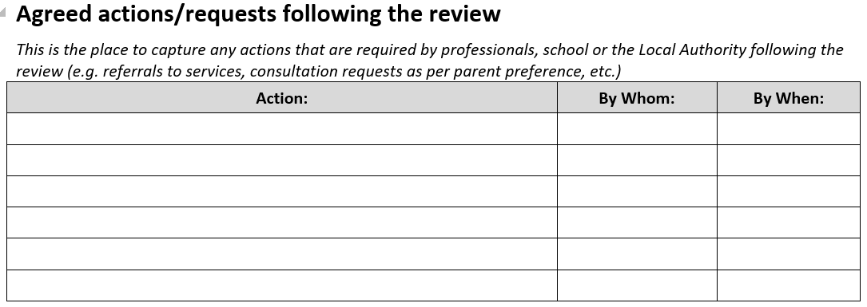
Agreed actions/requests following the review
Capture any actions that are required by professionals, school or the Local Authority following the review
Any actions not appropriately recorded may not be actioned causing delays

Slide 31
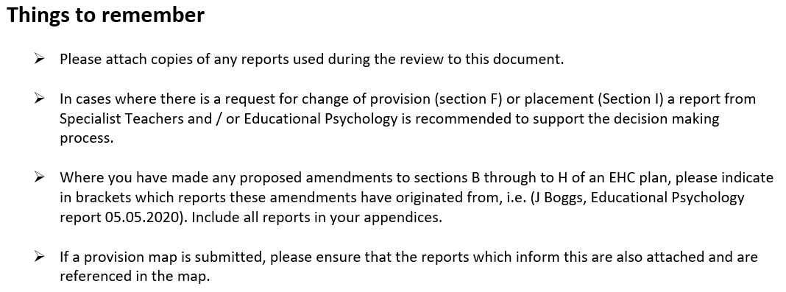
On the last page of the annual review paperwork…

Slide 32
Those not attending your school
Should monitor progress towards the outcomes throughout the year
If a child / young person is attending alternative provision then the school they are on roll at must still hold the review, not the alternative provision
If medically unwell to attend then the school must still co-ordinate and chair the review meeting

Slide 33
Getting your data right
Use the appropriate assessment tool for that year group
Do not use the EYDJ past the first term of year 1
Use pre-key stage standards or engagement model
Impact on the LA decision making
impact on families following naming of settings

Slide 34
Broad areas of need
6.27 (SEND CoP)
These four broad areas give an overview of the range of needs that should be planned for. The purpose of identification is to work out what action the school needs to take, not to fit a pupil into a category. In practice, individual children or young people often have needs that cut across all these areas and their needs may change over time. For instance speech, language and communication needs can also be a feature of a number of other areas of SEN, and children and young people with an Autistic Spectrum Disorder (ASD) may have needs across all areas, including particular sensory requirements. A detailed assessment of need should ensure that the full range of an individual’s needs is identified, not simply the primary need. The support provided to an individual should always be based on a full understanding of their particular strengths and needs and seek to address them all using wellevidenced interventions targeted at their areas of difficulty and where necessary specialist equipment or software.

Slide 35
Types of settings
Suitability – age, aptitude, ability and SEN
Schools who support children with SLD
High Park
Chellow Heights
Co-op Academy Delius
Beckfoot Phoenix
Southfield
Beechcliffe
Hazelbeck

Slide 36
The right to request a particular school or other institution is named in an EHC Plan
Section 38 (3)
A school or other institution is within this subsection if it is:
(a) a maintained school;
(b) a maintained nursery school;
(c) an Academy;
(d) an institution within the further education sector in England;
(e) a non-maintained special school;
(f) an institution approved by the Secretary of State under section 41

Slide 37
The Right to a Mainstream Education
Section 33 (2)
In a case within section 39(5) or 40(2), the local authority must secure that the plan provides for the child or young person to be educated in a maintained nursery school, mainstream school or mainstream post-16 institution, unless that is incompatible with—
(a) the wishes of the child’s parent or the young person, or
(b) the provision of efficient education for others

Slide 38
The LA cannot deny a child or young person mainstream education on the grounds that it is not suitable for them or that it is too expensive for them to attend a mainstream school/institution.
There are only two exceptions on which an LA can rely if they do not want to name a mainstream school or college placement in an EHC Plan set out in Section 33 (2) (a) and (b). The first (section 33 (2) (a)) is where it is against the child’s parent or young person wishes. The second (section 33 (2) (b) is incompatibility with the provision of efficient education for others (“the efficient education of others exception”).

Slide 39
The circumstances in which the “efficient education of others” exception can be relied on are limited
A local authority can only rely on this exception if it can show that there are no reasonable steps that it could take to prevent the incompatibility (section 33 (3) in relation to schools and institutions in its area and section 33 (4) in relation to a particular maintained nursery school, mainstream school or mainstream post-16 institution).
The governing body of a school or institution can only rely on this exception if they can show that there are no reasonable steps which they or the local authority could take to prevent the incompatibility (section 33 (5)).
The Code contains a discussion of what may constitute “reasonable steps” in paragraph 9.91.

Slide 40
The statutory process
LA consults with Section 38 (3) schools or other institution
Parents may also request a particular setting to be consulted
Setting has 15 days to respond
LA reviews response and make decision to name
If no response is given within 15 days then the LA can name without a response on the 16th day
Notes:
s38 (3) school or other institution:
(a) a maintained school;
(b) a maintained nursery school;
(c) an Academy;
(d) an institution within the further education sector in England;
(e) a non-maintained special school;
(f) an institution approved by the Secretary of State under section 41

Slide 41
The Secretary of state
Non statutory steps
Challenge the school response
Provide further opportunities for the school to give information
Can we make a decision based on this new information?

Slide 42
When do we challenge a response?
Further information may be required following consultation as the response may be brief or lack information required for making a decision. This is described as stage 2 casework.
Negative responses will be challenged via the ‘challenge email’ only if Insufficient information has been provided
The challenge email should pick out details from the original consultation and ask for further clarity
Further information may be required such as:
Number of commissioned places used and number available overall (not in a specific year group). Clarity around which setting is parent preference
Further professional reports

Slide 43
The challenge
Read the settings response
Have they itemised the parts of section F they cannot provide and the reasons why?
Have they school suggested reasonable adjustments?
What detail is contained in the response?
Is the response simply long and has no substance?
Notes:
If the consultation documentation does not include the draft EHCP and all the evidence listed in section K of the EHCP, there could be grounds to challenge the local authority’s consultation requirements.

Slide 44
The enhanced process
Stage 1: consult
Read the response against the EHC plan
Is the information given sufficient? Are you asking yourself questions?
Have the school suggested reasonable steps?
Stage 2: challenge
Highlight section F to the school
Provide an opportunity for them to provide reasonable steps

Slide 45
The enhanced process continued
Stage 3: panel
Only place to panel when all consultations have been returned and all information is collated.
Panel will either:
Name the school giving legal reasons why
Not name the school giving legal reasons why
Request for a multiagency meeting giving instruction to professionals to attend the meeting in the panel outcome
Stage 4: multiagency meeting
Information gather
Continue conversation around training, guidance support and funding

Slide 46
The enhanced process continued
Stage 5: Bring back to panel for decision
Submit your notes and action from multiagency meeting (include requests form school)
School is named and resourcing allocated
School is not named and further casework required
Stage 6: School refuses to place
Direction letter sent
School choose to appeal or work with support services

Slide 47
Caselaw
Bury Metropolitan Borough Council v SU [2010] UKUT 406 (AAC): when considering the right of a child with a Statement (now an EHC plan) to a placement in a mainstream school, whether or not the school is “suitable” is not a relevant consideration. The only issue to consider is whether attendance at the mainstream school would be incompatible with the education of other children and if so, that incompatibility cannot be removed by the taking of “reasonable steps”.
Harrow Council v AM [2013] UKUT 0157 (AAC): Where a parent requests a mainstream school and there is no suitable school available (whether inside or outside its area), the LA is under an absolute obligation to make a mainstream school suitable to meet the child’s needs, subject only to the qualification that it must be compatible with the efficient education of other children.

Slide 48
Review timetable

Slide 49
Correspondence
By June 9th 2023 families will receive letters requesting their preferences
All schools received a copy of this letter in April via email
Striving towards being an electronic service therefore would request that responses are via email.
Respond to the below email address using the following codes in the body of your email response:
transitionreviews@bradford.gov.uk
PP – name of setting
PP – name of setting
PP – name of setting

Slide 50
Transition reviews key dates
Friday 21st July 2023 - all reviews for F1, Y5 & Y10 are completed
Friday 15th September 2023 – request for mainstream provisions
Friday 29th September 2023- requests for Specialist Provision (including Resourced Provisions)

Slide 51
When will families find out?
Primary and Year 7 placements will be announced by 15th February 2024
Post 16 placements will be announced by 31st March 2024

Slide 52
Thank you

Slide 53
SEN Q and A

