Slide 1
Senco Network
Summer Term 2022

Slide 2
Agenda
 | Agenda | Presenter | Time
9.00 | Introductions and welcome | Ruth Dennis – Principal Educational Psychologist | 5 minutes
9.05 | Improving Outcomes for Children with SEND in Bradford | Ruth Dennis – Principal Educational Psychologist | 20 minutes
9.10 | Mental Health - Thrive Guide for Schools RD / LS | Ruth Dennis – Principal Educational Psychologist Lisa Stead - Programme Lead and Clinical Lead Mental Health Support Team | 15 minutes
9.55 | Update from SEN Transformation and Compliance Team | Sally Skipper - SEND Transformation and Compliance Coordinator | 15 minutes
10.10 | BREAK |  | 10 minutes
10.20 | Neurodiversity Future Pathway Update | Ruth Dennis - Principal Educational Psychologist | 15 minutes
10.55 | Annual Reviews and Phase Transfers / detail of July day | Charlie Lowe - 0-25 Integrated Assessment Team Manager/ Linzi Milward - 0-25 Integrated Assessment Team Assistant Manager | 30 minutes
11.00 | SEND Update and Q and A (including Personal Budget Training) | Niall Devlin / Charlie Lowe Strategic Manager, Integrated Assessment and Psychology | 30 minutes

Slide 3
Improving Outcomes for Children with SEND in Bradford
Ruth Dennis
Principal Educational Psychologist

Slide 4
SEND Green Paper
It sets out plans for an inclusive system:
improved mainstream provision
early and accurate identification of needs
high-quality teaching
prompt access to targeted support
Timely access to specialist services and support
Strong co-production with families
Accountability at every level
Improved data collection to give a timely picture of how the system is performing.

Slide 5
Ofsted Judgement (probably!)
Better communication across the system – aims and vision
Greater focus on SEND Support
Greater focus on progress for children with SEND

Slide 6
Improving Outcomes for Children with SEND in Bradford
Neurodiversity Future Pathway
Mental Health and Emotional Wellbeing
Trauma and Resilience
Improving progress for children with SEND
Meeting Individual Needs

Slide 7
Promoting Neurodiversity and Supporting schools via
ND Future Pathway Pilot
ND Profile
ND Friendly Schools Charter
AET training

Slide 8
Mental Health and Emotional Wellbeing
Supporting schools via
Mental Health Champions / MHC Plus
DfE Mental Health Lead
Healthy Minds Chartermark
Mental Health Support Teams
Education Emotional Wellbeing Practitioners
Thrive Guide for Schools
Living Well Schools

Slide 9
Trauma and Resilience
Supporting schools via
TRM Trauma informed model
SAFE project
Virtual School Support

Slide 10
Improving progress for children with SEND
Supporting schools via
SEND Spotlight Conferences
Improving Progress for Children with SEND Project
Developing SEND good practice ‘Beacon schools’
Revisioning SEND – Project to look at how we can do things differently post Covid

Slide 11
Meeting Individual Needs
Continuing to develop Statutory and Pre statutory processes:
New / New to Bradford Senco support
Panel engagement
Annual Review Team
Quality Assurance
JAMs

Slide 12
SEND Spotlight Conferences
2022 - 23 | Autumn 1 Senco Network (online) | Autumn 2 SEND Spotlight Conference – Improving Outcomes for children with SEND | Spring 1 Senco Network (online) | Spring 2 SEND Spotlight Conference – Neurodiversity | Summer 1 Senco Network (online) | Summer 2 SEND Spotlight Conference – Meeting Individual Needs
2023 - 24 | Autumn 1 Senco Network (online) | Autumn 2 SEND Spotlight Conference – Improving Progress for children with SEND | Spring 1 Senco Network (online) | Spring 2 SEND Spotlight Conference – Trauma and Resilience | Summer 1 Senco Network (online) | Summer 2 SEND Spotlight Conference – Mental Health

Slide 13
Feedback
Are these the right things to focus on?
Have we missed anything?
How likely are you to attend the Senco Networks?
Which projects are you interested in?
How likely are you to attend the conferences?
Other comments
Please fill in the Google Form: https://forms.gle/KEm3PkCvNkYAk2wcA

Slide 14
Supporting Children’s Emotional Wellbeing in Bradford Schools
Dr Ruth Dennis, Principal Educational Psychologist and
Lisa Stead Programme Lead and Clinical Lead
Mental Health Support Team
May 2022

Slide 15
Complexities of Supporting Emotional Wellbeing in School
Who to refer to;
Pathways
Lack of CAMHs support / School Nurse support
School Responsibilities

Slide 16
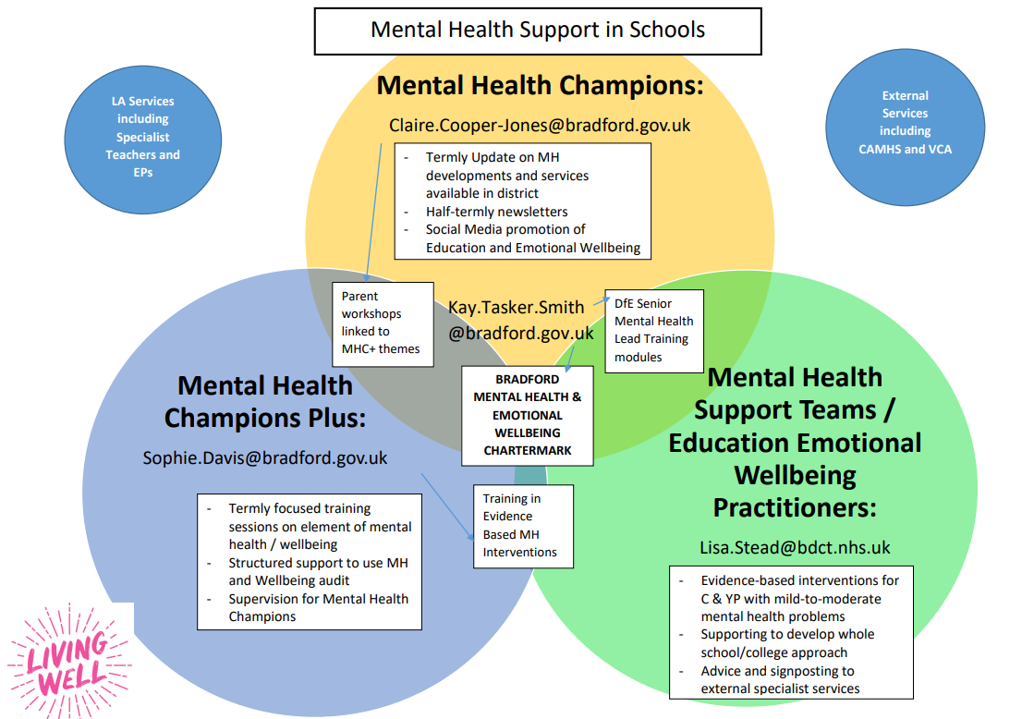

Slide 17
EEWP and MHST Working together
Increase to 50% by 2025
Schools supported by MHST
Available to schools without MHST
Schools supported by EEWP

Slide 18
Thrive Framework
The THRIVE Framework provides a set of principles for creating coherent and resource-efficient communities of mental health and wellbeing support for children, young people and families.
It aims to talk about mental health and mental health support in a common language that everyone understands.
The Framework is needs-led. This means that mental health needs are defined by children, young people and families alongside professionals through shared decision making.
Needs are not based on severity, diagnosis or health care pathways. The THRIVE framework is for all children and young people aged 0–25 within a specified locality and their families;

Slide 20
Emotional Wellbeing in Schools
School Environment Promotes Good Emotional Wellbeing
Signposted to information and support to promote Emotional Wellbeing including 3rd Sector
School based goal oriented support via Graduated Approach and Matrix Of Need
Specialist services from CAMHs
Specialist goal based wellbeing support from SCIL Teacher / Educational Psychology / CAMHs

Slide 21
Good Mental Health
Around 80% of children at any one time are experiencing the normal ups and downs of life but do not need individualised advice or support around their mental health issues.
They are considered to be in the ‘Thriving’ group and benefit from whole school practices promoting emotional wellbeing including:
Identified SMT lead for Emotional Wellbeing
DfE lead training
Relational approach
Healthy Minds Chartermark

Slide 22
Signpost to information and support to promote Emotional Wellbeing
This group includes both those with mild or temporary difficulties AND those with fluctuating or ongoing severe difficulties, who are managing their own health and not wanting goals-based specialist input.
School maintains up to date information on resources and other sources of support to support Emotional Wellbeing
Information is shared such that it empowers young people and families to find the best ways of supporting their mental health and wellbeing.
School actively engaged in :
Mental Health Champion
Mental Health Champion Plus
Primary Mental Health Worker
Signposting to Kooth etc.

Slide 23
School based goal oriented support via Graduated Approach and Matrix Of Need
This group comprises of CYP and families who would benefit from focused, goals based support, with clear aims, and criteria for assessing whether these aims have been achieved.
Individual Plan to identify needs, implement support and monitor progress.
Key-working approaches to ensure the child / young person has a trusted adult support during vulnerable times.
Additional adult support from delegated SEN budget (up to 16 hours) to facilitate:
Social and emotional skills taught explicitly individually or as part of group.
Intervention programmes with familiar skilled and experienced staff
Planned, frequent time in smaller groups and individually in order to develop social skills and emotional regulation.

Slide 24
Specialist goal based wellbeing support
This is not conceptually different from the previous group however requires more extensive, specialist goal based support.
External resource allocation for a small number of individuals may require particular attention and coordination from those providing services across the locality.
For example: assessment, consultation and intervention for staff and students, from external support services:
Specialist Teacher (SCIL) Team
Educational Psychology
CAMHs

Slide 25
Specialist Services
Those in crisis/approaching crisis who may present at risk to themselves and others, requiring an urgent /same day response
CAMHS Crisis Team or
First Response (all age crisis service)
Emergency Duty Team

Slide 26
Introducing the Thrive Guide
The Thrive Guide aims to help schools identify the most appropriate support for a YP;
https://docs.google.com/document/d/1u1uB6RkuAputUTc4Ouyqkkpz5sp0I0P7/edit?usp=sharing&ouid=104706017588770577396&rtpof=true&sd=true
It should link with Living Well Schools, and hyperlink to the services and resources listed;
The Guide expands each of the THRIVE categories to include:
Information about presenting need to help you identify which level of support / intervention is required;
School based Support strategies – what you can do to support the young person
Information on which external agencies you may wish to link with based on YP needs
Suggested tools and resources that may be useful in working with the young person.

Slide 27
Thrive Area | THRIVING Those whose current need is support in maintaining mental wellbeing through effective prevention and promotion strategies | Bradford Mental Health in Schools Guidance GETTING ADVICE Those who need advice and signposting | GETTING HELP Those who need focused goal-based input | GETTING MORE HELP Those who need more extensive and specialised goal-based help | GETTING RISK SUPPORT Those in crisis/approaching crisis who may present at risk to themselves and others, requiring an urgent /same day response
Presenting Needs | Around 80% of children at any one time are experiencing the normal ups and downs of life but do not need individualised advice or support around their mental health issues. They are considered to be in the ‘Thriving’ group and benefit from whole school practices promoting emotional wellbeing, for example: Feeling low after a poor test result; Falling out with a friend Feeling sad after a bereavement. | This group includes both those with mild or temporary difficulties AND those with fluctuating or ongoing severe difficulties, who are managing their own health and not wanting goals-based specialist input, for example: Coming to terms with neuro diversity issues Issues relating to sexuality Mild worries Friendship issues Family problems / home life | This group comprises of CYP and families who would benefit from focused, goals based support, with clear aims, and criteria for assessing whether these aims have been achieved, for example: Anger outbursts Mild anxiety Friend / Family / Home Issues (significant) Low Self Esteem Mild depressive Symptoms Eating Issues (change in weight/eating habits, Negative body image. | This is not conceptually different from the previous group however requires more extensive, specialist goal based support, for example: Complex Trauma Depressive Symptoms Eating Issues (change in weight/eating habits, Negative body image, purging or binging) Hyperactivity (levels of over activity and impulsivity Increased levels of self-harm Mood Disturbance Obsessive thoughts and/or compulsive behaviours Moderate Anxiety Some thoughts of ending life with no plan or intent | This group demonstrate the most complex mental health issues requiring highly specialist support for example: Delusional thoughts Increased levels and risk associated with self-harming Psychotic symptoms (hearing and/or appearing to respond to voices, overly suspicious) Suicidal ideation with plan and intent Thoughts of harming others or actual harming/violent behaviours towards others and associated mental health disorder
School based Support Strategies | Core School Offer Whole school approach to supporting emotional wellbeing; Identified SMT lead for Emotional Wellbeing DfE lead training Relational approach to manage behaviour Social and emotional skills modelled and taught explicitly throughout curriculum Healthy Minds Chartermark | Core School Offer School maintains up to date information on resources and other sources of support to support Emotional Wellbeing Information is easily available and shared such that it empowers young people and families to find the best ways of supporting their mental health and wellbeing. School actively keeps up to date via Mental Health Champions or Mental Health Champions Plus | School Support Level or EHCP (Code of Practice) Use of graduated response framework (Matrix of Need) Individual Plan / MSP to identify needs, implement support and monitor progress. Key-working approaches to ensure the child / young person has a trusted adult support during vulnerable times. Additional adult support from delegated SEN budget (up to 16 hours) Social and emotional skills taught explicitly individually or as part of group. Intervention programmes with familiar skilled and experienced staff Planned, frequent time in smaller groups and individually in order to develop social skills and emotional regulation. | School Support Level or EHCP (Code of Practice) As with previous but also referral to external service or school based MHP For example: Assessment, consultation and intervention from educational psychologist 6 weeks 1:1 evidence based intervention from Educational Emotional Wellbeing practitioner. | School Support Level or EHCP (Code of Practice) As with previous but also referral to external health based team. Support other agencies to understand the YP and their context A multi-agency response including Social Care is usually required
Accessing External Help | See Living Well Schools https://schools.mylivingwell.co.uk/ Specifically: | See Living Well Schools https://schools.mylivingwell.co.uk/ Specifically: Kooth Qwell SELFA Night Owls School Nurse Guideline Health Champions* Mental Health Champions Plus* *Support to staff National Resources: Childline Young Minds | See Living Well Schools https://schools.mylivingwell.co.uk/ Specifically: Youth in Mind Compass PHOENIX SCIL team SEND Hubs Educational Psychology Consultation hubs Mental Health Support Team Educational Emotional Wellbeing Practitioners Primary Mental Health Workers | See Living Well Schools https://schools.mylivingwell.co.uk/ Specifically: Specialist Teacher (SCIL) Team Educational Psychology CAMHs / Specialist CAMHS | See Living Well Schools https://schools.mylivingwell.co.uk/ Specifically: CAMHS Crisis Team or First Response (all age crisis service) Emergency Duty Team Young People Safer Space
Suggested Tools and Resources | ROAR Whole School Approach to Mental Health and Academic Resilience (primary focussed) Nurturing Schools (secondary focussed) Bradford Health Minds Chartermark Anna Freud Whole School Approach | Circle time Assemblies | Think Good, Feel Good Lego therapy Rainbow Fish, Socially Speaking Big book of worries Zones of regulation Nurture Group Worry Monsters | Therapeutic Story Writing Trauma Informed Practice Zones of Regulation Emotion Coaching
Bradford Mental Health in Schools Guidance
Presenting Needs | Around 80% of children at any one time are experiencing the normal ups and downs of life but do not need individualised advice or support around their mental health issues. They are considered to be in the ‘Thriving’ group and benefit from whole school practices promoting emotional wellbeing, for example: Feeling low after a poor test result; Falling out with a friend Feeling sad after a bereavement. | This group includes both those with mild or temporary difficulties AND those with fluctuating or ongoing severe difficulties, who are managing their own health and not wanting goals-based specialist input, for example: Coming to terms with neuro diversity issues Issues relating to sexuality Mild worries Friendship issues Family problems / home life | This group comprises of CYP and families who would benefit from focused, goals based support, with clear aims, and criteria for assessing whether these aims have been achieved, for example: Anger outbursts Mild anxiety Friend / Family / Home Issues (significant) Low Self Esteem Mild depressive Symptoms Eating Issues (change in weight/eating habits, Negative body image. | This is not conceptually different from the previous group however requires more extensive, specialist goal based support, for example: Complex Trauma Depressive Symptoms Eating Issues (change in weight/eating habits, Negative body image, purging or binging) Hyperactivity (levels of over activity and impulsivity Increased levels of self-harm Mood Disturbance Obsessive thoughts and/or compulsive behaviours Moderate Anxiety Some thoughts of ending life with no plan or intent | This group demonstrate the most complex mental health issues requiring highly specialist support for example: Delusional thoughts Increased levels and risk associated with self-harming Psychotic symptoms (hearing and/or appearing to respond to voices, overly suspicious) Suicidal ideation with plan and intent Thoughts of harming others or actual harming/violent behaviours towards others and associated mental health disorder

Slide 28
School based Support Strategies | Core School Offer Whole school approach to supporting emotional wellbeing; Identified SMT lead for Emotional Wellbeing DfE lead training Relational approach to manage behaviour Social and emotional skills modelled and taught explicitly throughout curriculum Healthy Minds Chartermark | Core School Offer School maintains up to date information on resources and other sources of support to support Emotional Wellbeing Information is easily available and shared such that it empowers young people and families to find the best ways of supporting their mental health and wellbeing. School actively keeps up to date via Mental Health Champions or Mental Health Champions Plus | School Support Level or EHCP (Code of Practice) Use of graduated response framework (Matrix of Need) Individual Plan / MSP to identify needs, implement support and monitor progress. Key-working approaches to ensure the child / young person has a trusted adult support during vulnerable times. Additional adult support from delegated SEN budget (up to 16 hours) Social and emotional skills taught explicitly individually or as part of group. Intervention programmes with familiar skilled and experienced staff Planned, frequent time in smaller groups and individually in order to develop social skills and emotional regulation. | School Support Level or EHCP (Code of Practice) As with previous but also referral to external service or school based MHP For example: Assessment, consultation and intervention from educational psychologist 6 weeks 1:1 evidence based intervention from Educational Emotional Wellbeing practitioner. | School Support Level or EHCP (Code of Practice) As with previous but also referral to external health based team. Support other agencies to understand the YP and their context A multi-agency response including Social Care is usually required

Slide 29
Mental/Emotional support services available in Bradford and Craven | See Living Well Schools https://schools.mylivingwell.co.uk/ See Healthy minds directory Bradford Healthy Minds Bradford and Craven Specifically: Bradford Healthy Minds Chartermark | Bradford Schools Online Anna Freud National Centre for Children and Families | See Living Well Schools https://schools.mylivingwell.co.uk/ See Healthy minds directory Bradford Healthy Minds Bradford and Craven Specifically: Kooth Home - Kooth Qwell Home - Qwell SELFA SELFA | SELFA Children's Charity Night Owls Night OWLS - MindMate School Nurse School Nurse teams - Bradford and Airedale - BDCT Guideline Home | Mind in Bradford Health Champions* Mental Health Champions Plus* *Support to staff National Resources: Childline Childline | Childline Young Minds YoungMinds | Mental Health Charity For Children And Young People | YoungMinds | See Living Well Schools https://schools.mylivingwell.co.uk/ See Healthy minds directory Bradford Healthy Minds Bradford and Craven Specifically: Youth in MindHome | Mind in Bradford Compass PHOENIX North Yorkshire (Compass Phoenix) (formerly BUZZ and REACH) - Compass (compass-uk.org) SCIL team SEND Hubs Educational Psychology Consultation hubs About the Educational Psychology Team | Bradford Schools Online Mental Health Support Team (mhst) Mental Health Support team - BDCT Educational Emotional Wellbeing Practitioners (EEWP) Education based Emotional Wellbeing Practitioners (EEWP) Team | Bradford Schools Online Primary Mental Health Workers (PMHW) Child and Adolescent Mental Health (CAMHS) - Fieldhead - Hillbrook (bdct.nhs.uk) | See Living Well Schools https://schools.mylivingwell.co.uk/ See Healthy minds directory Bradford Healthy Minds Bradford and Craven Specifically: Specialist Teacher (SCIL) Team Educational Psychology CAMHs / Specialist CAMHS Child and Adolescent Mental Health (CAMHS) - Fieldhead - Hillbrook (bdct.nhs.uk) Family action Bradford Services - Family Action (family-action.org.uk) | See Living Well Schools https://schools.mylivingwell.co.uk/ See Healthy minds directory Bradford Healthy Minds Bradford and Craven Specifically: CAMHS Crisis Team or First Response (all age crisis service) Child and Adolescent Mental Health (CAMHS) - Fieldhead - Hillbrook (bdct.nhs.uk) Emergency Duty TeamOut-of-hours emergencies | Bradford Council Young People Safer Space Safer space for children and young people - Mental Health support (bdct.nhs.uk)

Slide 30
Suggested Tools and Resources | ROAR Whole School Approach to Mental Health and Academic Resilience (primary focussed) Nurturing Schools (secondary focussed) Bradford Health Minds Chartermark Anna Freud Whole School Approach | Circle time Assemblies | Think Good, Feel Good Lego therapy Rainbow Fish, Socially Speaking Big book of worries Zones of regulation Nurture Group Worry Monsters | Therapeutic Story Writing Trauma Informed Practice Zones of Regulation Emotion Coaching

Slide 31
Questions / Next Steps
Thrive Guidance: https://docs.google.com/document/d/1u1uB6RkuAputUTc4Ouyqkkpz5sp0I0P7/edit?usp=sharing&ouid=104706017588770577396&rtpof=true&sd=true
Living Well Schools: https://schools.mylivingwell.co.uk/
Further development of MHST / EEWP team offer

Slide 32
Introducing ‘Step 2’
Our vision
Young people will be healthy in every way, supported by quality services and each other.
Our mission
Our mission is to enable children and young people to live healthy lives by providing information and delivering services to them, to their families, or to other professionals who work with them
Our Team
Professionally Qualified (Teachers, social workers, youth workers and counsellors) with a wealth of experience in helping children and young people with a range of issues.
We can offer a competitively priced package of support with a flexible service to suit your needs.
We also have a range of funded services we can offer free to schools.
For more information:
CEO: Liz Robinson, CEO liz@step2.org.uk, 07708 663822
Individual Counselling: Pauline Mullarkey, Service Lead, pauline@step2.org.uk, 07985 127097
Group sessions and teacher support/CPD: Kirsty Ferguson, Service Lead, kirsty@step2.org.uk, 07513 080668
Web site: click here Step2 web site
Twitter: click here Step2 twitter
Linkedin: click here Linkedin
Step 2 Young People's Health - YouTube
To view/sign up to our newsletter, click here email sign up

Slide 33
Direct Delivery
Counselling
RSE lessons
Time conscious but not time limited
Qualified, experienced therapists
Children and Parents of children accessing the service.
Step 2 is registered with British association of Counselling and Psychotherapy (BACP) and works to their Ethical Guidelines.
Step 2 offer a ‘pick and mix’ of lessons on specific topics to meet the new RSE government guidelines
URChoice programme
Primary and secondary
Sexual Health Services
Specialised group work
Outreach at special events.
Training and support to settings to become C-Card providers..
Education for adults with learning disabilities
Support for expectant parents who have social care involvement
Working with small groups of students (6-10)
Covering areas including:
Sexual harassment/Harmful sexual behaviour/peer on peer abuse
Domestic abuse prevention.
Child sexual exploitation.
Mental health and emotional wellbeing awareness and skills development.

Slide 34
Training and support
Training for Professionals
Supervision for safeguarding
Training for professional to deliver step 2 courses.
Talking taboos training series
Training to deliver RSE
C-Card Training
Support to implement delivery in your setting.
Clinical supervision sessions to support staff dealing with Child protection.
Mental health training for staff, tailored to meet your individual requirements.
Speakeasy training for parents
How to talk to their children about sex, relationships and growing up
What to expect during puberty
Answering difficult questions
Supporting their children to stay safe through adolescence.
Consultancy
Review current delivery of RSE and emotional support provision.
Identify gaps.
Support to develop new approaches
Recommendations for training and development.

Slide 35
Update from the SEND Transformation and Compliance Team
Sally Skipper SEND Transformation and Compliance Coordinator

Slide 36
SEND Transformation and Compliance SENCO Network Meeting May 2022

Slide 37
Local Offer Resources:
SEND Local Offer newsletter:
Monthly e- newsletter for SEN families and professionals
Updates from services and voluntary sector on SEN in Bradford
Will be sent directly too all SENCOs from now on
Please share newsletter with your SEN families and encourage them to sign up to it at.

Slide 38
Local Offer Resources:
SEND Local Offer Printed Resource – will be going direct to all EHCP families in September:
What is the Local Offer?
Education summary around SEN Support, EHCPs, How to apply, What to expect at your annual review.
Early Help and Short Breaks information.
SEN Transport information
Local Support groups contact details.

Slide 39
Local Offer Resources:
Specific One Minute Guides ( OMGs) covering the areas families have asked for most help with. 1 page document that provide quick, simple and accessible information.
OMGs printable format – please either print and share or email information to families before key stages eg – Applying for an EHCA, Annual Review.
https://localoffer.bradford.gov.uk/service/1436-an-introduction--one-minute-guides

Slide 40
Local Offer Resources:
One Minute Guides ( OMGs);
Annual Reviews
Annual Review - If you are not happy with the outcome
Early Years Enhanced Specialist Provision
EHCA Process
EHCP Content
Extra support/SEN support
Local Offer
Masking in Schools
Personal Budgets
Requesting an EHCP
SEND Complaint Process
SENDIASS
Sensory Impaired Resourced Provision
Special Schools

Slide 41
SEND Transformation Programme – Open Houses
Bradford
Marketplace
Family Finance
Employment
Training Education
Local Offer
Refresh
Performance and
Insight
A Service Improvement Project to set up A Family Finance Team to support DP and Personal Budgets
A Project to review the existing market for services in Bradford and stimulate the market / commission missing services .
A Service Improvement Project to put ETE at the Heart of our thinking for young people .
A co-produced refresh of the Local Offer as part of a commitment to evolution and improvement to the Local Offer
Development of new performance framework for SEN in Bradford .
Brokerage Services
Young Persons
Voice
QAF
Workforce
Development
Short Breaks
A Service Improvement Project to set up a Quality Assurance Framework and appropriate auditing functions of EHCP’s and SEND Functions
A Transformation Project to set up a SB team and undertake the O/S Assessments for Short Breaks.
A Transformation Project to establish a brokerage service for children with SEN in Bradford
To design and implement appropriate structures for CYP Participation in SEND
Development of new Workforce Development Plan across the Local Area

Slide 42
SEND Transformation Programme – Open Houses
Lead Workstream: Coproduction and Engagement
Project Sponsor: Julie Bruce
Progress So Far…
Focus meeting held SEND CYP Voice January 2022 with over 20 partners.
Scoped existing work in the Bradford District and identified examples of good practice
Surveyed CYP from across the district around their experiences and wishes for the future.
Starting planning to appoint SEND CYP voice lead.
Work started on the Local offer refresh to have a CYP section of the local offer.

Slide 43
CYP Survey Results- so far
38% CYP don’t go to or don’t know about their Review meetings.
31% CYP don’t understand or know about their support plan/ EHCP.
75% have not been involved in any working groups/ forums.
44% would like to be involved in working groups or forums about their experiences.
Notes:
Food for thought – what can we do in our own schools.

Slide 44
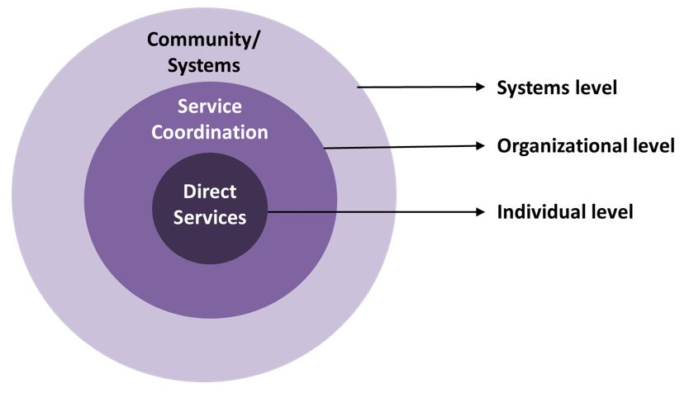
CYP Voice in SEND at School Level
Systems Level
CYP outcomes, SEND Transformation project, CYP SEND Forum for Bradford District.
Organisational Level
School council, school SEND CYP forum, Survey/ consultation on SEND experiences in school, opportunities to represent school.
Individual Level
EHC plans, CIN plans, My Support Plans,
Notes:
Asked at last forum
Therese Holden-

Slide 45
What would good in Bradford look like?
Every CYP who wants to can find and access information about what services are available to them.
Number of CYP who are happy with their EHCP/ other provision.
CYP know where to go for help.
Improved outcomes for CYP.
Visible model for CYP participation in coproduction of services and provision so CYP know they have voice and influence.

Slide 46
Next Steps:
Co-produce with Children and Young People a model for Bradford.
Expressions of interest from schools to be involved in a schools focus group.
Continue work CYP to develop an action plan to improve Voice.
Notes:
No expectations at this stage, we just want a point of contact to keep updated.

Slide 47
Resources
All resources will be made available via the Local Offer.
https://localoffer.bradford.gov.uk/
If you have any further questions about any of the resources mentioned in this presentation please email SENDTandC@bradford.gov.uk

Slide 49
Break

Slide 50
Neurodiversity Future Pathway Project
Ruth Dennis, Principal Educational Psychologist

Slide 51
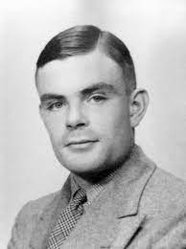
Difference and discrimination
Looking back on history we are often shocked by how we treated certain groups for example LGBGT individuals;
In the past homosexuality was illegal in the UK. Individuals were expected to live a secret life to conform with the accepted norms of the day.
Those not conforming were criminalised and often subjected to treatment in order to cure them of their condition.

Slide 52
Neurodiversity and Social Justice
Autism, ADHD and other developmental conditions are areas where we still expect people to conform to a notion of what is ‘normal’ or typical.
Neurodiversity is an approach that sees these ‘conditions’ as alternative or different was of experiencing the world;
Rather than seeking to ‘cure’ or make these people fit in with what is classed as ‘normal’ the neurodiversity approach focuses on accepting and accommodating individual differences.

Slide 53
Why Neurodiversity?
Recognising Neurodiversity acknowledges that we are all different and experience the world in different ways
Rather than focusing solely on diagnosis, the Neurodiversity Future Pathway seeks to accept and accommodate these differences.
This will require training and support for schools, families and other professionals.
It will also require series to be reconfigured so that support is available earlier and without need for a diagnosis.
Diagnosis will still be available, but resources won’t be constrained by this.

Slide 54
Introducing the Neurodiversity Future Pathway Project
Developing needs led rather than diagnosis led support and services
Help, support and resources available to a neuro diverse population, without need for diagnosis
Neuro-diversity recognised and acknowledged from an early stage
Neuro-diversity valued and celebrated

Slide 55
What will be different for schools?
Training and advice about Neurodiversity and support to become a ‘Neurodiversity Friendly’ school.
Access to the ‘Neurodiversity Profile’ to support school based identification of Neurodiversity.
Support on what to do when a YP is neurodiverse, based on the professionally developed ‘Advice Bank’.
Access to Neurodiversity professional consultations when a child’s needs are complex (OT / EP / Paediatrician / CAMHs etc).
School based multidisciplinary ND diagnosis if deemed appropriate
Access to the Neurodiversity Support web resource

Slide 56
Neurodiversity Future Pathways Summary
District Wide Neurodiversity Strategy and Training – Animated Video
Neurodiversity Profile and Support Plan
Specialist Neuro-diversity Consultation
MDA
Whole School Neurodiversity Training, ND Friendly School Charter and ND Passport
Plan
Do
Review

Slide 57
Neurodiversity Friendly School Charter
As a school, we recognise Neurodiversity as the differences between people in relation to how they socialise, learn, give attention and feel, in various areas of life. Instead of seeing these differences as deficits or things to be cured, we are committed to putting reasonable adjustments in place to support neurodiverse people to play a full part in the life of our school. We do this by:
Ensuring that everyone in our school community has received training on Neurodiversity and recognises their responsibility in making school as accessible as possible | Eg: Description of how individual school is doing this, co-constructed with school and community
Making reasonable adjustments as a matter of course so that neurodiverse members of the school community are able to work and learn successfully | Eg: Description of how individual school is doing this, co-constructed with school and community
Working with young people and their families, when they self-identify as neurodiverse to signpost to sources of information and identify what individual adjustments are required | Eg: Description of how individual school is doing this, co-constructed with school and community
Using the Neurodiversity profile, support plan and other tools to address more complex needs | Eg: Description of how individual school is doing this, co-constructed with school and community
Collaborating with other agencies to ensure that neurodiverse needs are identified and met in a coordinated way. | Eg: Description of how individual school is doing this, co-constructed with school and community

Slide 58
Neurodiversity Early Identification
Sometimes people who are neurodiverse need some changes to be made in school to help them get along better. Think about the statements below and see where you might be neurodiverse | Most people are like me | Some people are like me | There’s hardly anyone like me.
Talking to other people
Getting along with other people
Coping when things change
Managing my feelings
Concentrating on things in class
The things I’m interested in
Coping with different sounds, smells, tastes and textures
Moving around and doing sport

Slide 59
Neurodiversity Passport

Slide 60
Neurodiversity Profile Areas
Neurodiversity Area | Differences | Home Advice Bank | School Advice Bank
Social & Communication | Flexible communication
 | Social attention & interaction
 | Understanding
Regulation of Emotions | Self regulation
 | Co regulation
 | Impulse Control
Engagement with Learning | Motivational flexibility
 | Regulation of attention
 | Executive function
Adaptive & Functional | Motor skills
 | Self Care and Independence
 | Sensory Integration

Slide 61
Neurodiversity Support Plan
Fits in with Code of Practice – My Support Plan
Identifies in greater detail what the specific differences and needs are both at home and at school;
Identifies from ‘Advice Bank’ what school should be doing and what parents can do at home;
Ensures the provision is put in place and reviewed regularly;
Provides evidence for any future involvement with professionals.

Slide 62
Electronic Neurodiversity Resource
Self assessment and Advice resources – open to all
ND profile available to YP / family / school / health
ND Action plan generated with links to support, interventions and resources
Access to profile informs ND Professional Consultation and generates ND Action Plan
ND profile and Professional consultation form basis of MDA and generates ND Action Plan
General guidance, training and resources linked to Neurodiversity Strategy for schools and families
Collects data to look at effectiveness of interventions
Collects data to inform district wide feedback on use of pathway
* Open Areas
* Restricted areas

Slide 63
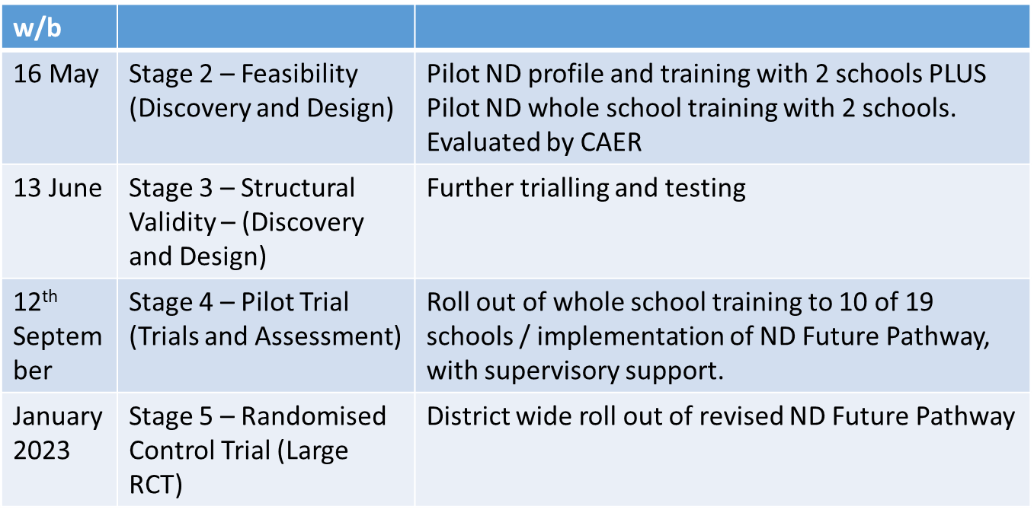
Phases and Timelines

Slide 64
Questions and Answers
What are your initial thoughts?
Will this help?
What else do we need to consider?
Anything else?
Any further comments, contact:
ruth.dennis@bradford.gov.uk
Lucy.Eddy@bthft.nhs.uk
Julia.Elliot@bradford.nhs.uk

Slide 65
Annual Reviews and Phase Transfers / detail of July day
Charlie Lowe - 0-25 Integrated Assessment Team Manager/ Linzi Milward - 0-25 Integrated Assessment Team Assistant Manager

Slide 66
Integrated Assessment Team Annual Reviews

Slide 67
What is a Review?
Statutory process where, at least annually, the progress towards outcomes in conjunction with needs and provision is formally reviewed.
The first review of the EHC plan must be held within 12 months of the EHC plan being finalised.
Subsequent reviews must be held within 12 months of the previous review.
Pre 5 reviews must be held every 6 months

Slide 68
Pupil voice
1.10 CoP 2015
Local authorities must not use the views of parents as a proxy for young people’s views. Young people will have their own perspective and local authorities should have arrangements in place to engage with them directly.
CYP views can only be from the Child / Young Person
Aspirations must be personal which create the…

Slide 69
Pupil voice
What would mean the most for that child / young person?
Could views be represented pictorially?
Would short phrases supplemented by symbols work?
Does the child / young person use alternative communication?

Slide 70
When proposing amendments
Any significant amends proposed to sections B and F, where both needs and provision are being heavily re-written with a significant increase in support, will require a professional report
Schools must commission these from a suitably qualified professional (EP or Specialist Teacher).

Slide 71
When proposing amendments
Section F cannot name settings or schools
Do not name internal provisions within Section F
Funding is base don provision on Section F

Slide 72
Tracking changes

Slide 73
Tracking changes
If struggling…
New information is written in blue italics
Please indicate in brackets which reports these amendments have originated from, i.e. (J Boggs, Educational Psychology report 05.05.2020, page 6)
Information to be removed is coloured red with a strikethrough

Slide 74
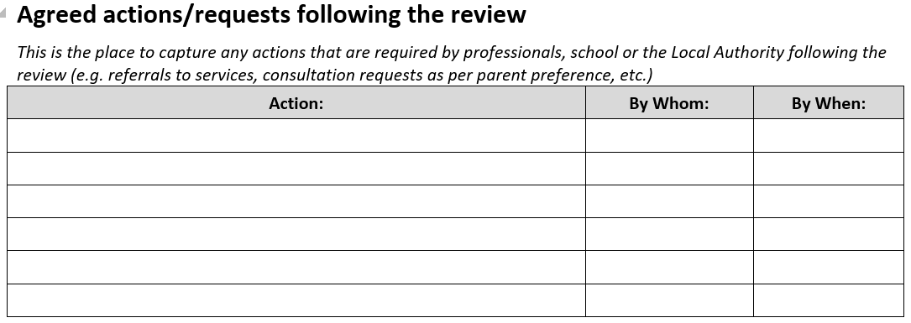
Agreed actions/requests following the review
Capture any actions that are required by professionals, school or the Local Authority following the review
Any actions not appropriately recorded may not be actioned causing delays

Slide 75
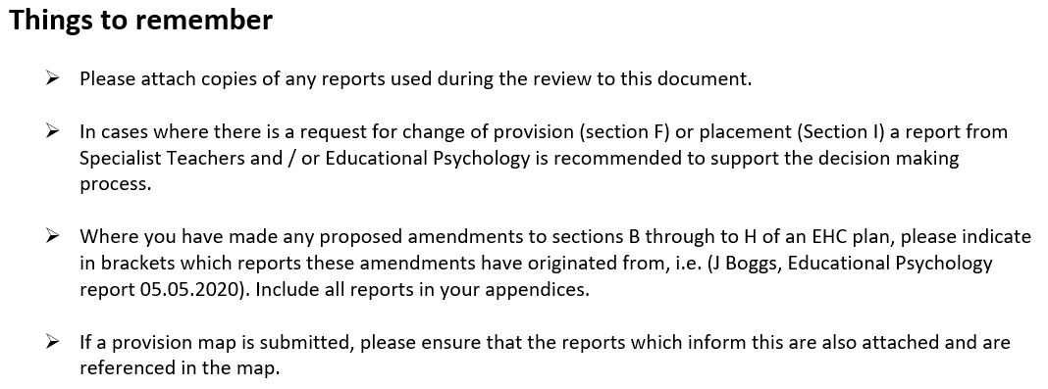
On the last page of the annual review paperwork…

Slide 76
Those not attending your school
Should monitor progress towards the outcomes throughout the year
If a child / young person is attending alternative provision then the school they are on roll at must still hold the review, not the alternative provision
If medically unwell to attend then the school must still co-ordinate and chair the review meeting

Slide 77
Getting your data right
Use the appropriate assessment tool for that year group
Do not use the EYDJ past the first term of year 1
Use pre-key stage standards or engagement model
Impact on the LA decision making
impact on families following naming of settings

Slide 78
Broad areas of need
6.27 (SEND CoP)
These four broad areas give an overview of the range of needs that should be planned for. The purpose of identification is to work out what action the school needs to take, not to fit a pupil into a category. In practice, individual children or young people often have needs that cut across all these areas and their needs may change over time. For instance speech, language and communication needs can also be a feature of a number of other areas of SEN, and children and young people with an Autistic Spectrum Disorder (ASD) may have needs across all areas, including particular sensory requirements. A detailed assessment of need should ensure that the full range of an individual’s needs is identified, not simply the primary need. The support provided to an individual should always be based on a full understanding of their particular strengths and needs and seek to address them all using wellevidenced interventions targeted at their areas of difficulty and where necessary specialist equipment or software.

Slide 79
The right to request a particular school or other institution is named in an EHC Plan
Section 38 (3)
A school or other institution is within this subsection if it is:
(a) a maintained school;
(b) a maintained nursery school;
(c) an Academy;
(d) an institution within the further education sector in England;
(e) a non-maintained special school;
(f) an institution approved by the Secretary of State under section 41

Slide 80
The duty on the LA to name the school/institution requested by the parent or young person
There are three elements to the section 39 (4) conditions:
That the school/institution requested is unsuitable for the age, ability, aptitude or SEN of the child or young person;
That the attendance of the child or young person would be incompatible with the provision of efficient education for others;
That the attendance of the child or young person would be incompatible with the efficient use of resources.

Slide 81
Element One – suitability
Whether or not a school/institution is suitable can be an issue. For example, parents may want a school for their child with severe learning difficulties which is for children with moderate learning difficulties. It is important in these cases to find out why the parent wants the particular school and find out whether or not the school can cater for children with the difficulties the child has. An LA cannot reject a choice of school or FE institution based on its designated range of pupils alone but it is usually a good indication as to the provision they are able to make.
The suitability test – as with all of these tests – has to be applied on an individual basis looking at the special educational needs and the special educational provision to meet the needs of the child or young person in question.

Slide 82
Element Two – incompatibility with the education of others
This is the test which is often referred to when a school is full. However, what the test requires, if it is to be used successfully by an LA, is that it is likely that adding just one more child to this school or other institution will create incompatibility with the education of others. This is not the same as showing that the addition of a child or young person will in some way impact upon the education of others. The test is whether the impact is so great that the child or young person attending the school or other institution would result in an incompatibility which cannot be resolved by the special educational provision being put in place as detailed in the EHC plan. The facts need to be examined in each case and this has been found by the courts to be a high bar.

Slide 83
Element Three – incompatibility with the efficient use of resources
Cost may be used as a reason for refusing a request for a particular school /institution where a LA can show that another school or institution can meet the needs of a child or young person more cheaply. However, even where the parental or young person’s requested school/institution is a little more expensive this is not an automatic barrier because the LA must balance the statutory weight given to the parental or young person’s request against the extra cost in deciding whether the extra cost is ‘inefficient’.
The argument of ‘inefficient use of resources’ may also be used when a school is full – i.e. for a mainstream school that it has reached its admission number for that year group, and for a special school that it has reached its approved number. However, it is not sufficient to assert the school is full. The LA must explain how placing this child in the school would be an inefficient use of resources – or possibly affect the efficient education of the other children as referred to under element two (above).

Slide 84
Types of settings
Suitability – age, aptitude, ability and SEN
Schools who support children with SLD
High Park
Chellow Heights
Co-op Academy Delius
Beckfoot Phoenix
Southfield
Beechcliffe
Hazelbeck

Slide 85
The Right to a Mainstream Education
Section 33 (2)
In a case within section 39(5) or 40(2), the local authority must secure that the plan provides for the child or young person to be educated in a maintained nursery school, mainstream school or mainstream post-16 institution, unless that is incompatible with—
(a) the wishes of the child’s parent or the young person, or
(b) the provision of efficient education for others

Slide 86
The LA cannot deny a child or young person mainstream education on the grounds that it is not suitable for them or that it is too expensive for them to attend a mainstream school/institution.
There are only two exceptions on which an LA can rely if they do not want to name a mainstream school or college placement in an EHC Plan set out in Section 33 (2) (a) and (b). The first (section 33 (2) (a)) is where it is against the child’s parent or young person wishes. The second (section 33 (2) (b) is incompatibility with the provision of efficient education for others (“the efficient education of others exception”).

Slide 87
The circumstances in which the “efficient education of others” exception can be relied on are limited:
A local authority can only rely on this exception if it can show that there are no reasonable steps that it could take to prevent the incompatibility (section 33 (3) in relation to schools and institutions in its area and section 33 (4) in relation to a particular maintained nursery school, mainstream school or mainstream post-16 institution).
The governing body of a school or institution can only rely on this exception if they can show that there are no reasonable steps which they or the local authority could take to prevent the incompatibility (section 33 (5)).
The Code contains a discussion of what may constitute “reasonable steps” in paragraph 9.91.

Slide 88
Caselaw
Bury Metropolitan Borough Council v SU [2010] UKUT 406 (AAC): when considering the right of a child with a Statement (now an EHC plan) to a placement in a mainstream school, whether or not the school is “suitable” is not a relevant consideration. The only issue to consider is whether attendance at the mainstream school would be incompatible with the education of other children and if so, that incompatibility cannot be removed by the taking of “reasonable steps”.
Harrow Council v AM [2013] UKUT 0157 (AAC): Where a parent requests a mainstream school and there is no suitable school available (whether inside or outside its area), the LA is under an absolute obligation to make a mainstream school suitable to meet the child’s needs, subject only to the qualification that it must be compatible with the efficient education of other children.

Slide 89
Review timetable

Slide 90
Correspondence
By June 10th 2022 families will receive letters requesting their preferences
All schools received a copy of this letter in April via email
Striving towards being an electronic service therefore would request that responses are via email.
Respond to the below email address using the following codes in the body of your email response:
transitionreviews@bradford.gov.uk
PP – name of setting
PP – name of setting
PP – name of setting

Slide 91
Transition reviews key dates
Friday 23rd July 2022 - all reviews for F1, Y5 & Y10 are completed
Friday 16th September 2022 – request for mainstream provisions
Friday 30th September 2022- requests for Specialist Provision (including Resourced Provisions)

Slide 92
When will families find out?
Primary and Year 7 placements will be announced by 15th February 2023
Post 16 placements will be announced by 31st March 2023

Slide 93
Thank you

Slide 94
Integrated Assessment Team Annual Reviews

Slide 95
What is a Review?
Statutory process where, at least annually, the progress towards outcomes in conjunction with needs and provision is formally reviewed.
The first review of the EHC plan must be held within 12 months of the EHC plan being finalised.
Subsequent reviews must be held within 12 months of the previous review.
Pre 5 reviews must be held every 6 months

Slide 96
Pupil voice
1.10 CoP 2015
Local authorities must not use the views of parents as a proxy for young people’s views. Young people will have their own perspective and local authorities should have arrangements in place to engage with them directly.
CYP views can only be from the Child / Young Person
Aspirations must be personal which create the…

Slide 97
Pupil voice
What would mean the most for that child / young person?
Could views be represented pictorially?
Would short phrases supplemented by symbols work?
Does the child / young person use alternative communication?

Slide 98
When proposing amendments
Any significant amends proposed to sections B and F, where both needs and provision are being heavily re-written with a significant increase in support, will require a professional report
Schools must commission these from a suitably qualified professional (EP or Specialist Teacher).

Slide 99
When proposing amendments
Section F cannot name settings or schools
Do not name internal provisions within Section F
Funding is base don provision on Section F

Slide 100
Tracking changes

Slide 101
Tracking changes
If struggling…
New information is written in blue italics
Please indicate in brackets which reports these amendments have originated from, i.e. (J Boggs, Educational Psychology report 05.05.2020, page 6)
Information to be removed is coloured red with a strikethrough

Slide 102
Agreed actions/requests following the review
Capture any actions that are required by professionals, school or the Local Authority following the review
Any actions not appropriately recorded may not be actioned causing delays

Slide 103
On the last page of the annual review paperwork…

Slide 104
Those not attending your school
Should monitor progress towards the outcomes throughout the year
If a child / young person is attending alternative provision then the school they are on roll at must still hold the review, not the alternative provision
If medically unwell to attend then the school must still co-ordinate and chair the review meeting

Slide 105
Getting your data right
Use the appropriate assessment tool for that year group
Do not use the EYDJ past the first term of year 1
Use pre-key stage standards or engagement model
Impact on the LA decision making
impact on families following naming of settings

Slide 106
Broad areas of need
6.27 (SEND CoP)
These four broad areas give an overview of the range of needs that should be planned for. The purpose of identification is to work out what action the school needs to take, not to fit a pupil into a category. In practice, individual children or young people often have needs that cut across all these areas and their needs may change over time. For instance speech, language and communication needs can also be a feature of a number of other areas of SEN, and children and young people with an Autistic Spectrum Disorder (ASD) may have needs across all areas, including particular sensory requirements. A detailed assessment of need should ensure that the full range of an individual’s needs is identified, not simply the primary need. The support provided to an individual should always be based on a full understanding of their particular strengths and needs and seek to address them all using wellevidenced interventions targeted at their areas of difficulty and where necessary specialist equipment or software.

Slide 107
The right to request a particular school or other institution is named in an EHC Plan
Section 38 (3)
A school or other institution is within this subsection if it is:
(a) a maintained school;
(b) a maintained nursery school;
(c) an Academy;
(d) an institution within the further education sector in England;
(e) a non-maintained special school;
(f) an institution approved by the Secretary of State under section 41

Slide 108
The duty on the LA to name the school/institution requested by the parent or young person
There are three elements to the section 39 (4) conditions:
That the school/institution requested is unsuitable for the age, ability, aptitude or SEN of the child or young person;
That the attendance of the child or young person would be incompatible with the provision of efficient education for others;
That the attendance of the child or young person would be incompatible with the efficient use of resources.

Slide 109
Element One – suitability
Whether or not a school/institution is suitable can be an issue. For example, parents may want a school for their child with severe learning difficulties which is for children with moderate learning difficulties. It is important in these cases to find out why the parent wants the particular school and find out whether or not the school can cater for children with the difficulties the child has. An LA cannot reject a choice of school or FE institution based on its designated range of pupils alone but it is usually a good indication as to the provision they are able to make.
The suitability test – as with all of these tests – has to be applied on an individual basis looking at the special educational needs and the special educational provision to meet the needs of the child or young person in question.

Slide 110
Element Two – incompatibility with the education of others
This is the test which is often referred to when a school is full. However, what the test requires, if it is to be used successfully by an LA, is that it is likely that adding just one more child to this school or other institution will create incompatibility with the education of others. This is not the same as showing that the addition of a child or young person will in some way impact upon the education of others. The test is whether the impact is so great that the child or young person attending the school or other institution would result in an incompatibility which cannot be resolved by the special educational provision being put in place as detailed in the EHC plan. The facts need to be examined in each case and this has been found by the courts to be a high bar.

Slide 111
Element Three – incompatibility with the efficient use of resources
Cost may be used as a reason for refusing a request for a particular school /institution where a LA can show that another school or institution can meet the needs of a child or young person more cheaply. However, even where the parental or young person’s requested school/institution is a little more expensive this is not an automatic barrier because the LA must balance the statutory weight given to the parental or young person’s request against the extra cost in deciding whether the extra cost is ‘inefficient’.
The argument of ‘inefficient use of resources’ may also be used when a school is full – i.e. for a mainstream school that it has reached its admission number for that year group, and for a special school that it has reached its approved number. However, it is not sufficient to assert the school is full. The LA must explain how placing this child in the school would be an inefficient use of resources – or possibly affect the efficient education of the other children as referred to under element two (above).

Slide 112
Types of settings
Suitability – age, aptitude, ability and SEN
Schools who support children with SLD
High Park
Chellow Heights
Co-op Academy Delius
Beckfoot Phoenix
Southfield
Beechcliffe
Hazelbeck

Slide 113
The Right to a Mainstream Education
Section 33 (2)
In a case within section 39(5) or 40(2), the local authority must secure that the plan provides for the child or young person to be educated in a maintained nursery school, mainstream school or mainstream post-16 institution, unless that is incompatible with—
(a) the wishes of the child’s parent or the young person, or
(b) the provision of efficient education for others

Slide 114
The LA cannot deny a child or young person mainstream education on the grounds that it is not suitable for them or that it is too expensive for them to attend a mainstream school/institution.
There are only two exceptions on which an LA can rely if they do not want to name a mainstream school or college placement in an EHC Plan set out in Section 33 (2) (a) and (b). The first (section 33 (2) (a)) is where it is against the child’s parent or young person wishes. The second (section 33 (2) (b) is incompatibility with the provision of efficient education for others (“the efficient education of others exception”).

Slide 115
The circumstances in which the “efficient education of others” exception can be relied on are limited:
A local authority can only rely on this exception if it can show that there are no reasonable steps that it could take to prevent the incompatibility (section 33 (3) in relation to schools and institutions in its area and section 33 (4) in relation to a particular maintained nursery school, mainstream school or mainstream post-16 institution).
The governing body of a school or institution can only rely on this exception if they can show that there are no reasonable steps which they or the local authority could take to prevent the incompatibility (section 33 (5)).
The Code contains a discussion of what may constitute “reasonable steps” in paragraph 9.91.

Slide 116
Caselaw
Bury Metropolitan Borough Council v SU [2010] UKUT 406 (AAC): when considering the right of a child with a Statement (now an EHC plan) to a placement in a mainstream school, whether or not the school is “suitable” is not a relevant consideration. The only issue to consider is whether attendance at the mainstream school would be incompatible with the education of other children and if so, that incompatibility cannot be removed by the taking of “reasonable steps”.
Harrow Council v AM [2013] UKUT 0157 (AAC): Where a parent requests a mainstream school and there is no suitable school available (whether inside or outside its area), the LA is under an absolute obligation to make a mainstream school suitable to meet the child’s needs, subject only to the qualification that it must be compatible with the efficient education of other children.

Slide 117
Review timetable

Slide 118
Correspondence
By June 10th 2022 families will receive letters requesting their preferences
All schools received a copy of this letter in April via email
Striving towards being an electronic service therefore would request that responses are via email.
Respond to the below email address using the following codes in the body of your email response:
transitionreviews@bradford.gov.uk
PP – name of setting
PP – name of setting
PP – name of setting

Slide 119
Transition reviews key dates
Friday 23rd July 2022 - all reviews for F1, Y5 & Y10 are completed
Friday 16th September 2022 – request for mainstream provisions
Friday 30th September 2022- requests for Specialist Provision (including Resourced Provisions)

Slide 120
When will families find out?
Primary and Year 7 placements will be announced by 15th February 2023
Post 16 placements will be announced by 31st March 2023

Slide 121
Thank you

Slide 122
SEND Q and A
Niall Devlin, Strategic Manager, Integrated Assessment and Psychology /Charlie Lowe SEN Assessment Team Manager

Slide 123
Feedback or Questions
Ruth Dennis - Principal Educational Psychologist
City Of Bradford Metropolitan District Council
Margaret McMillan Tower Princes Way BRADFORD BD1 1NN
ruth.dennis@bradford.gov.uk
07582 109129
01274 439417
Panel Volunteers contact: June.Eaton@bradford.gov.uk

Slide 124
Date of next meetings
Autumn 2022: 21st September
Spring 2023: 18th January
Summer 2023: 03 May
Book via S4B

Slide 125
Questions

