Slide 1
Senco Network
Summer Term 2021

Slide 2
Agenda
 | Agenda (* available on you tube playlist ) | Presenter | Time
9.00 | Introductions and welcome * | Ruth Dennis – Principal Educational Psychologist | 10 minutes
9.10 | District SEND Inspection * | Jane Hall, SEND Transformation ＆ Compliance Manager | 30 minutes
9.40 | Annual Review Update * | Charlie Lowe – Assistant Manager – SEN Assessment Team | 40 minutes
 | BREAK
10.45 | Introducing the ‘Exclusions Team’ * | Karen Roper - Exclusions Team | 20 minutes
11.05 | EHCP Transition Reviews * | Ruth Dennis – Principal Educational Psychologist | 10 minutes
11.15 | Living Well Schools * | Ruth Dennis – Principal Educational Psychologist | 10 minutes
11.25 | SEND Q and A | Niall Devlin, Strategic Manager, Integrated Assessment and Psychology | 35 minutes

Slide 3
Introduction and Welcome
New hybrid format:
Option 1: Brief highlights on YouTube – link available on day
or
Option 2:Live webinar format. 9 – 12
Slides and video format always available on BSOL after meetings.

Slide 4
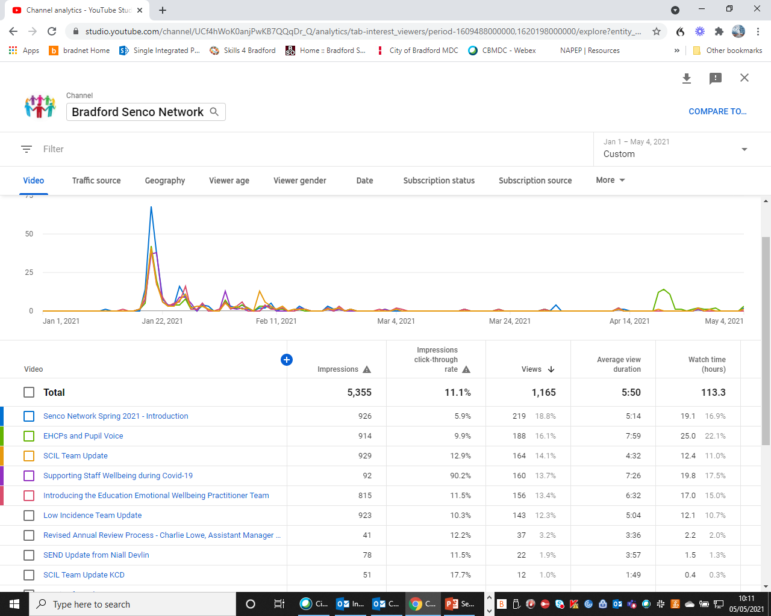

Slide 5
Covid Recovery Support from Bradford Educational Psychology Team
Dr Ruth Dennis
Principal Educational Psychologist

Slide 8
How helpful is this narrative?
Prevailing narrative catastrophises the situation for children;
The more we tell children that this is how it’s going to be, the more it will become so;
It’s important that we don’t create an expectation of negativity which, inevitably, children will pick up on and begin to believe themselves.
Whilst some children and some sectors will be more or less affected, most children will come through the epidemic with no serious long term problems
We need to change the narrative to one of hope and optimism as children return to school.

Slide 9
The ‘Bounce Back’ generation
Most children are resilient and can overcome setbacks;
We need to tell a better, more optimistic story:
celebrating their ingenuity in the face of multiple challenges
building on new things they have learned about themselves and
maximising the new skills they have acquired.
We need to back it up with the right approach:
strategic – what re our priorities in education?
financial - more for those most in need and
practical – what works, evidence based approaches

Slide 10
Bradford EPT and Covid Recovery
Core Function: Identifying and addressing barriers to learning; Meeting needs of complex learners.
Mental Health Focus: Mental Health Champions; Emotional Wellbeing Charter Mark; Wellbeing interventions; Staff wellbeing ; Educational Emotional Wellbeing Team
Enhancing Learning:
Paired Reading Project; All Aboard EY intervention; Direct Instruction Maths project.

Slide 11
EP Traded Services 2021-22
Book via:
www.skills4bradford.co.uk

Slide 12
Changing the Narrative
https://www.theguardian.com/commentisfree/2021/mar/07/enough-of-the-lost-generation-instead-lets-reimagine-school-for-our-children
https://charliewaller.org/blog/lost-generation-changing-the-narrative

Slide 13
District SEND Inspection
Jane Hall, SEND Transformation ＆ Compliance Manager

Slide 14
Annual Review Update
Charlie Lowe – Assistant Manager – SEN Assessment Team

Slide 15
Integrated Assessment Team Annual Reviews

Slide 16
Discussion points
Understanding of the review process and timescale
How to complete the New Paperwork
Updating an EHC plan
Phase transfers

Slide 17
What is a Review?
Statutory process where, at least annually, the progress towards outcomes in conjunction with needs and provision is formally reviewed.
The first review of the EHC plan must be held within 12 months of the EHC plan being finalised.
Subsequent reviews must be held within 12 months of the previous review.
Pre 5 reviews must be held every 6 months

Slide 18
Things to remember
Should monitor progress towards the outcomes throughout the year
If a child / young person is attending alternative provision then the school they are on roll at must still hold the review, not the alternative provision
If medically unwell to attend then the school must still co-ordinate and chair the review meeting

Slide 19
Timeline part 1a
Timeline | Actions
6 weeks prior to the review | Send invitations to parents / carers and relevant professionals Request reports to form a pre review pack
2 weeks prior to the review | Collate reports from all invited and distribute as a pre review pack 2 weeks prior to the annual review For those that cannot attend, gather opinions and feedback to those in attendance If amendments are being requested, provide a set of proposed amendments to the EHC plan in the pre review pack using tracked changes Significant amendments made to sections B and F must be supported by a commissioned report from Educational Psychology or the SCIL Team.

Slide 20
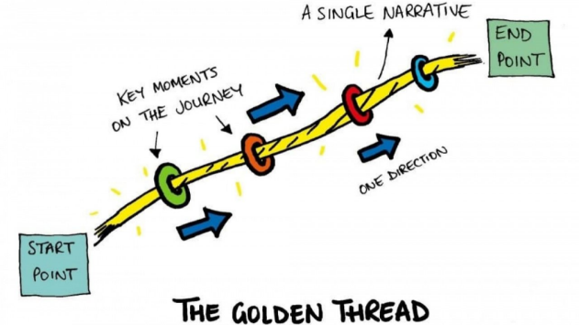
Pupil voice
1.10 CoP 2015
Local authorities must not use the views of parents as a proxy for young people’s views. Young people will have their own perspective and local authorities should have arrangements in place to engage with them directly.
CYP views can only be from the Child / Young Person
Aspirations must be personal which create the…

Slide 21
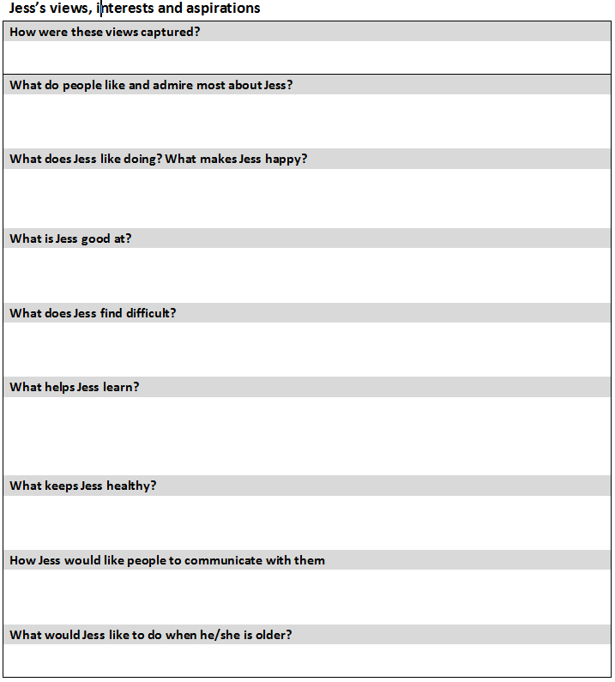
Capturing pupil voice
How could you articulate the views of a child / young person who has limited language or communication difficulties?

Slide 22
Pupil voice
What would mean the most for that child / young person?
Could views be represented pictorially?
Would short phrases supplemented by symbols work?
Does the child / young person use alternative communication?

Slide 23
New Paperwork: Part 1
Complete and circulate pages 2 – 6 at least two weeks prior to the review
Attendance and attainment data
Progress towards outcomes
Education
Health
Social care
Complete an edited EHC plan if you are proposing any changes
Evidence and advice must be provided to triangulate your proposed changes

Slide 24
Tracking changes

Slide 25
Tracking changes
If struggling…
New information is written in blue italics
Please indicate in brackets which reports these amendments have originated from, i.e. (J Boggs, Educational Psychology report 05.05.2020, page 6)
Information to be removed is coloured red with a strikethrough

Slide 26
Section B: Special Educational needs
Identifies pure strengths
Describes emerging skills which can be built upon as well as difficulties which they may face.
Refers to skills/abilities/knowledge which are in their infancy and can be developed upon.
Describe deficits and struggles as well as the ‘impact’ these have / could potentially have on the child / young person.

Slide 27
NEW: Preparation for adulthood
To be completed for young people in Year 9 (at the latest) and over
Some EHC plans may require Strengths and Needs in these sections
Higher education and/or employment
Independent living
Participating in society
Being as healthy as possible in adult life
These 4 sections are extensions of the 4 main areas of need not replacements

Slide 28
Preparation for adulthood
Area of need | Probe questions
HE and / or employment | Do they have a part time job? This could be paid or voluntary work Have they completed work experience? What are their career aspirations (triangulated with Section A)? What course are they studying which will / could lead onto either HE or employment?
Independent Living | Can they cook a simple meal or make a drink for themselves? Do they under stand the value of money? Can they apply this to a practical experience? Are they able to travel independently? Do they want to learning how to drive (triangulated with Section A)?
Participation in society | Do they attend clubs / organisations in their community? What is the impact on doing so? What networks do they have / are apart?
Being as healthy as possible in Adult Life | Are they able to tend to their self care needs? Can they make good choices in regards to diet? Do they play sports or are they active in other ways and under stand the benefits of a healthy lifestyle?

Slide 29
Section E: Outcomes
9.66 CoP 2015
An outcome can be defined as the benefit or difference made to an individual as a result of an intervention. It should be personal and not expressed from a service perspective; it should be something that those involved have control and influence over, and while it does not always have to be formal or accredited, it should be specific, measurable, achievable, realistic and time bound (SMART).

Slide 30
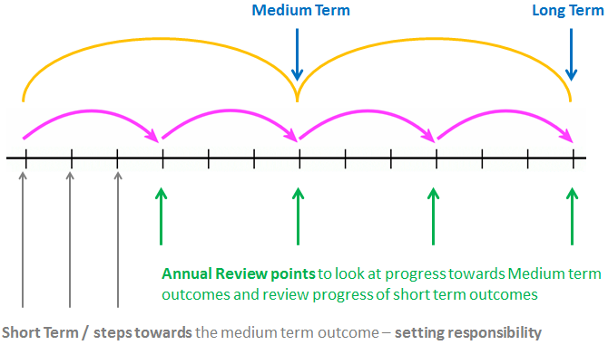
Outcome timeframes

Slide 31
Proposing new outcomes
Year 5
Long Term - End of year 9 or year 11
Medium Term – End of year 8 or year 9
Year 10
Long term - End of year 14
Medium Term – End of year 13

Slide 32
Remember when proposing changes to Section B
Strengths | Needs
Pure can do’s Positive statements What the child / young person has achieved May indicate small steps which to the individual are positive achievements Contains no negatives | Barriers to learning Skills which the young person is ‘yet to’ accomplish Areas / skills which they find difficult Needs are not outcomes or provision Do not mention that a child / young person requires something this is provision If they need ‘to do’ something then this is an outcome.

Slide 33
Timeline part 1b
Timeline | Actions
The Review meeting | Feedback opinions of professionals collated in the pre review pack Provide an update against the outcomes and report progress Discuss any proposed amendments made to the EHC plan
2 weeks following the review | Submit all documentation to the Local Authority as well as a copy to parent / carers and those invited. SENDAnnualReview@bradford.gov.uk

Slide 34
New Paperwork: Part 2 at the review
Complete the Summary of discussion either at or following the annual review
Discuss parent / carer and child / young person views
This is key to effective co-production
Feedback professional views
Review the progress towards the outcomes
Discuss needs and provision where appropriate
Discuss your proposed changes to the EHC plan where appropriate

Slide 35
Important things to note
If the setting are indicating they can no longer meet need then they must indicate this within the review minutes
Have professional reports been commissioned and implemented through a graduated approach?
Provide a detailed evidence trail through your graduated approach which shows advice has been implemented, reviewed with parents / carers and its impact.
If a personal budget is being requested or reviewed the setting must indicate if they would be or are still in agreement with such and if not, why not.
Parents must also detail what outcomes the budget is to achieve, the provision they wish to purchase and the annual cost

Slide 36
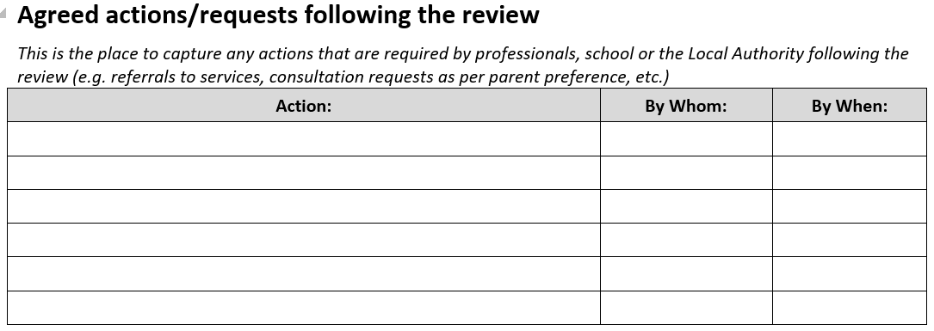
Agreed actions/requests following the review
Capture any actions that are required by professionals, school or the Local Authority following the review
Any actions not appropriately recorded may not be actioned causing delays

Slide 37
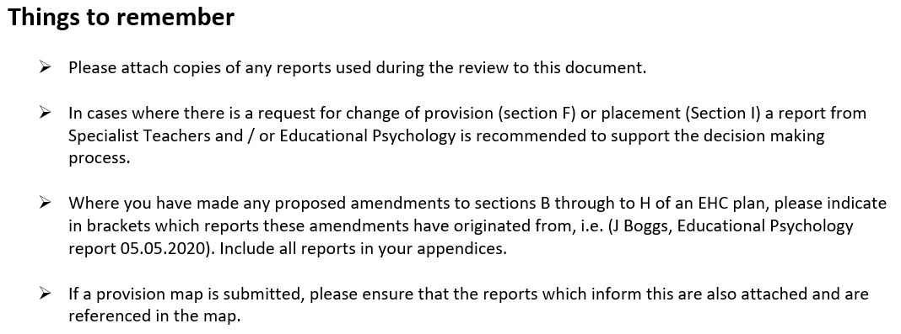
On the last page of the annual review paperwork…

Slide 38
Timeline part 2: After the review
Timeline | Actions
4 weeks after the review | The LA will notify all parties if it proposes to amend the EHC plan or not If not, a ‘no amendments’ letter will be provided to the parent / carer / young person giving their rights of appeal.
8 weeks after the review | The LA will have provided a proposed amended EHC plan to the parent / carer / young person for them to make representations The setting will also receive a copy.
12 weeks after the review | A Final amended EHC plan will be issued A letter will be accompany the EHC plan to the parent / carer / young person giving their rights of appeal.

Slide 39
Transition reviews key dates
Friday 23rd July 2021 - all reviews for F1, Y5 & Y10 are completed
Friday 10th September 2021 – request for mainstream provisions
Friday 24th October 2021- requests for Specialist Provision (including Resourced Provisions)

Slide 40
Please Remember
Any significant amends proposed to sections B and F, where both needs and provision are being heavily re-written with a significant increase in support, will require a professional report
Schools must commission these.

Slide 41
Correspondence
By June 11th 2021 families will receive letters requesting their preferences
Striving towards being an electronic service therefore would request that responses are via email.
Respond to the below email address using the following codes in the body of your email response:
transitionreviews@bradford.gov.uk
PP1 – name of setting
PP2 – name of setting
PP3 – name of setting

Slide 42
When will families find out?
Primary and Year 7 placements will be announced by February 15th 2022
Post 16 placements will be announced by March 31st 2022

Slide 43
New Review timetable

Slide 44
Thank you

Slide 45
Take a Break

Slide 46
Introducing the ‘Exclusions Team’
Karen Roper - Exclusions Team

Slide 47
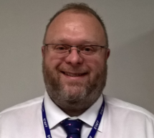
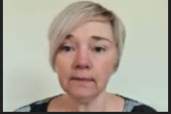
The Bradford Exclusion Team
Senior Exclusion Officer
Karen Roper
Exclusion Officers
Paul Jennings Samantha Griffiths

Slide 48
Our Role
The Exclusion Team has the following responsibilities:
Ensure that the Local Authority’s statutory responsibilities relating to exclusion are met
Gives advice to schools, parents and carers and other professionals on statutory and non-statutory exclusion processes
Maintains an exclusions helpline 5 days per week
Provides statistical information to the DfE
Offers training to Governors and school staff on their statutory responsibilities connected to school exclusion
Offers advice to support schools in the use of alternatives to exclusion, such as a managed move, Pastoral Support Plan (PSP), phased reintegration and referrals to other supporting services
Reviews both fixed period and permanent exclusions across the LA
Advises and guides governors on all aspects of exclusion law
Attends permanent and over 15 days exclusion Governing Board Meetings in maintained schools and where invited for Academy schools, as appropriate
Attends Independent Review Panel Hearings

Slide 49
Data – Permanent Exclusions and SEND
There were 52 permanent exclusions in 2019-20.
Those pupils at School Support on the SEN register account for over half of the permanent exclusion group.
 | 2017-18 |  |  |  | 2018-19 |  |  |  | 2019-20
SEN Status | Autumn | Spring | Summer | Total | Autumn | Spring | Summer | Total | Autumn | Spring | Summer | Total
E |  |  |  |  |  | 2 | 2 | 4
K | 9 | 4 | 2 | 15 | 14 | 13 | 10 | 37 | 8 | 19 |  | 27
N | 7 | 1 | 1 | 9 | 5 | 3 | 8 | 16 | 13 | 12 |  | 25
Total | 16 | 5 | 3 | 24 | 19 | 18 | 20 | 57 | 21 | 31 |  | 52
Local Authority, Region and England |  | 2015/16 | 2016/17 | 2017/18 | 2018/19 | Change from previous year
 | Bradford | 0.02 | 0.04 | 0.03 | 0.06 | 0.03
 | Yorkshire and The Humber | 0.07 | 0.07 | 0.09 | 0.09 | 0.00
 | Statistical Neighbours | 0.11 | 0.10 | 0.12 | 0.15 | 0.03
 | England | 0.08 | 0.10 | 0.10 | 0.10 | 0.00

Slide 50
Data – Fixed Term Exclusions and SEND
SEN Status |  | 2017-18 | 2018-19 | 2019-20
E | Days Lost | 875 | 924 | 680
 | No of Pupils | 174 | 154 | 151
 | No of Incidents | 417 | 433 | 338
K | Days Lost | 3,896 | 5,165 | 4,182
 | No of Pupils | 831 | 925 | 805
 | No of Incidents | 1,903 | 2,426 | 1,811
N | Days Lost | 5,682 | 8,698 | 6,208
 | No of Pupils | 1,631 | 1,978 | 1,553
 | No of Incidents | 2,655 | 3,735 | 2,747
Total | Days Lost | 10,453 | 14,787 | 11,070
 | No of Pupils | 2,635 | 2,980 | 2,442
 | No of Incidents | 4,975 | 6,594 | 4,896

Slide 51
A whole school approach
Effective schools closely monitor the implementation of their behaviour policy and its impact on individuals. They use tools such as Provision Map, CPOMs, frequency observations, ABC reviews amongst others to track behaviour incidents, support pupils to reflect and collaborative problem solve for situations where they are frequently demonstrating ‘undesirable’ behaviours, and use information to plan next steps of support.
Keeping this close watch on behaviour incidents can support teachers to understand some of the reasons behind the behaviour, ensure they know when to link with the senco where concerns are growing.
Having a strong link between pastoral teams and SEN teams within the schools can support staff to develop a holistic understanding of the pupil and all the contextual factors that can affect their behaviour.

Slide 52
SEND Exclusion – Considerations, overview and scrutiny
SENCo’s may become involved following multiple fixed exclusions of a pupil for example in looking at underlying needs.
A SENCo’s overview related to exclusion of your SEND cohort is where your role will connect with considerations of SEN within breaches of behaviour policy and where reasonable adjustment to policy and practice should be made to ensure SEND pupils are not disadvantaged due to their SEN and application of policy – thinking especially about your ADHD, SEMH and ASC cohorts here.

Slide 53
SEND Exclusion – Equality Act 2010
Under the Equality Act 2010, schools must not discriminate against, harass or victimise pupils because of: sex; race; disability; religion or belief; sexual orientation; pregnancy/maternity; or gender reassignment.
For disabled children, this includes a duty to make reasonable adjustments to policies and practices. In carrying out their functions, the public sector equality duty means schools must also have due regard to the need to:
eliminate discrimination, harassment, victimisation, and other conduct that is prohibited by the Equality Act;
advance equality of opportunity between people who share a protected characteristic and people who do not; and
foster good relations between people who share a protected characteristic and people who do not share it.

Slide 54
Permanent Exclusions – SENCo as SEN Expert
The SEN expert provides impartial specialist advice to the panel on how SEN might be relevant to the exclusion.
The focus of the SEN expert’s advice should be on whether the school’s policies which relate to SEN, or the application of these policies in relation to the excluded pupil, were lawful, reasonable and procedurally fair. If the SEN expert believes that this was not the case, they should, where possible, advise the panel on the possible contribution that this could have made to the circumstances of the pupil’s exclusion.

Slide 55
Questions for reflection
Do you have an overview of your SEND cohort and exclusion data?
Do you have regular review and planning sessions about pupils at school support and with an EHCP at risk of exclusion?
Does your school behaviour policy (relational policy, behaviour regulation policy or similar) and school exclusion policy set out your reasonable adjustments for SEND pupils?
Do you have a link with your SEND Governor to discuss school exclusion for this group?
Do you regularly review pupils vulnerable to exclusion as a senior leadership team in connection with your school policy and practice?

Slide 56
Contact details
Email
Exclusionsteam@bradford.gov.uk
Phone
Karen Roper Senior Exclusions Officer 01274 439333
Paul Jennings Exclusions Officer 01274 432446
Samantha Griffiths Exclusions Officer 01274 435239
Information on BSO
https://bso.bradford.gov.uk/content/exclusions
Information for parents on the Local Offer
https://localoffer.bradford.gov.uk/service/1312-bradford-school-exclusions-team
Notes:
Our team can be contacted for advice.

Slide 57
EHCP Transition Reviews
Ruth Dennis – Principal Educational Psychologist

Slide 58
What’s the Problem?
Mixed response from schools to current system of supporting all Y6 – 7 and Y 11 reviews
Issues with plans not being updated following reviews
Preparation for Adulthood outcomes unclear in EHCPs
Unclear pathway and options for CYP post 16
Lack of connection between Health Education and Social Care
Difficulties accurately planning for this phase.

Slide 59
What’s New
16 – 25 Transition Project
September – March 2022
Work with Education, Health and Social Care in Bradford to articulate a coherent post 16 offer;
Support YP within the system to produce publicity materials themselves about the ‘Bradford PfA Offer’
Pilot Preparation for Adulthood Planning meetings (Y11) using PATH
March 2022 – October 2022
Publication of Bradford PfA resource
Training and delivery of PfA Transition Planning Meetings for YP due to transition to post 16 provision in September 2023.

Slide 60
Other Transitions
There will no longer be automatic Y6-7 Transition review support from the EPT.
HOWEVER:
If transition review support will be given where:
There is likely to be a request for transition to specialist provision
There are specific vulnerabilities eg complex care case.
If you would like to request transition review support, email: educationalpsychologyteam@bradford.gov.uk

Slide 61
Living Well Schools
Ruth Dennis – Principal Educational Psychologist

Slide 65
Headlines
Web resource detailing all of Living Well interventions available in your area (by postcode);
Eligibility criteria and costs of project clearly visible
Projects quality assured and endorsed by CCG / BMDC
Link interventions into individual School’s development plan;
Chartermark for individual elements eg Emotional Wellbeing Chartermark or in future ‘Living Well’ award.

Slide 67
Next Steps
Launch early in new school Year.

Slide 68
SEND Q and A
Niall Devlin, Strategic Manager, Integrated Assessment and Psychology

Slide 69
Feedback or Questions
Ruth Dennis - Principal Educational Psychologist
City Of Bradford Metropolitan District Council
Margaret McMillan Tower Princes Way BRADFORD BD1 1NN
ruth.dennis@bradford.gov.uk
07582 109129
01274 439417

Slide 70
Questions

