Slide 1

Senco Network
Spring Term 2022

Slide 2
Agenda
 | Agenda | Presenter | Time
9.00 | Introductions and welcome | Ruth Dennis – Principal Educational Psychologist | 10 minutes
9.10 | Update from the Hospital and Home Teaching Service | Hannah Whittaker - Service Manager Medical Needs and Hospital Education Service | 15 minutes
9.25 | Update from the SCIL Team | Lucy Stead - Service Manager Social, Communication, Interaction and Learning (SCIL) Team | 15 minutes
9.40 | Update from SENDIASS | Debbie Jowett - Team Manager Bradford SENDIASS | 15 minutes
9.55 | Update from the Virtual School | Louise Coates-Black SEND Lead Specialist teacher and Attachment Lead Virtual School for Children in Care | 15 minutes
10.10 | BREAK |  | 10 minutes
10.20 | Steps Towards Neurodiversity | Ruth Dennis - Principal Educational Psychologist / Joe Krasinski - SEMH Consultant / Diane Daley General Manager Autism Service, Bradford Teaching Hospitals NHS Foundation Trust | 35
10.55 | Parent Carer Forum | Julie Bruce | 5 minutes
11.00 | SEND Update and Q and A (including Personal Budget Training) | Niall Devlin / Charlie Lowe Strategic Manager, Integrated Assessment and Psychology | 30 minutes

Slide 3
Introduction and welcome
Welcome
Senco Network live webinar
  Video available after the event
Bradford Schools Online: https://bso.bradford.gov.uk/content/senco-networks
Survey – what next?
Mental Health Services: CAMHs etc
What is a good EHCA referral
Evidence based practice ad interventions
Transitions: Y6 – 7 / Mainstream – special / Annual review

Slide 4

Educational Psychology Team
2022 – 23
Early Bird until 31st March 2022
Standard Price April to 31 July 2022
‘Pay as you Go’ from August 2022

Slide 5
Update from the Hospital and Home Teaching Service
Hannah Whittaker - Service Manager
Medical Needs and Hospital Education Service

Slide 6
Medical Needs and Hospital Education Service
Hannah Whittaker (07974)623628
HANNAH.WHITTAKER@BRADFORD.GOV.UK
Service Manager

Slide 8
Which children can be referred?
In majority of cases – pupil can stay in school without any LA intervention – Supporting pupils at school with medical conditions guidance December 2015
Live in Bradford Local Authority
Statutory school age (Y1 – Y11)
Whether on roll at a school or not
Have medical issues (physical or mental health) that prohibit them from attending full time school

Slide 9
School vs Service
Pupil remains on home school roll
Pupils continue links with school

Slide 10
Types of health condition
Any type of health condition
ASD
  ASD is not a health condition
  If the pupil is not attending school due to ASD needs not being met – not appropriate
  If the pupil has diagnosed ASD but has an additional health condition that prohibits them from attending full time school – can refer to service

Slide 11
What can we offer?
Education Service
  Full time education (relating to number of pupils being taught)
  Part time education if in best interest of pupil’s physical or mental health
  One or more part time provisions

Slide 12
What does the education look like?
Groups/Pairs/1:1
Remote/Owlet Road/at school/other establishment/home
Guided independent learning
Any amount of hours – initial offer of 5 to be increased or decreased according to need

Slide 13
When can a pupil be referred?
When pupil will be away from school for 15 school days or more (consecutive or cumulative) in one school year due to a diagnosed medical issue

Slide 14
What happens after a referral is received?
Hannah Whittaker (Service Manager) will ensure all information is received and appropriate
HW to allocate to appropriate team within service
Teacher will contact school/home/agencies/referrer

Slide 15
Reviews
This is a temporary service
  Not in best interests of pupil to stay with service for prolonged period of time
6 weekly reviews
  Establish whether pupil can be reintegrated
  Ascertain what further medical intervention is needed
  Alternative educational establishments?

Slide 16
School’s Role
Have a policy
Provide information
Have a named person
Organise EHCAs and EHCP Reviews
Host and chair meetings
Provide materials
Make examination arrangements (Owlet Road is an exam centre)
Organise P16
Arrange work experience
Organise and cover cost of transport
Provide suitable working area within the school
Continue links with pupil

Slide 17
Health’s Role
To keep the child in school where possible – only refer in extreme circumstances
Inform MNHES of the Care Treatment Plan on referral and reviews
To continue working with the pupil until they can successfully reintegrate into school
  Staff at MNHES are teachers, not medical experts
  To attend 6 weekly reviews
  Put in written report if you cannot attend

Slide 18
SEN responsibilities
Not an SEN educational establishment BUT do have pupils with SEN
Role of home school SENCO is vital – EHCP reviews etc.

Slide 19
Reintegration
Focus for all pupils
  Back to home school
  Find place at more appropriate establishment

Slide 20
Hospital Education
AGH & BRI
  Regular pupils – have planned visits to hospital
  Recurring pupils – have repeated admissions to hospital
  Long stay pupils – 5+ school days over an academic year
MNHES works with home schools

Slide 21
Pupils with life limiting illness
Parents and medical staff to agree

Slide 22
Pupils with long term medical conditions
Not in best interests of pupil to remain with MNHES for a prolonged period of time
Discussions should take place to best meet need

Slide 23
Additional Services
Brathay
  Youth Work
  Counselling
AWCC counselling
  GP Notes only as evidence

Slide 24
S-19 Provision
For those pupils without a school roll whose education can be met effectively through mainstream schools, an immediate directive can be provided by the LA Admissions Team.
For those pupils with additional needs without a school roll, where mainstream school would be inappropriate, there may be a short gap in learning and safeguarding whilst an effective educational provision is established.
The Local Authority will provide education and safeguarding through the S-19 Provision where appropriate to the individual needs of the pupil which is based at Owlet Road in Shipley

Slide 25
Update from the SCIL Team
Lucy Stead - Service Manager
Social, Communication, Interaction and Learning (SCIL) Team

Slide 26





Spring Term SENCO Network
26th January 2022
Social, Communication, Interaction and Learning (SCIL) Team
Lucy Stead
Service Manager
Early Years
Learning Support
Communication and Interaction
Social, Emotional and Mental health
© Copyright applies to the whole document - Written and developed by 0-25 Specialist Teaching & Support Services, City of Bradford MDC

Slide 27


The Social, Communication, Interaction and Learning (SCIL) Team Vision
“To offer a flexible and responsive service, supporting schools and private, voluntary and independent (PVI) (birth-5 years) settings to better understand and meet the needs of children and young people across Bradford in order to improve outcomes and life chances.”

Slide 28

Key Updates
Updates to the referral form found at Referral Forms | Skills 4 Bradford
Social media – Twitter @SENDBradford
Graduated approach to Dyslexia
Scheduled training dates
Networks
SCILTeam@bradford.gov.uk

Slide 29
Update from SENDIASS
Debbie Jowett - Team Manager
Bradford SENDIASS

Slide 30
Bradford SENDIASS

Slide 31

Meet the Bradford SENDIASS team
Debbie
Team manager
Imogen
Caseworker
Humaira
Participation and engagement worker/ caseworker
Farzana
Caseworker
Joslyn
Caseworker
Heidi
Caseworker

Slide 32
About us
There are five of us on the Bradford SENDIASS team.
We have experience in teaching, learning support, social care, the advice sector and youth work.
We have all undergone extensive training from both the Council for Disabled Children and the Independent Parental Special Education Advice organisation (IPSEA).
We are all committed to securing the best outcomes for children and young people through the work that we do with them and their parents

Slide 33
What is SENDIASS?
Bradford SENDIASS offers:
Impartial information, advice and support to families of children and young people with special educational needs or disabilities in the Bradford area.
The service is impartial, confidential, statutory, free, and can help with a range of subjects.
You do not need to have an EHCP for your child to access our service
Support to parents/carers and young people

Slide 34
Our Role
Our role is to give information and advice on policy and procedure, the SEND legal framework, rights and responsibilities.
We give you the information you need to make informed decisions. We are an impartial service so we can’t make decisions on your behalf, and we don’t have any influence over waiting lists or decisions made by other services.
We can advise you of your options to help you to navigate the system.

Slide 35
Notes:
We can also support where issues are escalated to: Complaints, mediation and disagreement resolution, tribunals and appeal.

Slide 36
How can we help?
Providing you with impartial information and advice on a range of topics related to SEND
Explaining the legal framework around SEND, including rights and responsibilities
Explaining and talking you through local and national SEND processes including appeals
Helping you to make informed decisions and plan your next steps
Signposting to further sources of information and support
Providing training workshops for parents/carers
Helping you and your child/young person to contribute to decision making and have your voice heard through providing accurate information advice and support
Liaising across a range of agencies to provide person centred support.

Slide 37
How do we work?
The majority of enquiries will be dealt with through our ‘duty’ service. You can call back through duty as often as you need to.
Parents/carers receive a call back or email response within 3-5 working days to discuss your concern and offer information, advice and next steps.
We may follow this up with information sheets, workshop sessions, or make an appointment to help you with a form for example.
A small percentage of cases will be allocated an individual worker for more complex casework support. This is targeted at the most vulnerable families and there is currently a waiting list for this support.
Notes:
Our role is to give information and advice on policy and procedure, the SEND legal framework, rights and responsibilities. We give you the information you need to make informed decisions. We are an impartial service so we can’t make decisions on your behalf, and we don’t have any influence over waiting lists or decisions made by other services. We can advise you of your options to help you to navigate the system.

Slide 38
How to refer into our Service
Parents can self-refer into our service by contacting Barnardos on 01274 513300 where our admin team will take details of your enquiry.
A Duty worker will then contact you to provide advice and support.
You can also contact us via our facebook/twitter page or via our website https://www.barnardossendiass.org.uk/bradford-sendiass/
Professionals such as schools, health professionals or social care professionals can refer into our service on the behalf of parents.

Slide 39
Thank you!

Slide 40
Update from the Virtual School
Louise Coates-Black
SEND Lead Specialist teacher and Attachment Lead
Virtual School for Children in Care

Slide 41


Bradford Virtual School Training and Development
SENDCO NETWORK
Bradford Virtual School For Looked After and Previously Looked After Children
Louise Coates-Black

Slide 42
Bradford Virtual School
Virtual School Head
Jonathan Cooper
Business Support Officers
Yvett Green, Fiona Wood, Joanne Henry
Deputy Virtual School Head
Caroline Dolan
Specialist Teacher
(Secondary)
Rita Kumar
Specialist Teacher
(SEND)
Louise Coates-Black
Specialist Lead Teacher (Primary)
Vacancy
Secondary Link Teachers
Lisa Trusdale
Rachel Davies
SEND Link Teacher & Support Officer
Frances McGoldrick
Hollie Carter
Primary Link Teachers
Heather Dey
Felicity Rushworth
Post 16 transitions
Richard Miller
Link Teacher (OOA)
Aileen Whiteley

Slide 43
Children in the care of Bradford
In Bradford there are currently 1414 CiC under 18 years.
Jan-22
Reception – Yr13 1132
Reception to Year 11 890
Early Years 282
Primary 470
Secondary 420
Post 16 242
OLA 303
Notes:
Jonathan

Slide 44
Virtual School Context & Focus
 | GCSE Grade 5-9 English and Maths | GCSE Grade 4 -9 English and Maths | 5 + GCSE Grade 4-9 inc En and Ma
National CLA 2020 | 10.9% | 24.4% | 13%
Bradford CLA 2020 | 14.3% | 23.8% | 20%
Bradford CLA 2021 | 11.4% | 27.1% | 24.3%
Narrow the gap
Reduce the time Children are without full time education
Review PEP processes and improve quality
Support Inclusive practice to reduce exclusions
Improve attendance rates
Notes:
Jonathan

Slide 45
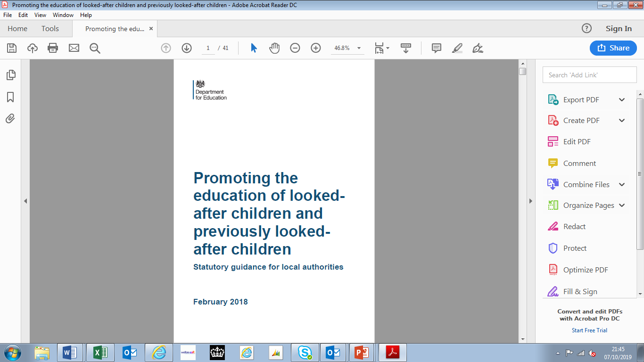
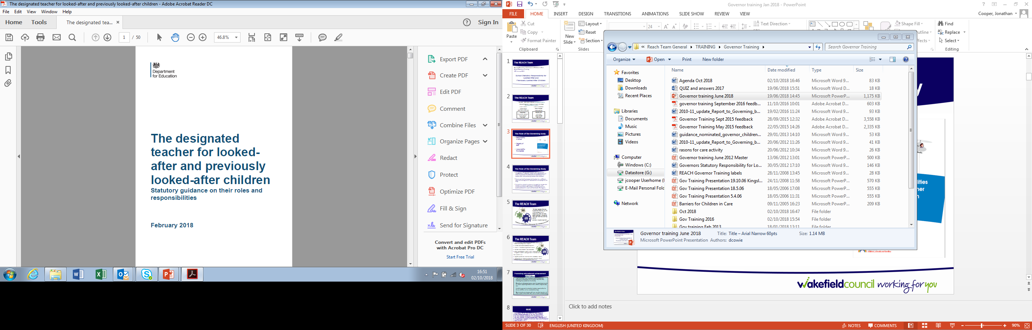
Statutory Guidance for Local Authorities & Schools
Promoting Educational Achievement
Notes:
Caroline

Slide 46
Bradford Virtual School
PEPS
Pupil Premium Plus
The LA’s corporate parenting role
Tracking attendance and progress
Designated teacher for children in care

Slide 47
Bradford Virtual School
Designated teacher for previously children in care
Children missing from education
Inclusion Protocol- reintegration timetables, exclusions
Virtual School Head role extension to children with a social worker

Slide 48
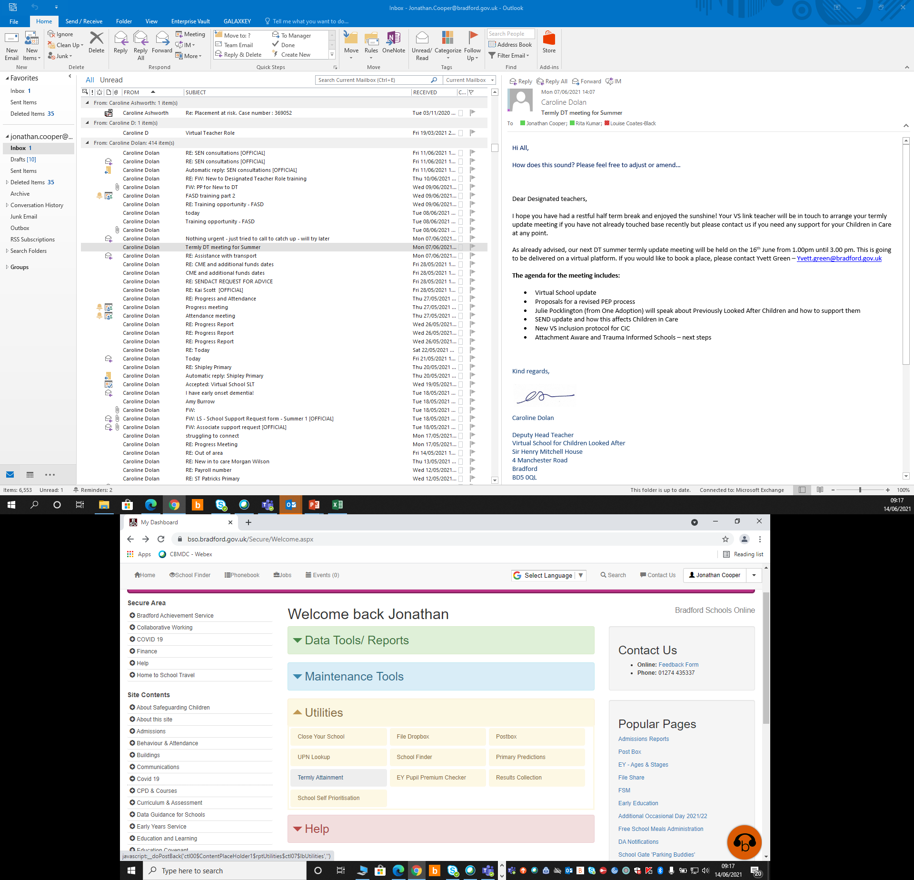
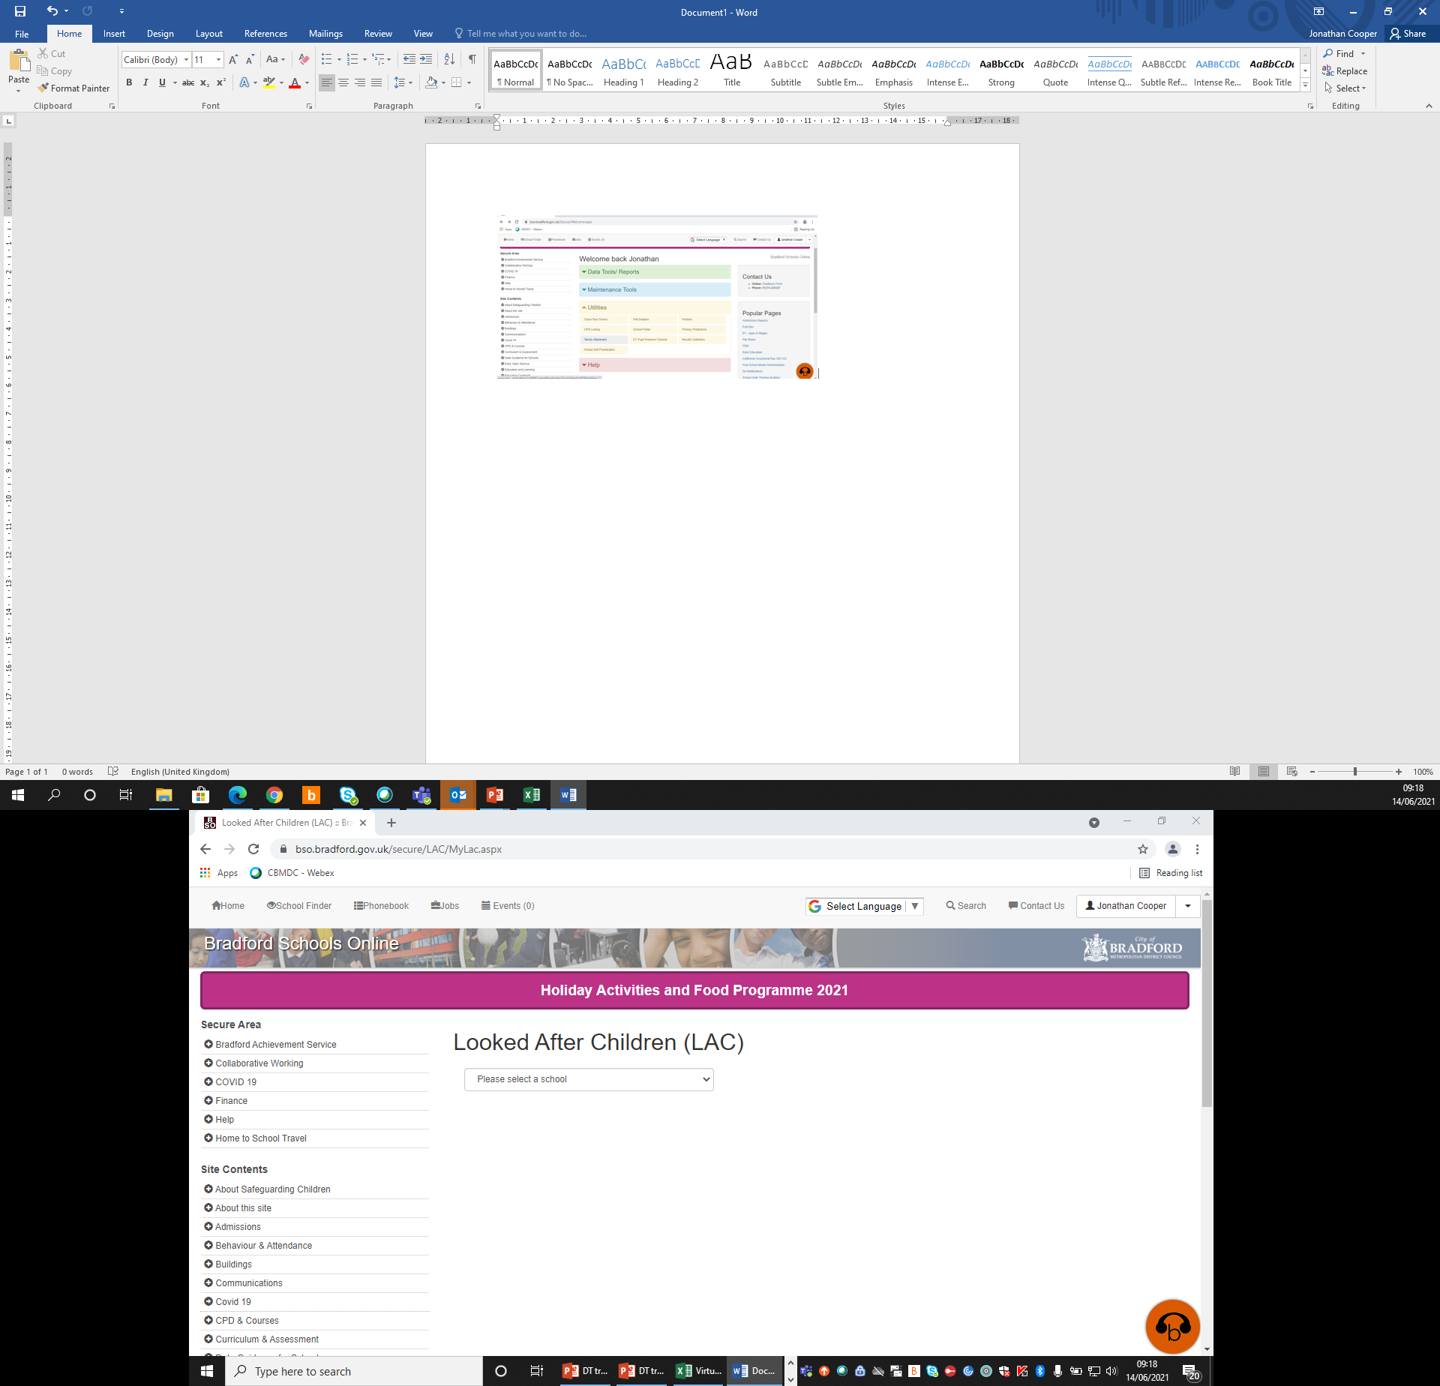
Bradford Schools Online

Slide 49

SEND support
Notify VS link teacher of any changes
SEMH needs
Graduated response
Bradford Matrix of Needs V2.2
My Support Plans
Involvement of outside agencies includes VS
Requesting EHCAs
Involvement of social care when requesting
VS support with reports

Slide 50
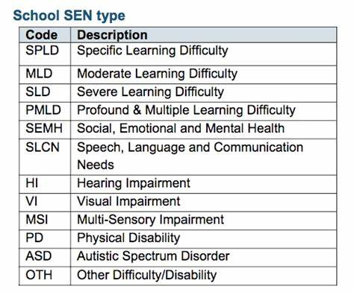
SEND support
Health & social care contributions
EHCP guidance for social workers
Work with SENCo to increase number of EHCA for children with a social worker

Slide 51

Break

Slide 52
Parent Carer Forum
Julie Bruce / Sally Skipper
Bradford PCF

Slide 53

The Parents’ Forum for Bradford & Airedale (PFBA)
Established in 2009 and run and governed by parent/carers as a Registered Charity.
Part of the National Network of Parent Carer Forums (NNPCF)
We offer information and support for parent carers of children and young people with Special Educational Needs and/or Disabilities (SEND) 0 – 25yrs.
Our aim is to gather the voices and views of parent/carers and support organisations and be part of planning and developing services as equal partners and at all levels across the Bradford District.
We believe that working co-productively with Health, Education and Social Care can lead to more informed decision-making and improved services and outcomes for children and young people with SEND and their families.

Slide 54
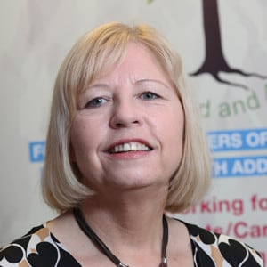

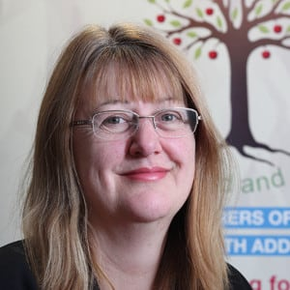
How we can work with your school
Julie Bruce
Manager
Do you have children and young people with SEND in your school?
How do you communicate with parent/carers?
What information do you provide your parent/carers? E.g. the local offer
Do you hold parent/carer groups? E.g. coffee morning’s
Do you want support in informing and signposting your parent/carers?
PFBA is able to provide a session at your school to meet your parent/carers and link them up to important and useful information.
PFBA can also help develop a ‘peer support’ parent/carer group
If you are interested or for further information then contact:- adele@pfba.org.uk
www.pfba.org.uk Facebook: @ParentsForumBradfordAiredale
Twitter: @infopfba Instagram: parentsforumbradfordairedale
Adele Jones
Engagement Lead
Louise Connors
Comms Lead

Slide 55
Parent/Carers & SEND Services working together

Slide 56




SEND Parent/ Carer Information and Signposting
SENCO Network Meeting 26 January 2022

Slide 57
Overview
What parent/ carers are telling us.
What they want to see happen.
What resources are out there already.
What is being developed.
What is our parent/ carer model for Bradford area.
Signposting our parent/ carers to support and services

Slide 58
What are parent/carers telling us?
Many parents do not know what support is out their for SEND families in the Bradford District.
Many parents feel isolated and struggle to find information, help or advice.
Parents are not being signposted to resources already available.
When families do contact services they do not always get a response or the response they should get.
Many families do not know about the local offer, the SEND Local offer newsletter or what they should expect. Mentioning the local offer is not enough – families need sign posting to specific services on there too.
What they want to see happen.
Improved communication.
Better promotion of services available eg, short breaks, One Minute Guides.

Slide 59
What information is already out there?
Bradford Local Offer.
SEND Local Offer One Minute Guides - OMGs
Bradford Local Offer newsletter.
PFBA
SENDIASS
Parent/ Carer Groups.
Other National Resources.
Ipsea
Contact A Family
Family Fund
Notes:
All have websites

Slide 60
Local offer and OMG’s
Statutory provision of a dedicated website for the local area for all things SEND for families in the district.
XXX number of services on the website covering short breaks, resourced provisions, SCIL, voluntary sector groups, training and support.
Specific One Minute Guides ( OMGs) covering the areas families have asked for most help with.
OMGs printable format so SENCOs working with families can share information direct with families.
One Minute guides are a 1 page document that provide quick, simple and accessible information.
https://localoffer.bradford.gov.uk/service/1436-an-introduction--one-minute-guides
Notes:
Contact our team if you need more info

Slide 61
SEND Local Offer Newsletter
Monthly e-newsletter sent out to 6000 contacts both parent/ carers and professionals with information and advice from SEND partners and service providers within the district.
Coproduced with parent/ carer groups to ensure right content is shared at the right time.

Slide 62
Bradford SEND Parent/ Carer Model
SEND Parent/ Carer Group Network meeting.- All SEND parent/ carer groups leaders invited to termly meetings with SEND Services.
SEND Parent/ Carer Ambassadors- A group of SEND Parent/ carers who meet monthly and support the coproduction of services and resources.
SEND Parent/ Carer Workstream Reps- SEND Parent/ carers who attend SEND partnership workstream meetings monthly with services.
SEND Parent/ carer group members- parent/ carer who actively engage with a support group in the Bradford area/ attend training courses/ feedback on services.
SEND Parent/ carer participant- receives newsletter, is aware of the local offer.

Slide 63
Coming soon….
What is being developed.
Local offer refresh.
SEND printed resource for all EHCP families co-produced with SEND Ambassadors.
CYP Voice Focus Group.

Slide 64

Resources
All resources will be made available via the Local Offer.
https://localoffer.bradford.gov.uk/
If you have any further questions about any of the resources mentioned in this presentation please email SENDTandC@bradford.gov.uk

Slide 65
Steps Towards Neurodiversity
Ruth Dennis - Principal Educational Psychologist / Joe Krasinski - SEMH Consultant / Diane Daley
General Manager Autism Service, Bradford Teaching Hospitals NHS Foundation Trust

Slide 66







DATA 1: Digitally Acting Together As One … on autism and neuro-diversity
SENCO Network 26/01/22

Slide 67
Been here before…?
Increased demand
Capacity Issues
Funding Issues
Autism and Diagnosis

Slide 68



  Long and challenging autism diagnosis waitlist
  No/ limited information before and while on the varied waiting lists
  No/ limited support before and once the diagnosis is given
  Poor communication
  Lack of staff knowledge (including schools) about the other services and effective signposting
Previous parent/ carer feedback
£1.7 million on outsourcing diagnostic assessments to external providers
  to significantly reduce the diagnosis waiting list over the next 12 months (Priority to those waiting the longest)
Additional funding to increase ongoing capacity for diagnostic assessments
Info out to families on the waiting lists / post diagnosis via the external providers (created with families)
Social Communication Interaction & Learning (SCIL) Team -
  - pro actively working with schools on a “graduated response” (inclusive practice for ALL pupils; what works well for those with autism in the classroom)
  - Team is often alerted when a child or young person gets a diagnosis and Team contacts relevant school and letter to parent/ carer
So what happened as a result of this?
Creating DATA1 Project:
  Quicker, easier, reduced need for diagnostic assessment to get suitable support, co creation and communication; data driven
Now What? (So it doesn’t happen again)
Notes:
Staff shortages
We want to make the Autism (ASC) / ADHD (neuro-divergent/ ND) assessment and support process better so it’s quicker and easier.
We’re putting a lot of resource to clear ASC assessment queue
We have a plan to remove the need for (long wait for) diagnosis of ASC/ ND to access suitable support
We want to keep you updated on what we are doing and how we listened to you
We want your opinions on how to get to better outcomes

Slide 69
Thanks
Autism Information Poll
Brief Summary

Slide 70
New Profiling Tool for Earlier and Faster Identification in Schools and Validation of Issues. Trained Staff
Data Science to Identify Children (who may be autistic) and to Design Useful Tools
Co Creation with Parents/ Carers, Young People, Communities and Professionals
Better Awareness for Families, Professionals and Communities
Earlier Effective Advice, Information and Support for Families to Meet Identified Needs
Faster Diagnostic Assessment Access for Those Who Still Need It (to Access support)
Better Information Sharing Between Services
Better Inclusive Practice in Education, Communities and at Home
3 Pilot areas: Keighley, Holme Wood, Manningham and Girlington
DATA1
- Needs NOT Diagnosis Led
Based on Portsmouth Work
Notes:
Explains the main elements of the project
Vaguely chronological left to right
Use zoom (ctrl+) on diagram to go through when presenting on teams/ zoom to make it readable
Questions in messages: few mins on collated questions
Reply afterwards in email
Tool: Also
ADHD
Developmental Language Disorder

Slide 71
Neurodiversity Support Pathway
District Wide Neurodiversity Strategy and Training
Neurodiversity Profile and Support Plan
Specialist Neuro-diversity Consultation
MDA
Neurodiversity Passport and ND Friendly Schools
Plan
Do
Review

Slide 72
Why Neurodiversity
Neurodiversity refers to the normal variation in the ways human beings experience the world, especially in relation to sociability, learning, attention, mood and other areas of life.
It encourages people to view differences such as autism, ADHD and DCD as natural and normal variations of the human life rather than deficits.
Previous approaches have focused predominantly on identification and diagnosis, with limited support available to help neurodiverse individuals and their families make sense of their lives.
Working with families, the Future Pathway aims to reverse this and focus on a needs led, early intervention approach.

Slide 73
Phases and Time lines
 | What | When
Phase 1 - Preparation | Preparation of resources and Profile materials; Co production work with parents Co production with YP (Sheffield University) Early prototype of ND e-Profile tool | September 2021 – February 2022
Phase 2 - Pilot | Trial of ND Pathway in selected areas of Bradford Evaluation by CAER / BiB Refined version of ND e-Profile tool | March 2022 – July 2023
Phase 3 - Roll out | Adaptations and roll out to other areas Refined version of ND e-Profile tool | September 2022 onwards

Slide 74
Requests
Feedback on how to communicate with you
Join focused Task & Finish Groups on specific topics/ complete surveys via email distribution
SENCO representation on the Core Comms, Co Production and Skills Core Team (Strategic Steer) – Next one: Feb 9th 2 – 3:30pm
Notes:
https://forms.office.com/Pages/ResponsePage.aspx?id=8ve_JerEBEeliG1wivSiqBaeE7W4YnhAkBlZqmmsp5pUQzRXT09XSklDSkZZOEJXNEZSRFoyVlJXQy4u

Slide 75

Any questions
ruth.dennis@bradford.gov.uk
Julia.Elliot@bradford.nhs.uk
Diane.Daley@bthft.nhs.uk
joe@krasin.ski

Slide 76
SEND Q and A
Niall Devlin, Strategic Manager, Integrated Assessment and Psychology /Charlie Lowe SEN Assessment Team Manager

Slide 77
Personal Budgets
Charlie Lowe: Acting SEN Team Manager

Slide 78
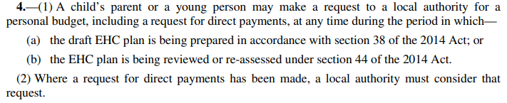
Request for a personal budget including direct payments

Slide 79
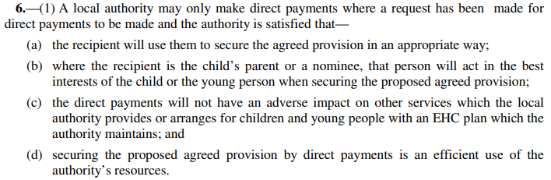
Our decision Making

Slide 80
What can be requested?

Slide 81
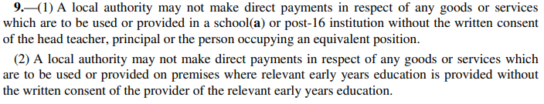
Permission of the school

Slide 82
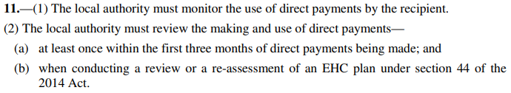
When do we review a personal budget?

Slide 83
Common requests
Horse riding
A specific qualification or course
Tutoring – Dyslexia / Dyscalculia
Therapy such as ABA
Sensory assessments
Non registered providers

Slide 84
Feedback or Questions
Ruth Dennis - Principal Educational Psychologist
City Of Bradford Metropolitan District Council
Margaret McMillan Tower
Princes Way
BRADFORD
BD1 1NN
ruth.dennis@bradford.gov.uk
07582 109129
01274 439417
Panel Volunteers contact: June.Eaton@bradford.gov.uk

Slide 85
Date of next meeting
Summer: 18/05/22
Book via S4B

Slide 86

Questions

