Slide 1
Senco Network
Spring Term 2021

Slide 2
Welcome
Agenda | Presenter | Time
Introduction and welcome | Ruth Dennis – Principal Educational Psychologist | 10 mins
Update on SEN Assessment Team and statutory systems | Niall Devlin - Strategic Manager, Integrated Assessment, Children's Services | 20 minutes
SCIL Team Update | Lucy Stead – SCIL Team Manager | 20 minutes
Low Incidence Team Update | Karen Turner | 20 minutes
Education Health and Care plan Developments: Section A / Person Centred Planning | Charlie Lowe – Assistant Manager – SEN Assessment Team | 20 minutes
Introducing the Educational Emotional Wellbeing Practitioner team | Rebecca Horn – Lead Practitioner – EEWP Team | 30 minutes
Whole School Emotional Wellbeing and Covid-19 | Ruth Dennis – Principal EP | 20 minutes

Slide 3
Online Senco Network
Positives
Can access when suits;
Wider audience (within and beyond Bradford)
Same training can be re-run;
Room booking and refreshments are not an issue
Negatives
No opportunity for discussion;
Practical aspects hard to recreate;
How to cost?
Can we manage the technology?
How to control release or unauthorised sharing?

Slide 4
Online Senco Network

Slide 5
Online Senco Network

Slide 6
FAQ from Autumn Senco Network
There were no questions!
Are there any ways we can make Virtual Senco Network more interactive?
How | + | -
Follow up Webex meeting with panel for anyone who has questions | Interactive and pick up questions promptly | Only those who attend get answers; If only a few attend it is inefficient use of time for presenters
Continuation of FAQ response document | No duplication of work | Delay in collating questions and replying
‘Live’ online meeting recorded | More interaction possible and questions answered at source | Recording would be very long; Duplication if have to record separately; Set time for meeting so loss of flexibility

Slide 7
Key Points:
SEN documents are always updated on BSOL:
SEND / SEN Graduated Approach / Documents
Presentations / other documents from Senco Network are always posted on BSOL:
SEND / Senco Support / Senco Network

Slide 8
Notices
Bradford Matrix of Need:
Please ensure you are using the most up to date version and you have the up to date version on your website.
Newest Version 2.1 is here
Update form Neurodevelopmental Pathway:
Letter sent to families re delay.

Slide 9
EP Traded Services 2021-22
Book via:
www.skills4bradford.co.uk

Slide 10
Senco Network Online Forum
1. Navigate to Skills4 Bradford: http://www.skills4bradford.co.uk
2. Log in or sign up for an account;
3. Select Communication
4. On the orange banner, click the small arrow next to ‘Groups’
Browse groups and you should find Senco Network.

Slide 11
Update on SEN Assessment Team and statutory systems
Niall Devlin
Strategic Manager Integrated assessment and Psychology

Slide 12
SCIL Team Update
Lucy Stead – SCIL Team Manager

Slide 13
SCIL Team Update Social, Communication, Interaction & Learning Team.
Our aim is:
“To offer a flexible and responsive service, supporting schools and PVI (pre 5) settings to better understand and meet the needs of children and young people across Bradford in order to improve outcomes and life chances”.
Lucy Stead
Service Manager
© Copyright applies to the whole document - Written and developed by 0-25 Specialist Teaching & Support Services, City of Bradford MDC

Slide 14
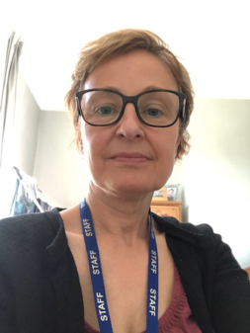
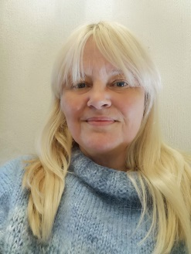
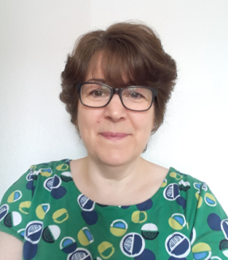
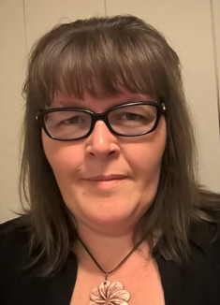
Our Leadership Team Each key area has a Lead Specialist Teacher. We also have a Lead Specialist Officer and a Business Support Manager.
Learning Support Lead Fiona Whitaker | Social Emotional & Mental Health Lead Sara Burgess | Early Years Lead Lucy Stead
Communication & Interaction Lead Ruth Péchèr | Specialist Officer Lead Kath Tate | Business Support Manager Lynda Hitchen
Fiona Whitaker
Sylvia Cramp

Slide 15
Head of Service: Lucy Stead
Specialist Teachers
SEMH | C&I | EY | C&L
Team Lead: Sara Burgess | Team Lead: Ruth Péchèr | Team Lead: Lucy Stead (Interim) | Team Lead: Fiona Whitaker
Martina Woodworth Rebecca Hayward Justine Burnhill David Chadwick Sharon Carr Amanda Aldin Carlie Watts Alison Copley | Sarah Gates Joanne Boden-Hook Hannah Rowlands Jason Bew Nicola Weston | Gail Swinfield Nasrat Raqib | Nicola Gaunt Katy Walker Malgorzata Lewalski Joanne Callaghan Jemma Haynes Sabina Iqbal
Specialist Practitioners
Team Lead: Kath Tate
Angela Buckle Debbie Bower Sharon Light Hannah Rattenbury Tracy Watson Fern Burton | Nigel Hunter Pauline Dempsey Shelley Donnison |  | Julie Wilson
Access & Inclusion Officers - PVI |  | Early Years Inclusion Funding Support Officer
Julie Coverdale Bev Ellis Sarah Jamieson Lauren Potter Amy Brotherton |  | Paula Hart

Slide 16
What can we do to help?
Our team of Specialist Teachers, Practitioners and Access & Inclusion Officers are able to work alongside key staff in schools and PVI settings (pre 5) to:
Help staff to better understand the needs of pupils with SEND.
Support to plan provision to meet the needs of
pupils.
Advise on strategies and interventions and,
where appropriate, model within the setting.
Provide training and coaching for staff at all levels to build capacity within schools and settings.

Slide 17
How to access the SCIL team
Referrals are made by settings/mainstream schools with parental consent. Information can be found on BSO and on the Local Offer.
For Telephone Hub Advice, please email: SCILTeam@bradford.gov.uk
To make a referral, please visit Skills4Bradford https://skills4bradford.co.uk/Page/14898 to download a referral form and then email securely to: SCILTeam@bradford.gov.uk
For further information regarding training and to book, then please visit Skills4Bradford https://skills4bradford.co.uk/Page/14311
In the current situation, we are accepting referrals as we are striving to maintain our service delivery where possible.

Slide 18
How we measure our impact
A link to SNAP Survey questions is sent to referrer once a piece of work comes to a close. Data gathered since September tells us that:
100% of schools agree or strongly agree that our service has a positive impact on meeting pupils’ needs and ensuring effective provision.
100% of schools stated that training delivered by the SCIL team would have a positive impact on both their own practice and also pupil outcomes. Also 100% of participants said they would recommend our training to others.
When asked whether support from our team had impacted positively upon pupil outcomes, 96% of respondents strongly agreed or agreed.
Similarly, when asked whether our support from our team had impacted positively on staff’s confidence and ability to understand pupils and meet their needs, 96% strongly agreed or agreed.

Slide 19
Low Incidence Team Update
Karen Turner
Interim Team Manager

Slide 20
Low Incidence Team
Sensory Service
Deaf and Hearing Impaired Children
Children with Vision Impairment
Physical and Medical Team

Slide 21
What do we do?
Large team made up of a range of professionals, who provide advice, teaching and support to schools and settings, families and children and young people who are:
Visually impaired
Deaf / hearing impaired
Multi sensory impaired
Physical and medical needs
Children and young people from birth / diagnosis to leaving school

Slide 22
Outreach Teams
The outreach teams –
Support Team for Deaf Children – Interim Lead Teacher, Antony Limbert
Vision Impairment Team – Interim Lead Teacher, Hayley Cooper
Physical and Medical Team– Interim Lead Teacher, Deborah Craig

Slide 23
Babies, children and young people with a permanent hearing loss, severe vision impairment, multi sensory impairment .
Physical and medical team support children with a range of physical difficulties and medical conditions.
Assess the needs of the children in a range of settings and provide advice, support and training to ensure their needs can be met appropriately in the settings.
Bradford Matrix of Needs has recently been updated to better reflect the needs of these children and provide information about what you can expect from our teams for these children.
Notes:
NHSP since 2002 in Bradford – a national programme brought in because the importance of issuing hearing aids early acknowledged to improve educational outcomes and life chances in general

Slide 24
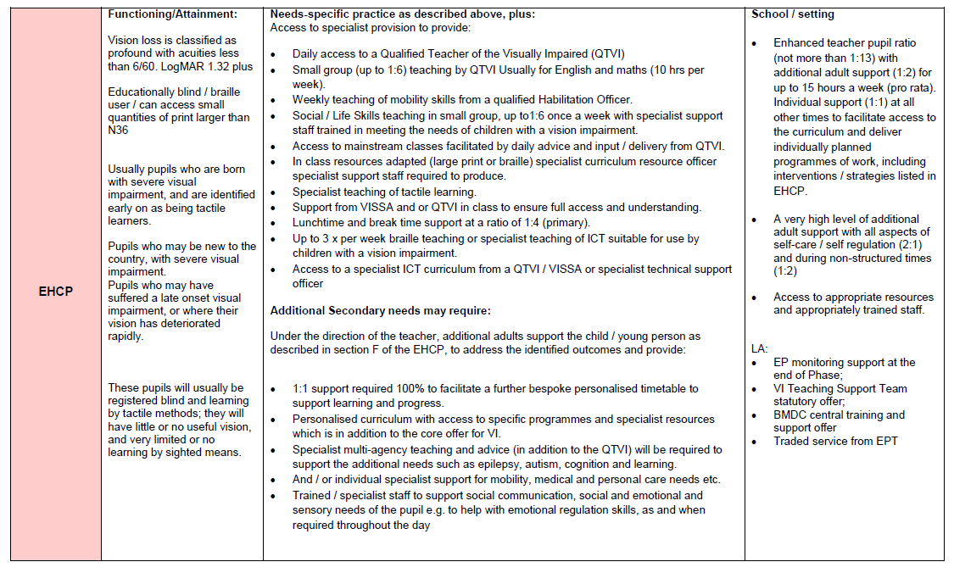
Matrix of Need - Vision Impairment (page 28)

Slide 25
The COVID-19 pandemic has obviously had an impact, however our teams are all continuing to work as normal as long as there are COVID-19 safe practices in place in your settings.
We can continue to carry out visits and provide advice and support.
Training is continuing both face to face and virtually where required and we are in the process of developing some online training which will be accessible via BSO once completed.

Slide 26
Local Authority led Resourced Provisions
The service leads 4 Local Authority Led Resourced Provisions – previously known as ARCs (Additionally Resourced Centres) which are:
Grove House Primary School – Resourced for visually impaired children. Interim Lead Teacher – Grace Barrowclough
Swain House Primary School and Girlington Primary School, both resourced for Deaf and hearing impaired children.
Swain House Lead Teacher – Christine Cashman
Girlington Lead Teachers – Claire Hussain and Ruba Hussain
Hanson School - resourced for both Deaf and hearing impaired and visually impaired children.
Interim Lead teachers – Sarah Rothera (Deaf / HI)
Robert Whitehouse (VI)

Slide 27
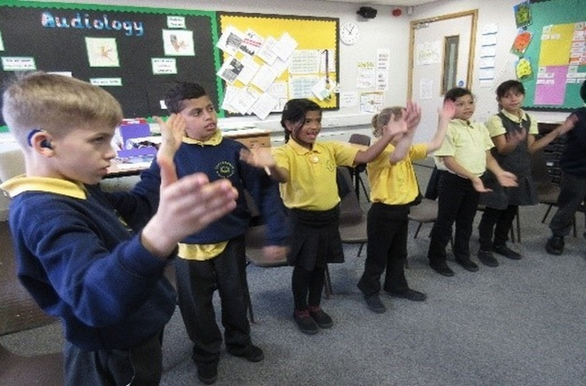
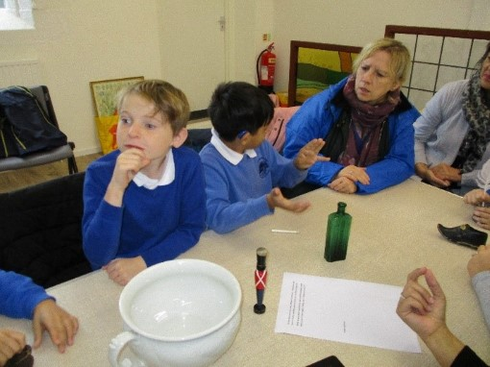
Resourced Provisions
Pupils will be those with most severe and profound degrees of Deafness /Vision Impairment/Multi Sensory Impairment
These are mainstream pupils, functioning at a range of abilities
Mainstream school additionally resourced, with sensory service specialist staff and specialist equipment to meet the need of the pupils who will have or are in the process of getting an EHCP

Slide 28
Resourced Provisions
All 4 local authority resourced provisions are continuing to provide a curriculum to deaf, hearing impaired and visually impaired children during this current lockdown.
We have a number of children still attending school and accessing learning as they would usually do and a number of children who are accessing remote learning with support from our specialist staff to ensure we continue to meet their needs as specified in their EHCPs

Slide 29
Referrals and Information
Our team accepts referrals via a number of routes:
Local health trusts – Bradford and Airedale
Parent / Carer referrals
Schools and settings
Referral form can be accessed along with more detailed information about each part of the Low Incidence Team on BSO

Slide 30
Education Health and Care plan Developments: Section A / Person Centred Planning
Charlie Lowe – Assistant Manager – SEN Assessment Team

Slide 31
Integrated Assessment Team Pupil voice

Slide 32
Goals
To understand the importance of co-production from the earliest opportunity
To recognise the importance of not using others views as a proxy for the child or young person
To establish where we record views
To gain new ideas around capturing pupil voice

Slide 33
Holistic co-production
‘…ensures that children, young people and parents feel they have participated fully in the process and have a sense of co-ownership.’
SEND Code of Practice 2015, Section 4.9, page 61
‘…provide support that enables children, young people and parents to contribute to decision-making…’
- SEND Code of Practice 2015, Section 4.9, page 62

Slide 34
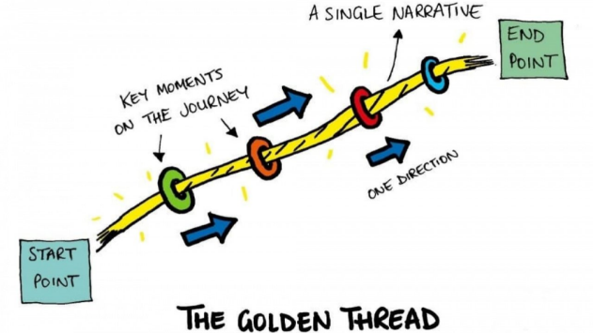
Children and young peoples views
Local authorities must not use the views of parents as a proxy for young people’s views. Young people will have their own perspective and local authorities should have arrangements in place to engage with them directly.
SEND Code of Practice 2015, Section 1.10, page 22
CYP views can only be from the Child / Young Person
Aspirations must be personal which create…

Slide 35
When does it all start?
Earliest opportunity
Must involve the family
As part of a schools graduated approach at the SEN support stage

Slide 36
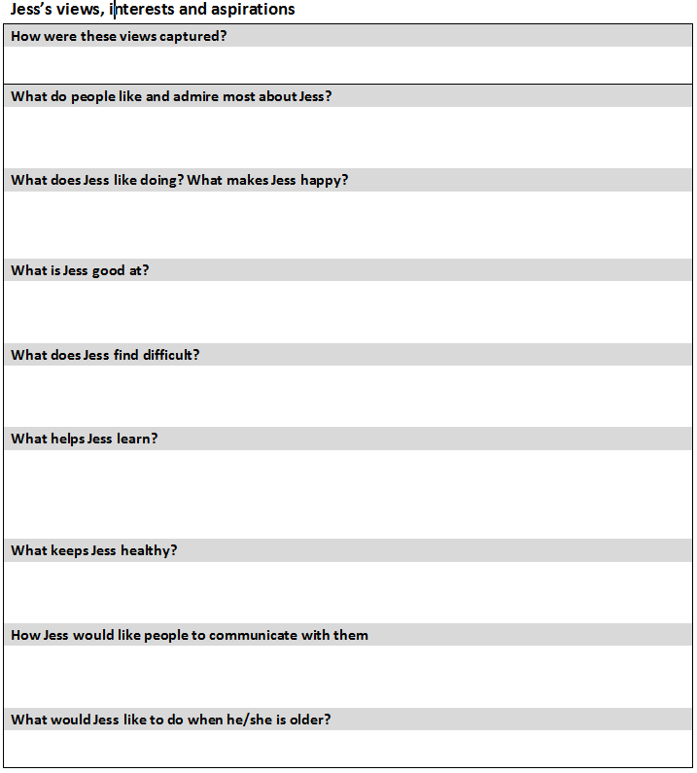
Capturing pupil voice
How could you articulate the views of a child / young person who has limited language or communication difficulties?

Slide 37
Ideas
Could views be represented pictorially?
Is a short narrative required to supplement?
Would short phrases supplemented by symbols work?
Does the child / young person use alternative communication?
Could software packages support?

Slide 38
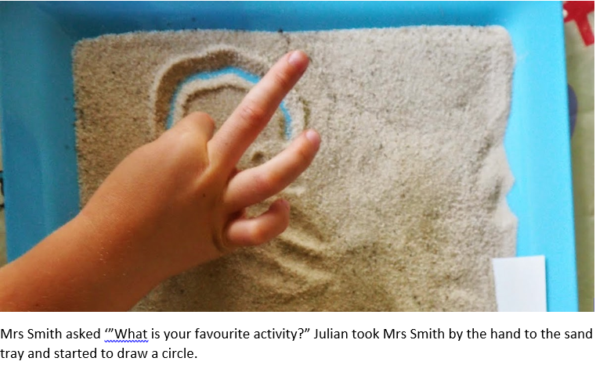
Be creative

Slide 39
Which method / strategy / resource would mean the most for that child or young person?

Slide 40
Aspirations
Long term outcomes must link with the aspirations of the child / young person
Will be a link to the preparation for adulthood

Slide 41
Section B: Special Educational needs

Slide 42
Section B: Special Educational needs
Identifies pure strengths
Describes emerging skills which can be built upon as well as difficulties which they may face.
Refers to skills/abilities/knowledge which are in their infancy and can be developed upon.
Describe deficits and struggles as well as the ‘impact’ these have / could potentially have on the child / young person.

Slide 43
Preparation for adulthood
Area of need | Probe questions
HE and / or employment | Do they have a part time job? This could be paid or voluntary work Have they completed work experience? What are their career aspirations (triangulated with Section A)? What course are they studying which will / could lead onto either HE or employment?
Independent Living | Can they cook a simple meal or make a drink for themselves? Do they under stand the value of money? Can they apply this to a practical experience? Are they able to travel independently? Do they want to learning how to drive (triangulated with Section A)?
Participation in society | Do they attend clubs / organisations in their community? What is the impact on doing so? What support networks do they have / have knowledge off / can access?
Being as healthy as possible in AL | Are they able to tend to their self care needs? Can they make good choices in regards to diet? Do they play sports or are they active in other ways and under stand the benefits of a healthy lifestyle?

Slide 44
Remember to…
Capture views and include the evidence when submitting an EHC assessment
Capture views prior to the annual review meeting
Distribute 2 weeks prior to the review meeting

Slide 45
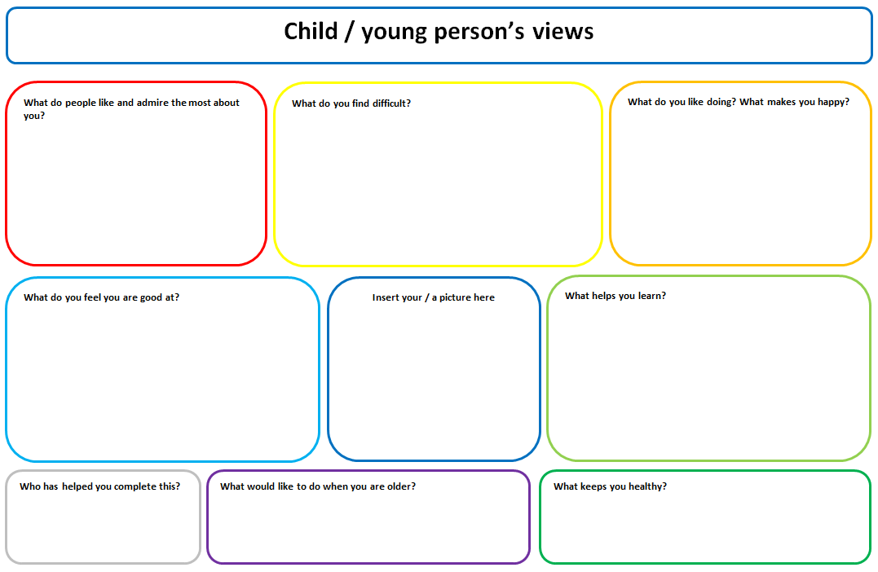
What resources are available?

Slide 46
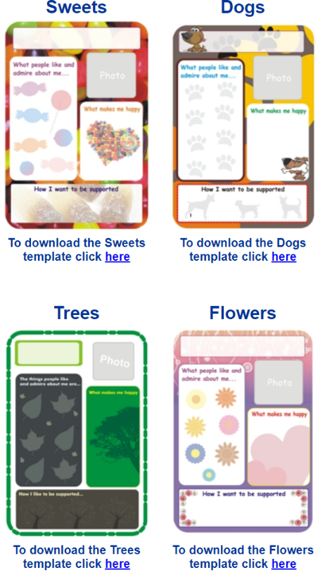
What resources are available?

Slide 47
Useful websites
http://www.sheffkids.co.uk/adultssite/pages/onepageprofilestemplates.html
https://www.preparingforadulthood.org.uk/downloads/person-centred-planning/like-and-admire.htm
https://www.ndti.org.uk/projects/preparing-for-adulthood

Slide 48
Transitions reviews?
Final Primary and Year 7 placements will be announced by February 15th 2021
Final Post 16 placements will be announced by March 31st 2021

Slide 49
Transition reviews Sept 2022
June 2021 current Y5 and Y10 will receive letters requesting their preferences
Current year 5 reviews to be completed in Summer 2
Year 5 CYP will have their EHC plans updated during the Summer holidays (2021)
Current Y10 moving into Y11 reviews to be completed in Autumn 1
EHC plans will be updated in Autumn 2 (2021) and Spring 1 (2022)

Slide 50
Transition reviews
Striving towards being an electronic service therefore would request that responses are via email.
Respond to the below email address using the following codes in the body of your email response:
transitionreviews@bradford.gov.uk
PP1 – name of setting
PP2 – name of setting
PP3 – name of setting

Slide 51
Thank you

Slide 52
Introducing the Educational Emotional Wellbeing Practitioner team
Rebecca Horn – Lead Practitioner EEWP Team

Slide 53
The Education Emotional Wellbeing Practitioners (EEWP)
EEWP Lead North – Rebecca Horn
EEWP North – Sophie Dinsdale
EEWP East – Jade Kernick
EEWP South – Lisa Aveyard
EEWP West – Simrit Bharaj

Slide 54
Introduction
The EEWP team is part of the Bradford Educational Psychology Team.
The team has been developed in response to the Covid – 19 pandemic and as part of the DfE Wellbeing for Education Return programme.
The purpose of the team is to support the emotional wellbeing of children and young people (CYP) who have been particularly and negatively affected by the Covid – 19 pandemic.
This service will be offered to all educational settings in Bradford at no cost.
So far there is funding for this team up to November 2022.

Slide 55
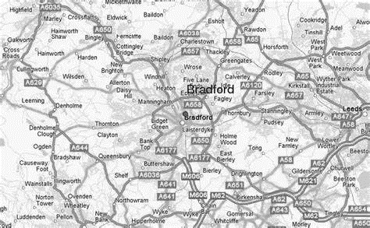
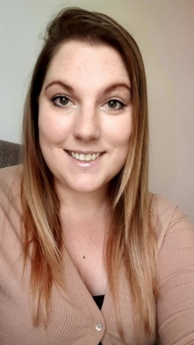
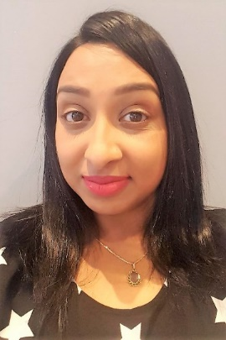
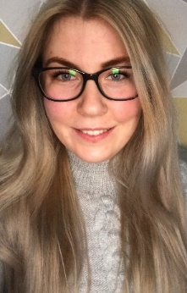
our team
Rebecca Horn – Education Emotional Wellbeing Lead
Sophie Dinsdale – Education Emotional Wellbeing Practitioner
North – Rebecca & Sophie
West - Simrit
East – Jade
Jade Kernick – Education Emotional Wellbeing Practitioner
Simrit Bharaj – Education Emotional Wellbeing Practitioner
Lisa Aveyard – Education Emotional Wellbeing Practitioner
South – Lisa

Slide 56
Aims of the eewp team
The team’s focus is on the emotional wellbeing needs that have arisen to due Covid – 19.
Identify issues with emotional wellbeing.
Provide tailored support to meet the individual needs of the CYP.
Collaborate with schools to promote and improve CYP wellbeing.
Advise schools on how to utilise internal resources.
Provide materials to school staff to support CYP’s.
Provide psycho-education, support and guidance.
Signpost to alternative services where appropriate
Continuously monitor the impact of all support offered.
Due to COVID – 19 restrictions, the EEWP team will initially provide one-to-one and small-group support.
To prevent the onset of mental health problems and support with emerging difficulties.
Notes:
What the EEWP team will do:
Identifying issues and make use of School’s internal resources
Provide psycho education
Non judgmental emotional support advice and guidance
Work with educational settings to promote and improve CYP Emotional Health
Assist school staff in skill development, understanding, knowledge of CYP Emotional Health
Signpost to other support services as appropriate
Monitor impact of interventions
Each CYP referral will be met with Child Focused Support. This may differ dependent on CYP need
Initially the EEWP team will concentrate on individual CYP’s or a small group (within the same bubble due to current Covid – 19 restrictions)

Slide 57
Why is the EEWP team needed?
In order to access learning, CYPs need to feel safe and happy.
Covid – 19 is still affecting daily life for both CYP’s and adults worldwide.
CYP are often more resilient than we think; most CYP have managed well with the changes and uncertainty that COVID – 19 has brought along.
As a result, it is thought that the majority of CYP will not suffer from any long-term emotional difficulties as a result of the pandemic.
However, some CYP will require additional support.
Research has indicated that the presenting concerns are likely to include low mood, anxiety, low levels of resilience, and bereavement. However, this list is not exhaustive.

Slide 58
Universal
Targeted
Individual
It is normal for CYP’s and adults to experience mild or occasional difficulties during the Covid-19 period.
School will be providing support through structure, routine and Whole School Approach. Some CYP’s may need additional support to cope with or adjust to the challenges of living through the pandemic. School will use their targeted Emotional Wellbeing Support within the setting.
Some CYP’s may require more specific support from an EEWP for difficulties that have not responded to the targeted support from school. These may be ongoing difficulties due to anxiety, low mood, resilience and bereavement.
EEWP’s support through tailored interventions or supporting schools to facilitate individualised recovery.
Some CYP’s may have more severe difficulties that require individual specialist support from CYP Mental Health services.
Notes:
Who EEWP’s Support
allow CYP’s to initially go through the school’s graduated response. If those CYP’s are struggling following this – it may be time to refer to the EEWP’s.
All therapeutic interventions / support from EEWP’s is child focused and evidence based. Interventions / support will be monitored and evaluated for impact.

Slide 59
Who do EEWP support?
Out of Character behaviours
Change in normal presentation
Physical complaints – stomach / head aches
Difficulty sleeping / eating / concentrating
Worry
Irritability or “acting out”
Difficulty / avoiding engaging in day to day tasks
Noticeable reduction in resilience
Withdrawal
Poor school performance
Mild to Moderate emotional wellbeing difficulties that have presented due to the Covid – 19 pandemic.
EEWP
Mild: small number of symptoms impacting daily life
Moderate: more symptoms that makes daily life more difficult
Severe: high number of signs / symptoms that have major impact on life and functioning
Single Referral Pathway for Mental Health

Slide 60
Working with EEWP
School consider / refer CYP’s who may benefit from the additional support.
School will be required to identify a key adult who will be responsible for facilitating the additional support and continue once EEWP input has ended.
EEWP’s will work collaboratively with CYP’s and school. Although the EEWP’s may contact families, school will be their main contact.
EEWP’s provide targeted intervention to meet the specific need of CYP.
CYP
School
EEWP
Notes:
EEWPs will make initial contact with schools on the 20th January. The schools SENDCo/Mental Health Champion will be invited to begin communication with the team.
Schools will be asked to identify a key contact who will hold responsibility for ensuring that the work of an EEWP can go ahead (for example, ensuring the CYP is available for a pre-arranged timeslot, locating a room for use).
EEWPs will work collaboratively with the CYP, their family, and the school; all communication with families will be made through the school.
EEWPs will provide a targeted intervention to meet the specific need of the CYP.

Slide 61
Timeline of support
1. Concerns about a CYP’s emotional wellbeing (March 2020 onset, COVID-19 related).
2. Consider if a referral to the EEWP team is needed.
3. Gain parental consent, speak with CYP about the referral if appropriate.
4. Complete referral form and send to EdEmotionalWellbeing@Bradford.gov.uk.
Role of the school
Role of the EEWPs
5. Receive and triage referral forms. If EEWP support is deemed to be inappropriate, schools will be informed.
6. Contact school if further information is needed.
7. Initial visit: meet the CYP and their trusted adults.
10, The impact of the intervention will be monitored throughout and exit data will be collected to establish the impact.
9. Intervention based upon the CYP’s individual needs commences.
8. If EEWP support is deemed to be inappropriate, schools will be informed. If referral is accepted, identify key contact from school.
Notes:
Concerns about CYP’s emotional wellbeing – covid – 19 related.
Is a referral needed? What has been done in setting?
Speak with parent / carers and gain consent to refer to the EEWP
Complete referral form – parent / carers signature is required, without this we will not be able to process the referral further.
The EEWP’s will triage referrals weekly and assess the appropriateness of the referral. If the referral is not appropriate, it will be returned to school with a rationale and guidance if appropriate.
An appropriate referral will be followed up by contacting school to gather further information as needed.
EEWP’s will then conduct an initial visit with the CYP and trusted adult to clarify how to proceed with the referral. Complete the screening and initial assessment process. Complete a formulation of the CYPs needs.
If at this point, it is not appropriate for support by the EEWP’s then we will inform school with a rationale and guidance. If appropriate, school will be required to identify a key contact who will facilitate the intervention.
The intervention will be commenced.
Once the intervention is completed or handed over to the key contact, exit data will be collected and involvement with EEWP will end.

Slide 62
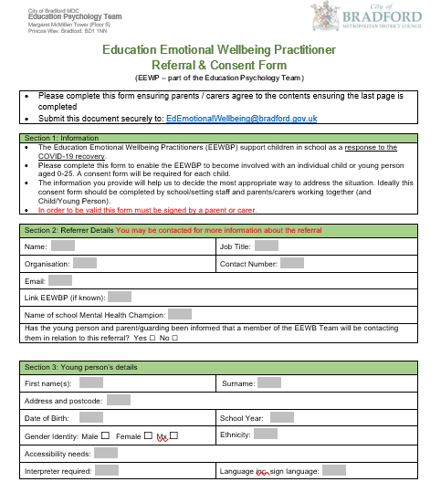
Referral to EEWP
4. Complete referral form and send to EdEmotionalWellbeing@Bradford.gov.uk.
When to refer:
emotional difficulties have appeared due to the covid – 19 pandemic
Emotional difficulties are mild to moderate
School have used internal resources to support – through the graduated approach and plan do review process.
When not to refer:
If the CYP has been referred to or is working with another service for similar difficulties
Emotional difficulties have a severe impact on day to day functioning
If emotional difficulties are enduring and emerged prior to the Covid – 19 pandemic.
A signed referral form is necessary – we will not be able to process the referral without this.
The team is a finite resource and can take a maximum of 60 cases a term.

Slide 63
Interventions
7. Initial visit: meet the CYP and their trusted adults.
9. Intervention based upon the CYP’s individual needs commences.
Consultations with CYP’s (where age appropriate), parents and school will be completed prior to interventions taking place.
Short term interventions – last up to six sessions, up to one hour per session.
We will work with the school to arrange appropriate times to complete these sessions within the school day.
Delivered to CYP’s alongside a consistent member of staff who will be able support the CYP during and after the input from EEWP.
It may be more beneficial that some interventions are started with the EEWP but continued with the staff in school.
Part of the purpose for this team is to be able to provide support for CYP’s and upskill staff within school so they can use the skills .
Notes:
Interventions will be delivered to CYP’s with support from a consistent key adult from the school. The interventions purpose is not only to support the CYP but to upskill staff within the school to enable them to support similar difficulties in the future.
The amount of involvement by EEWP’s will be reviewed on a case by case basis.
At times, we may require use of school resources, such as photocopiers.

Slide 64
Managing Covid Risk
Prior to any in-person meeting, schools are required to provide the EEWP with their up-to-date COVID-19 risk assessment.
Schools are required to book rooms for use by the EEWP and CYP. They should be sanitised and adequately ventilated prior to EEWP’s arrival.
For the EEWP to conduct an in-person session, the CYP’s bubble must not have any positive COVID-19 cases in the past 14-days.
Schools are required to contact the EEWP if there have been any CYP or adults in the “bubble” that have shown any symptoms within the past 14 days.
EEWPs will follow their personal risk assessment guidance at all times, including social distancing and wearing face coverings.
Notes:
Delivering this support during the ongoing Covid – 19 period means that additional risk assessments are required.
Risk of transmission will be consistently reviewed and precautions will be put in place. We will require school’s up to dates risk assessments and complete our own risk assessment to plan safe visits to school settings.
With the ongoing changes in government and local authority we will review this process as we go on.

Slide 65
Work During Lockdown from January 2021
Your link Education Emotional Wellbeing Practitioner will be in touch with you by the end of January to discuss this further.
Notes:
As we know, we are currently in another lockdown and this will affect how schools work internally and externally. Whilst we are aiming to support schools as fully as possible, it will not be appropriate for us to visit schools at this time

Slide 66
Thank you
This is a new project being developed in challenging times, our aim is to support CYP’s and we endeavour to do this in a safe way.

Slide 67
Supporting Staff Wellbeing during Covid-19
Dr Ruth Dennis
Principal Educational Psychologist
January 2021

Slide 68
Why does staff wellbeing matter?
How teachers feel on a daily basis is likely to affect their performance and, in turn, the performance of the pupils they teach
Happier, motivated teachers may make pupils feel happier, motivated and more confident
Happier teachers may also be able to concentrate better on the job of teaching and experience more motivation to help pupils in need of special attention
Less sickness absence
Enhanced staff retention

Slide 70
How schools can support staff wellbeing
Strategy and policies
Help and support
School culture and environment

Slide 72
How Covid-19 is impacting on staff wellbeing
 | Home life | Work life
Physiological | Food availability Limits on physical activity Disturbed sleep | No rest / holidays
Safety | Risk of catching covid Being unwell Managing wellbeing of family members | Loss of structure and routine
Love and Belonging | Illness and loss of loved ones Loss of social contact | Illness and loss of colleagues / members of school community Loss of colleague support
Esteem |  | Loss of feeling of competence
Actualisation

Slide 73
Evolution and Covid-19
Evolution did not prepare us for the stress of Covid-19
Traditionally, threatened by a predator, we would fill up with adrenaline and cortisol, then our ‘fight or flight’ impulse would kick in. As a result, we’d either kill or be killed. If we survived, our hormone levels would return to normal and we’d feel better.
Nowadays those hormones are still released regularly in relation to stress, but they stay in our body and we’re in a constant state of alarm. What once made us safe, now threatens our mental health.
In supporting wellbeing, we need to offer coping strategies for modern life.
To do this, we need to understand how our brains work, rewire our thinking and find calm in our frantic modern day world.

Slide 74
Happiness v Wellbeing
Happiness is defined as ‘the state of being happy’. It is like getting complete fulfilment.
Well-being is defined as ‘a satisfactory condition of existence’. It is characterized by good health, happiness, and prosperity.
Happiness in a time of pandemic is unrealistic, but supporting the development of wellbeing is achievable

Slide 75
The science of happiness
We have within us the capacity to manufacture the happiness we are constantly chasing.
Dan Gilbert, (psychologist and happiness expert) teaches about the human ‘psychological immune system’. This is a system of cognitive processes, largely non-conscious, which help us change our views of the world so we can feel better about the situations in which we find ourselves.
A year after losing the use of their legs and a year after winning 314 million dollars in the lotto, lottery winners and paraplegics were found to be equally happy with their lives. According to Gilbert, this is because happiness can be synthesized.
The 2 types of happiness:
1. Natural happiness – what we get when we get what we wanted
2. Synthetic happiness – what we make when we don’t get what we wanted
We are wrong to think of synthetic happiness as inferior - it’s every bit as real and enduring as when we get exactly what we were aiming for.
In fact, we are actually happier when we don’t have a choice and accept our situation.

Slide 76
Seligman’s PERMA Model
Martin Seligman, one of the founders of positive psychology, developed a five core element of psychological well-being and happiness.
Seligman believes that these five elements can help people work towards a life of fulfilment, happiness, and meaning.
Schools can also use this model to develop programmes that help people discover and use new cognitive and emotional tools.

Slide 79
Introducing PERMA during Covid-19
Staff are tired
Emotional resources are low
Resilience is stretched.
The model needs to be applied with kindness and implemented through whatever means people can manage

Slide 80
Staff Wellbeing Support from the EPT
Introductory video training for senior leaders on Staff Wellbeing during Covid-19
5 x Mini PERMA videos for staff
Individual PERMA Audit and Plan for school staff
PERMA Audit and Action Plan for whole school
PERMA Action Plan Support for Senior Managers– bookable consultation sessions to plan and support implementation in schools

Slide 81
Further Information
Ruth Dennis - Principal Educational Psychologist
City Of Bradford Metropolitan District Council
Margaret McMillan Tower Princes Way BRADFORD BD1 1NN
ruth.dennis@bradford.gov.uk
07582 109129
01274 439417

Slide 82
Questions

