Slide 1
Senco Network
Spring Term 2020

Slide 2
Welcome
Agenda | Presenter | Time
Introduction and welcome | Ruth Dennis – Principal Educational Psychologist | 9 .00
Update on SEN Assessment Team and statutory systems | Niall Devlin - Strategic Manager, Integrated Assessment, Children's Services | 9.20
SEN Funding and High Needs Block consultation | Andrew Redding - Business Advisor, Corporate Resources | 9.45
Senco CPD Requirements | Michael Purches - Interim SEND Transformation and Compliance Coordinator | 10.30
Networking Break | Sleeping on Vocabulary Project sign up | 10.40
Welcome to Parent Forum | Julie Bruce – Parent Forum | 11.00
The new Autism Diagnostic Pathway | Ruth Shaw / Diane Daley | 11.30
Any Questions |  | 11.55

Slide 3
Educational Psychology Team Update
Ruth Dennis
Principal Educational Psychologist

Slide 4
EP Traded Services 2020- 21

Slide 5
Skills4Bradford
www.skills4bradford.co.uk
Create school account;
Use to book onto courses / purchase additional EP time etc.
NB you must have a finance manager on the account who is authorised to sign off the purchase.

Slide 6
Courses for Sencos
A full programme of EP led Senco training events has been sent into schools;
They are also available to view and book via Skills4Bradford
Log in to ‘Skills4Bradford’
Click ‘Training’ in the top banner
Browse ‘roles / Senco’ and click the green arrow next to it.
This should take you to a full list of available courses from the EP team and other services.

Slide 7
Changes to Monitoring Reviews
Monitoring reviews will be carried out in order to support the transition of young people with EHCPs when they move from primary to secondary school or from secondary to tertiary education.
The process is currently being trialled and will involve children and young people who are currently in Y5 and Y10, who will be transitioning at the end of next academic year. This is to fit in with the tight timescales around annual review completion in Years 6 and 11.
The process will include an Assistant Educational Psychologist working with your Senco to revise and update the EHCP in preparation for the Y6 /11 annual review.
Please be aware that if there are significant changes you wish to make, there will need to be advice from external professionals to evidence this.
The reviewed document will form the basis of the annual review meeting and will ensure that plans are updated and returned to schools in a timely way.
AEPs will be contacting schools over the next few months to arrange the first of these revised monitoring reviews.
If you have any queries or questions about this please contact the Educational Psychology team: 01274 439444

Slide 8
EP Early Help Hub Consultations
Early Help hub sessions enable schools to access support and advice from an EP in a timely and efficient way.
Early Help hub sessions are available across the year at a number of locality and central locations.
EP Early Help hub sessions are fully subsidised for Bradford maintained schools and at a cost of £80 per session for other users.
How to Book a Consultation
Log into your Skills4Bradford account
Click ‘Training’ in the top banner
Browse ‘roles / Senco’ and click the green arrow next to it.
This should take you to all the Early Help Hub meetings.
Select your preferred date and make your booking.
Please remember to complete the parent / carer consent form and the ‘Getting the Most out of Your Consultation’ form.

Slide 9
Senco Network Online Forum
1. Navigate to Skills4 Bradford: http://www.skills4bradford.co.uk
2. Log in or sign up for an account;
3. Select Communication
4. On the orange banner, click the small arrow next to ‘Groups’
Browse groups and you should find Senco Network.

Slide 10
Annual Reviews - Person Centred Planning
What?
To create resources and look at the ways in which we can make annual reviews more person centred
Why?
We would like children and young people to engage more with their EHCP reviews and target setting
When?
Spring 2 – we will be enlisting educational provisions across all ages to trial the resources and gather feedback

Slide 11
Update on SEN Assessment Team and statutory systems
Niall Devlin - Strategic Manager, Integrated Assessment, Children's Services

Slide 12
SEN Funding and High Needs Block consultation
Andrew Redding - Business Advisor, Corporate Resources

Slide 13
Challenges and Responses
Compliance
Quality of EHC plan
Annual Review
Communication
Staff Competency
School Payments
Restructure , changing Team roles, new posts of Assistant Manager (ensuring compliance) and Panel Coordinator.. Additional capacity to write EHC plans to work through legacy issues.
Quality assurance now part of Assistant manager Role, Working with North Yorkshire to Audit Plans, Quality Assurance matrix, Training to all plan writers on quality plans. Monitoring quality of Plans. Works Streams on EHC assessment and Preparation for Adulthood
Retraining staff on Annual Review process, Issue new guidance on amends. Employing staff to specifically to review plans. Work stream objective focused on Annual reviews, developing new guidance, Annual review check list, EP pilot project on CYP chairing Annual reviews, Developing guidance on Person Centred Reviews.
Bradford SEND Updates as direct communication, new protocols on staff the phone lines. Develop guidance on responses to emails. Reviewing the use of SEND inboxes, updating Bradford Local Offer, parental Engagement events.
All Staff have been/are on retraining related to Code of Practice and use of IT systems. Practice Handbook on new procedures. Building in supervision and 1:1s
Expanding the Finance and Payments team to increase capacity. New SLA for School lead resource Provisions (DSP)

Slide 14
Senco CPD Requirements
Michael Purches - Interim SEND Transformation and Compliance Coordinator
SEND Transformation & Compliance Team
SENDT&C@bradford.gov.uk
01274 435300

Slide 15
Bradford District’s Revised SEND Strategy 2018-2022: Summary January-March 2020
Key Priority | What we will do | How we will do it | How we will know when we have done it | How will we know we have improved
To improve the way we communicate with children & young people and their families and share information about provision and services. | Raise the profile of the Local Offer (LO) as a source of information about SEND help and support. Increase the accessibility of the LO website. Engage more with children and young people and their families to shape the website. | Encourage schools and organisations to encourage ‘sign up’ to the LO website. Review our LO website. Empower our young SEND Ambassadors. Hold monthly engagement events with families. | Children & young people, families and professionals will be able to use the LO website effectively to access information about services and provisions available. Our SEND Ambassadors have a high profile in the area. | Better outcomes for children & young people with SEND Improved progress and attainment for children and young people with SEND. Increased attendance rates and a reduction in persistent absence. Reduction in fixed term and permanent exclusions. On leaving school, more will be in education, employment or training and independent living.. Children and young people will have timely access to good-quality schools, colleges and services. Increased percentage of children will have their needs met in a mainstream school. Trends in demand for special school placements remain stable. Reduction in the average distance travelled to access appropriate provision. Out of district placements reduced. Children, young people and families will tell us they feel more supported by education, health and social care services.
To better support children & young people with SEND along their journey, putting them at the centre of plans and decision-making. | Improve ‘person-centred’ planning in schools and colleges. Provide guidance on Annual Reviews to schools and colleges. Make sure that children and young people have greater access to information on which to inform their decisions. Develop voice and influence of children and young people. | Provide guidance to schools and colleges on person-centred planning and how children and young people can shape the help they get. Increase access to information for children & young people. | Children, young people, families and professionals will be able to use the Local Offer effectively to support their own SEND journey. The Education, Health and Care Planning process will deliver timely, high quality co-produced Plans with children, young people and families.
To further improve provision and services for children & young people with SEND. | Support children & young people with SEND more by greater joined up work by education, health and social care (e.g. regular meetings with Health/CCG managers. Find out what additional support schools need. Develop children and young people’s voice and role of SEND Ambassadors. | Promote the voice of young people with SEND in reviewing the support they receive and influencing changes. Send questionnaire to SENDCos and identify what extra support is required. Develop role of parent ambassadors. Involve children & young people in commissioning cycle. | A clear understanding of the gaps in services and provision. Co-production of new offers/services to meet identified need.
To better prepare young people with SEND for adulthood. | Develop a clear pathway for young people as they approach adulthood that provides advice and guidance for them and sets out who should do what. Improve person-centred planning in schools and colleges. | Create a pathways document and visual guidance for schools and colleges so that all agencies can be better held to account in supporting young people towards adulthood. | The transition through to adulthood will be well understood by children and young people and families with jointly commissioned pathways being developed.

Slide 16
Support for schools – audit questions
How do you identify children and young people’s special educational needs?
How do you work with others to achieve good outcomes?
Are outcomes set on baseline assessments?
What types of evidence do you record?
How do you record and share progress towards outcomes?
How do you involve appropriate professionals?
When do you involve appropriate professionals?
Can you describe how parents and children and young people are involved in the assessment and review process?
How do you evaluate the impact of interventions?
Do you have a provision map?
Can you show your graduated approach?

Slide 17
Voice & Influence – a request
What did children and young people say about the support they get?
What did you change based on their feedback?
What was the impact?

Slide 18
SEND: No Limits!

Slide 20
https://bso.bradford.gov.uk/news/18902-attention-all-sendcos

Slide 21
Thank you!
Bradford’s SEND Transformation & Compliance Team
SENDT&C@bradford.gov.uk
01274 435300

Slide 22
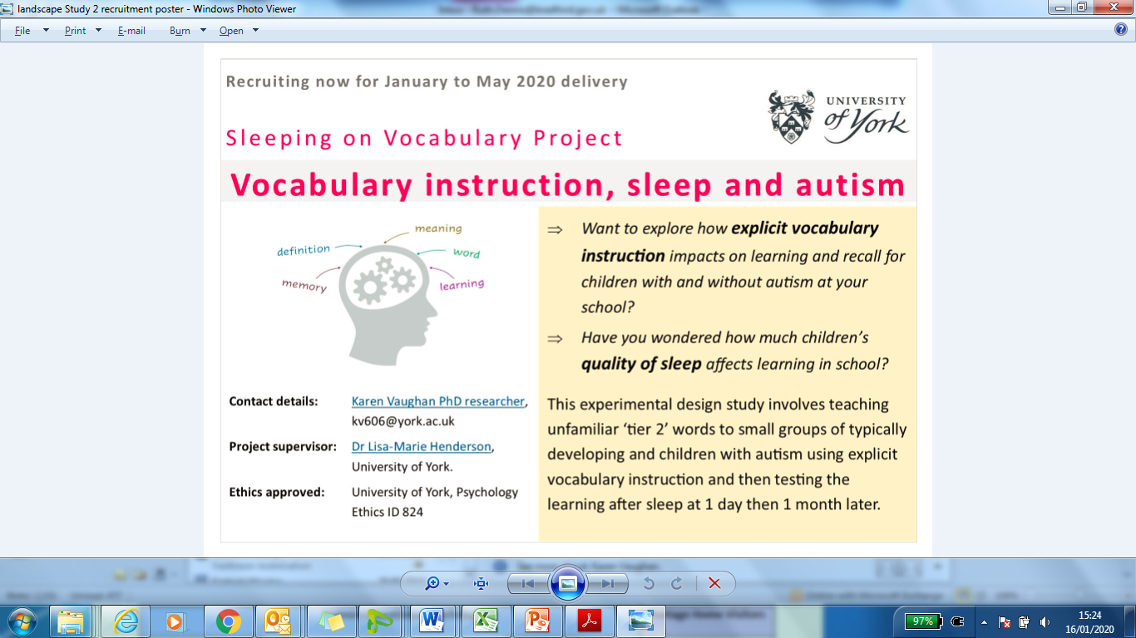
Networking Break

Slide 23
Welcome to Parent Forum
Julie Bruce – Parent Forum

Slide 24
The Parents’ Forum for Bradford & Airedale
(PFBA)
Senco Network
5th February 2020

Slide 25
Our Vision
To empower parents/carers by influencing positive changes in health, education and social care policies and practices for families, children and young people with disabilities/additional needs.

Slide 26
PFBA – Background
Involvement in new Special Schools
Became a registered charity with shared values and peer support
Independent Parent/carer run and led organisation
Knowing we’re not alone and part of the National Network of Parent Carer Forums (NNPCF)
Acknowledged and supported by the Local Authority

Slide 27
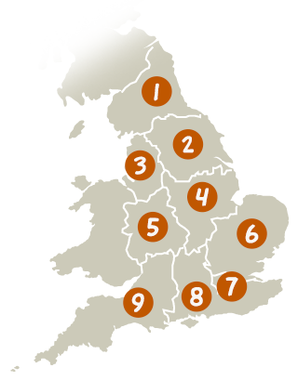
Membership organisation of 151 local parent carer forums
93,000 members
Core work is around strategic participation of families to getting voices heard and to shape services
Parent Carer Forum includes parent carers with a full range of experiences in Health, Education and Social Care as their children/young people have a wide range of conditions
We are a parent carer led organisation
Evidence Based
Solution Focused
The NNPCF
Paragraph 1.13 SEND code of practice:
“Parent Carer Forums are representative local groups of parents and carers of children and young people with disabilities who work alongside local authorities, education, health and other service providers to ensure the services they plan, commission, deliver and monitor meet the needs of children and families”

Slide 28
What we do
Hold Events & workshops PBS workshops EHCP workshops Information Days/Listening Events Bigger Voice Events (for support group reps) | Work in partnership Support groups Health & Social Care Teams Special Schools SENDIASS
Representation on Strategic Groups SEND Strategic Forum Carers Partnership Transforming Lives Short Breaks Forum | Ongoing surveys What is working well/ not so well What’s important Consultation work

Slide 29
Focused support:- Killinghall Project
Awards for all
Working closely with Lynne
Setting up an SEN support Forum for parent/carers
Peer support and learning
For any more info – contact
Lynne.Clegg@killinghall.bradford.sch.uk

Slide 30
What parents have told us
Would like a better relationship with school
Would like to support their child’s learning
Have difficulty understanding how SEN support works in school
Would like to have a voice in planning

Slide 31
Next steps
Would like to work more closely with schools and Senco’s
Would like schools to help us reach parents so we can offer early support and information.

Slide 32
Any questions?
Email: info@pfba.org.uk
Phone: 01274 397396
Web: - www.pfba.org.uk

Slide 33
The new Autism Diagnostic Pathway
Ruth Shaw /

Slide 34
Senco Networks 2019 - 20
Senco Network (Autumn) | 10.09.19 | Hockney
Senco Network (Spring) | 05.02.20 | Hockney
Senco Network (Summer) | 20.05.20 | Hockney
Book via Skills4Bradford
You must make a confirmed booking and check it out so that we can comply with fire regulations.

Slide 35
Questions

