Slide 1

Senco Network
Spring Term 2018

Slide 2
Welcome
Welcome – Senco Update | 1.00
Funding for Children with SEND – Andrew Redding / Ruth Dennis | 1.15
Networking Break | 2.30
SEN Progress grids & SEN Support Grids | 3.00
14 – 25 developments | 3.45
Any Questions | 4.00

Slide 3
Funding SEN in Schools
Andrew Redding

Slide 4
The Graduated Approach in Bradford
Range 1, 2 & 3
Setting’s own approach to planning and recording for SEND
Range 3
My Support Plan
Range 4
EHCP / Funded MSP

Slide 5
Mainstream School SEN Funding
At Ranges 1 – 3, schools have agreed to fund SEN using Elements 1 and 2;
Don’t forget Pupil Premium;
Additional ‘Element 3’ funding is issued from the High Needs Block when an EHCP / MSP is issued.
Element 1
Notional 5.5% of school budget
Element 3
High Needs Block element (EHCP)
Element 2
SEN Formula <£6000
Pupil Premium

Slide 6
Notional SEN Funding
Agreed between LA and Head Teacher group annually;
Primary:
Secondary:
Lowest | £19,106
Highest | £322,222
Lowest | £175,000
Highest | £865,095

Slide 7

Increased demand on the
High Needs block
Schools
EHCP request
Schools
Specialist place
Less and less in pot for Element 3 EHCP funding
EHCP request
Specialist place
Schools
EHCP request
Specialist place
HIGH NEEDS BLOCK
Increased number of requests for Specialist provision / Out of District / other placements
Schools
EHCP

Slide 8
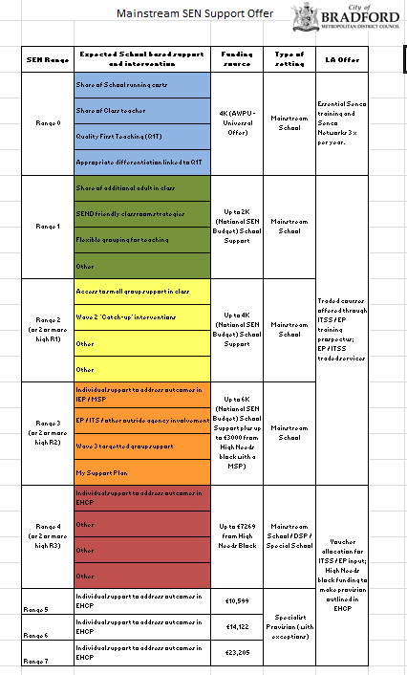
Mainstream SEN Support Offer
Provides clear guidance on your offer;
Demonstrates a graduated approach;
Allows you to promote good practice;
Shows a clear pathway from school based to LA support.

Slide 9
Individual SEN Support Offer
Previously schools submitted ‘provision maps’ to support EHCA request;
The ‘Individual SEN Support Offer’ is a development of this;
It allows you to demonstrate what additionality you are providing for the C/YP;
It allows you to demonstrate your financial accountability for notional SEN funding.

Slide 10
Range 0
This is the universal offer that all children in your school are entitled to;
It is funded via AWPU and is assumed to be in place;
You need to be able to demonstrate elements such as:

Slide 11
Range 1
Up to 2K SEN notional funding should be in place, to allow flexible grouping and some small group work;
Calculate adult support: TA salary / number of children in class.
Share of additional adult in class
SEND friendly classroom strategies
Flexible grouping for teaching
Other

Slide 12
Range 2
Up to 4K SEN notional funding should be in place, to allow regular small group work and some focused individual support;
Calculate adult support: TA salary / children in group x % of week.
Access to small group support in class
Wave 2 ‘Catch-up’ interventions
Other
Other

Slide 13
Range 3
Up to 6K SEN notional funding should be in place, to allow small group work and focused individual support on areas of identified need;
Calculate adult support: TA salary / children in group x % of week;
Add in cost of buying in EP / other services.
Individual support to address outcomes in IEP / MSP
EP / ITS / other outside agency involvement
Wave 3 targetted group support
My Support Plan

Slide 14
Frequently Asked Questions
For nursery children on 15 hour places the funding expectation is halved;
For nursery children on 30 hour places, the full £10K must be evidenced;
Information about your school’s notional SEND funding can be found on BSOL.
https://bso.bradford.gov.uk/Schools/CMSPage.aspx?mid=3475

Slide 15

Networking Break

Slide 16
Why We Need the Progress Grids
Lack of existing tools eg CASPA
Change to ‘Assessment Without Levels’
Consistency and transparency relating to Statutory Assessment / MSP / school based support
Appropriate target setting and measuring progress for children with a high level of need
Measure of ‘Value Added’ for children with a high level of need.

Slide 17
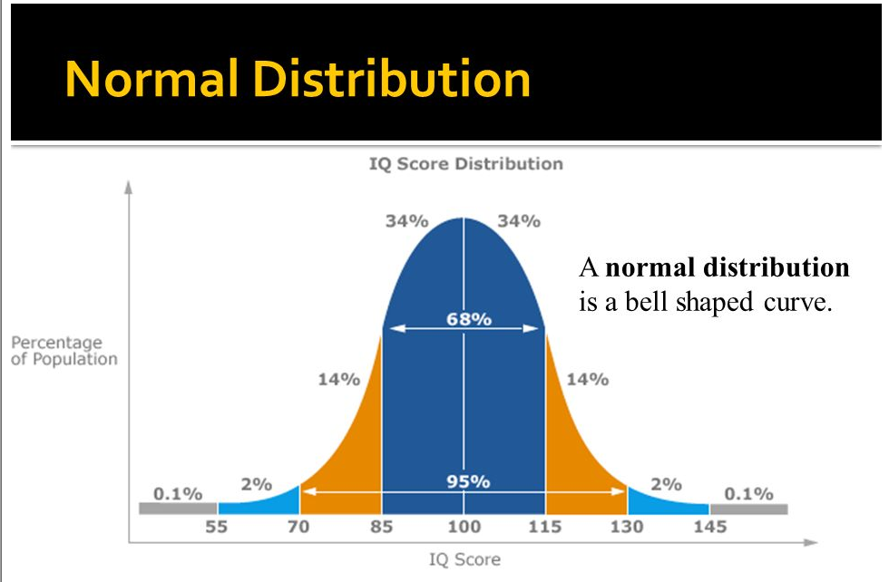

Slide 18
General Expectations
The vast majority of children will be operating within ‘Age Related Expectations’;
When children are operating outside of this or have clear Special Educational Needs, the ‘Progress Grids’ should be used;
The ‘Early Years Progress Grid’ allows you to make finer judgements about children in the Early Years;
The Grids allow you to consistently apply SEN ranges to C/YP and plan for their progress, based on current attainment.

Slide 19
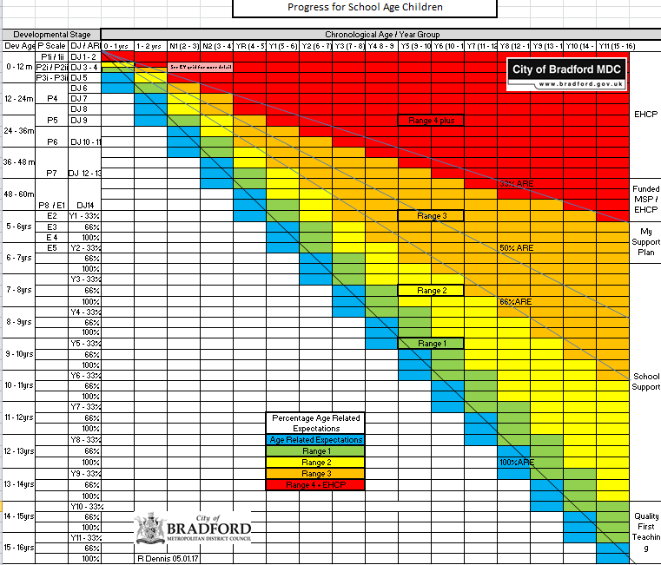
Progress for School Aged Children

Slide 20
Understanding the School Age Progress Grid
Horizontal Axis refers to:
  Chronological Age / Year Group;
Left Vertical Axis refers to:
  EY Developmental Journal / Age Related Expectations; or
  P Scales; or
  Developmental Age
Colour / Right Vertical Axis identifies SEN Range and suggested response.

Slide 21
Understanding the School Age Progress Grid
Radiating lines relate to the percentage of age related expectations achieved;
For example if you are chronologically Y4 :
  and achieving all of the Y4 ARE you would be at 100% ARE (100% line);
  and working within Y1 ARE you would be at 66% ARE (66% line);
  and operating at P6 you would be at 33% ARE (33% line);

Slide 22
Understanding the School Age Progress Grid
Developmental Age can also be used to identify range if the primary need is not measurable in NC terms;
For example a child who is chronologically YR :
  And has only just started walking (12 month level) would be below 33% level;
  And has just started using two words together would be between 33 - 66%
This is not an exact science, it is based on a combination of NC/ Child Development and your professional judgement as an educator.

Slide 23
Planning using the SEN Progress Grids
The ‘Percentage of Age Related Expectations’ lines indicate the level of discrepancy between the child’s development and typical age related progress;
This is not the same as a ‘percentile’; a percentile gives the percentage of children who are likely to be functioning at each level.
‘Expected Progress’ is defined as: ‘the progress the child should make if they continue to develop at their current rate’
This is shown by following the most appropriate percentage of typical age related development line.

Slide 24
‘Expected’ and ‘good’ progress
‘Expected’ progress would be evidenced by a C/YP maintaining the current level of progress ie following the percentage ARE line they are on;
‘Good’ progress would be evidenced by a C/YP developing at a greater rate than their current rate;
This would be shown by the child moving towards a higher percentage ARE line;
For example if expected progress is on the 50% line, good progress would be shown if the child moves towards the 66% line;
To achieve good progress we need to set ‘challenging’ targets.

Slide 25
Target setting using the grid
Once a starting point has been established, ‘expected’ and ‘good’ levels of progress can be identified;
This can be translated into NC ‘Age Related Expectations’ targets;
This may be recorded as the level the c/yp will achieve eg 66% Y2 ARE or as specific skills from this framework eg ‘will use a wide range of suffixes and spell non phonetic graphemes’

Slide 26
Developments in 14 - 25

Slide 27

Questions

