Slide 1
Senco Network
Autumn Term 2023

Slide 2
Agenda
 | Agenda | Presenter | Time
09:00 | Introduction and Welcome | Ruth Dennis - Principal EP | 15 minutes
09:15 | WAGOLL 1 - Section A: Child & Young Person's view / Parent / Carer's views | Chelsea Freeman and Lucy Skirrow - SEN Auditors | 30 minutes
9.45 | SEND Provision in Bradford: What's out there and how to access plus planning for future cohorts. | Strategic Manager - Intelligence & Sufficiency | 30 minutes
10.15 | Pathways for Health Referrals | Diane Daly - NHS West Yorkshire Integrated Care Board | 15 minutes
10.30 | Break |  | 20 minutes
10.55 | Update from SCIL | Lucy Stead / Alice Ngondi | 25 minutes
11.10 | Long term educational Implications of covid / SEND | Ruth Dennis - Principal EP | 35 minutes
11.45 | SEND Q & A: SEN Assessment Team Manager | Niall Devlin, AD Inclusion / Bev Williams – SEN Assessment Team | 15 Minutes

Slide 3
Introduction
Welcome
Feedback from Senco Survey:
Face to Face meetings
Agenda in Advance for Senco Networks
Information on ‘What a Good One Looks Like’
Updates from BMDC Teams
Updates from Health
SEND Focus / area of interest
Updates from the LA
Children’s Trust launched
Review of AD roles
Changes in SEN team

Slide 4
Sneak Preview
Tuesday 16th January - MMT |  |  | Monday 20th May - MMT
Introduction and Welcome | Ruth Dennis - Principal EP |  | Introduction and Welcome | Ruth Dennis - Principal EP
WAGOLL 2 - Section B / C / D: Education, health and social care needs | Chelsea Freeman and Lucy Skirrow - SEN Auditors |  | WAGOLL 3 - Section E: Outcomes and Provision | Chelsea Freeman and Lucy Skirrow - SEN Auditors
TBC |  |  | SEN Funding and Finance | Ruth Dennis - Andrew Redding - School Funding
Update from OT | TBC |  | Update from CAMHs | TBC
Break |  |  | Break
Update from Low Incidence Team | Karen Turner |  | Update from MNHES | Hannah Whittaker
Emotion Based School Avoidance Project | Victoria Morris Specialist EP |  | TBC
SEND Q & A: SEN Assessment Team Manager |  |  | SEND Q & A: SEN Assessment Team Manager
Finish |  |  | Finish

Slide 5
Update from EP Team 2023 - 24
Small number of traded sessions still available
EP hub consultations (S4B)
EBSNA Project
Neurodiversity Future Pathway Project (Jan 2024)
All Aboard (Oct 2023)
Improving Outcomes Project Oct (2023)
Beacon Schools Project

Slide 6
SEND Auditors Team
Section A – Pupil Voice

Slide 7
Introduction
The SEND Auditors role is to oversee the quality assurance of EHC plans.
The SEND Auditors will audit EHC plans:
produced by each locality SEN Team;
produced by the Complex and Vulnerable casework team;
thematically based on the Forward Thematic Auditing Schedule.
As such, we do not undertake any individual casework.

Slide 8
Goals
To understand the importance of co-production from the earliest opportunity
To recognise the importance of avoiding using other people’s views as a proxy for the child or young person
To gain ideas around creative ways to capture pupil voice – ‘The Golden Thread’

Slide 9
Why is it important to hear the Child’s voice?
Enter the Code to Join & Vote on a Presentation - Mentimeter

Slide 10
Holistic Co-production
‘…ensures that children, young people and parents feel they have participated fully in the process and have a sense of co-ownership.’
SEND Code of Practice 2015, Section 4.9, page 61
‘…provide support that enables children, young people and parents to contribute to decision-making…’
- SEND Code of Practice 2015, Section 4.9, page 62

Slide 11
Holistic Co-production
Council for Disabled Children

Slide 12
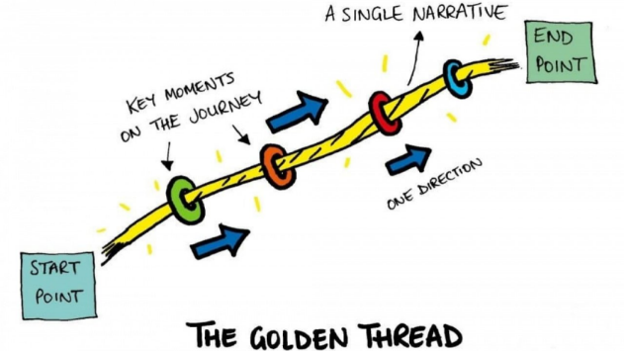
What do we mean by the Child’s voice?
Local authorities must not use the views of parents as a proxy for young people’s views. Young people will have their own perspective and local authorities should have arrangements in place to engage with them directly.
SEND Code of Practice 2015, Section 1.10, page 22
All children have a voice, whether preverbal, nonverbal or EAL.
Professionals working with children have a responsibility to recognise and make sense of what children are thinking, feeling, and communicating.
Communication is not just verbal 70% of communication is not through speech.
When we talk about the voice of the child it is important that we reflect what we observe in our contacts not just what parents, carers and children directly say.
Aspirations must be child-centred and personal which creates..

Slide 13
Why is it important?
Anyone working with children should see and speak to the child: listen to what they say; take their views seriously; and work with them and their families collaboratively when deciding how to support their needs. Special provision should be put in place to support dialogue with children who have communication difficulties…
- Working Together to Safeguard Children 2018, page 11
CYP voice should underpin everything we do but is often completely missing.
For example, in May/June 2023, an audit of the Child in Need (CIN) cohort was completed.
Out of 154 plans that were audited, 39% (60) included CYP voice that was their own in section A.
To reflect the voice of the children back to parents so they can understand their needs, limitations and capabilities.
As professionals, we are unable to support the child unless we understand the needs of the CYP.
Children have rights from birth and the UN conventional rights for the child 1989 places the importance on the wishes and feelings of a child in any decision affecting their lives.
Children should be on the same merit of being respected as adults are - children are individuals in their own right.

Slide 14
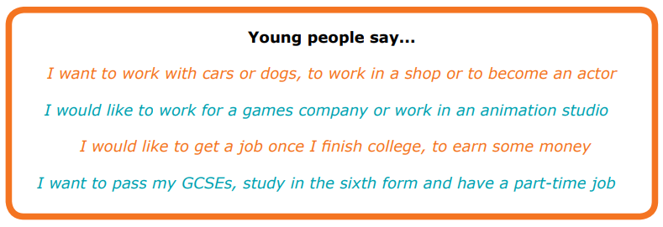
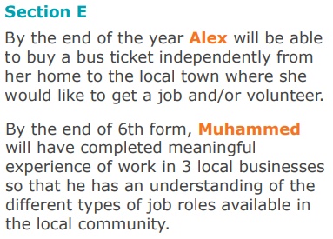
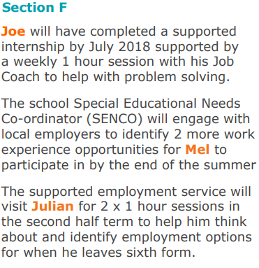
Aspirations
Long term outcomes must link with the aspirations of the child / young person identified in Section A.
This will provide a link to Preparation for Adulthood whereby children’s aspirations should be clearly referenced along with the pathways to achieve this aspiration.

Slide 15
Case Study – Capturing Pupil Voice
How could you articulate the views of the child with the needs outlined below?
James has been diagnosed with Autism Spectrum Disorder (ASD). He presents with multiple difficulties including managing and regulating his behaviour, creating and maintaining friendships, interacting appropriately and presents with some sensory difficulties.
James finds it difficult to communicate his emotions verbally.
When dysregulated, James chooses to use single words or two-word (noun-verb) phrases to comment on his actions. At these times, visual resources help James to make safe and positive choices.

Slide 16
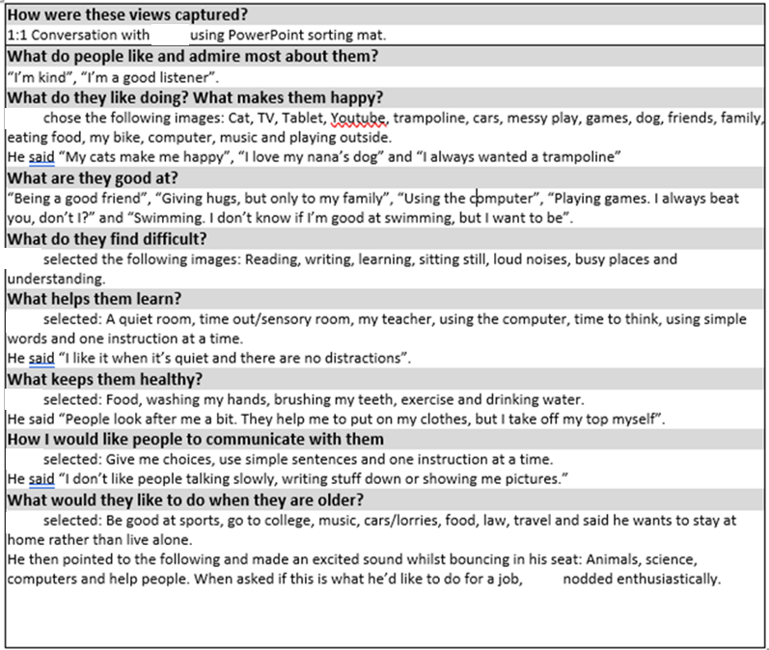
Case Study – Capturing Pupil Voice

Slide 17
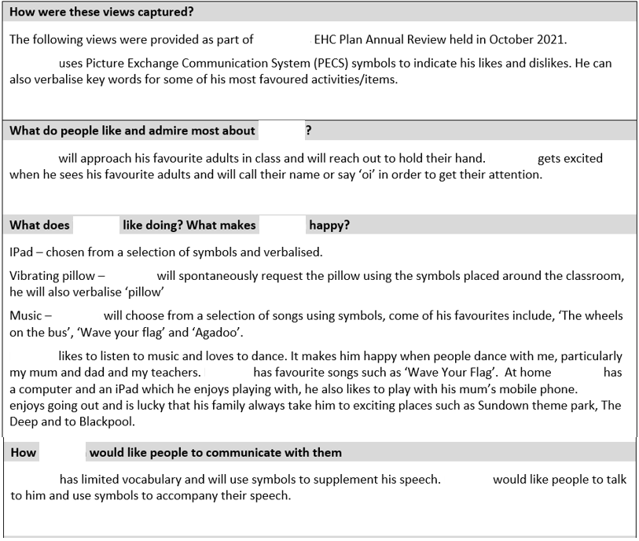
Case Study – Capturing Pupil Voice

Slide 18
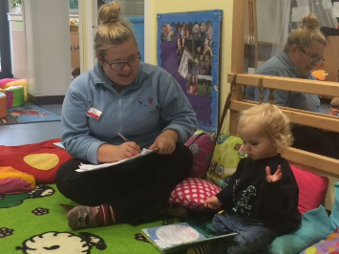
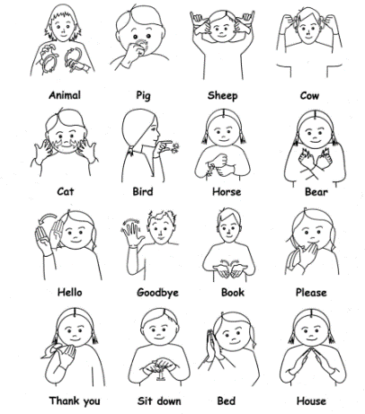
Ideas
Could views be represented pictorially?
Is a short narrative required to supplement?
Would short phrases supplemented by symbols work?
Does the child / young person use alternative communication?
Could software packages support?

Slide 19
Ideas
Be aware of:
Specific speech and language access needs (such as Makaton, BSL, Talking Mats, PECS or technological resources).
These communication methods may take more time than conventional speech, so take this into account when setting the agenda.
Non-verbal communication (body language, facial expressions).
For some young people, this is their primary form of communication. Ensure they are supported by someone who knows them well, but also find out if the child or young person has a pupil passport or similar to explain their communication.

Slide 20
Any Questions? Please email the team with any questions or queries you may have after the meeting. SEND.Auditors@bradford.gov.uk

Slide 21
Update from Sufficiency team

Slide 22
Neurodevelopment Assessments for Bradford District and Craven Update

Slide 23
Waiting times background
Historic issues with increasing demand for autism and ADHD assessments and several attempts to address the waiting list.
2018:
Demand had increased from 541 referrals in 16/17 to 750 per year
Business case 2019 - recurrent funding increased capacity to meet demand & non recurrent funding supported outsourcing.
2020:
Demand increased to 1065 per year, significant number* waiting for assessment and long waiting times*.
Business case resulted in further recurrent funding to increase capacity to meet demand and non recurrent funding to transfer 1,000+ cases to external providers to reduce the waiting list backlog.
Positive outcome with significant reduction in those waiting for assessment* and longest wait* was reduced BUT demand/referrals have continued to increase.

Slide 24
Increasing demand
Demand/referrals have continued to increase
2020 referrals 1065
2022 referrals now 2337 - 122% increase. In July 22 highest referral rate with 310 referrals against capacity of 88 assessments.
Increase in referrals correlates with opening up referral to SENDco’s/schools in Sept 2020
51% of referrals from SENDco’s/schools
Positive development - reduced delays with referral, feedback directly to schools, addresses unmet need
Current waiting times are increasing due to increasing referral rates *.

Slide 25
What have we done to reduce waits
Business case – a further case will be submitted but significant funding would be required to provide sufficient capacity and address the waiting list backlog.
Regional discussion/approach.
More efficient assessment process e.g. CDC will assess at first appointment, remote elements

Slide 26
Thank you for referrals - school information is pivotal.
Thank you for your support during outsourcing and for providing duplicated school information.
Outcome reports – templates are being reviewed by the Child Development Services and CAMHS, they are lengthy documents but any feedback would be appreciated
Questions or issues to raise
Contact details – Diane Daley – diane.daley@bthft.nhs.uk or 07976510875

Slide 27
Break

Slide 28
SENCO Network Wednesday 13th September 2023 Social, Communication, Interaction and Learning (SCIL) Team Updates
Access and Inclusion Officers
Communication and Interaction
Learning Support
Social, Emotional and Mental health
Children’s Community Support Team
Early Years
© Copyright applies to the whole document - Written and developed by 0-25 Specialist Teaching & Support Services, City of Bradford MDC

Slide 29
Vision
Specialist Teaching and Support Service (STaSS)
“Our vision is to provide high quality support for all Bradford children and young people using a collaborative approach through transformational learning experiences so that they can flourish, make excellent holistic progress and successfully transition to responsible citizens”.
Notes:
Start with a ‘why’.
Vision across STaSS, includes - The Children’s Sensory and Physical Needs Service, The Local Authority Led Resourced Provisions and the Medical Needs and Hospital Education Service.

Slide 30
Updates
Aims of the session:
Share Feedback
Staffing Update
Service Offer Improvements
Welcome to 0-25 Specialist Teaching and Support Services | Skills 4 Bradford
Notes:
Updates
Aims of my session are:
To share a summary of the feedback received from SCIL Team staff and school colleagues via the Snap Survey last summer term.
To provide details of the current team with staff new to role from September.
To provide an update on the service offer.
Hopefully this information will also have been shared with you by your link Specialist Teacher.
If you are one of the few schools (96% do) without a link Specialist Teacher, the request form can be found on skills4bradford

Slide 31
Feedback
Snap School/Setting Survey – 124 Responses
Extremely positive
96% or higher agreed or strongly agreed with the positive impact statements
Key themes what we are doing well
Key Themes – what can we improve next year and how?
Notes:
Thank you for completing the Snap survey – all responses were from schools/settings that have requested SEND support.
Share summary document and pick out key data to share.

Slide 32
Staffing Update
Head of Service: Lucy Stead
Specialist Teachers
SEMH Team Lead: Sara Burgess | C&I Team Lead: Ruth Péchèr |  | EY Team Lead: William Langdale | LS Team Lead: Fiona Whitaker
Martina Woodworth Rebecca Hayward Justine Burnhill David Chadwick Sharon Carr Amanda Aldin Alison Copley Sula Cameron-Bhandal Rachel Pouncey | Joanne Boden-Hook Hannah Rowlands Jason Bew Nicola Weston Rachel Porter Tasleem Alam Jodie Mercer Esther Veale |  | Nasrat Raqib Sylvia Cramp Deborah Gibbs Rachel James Louise Parkman Elizabeth Pawson Melissa Gadsby Rosie Watkins | Nicola Gaunt Katy Walker Malgorzata Lewalski Joanne Callaghan Jemma Haynes Sabina Iqbal
Specialist Practitioners |  |  | Team Manager CCST: Naina Hayaat
Team Lead: Shelley Strutt |  |  | CCST Senior Specialist Practitioner: Kelly Galloway
 |  |  | CCST Specialist Practitioners
Sharon Light Hannah Metcalfe Tracey Watson Fern Burton Julie Wilson Debbie Bower | Kate Armitage Leanne Ingham Kirsty Regan Sam Redgrave Shabana Ahmed Charlotte Dunne |  | Andrea Elders Cassandra Hall Russ Tully |  | Saimah Akram Fakra Wahid Sumera Hussain Lauren Hawksworth-Quill
Access & Inclusion Officers - PVI |  |  | Early Years Inclusion Funding Support Officer
Julie Coverdale Beverley Ellis Amy Brotherton |  | Heather Gibson Lisa Bradley Sarah Jamieson | Paula Hart
Notes:
Plenty of familiar names – new staff joining the SEMH and Early Years Team as well as a new Practitioner and a new team, the ‘Children’s Community Support Team’.

Slide 33
Service Offer Improvements
CCST Offer/parent/carer sessions
Clarify process of provision first
Parent/carer consent for Individual Support
Support Staff Training
Notes:
Talk through/use the schools flowchart and criteria.

Slide 34
ANY QUESTIONS OR COMMENTS?
Contact Details:
lucy.stead@bradford.gov.uk
07582 100955

Slide 35
The Curious Case of Covid 19

Slide 36
Lost Learning due to covid

Slide 37
Known Impacts
‘Findings showed that while school closures may reduce COVID-19 transmission, they were also associated with negative impacts on children's education, health, and wellbeing including increased anxiety, reduced learning, and increased obesity.’
University of Oxford 2023

Slide 38
A Double Whammy?
‘Lower‐income families have been disproportionately impacted by an increased prevalence of infections, deaths, unemployment, and mental ill‐health, all stressors which are likely to negatively affect home interactions with children.’
‘The result is that Covid-19 is widening existing attainment gaps; it is not only a health crisis but also an education crisis (UNESCO 2020b).’
DAVIES, C. et al. Early childhood education and care (ECEC) during COVID‐19 boosts growth in language and executive function. Infant & Child Development,

Slide 39
Impact of Covid on infant and child development
Children born during the pandemic have significantly reduced verbal, non-verbal, motor, and overall cognitive performance compared to children born pre-pandemic.
Boys and children in lower socioeconomic families have been most affected.
Even in the absence of COVID-19 illness, the environmental changes associated COVID-19 pandemic are significant and negatively affecting infant and child development.
The closure or reduced capacity of preschools may be associated with impaired motor development, motor coordination and visual processing, language development, and socioemotional processing.
In addition, masks worn in public settings and in school or daycare settings may impact a range of early developing skills, such as attachment, facial processing, and socioemotional processing
Spiteri, J. (2021). Quality early childhood education for all and the Covid-19 crisis: A viewpoint. Prospects, 51(1–3), 143–148

Slide 40
Impact of Covid in EY settings
Many providers reported delays in children’s speech and language development. For example, some have noticed that children have limited vocabulary or lack the confidence to speak.
Children have missed out on hearing stories, singing and having conversations… children appear to have spent more time on screens and have started to speak in accents and voices that resemble the material they have watched.
Some providers have reported that delays to children’s speech and language development have led to them not socialising with other children as readily as they would have expected previously.
Children were lacking confidence and were shy in childcare settings, especially when taking part in group activities.
Children’s social and friendship-building skills have been affected. Some providers reported that toddlers and pre-school children needed more support with sharing and turn-taking.
OFSTED: Education recovery in early years providers: spring 2022

Slide 41
Covid and SEND
Children born August 2019 – August 2022 had some or all of their early learning opportunities disrupted.
Many of them are being referred for EHCA due to delays with language / social skills etc
Numbers of referrals for EY EHCAs have doubled – particularly 2019 birthdays.
Do these children have SEND or is it a delay due to lack of early opportunities?
Discuss in your group

Slide 42
What Provision is Required?
Language rich environment
Opportunities to develop social / relational skills
Small group support
Is this ‘Quality First Teaching’ / School Support?
Are these reasonable adjustments?
Do these children require EHCA?
Do they require a special school?
Discuss

Slide 43
So What Happens Next?
All Aboard – email ruth.dennis@bradford.gov.uk / Jessica.Allen-Summers@bradford.gov.uk
Research and evidence?
Keeping tabs?
Relationship with Matrix of Need

Slide 44
SEN Q and A

