Slide 1
Senco Network
Autumn Term 2020

Slide 2
Welcome
Agenda | Presenter | Time
Introduction and welcome | Ruth Dennis – Principal Educational Psychologist | 5 mins
Update on SEN Assessment Team and statutory systems | Niall Devlin - Strategic Manager, Integrated Assessment, Children's Services | 30 mins
Bradford Matrix of Need and Graduated Approach document | Ruth Dennis – Principal Educational Psychologist | 30 mins
Mental Health Champions Network | Claire Cooper Jones – Specialist Senior Educational Psychologist | 15 mins
SCIL Team Update | Kelsey Clarke Davis | 15 mins
Low Incidence Team Update | Karen Turner | 15 mins
Covid-19 Emotional Wellbeing Support | Ruth Dennis – Principal Educational Psychologist | 15 mins
Autism Assessment Pathway Update | Ruth Dennis – Principal Educational Psychologist | 5 mins
Any Questions?

Slide 3
Some you win, some you lose
Positives
Can access when suits;
Wider audience (within and beyond Bradford)
Same training can be re-run;
Room booking and refreshments are not an issue
Negatives
No opportunity for discussion;
Practical aspects hard to recreate;
How to cost?
Can we manage the technology?
How to control release or unauthorised sharing?

Slide 4
What we’ve learnt so far

Slide 5
FAQ from Summer Senco Network
Answers document on BSOL
Key Points:
SEN documents are always updated on BSOL:
SEND / SEN Graduated Approach / Documents
Presentations / other documents from Senco Network are always posted on BSOL:
SEND / Senco Support / Senco Network
P Scales: The P scales are no longer officially recognised but the content and descriptions can be used informally to plan next small steps for CYP in relation to Communication and Interaction, SEMH and Physical needs but it.

Slide 6
Senco Essentials
Annual Update to bring together any changes in relation to:
SEN processes
New services and provisions
Contact details etc.
Please let us know if there is anything else you think we need to add to this.
It will be available on BSOL and sent out by email shortly.

Slide 7
Update on SEN Assessment Team and statutory systems
Niall Devlin
Strategic Manager Integrated assessment and Psychology

Slide 8
Bradford Matrix of Need and Graduated Approach Senco Handbook
Ruth Dennis
Principal Educational Psychologist

Slide 9
Why amend the Matrix?
Revised in consultation with LA staff, school staff, health colleagues and parents to ensure it provides clear and consistent guidance.
Bring in line with Code of Practice categories and School Census codes
Bring in line with changes to Learning Difficulties definitions
Bring in line with funding changes (agreed with Schools Forum) brought in in April
Comply with the Code of Practice and ISPSEA re specificity
Reduce any duplication.

Slide 10
Areas Of Need
Code of Practice Area of Need | Sub Category
1.a Cognition and Learning | Learning
1.b Cognition and Learning | Specific Learning Difficulties
2.a. Communication and Interaction | Speech and Language
2.b Communication and Interaction | Social Communication including those with a diagnosis of ASC
3. Social, Emotional and Mental Health Needs
4.a Sensory and/or Physical Needs | Visual Impairment
4.b Sensory and/or Physical | Hearing Impairment
4.c Sensory and/or Physical Needs | Multi-Sensory Impairment
4.d Sensory and/or Physical | Physical

Slide 11
Code of Practice Stage
Below Age Related Expectations | Require high quality teaching within an inclusive setting SEN need-specific practice or adaptations which are additional to and different from those which are normally available. These children do not necessarily have special educational needs and do not need to be placed on the SEND register.
SEND Support | Requite bespoke intervention – time bound and quantifiable ‘additional to’ or ‘different from’ interventions. May have special educational needs and should be placed on the SEND register using K code
EHCP | Have special educational needs that require SEND provision and should be placed on the SEND register using E code. Mainly mainstream placement
EHCP | Have special educational needs that require SEND provision and should be placed on the SEND register using E code. Mainly specialist placement

Slide 12
Individual learner characteristics
Section revised to match local and national agreed definitions;
Includes NC descriptors to assist identification
Also includes standardised assessment score boundaries
Additional narrative description.

Slide 13
Additional to and Different from Interventions and Strategies
Needs-specific practice:
classroom approaches and strategies that are commonly used in relation to a specific need for example use of a visual timetable for YP with social communication needs.
Bespoke Intervention :
time bound and quantifiable:
Specific interventions such as ‘Time to Talk’ / social skills group / Precision teaching.
A list of recommended strategies and interventions can be found on Bradford Schools Online ‘Best Endeavours and Quality First Teaching Spreadsheet’

Slide 14
Provision
Describes expectations of school and Local Authority in terms of:
Amount of support that should be put in place (hours) from delegated SEND budget eg:
Additional adult support amounting up to 10 hrs per week (pro rata) comprising of small group and 1:1 support to facilitate access to the curriculum and deliver individually planned programmes of work.
Support available from LA eg:
Hub support from Specialist teaching and Support Service (STASS) and/or EP Team
BMDC central training and support offer
Traded service from EPT

Slide 15
Using the Matrix of Need
The Matrix should be referred to when:
Identifying and classifying the severity of a young person’s needs
Considering whether to place on SEND register
Considering how to respond the a YP’s needs
Reviewing what support to put in place fro a YP.

Slide 16
Matrix and the EHC Panel
Panel have to address two questions:
May the YP have SEND?
Do they require provision over and above that normally available (SEN Support)
They will use the Matrix and the evidence presented by school to establish the answer to those two questions.
Provision should match need and CoP stage.

Slide 17
Bradford Graduated Approach Senco Handbook
Sets out key expectations and requirements in relation to SEND and the Code of Practice;
Explicit about underlying assumptions around inclusion for all children
Expands upon information in Matrix of Need
Provides Senco Audit and other tools
Sits alongside ‘Senco Essentials’ annual update

Slide 18
1. Developing High Quality Teaching within an Inclusive Setting

Slide 19
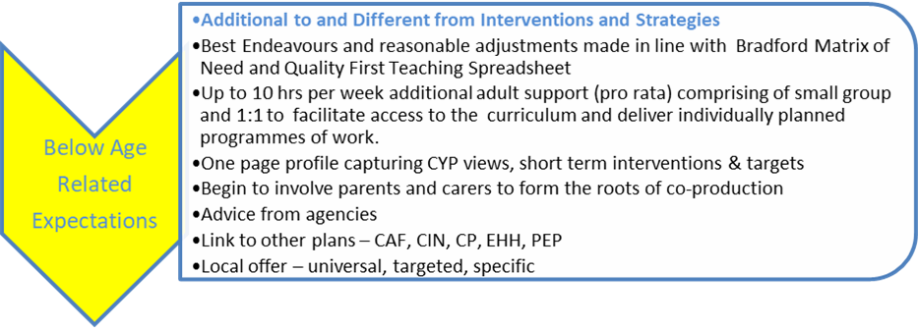
2. Additional to and Different from Interventions and Strategies

Slide 20
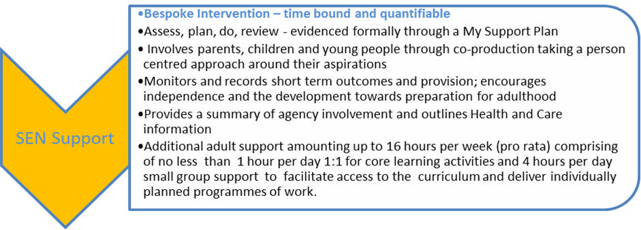
3. SEN Support

Slide 21
4. Additional support in line with EHCP

Slide 22
Where to Find the New Documents
Bradford Schools online (from 23rd September 2020)
https://bso.bradford.gov.uk/content/send-documentation
Fully subsidised training course: Understanding and Implementing the SEND Code of Practice 1: The Graduated Approach
Available as ‘bitesized’ recorded headlines and live online course.
Book via Skills4Bradford

Slide 23
Any Questions

Slide 24
Covid-19 Emotional Wellbeing Support
Ruth Dennis
Principal Educational Psychologist

Slide 25
Covid-19 and Emotional Wellbeing
Children and Young people are generally resilient and will suffer no long term emotional harm from the pandemic.
It is normal for children and young people to experience mild or intermittent emotional symptoms, such as having days or times when they eat less, have trouble sleeping, seem more irritable, or express more worries.
Some children may however have difficulty adjusting to the changes we are all experiencing due to the pandemic and may need more support to cope during this time.
These children and young people may benefit from tailored interventions or support to facilitate their recovery.

Slide 26
The Education based Emotional Wellbeing practitioners (EEWP) Team
The EEWP Team is part of the Educational Psychology Service. It is a 12 month funded ptoject.
The therapeutic work of EEWP is underpinned by child focused approaches.
The aim of the EEWP is to work proactively in educational settings to improve children and young people’s emotional wellbeing following coronavirus.
EEWP provide a flexible and non-threatening first point of contact into wellbeing and mental health services area for children and families.
Interventions will be monitored and evaluated for effectiveness.

Slide 27
What does the EEWP Team do?
Educational Emotional Wellbeing practitioners will provide support to children and young people on a one-to-one or small group basis. They will work in schools and early years settings and will also liaise with parents and carers.
Their role is to work across education and healthcare to provide mental health support for children and young people in schools and colleges showing signs of stress or anxiety relating to coronavirus.
They will provide low intensity interventions such as guided self-help based on cognitive behavioural therapy (CBT) and group-based CBT for those with persistent mild to moderate concerns. This might include:
Enabling children and families to recognise problems and make use of their own internal resources to improve the quality of their lives.
Assisting school professionals in developing skills, understanding and knowledge of child mental health issues.
Promoting approaches to improve emotional health and wellbeing
Providing non-judgmental emotional support, advice and guidance for parents.
Individual and group support for children in school.
Strengthening child/parent and school relationships.
Signposting to CAMHS specialist services for further help and support.

Slide 28
How to make a referral
As part of the Mental Health Champion’s project, schools will fill out a half termly audit of any emerging emotional wellbeing needs in relation to coronavirus transition and recovery.
Educational Emotional Wellbeing practitioners will use the data from the audit to identify settings where there are pockets of concern
Schools will also be able to refer directly to the team for individual CYP requiring intervention.
One of the EEWPs will contact schools directly to discuss what intervention would be most appropriate and how and when to implement this.
In all cases, there must be informed parental consent and consent from the CYP to engage with the intervention.

Slide 29
Next Steps
Interviewing 28th September.
Team in place by half term.
Begin taking referrals from November 2020
Full details on finalised process will be posted on BSOL once team in place.

Slide 30
All Aboard - COVID recovery programme for Children in the Early Years .
In order to support pupils who have fallen behind furthest, structured interventions, which may also be delivered one to one or in small groups, are likely to be necessary.
Interventions might focus on other aspects of learning, such as behaviour or pupils’ social and emotional needs, or focus on particular groups of pupils with identified special educational needs or disabilities.
In the early years, rather than 1:1 tuition, a play based group intervention is most appropriate.
All Aboard has been used over a number of years to specifically target under-achieving children in the Early Years, aiming to improve outcomes.
This is ideal for children in the early years who have been disadvantaged by COVID.
Bradford Educational Psychology Team is again delivering All Aboard training - this year with additional COVID perspectives.

Slide 31
More about All Aboard
By the end of the 4 part course you will have:
Explored the nature of under-achievement in the Early Years including the impact of COVID;
Used the All Aboard structure to plan a tailor-made intervention programme;
Delivered All Aboard in your setting; and
Evaluated the impact of All Aboard.
There will be two cohorts starting in November and January.
Priced at £300 for two practitioners the course is a cost-effective, catch-up intervention for COVID recovery in the Foundation Stage.
Data will be collected and analysed by the Centre for Applied Education Research to demonstrate progress made by children involved in the programme.
Further information and booking on skills4bradford.co.uk

Slide 32
Referral for Autism Spectrum Condition (ASC) and/or Attention Deficit Hyperactivity Disorder (ADHD) Assessment

Slide 33
Revised ASC/ADHD assessment pathways: where to refer children who may require assessment
0 – 2.5 years: refer to a Child Development Service Paediatrician at ANHSFT or BTHFT, as it is inappropriate to enter the ASC/ADHD pathway at this age.
2.5 to 7 years: refer to the Child Development Services at ANHSFT or BTHFT (ASC only)
7 to 18 years: refer to BDCFT CAMHS service. (ASC and/or ADHD)

Slide 34
Waiting Lists
In view of the high demand for ASC/ADHD assessment service, a waiting list is in operation at each service.
It is important referrals reach the correct department and have the requested information completed to avoid any delay in addition of the child or young person to the waiting list where appropriate.
Referrals are triaged, where the submitted information is reviewed and the child added to the waiting list where appropriate.
Incomplete referral information may result in the referral being returned to the referrer, with advice on next steps e.g. referral to community paediatrics or speech and language therapy

Slide 35
Referral Process
Under 7 year – ASC referral process
Refer to ANHSFT or BTHFT as follows:
Under 7 year autism referral | Referrals pathway | Referrals accepted from
Airedale (ANHSFT) CDS | Send to cdc.referrals@nhs.net marked ‘Autism assessment referral’. Send by post to Autism Assessment, Child Development Centre, Airedale General Hospital Steeton, Keighley BD20 6TD | Consultant Paediatrician, Health Visitor, School Nurse, GP, Allied Health Professional, Educational Psychologist, SENCO, Specialist Teacher.
Bradford (BTHFT) CDS | Via Systmone If the referrer does not have Systmone access a paper referral can be sent to Paige Hayes, CDS Secretary, Third Floor, Extension Bloc SLH, Little Horton Lane BD5 ONA | Consultant Paediatrician, Health Visitor, School Nurse, GP, Allied Health Professional, Educational Psychologist, SENCO, Specialist Teacher.
7 to 18 years – ASC and /or ADHD referral process
Please complete the referral form on the CAMHS page on the BDCT website:
https://www.bdct.nhs.uk/services/child-adolescent-mental-health-camhs/
It is essential to complete as directed the SNAP-IV template and ASC and ADHD observation template, to allow the referral to be processed.
We understand that parents or carers may struggle to complete this lengthy form but the information is very helpful to us in deciding whether this is an appropriate referral. The referral will not be rejected if parents or carers are struggling to complete this fully. Part of the assessment process will involve an appointment for parents with a clinician to go through this information in more detail.

Slide 36
EP Traded Services 2020- 21
Book via:
www.skills4bradford.co.uk

Slide 37
Senco Network Online Forum
1. Navigate to Skills4 Bradford: http://www.skills4bradford.co.uk
2. Log in or sign up for an account;
3. Select Communication
4. On the orange banner, click the small arrow next to ‘Groups’
Browse groups and you should find Senco Network.

Slide 38
Questions

