Slide 1
Senco Network
Autumn Term 2019

Slide 2
Welcome
Agenda | Presenter | Time
Introduction and welcome | Ruth Dennis – Principal Educational Psychologist | 9 .00
Update on SEN Assessment Team and statutory systems | Gary Saul, SEN Team Manager. | 9.15
EPT Support for Sencos: Senco Network online / Skills 4 Bradford / EP Hubs | Ruth Dennis | 9.45
Inclusive Teaching Support Service | Wendy Fairman | 10.05
Networking Break |  | 10.20
Mental Health Champions Roll out | Claire Cooper Jones, Specialist Senior EP | 10.50
My Support Plan update | Charlie Lowe – Targeted Assessment Team | 11.10
pdnet Champion Role | Ann Tolan and Julie Vaughan - Physical and Medical Team | 11.30

Slide 3
Senco Hot Topics 2019 -20
Read through the list of ‘buzz words’
Can you link them with their definition?
How well did you do?

Slide 4
Update on SEN Assessment Team and statutory systems
Gary Saul, SEN Team Manager.

Slide 5
Educational Psychology Team Update
Ruth Dennis
Principal Educational Psychologist

Slide 6
Capacity

Slide 7
EPT Performance Data

Slide 8
Feedback Survey
“Given the state of school budgets, being able to access the EP service in this way is really, really helpful. PLEASE KEEP IT!”

Slide 9
Feedback Survey

Slide 10
Feedback Survey

Slide 11
Feedback Survey
‘The EP was EXCELLENT! I cannot stress enough the care, compassion and understanding he showed not only for the child but the family involved’
‘Excellent support offered, aided whole school development which has had a positive impact on pupils’
‘I felt supported by our EP. She always gives sound advice and is extremely knowledgeable and helpful. Our EP has provided many aspects of support to the school.’
‘The work from the EP team has been able to impact positively upon outcomes for the children involved.’

Slide 12
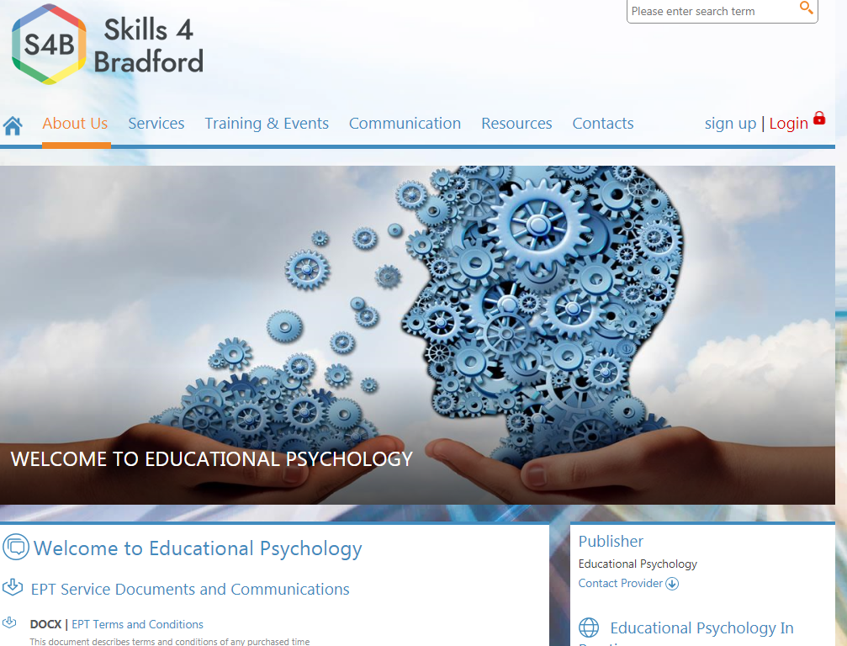
Skills4Bradford
www.skills4bradford.co.uk
Create school account;
Use to book onto courses / purchase additional EP time etc.
NB you must have a finance manager on the account who is authorised to sign off the purchase.

Slide 13
Courses for Sencos
A full programme of EP led Senco training events has been sent into schools;
They are also available to view and book via Skills4Bradford
Log in to ‘Skills4Bradford’
Click ‘Training’ in the top banner
Browse ‘roles / Senco’ and click the green arrow next to it.
This should take you to a full list of available courses from the EP team and other services.

Slide 14
EP Early Help Hub Consultations
Early Help hub sessions enable schools to access support and advice from an EP in a timely and efficient way.
Early Help hub sessions are available across the year at a number of locality and central locations.
EP Early Help hub sessions are fully subsidised
How to Book a Consultation
Log into your Skills4Bradford account
Click ‘Training’ in the top banner
Browse ‘roles / Senco’ and click the green arrow next to it.
This should take you to all the Early Help Hub meetings.
Select your preferred date and make your booking.
Please remember to complete the parent / carer consent form and the ‘Getting the Most out of Your Consultation’ form.

Slide 15
Senco Network Online Forum
1. Navigate to Skills4 Bradford: http://www.skills4bradford.co.uk
2. Log in or sign up for an account;
3. Select Communication
4. On the orange banner, click the small arrow next to ‘Groups’
Browse groups and you should find Senco Network.

Slide 16
Inclusive Teaching Support Service
Wendy Fairman / Ronnie Hartley

Slide 17
Service Offer
The 0-25 SEND Inclusive Education Service
SENCO Network
September 2019

Slide 18
Agenda
Recap from last year
Wendy Fairman 0-2 Inclusive Education Service Interim Head of High Incidence
Revised offer 2019-20

Slide 19
Total Sessions Delivered by type 18-19

Slide 20
Referrals and Sessions 18-19

Slide 21
Frequency chart - Core school Session delivered 18-19

Slide 22
Referrals not allocated 2018/19
Area | Referral not allocated – schools notified/recommended hubs | Referral to allocate
AS Teachers | 42 | 3 teacher + 2 practitioner on current allocation list
CL Teachers | 62 (mainly Dyslexia assessment requests) | 25 teacher requests on current allocation list
SEMH | 26 (mainly no package or no involvement and SEN request) | 4 teacher requests
EY Teachers | 9 | 2 teacher + 1 practitioner request on current allocation list

Slide 23
Headlines
1752 new referrals from Sept 18
Capacity to deliver on a referral model
Packages and carry forward

Slide 24
Service delivery 2019-20

Slide 25
Model proposal
Tiered approach to responding to need across the LA.
Increase capacity within the team for effective working by creating a triage approach
Intervention based on a planned approach which is proactive rather than all referral based and reactive
The traded target is met across the whole Inclusive Education Service not just SEMH. Carry over could be used from September to support this model.
Increase capacity within school/settings to reduce the need for individual referrals about the same thing
To increase time in supporting schools/settings with embedding the graduated approach
To create an ethos of inclusion and quality first teaching as a ‘given’ before more intense work would be completed
Referrals from schools and settings and not from SEN

Slide 26
Autumn School Visits
Read OFSTED Review
Check BSO Data dashboard
SEN offer from school. (See school website).
Note SEN Officers and Caseworker and Link EP for school.

Slide 27
In discussion with School Leadership/SENCO
General picture and SEN needs including 3 priority areas
What Training and CPD needs are for whole school.
SEN register ( and LAC) and overview of current and future provision.
Whole school Provision Map
MSP and EHCP
Priority cases to discuss.
What are you doing to support SEN parents?
Year 5 Reviews
Base line rating of skills and confidence, knowledge and practice.

Slide 28
The Service Offer
The universal offer from the IES High Incidence Team is:
1 Autumn Term planning session
3 sessions, Universal training and support
Access to half termly hubs
Early Years referrals
Enhanced offer for DSP/EY Hub/RP
Primary 1 in addition to the universal offer you get x 1 referrals per term
Primary 2 in addition to the universal offer you get x 2 referrals per term
Secondary in addition to the universal offer you get x 2 referrals per term

Slide 29
The Service Offer
The traded offer includes:
All targeted and specialist interventions
Training not specified as part of the universal offer
Any additional referrals above allocation

Slide 30
Universal
To support children and young people with emerging needs that can be met within the universal graduated approach and quality first teaching.

Slide 31
Targeted Support
as Universal plus additional needs:
To support children and young people who require a more targeted approach from services in addition to universal provision.

Slide 32
Specialist
Complex needs
To support are children and young people whose needs are complex and enduring requiring a multidisciplinary response from the relevant professionals including the IES. They are at risk of social or educational exclusion. Their health, welfare, social or development is being negatively impacted upon. The child or young person could be at significant risk of harm

Slide 33
Michael Purches Interim SEND Transformation and Compliance Coordinator
Revising SEND Strategy:
Pupil voice and influence
‘I’ statements
SEND Information Report:
Guidance on content
Accessibility Strategy:
Audit Tool
Guidance on Accessibility Plans
Pupil voice – ‘my barriers and how they reduced’
Local SENDCo networks/forums?
michael.purches@bradford.gov.uk

Slide 34
Networking Break

Slide 35
Mental Health Champions roll out
Claire Cooper Jones,
Specialist Senior EP

Slide 36
Mental Health Champions in Bradford Schools: A Future in Mind Initiative
Dr Claire Cooper-Jones
Specialist Senior Educational Psychologist Autumn 2019

Slide 37
Mental Health Champions project
Sometimes referred to as the ‘Schools Links’ project, or ‘Mental Health Matters in Schools’
Currently 100 Bradford school access the ‘opt in’ model.
Model will now be ‘opt out’ – all Bradford Schools are expected to participate*
Each school nominates a ‘champion’ for mental health in their school. **
Notes:
*Unless there is a very good reason why not!
** Does not have to be an expert – just someone with an interest in mental health and wellbeing.

Slide 38
Who are our Champions? They…….
Are interested in the mental health and emotional well-being of students and staff.
Are a point of call for staf and students RE mental health issues.
Act in small ways to deliver big changes
Reduce shame and stigma
Find easier ways to talk about difficult things

Slide 39
What is the project?
Training for nominated Mental Health Champions written and delivered by the educational psychology team (6 sessions per year)
Structured reflective supervision groups for MHCs.
Advice on and signposting to evidence-based interventions and psycho-educational resources for use in schools.
Assembly presentations on MH related topics designed by the EP team given to schools for use with students
MHCs are able to use their training in schools either directly with students, and/or to cascade to colleagues.

Slide 40
Where and when?
Previous system: 4 sessions (‘network meetings’) each half term, one for each area (N, S, E, W).
MHCs attended one network meeting per half term, where they received the training and supervision.
New plans for expansion: 8 sessions per half term, two for each area.
MHCs still only need to attend one network meeting per half term, but there will be an option of a morning or afternoon session.*
Depending on availability, sessions are held either in MMT, or in ‘host’ schools if they are able to offer use of a large room and refreshments (the latter means less travel for MHCs)
Notes:
*As the expansion of the project is in the very early stages, we are still working on a model for attending/booking your preferred session. More details will be sent out asap.

Slide 41
The big question… Do schools have to pay?
No! Schools do not have to pay anything to join the project.
All training, supervision and selected resources are free to schools.
Why? The project is funded by the Bradford CCGs, who commission the EP team to deliver it.

Slide 42
What have we done this year?
High quality training sessions on topics such as:
Self-harming
Social anxiety
Challenging behaviour
Working with parents
School refusal
Resiliency
Bullying
Feedback overwhelmingly positive – 100% rated good or excellent.

Slide 43
The expectations for schools
Elect an MHC
Release MHCs to attend training for one 3-hour session per half-term.
Ensure support and supervision is available for MHC from SLTs in each school.

Slide 44
Key Contacts
Project Lead: Dr. Claire Cooper-Jones, Specialist Senior Educational Psychologist, BMDC.
Admin support: Previously provided by Relate – please note that admin has now transferred to the EP team, and Relate are no longer involved in the project.*
Email: We are hoping to set up a dedicated email address for the project. Until then, please contact EPTadmin@bradford.gov.uk and please ensure you put MHC as the subject.
Notes:
* A reminder for those already in the project not to email/call Faye or Kelly at Relate.

Slide 45
How do we join?
Email EPTadmin@bradford.gov.uk using ‘MHC join’ as the subject.
Further info is on our dedicated website https://mentalhealthmattersinschools.org.uk/

Slide 46
Quality Assurance: Content updates
September 2019

Slide 47
Section A: CYP and Parent Views
Section 1.10 of CoP 2015
Local authorities must not use the views of parents as a proxy for young people’s views. Young people will have their own perspective and local authorities should have arrangements in place to engage with them directly.

Slide 48
Section B
Summary of SEND
Social Model of SEND
Holistic approach - no more than 2 – 3 sentences.
Brief overview of SEND
Example
Bryan has a communication and interaction difficulties which affect his ability to develop relationships with adults and peers. This also impacts on his ability to access the curriculum independently and his daily environment.

Slide 49
Section B
Strengths
Pure can do’s from within each area as appropriate
Positive evidence based comments
Often these may be the smallest steps of achievement
Example
Graham is able to make and maintain friendships; he has also a good sense of humour and enjoys to make others laugh.
Salma is able to read CVC words and the 10 HF words.

Slide 50
Section B
Needs
Emerging skills are in their infancy and are areas for consolidation and development. These are also skills which are yet to develop however there is the potential to do so.
Barriers to learning are difficulties. A barrier does not always have to link to an emerging skill.
Example
Bertha is beginning to recognise emotions happy and sad in others; however she is yet to recognise and name her own emotions in context.
Bertha has yet to make and maintain any friendships.

Slide 51
Preparation for adulthood
This will fall under the statutory headings:
Higher education and/or employment
Independent living
Participating in society
Being as healthy as possible in adult life
Future training will be provided around Section B, E and F

Slide 52
Section C
Area of Special Educational Need | Related Health Need
Section C | Health needs related to SEN (What is the impact?) No Health needs have been identified at this moment of time. Health Needs not related to SEN (What is the impact?)

Slide 53
Section E and F
Need (Section B) | Outcomes Sought (Section E) | Educational Provision (Section F) | Provided by: | Monitored by
Cognition and Learning | By the end of… By the next review… | Bespoke Intervention – time bound and quantifiable: Staff will… Needs specific practice which is different from and in addition to: Staff will… | School Staff | Educational Psychologist to monitor progress at the time of Key Stage transition SENCO Class Teacher

Slide 54
Outcomes
Long Term outcomes must link with CYP aspirations
They must have an element of being ‘time bound’ however these are overarching outcomes.
They must indicate a ‘so that’ or ‘in order to’
Medium Term outcomes must be an interim step towards a long term outcome usually by the following year.
Must be SMART
Short Term outcomes must create steps towards the Medium Term.
Must be SMART
Recorded and Reviewed in a MSP

Slide 55
Outcomes
Long Term: By the end of Key Stage 1, Riley will have developed his social emotional skills so that he able to play with his peer group at play time appropriately.
Medium Term: By the end of Year 1, Riley will be able to play a short game of 7 minutes with 2 friends and an adult at least 4 times a week.
Short Term: By the end of the Autumn Term, Riley will be able to play a short game of 5 minutes with another peer and an adult at least 3 times a week.

Slide 56
Section G
Need | Outcomes Sought (Section E) | Educational Provision (Section G) | Provided by: | Monitored by
Section C | By the end of… By the next review… | Bespoke Intervention – time bound and quantifiable: Staff will… Needs specific practice which is different from and in addition to: Staff will… | (Health Service) | (Health Professional) SENCO Class Teacher

Slide 57
Section H1 and H2
Need | Outcomes Sought (Section E) | Educational Provision (Section H1 / H2) | Provided by: | Monitored by
Section C | By the end of… By the next review… | Bespoke Intervention – time bound and quantifiable which is different from and in addition to targeted and universal services: Other support which is different from and in addition to targeted and universal services: Individuals will… | (Social Care) | Social Care SENCO Class Teacher

Slide 58
Additional Information
New My Support Plan format
24th September @ MMT
Revised EHC plan template v1.4
Upcoming trials of an Enhanced My Support Plan for LA use only when conducting an EHC assessment

Slide 59
pdnet Champion Role
Ann Tolan and Julie Vaughan Physical and Medical Team

Slide 60
An overview of pdnet (physical difficulties network), the pdnet standards and Physical Friendly Schools.
pdnet want children and young people to:
Be fully included in their school/learning community
Actively take part in high quality learning activities with their peers
Thrive and enjoy learning
Develop knowledge and skills so they can go on to lead fulfilled lives as adults
Be empowered, confident and able to function as independently as possible

Slide 61
Our Objectives today:
Equip SENDCOs with information regarding pdnet and the pdnet Standards.
To inform SENDCOs of the work the Physical and Medical team are doing in creating ‘Physical Friendly Schools’ in Bradford that meet the pdnet standards.

Slide 62
Who are pdnet and what do they do?
pdnet is a national membership network for those who support learners with a physical disability and will be of interest to any staff or other professionals working in schools to support the needs of pupils with physical disabilities.
Membership is free and there are currently just over 800 members. Membership is achieved by registering on www.pdnet.org.uk
Bradford’s Low Incidence Service Physical & Medical team have been attending pdnet network meetings for a number of years. More recently two team members have become pdnet champions for Yorkshire and Humber.

Slide 63
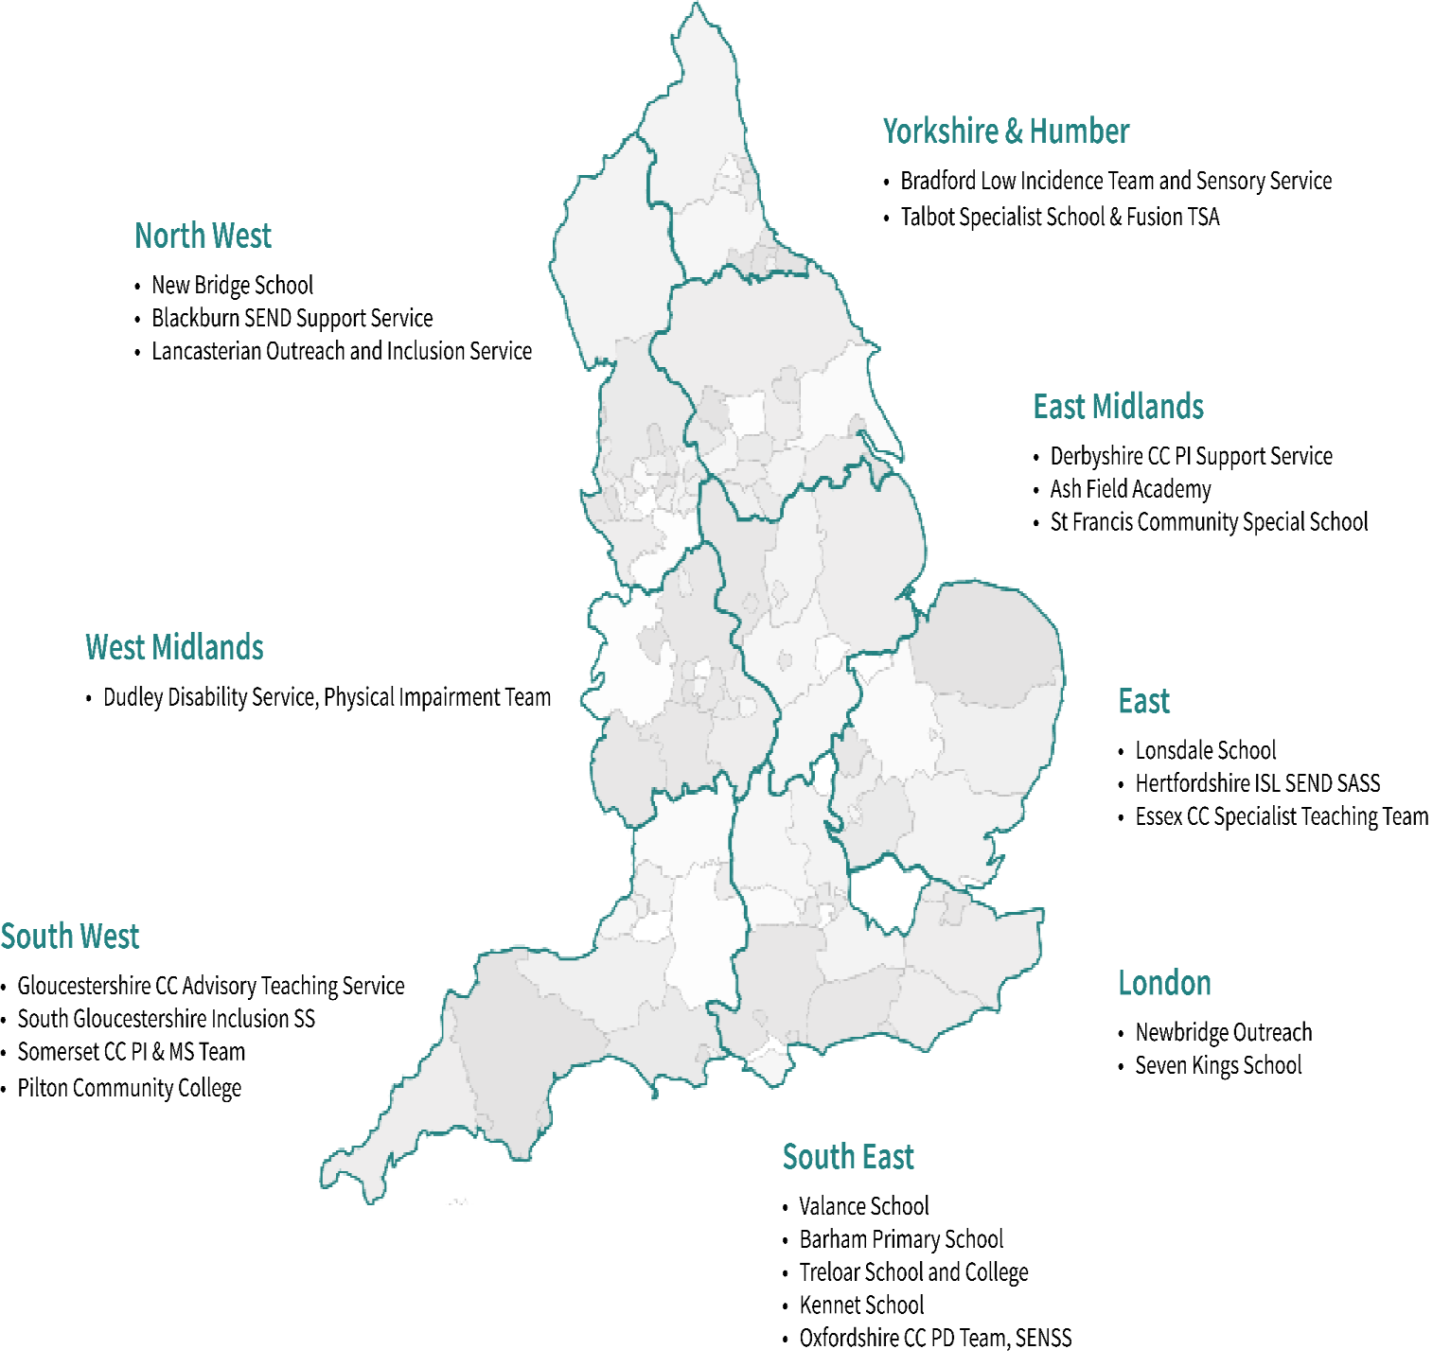
pdnet Champions

Slide 64
The pdnet journey
In April 2017, pdnet was awarded DfE Contract - Support for CYP with PD.
3 main contract requirements
Promote effective practice on supporting children and young people with physical disability
Equip the workforce to deliver high quality teaching and SEND support for pupils with a physical disability
Promote the use of technology to improve the accessibility of education and outcomes for children and young people with physical disability that affects their mobility

Slide 65
pdnet Benchmarking Survey 2018
Responses from 44 local authorities
the population of learners with PD has increased from 32,897 to 34,765
At least 70,000 support staff (estimate)
88 % in mainstream schools and settings
69% have an EHCP plan

Slide 66
WSS Gap Analysis Survey
Themes arising:
Lack of knowledge across the sector/age phases on how to meet the needs of learners with a physical disability particularly those with more complex /and or multiple needs
Poor awareness in schools of how to plan and deliver positive and inclusive teaching and learning activities which CYP with PD can access and participate in as independently as possible
Published Summer ‘19

Slide 67
DfE Contract Year 2
Three main priorities…
Raising Awareness of good and evidence-based practice (pdnet standards)
Training to improve the knowledge and skills of the early years, schools and post 16 workforce. (free Level One online training accessible to all via pdnet website)
“This is a fantastic, visual resource that ensures learning and awareness for anyone using it.”
“Ideal for lunchtime training sessions!”
Developing a sustainable model of ongoing support to professionals who support PD learners

Slide 69
Reasonable Adjustment Scenario

Slide 70
DfE Contract Year 2
Outcomes:
Pdnet Level 2 training is currently under development and will be available later this year. This is an accredited training module aimed primarily at support staff. There will be some costs associated with access to this level 2 training.

Slide 71
Developing Infrastructure
pdnet Standards
The pdnet Standards are a free resource designed to provide a practical structure for schools and settings to self-evaluate current provision and reflect on the effectiveness of their organisation in meeting the diverse needs of children and young people with physical disability.
pdnet Standards have been written for Early Years, Schools and Post-16
They can be applied to any educational setting, whether mainstream or special
They can be applied to any learner with PD, at any stage of the Code of Practice
The Standards work most effectively when downloaded and viewed in Adobe Acrobat Reader. This will enable you to input and save information and to revisit later.

Slide 72
The standards are split into 4 keys areas:
Vision, ambition and expectation Focus: Leadership, Policy, Practice and Procedures, Setting ethos
Identifying and assessing need Focus: Assessing CYP with PD, using CYP and Parental feedback, accessing external professionals and sources of information
Meeting diverse need Focus: Reasonable adjustments, planning for CYP with PD, working with others, safeguarding, transition
Enabling individual outcomes Focus: Achieving positive outcomes, developing independence, using technology, preparation for adult hood

Slide 74
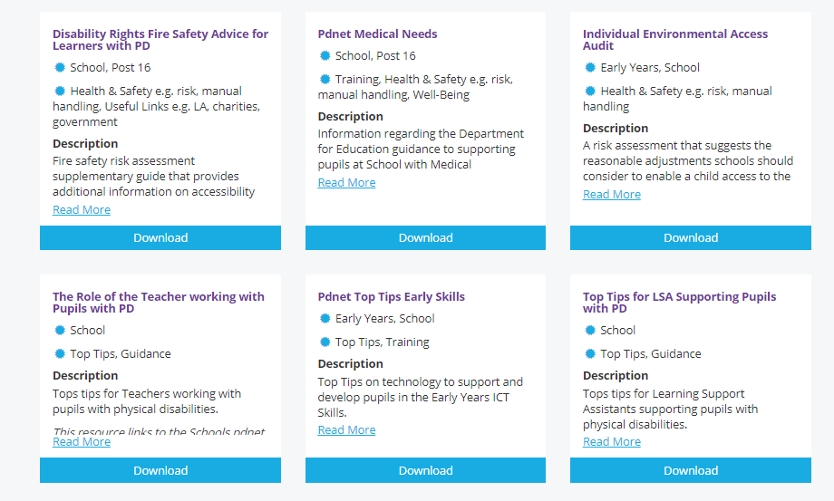
Effective Practice Hub

Slide 75
We are currently working with four settings to become the first Physical Friendly Schools in Bradford
St Edmund’s Nursery School and Children’s Centre
Keighley St Andrew’s C of E Primary School and Nursery
Crossley Hall Primary School
Bradford Academy

Slide 76
Next steps -visit PD net website and register www.pdnet.org.uk -look at the Standards and consider how close your setting is to meeting them -complete the free Level 1 online training -look at the resources available on the effective practise hub

Slide 77
Your setting may be the next Physical Friendly School in Bradford!

Slide 78
Getting in touch
Your pdnet contact is Kate Drurey:
School Development Support Agency (SDSA)
kate.drurey@sdsa.net
0116 299 5978
Your pdnet champions are Julie Vaughan and Ann Tolan:
julie.vaughan@bradford.gov.uk
ann.tolan@bradford.gov.uk
01274 439500

Slide 79
Senco Networks 2019 - 20
Senco Network (Autumn) | 10.09.19 | Hockney
Senco Network (Spring) | 05.02.20 | Hockney
Senco Network (Summer) | 20.05.20 | Hockney
Book via Skills4Bradford
You must make a confirmed booking and check it out so that we can comply with fire regulations.

Slide 80
Questions

